Slide 1



Microphysical Characteristics of Select MCSs Observed During the 2015 PECAN Experiment
Daniel M. Stechman, Greg M. McFarquhar, Robert M. Rauber, and Brian F. Jewett
University of Illinois at Urbana-Champaign, Urbana, IL
Michael M. Bell
Colorado State University, Ft. Collins, CO
Robert A. Black
NOAA/HRD, Miami, FL
David P. Jorgensen
NOAA/NSSL, Norman, OK
Terry J. Schuur
Coop. Institute for Mesoscale Meteorological Studies, Norman, OK

Slide 2


PECAN 2015:
Plains Elevated Convection at Night
Our Overarching Goal
Understand the role of microphysical cooling processes in the organization and maintenance of elevated nocturnal MCSs

Slide 3
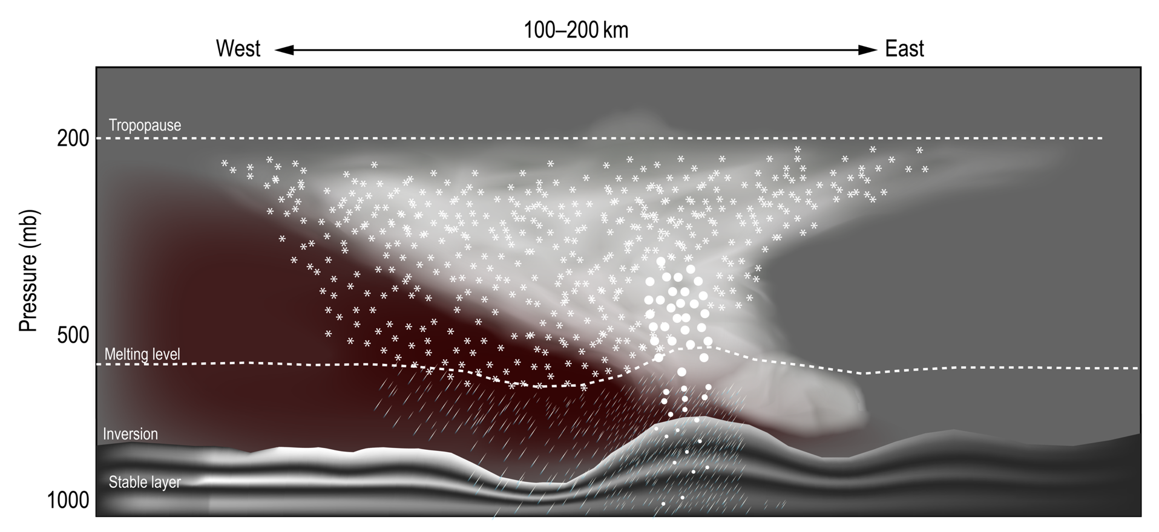
Our Hypothesis
Cooling drives downdraft circulations
Evaporation and sublimation in dry air behind convective line
These downdrafts impinge upon the stable layer driving gravity waves

Slide 4
Sampling Methods / Instrumentation
Spiral ascents/descents
Vertical profiles of microphysical and thermodynamic quantities

Slide 5
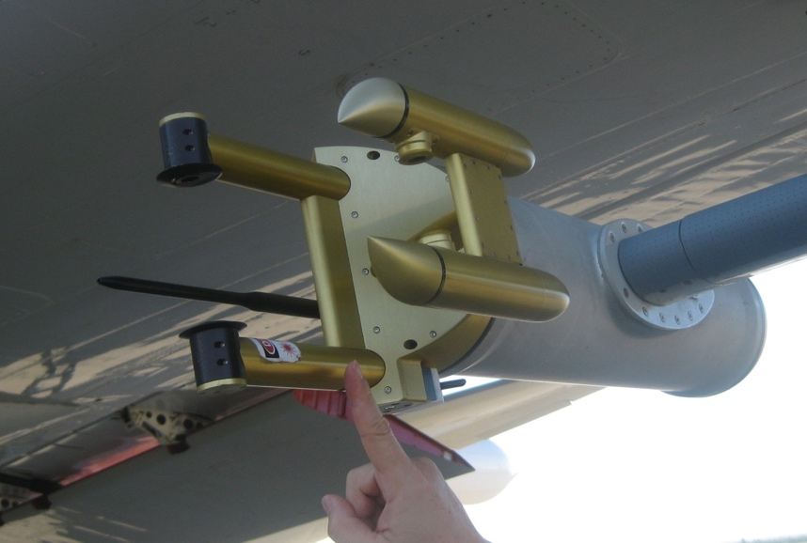
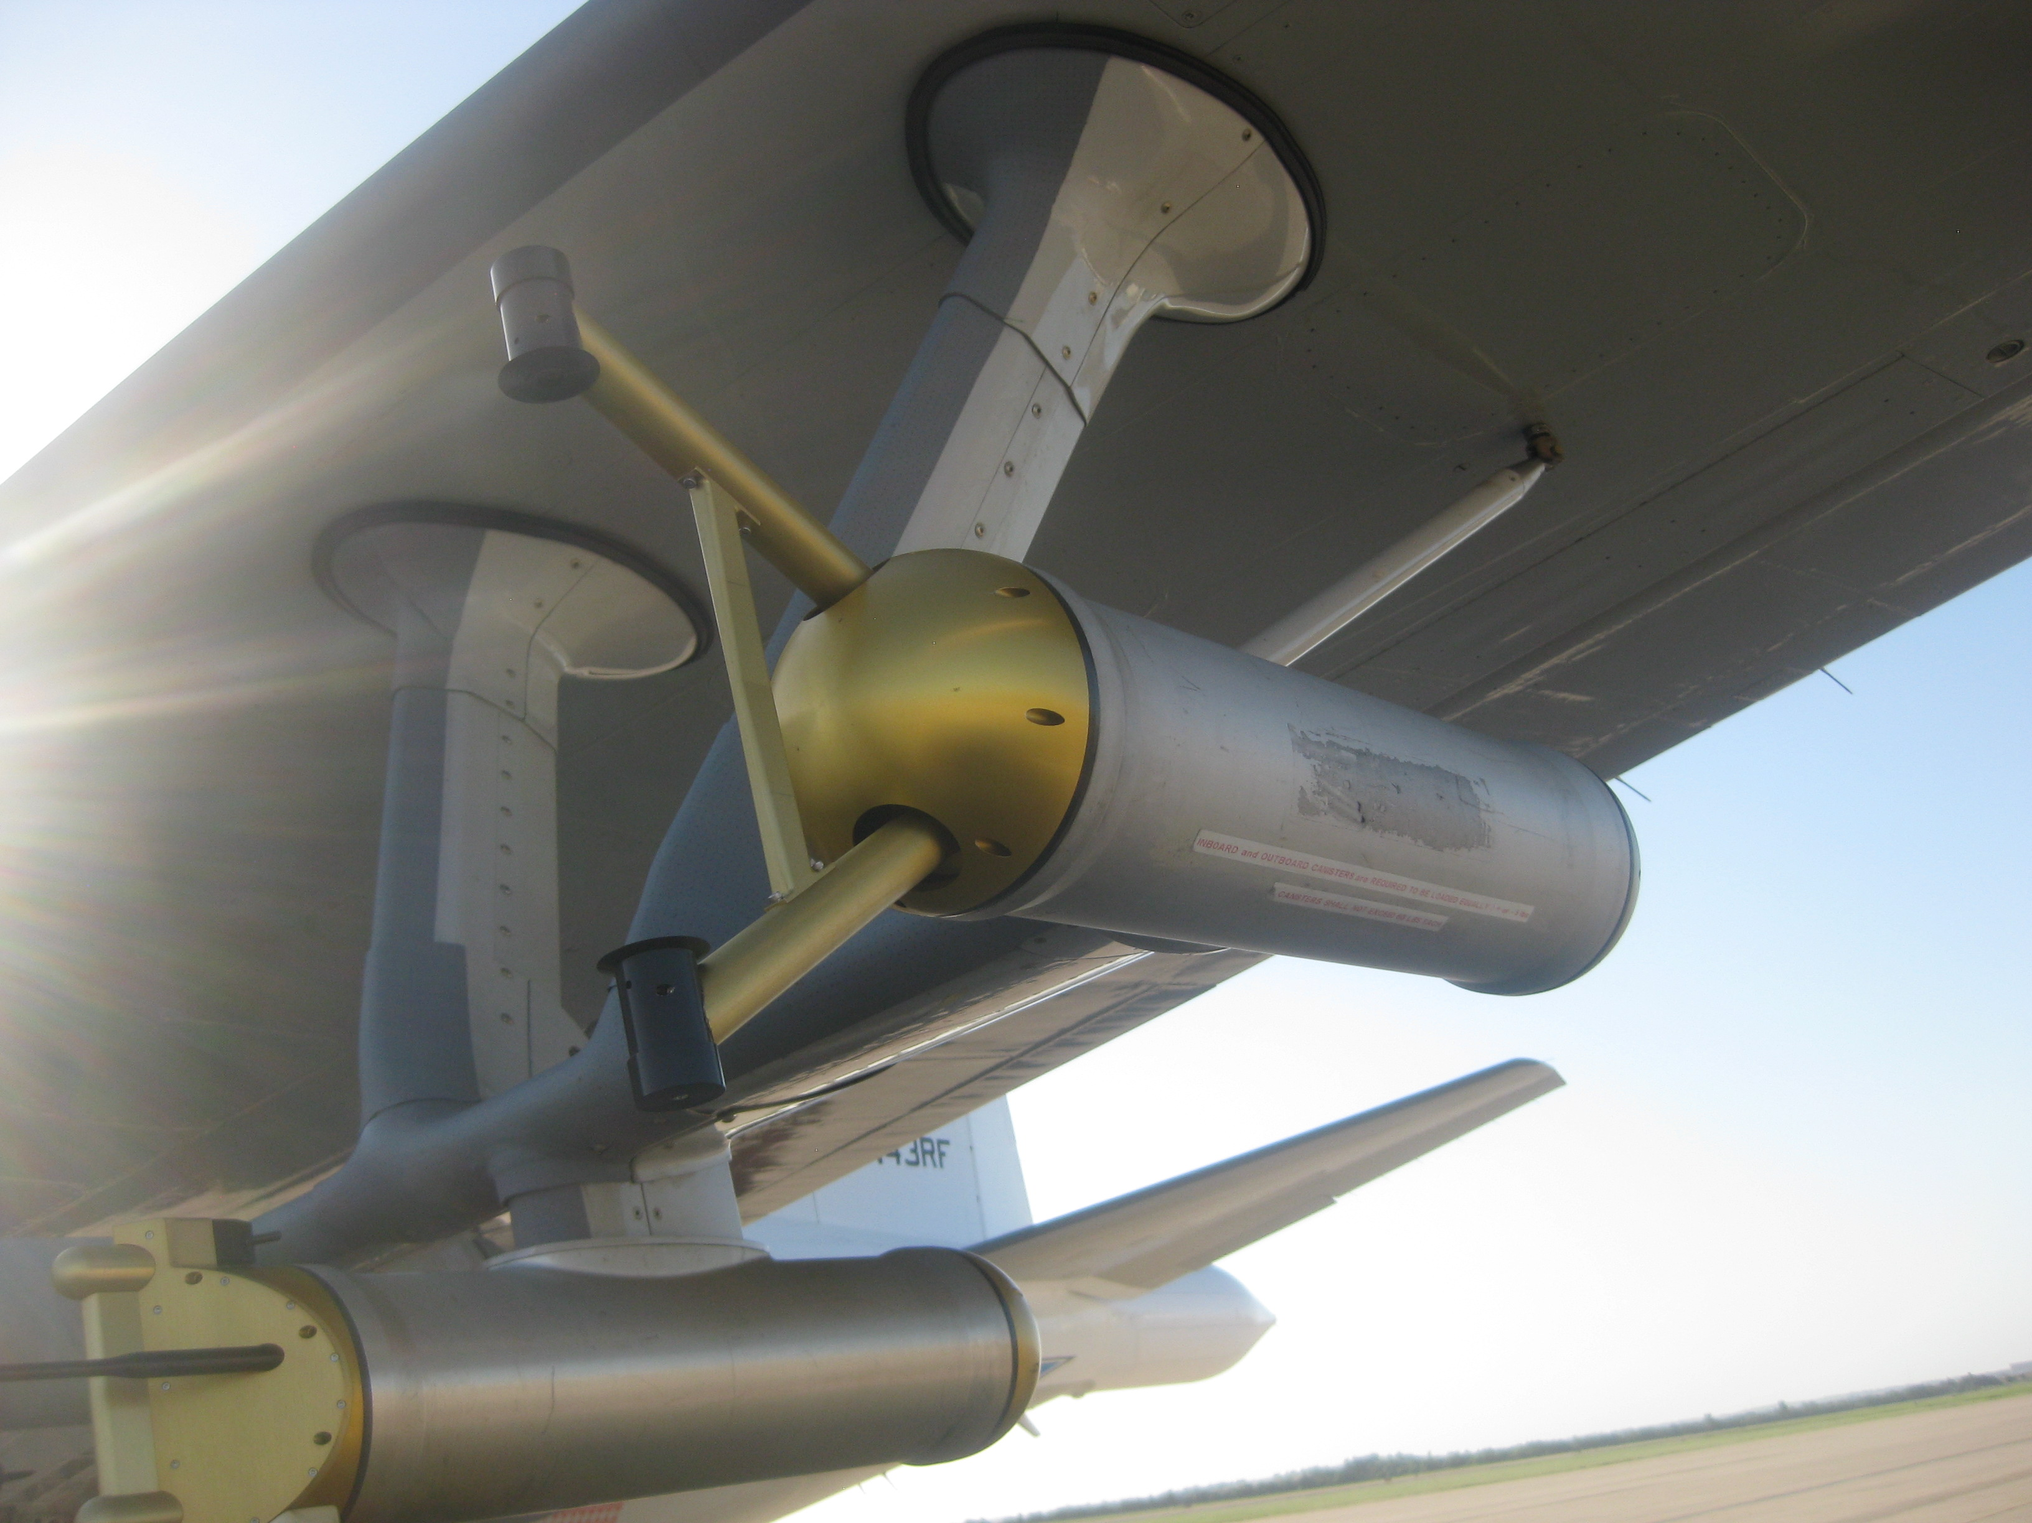
Sampling Methods / Instrumentation
Cloud Imaging Probe (CIP)
Resolves particles ~150-1600 µm
  Bulk properties
  Determined using particles with max diameter > 150 µm
Total Water Content (TWC)
Total Number Concentration (N_{T}) D_{mm} determined including contributions from particles with D_{max} > 150 µm
Precipitation Imaging Probe (PIP)
Resolves particles ~200-6400 µm
PIP data quality is still being investigated and is not included in the following analyses

Slide 6

Sampling Methods / Instrumentation
NOAA Tail Doppler Radar (TDR)
3.2-cm X-band Doppler radar
1200-1400 m along-track resolution
±51 m/s Nyquist velocity
Alternating fore/aft scans allow for pseudo dual-Doppler analyses

Slide 7
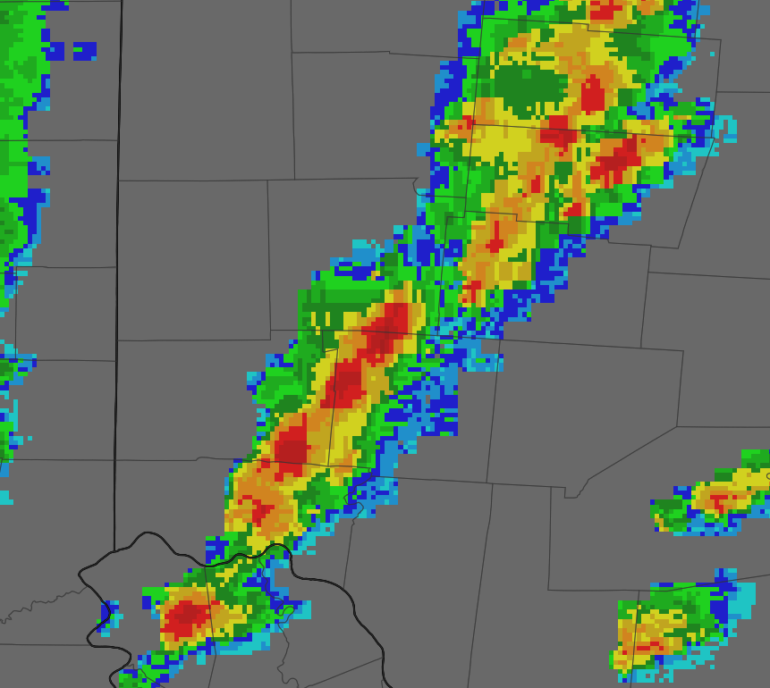
Sampling Methods / Instrumentation
Horizontal flight legs
Multiple-Doppler syntheses
NOAA P-3
Jorgensen et. al. 1996
Fore Sweep
Aft Sweep

Slide 8
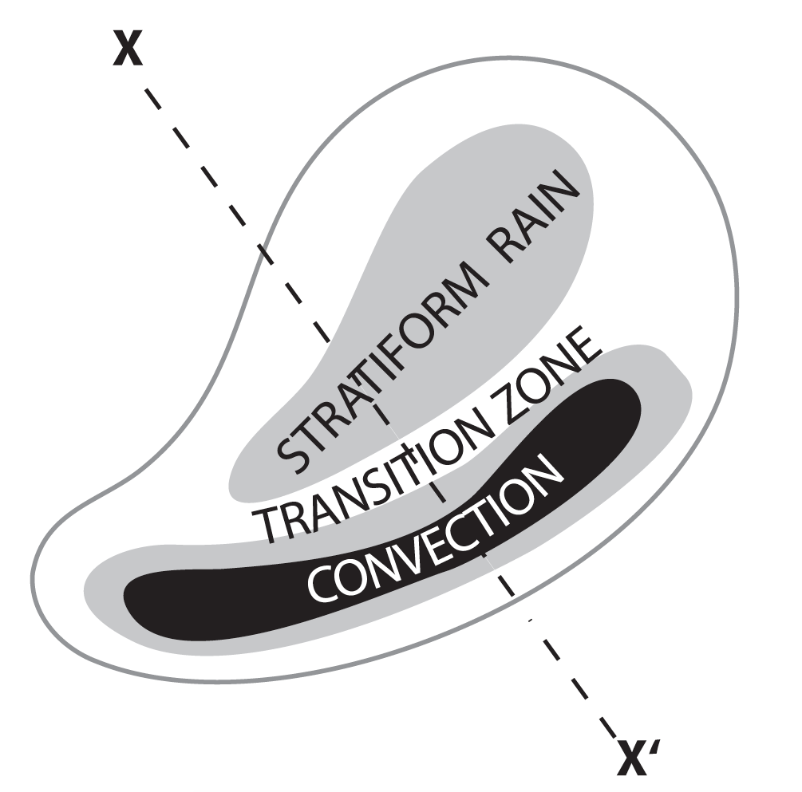
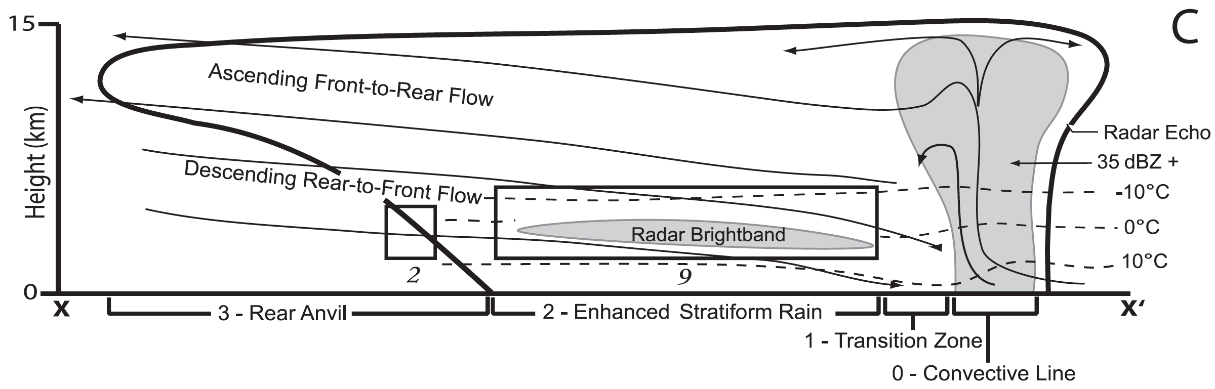
Nomenclature
Idealized MCS Structure
Enhanced Stratiform Rain (ESR)
Transition Zone (TZ)
Melting Layer (ML)
Smith et al. 2009 (based on Houze et al. 1989)
Smith et al. 2009 (based on Houze et al. 1989)

Slide 9
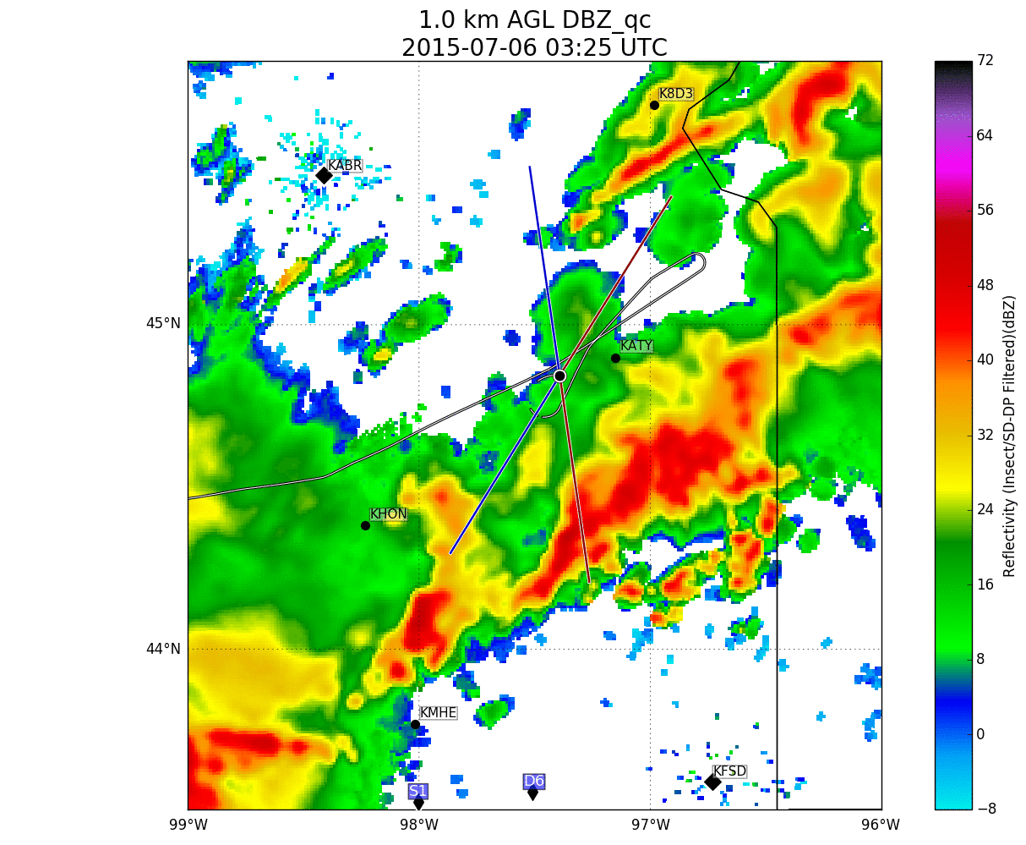
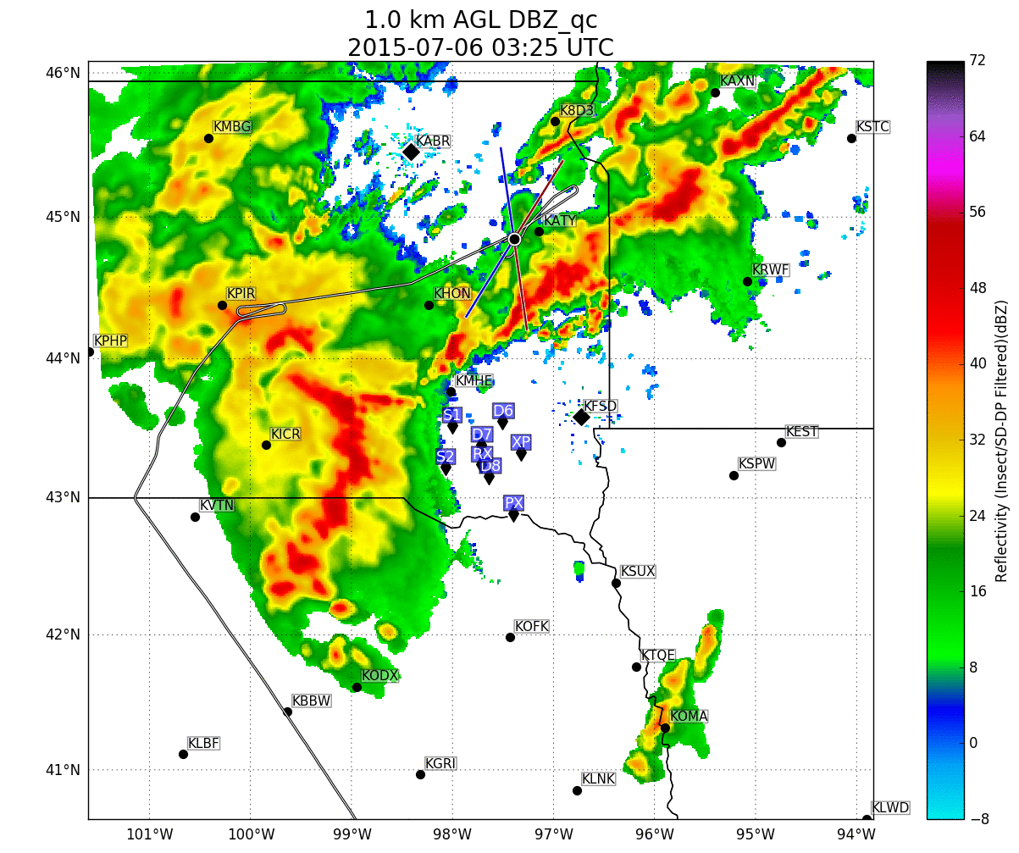
6 July 2015
Spiral 2
TZ in formative MCS
Notes:
0 deg – 4.5 km MSL
-10 – 6.3 km
+10 – 3.1 km

Slide 10
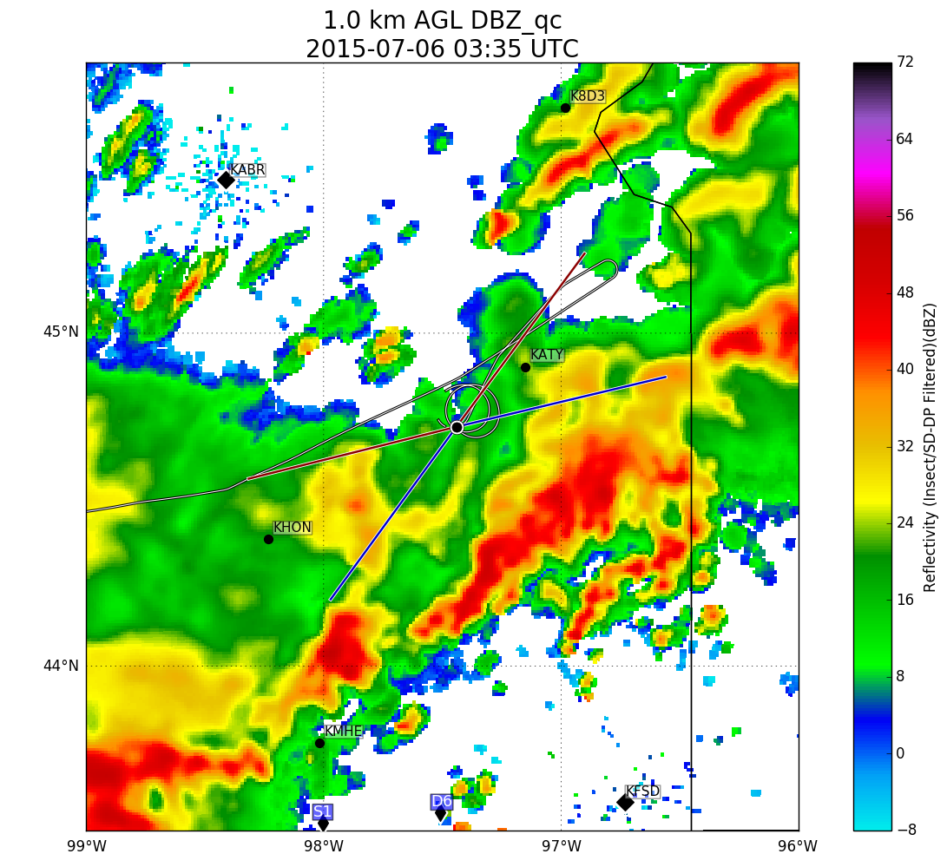
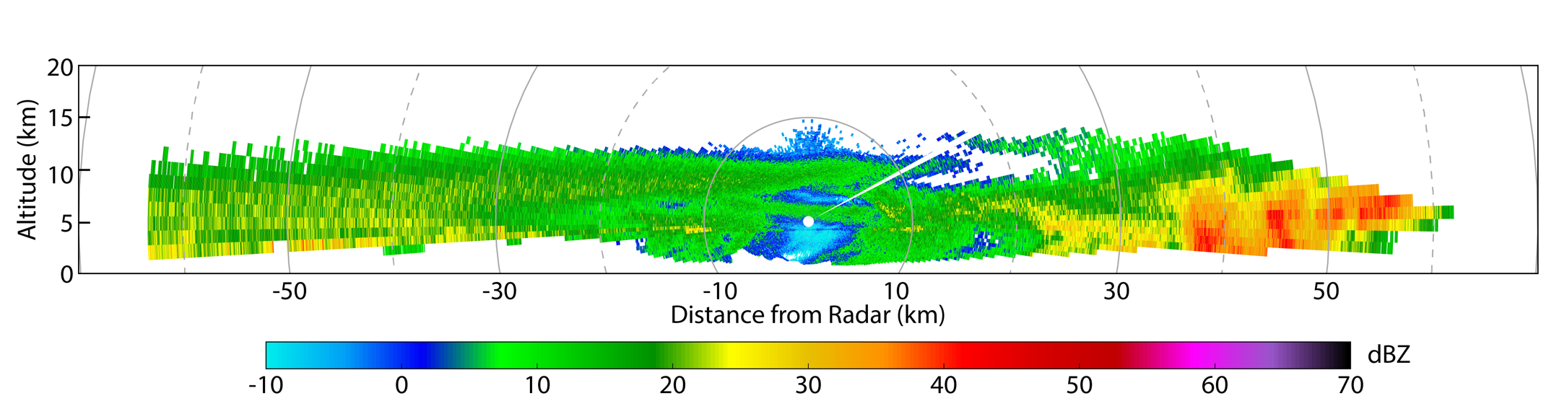
6 July 2015
Spiral 2
TZ in formative MCS
B
A
A
B
Aircraft Position
TZ
Convective Line
Notes:
0 deg – 4.5 km MSL
-10 – 6.3 km
+10 – 3.1 km

Slide 11
6 July 2015
Spiral 2
TZ in formative MCS
B
Precipitation evaporating / sublimating in dry air
A
A
B
-10°C RH_{ice} = 110%
0°C RH_{ice} = 92%
10°C RH = 70%
Notes:
At this time, the aircraft is just above the melting level (0°C)
Air is subsaturated w.r.t. ice
Any precipitation here is evaporating or sublimating

Slide 12
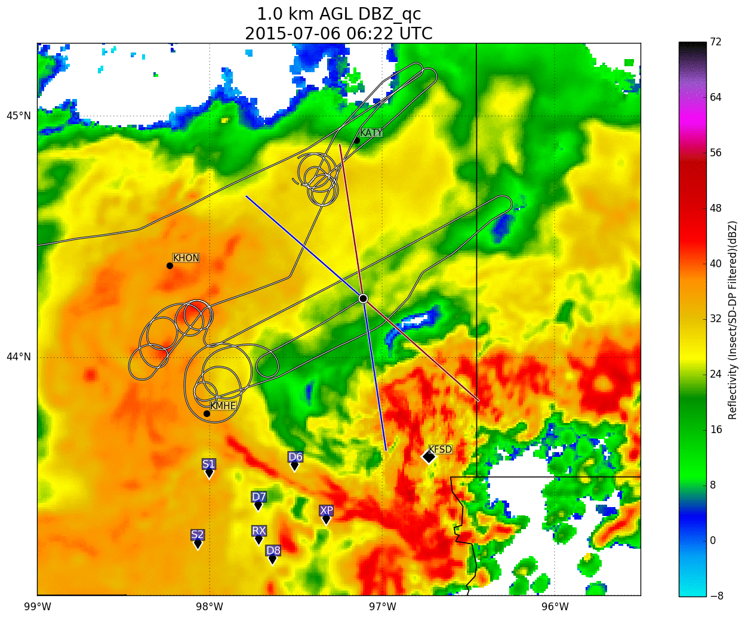
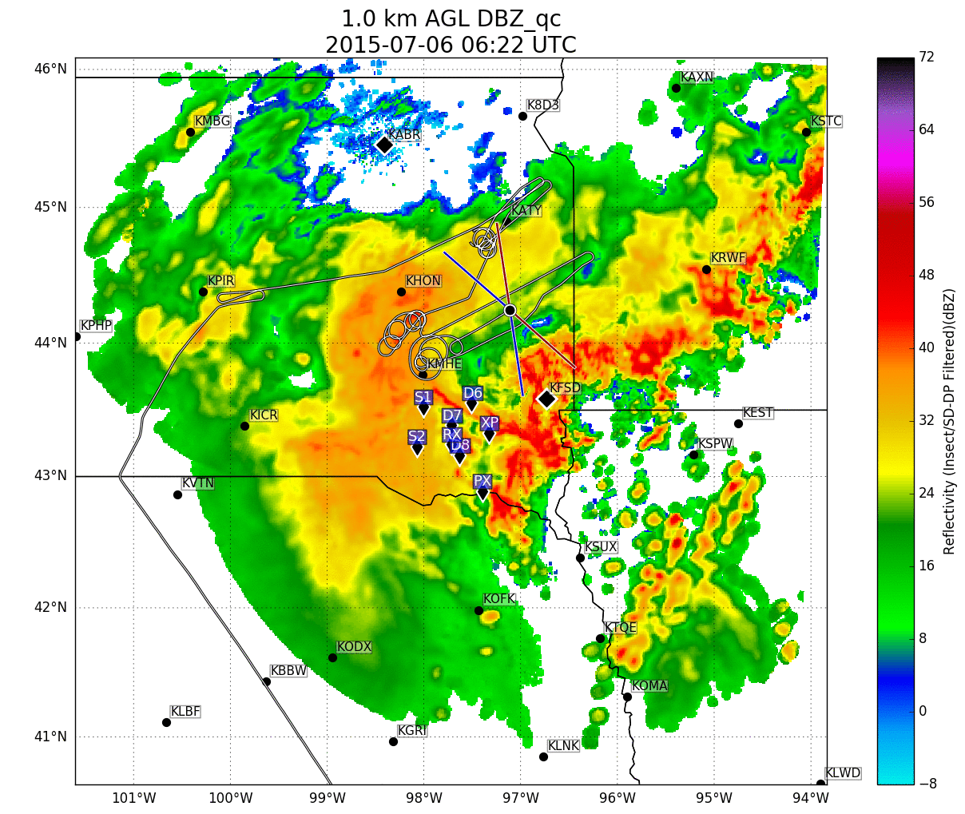
6 July 2015
Spiral 7
ESR in mature MCS
Notes:
0 deg – 4.5 km MSL
-10 – 6.3 km
+10 – 3.1 km

Slide 13

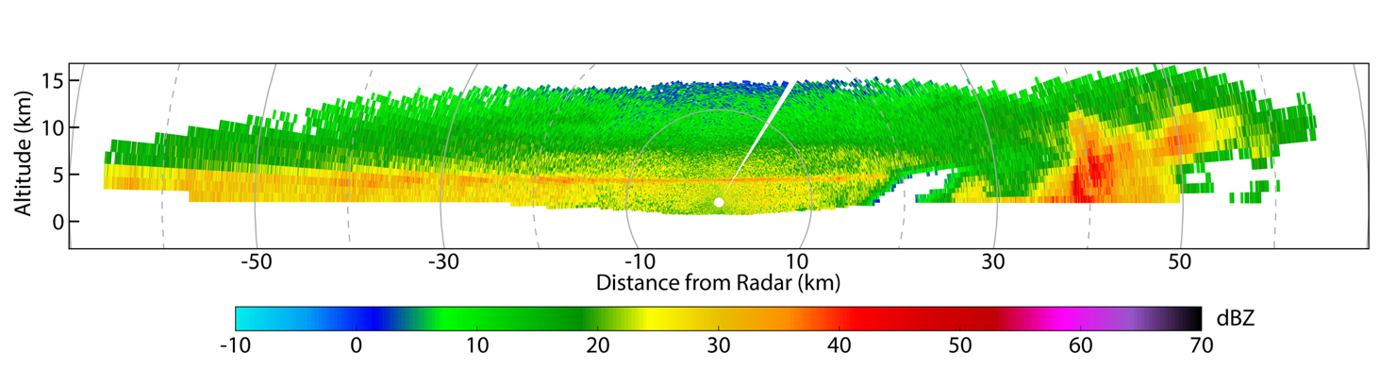
6 July 2015
Spiral 7
ESR in mature MCS
A
B
A
B
ESR
TZ
Convective Line
Aircraft Position

Slide 14
6 July 2015
Spiral 7
ESR in mature MCS
A
B
Melting Layer
A
B
-10°C RH_{ice} = 110%
0°C RH_{ice} = 93%
10°C RH = 71%
Notes:
Aircraft is well below melting layer
Subsaturated w.r.t. water
Evaporation expected to be prevalent here driving cooling

Slide 15
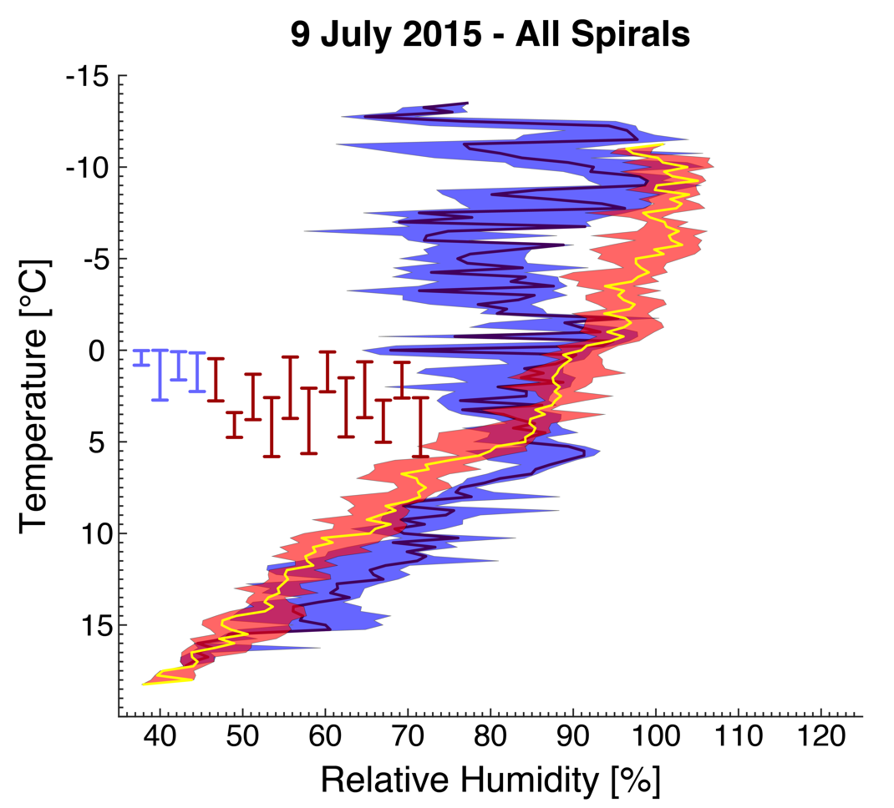
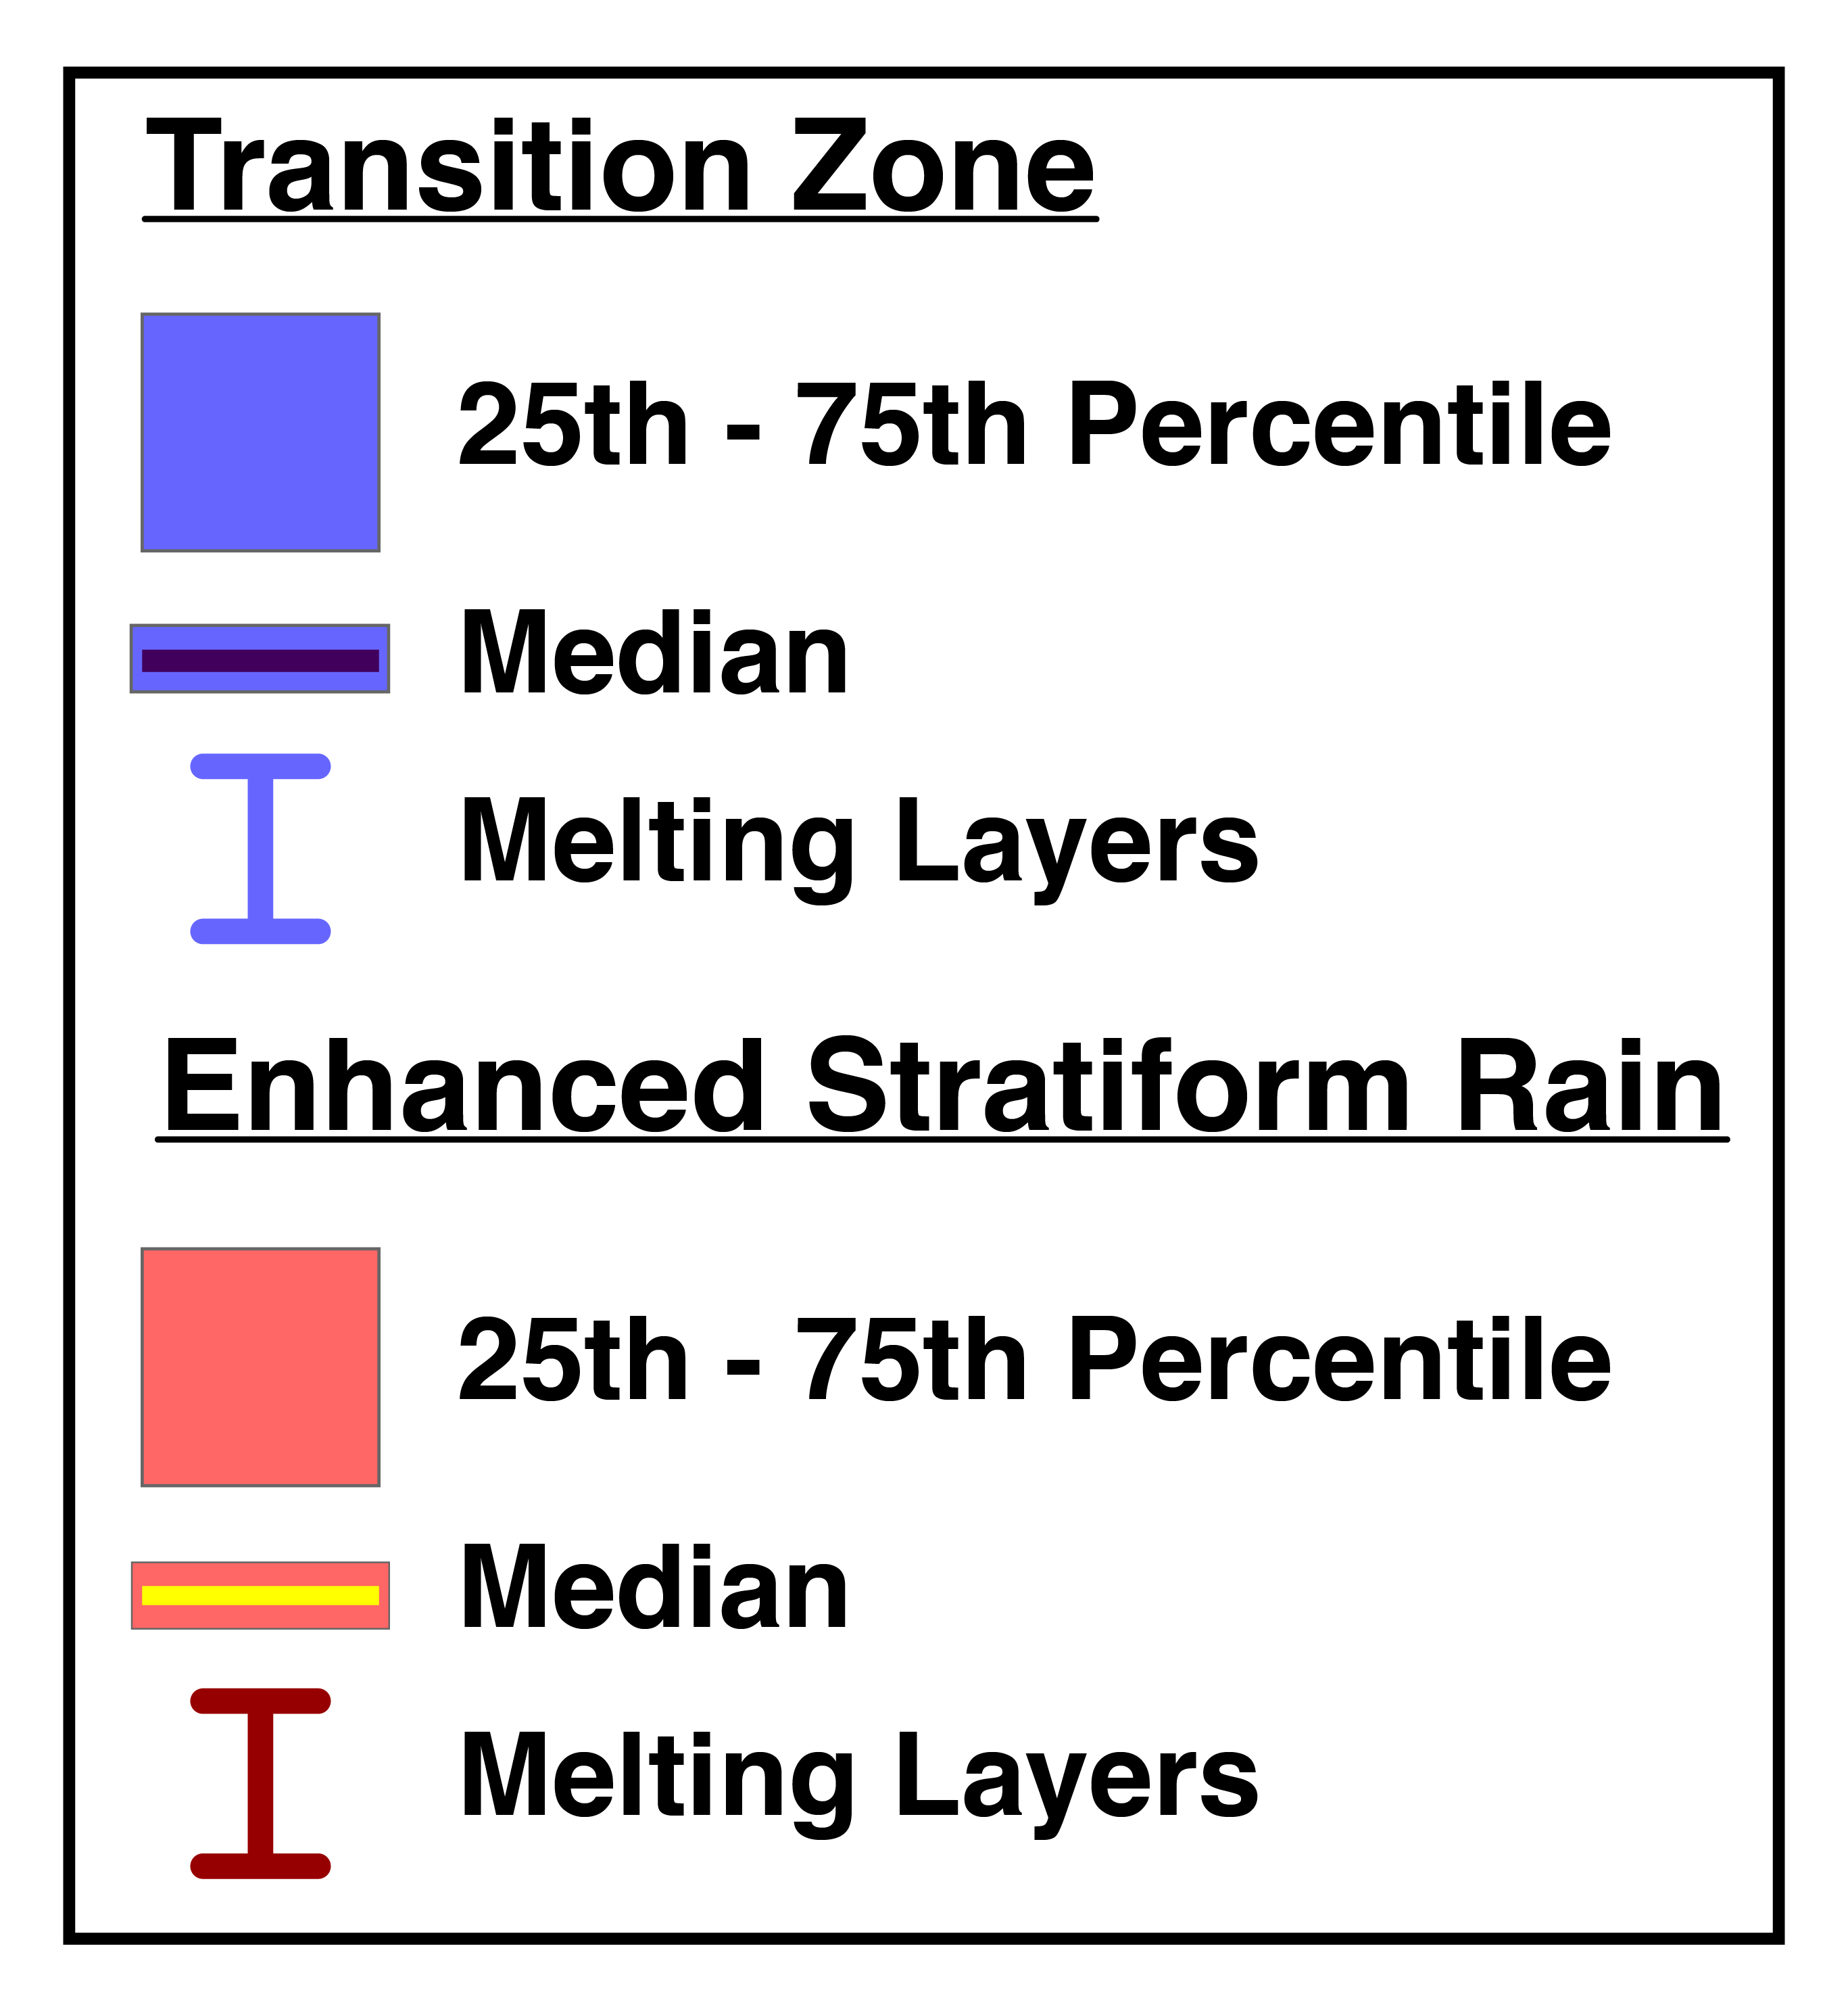
Microphysical and Thermodynamic Vertical Profiles
Combination of data from all spirals in each MCS region
  Helps to determine the how thermodynamic and microphysical quantities vary relative to temperature (melting layer)
TZ
ESR

Slide 16

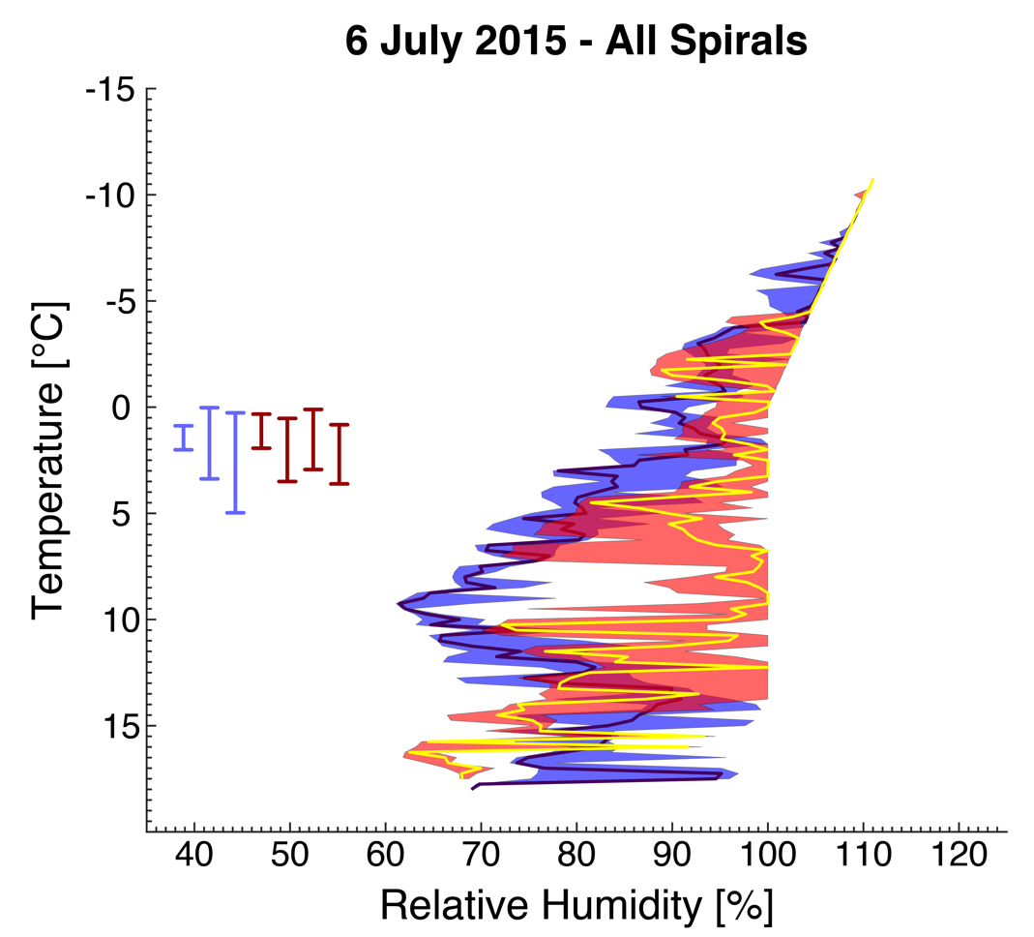
RH vs. Temp – All Spirals
RH up to ~40% greater for ESR compared to TZ below the melting layer
→ Evaporation/sublimation below the melting layer humidifies the air in the ESR
Notes:
Lowe and Ficke (1974) provided the empirically-derived expressions for VP and SVP/SVPice used in RH calculations

Slide 17
RH vs. Temp – All Spirals
RH up to ~20% greater for ESR compared to TZ above the melting layer

Slide 18
RH vs. Temp – All Spirals
RH up to ~10% greater in TZ compared to ESR, below the melting layer
→ Reason currently unknown; possibly case-specific variability

Slide 19
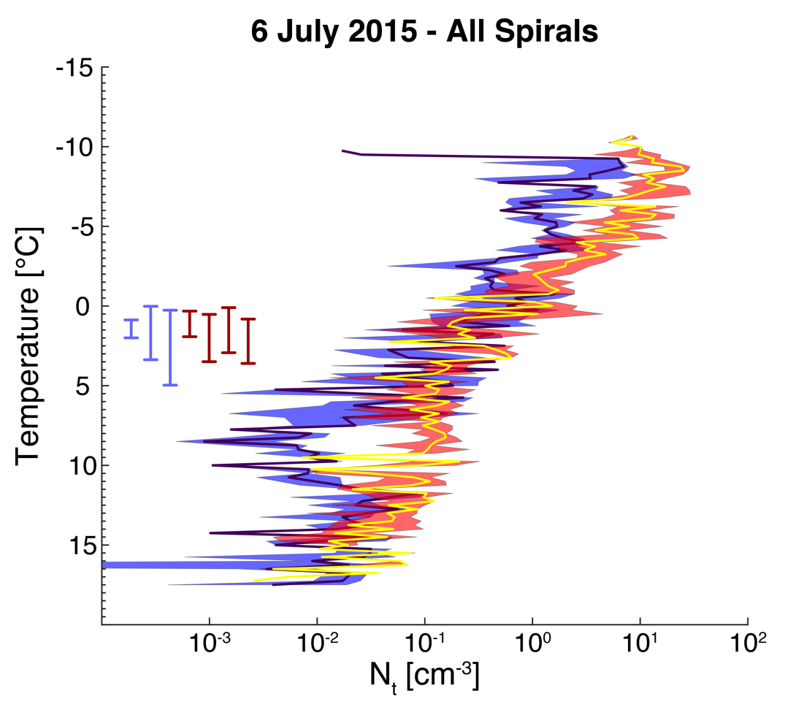
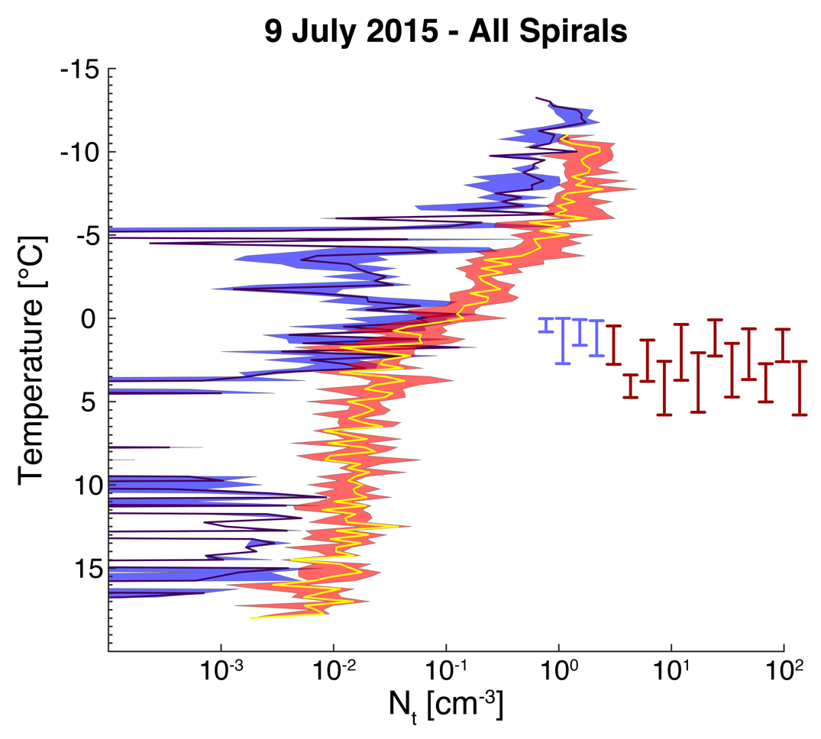
N_{t} vs. Temp – All Spirals
ESR above and below the melting layer had total number concentrations ~2-3 times greater than the TZ
This is expected → Higher precipitation rate in the ESR
Notes:
This is what we would expect given the higher precipitation rate in the ESR and the maturity of the MCS when the ESR is present.

Slide 20
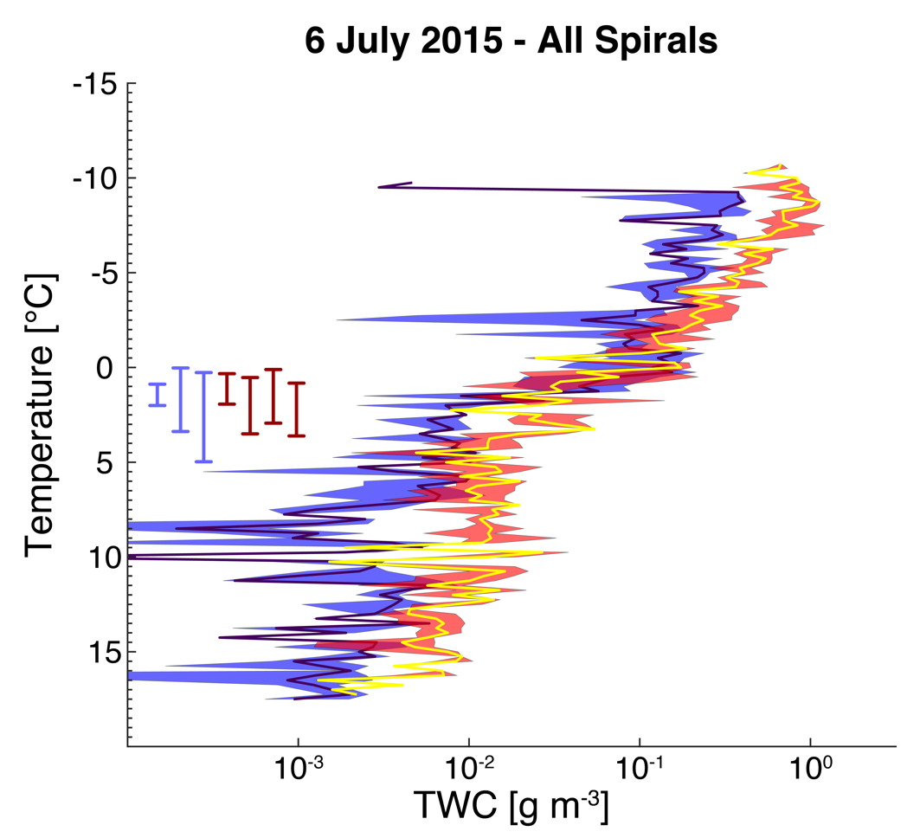
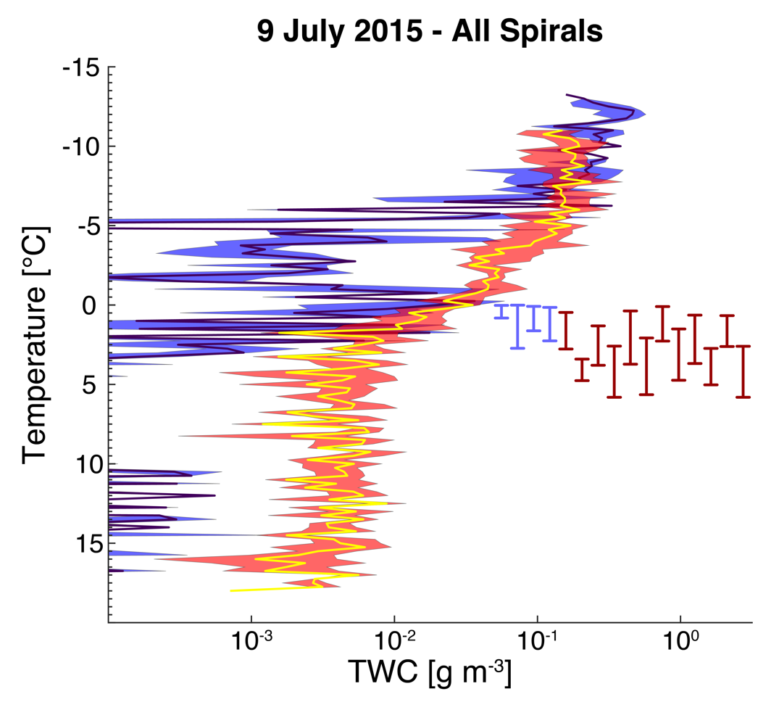
TWC vs. Temp – All Spirals
ESR above and below the melting layer had ~2-3 times greater TWC than the TZ on average

Slide 21
Conclusions
Good Agreement Between Cases:
The ESR was more humid than the TZ above the ML
N_{t} and TWC were on average 2-3 times greater in the ESR than in the TZ for both cases
  Indicates more particles in the ESR, not necessarily larger particles
More, small particles were observed above ~ -5 °C in the ESR than in the TZ (based on median mass diameter; not shown)
Poor Agreement Between Cases:
ESR was drier than TZ below the ML on 9 July
9 July case had more, large particles in the ESR below the ML (based on median mass diameter; not shown)
6 July case had very similar D_{mm} in each region for all temperatures warmer than ~ -5 °C (based on median mass diameter; not shown)

Slide 22
Future Studies
Consider similar vertical profiles from the remaining 4 cases
  Do any statistically significant patterns emerge?
Include PIP data
  How does extending the distributions to larger diameters affect the results?
Complete multiple-Doppler syntheses using the Spline Analysis at Mesoscale Utilizing Radar and Aircraft Instrumentation (SAMURAI) technique ( Bell et al. 2012)
Acknowledgements
This work was sponsored by the National Science Foundation (NSF) under Grant AGS-1359098
Many thanks to the NOAA P-3 flight crew and science team for their work in collecting the datasets presented

Slide 23


Slide 24
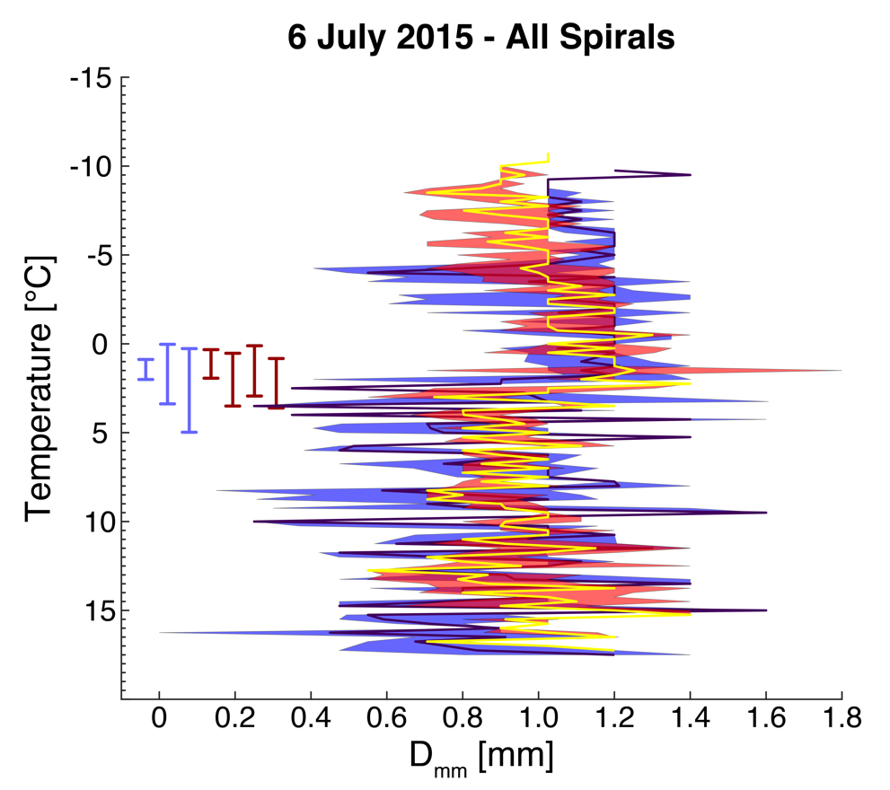
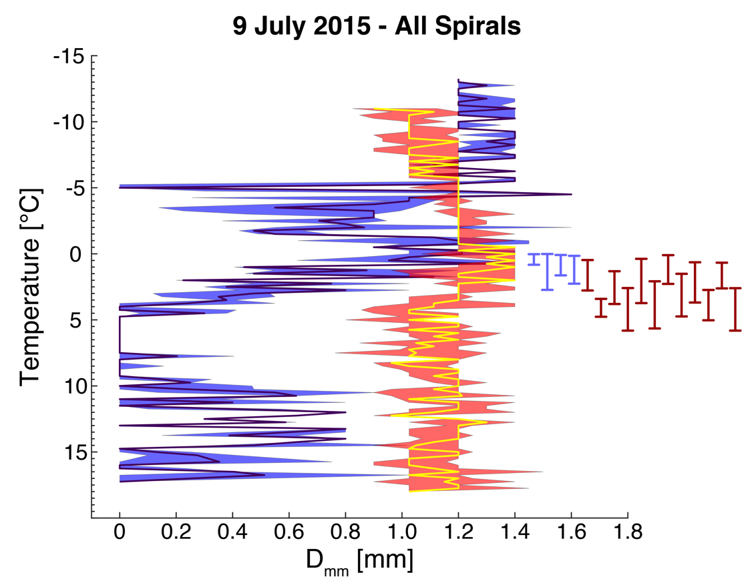
D_{mm} vs. Temp – All Spirals
D_{mm} 250 µm greater on average in the TZ at temperatures below ~-5 °C
→ More, small particles in the ESR at these temperatures

Slide 25
D_{mm} vs. Temp – All Spirals
Much larger spread in D_{mm} below the melting layer
ESR and TZ D_{mm} quite similar up to ~ -5 °C
Why is there such disagreement?

Slide 26
Total Water Content (TWC)
TWC calculated using habit-dependent m-D relationships from Mitchell (1996) above the ML bottom
0°C
Melting Layer
~5°C
Melting Layer Bottom
  Liquid drops assumed below the ML bottom

