Slide 1
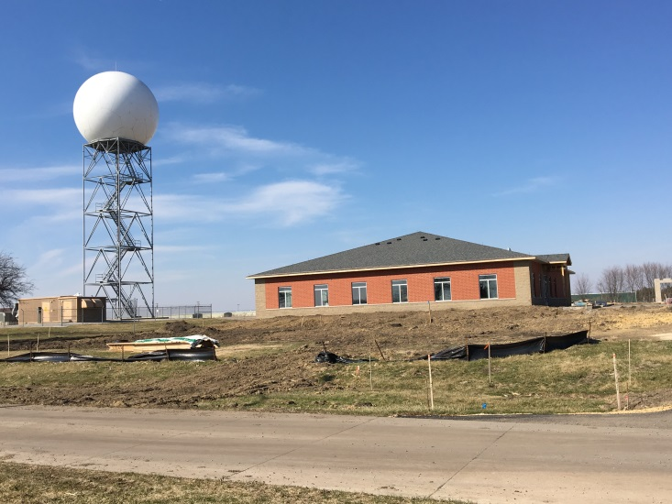


Use of WSR-88D Spectrum Width as a Diagnostic and Prognostic Tool in the Tornado Warning
Decision-Making Process
Ray Wolf and Alex Gibbs
NOAA/NWS Davenport, Iowa

Slide 2
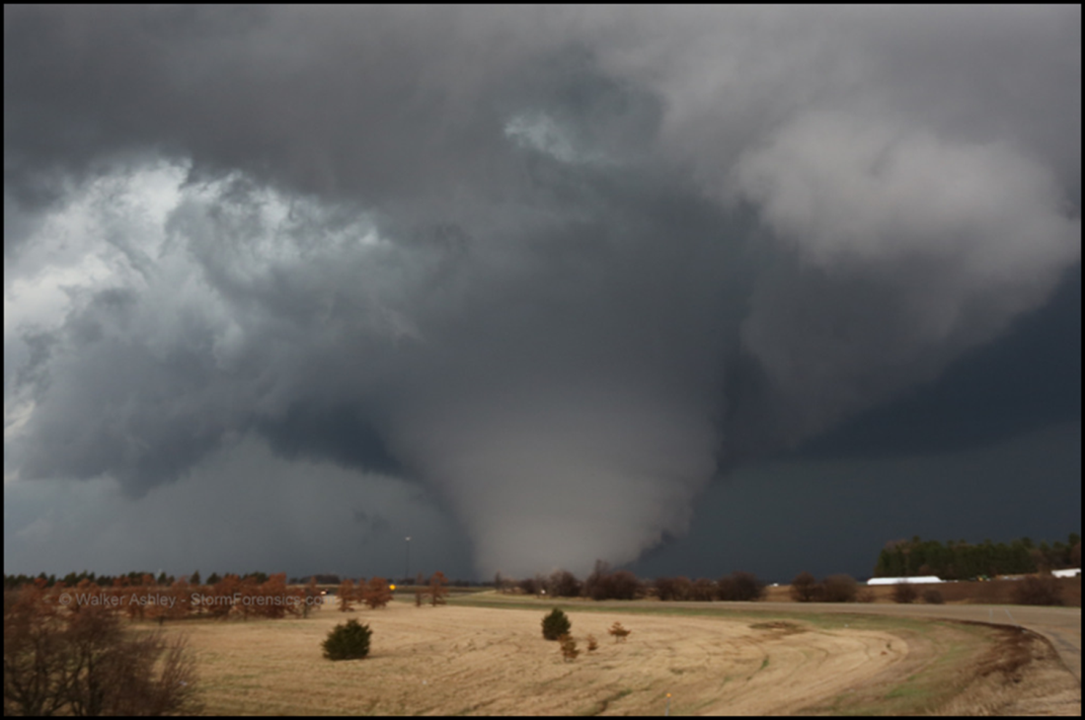
Goal
Explore temporal trends and scalar values of
spectrum width maxima in tornado-producing circulations
to determine potential use as a diagnostic and warning decision-making tool.
Courtesy of Walker Ashley

Slide 3
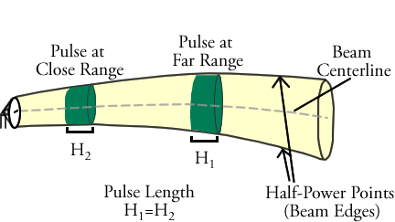
Spectrum Width Refresher
One of three original Doppler moments
Measure of velocity dispersion (variance) within pulse volume
Produced primarily by wind shear and turbulence
Standard radar limitations and data quality issues apply
Use in context with Z and V and environmental data

Slide 4
Method
Identified tornado-producing circulations and tornado initiation times
  Each new mesocyclone/mesovortex constituted a circulation
0.5° Spectrum Width maxima values (kts) determined for time t = -20 to t = +5 relative to nearest Spectrum Width product time associated with tornado initiation
  Values must be associated with a circulation
  Maximum bin in the circulation tabulated
Composited data to assess trend and absolute values

Slide 5
Data
KDVN WSR-88D observed tornadic storms 2008–2016 (130)
MESOSAILs/AVSET and non-MESOSAILs/non-AVSET cases
Few cases (< 1%) had data quality issues (range folding)
Tabulated EF scale, storm mode, and distance from radar
CAVEAT: standard radar data sampling issues
CAVEAT: compositing can average out details important to individual cases

Slide 6
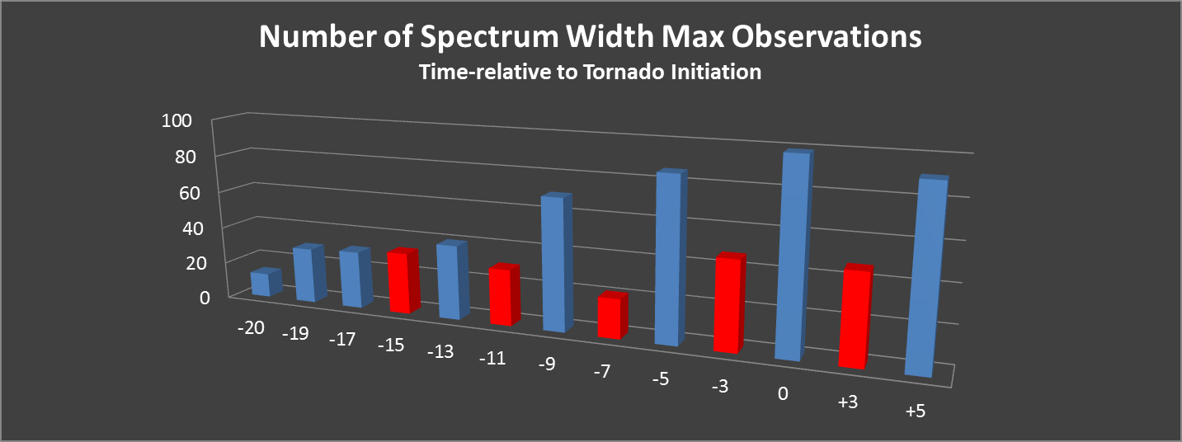
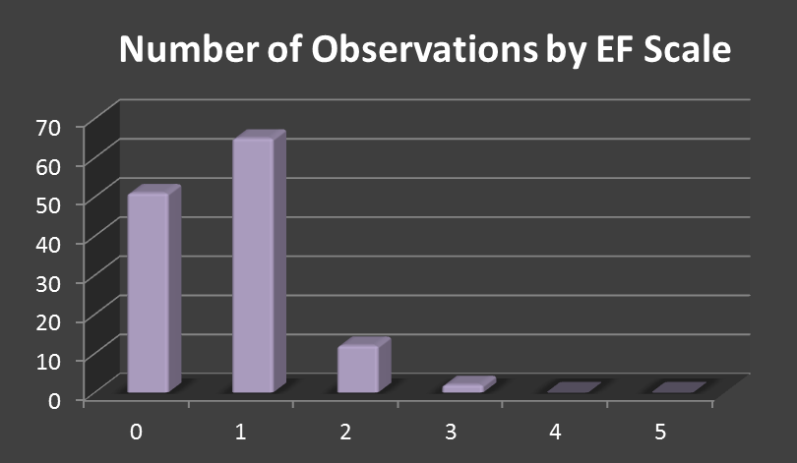
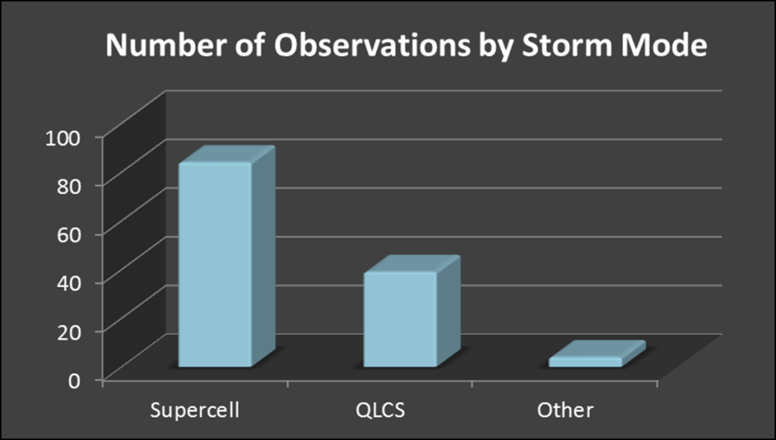
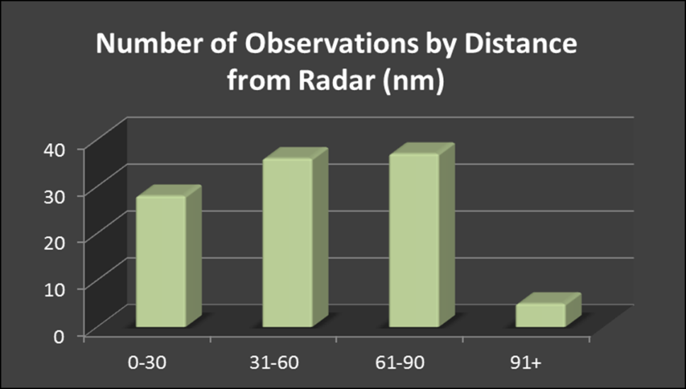

Slide 7
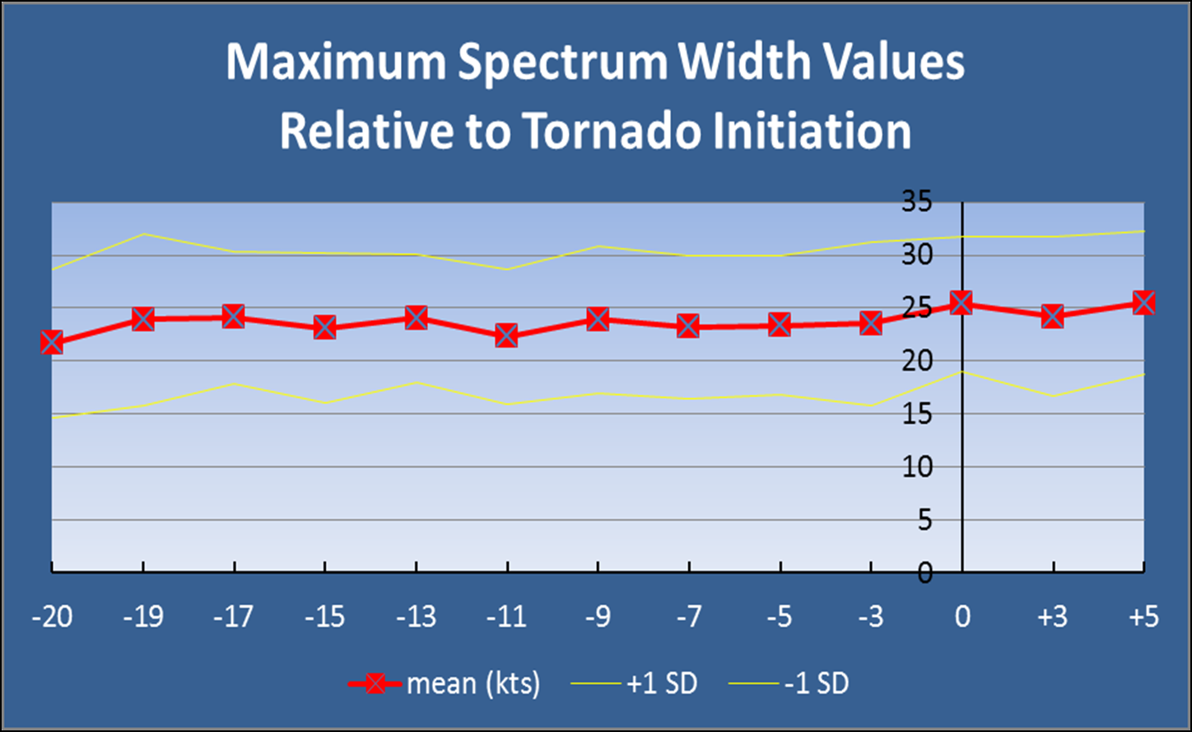
Results

Slide 8
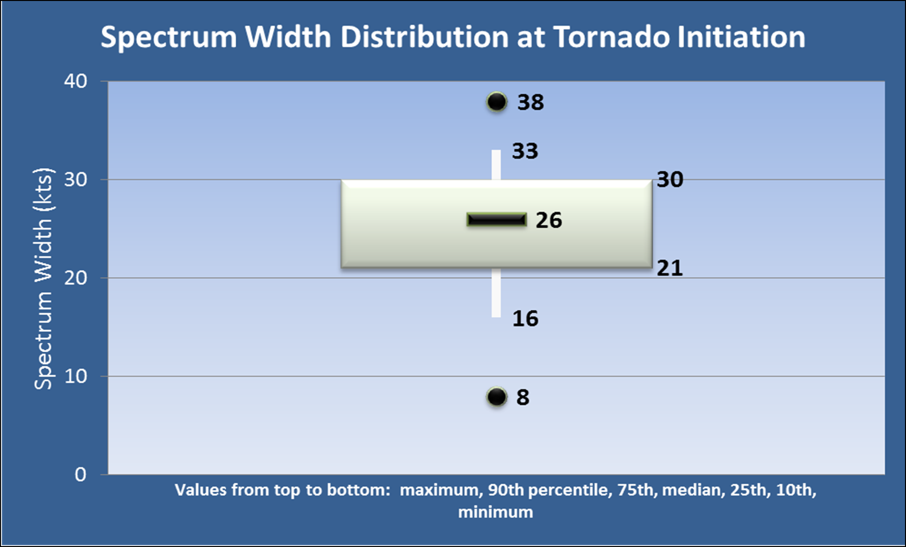
Results

Slide 9
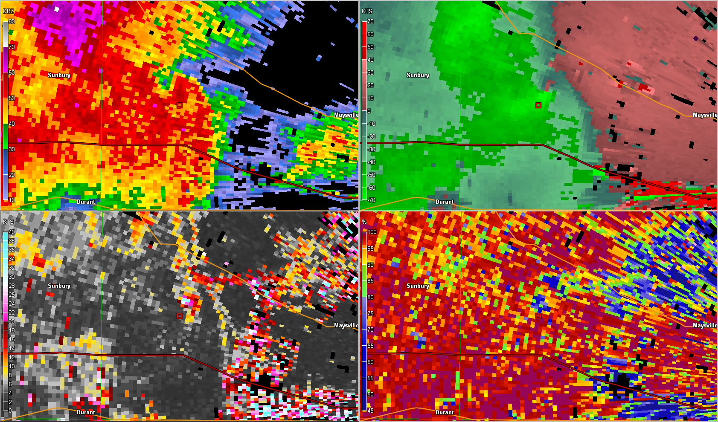
Supercell Example – 9 April 2015

Slide 10
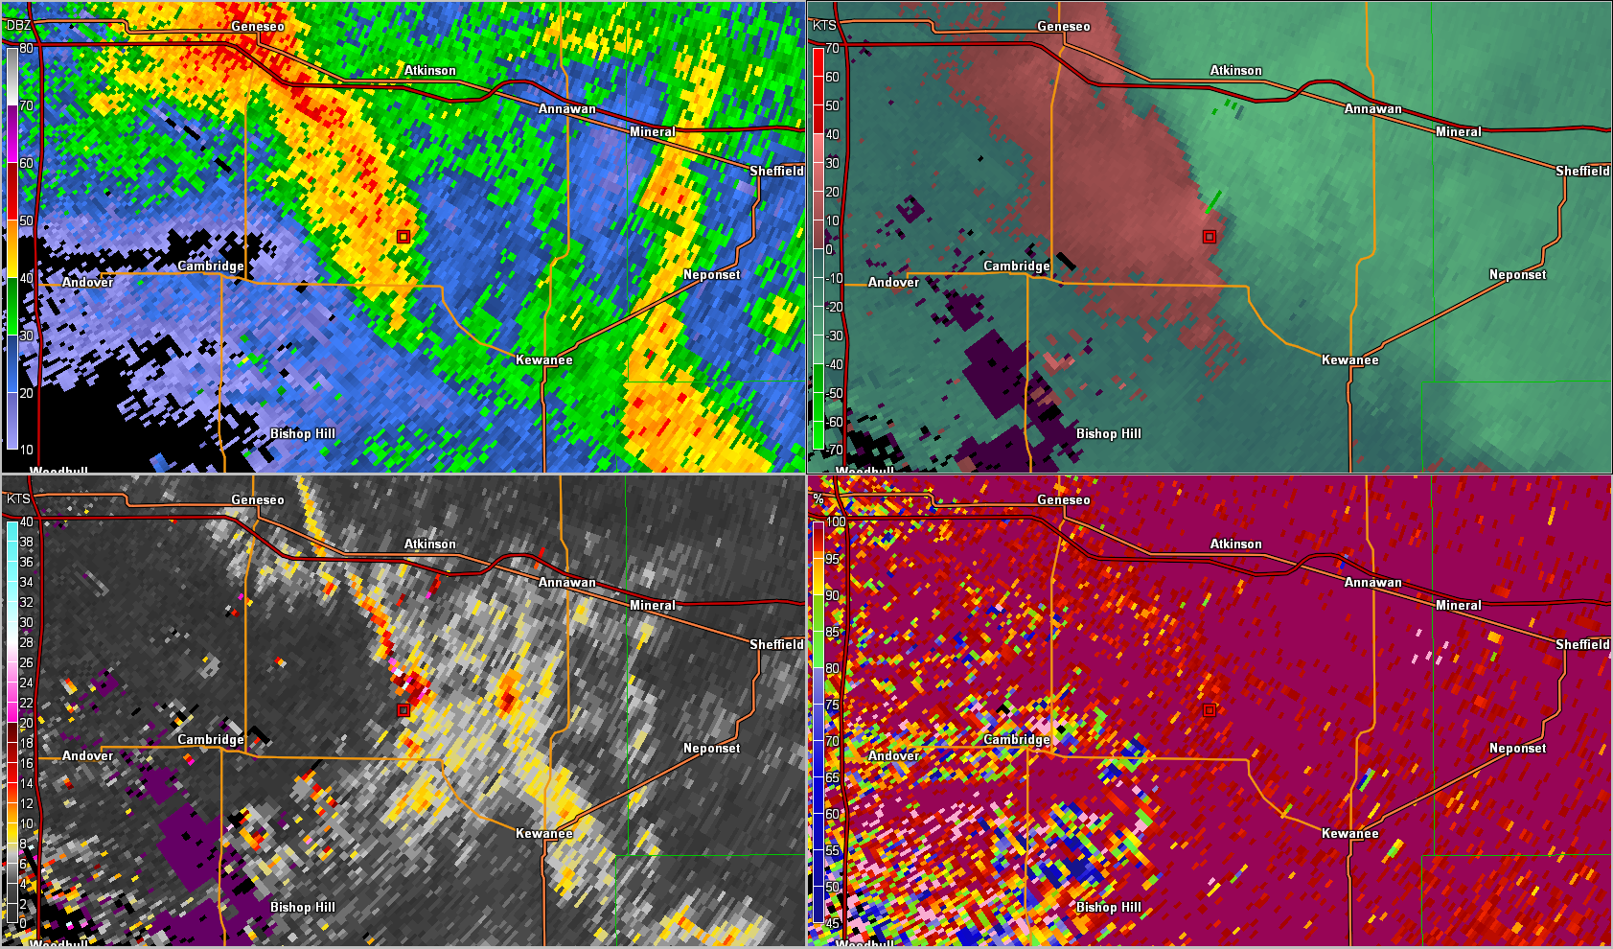
QLCS Example – 26 May 2015

Slide 11
Conclusions
Tornadoes very frequently associated with high SW max (20+ kts)
No clear SW max trend prior to tornado initiation; already at high values
Can help diagnose tornados. May aid with warning decisions
Well-designed color curve will enhance visibility of key values

Slide 12
Conclusions
SW max sometimes easier to track than circulation in velocity
SW max typically not observed with landspouts
MESOSAILs/AVSET greatly enhance data for evaluation
No relationship of SW maxima to
  EF scale,
  storm mode,
  distance from radar

Slide 13
Future Study
Conduct same evaluation for Tornado False Alarm cases
Are data sets significantly different?

