Slide 1
Non–Traditional Tornado Signatures
Doug Cramer
National Weather Service
Springfield Missouri

Slide 2
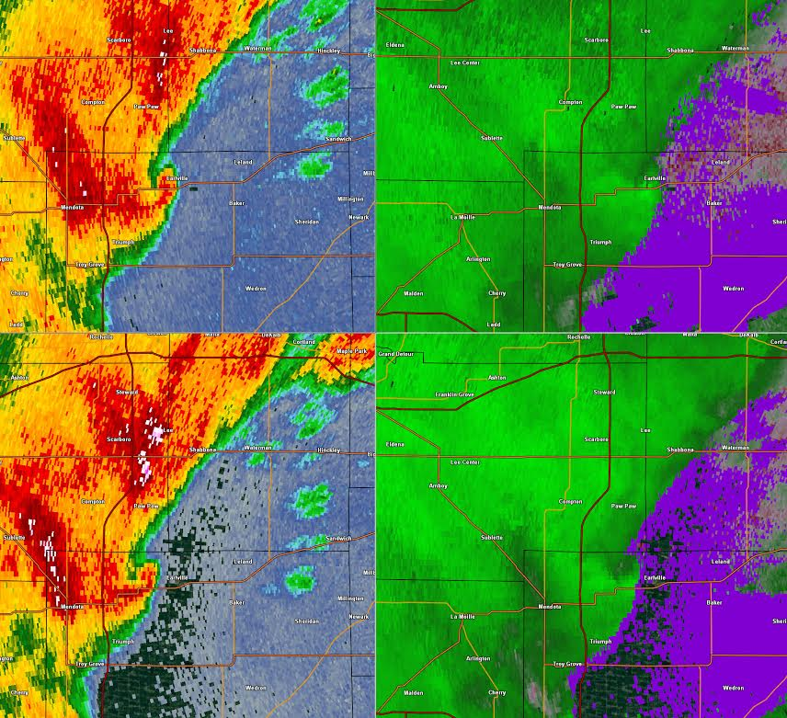
Front End Nubs (Nubs)
EF – 1
STORM
MOTION

Slide 3
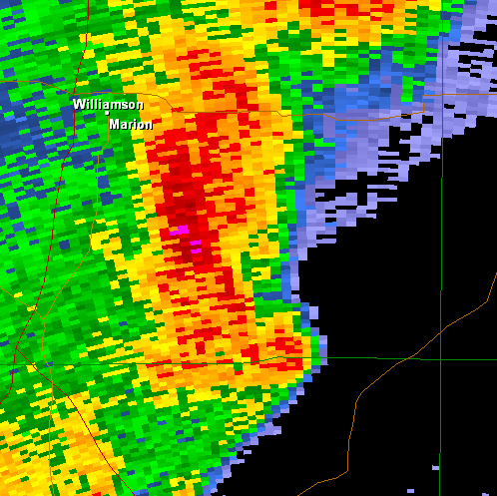
Front End Nubs (Nubs)
NUB

Slide 4
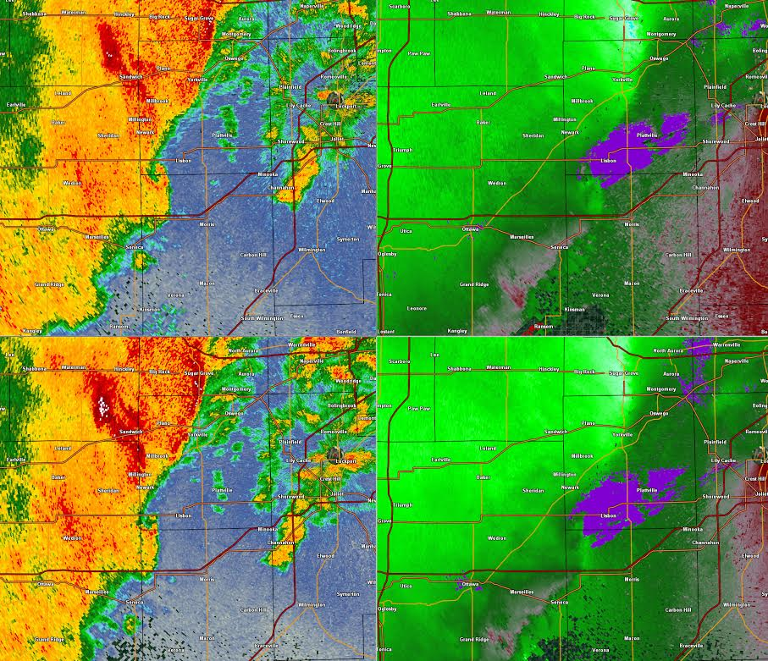
Front End Nubs (Nubs)
EF – 1

Slide 5
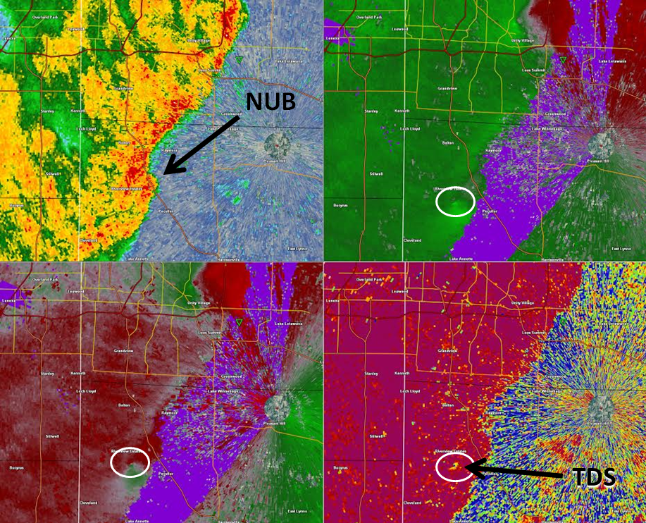
Front End Nubs (Nubs)

Slide 6
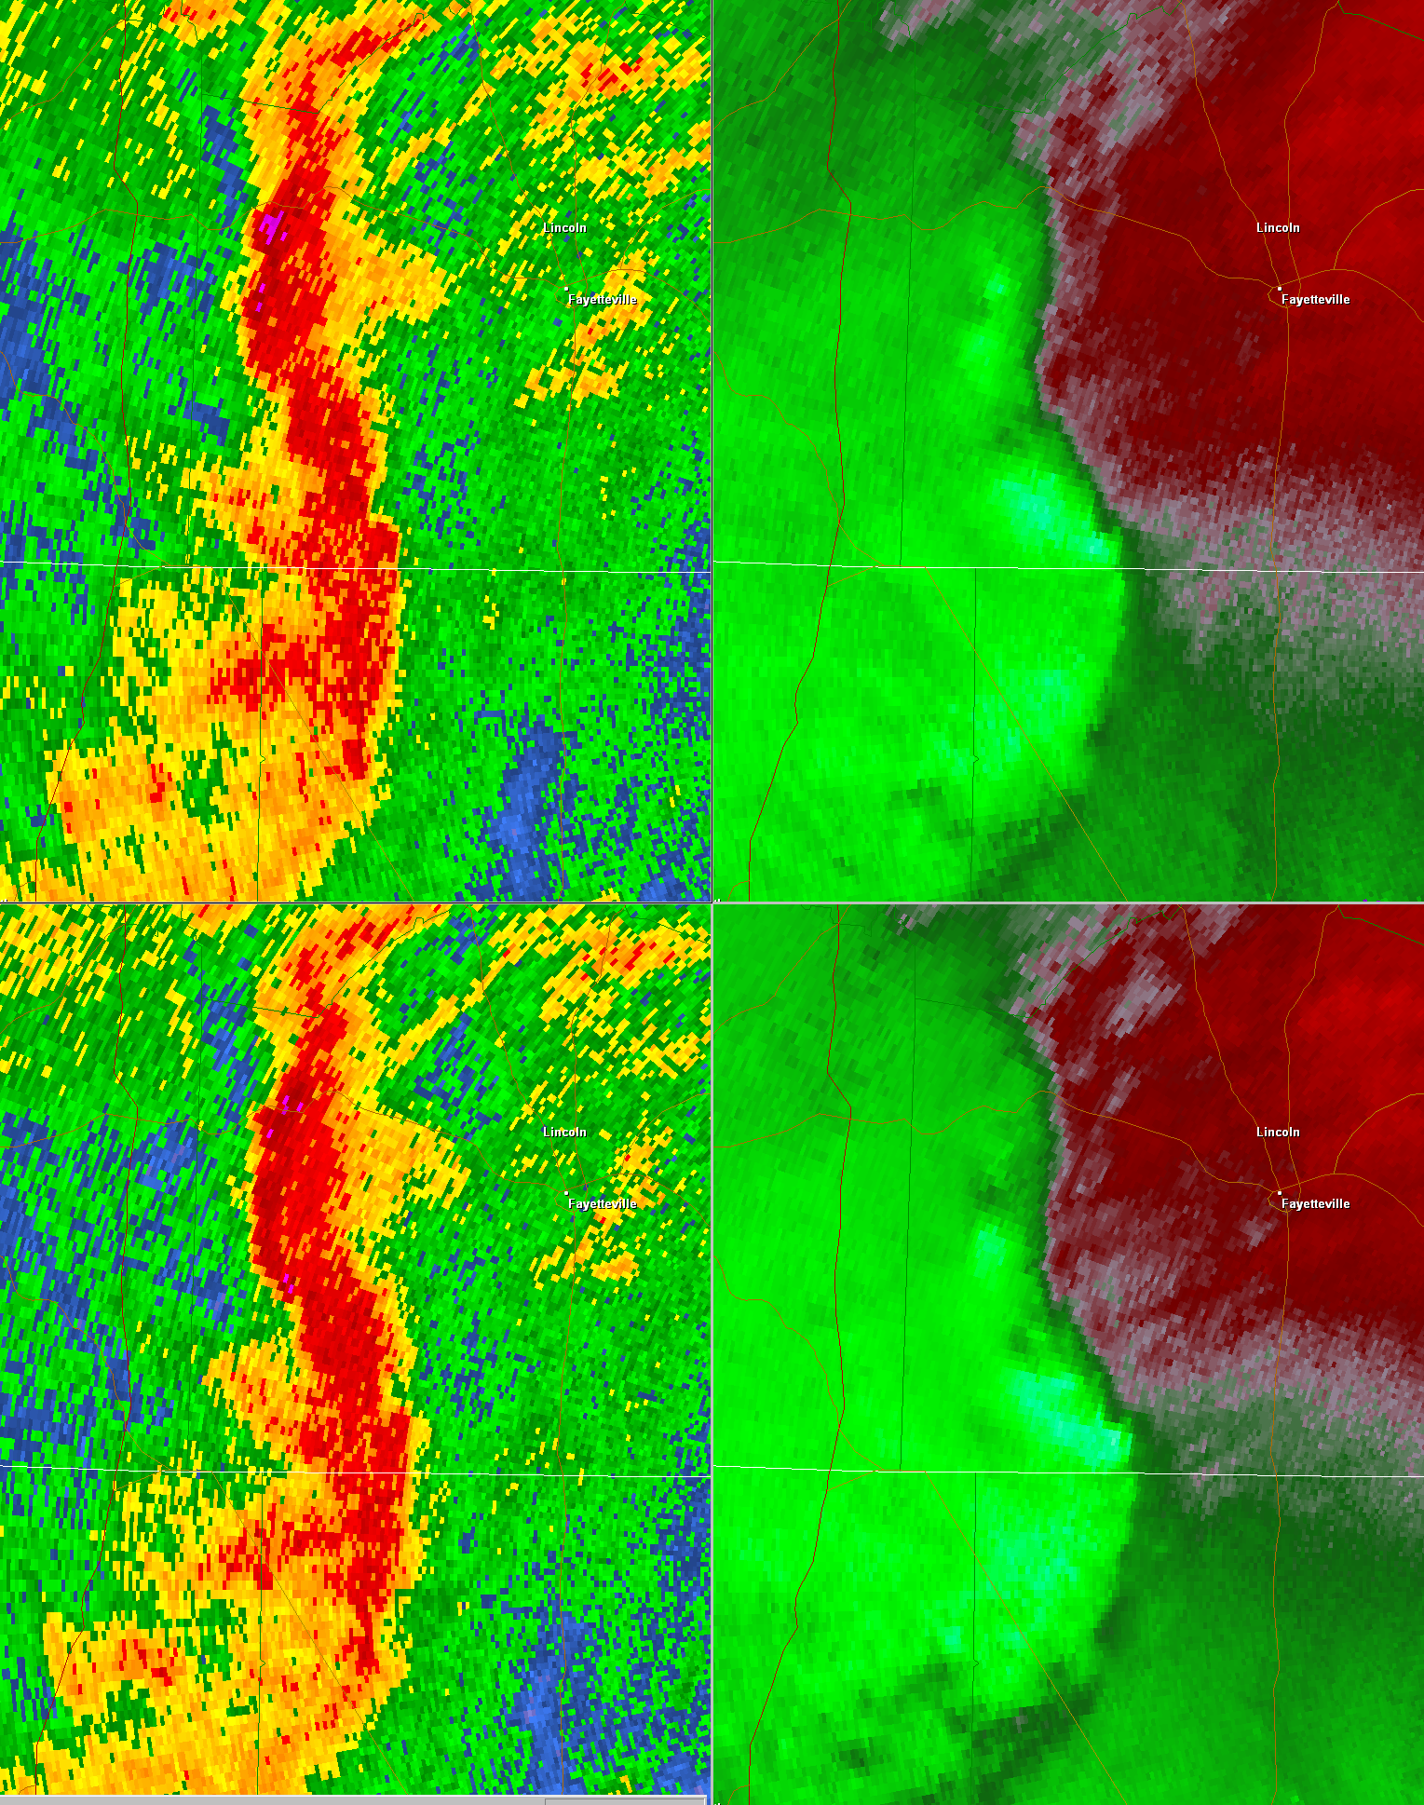
TORNADO

Slide 7
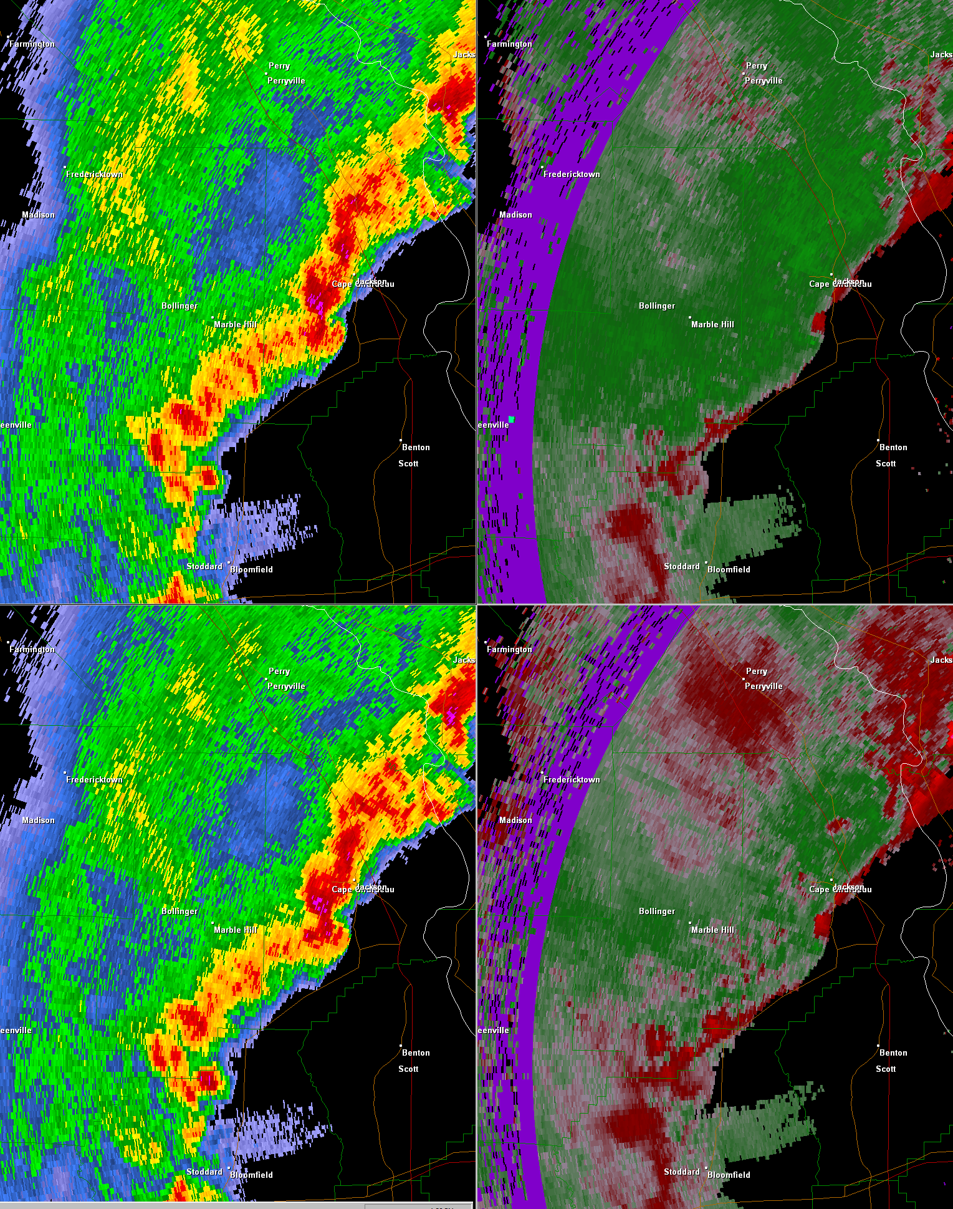

Slide 8
TORNADO

Slide 10
TORNADO

Slide 11
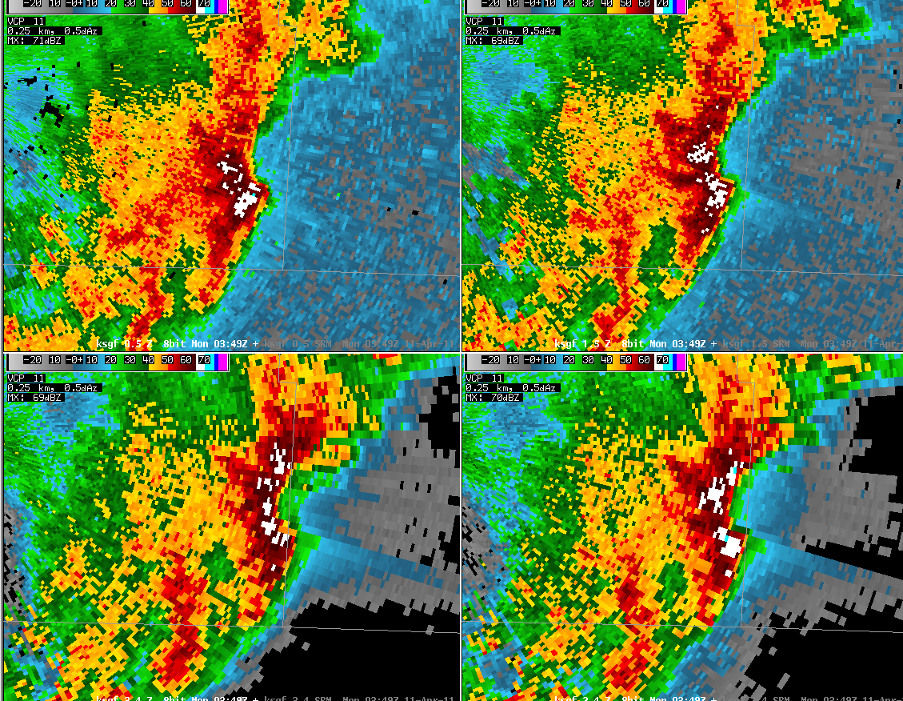

Slide 12
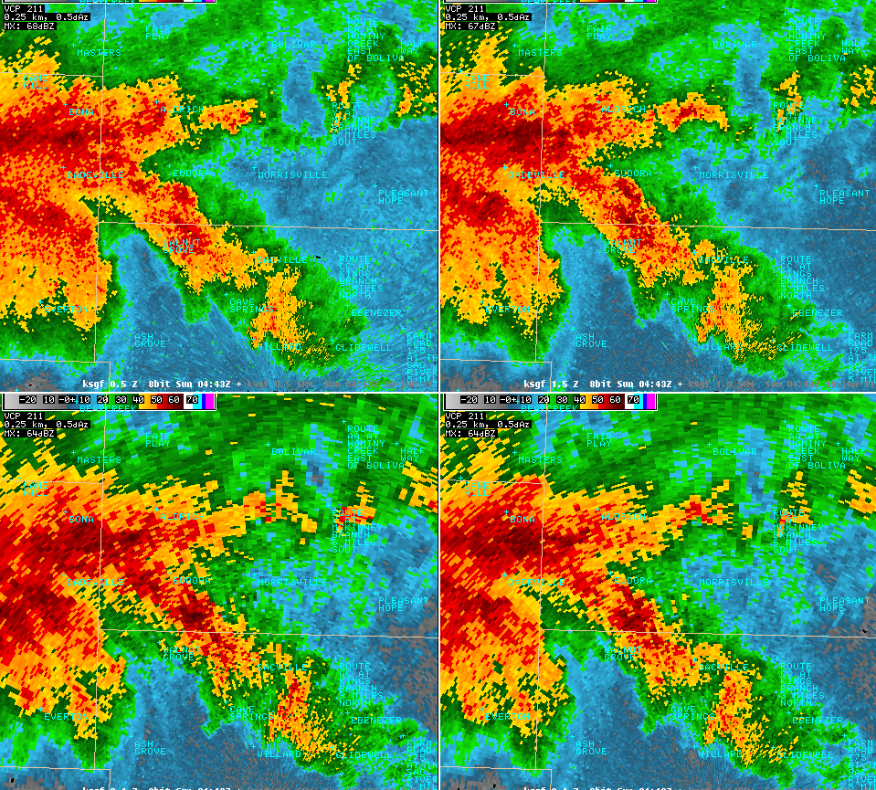

Slide 13
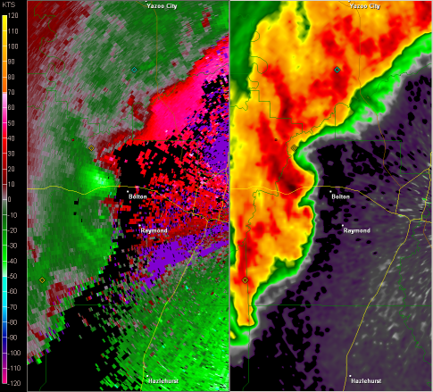

Slide 14
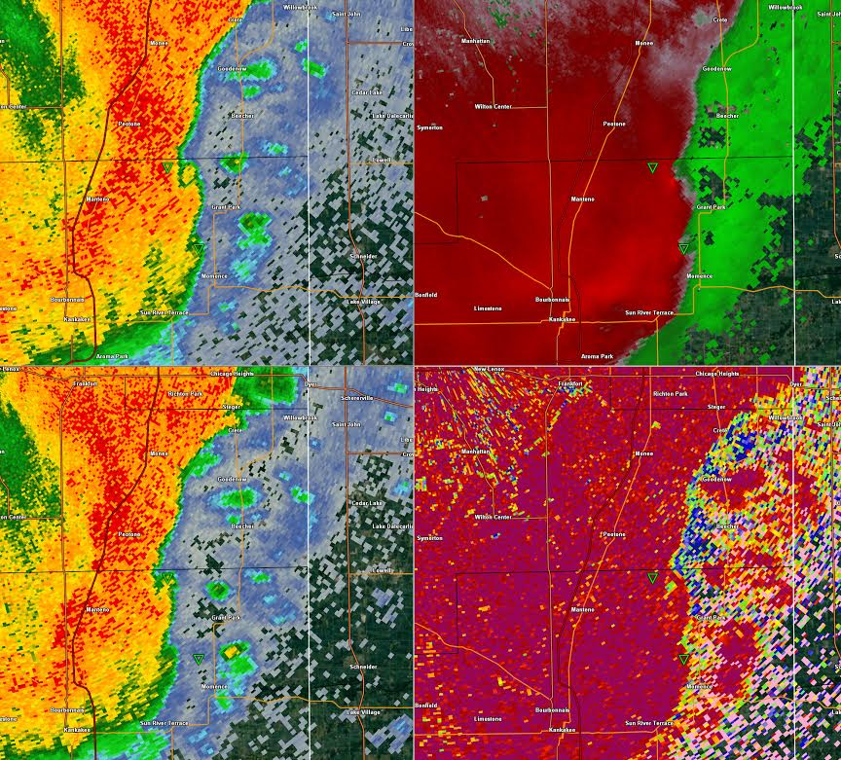
EF-1
TDS

Slide 15
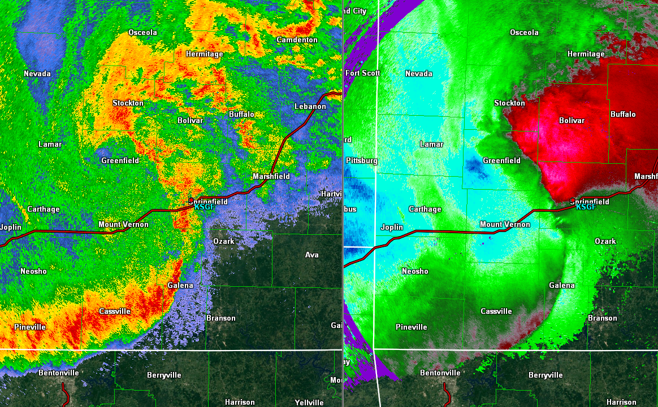
Leading Stratiform

Slide 16
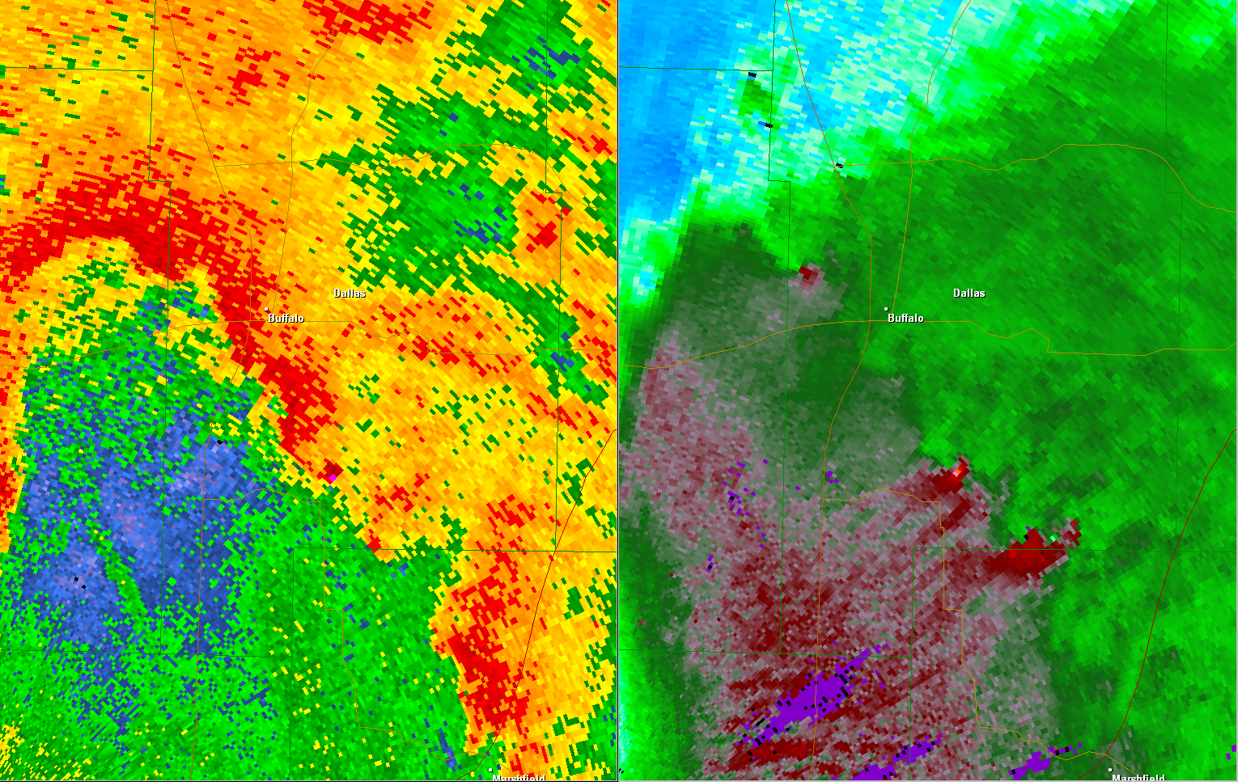
Leading Stratiform
TORNADO
TORNADO

Slide 17
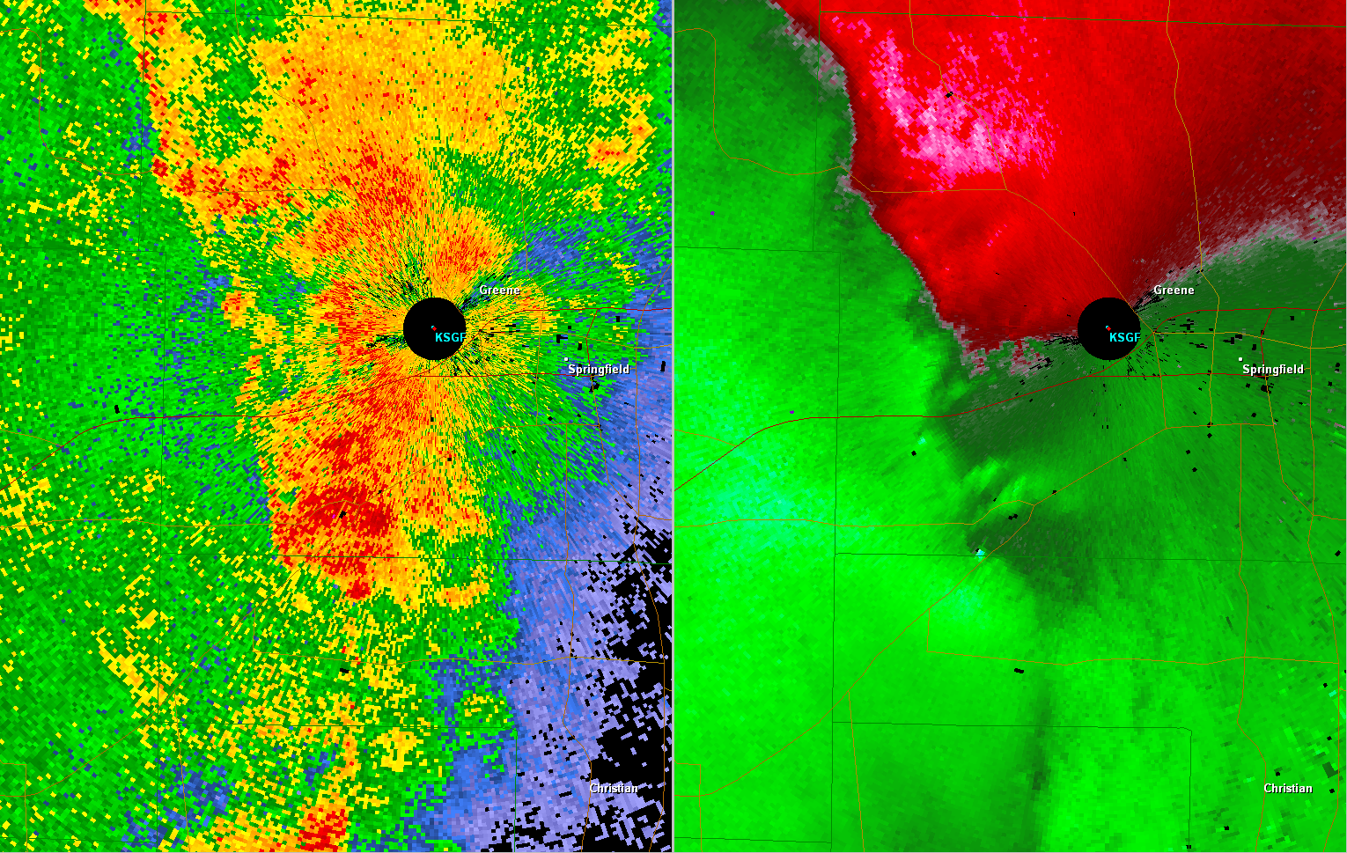
Leading Stratiform
TORNADO
TORNADO

Slide 18
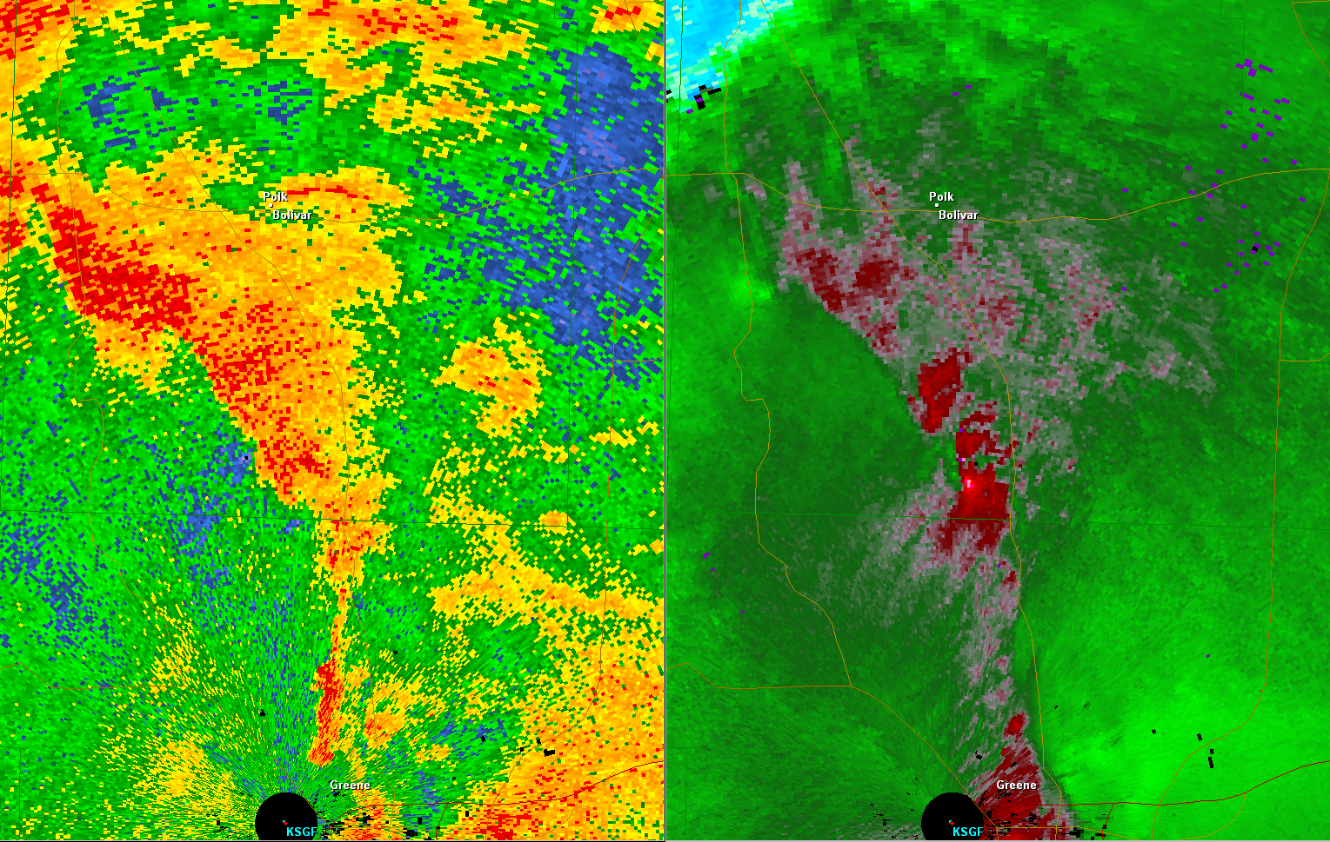
Leading Stratiform
TORNADO
TORNADO

Slide 19
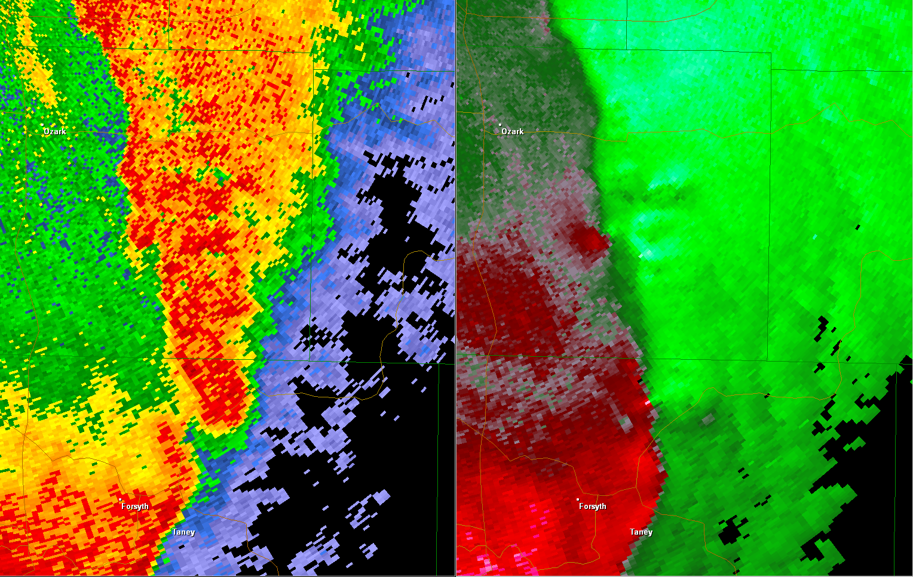
Leading Stratiform
MESO-VORT
MESO-VORT
TORNADO
TORNADO

Slide 20
TORNADO

Slide 21
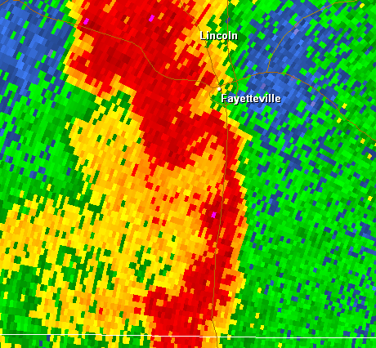
Coupled Inflow Notch
T

Slide 22
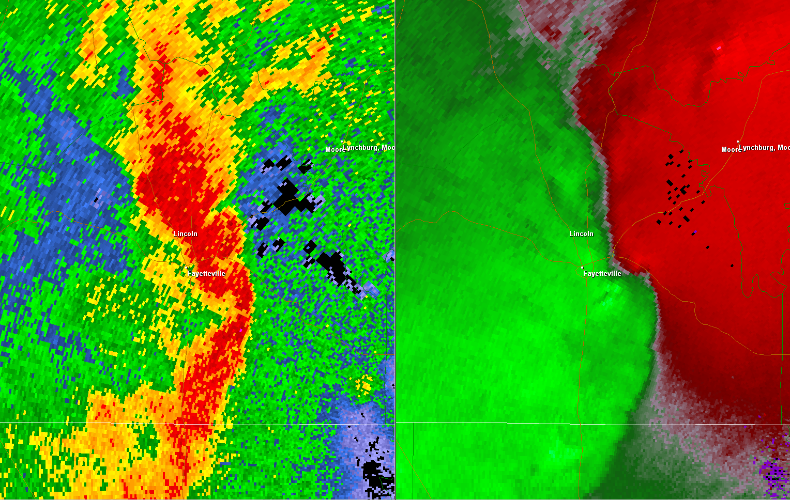
Coupled Inflow Notch
T

Slide 23
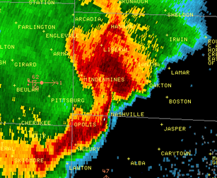
Coupled Inflow Notch
T

Slide 24
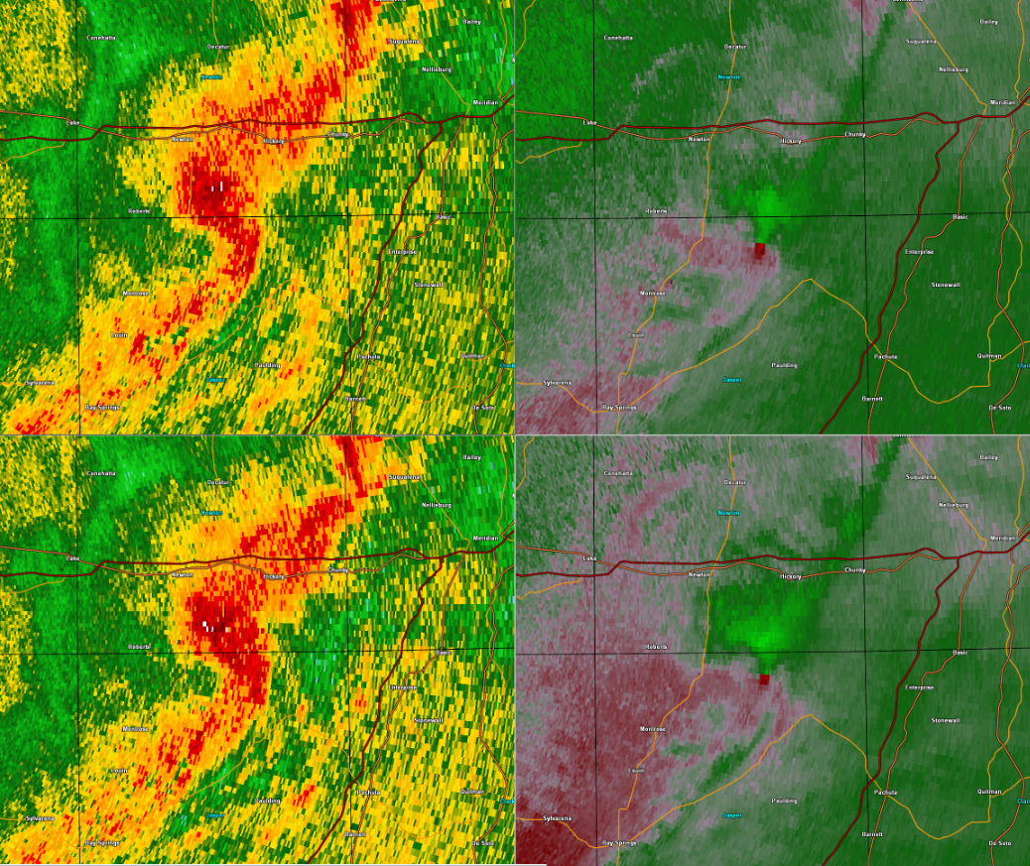
T
T

Slide 25
T

Slide 26
T

Slide 27
Reflectivity Tags

Slide 28
Reflectivity Tags

Slide 29
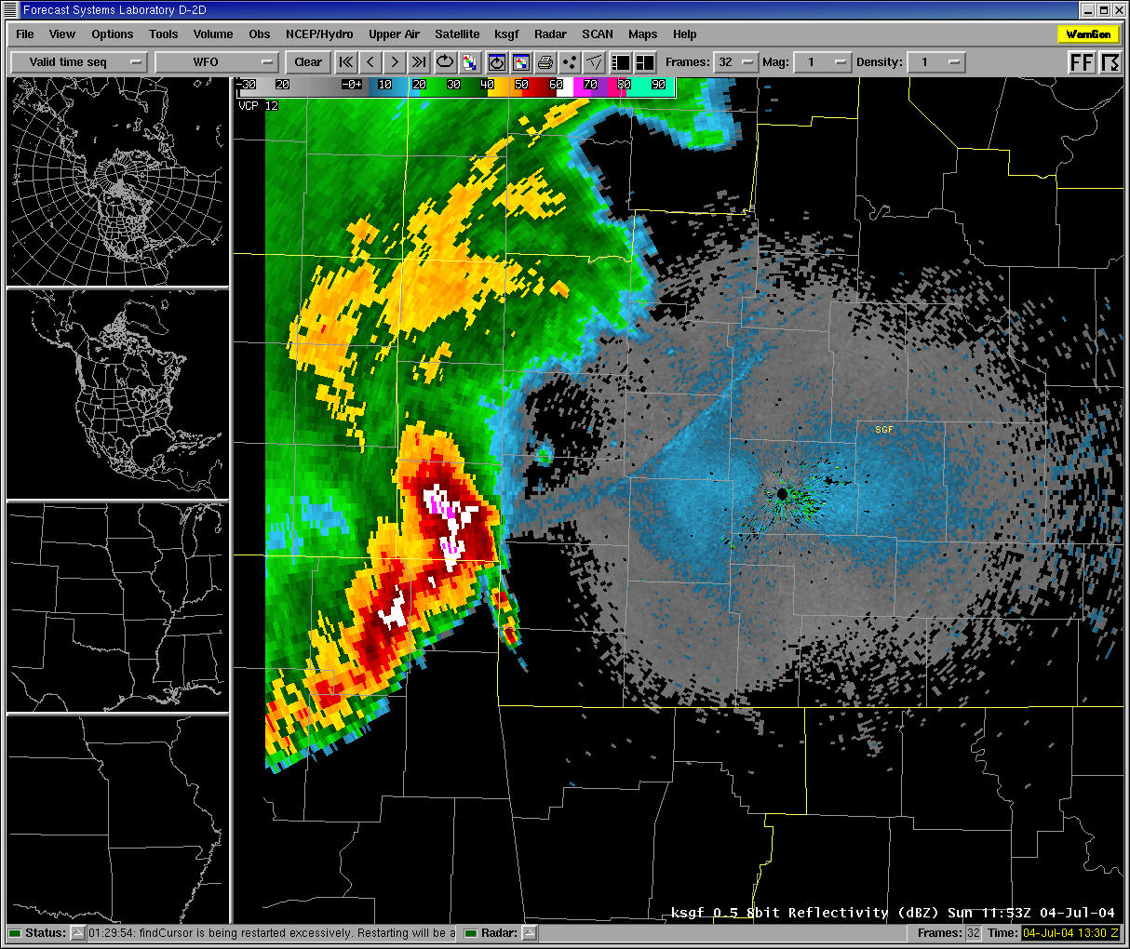

Slide 30
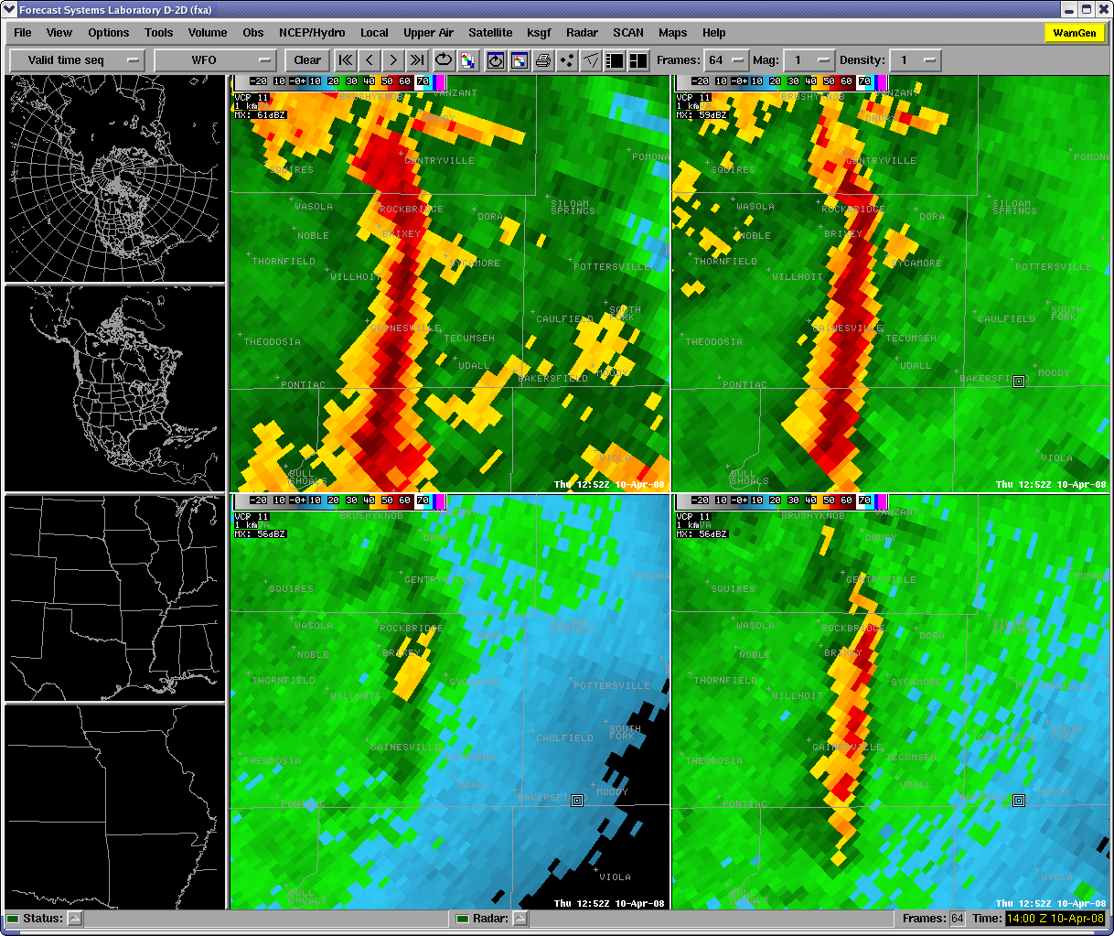

Slide 31
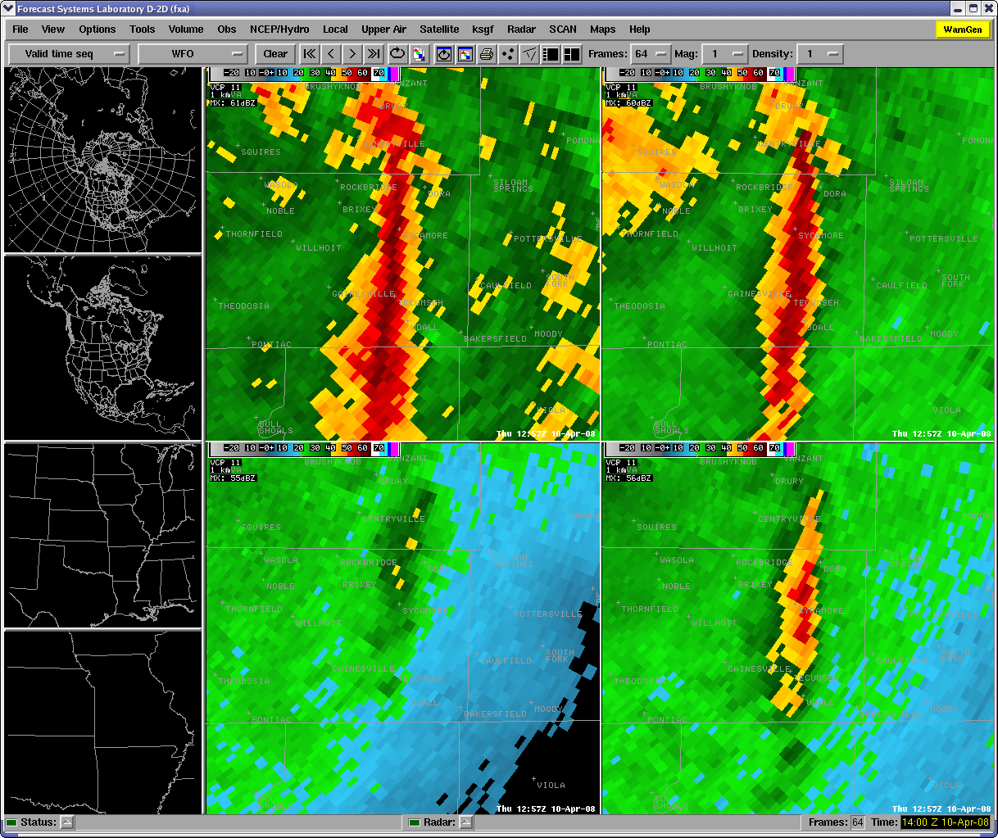

Slide 32
