Slide 1
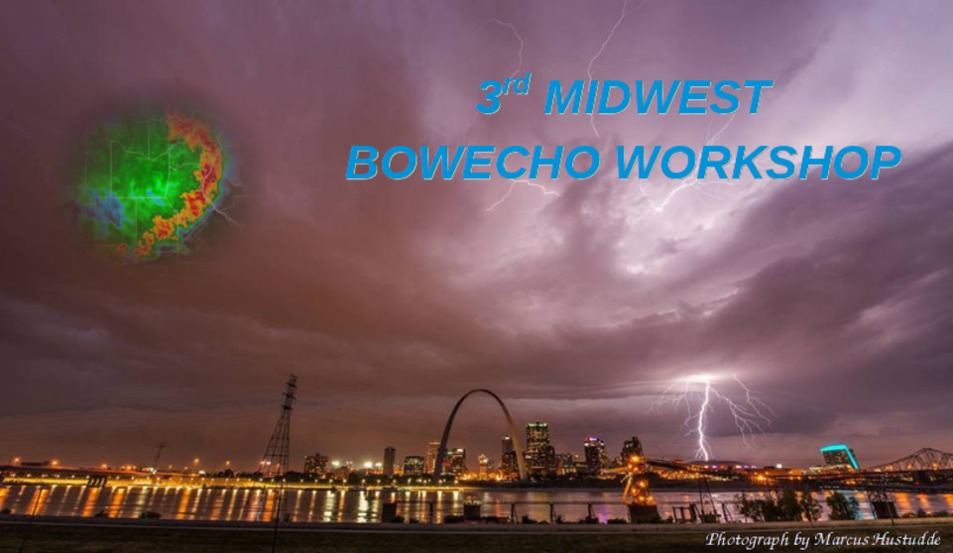
Examination of Radar Features and Mesoscale Parameters Which May Lead to an Increased Likelihood for Mesovortex Tornadoes
Conducted by:
Robert Frye & Jason Schaumann
NWS Springfield, MO

Slide 2
Overview
Finish review of confidence builders/nudgers as a continuation of the last 2 presentations
Find out if there is a correlation between specific Confidence Builders/Nudgers and surveyed Tornadoes

Slide 3
Introduction to Additional Features
Remaining Confidence Builders and “Nudgers” NOT already covered in the prior presentations

Slide 4
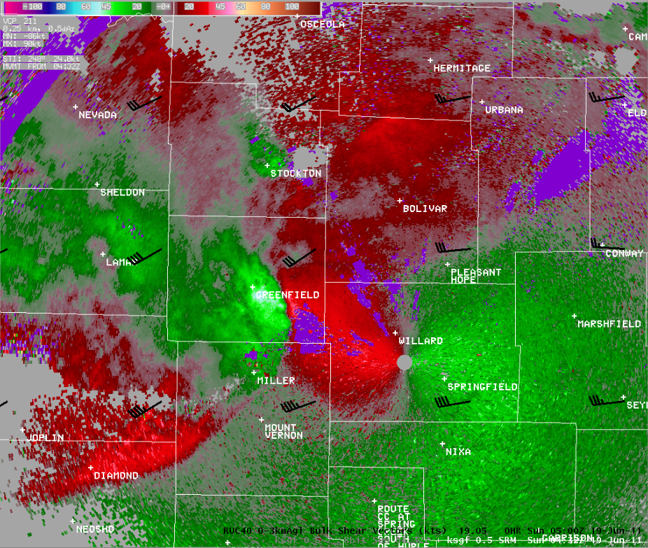
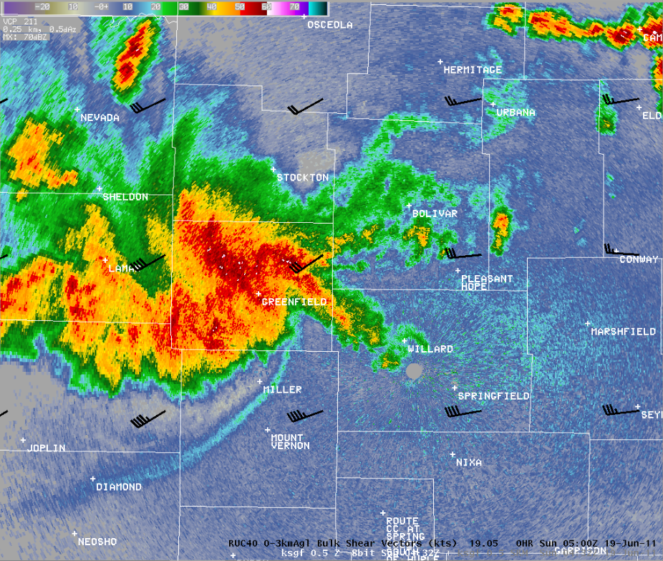
Confidence Builders for Considering a Tornado Warning
An entry/inflection point
  Area where UDCZ curls back into precipitation
  Transition area between balanced and slightly shear dominant regimes
0.5° SRM
0-3 km Bulk Shear Vectors
0.5° Z
0-3 km Bulk Shear Vectors
UDCZ
Entry point
Notes:
75% of EF-0 tornadoes had a Vr of at least 24 knots
Max Vr using pixels within 5 miles of each other from immediately prior to tornadogenesis to immediately before termination

Slide 5
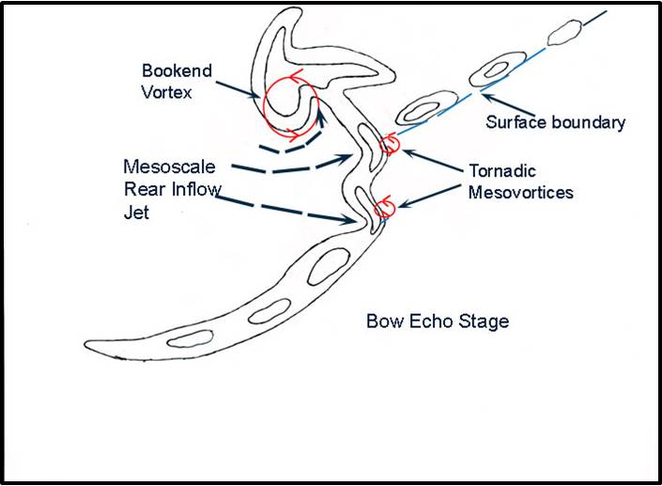
Confidence Builders for Considering a Tornado Warning
A surge/bow ingesting a stationary or quasi-stationary vorticity source
  Synoptic front
  Convective outflow
Przybylinski 2012

Slide 6
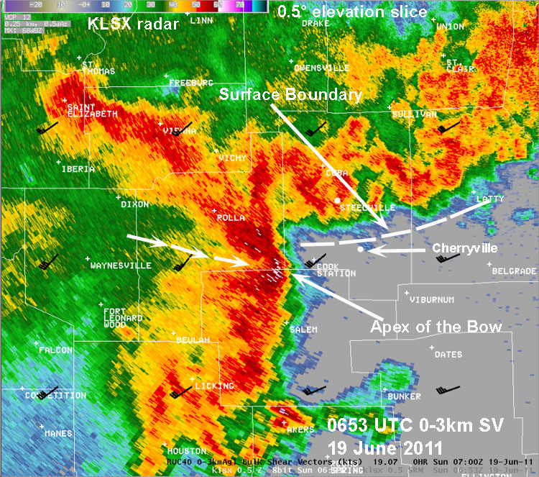
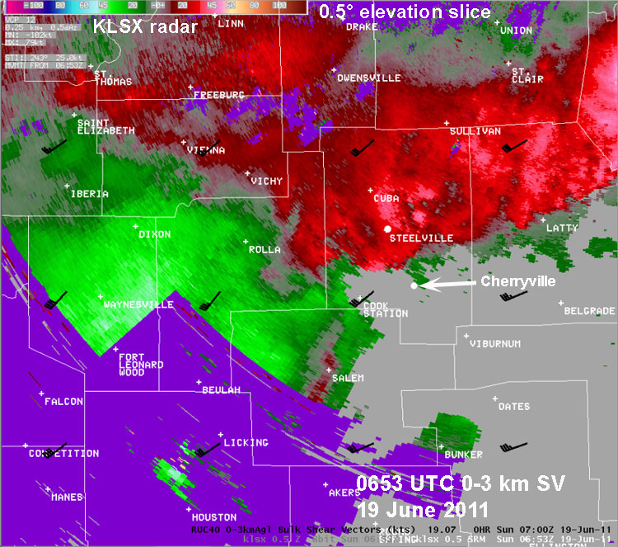
Boundary Interaction
Surface Boundary
19 Jun 2011 Central Missouri
Courtesy of Ron Przybylinski
Boundary should be stationary or quasi-stationary. A boundary moving too quickly to the south would greatly reduce tornado potential given a limited time for the surge to interact with the boundary’s vorticity.
Notes:
Courtesy of Ron P.
A surge moving into an area where the line is folded over (cold pool dominant) can be trouble

Slide 7
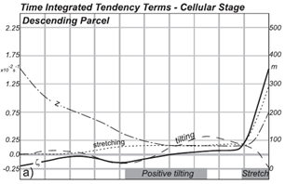
Tornado Warning Decision “Nudgers”
The presence of at least 40 J/kg of low level CAPE
  Based on local study
  Increases mesovortex stretching potential
  Could be a correlation to “stronger” tornado potential with higher values

Slide 8
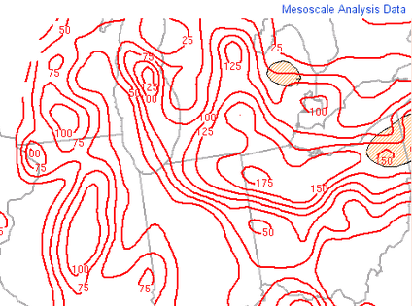
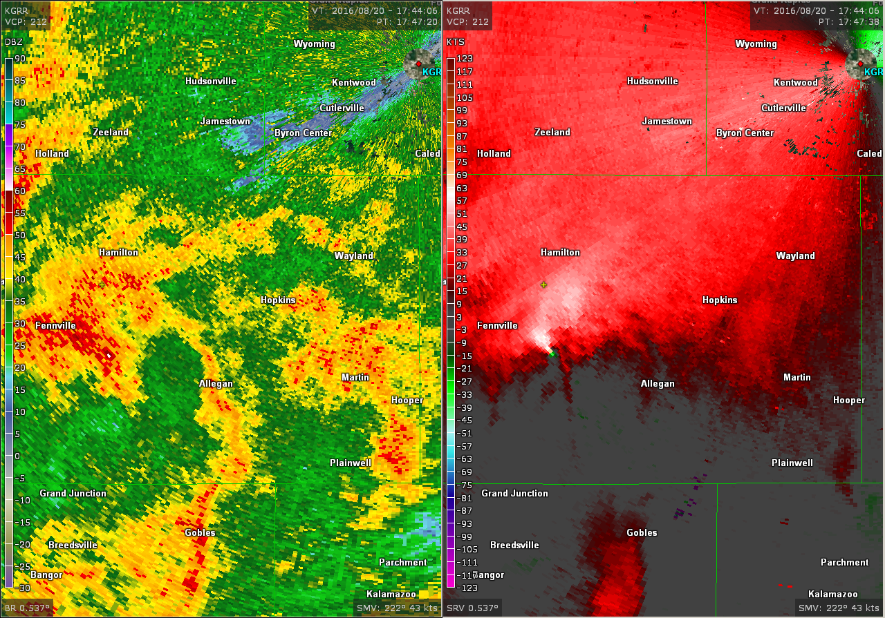
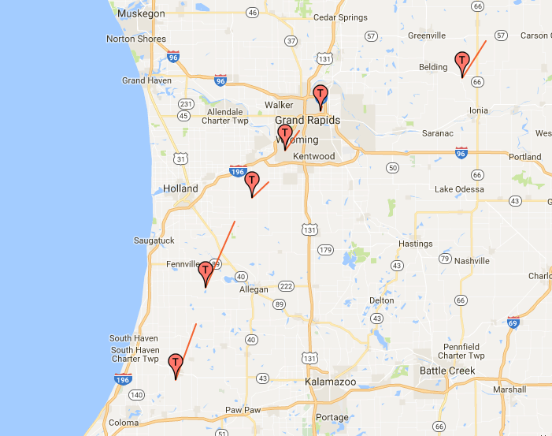
Low Level CAPE
20 August 2016
Grand Rapids (just a low level MLCAPE example…other confidence builders present)

Slide 9
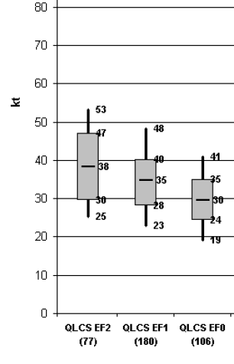
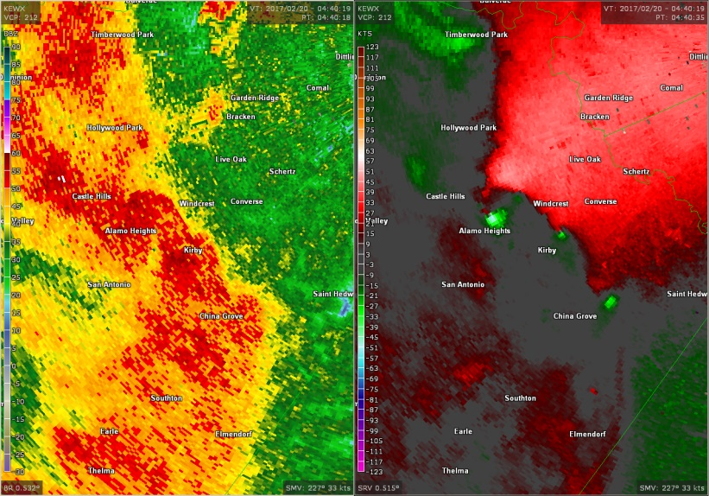
Confidence Builders for Considering a Tornado Warning
A tight and strong mesovortex
  Low level Vr >= 25 kts
  May not be visible at greater distances from the radar
  May be too late!
Vr
Smith et al. 2012
Notes:
75% of EF-0 tornadoes had a Vr of at least 24 knots
Max Vr using pixels within 5 miles of each other from immediately prior to tornadogenesis to immediately before termination

Slide 10
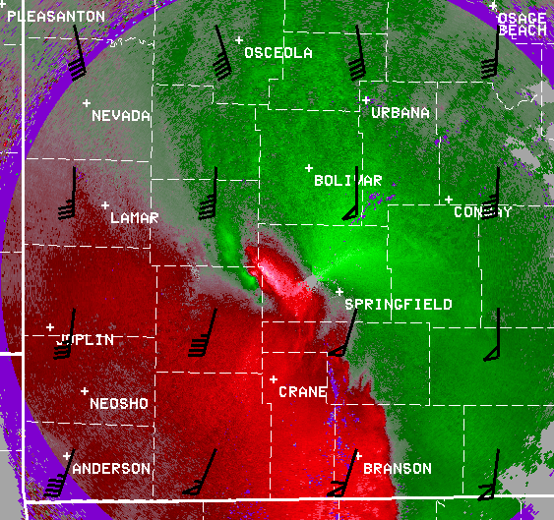
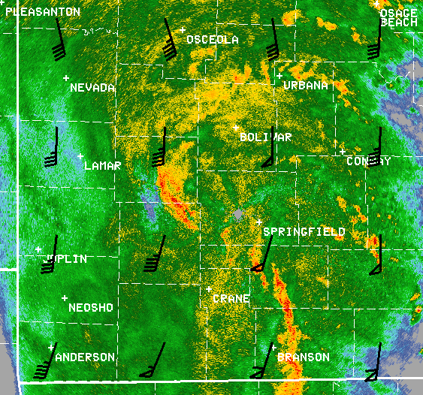
Contracting Bookend Vortex
13 Oct 2014 Southwest Missouri
Look for increasing gate-to-gate signatures within the broader circulation. A Vr of 25 knots is a good low-end threshold for considering a Tornado Warning. Three ingredients NOT required.

Slide 11

Perfect Recipe?
With the confidence builders and “nudgers” identified, is there a correlation in terms of numbers and/or certain variables that lead to tornadic development?

Slide 12
Methodology
-Use WFO SGF mesovortex database from a previous Hollings Project
-Review radar data and simply identify the presence of confidence builders per case (30 min prior to mesovort development)
-Total mesovortex Sample Size: 66

Slide 13
Methodology
-Each case was within 40nm of the RDA
-Many cases lack super-res (2006-2011) and ALL lack Dual Polarization. (No TDS considered for this study)

Slide 14
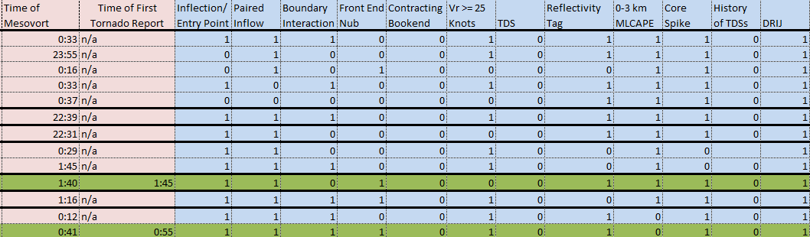
Methodology
-Given the binary nature (yes or no) in ranking the presence of each Confidence Builder/Nudger statistics were rather simplistic.

Slide 15
Limitations
Event catalog is dated (again, no dual-pol and in many cases no super-res)
Storm database not always 100% (i.e. tornadoes occurring but left unreported in rural areas)
Known radar limitations such as attenuation and cone of silence

Slide 16
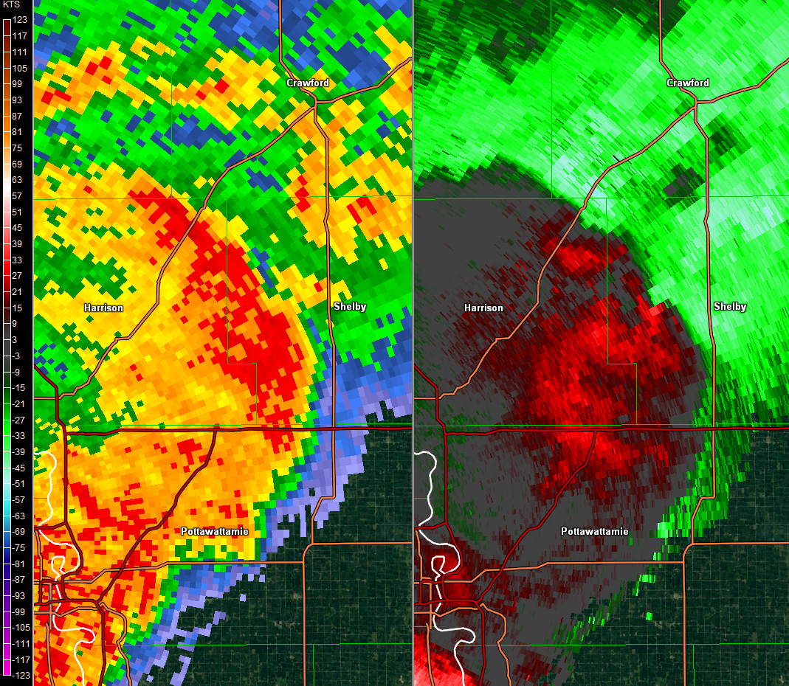
Shelby Co., IA - 8/12/2007
-DRIG
-25+kt Vr
-Core Spikes
-Ref Tag
-Paired Inflow/outflow
-Inflection/entry
-Nub
-Boundary?
-0-3km MLCAPE 40+J/kg
0.5 Ref
0.5 SRV

Slide 17
Limitations
Examination of 66 events, 20 of which a tornado occurred were examined, but findings were inconclusive due to inherent issues pertaining to storm data.
**For this reason we are ONLY considering the 20 known cases to alleviate this limitation.

Slide 18
Results
DRIJ and Core Spikes in ALL.
Beyond that, a majority of the observed tornadoes had 6 total confidence builders/nudgers

Slide 19
Results
Tornado
NonTornado
Looking at percentages, the number of nontornado cases does take a subtle shift downward when compared to tornado cases beyond 4 or more confidence builders/nudgers

Slide 20
Conclusions
-No perfect recipe (No perfect combination of confidence builders/nudgers stood out to have a higher likelihood of a reported tornado)
-60% tornado cases had 6 or MORE confidence builders and nudgers
-Although nontornado cases are mostly inconclusive, it is interesting to note the subtle decrease in numbers middle of the pack

Slide 21
Conclusions
Biggest winner in terms of confidence builders for tornado cases (all 20) were…
DRUM ROLL…

Slide 22
Conclusions
Biggest winner in terms of confidence builders for tornado cases (all 20) were…
DRUM ROLL…
DRIJ and Core spikes

Slide 23
Conclusions
Future Research:
Add additional cases
  This includes newer technology such as super-res and dual pol
Additional confidence builders/nudgers?
  Always looking to expand. (e.g. terrain influence)

