Slide 1
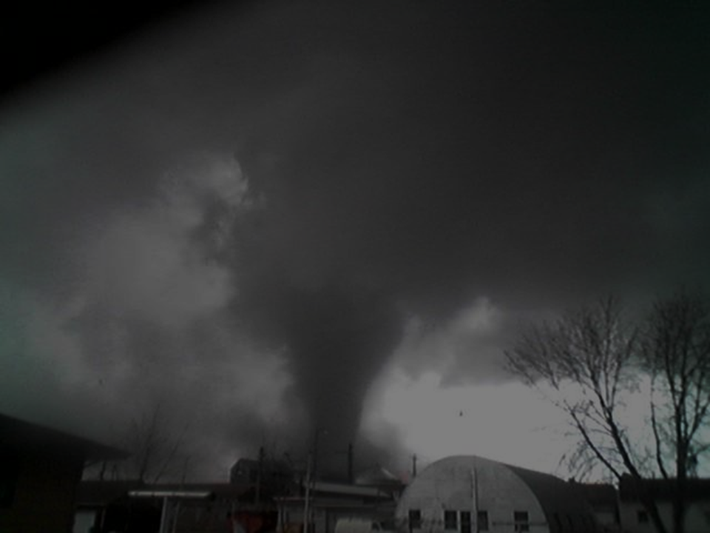

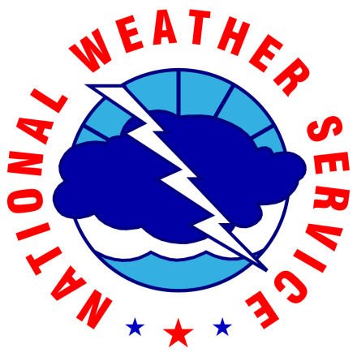
Analysis of Unwarned Tornado Events from
2014-2015 Across the NWS Central Region
3rd Midwest Bow Echo Workshop, St. Louis
Rod Donavon, NOAA/NWS Des Moines, IA
Fred H. Glass, NOAA/NWS St. Louis, MO
Jacob Beitlich, NOAA/NWS Chanhassen, MN
Craig Cogil, NOAA/NWS Des Moines, IA
Kevin Deitsch, NOAA/NWS St. Louis, MO
Alexander Gibbs, NOAA/NWS Davenport, IA
Aaron Johnson, NOAA/NWS Dodge City, KS
Ray Wolf, NOAA/NWS Davenport, IA
Andrew R. Dean, NOAA/NWS/NCEP/Storm Prediction Center Norman, OK
The views expressed are those of the author and do not necessarily represent those of the National Weather Service

Slide 2
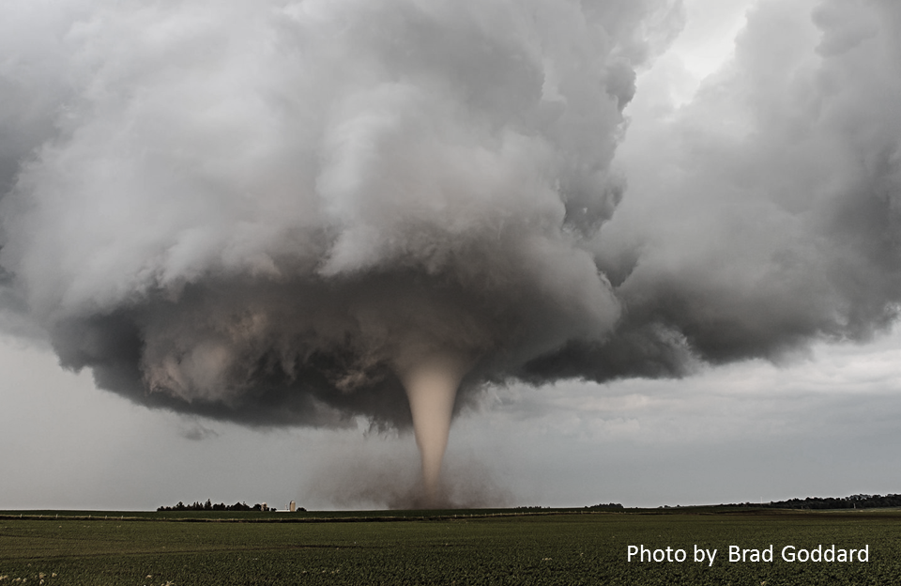
Creation of TWIP Team
Assembled by CR SSD/Consistency Team
Significant regional differences in tornado warning POD/FAR and IDSS due to:
  Inconsistent education and experience
  Varied or improper radar/NSE data usage
  Philosophical differences in QLCS warning paradigm
  Human factors (behavior, personal bias, etc.)
  Office culture/operational environment
Focused on the tornado warning process

Slide 3
Purpose and Motivation
Examine the unwarned and partially warned tornadoes in the NWS Central Region for 2014-15
Determine if there are any common elements or factors that may have contributed to the lack of advanced warning
The ultimate goal is to leverage the results to identify training needs, minimizing these events in the future and improving warning operations

Slide 4
NWS CR Verification Stats
2014-2015
621 Unwarned Tornado events (county based and includes 174 partial warned events)
  Database narrowed to 495 consolidating border crossers
POD per EF scale
  EF0 – 0.509 (301 unwarned, 75 partial warned)
  EF1 – 0.557 (145 unwarned, 79 partial warned)
  EF2 – 0.812 (10 unwarned, 14 partial warned)
  EF3 – 0.876 (5 unwarned, 1 partial warned)
  EF4 – 0.936 (0 unwarned, 1 partial warned)

Slide 5
Storm Data Quality
26 Unwarned Tornadoes were actually WARNED!
- Impacts POD, FAR and CSI
37 more Tornadoes had incorrect time and/or placement errors
At least 11% of the events had time/placement errors
Other errors include TDSs prior to Storm Data start time
Storm Data Entry Training is needed. All Storm Data entries should undergo a rigorous QC process before being finalized

Slide 6
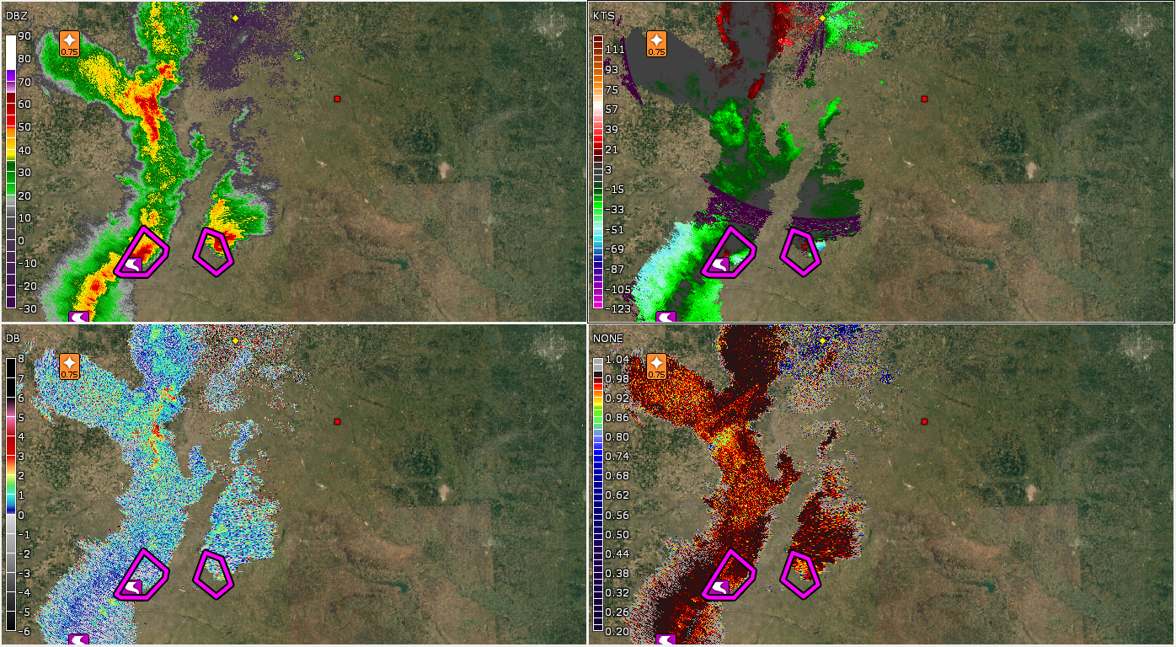
Unwarned Tornado Review - Findings
Storm Data Errors: Common Time Errors 1-2 hours
REF
SRM
ZDR
CC
2 hours too early, 75 nm from any storm

Slide 7
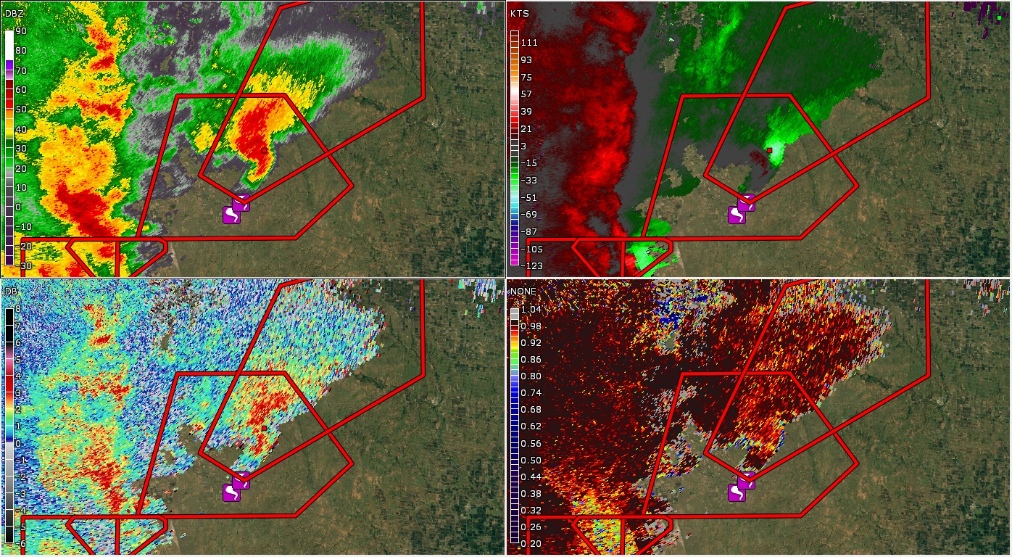
Unwarned Tornado Review - Findings
Storm Data Errors: Common Time Errors 1-2 hours
REF
SRM
ZDR
CC
Correct Time that SHOULD be in Storm Data 2 hrs later

Slide 8
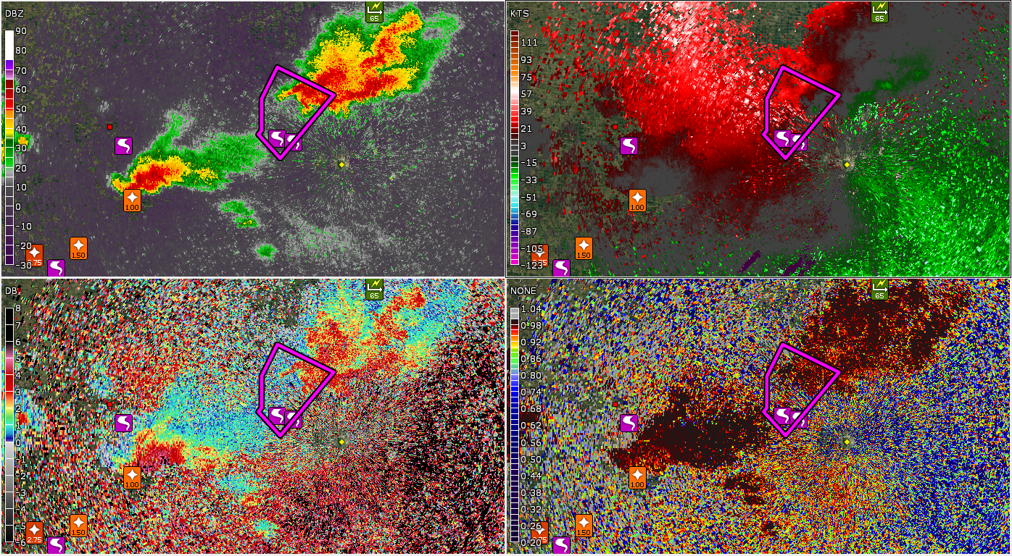
Unwarned Tornado Review - Findings
Storm Data Errors: Incorrect Location
REF
SRM
ZDR
CC
Red Dot is Storm Data Location/Icon LSR Location

Slide 9
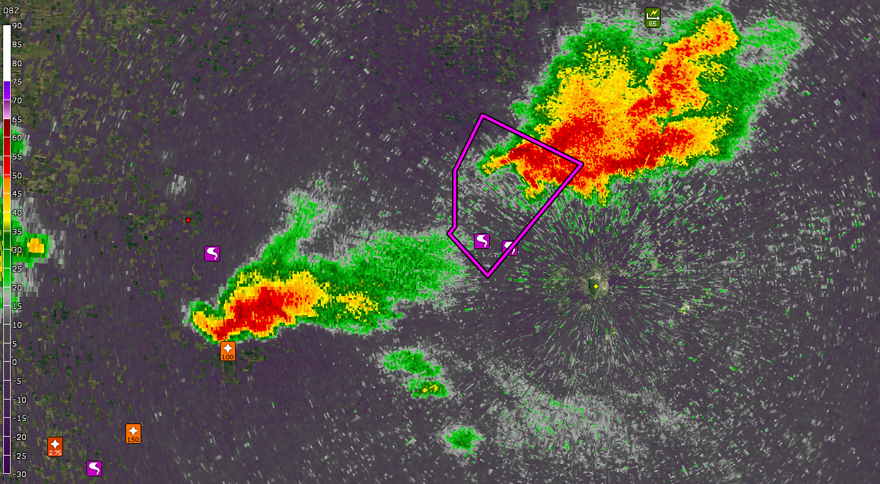
Unwarned Tornado Review - Findings
Storm Data Errors: Incorrect Location
REF
SRM
ZDR
CC
Red Dot is Storm Data Location/Icon LSR Location

Slide 10
Radar Data Observations
Bad data due to range folding – VCP212 Adaptive PRF an issue?
Big change from TOP data and TDS for awhile, great example for using multiple radars
Landspout, difficult to see anything
This was not a tornado, the damage was almost totally removed from the western part of the storm
Rotation looks a lot better at 0.9 and aloft before it shows up at 0.5, close proximity to the radar means that higher tilts should be used for warning decisions
Dealiasing issues on scans previous to tornado
Very strong sig within 3.5 nm of the RDA. Once polygon issued, storm motion way off
Using VCP 121!

Slide 11
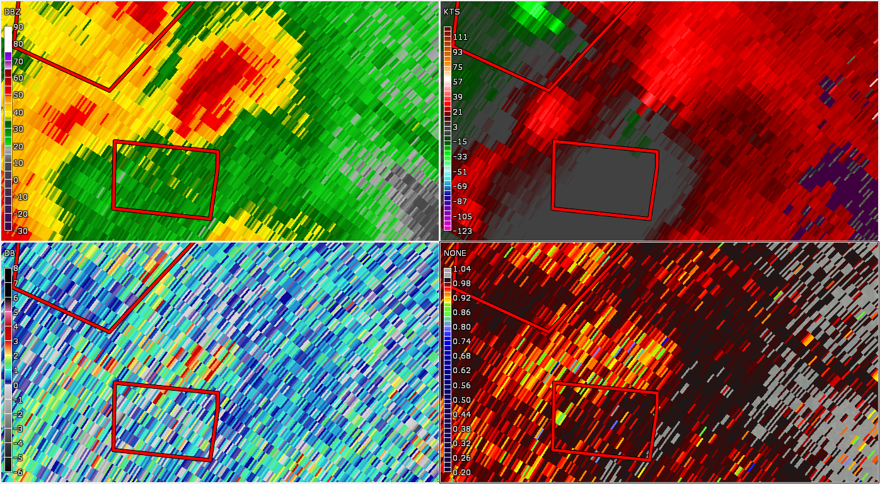
Unwarned Tornado Review - Findings
Storm Structure from Home Radar: Range 100 nm Beam Height 12.4 kft
REF
SRM
ZDR
CC

Slide 12
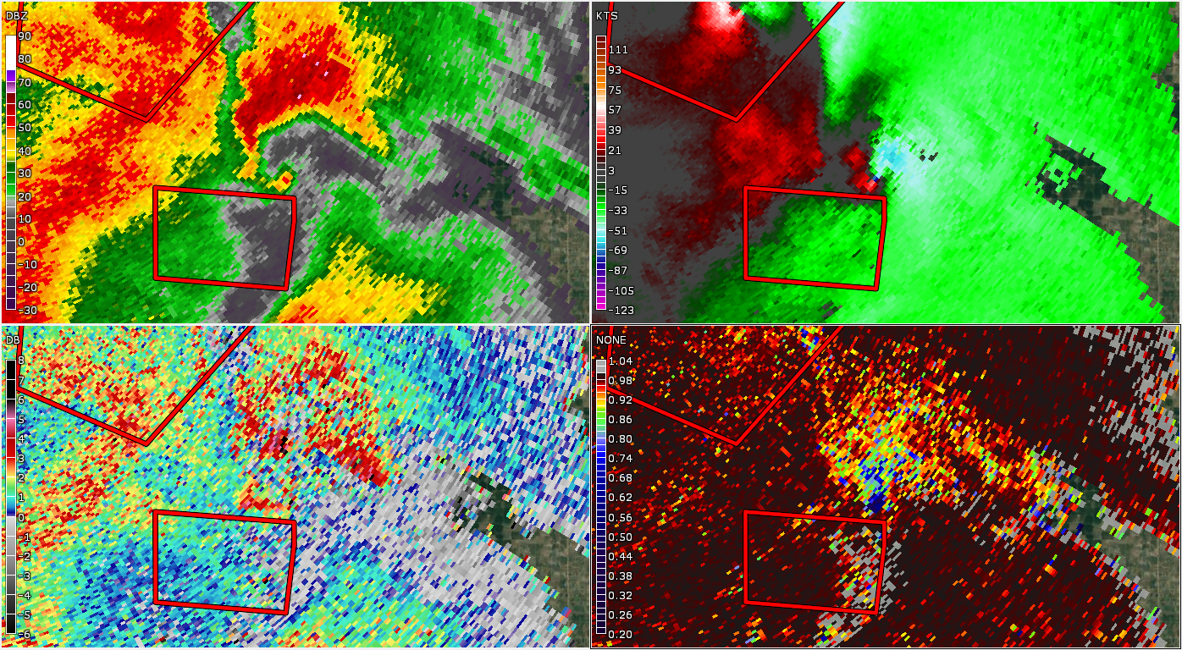
Unwarned Tornado Review - Findings
Storm Structure from Other Radar: Range 30 nm Beam Height 2.2 kft
REF
SRM
ZDR
CC

Slide 13
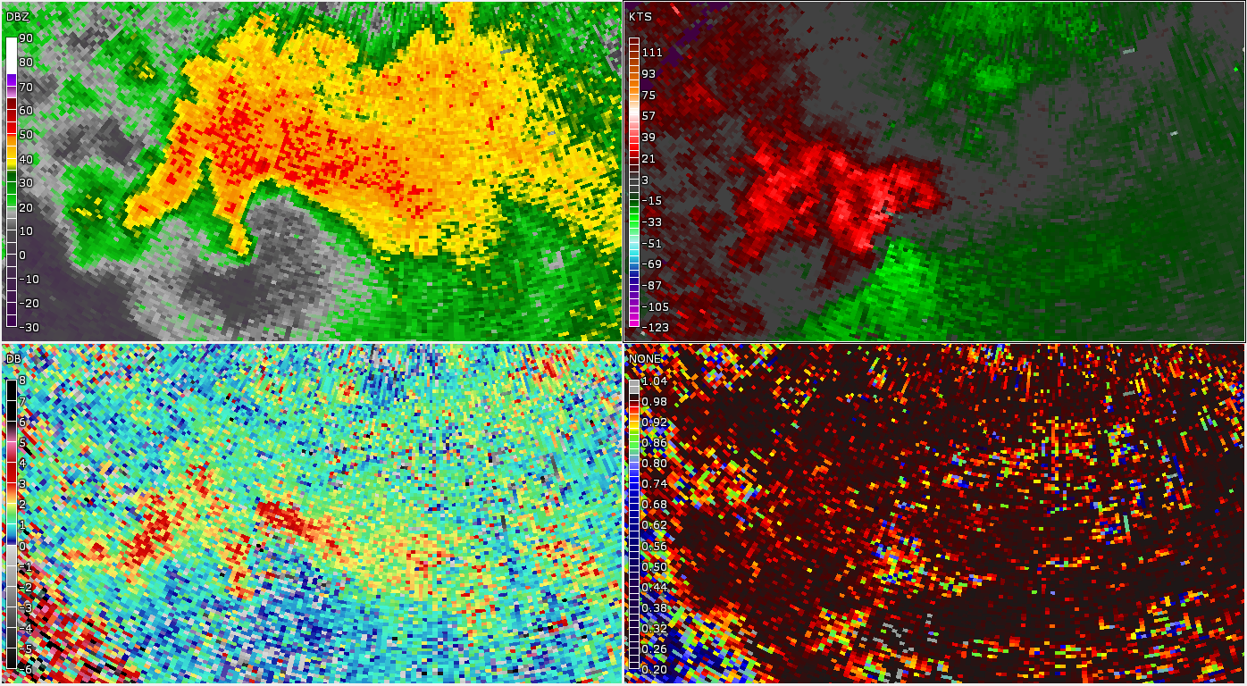
Unwarned Tornado Review - Findings
Storm Structure Close to the RDA: 0.5º Elevation 13 minutes Prior to Tornado
REF
SRM
ZDR
CC
Range 22 nm Beam Height 1.5 kft

Slide 14
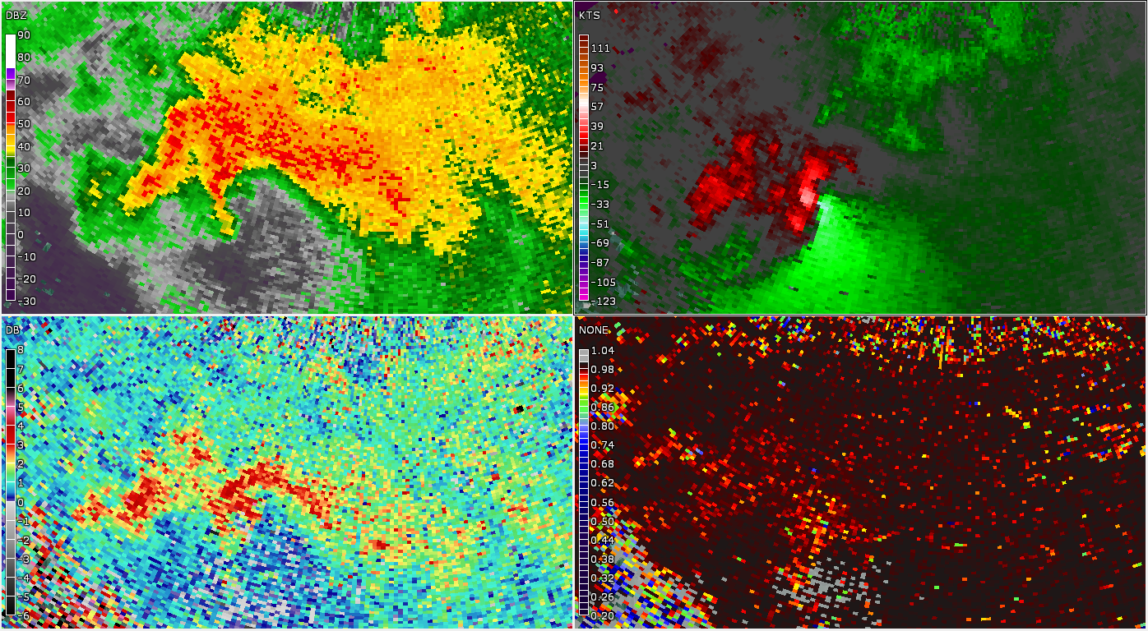
Unwarned Tornado Review - Findings
Storm Structure Close to the RDA: 0.9º Elevation 12 minutes Prior to Tornado
REF
SRM
ZDR
CC
Range 22 nm Beam Height 2.3 kft

Slide 15
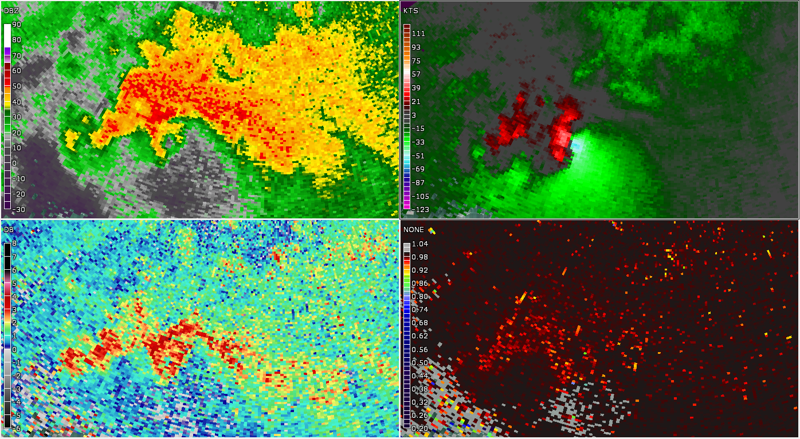
Unwarned Tornado Review - Findings
Storm Structure Close to the RDA: 1.3º Elevation 11 minutes Prior to Tornado
REF
SRM
ZDR
CC
Range 22 nm Beam Height 3.3 kft

Slide 16
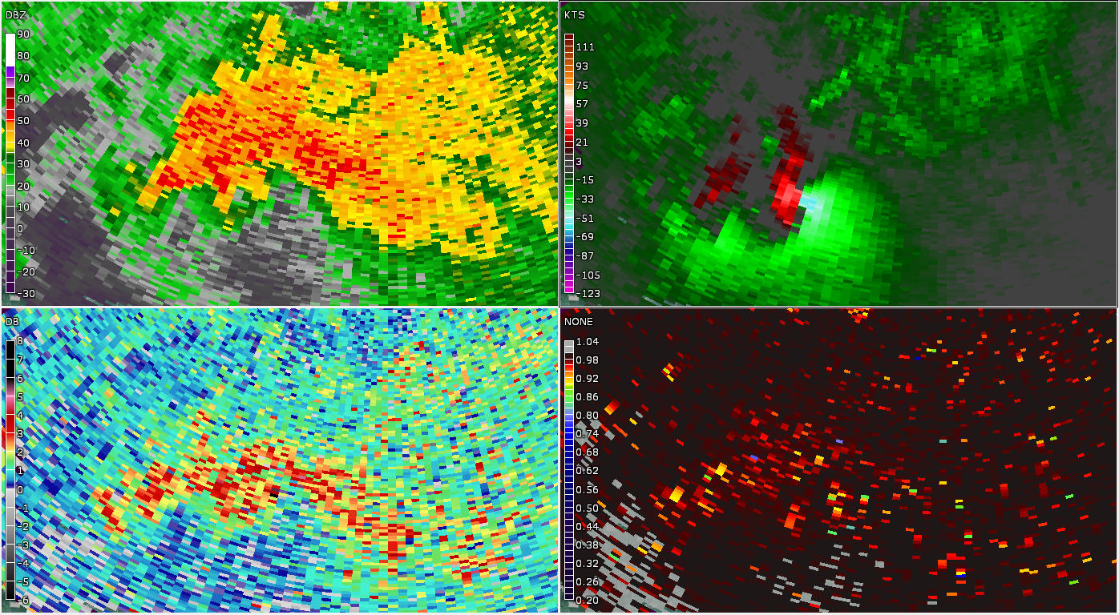
Unwarned Tornado Review - Findings
Storm Structure Close to the RDA: 1.8º Elevation 11 minutes Prior to Tornado
REF
SRM
ZDR
CC
Range 22 nm Beam Height 4.5 kft

Slide 17
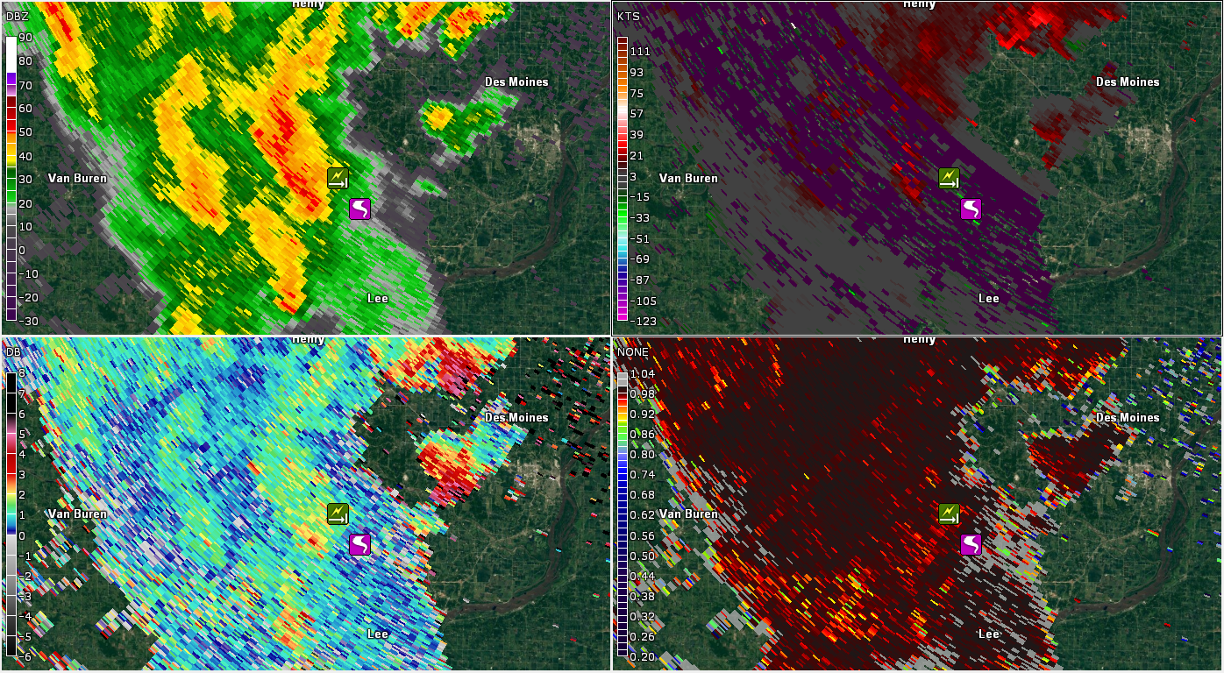
Unwarned Tornado Review - Findings
VCP 212: Adaptive PRF
REF
SRM
ZDR
CC
Range 67 nm Beam Height 6.7 kft

Slide 18
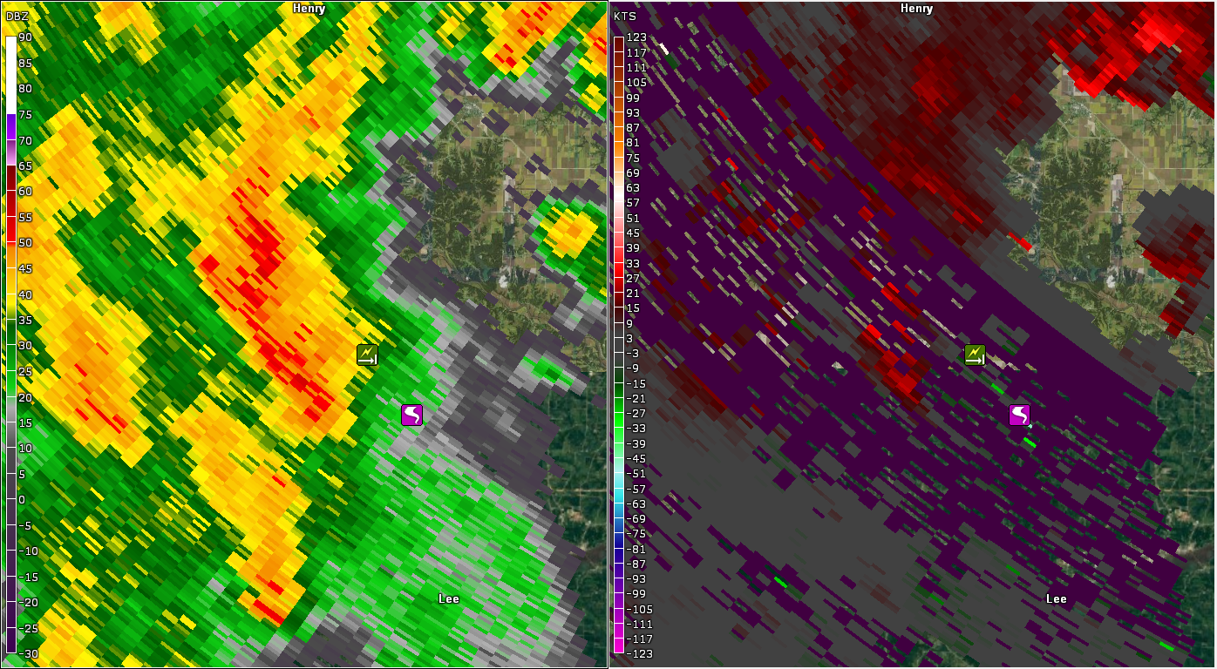
Unwarned Tornado Review - Findings
VCP 212: Adaptive PRF
REF
SRM
Range 67 nm Beam Height 6.7 kft

Slide 19
Methodology (NSE)
Methodology and use of SPC Mesoscale Analysis parameters similar to Thompson et al. (2012) (T12)
NSE data was taken at point of initial tornado touchdown.
NSE data was sampled in the pre-storm environment to prevent contamination of storm/boundary passages. Therefore, previous top of the hour data. Ex, a 2223z event would use 22z data.

Slide 28
m² s²

Slide 31
Methodology (Radar Interrogation)
Examined some of the general statistics of the unwarned and partially warned tornadoes such as EF scale, path length, duration, time of day, month of year, and distance from the radar
Stratified the unwarned and partially warned events by convective mode and examined attributes of the tornado producing storm such as low-level (0.5⁰) Vr and NROT magnitude of the parent circulation/mesovortex

Slide 32
Methodology (Radar Interrogation)
There were 490 unwarned or partially warned events
294 events (60%) were available for this preliminary analysis
The total number was reduced from 490 to 294 due to:
  CR CWA’s where analysis has yet to be completed
  Cases were no radar data was available
  Cases with bad radar data
  Single cell and landspout/boundary cases

Slide 33
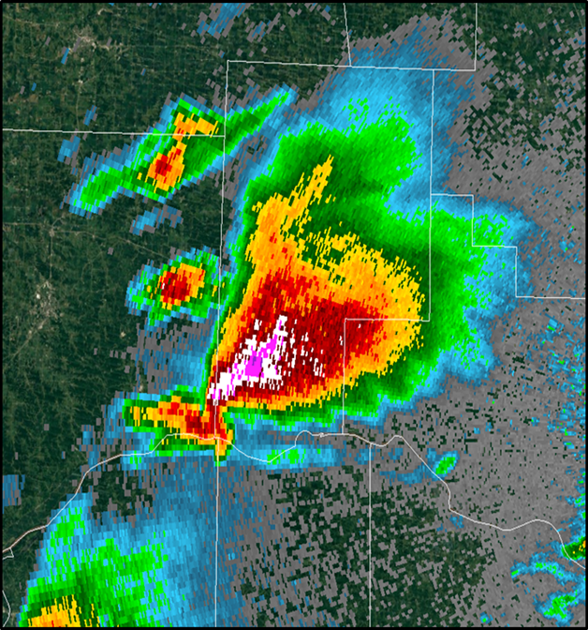
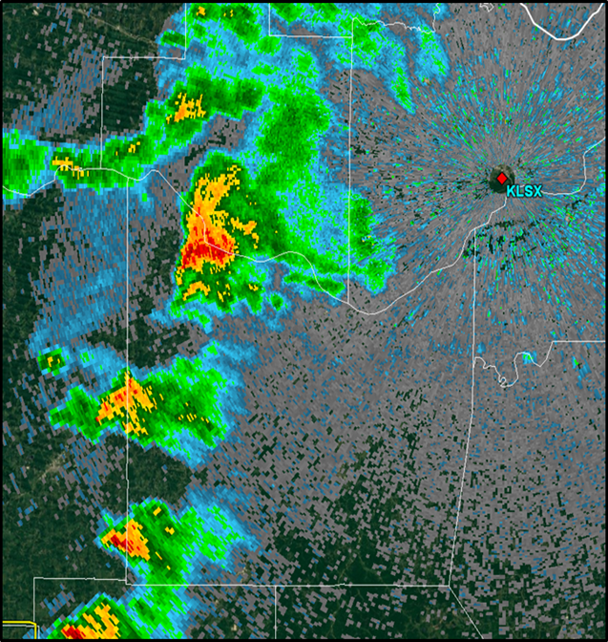
Convective Mode Classification
Supercell
Mini-supercell

Slide 34
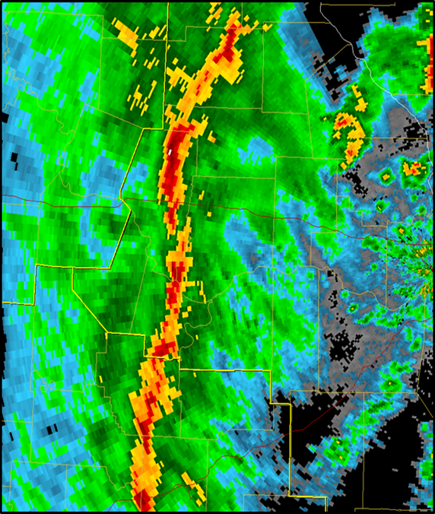
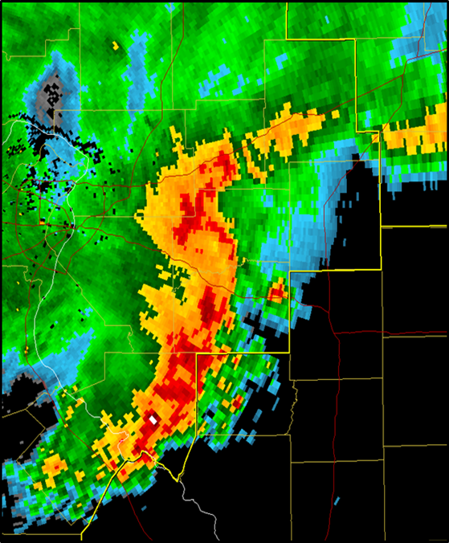
Convective Mode Classification
QLCS
Bow Echo

Slide 35
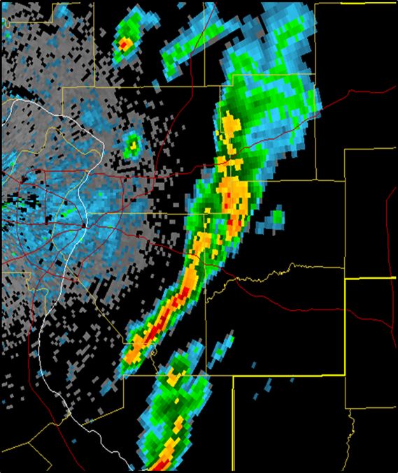
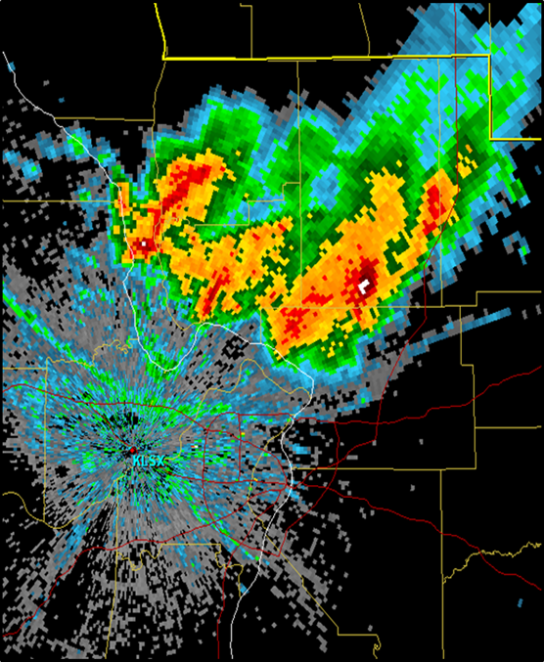
Convective Mode Classification
MC Line Segment
MC Cluster

Slide 36
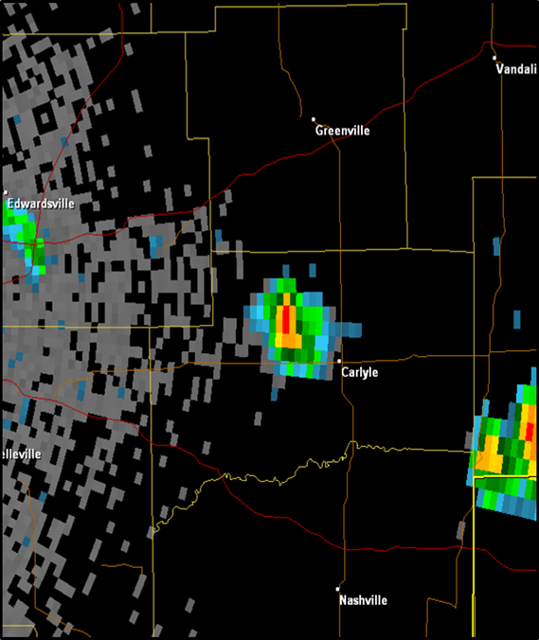
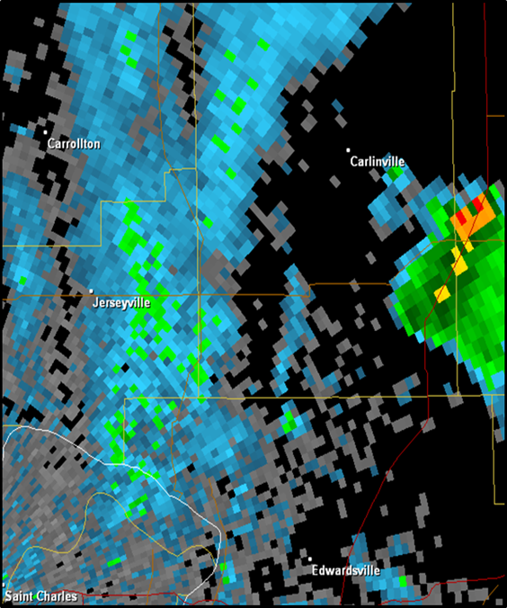
Convective Mode Classification
Single Cell
Boundary/
Landspout

Slide 37
Distribution By Convective Mode

Slide 38
Distribution By Convective Mode
43% of the tornadoes were associated with linear
convective modes – QLCS, bow echo, MC line segment

Slide 39
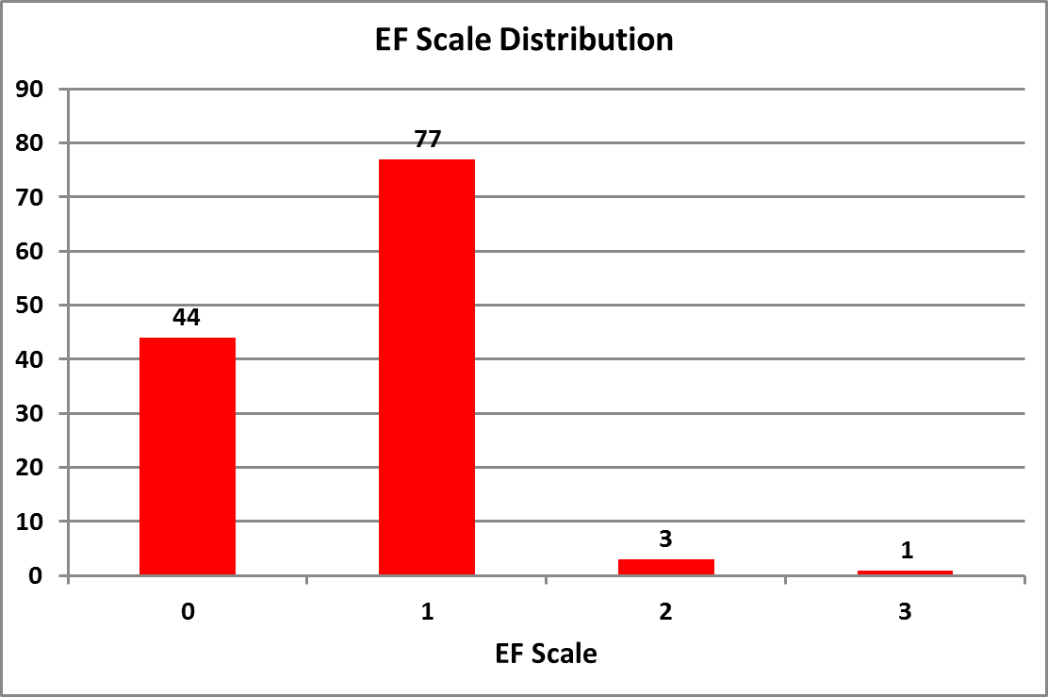
EF Scale Distribution
97%
121 of the 125 tornadoes or 97% were weak
4 of the 125 tornadoes or 3% were strong

Slide 40
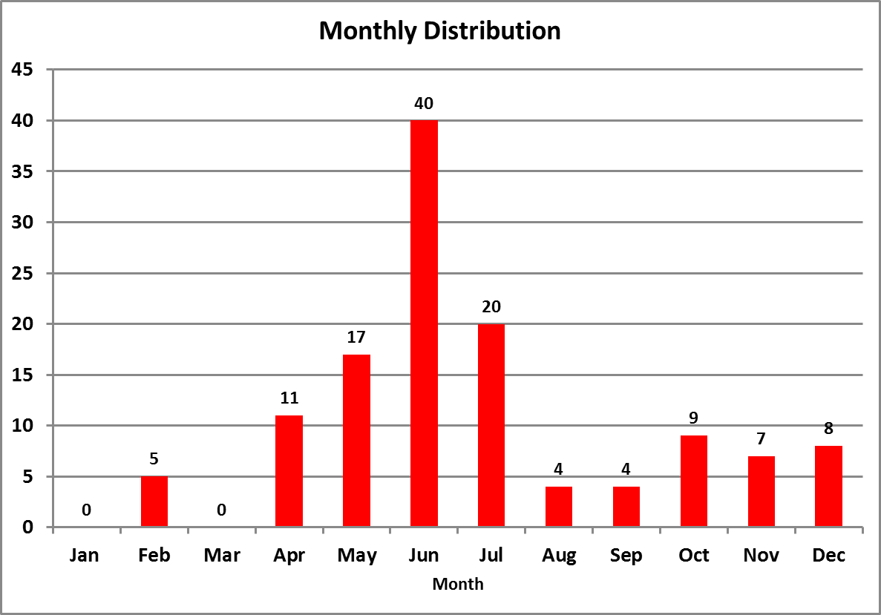
Monthly Distribution

Slide 41
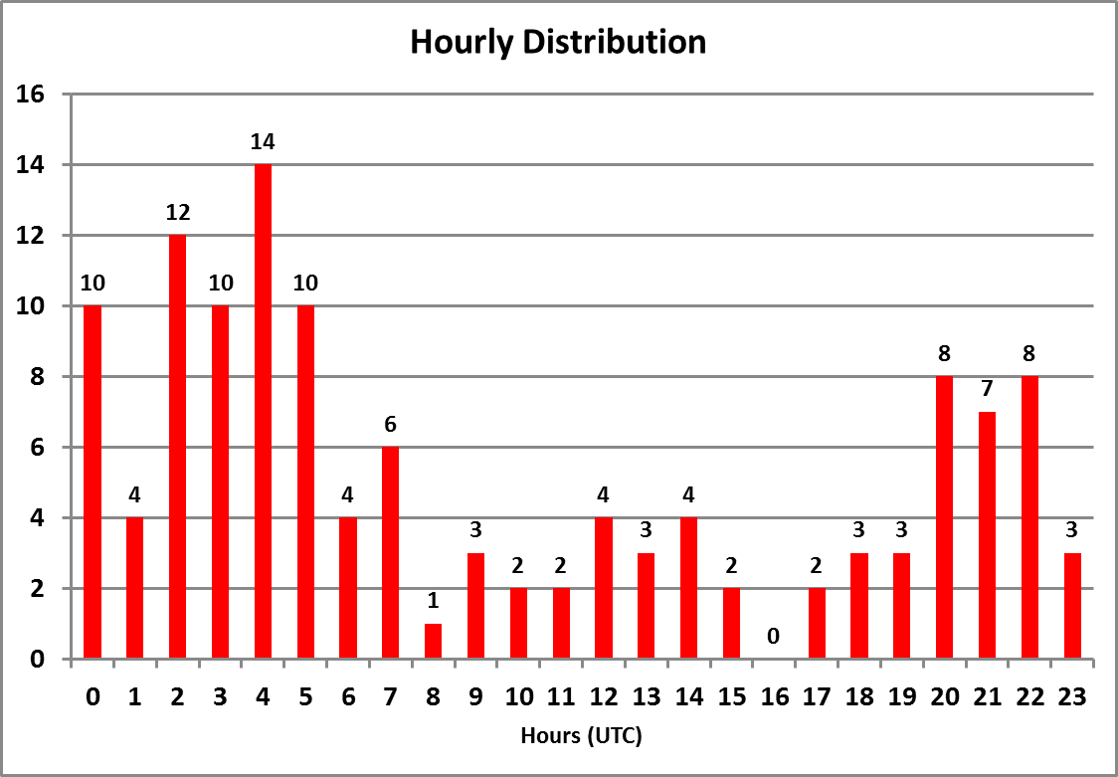
Hourly Distribution

Slide 42
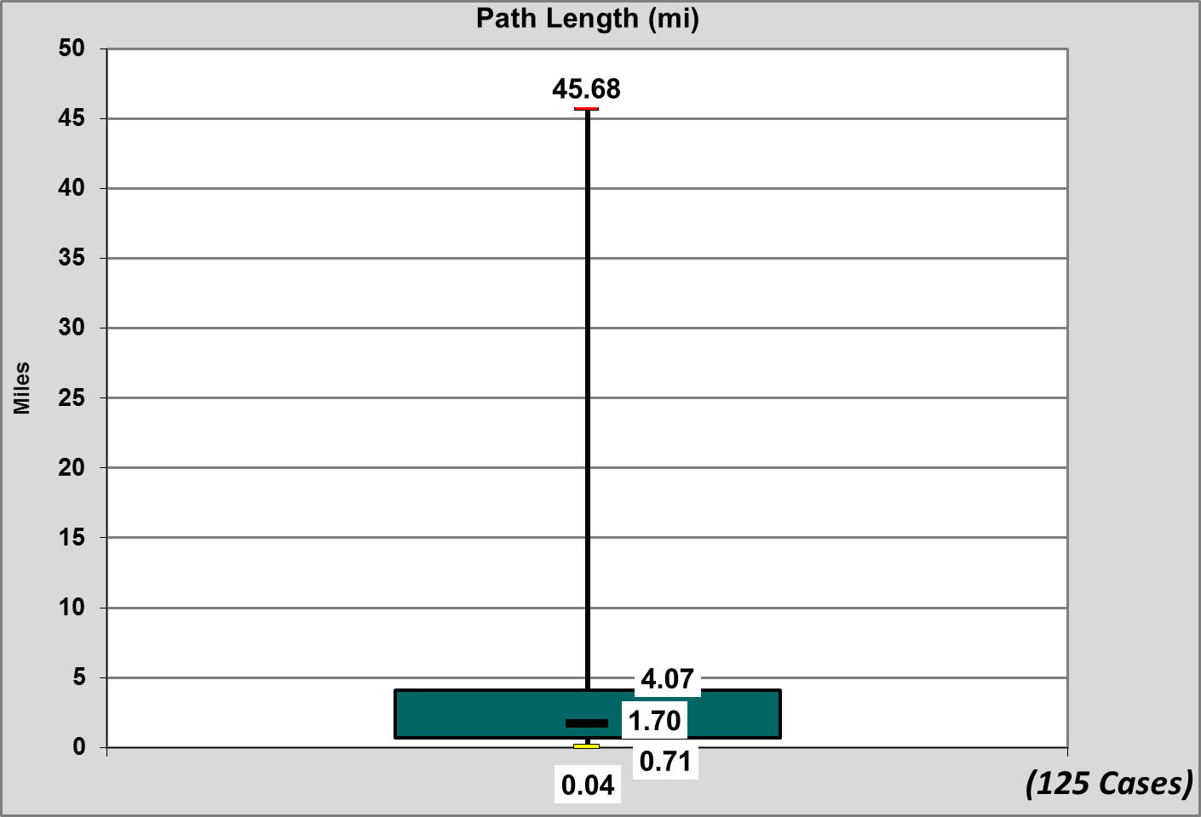
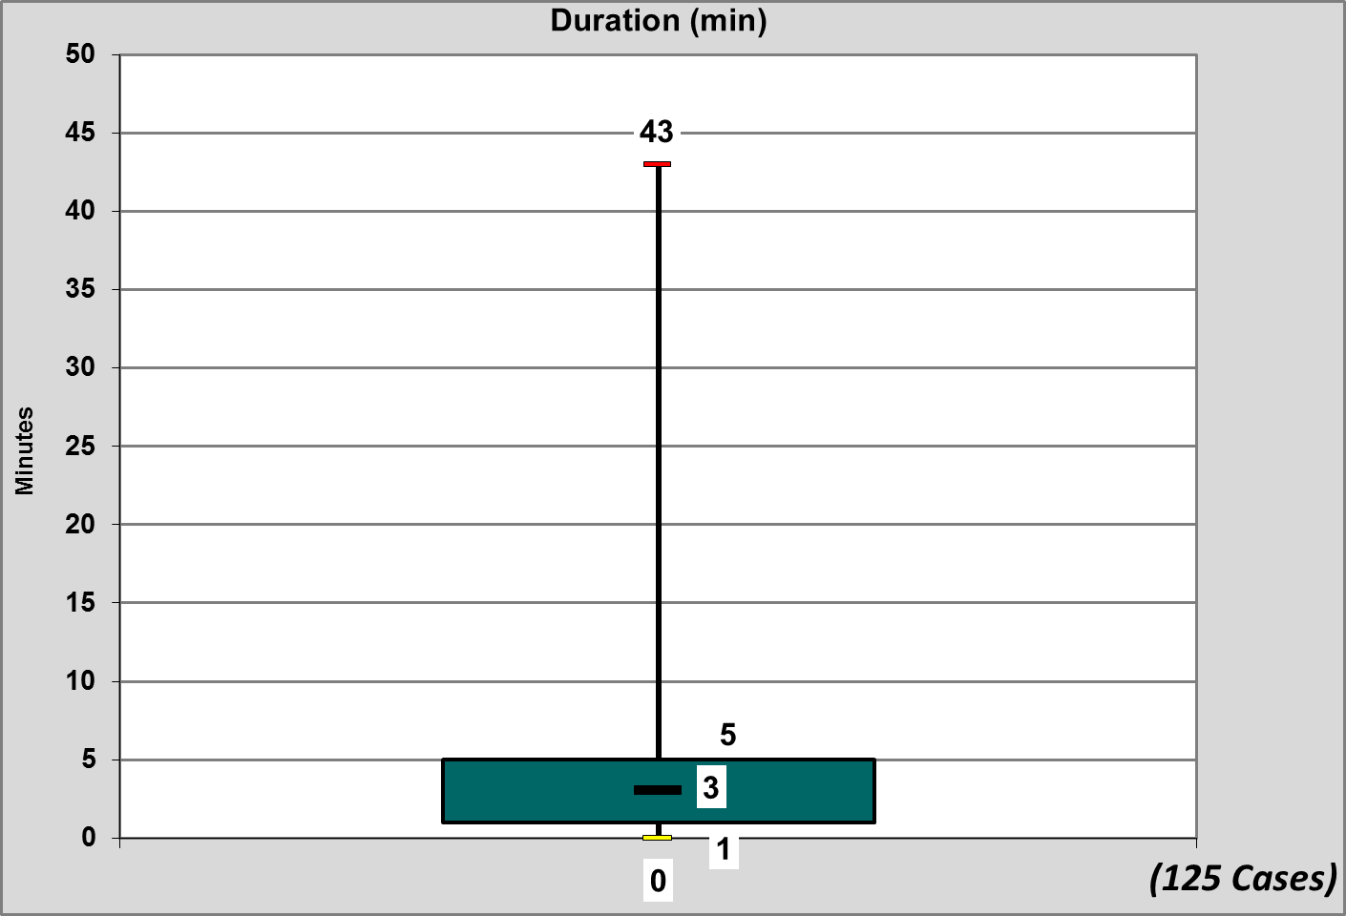
Path Length (miles)
Median: 1.70
Shortest: 0.04
Longest: 45.68
Tornado Duration (mins)
Median: 3
Shortest: ~0
Longest: 43
Maximum
75th Percentile
Median
25th Percentile
Minimum

Slide 43
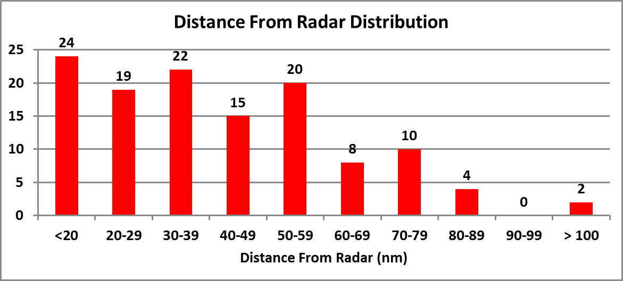
Tornado Location vs. Radar Range

Slide 44
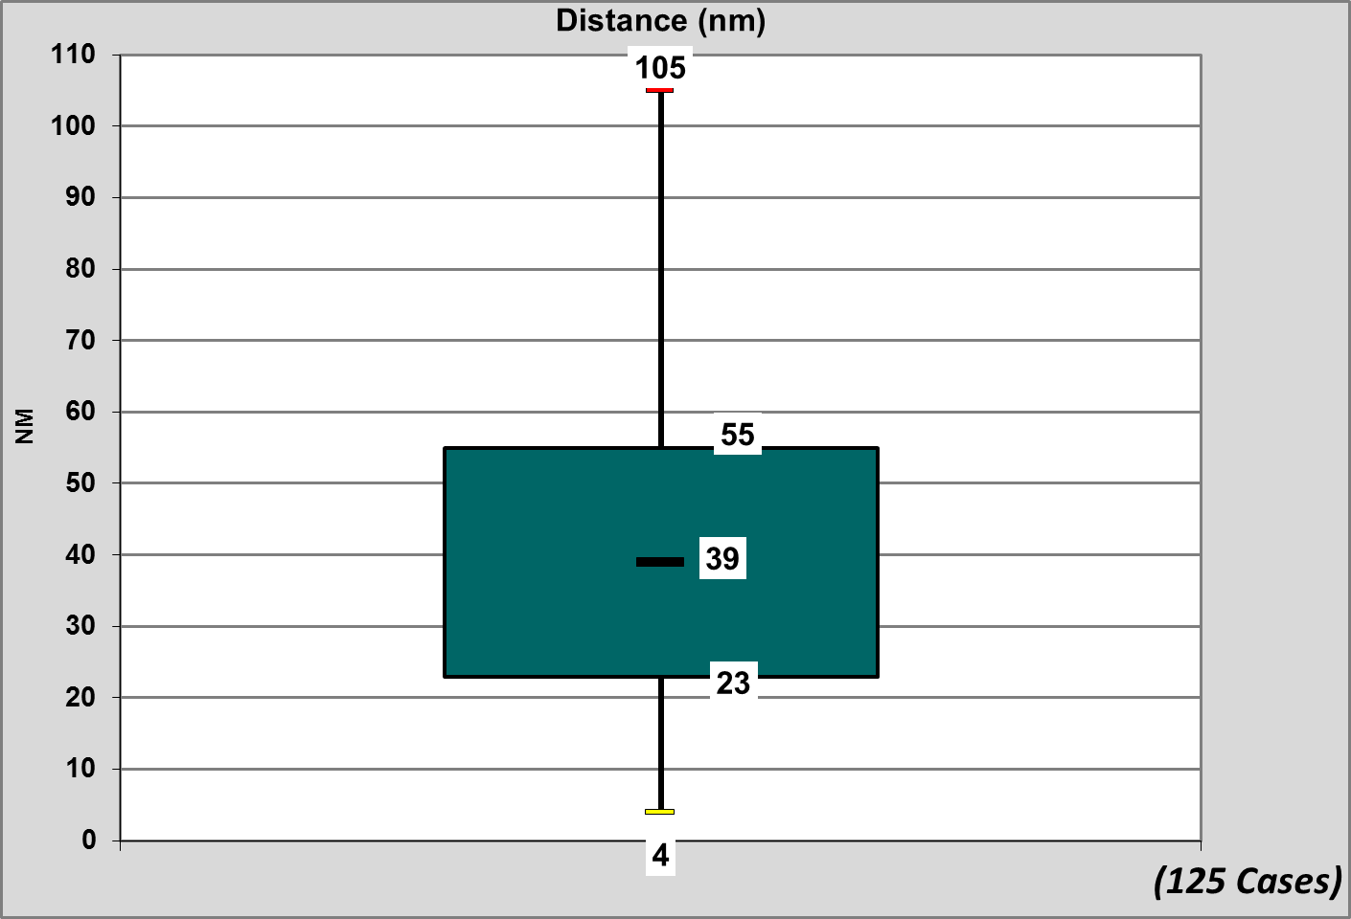
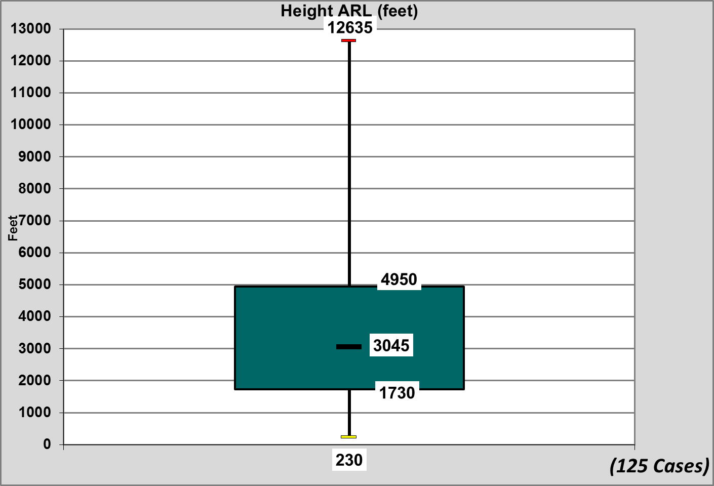
Tornado Location vs. Radar Range/Beam Height
Distance From Radar (nm)
Median: 39
Closest to radar: 4
Farthest from radar: 105
Radar Beam Height (ft ARL)
Median: 3045
Closest: 230
Farthest: 12635

Slide 45
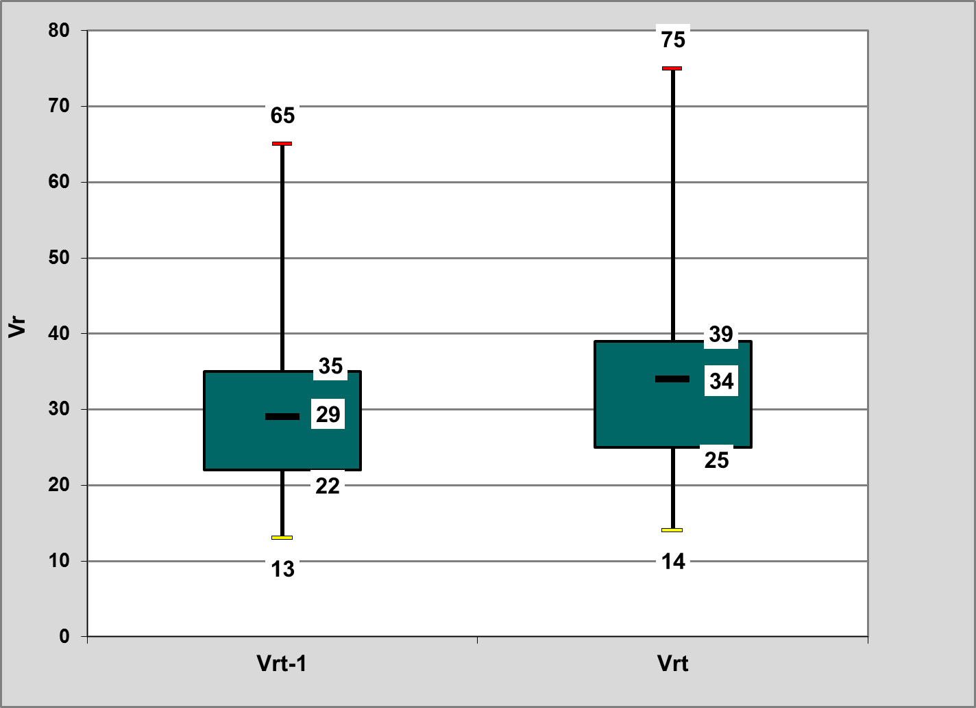
Vr Magnitude/Mesovortex Strength (V_{r})
Volume scan nearest tornado time and
volume scan prior to the tornado
Cases a mesocyclone/mesovortex was identifiable in the volume scan immediately prior to the tornado

Slide 46
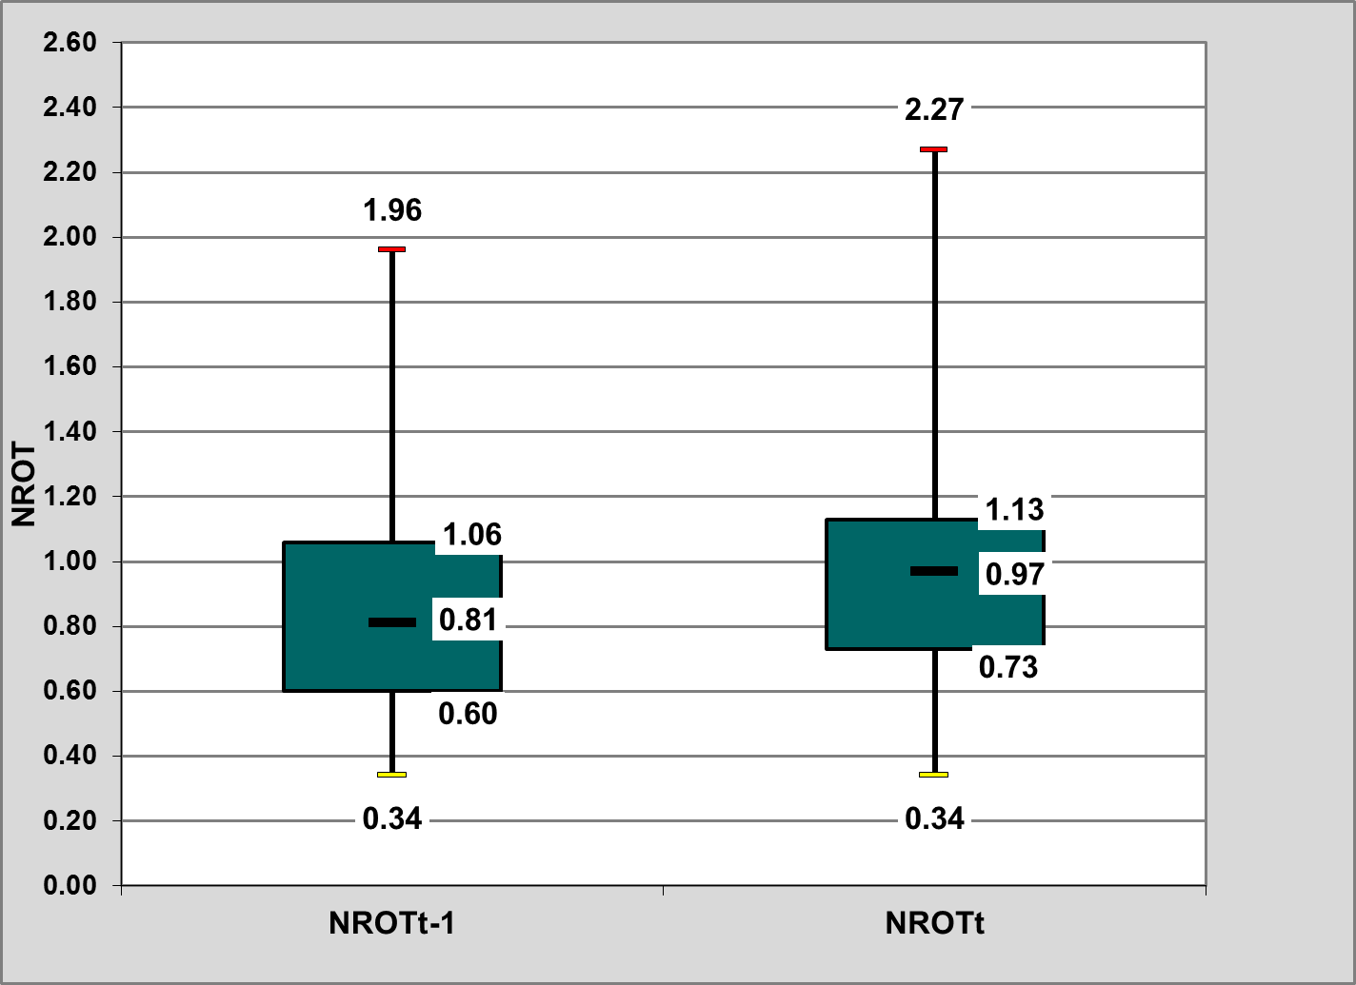
NROT Magnitude
Volume scan nearest tornado time and
volume scan prior to the tornado
Cases a mesocyclone/mesovortex was identifiable in the volume scan immediately prior to the tornado

Slide 47
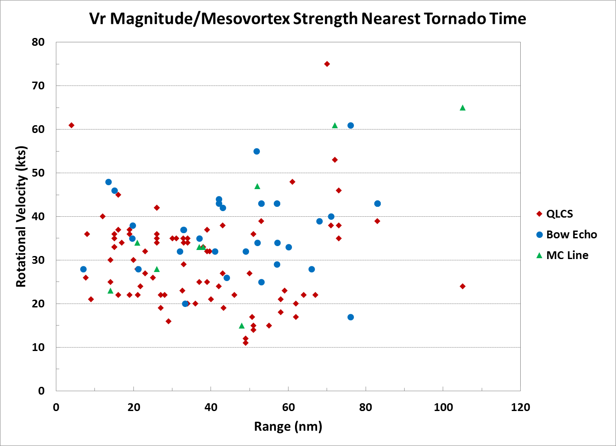

Slide 48
Summary/Concluding Remarks
For Linear Modes
The vast majority of the unwarned and partially warned tornadoes were weak (97%) and short-lived with a median path length of 1.7 miles and median duration of ~ 3 minutes.
Most of the events occur in the late Spring-early Summer during the evening hours.
Radar range does not appear to significantly impact the lack of warning in all cases; median range is 39 nm and beam height 3045 ft ARL, 34% of the events were < 30 nm, and 64% of the events were < 60 nm
In general the Vr and NROT were increasing at tornado time; the median magnitude could be characterized as weak (range dependent)

Slide 49
Questions
rodney.donavon@noaa.gov
fred.glass@noaa.gov

