Slide 1
Quasi-Linear Convective System (QLCS) & Non-Supercell (Landspout) Tornadoes
Across Eastern Kentucky
Jonathan Guseman
Barrett Goudeau
Edward Ray
National Weather Service - Jackson, Kentucky

Slide 2
The Problem
Difficult/impossible to detect rotation on radar
Features typically shallow & not linked to mesocyclone
Normally short-lived (a few minutes)
Lifetime dependent on balance between updraft (shear) and cold pool generation
Verification Statistics (2011-2016)
  QLCS POD: 0.714 FAR: 0.855
  Supercells POD: 0.923 FAR: 0.815
  Total POD: 0.800 FAR: 0.840

Slide 3
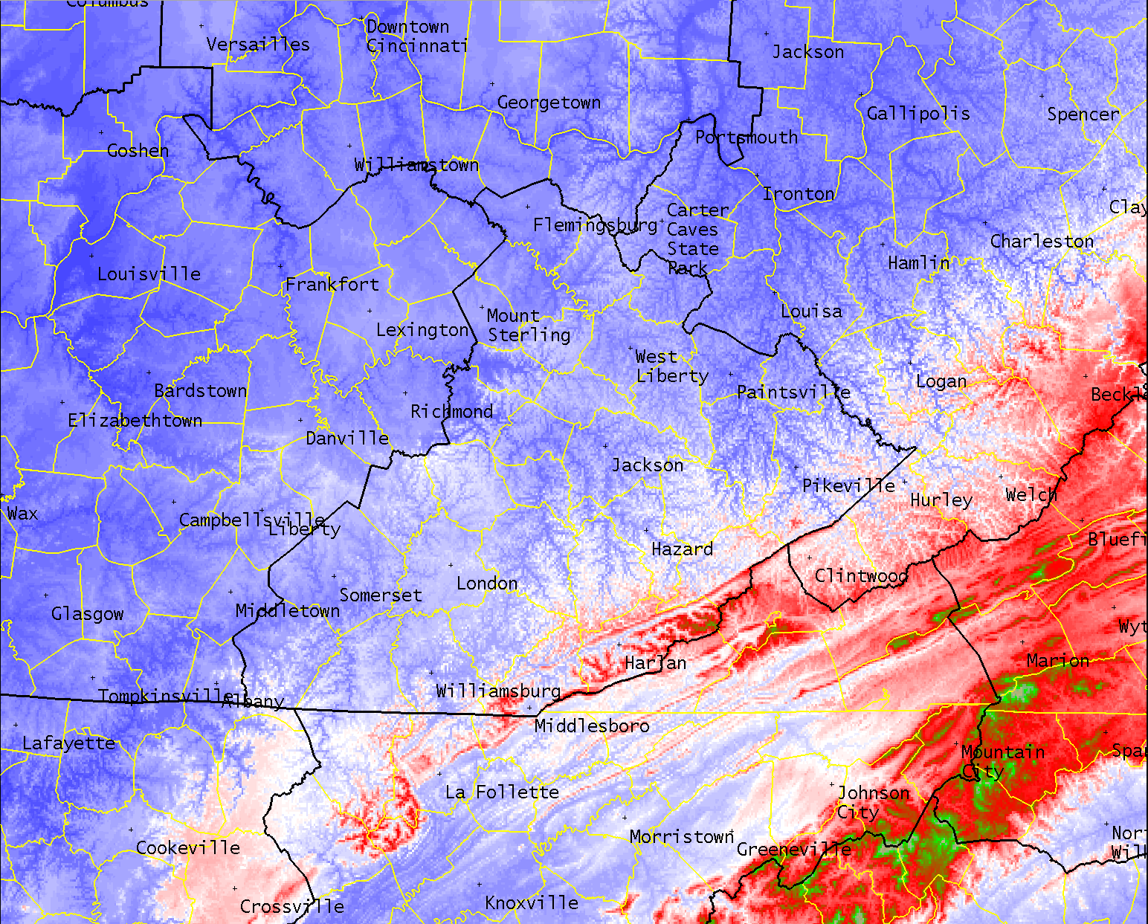
Varying Terrain

Slide 4
Local Study
The NWS Jackson, KY county warning area experiences ~ 2.2 tornado days/year, or ~ 3.37 tornadoes per year over a 30 year climatology (1987-2016)
  25.1 Tornado Warnings issued per year
Goal - improve Tornado Warning performance

Slide 5
Local Study
All Tornado Warnings 2011-2016
Radar data used to determine storm mode/orientation
RUC/RAP BUFKIT soundings from most representative near-storm environment used
  Avoided convective contamination
Separated QLCS/Supercell warned storms & those that did/did not produce a tornado

Slide 6
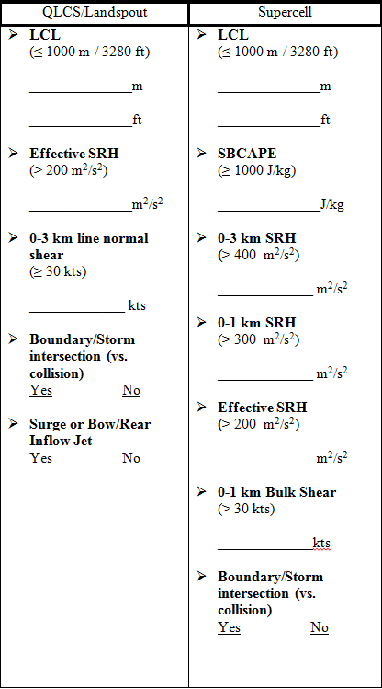
  Data Collected:
    0-1, 0-3, 0-6 km bulk wind shear (kts)
    0-1, 0-3 km, effective SRH (m²/s²)
    MLCAPE, SBCAPE, 0-3 km MLCAPE (J/kg)
    Lifted Condensation Level (m)
    0-3 km Low-Level Lapse Rate (°C/km)
    UDCZ Orientation
    0-3 km shear vector (magnitude & direction)
    0-3 km line normal shear (kts)

Slide 7
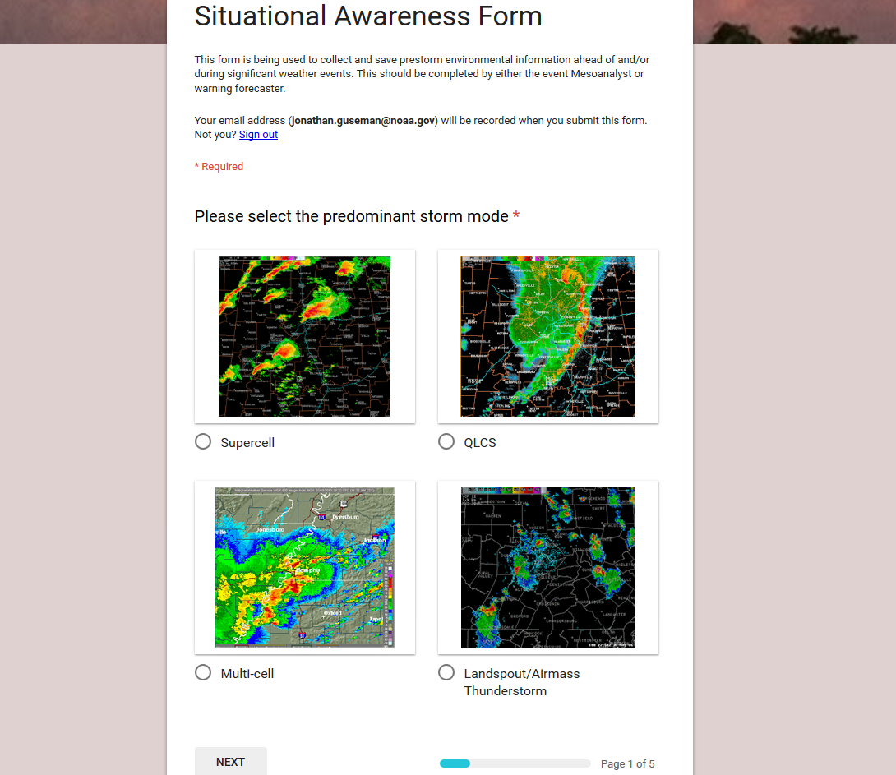
https://docs.google.com/a/noaa.gov/forms/d/e/1FAIpQLSc-K2nxlHS-dUcDC7tUqnGgTJu3P4QNPkdBmiknBg-q2_TYQA/viewform?fbzx=8252566990121517000

Slide 8
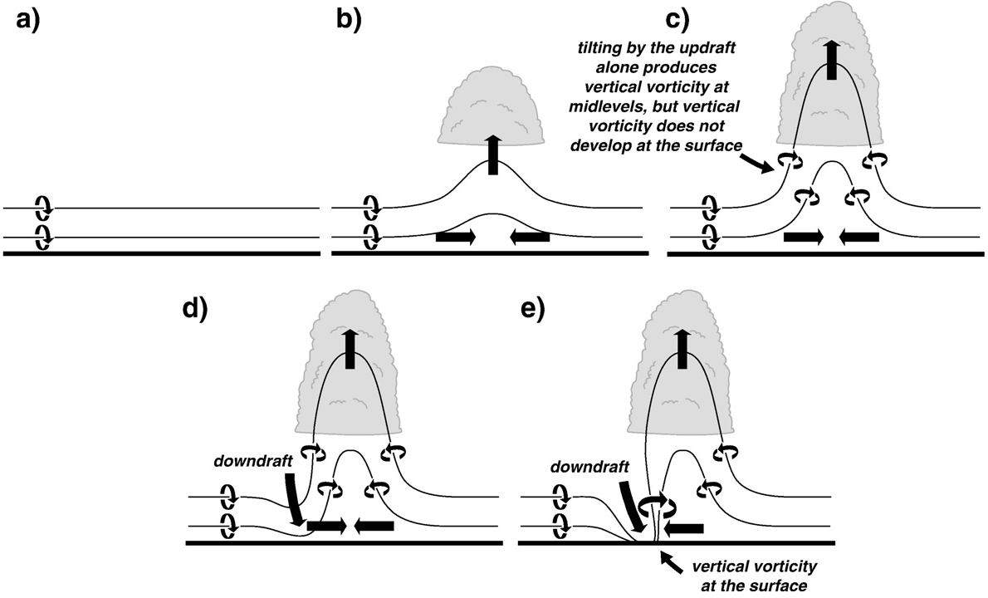
Current Understanding of Mesocyclone-Induced Tornadogenesis
Markowski and Richardson, 2010

Slide 9
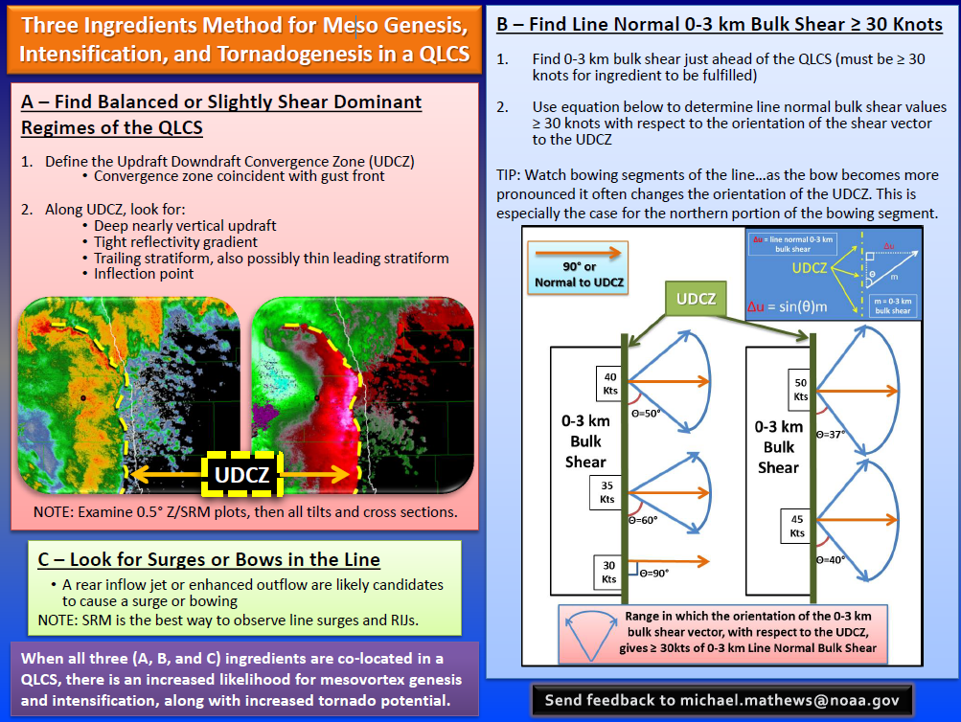

Slide 10
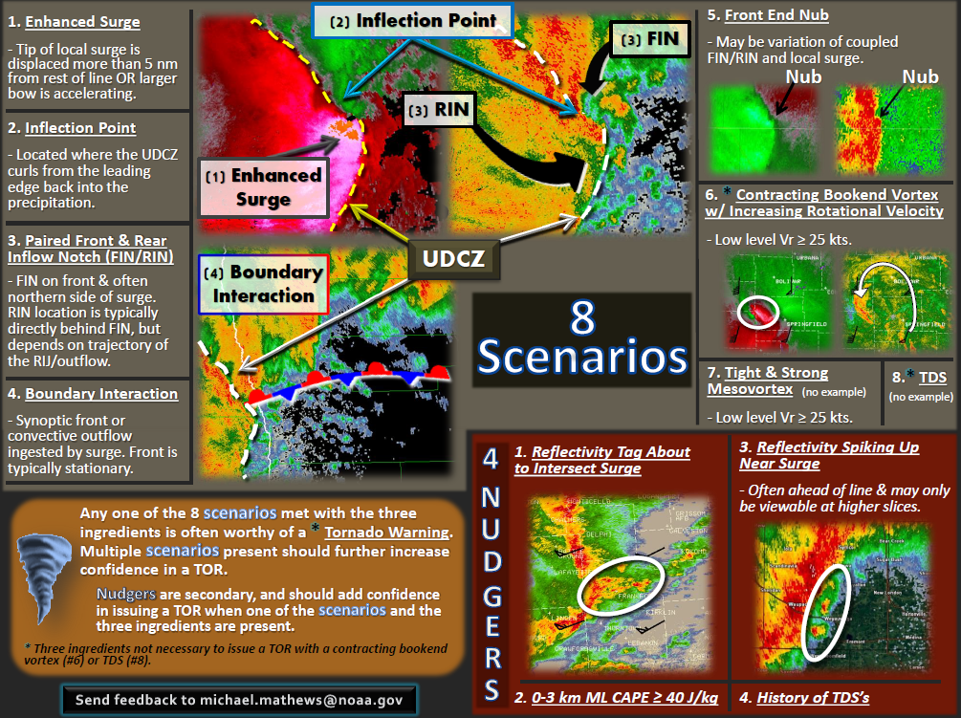

Slide 11
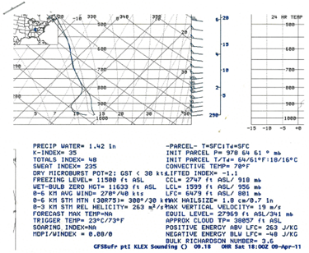
April 9, 2011 QLCS Tornado

Slide 12
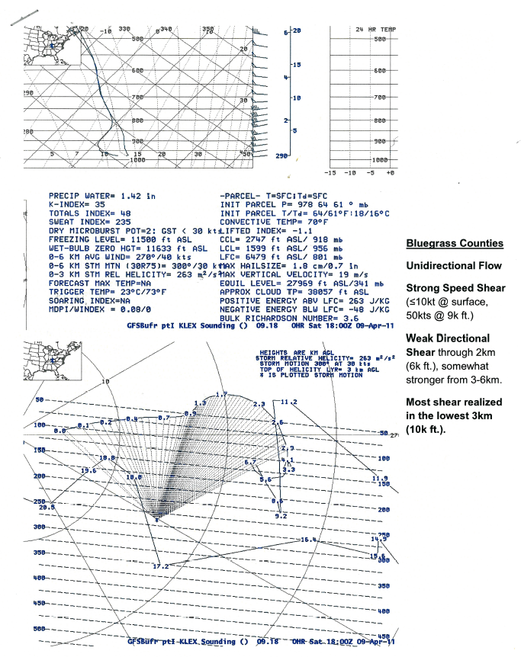

Slide 13
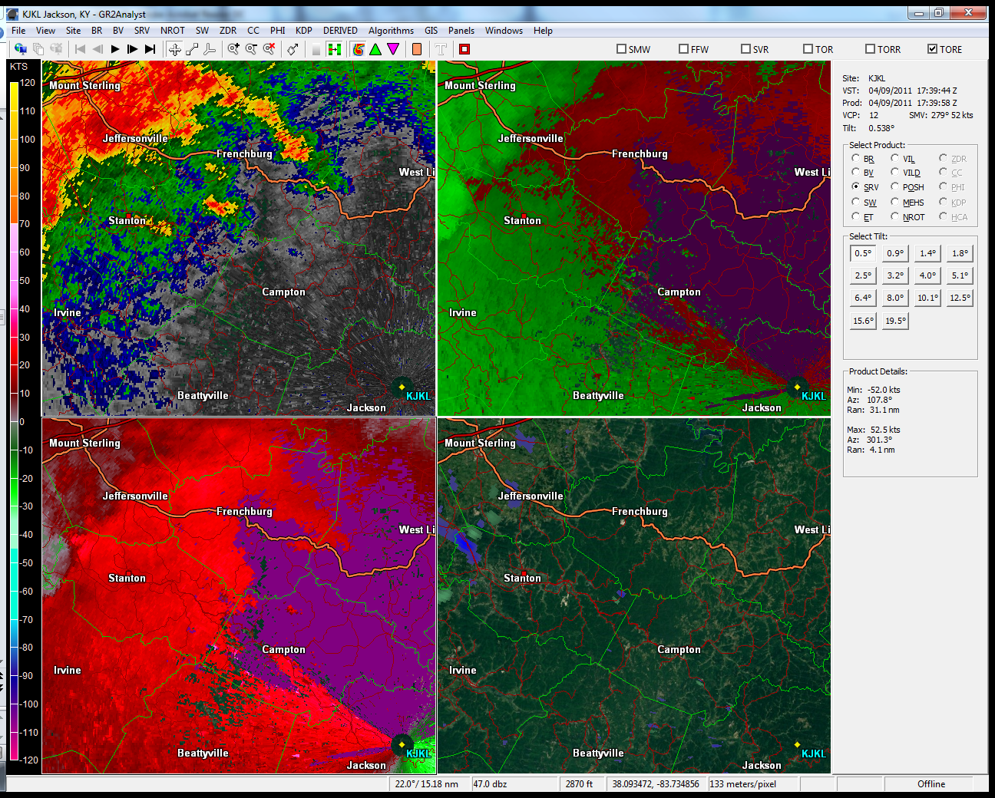

Slide 14
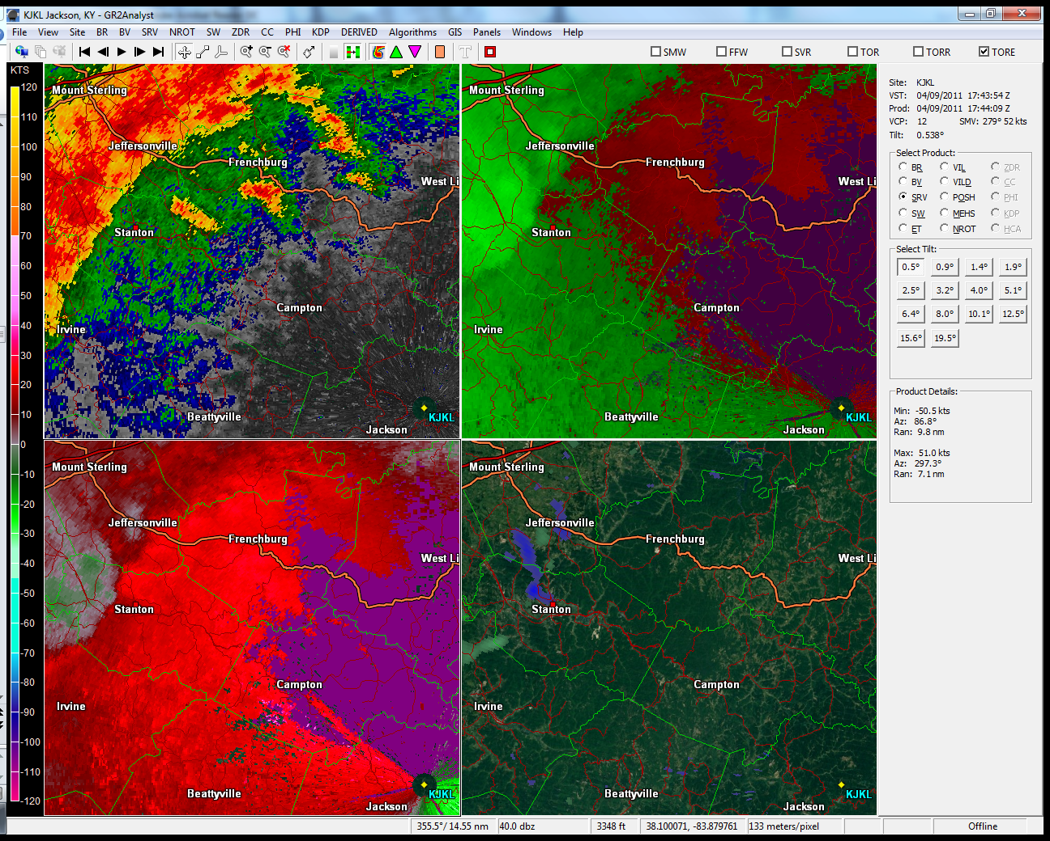

Slide 15
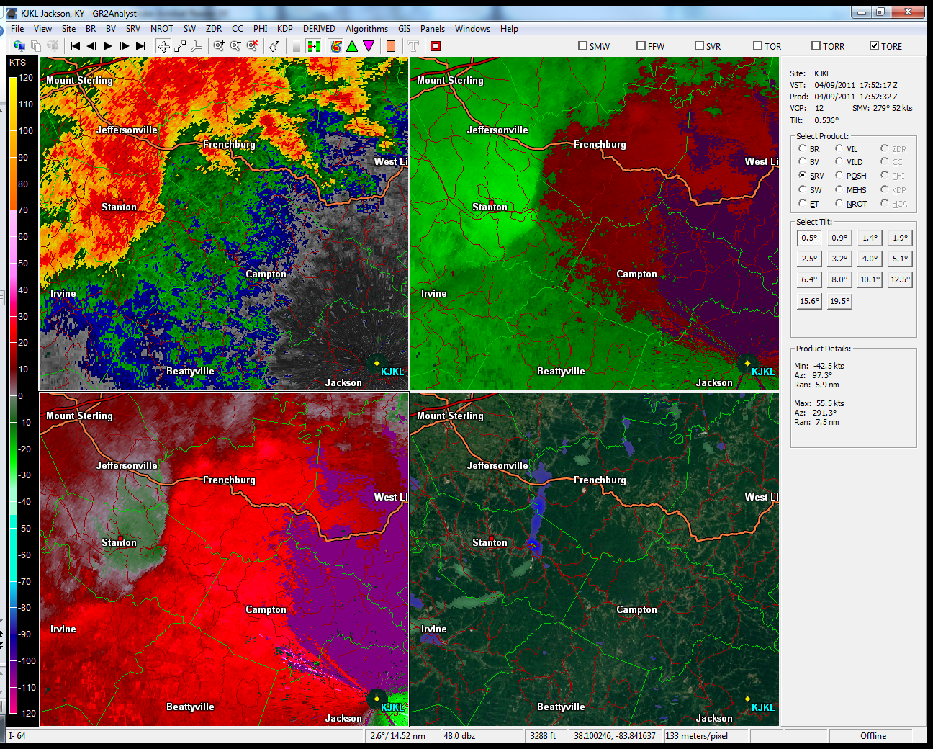

Slide 16
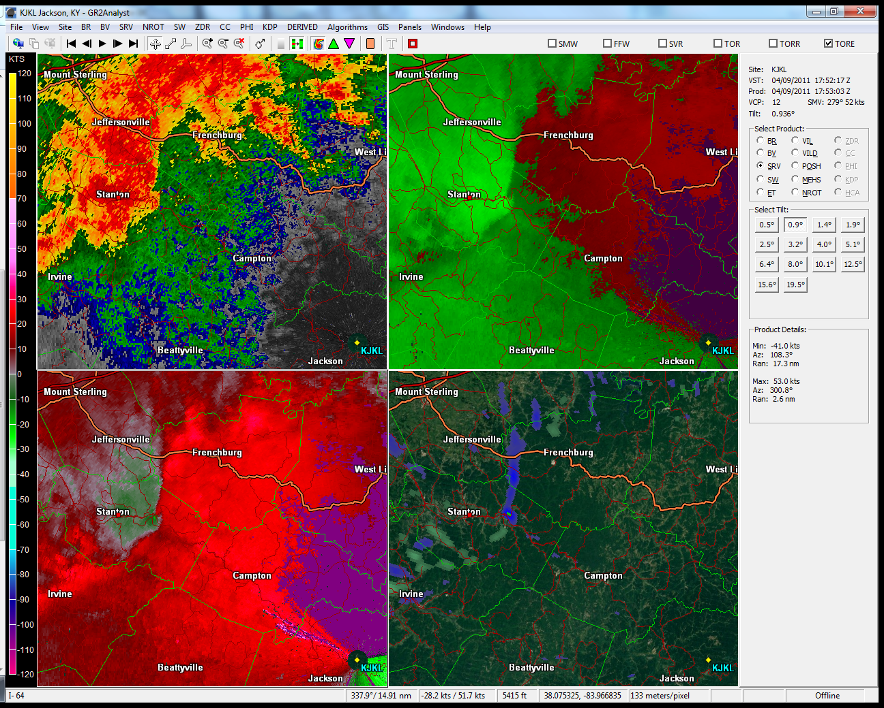

Slide 17
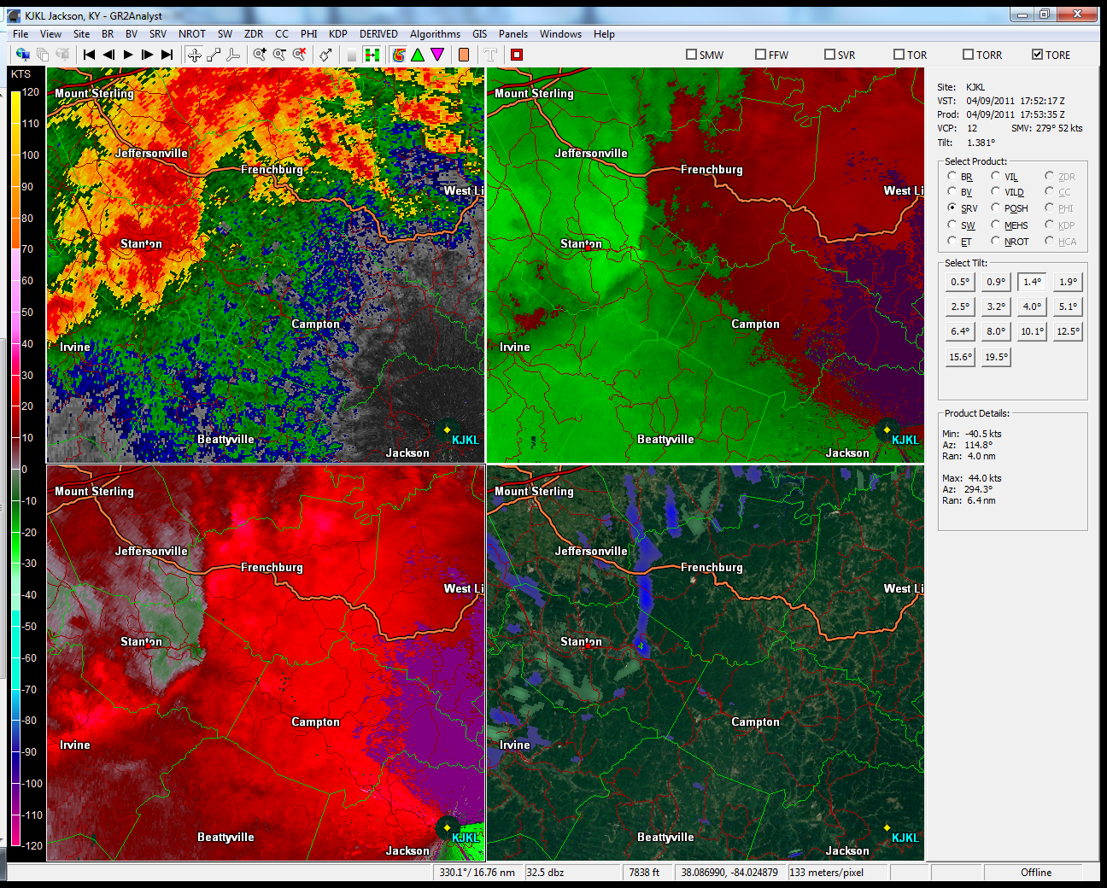

Slide 18
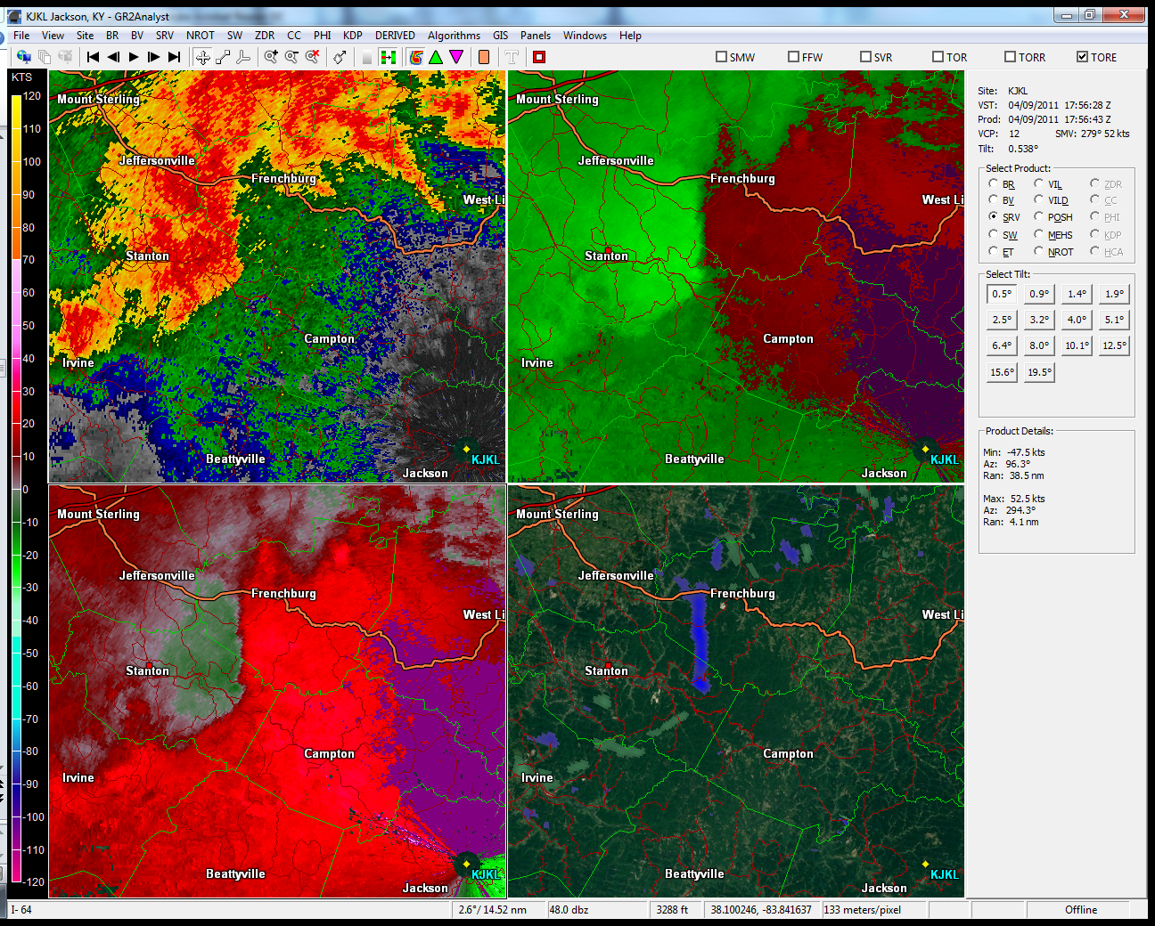

Slide 19
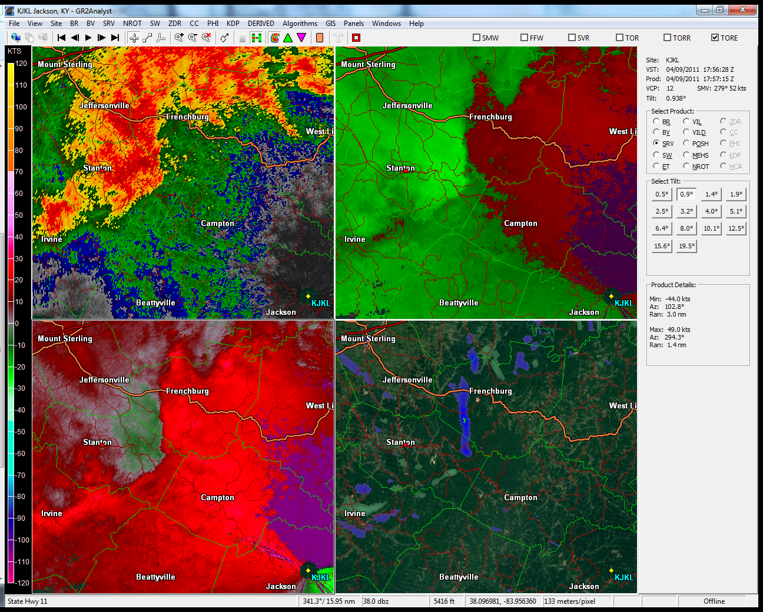

Slide 20
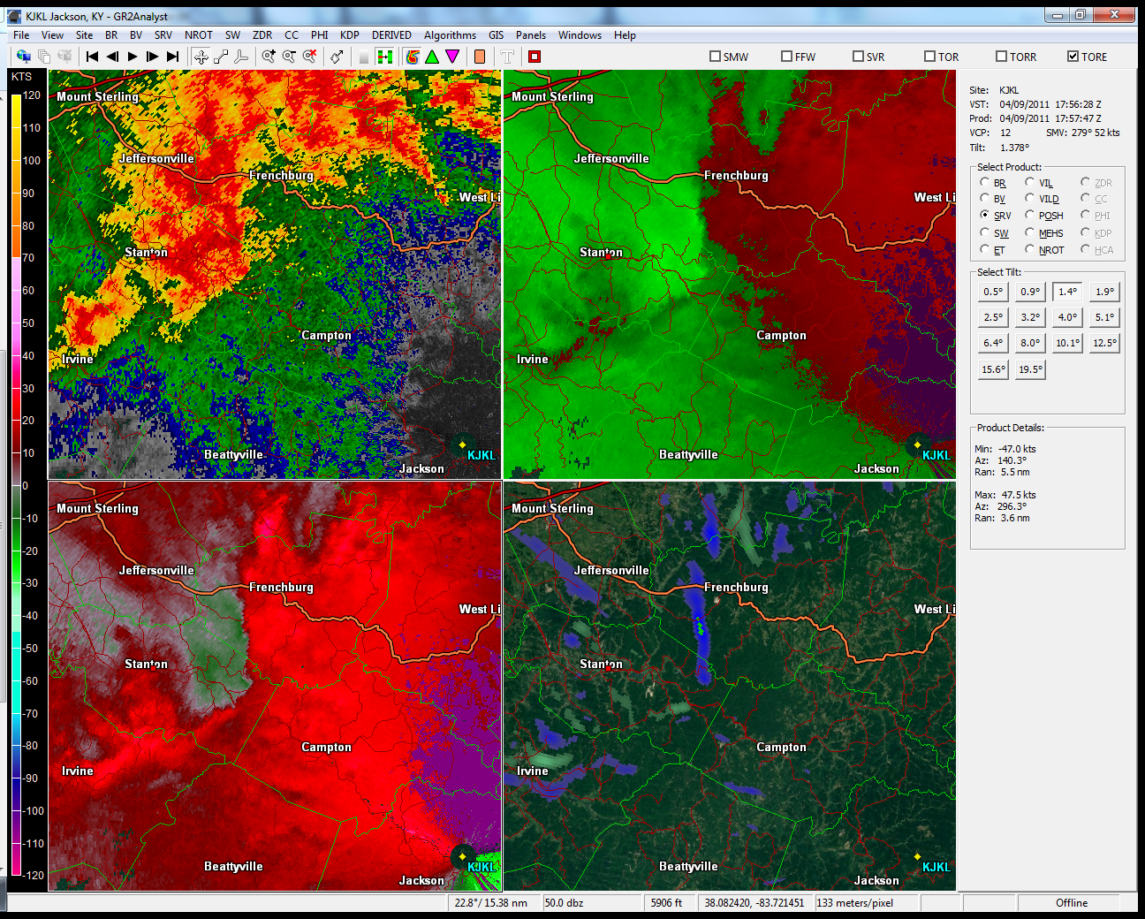

Slide 21
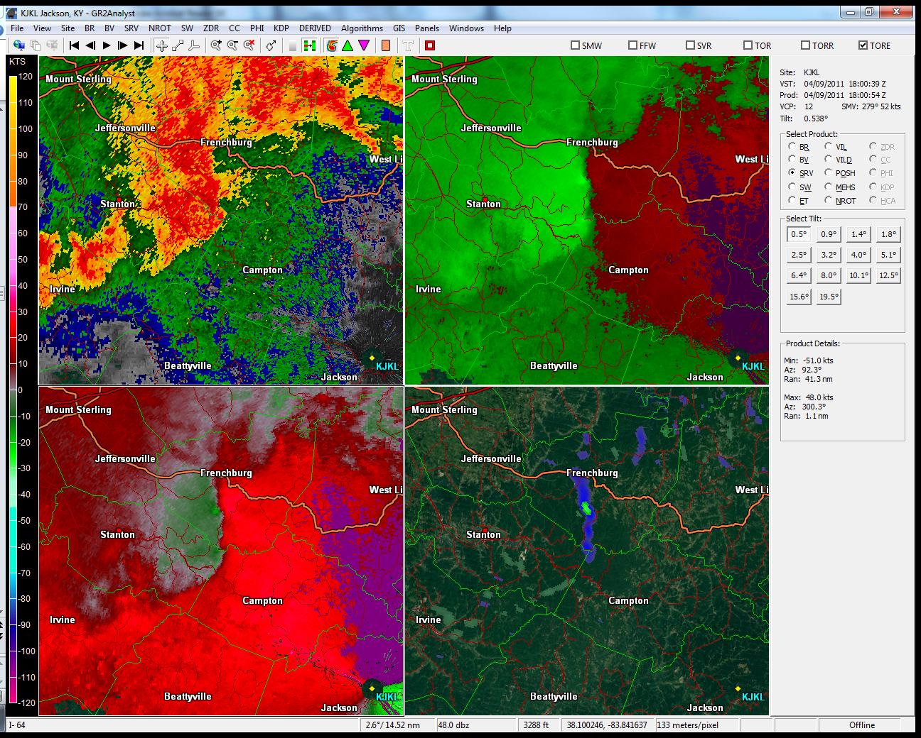

Slide 22
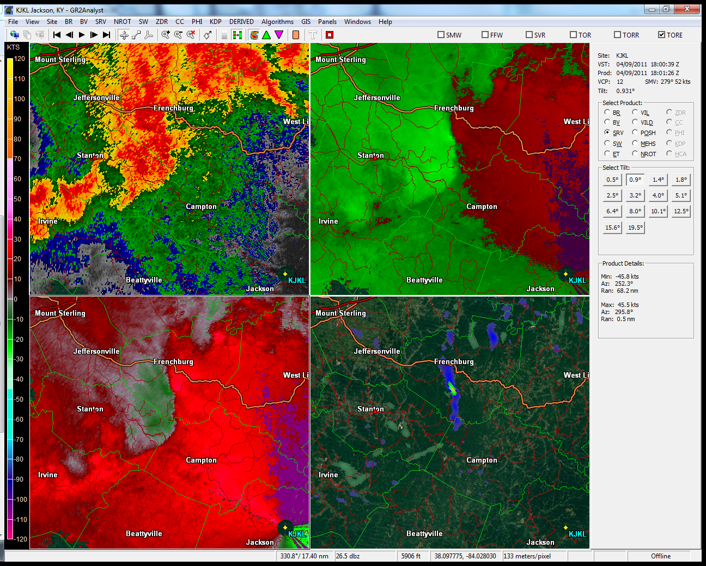

Slide 23
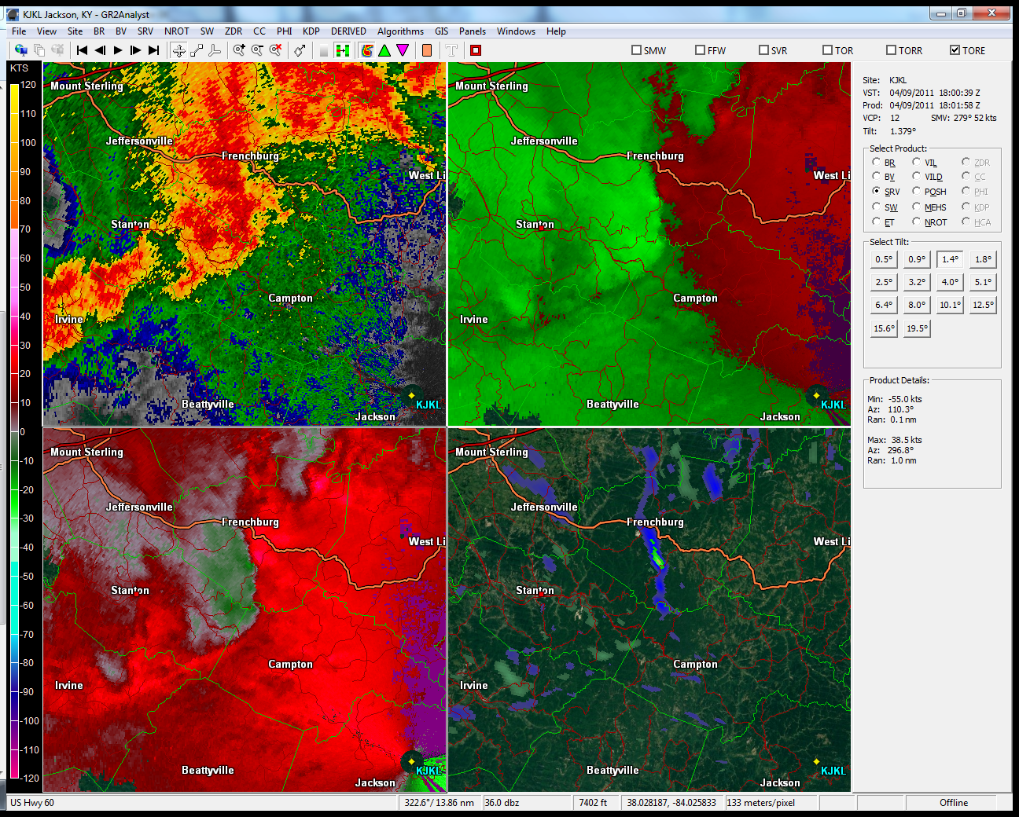

Slide 24
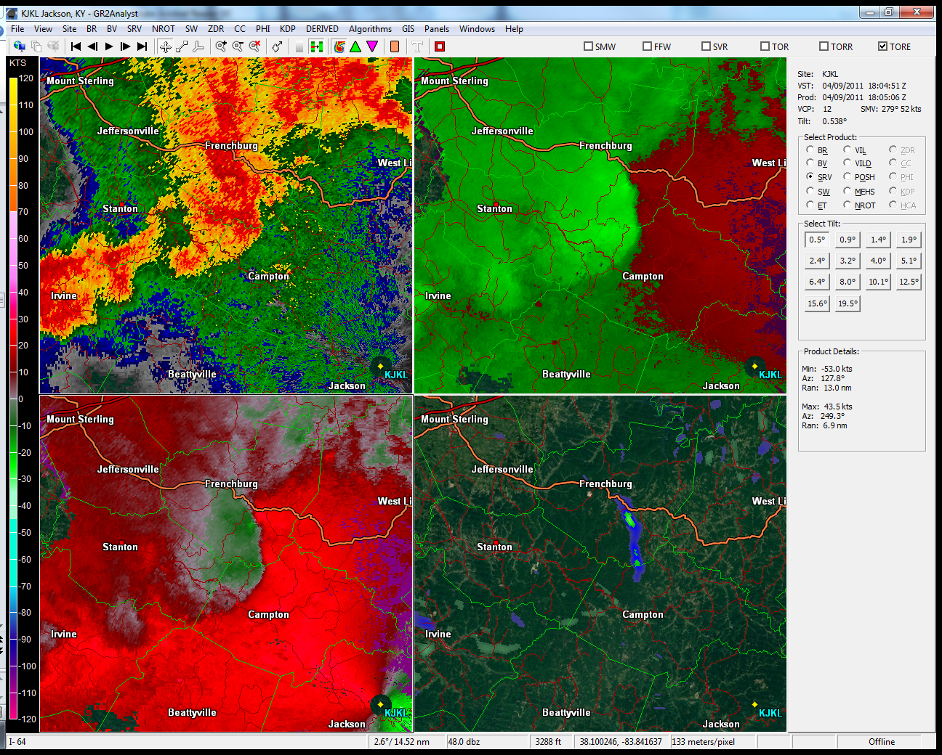

Slide 25
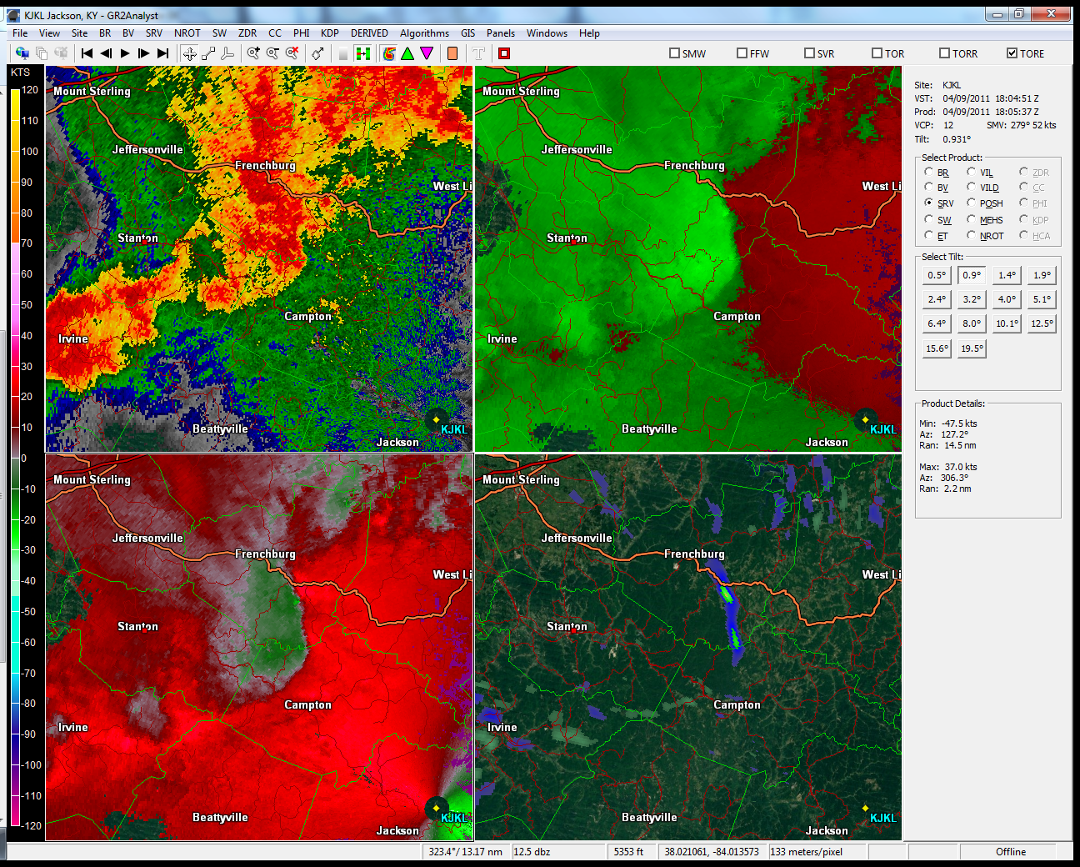

Slide 26
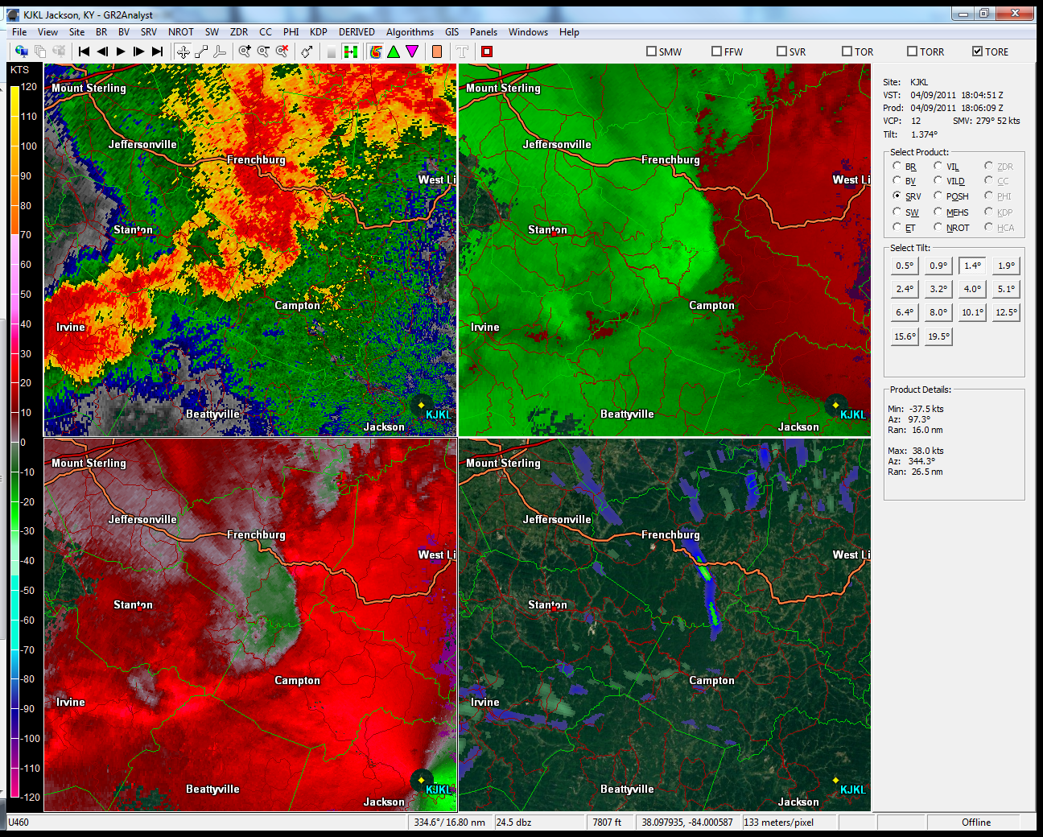

Slide 27
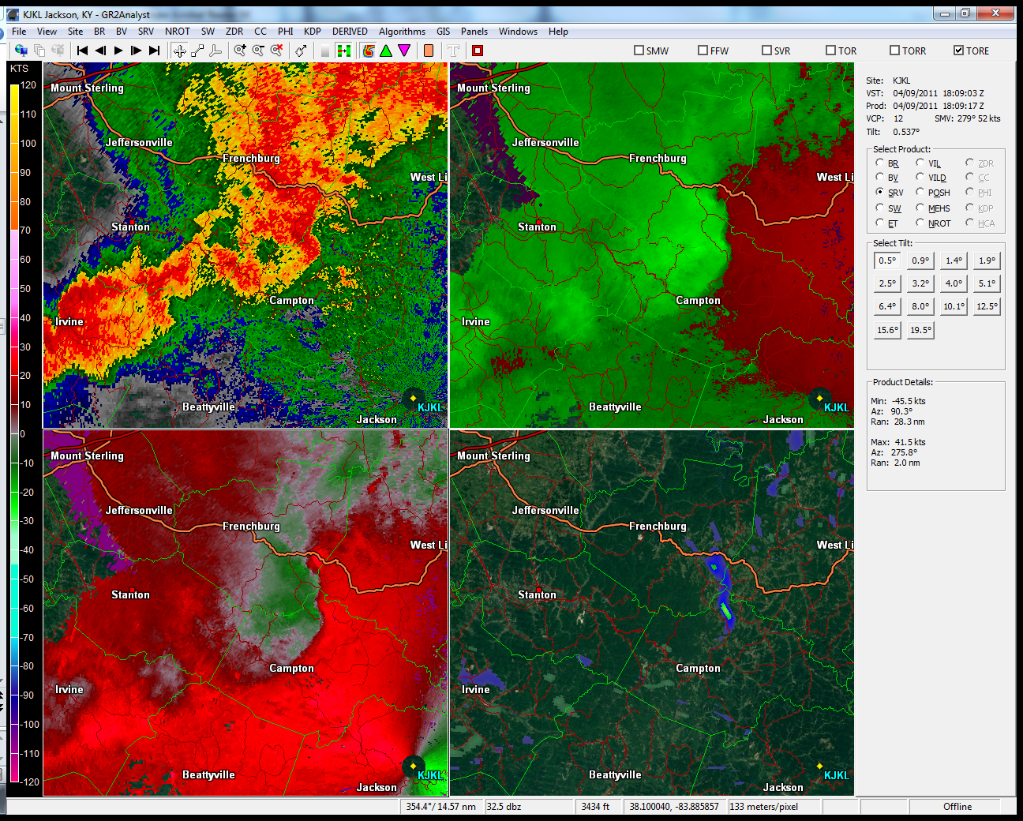

Slide 28
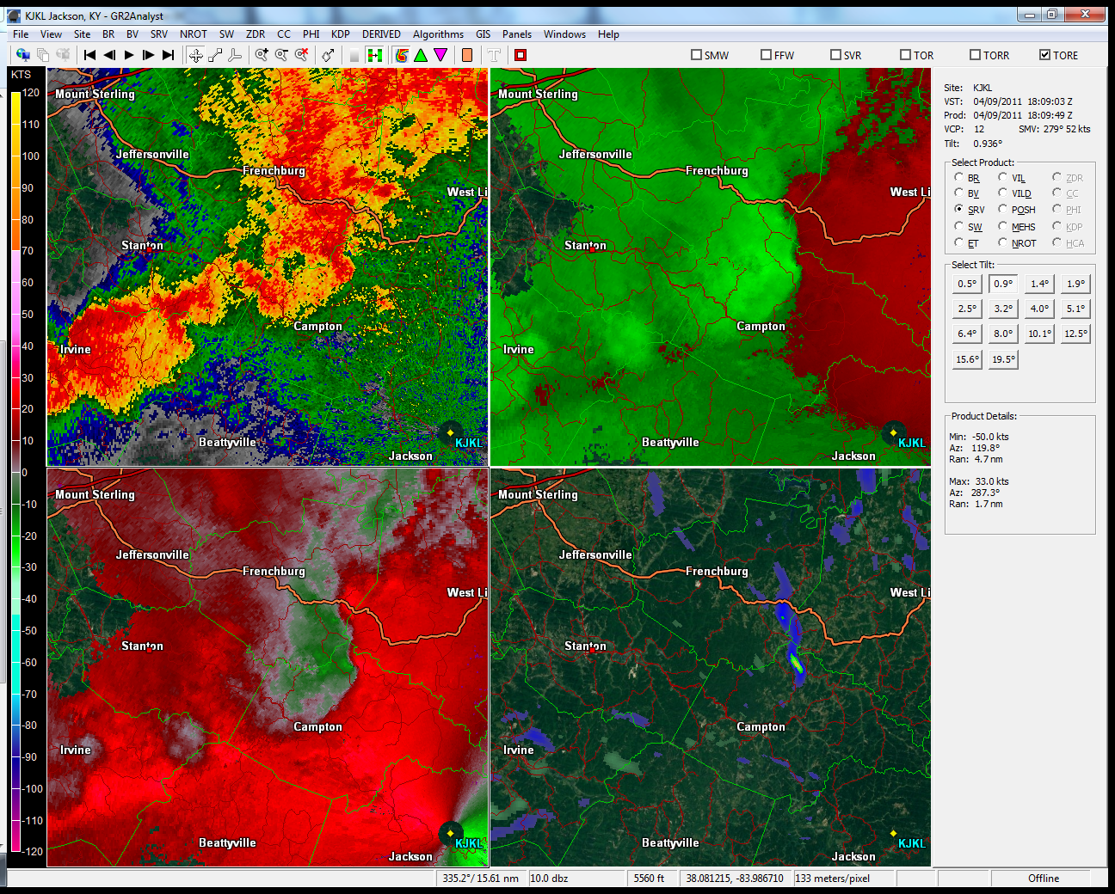

Slide 29
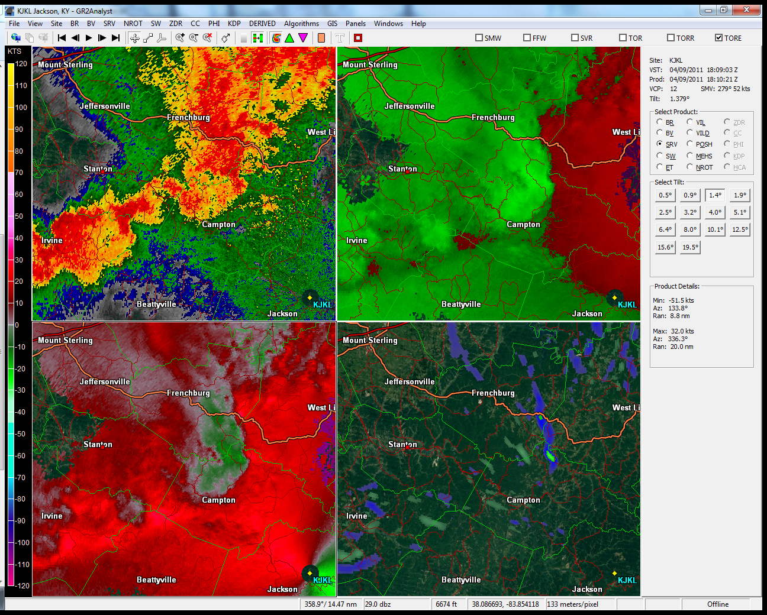

Slide 30
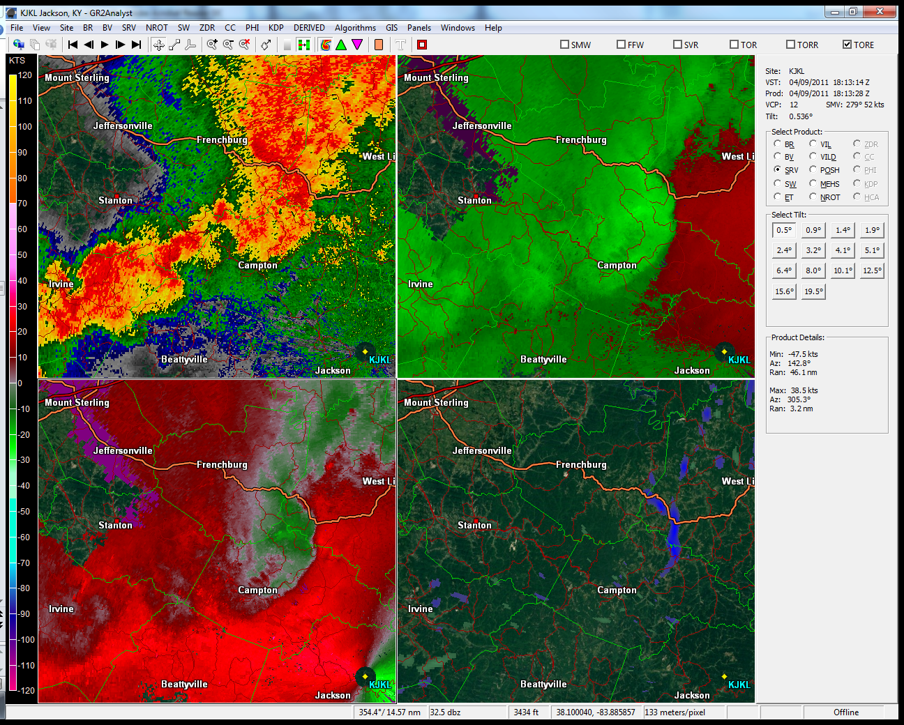

Slide 31
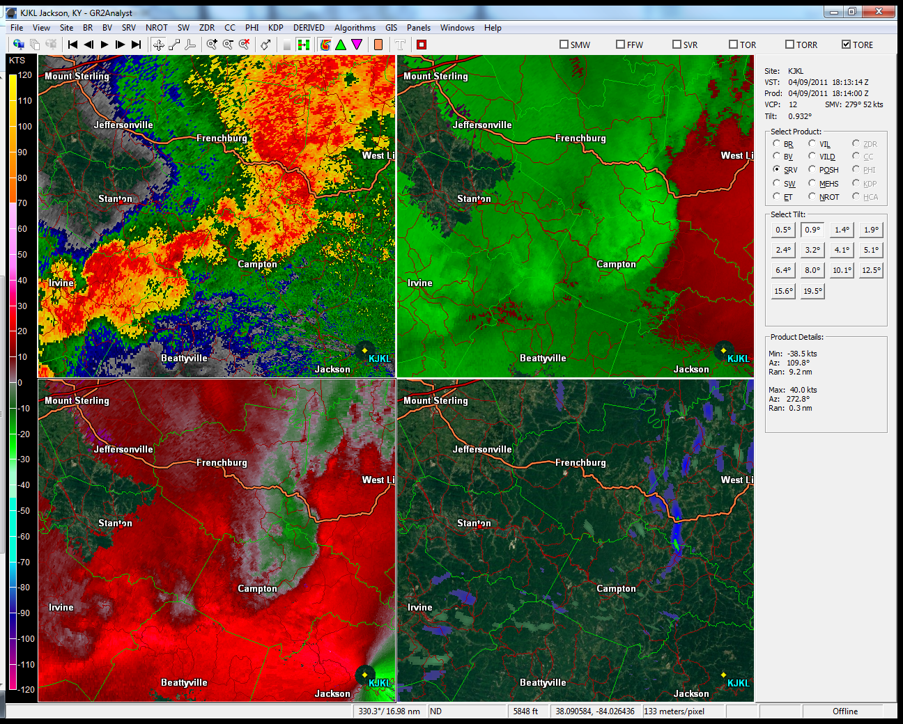

Slide 32
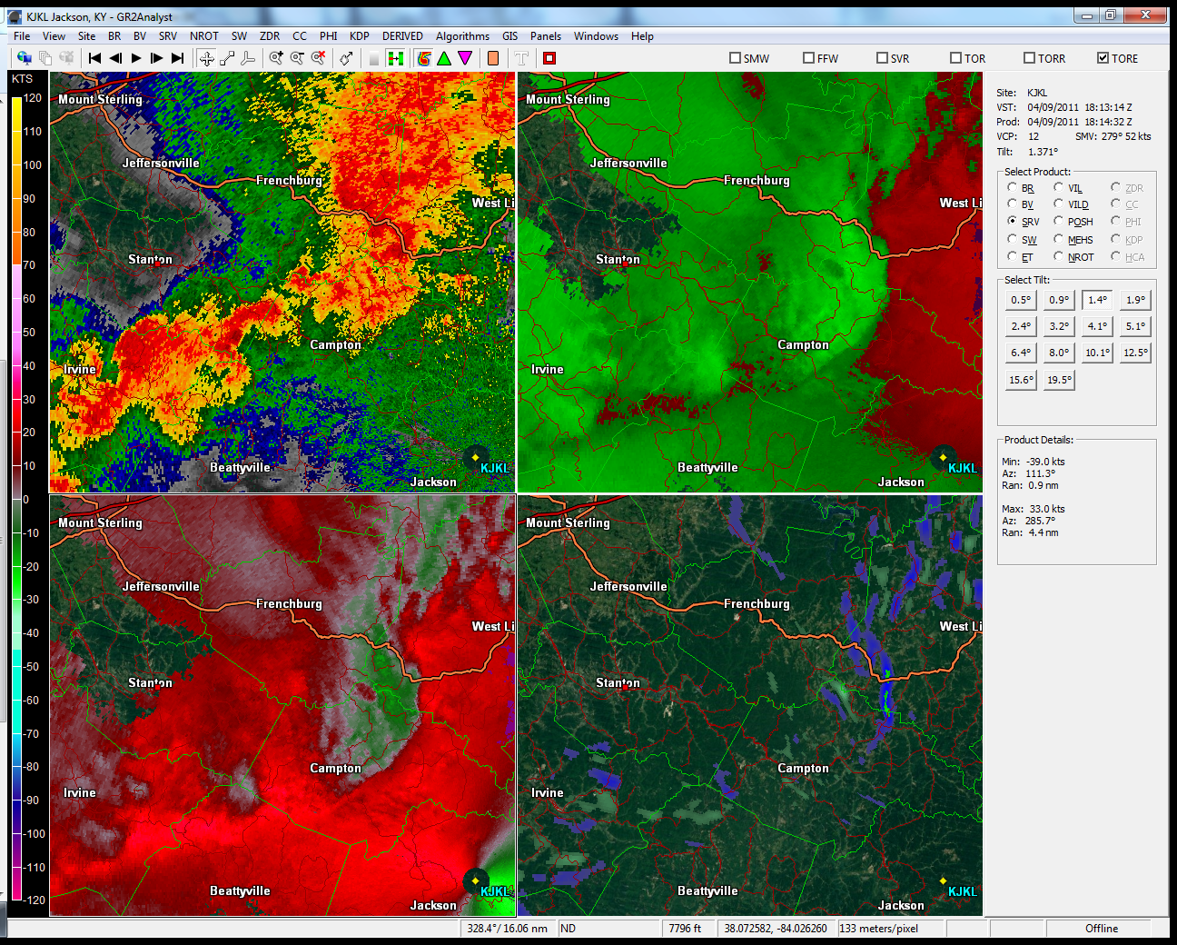

Slide 33
April 9, 2011 QLCS Tornado
EF-0 from southeast Menifee County into northern Wolfe County
9 minutes, ~ 1/2 mile path length, 100 - 250 yards wide
Winds ~ 80 - 85 mph
Numerous trees uprooted, moved well-constructed barn, destroyed/tossed well-anchored carport, minor house/car damage
16 minute lead time
Radar beam 1500’ above ground level

Slide 34
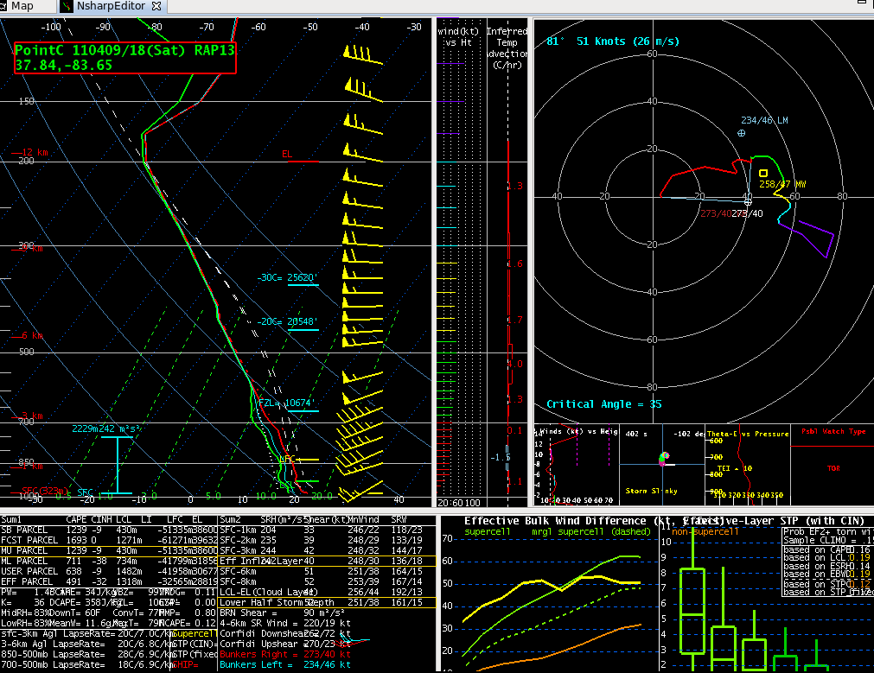
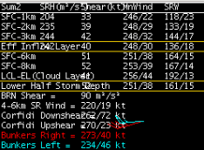
0-3 km Bulk Shear - RAP

Slide 35
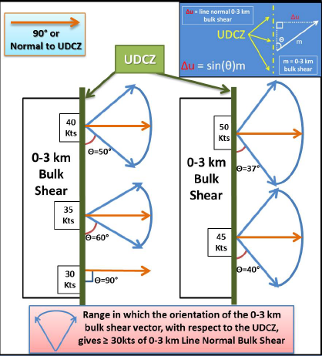
0-3 km Line Normal Shear
m = 42 knots from 260°
Θ = 80°
Δu = sin(80°)*42 = 41.4 knots
UDCZ
Δu = 41.4 kts
Θ = 80°
m = 42 kts

Slide 36
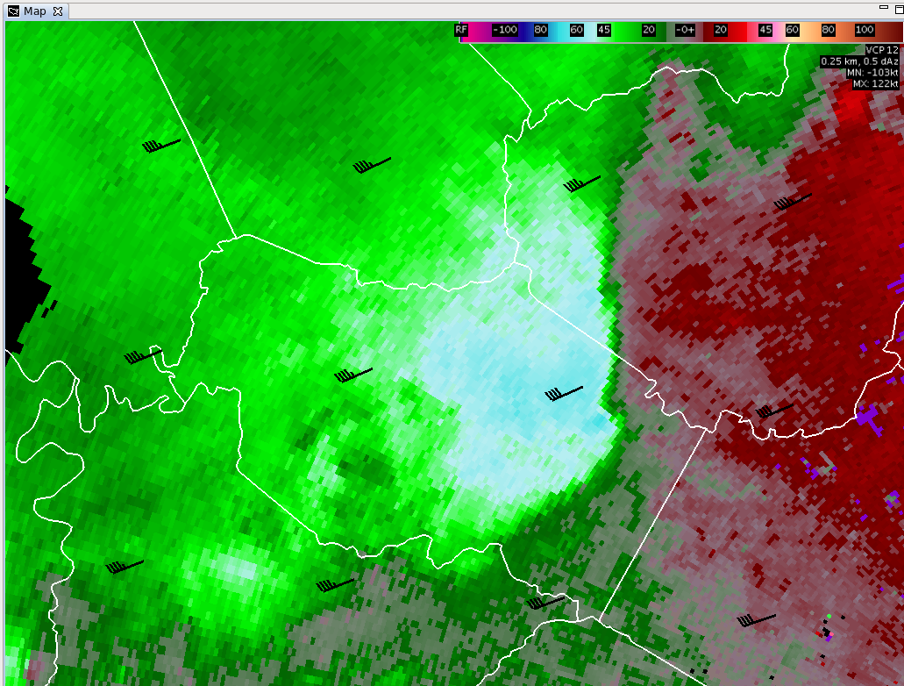
41 kts

Slide 37
Landspout Definition
Tornado formed along weak boundary underneath cumulus cloud with no organized large-scale rotation
Pre-existing rotation (vorticity) near ground stretched vertically upward
Different from typical tornado, where circulation forms well above ground within parent storm/mesocyclone

Slide 38
Characteristics
Boundary layer vorticity stretched vertically underneath funnel cloud in moist environment with light winds
Column of air reaches from ground to funnel cloud
Good directional wind shear, low wind speeds overall
Modestly steep low to mid-level lapse rates
Minor localized or no damage. Rare instance of up to F3 damage on periphery of microburst on 6 August 1977 east of Springfield, IL (Forbes and Wakimoto, 1983).
  F3: 158-206 mph EF3: 136-165 mph
Winds commonly on order of 60 mph or less – below EF-0 estimated damage threshold

Slide 39
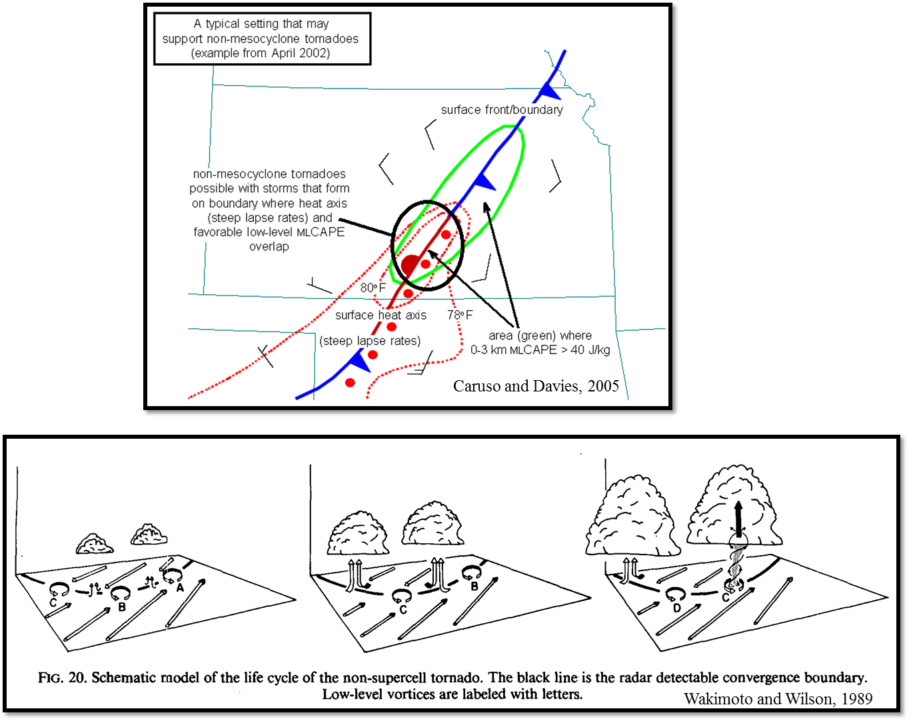

Slide 40
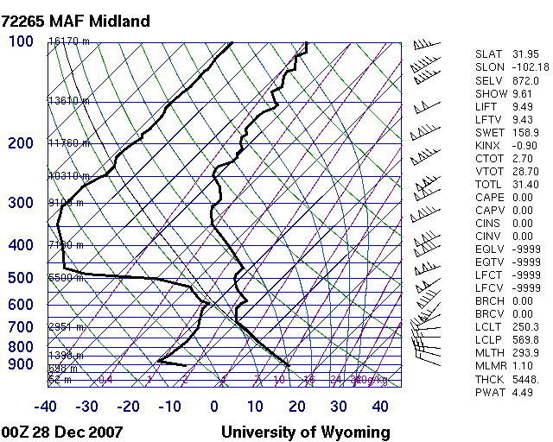
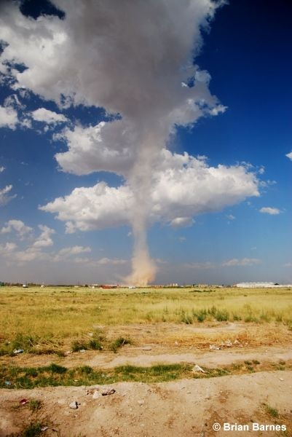
Characteristics – Dust Whirl/Tube
Tend to begin as an intense rotating whirl/tube of dust at ground (sometimes hollow or soda-straw like appearance)
Warm unstable near-surface air produces thermal overturning and vorticity, which gets stretched vertically
Form beneath and attached to developing cumulus cloud

Slide 41
Formation/Detection
Often develop along a boundary/fine-line - research suggests NE/SW orientation is favorable (Conder et al. 2007)
Colliding boundaries enhance low-level vorticity
Perpendicular intersection of west-east propagating outflow boundary & south-north moving storm stretches low-level vorticity vertically (Guseman, 2012)
Strengthening radar signatures in presence of well-defined boundary indicate potential landspout formation

Slide 43
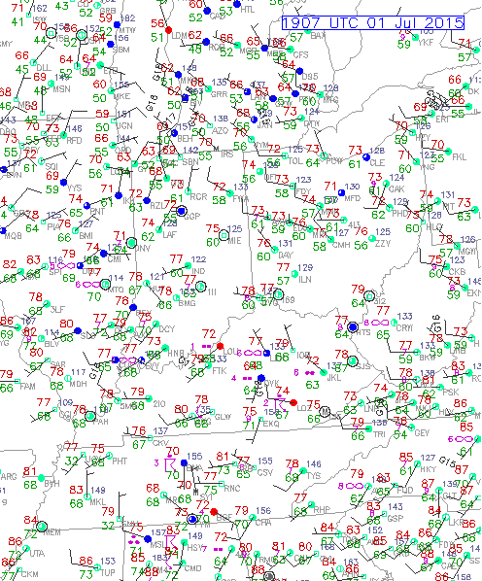
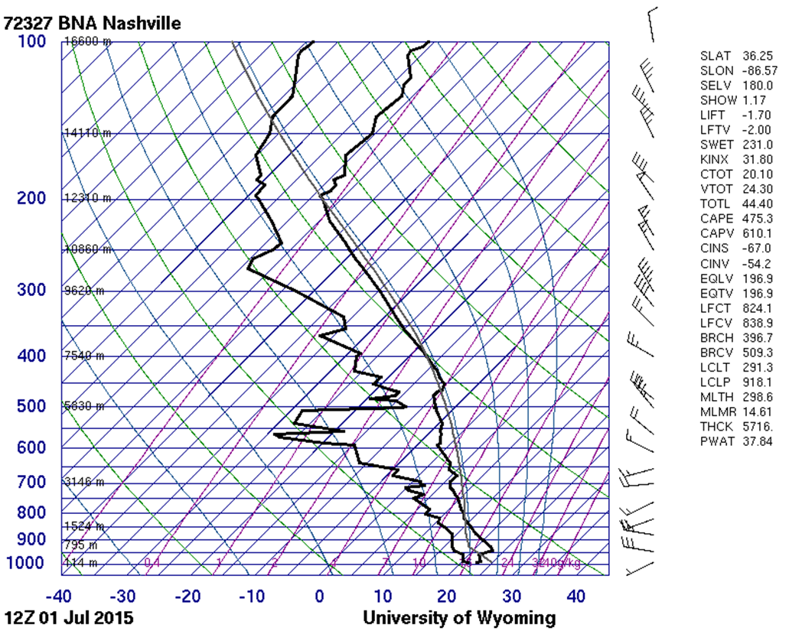
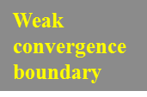

July 1, 2015 Landspout Tornado

Slide 44
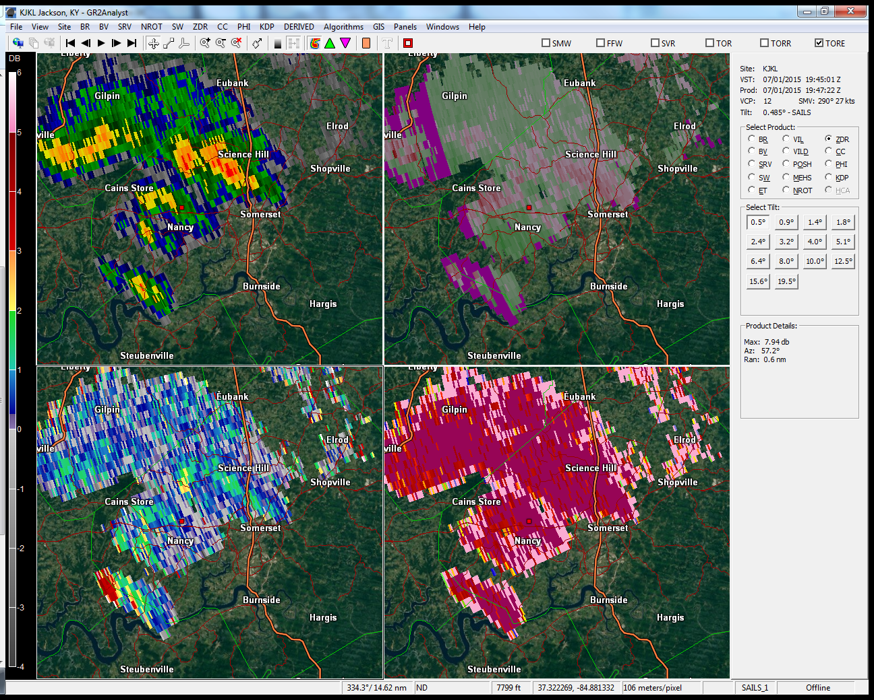

Slide 45
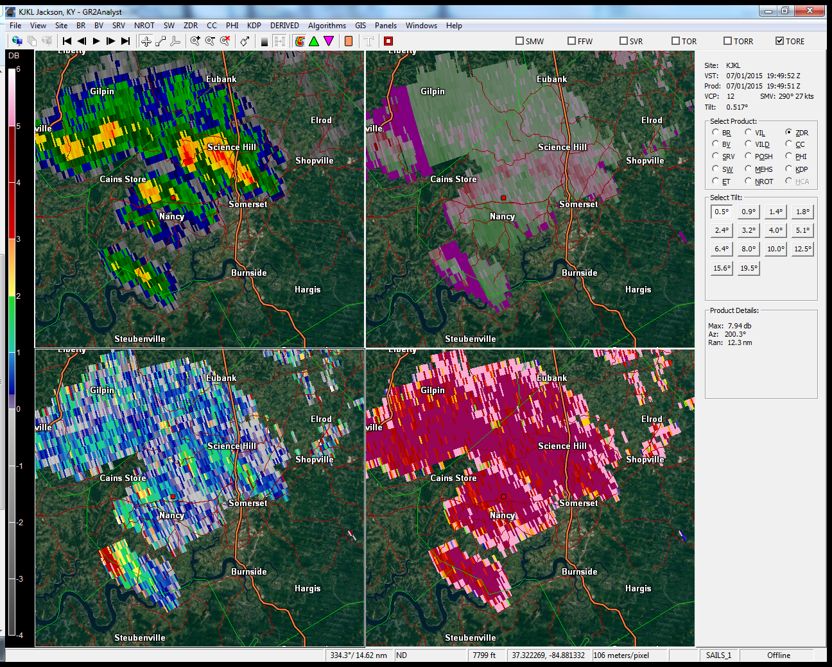

Slide 46
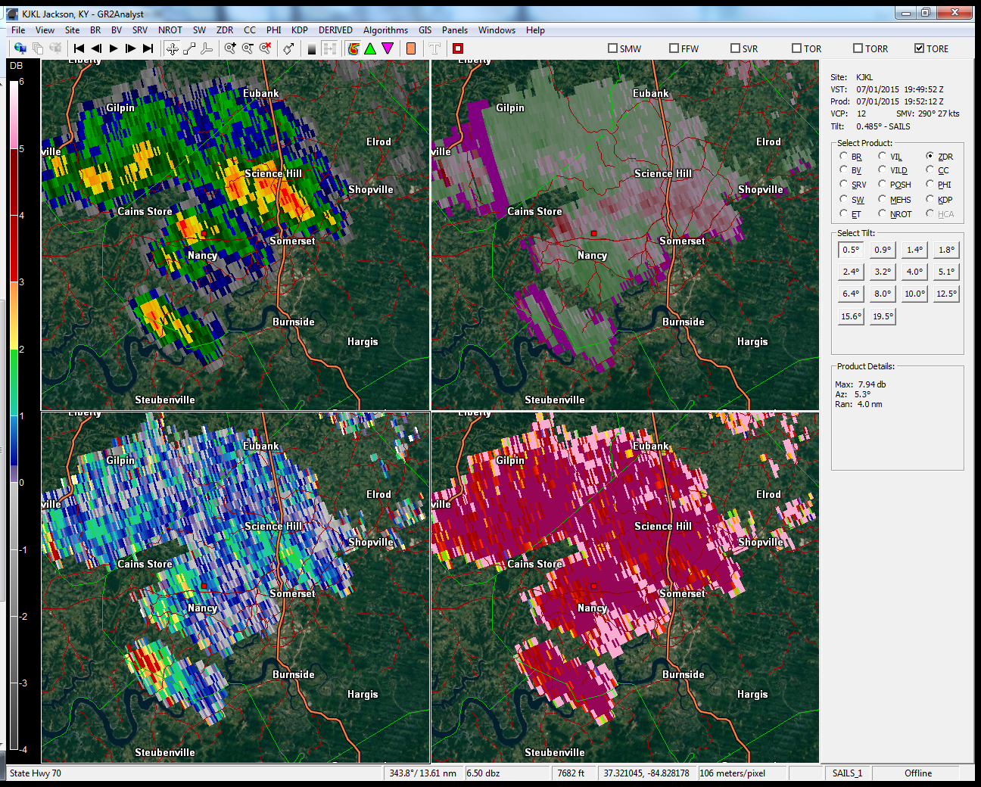

Slide 47
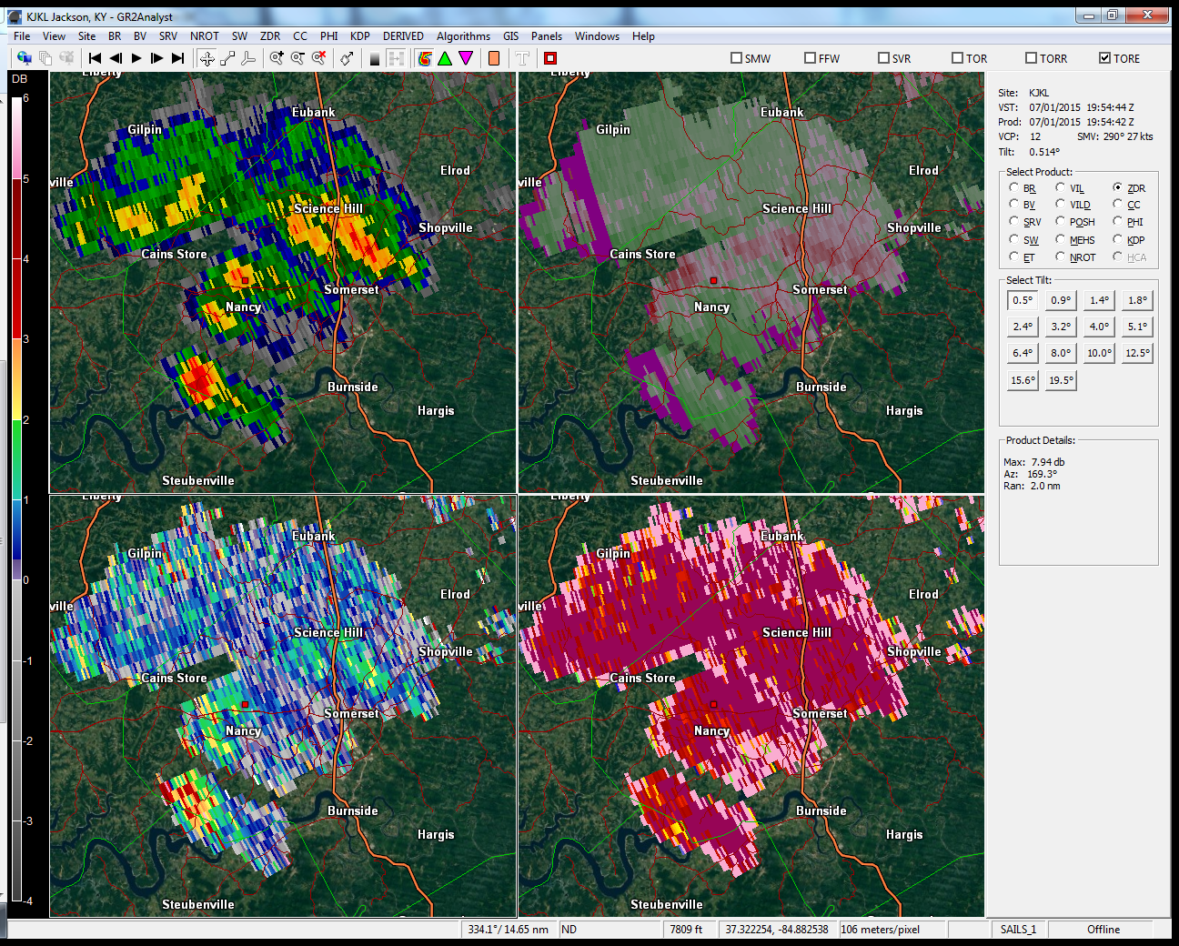

Slide 48
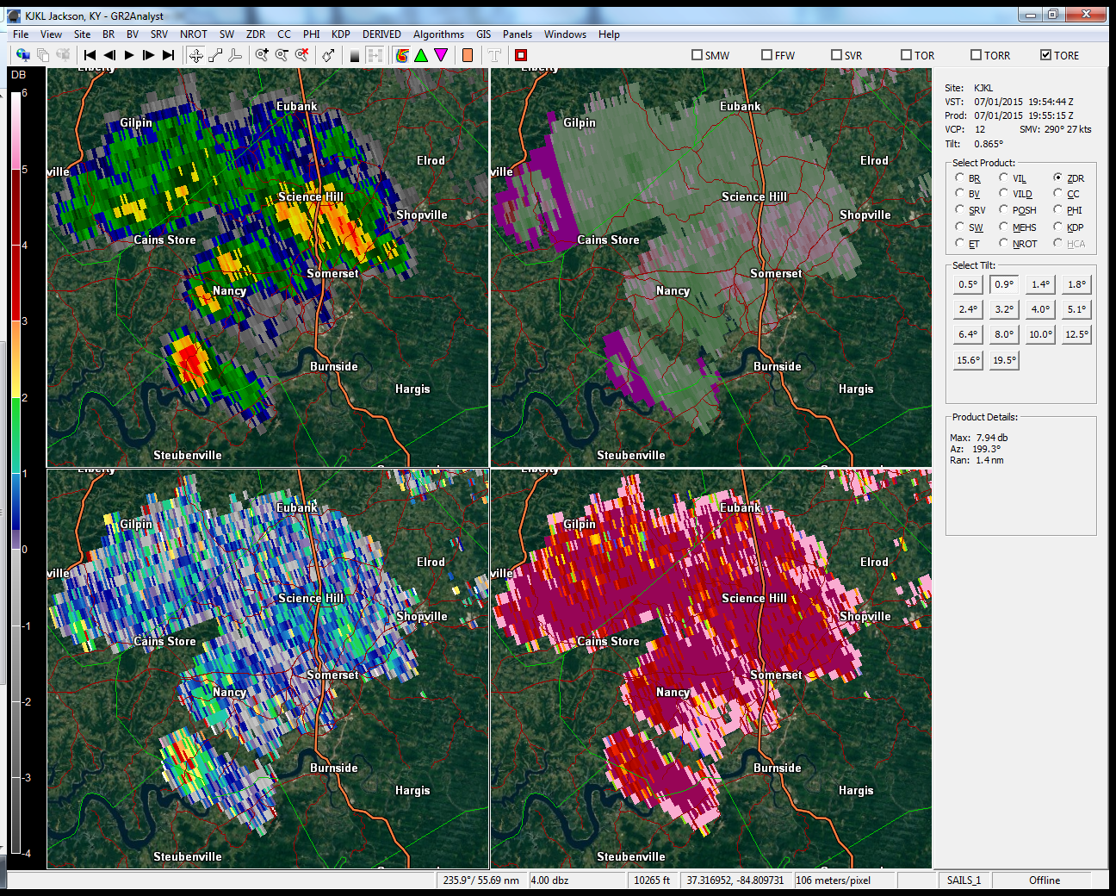

Slide 49
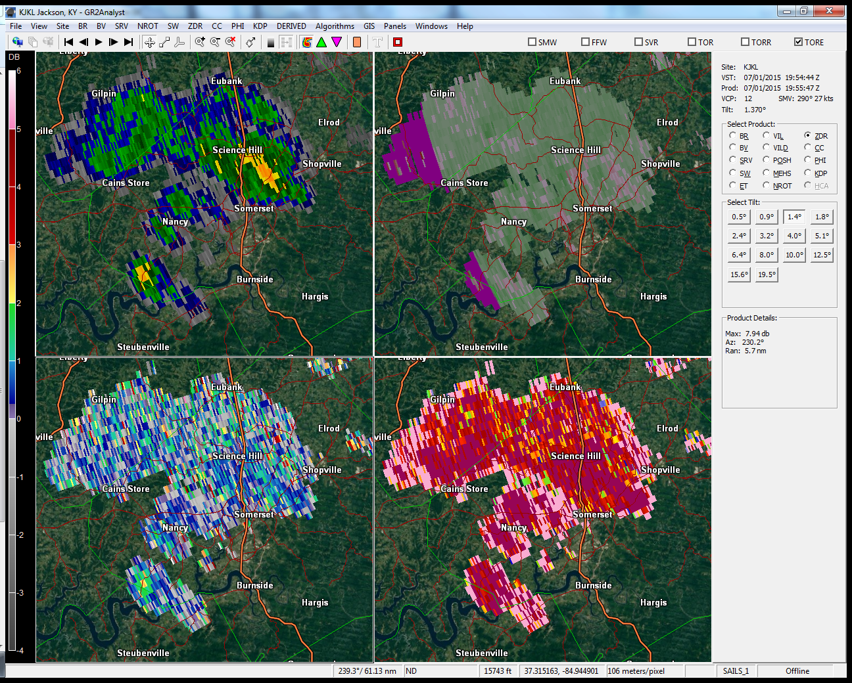

Slide 50
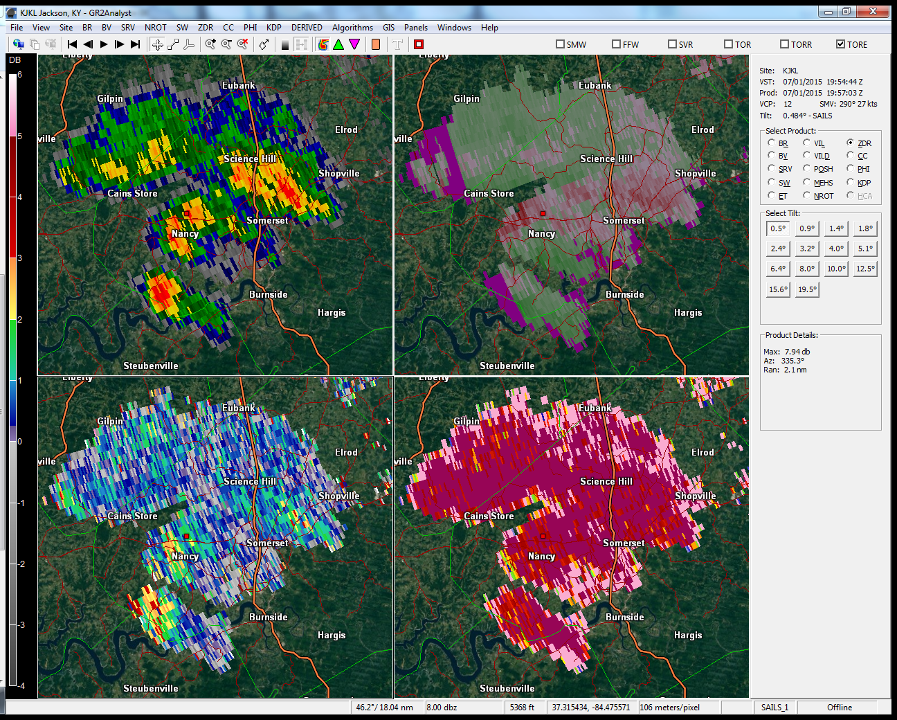

Slide 51
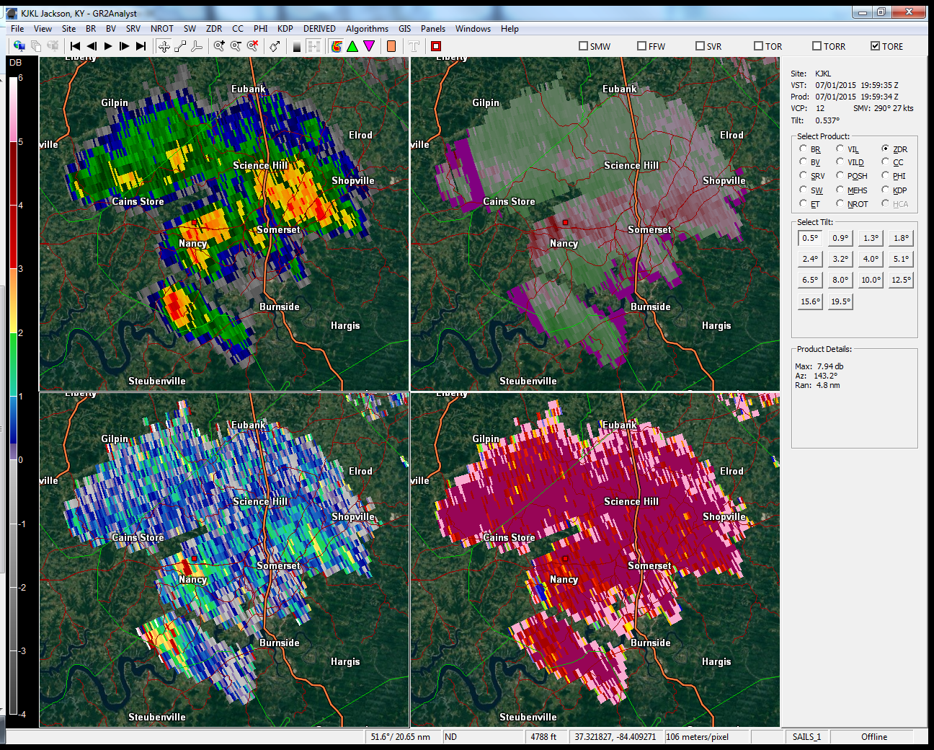

Slide 52
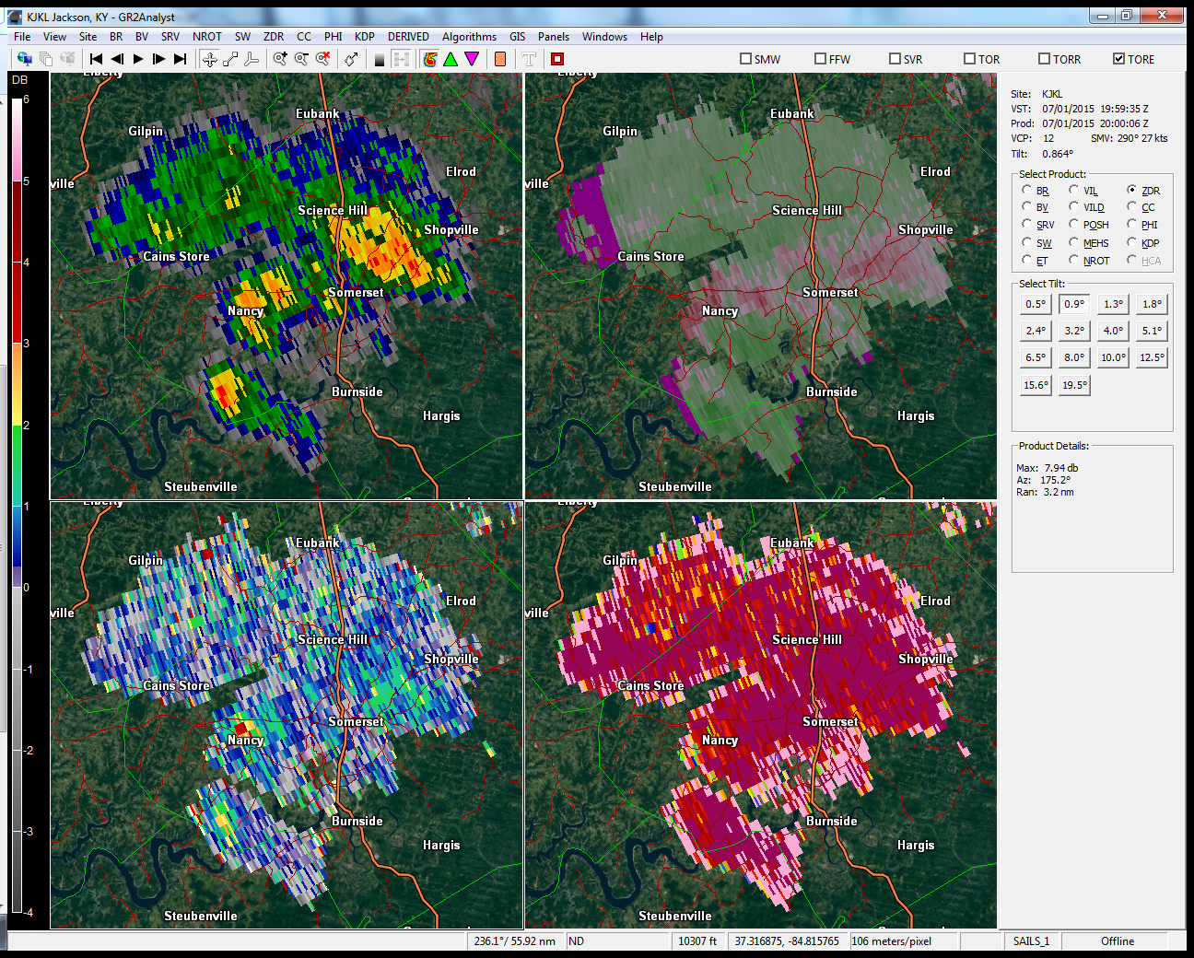

Slide 53
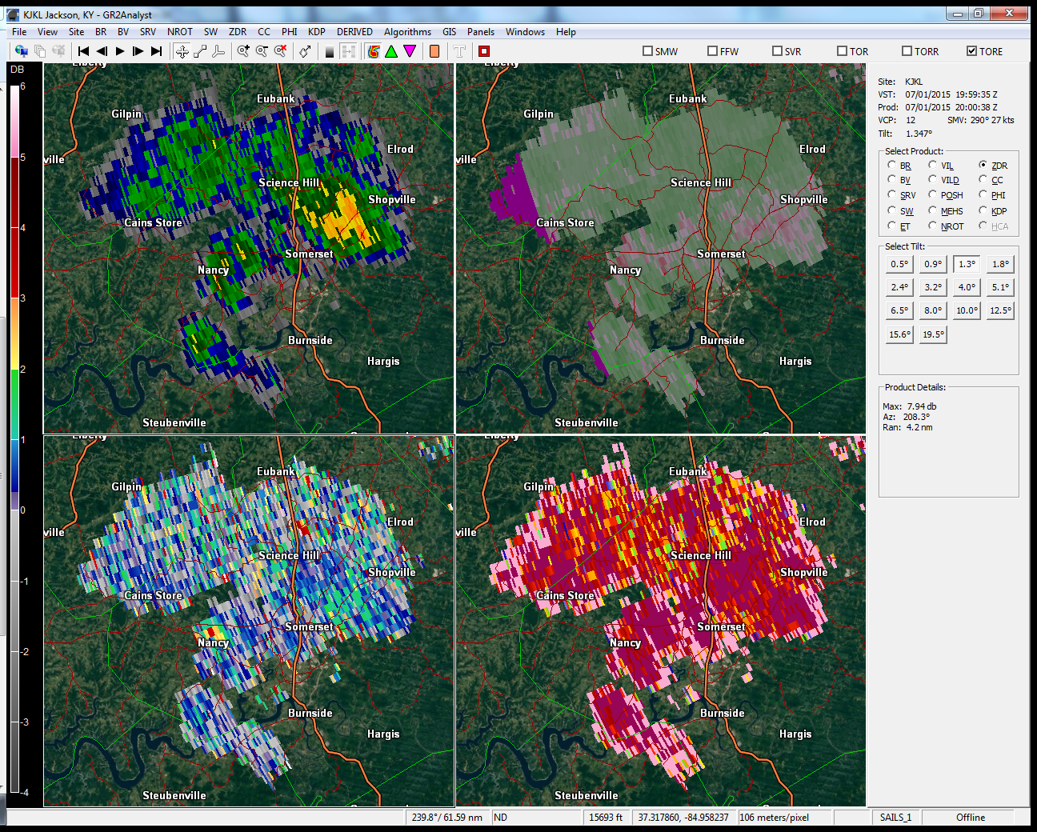

Slide 54
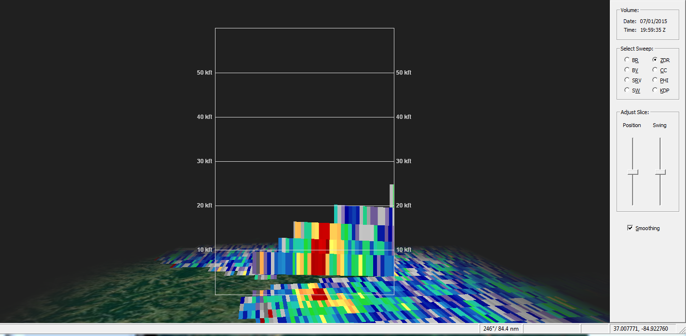
ZDR Column Preceding Landspout

Slide 55
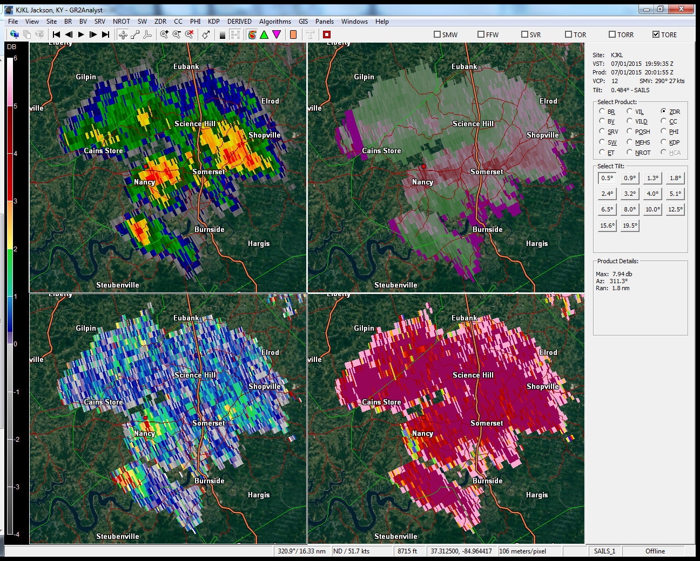

Slide 56


Slide 57


Slide 58


Slide 59


Slide 60


Slide 61


Slide 62


Slide 63


Slide 64
July 1, 2015 Landspout Tornado
EF-0 just southwest of Nancy, KY
1 minute, 3/10 mile path length, 100 yards wide
Winds ~ 75 mph
Minor tree damage & structural damage to old barn/house, few tombstones overturned in cemetery
NO LIGHTNING
25 second lead time from correlation coefficient
Radar beam 8300 – 8400’ above ground level

Slide 65
The Landspout Menace
Landspouts officially get documented as tornado events in Storm Data
High FAR if a Tornado Warning is issued for every possible landspout case
Special Weather Statement alerts the public, while not over-warning
  NWS way of highlighting significant but not yet severe weather phenomena
If further growth leads to imminent danger, a Tornado Warning could be issued

Slide 66
Special Weather Statement – Conditions Favorable
...Special Weather Statement for |insert area|...
At |time|, National Weather Service Doppler radar indicated |strong/rapidly developing storms| over |location|, moving |direction and speed|. Conditions are becoming more favorable for the possibility of funnel clouds or weak tornadoes. A funnel cloud can occasionally briefly reach the ground and become a weak short-lived tornado, capable of producing minor damage and injuries in its direct path. Get inside a sturdy structure and stay alert for any possible warnings.

Slide 67
Special Weather Statement – Reports Received
...Special Weather Statement for weak short-lived tornadoes reported in |insert area|...
At |time|, the National Weather Service in Jackson received reports of a weak short-lived tornado over |area|, moving |direction and speed|. Although this tornado has since dissipated, additional funnel clouds and weak short-lived tornadoes may be possible. Any that develop will be capable of producing minor damage and injuries in their direct path. If you observe a funnel cloud or weak short-lived tornado, take shelter in a sturdy building.

Slide 68
Operational Considerations
Be aware of environment
  Moist & light winds for funnel clouds and landspouts along boundaries
  Primed for generating numerous mesoscale boundaries, supporting rapid storm growth
  Hot & dry with ample shear underneath developing cumulus
Remain vigilant for strong downdrafts in boundary-rich environments & processes that accentuate them
  Pulse storm downdrafts resulting from precipitation loading & evaporative cooling
  Outflows interacting with other boundaries to quickly stretch vorticity in secondary convection

Slide 69
Operational Considerations
Watch for rapid cell growth along boundaries & boundary “intersections” as opposed to boundary “collisions”
  Near-perpendicular intersection of 2 boundaries allows for localized lift in presence of aggressive turning of low-level winds, leading to brief spin-ups
  Head-on (parallel) collisions of boundaries result in broader & more linear-shaped clusters, intensifying then weakening once temporary source of convergence is lost
Circulations associated with landspouts order of magnitude smaller than highest resolution available from any radar product, causing circulations to be virtually unresolvable
Issue SPS to alert public, or TOR if confidence very high (report)

