Slide 1
An Examination of High-Shear/Low CAPE QLCS Events in the Lower Ohio Valley: Environments and Vr Shear Details
Patrick J. Spoden, Daniel Spaeth, Christine Wielgos, Mike York, Robin Smith, Gregory Meffert, Ryan J. Presley, Ken Ludington, Brittany Peterson (FGF)
Bow Echo Workshop March 2017

Slide 2
Why?
Between 2005 and 2013, we experienced 48 high shear/low CAPE tornadoes.
We do OK during the outbreaks
Not so much when we have an isolated event
These are real tornadoes, CC from dual pol often indicated debris
Improving? Two isolated tornadoes this winter both had lead times (not QLCS)
5 EF2’s
14 EF0’s
29 EF1’s

Slide 3
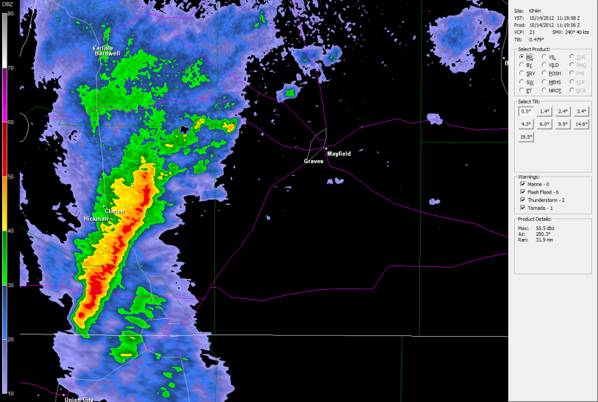
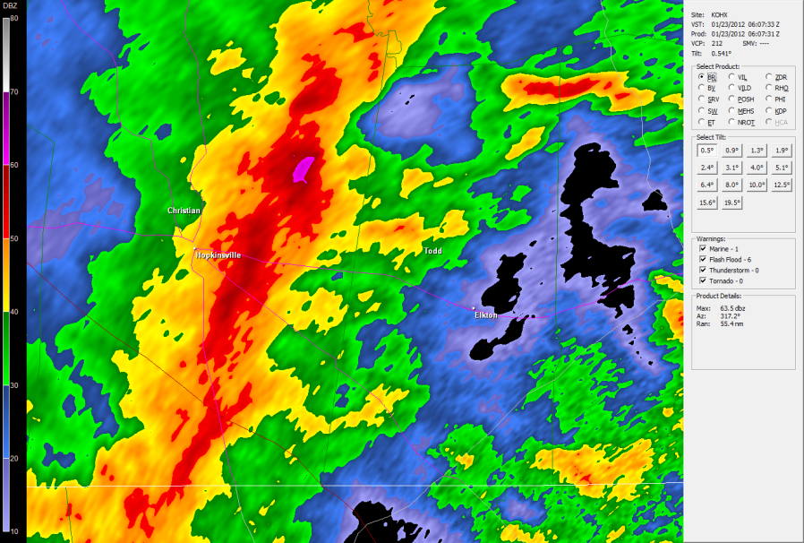
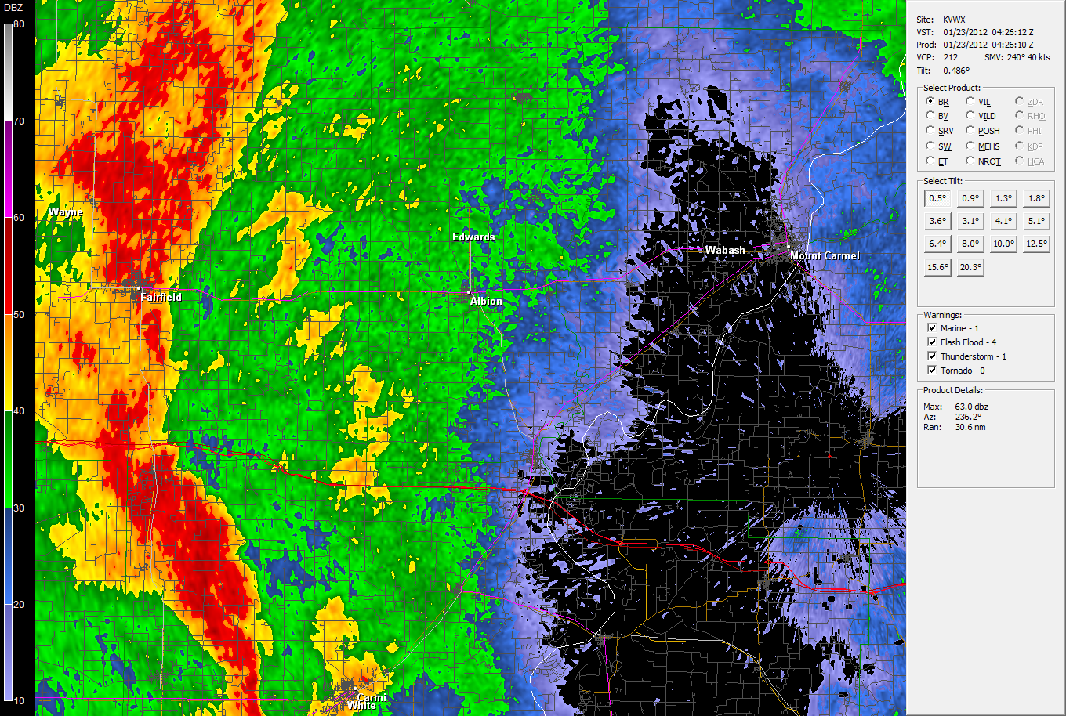
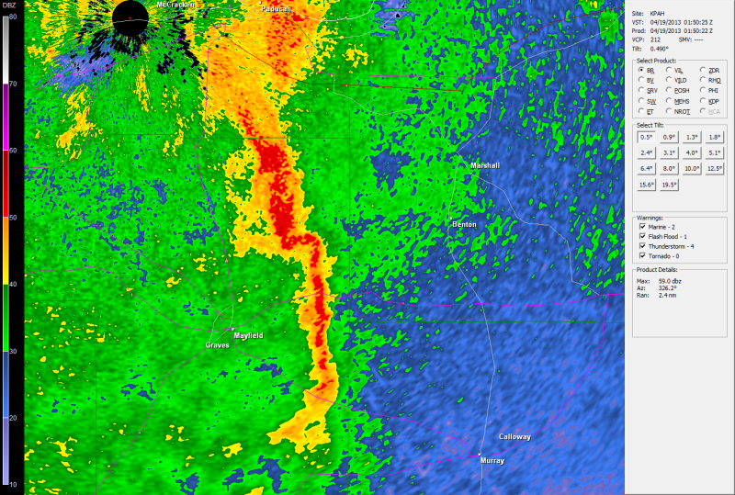
Reflectivity Patterns

Slide 4
Methodology
Analyze all HSLC QLCS tornadoes (no false alarms) 2005-2013
48 tornadoes
Create Vrot shear diagrams for each
Analyze trends
Height of highest Vrot
Volume scan when it occurred
Other general trends
Environment – Smith et al. (2012) and Thompson et al. (2012) database
Analyzed isolated vs. multiple tornado events
Numerous box and whisker plots

Slide 5
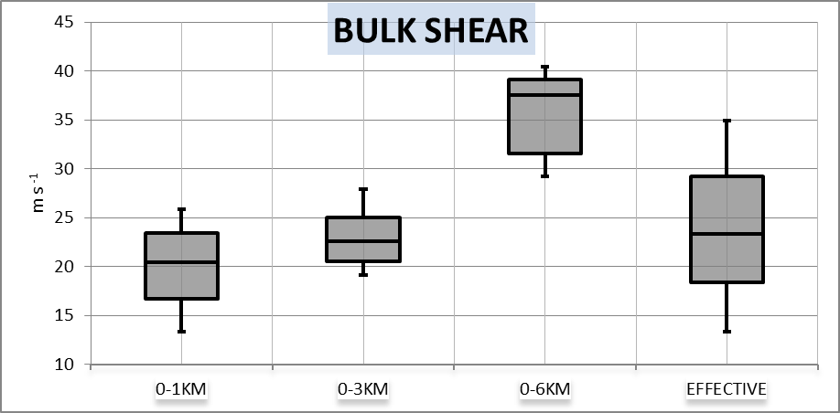
Findings - Environment
Bulk Shear - All Tornadoes

Slide 6
Findings - Vrot
18
Where the VS# is the volume scan prior
to tornado formation
Vrot All contains all volume scans for all
tornadoes in that range
Vrot NoEF0 contains all volume scans
for all non EF0 tornadoes in that range.
Red = # of tornadoes in those ranges
Lead time is possible
20
5
3

Slide 7
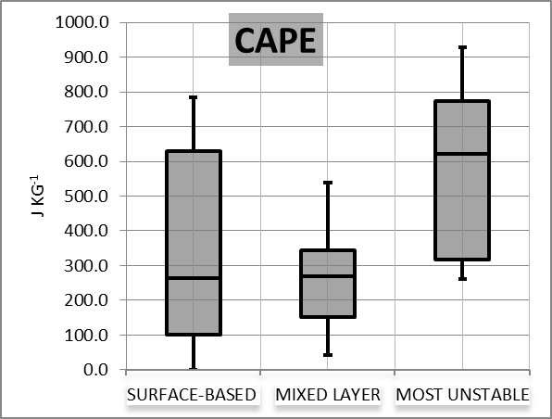
Findings - Environment
CAPE – All Tornadoes
Comparison of SBCAPE, MLCAPE, and MUCAPE of all tornadoes. Note that 7 of the cases
had no SBCAPE and 1 case exhibited no MLCAPE.

Slide 8
Most of this is not new, so far
We also looked at the location within the QLCS where the tornado was located.
Leading edge
Embedded within
Rear flank

Slide 9
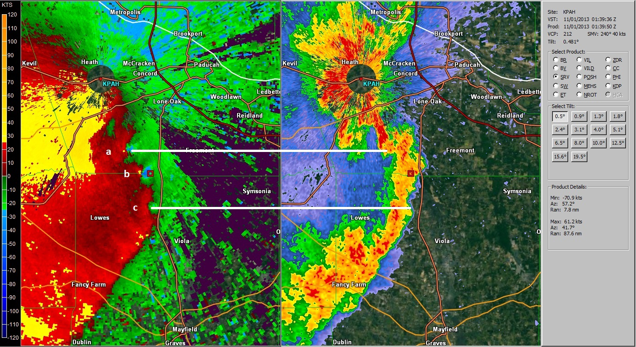
Where to Look?
7 multiple tornadic events
3 events - all tornadic signatures were along the leading edge
4 events – mixed mode, some on leading edge, some embedded, some along the rear flank
This is when the tornadoes occurred. Many (not all) went through the typical start at leading edge and work their way towards the rear flank.
Have not looked into why the difference

Slide 10
Typical Vortex Progression

Slide 11
Storm-Relative Vortex Progression

Slide 12
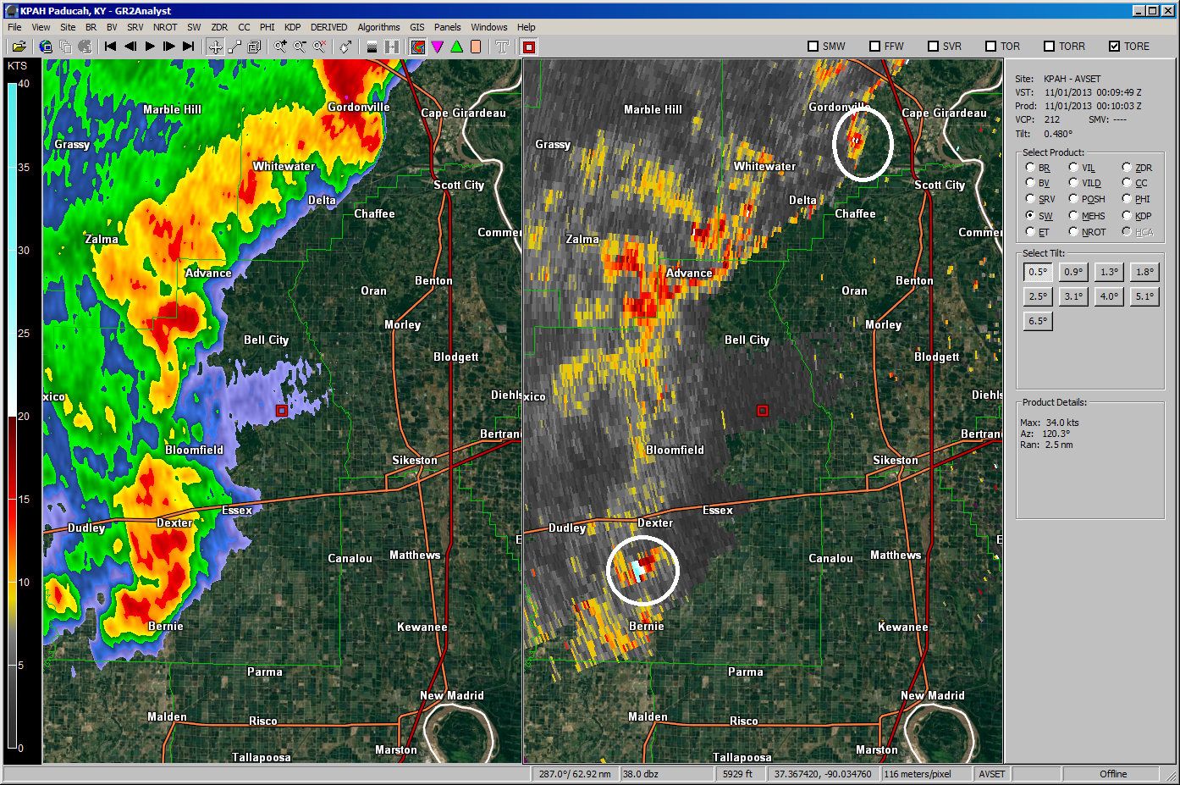
Spectrum Width
44 of the 46 events showed spectrum width values of 20 kts or greater at least once in the 4 volume scans prior to or at the time of tornado formation.
Tornadoes on the ground
at both locations

Slide 13
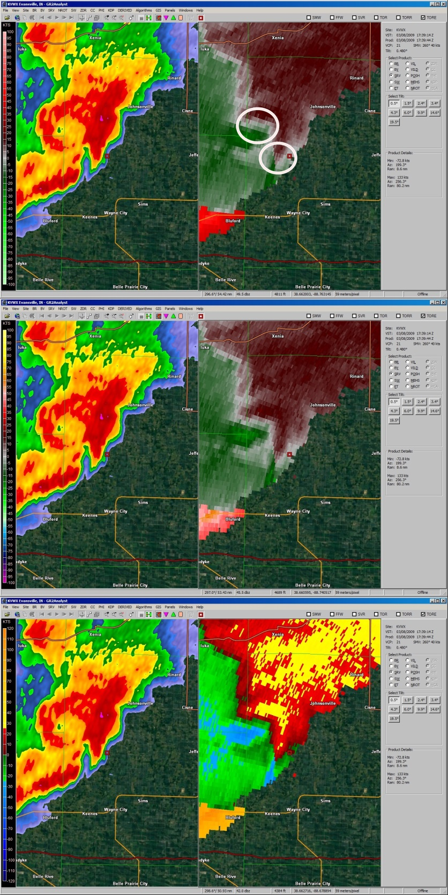
Colors are Everything!
Typical red/green
The ability to spot the circulation early
depends upon the color scale used
Bookbinder
Local with 25 kt color change

Slide 14
Operational Considerations
Strongly think about TOR
Upper 20s to 30 kt of rotation
2 or more consecutive scans
Vertical depth
Plus to have SW values at or above 20 kts
Toggle between BV and SRM
Use 4 panels (esp. with SAILS)
Better chance to see highest Vrot
MERL coming soon to help?
Color Scales are critical
0-6 km Bulk Shear may be the best discriminator between isolated and multiple tornado events.

Slide 15
Operational Considerations – Isolated Tornadoes
VIGILANCE is the KEY
Forecasters cannot lean on
Lightning
SWOMCD (from SPC)
Typical severe weather parameters
In these types of environments, even in a large area of showers, one must look for small lines of 40-50 dBZ echoes

