Slide 1
An Analysis of Tornado Debris Signatures in the 30 June – 1 July 2014 Quasi-Linear Convective System Tornado Outbreak
Adam W. Clayton, Anthony W. Lyza, and Kevin Knupp
Department of Atmospheric Science, Severe Weather Institute – Radar and Lightning Laboratories, University of Alabama in Huntsville (UAH-SWIRLL)
3rd Midwestern Bow Echo Workshop
9 March 2017

Slide 2
Background
Since the NWS dual-polarization upgrade from 2011 to 2013, the identification of tornado debris signatures (TDS) has become common practice
Research regarding TDSs for tornadoes producing EF-3 or greater damage has been well-documented (e.g., Ryzkhov et al. 2005; Kumjian and Ryzkhov 2008; Schultz et al. 2012 a,b)
However, research regarding TDSs for tornadoes of lesser strength are not well documented
Furthermore, TDSs in QLCSs are difficult to analyze during an event
TDSs from this case are associated with tornadoes that produced EF-1 or lesser damage
QLCS TDSs are different than supercell TDSs
QLCS updrafts are not as strong, deep, or persistent

Slide 3
Comparing TDS Criteria
 | Ryzhkov et al. 2005 (S-band) | Schultz et al. 2012 (C-band) | WDTD (S-Band)
Velocity | Velocity Couplet | Velocity Couplet | Velocity Couplet
Reflectivity (dBZ) | 45 ≤ x ≤ 55 | ≥ 30 | ≥ 35
ρ_{hv} | ≤ 0.8 | ≤ 0.8 | ≤ 0.8
Z_{DR} (dB) | ~0 | ~0 | ~0

Slide 4
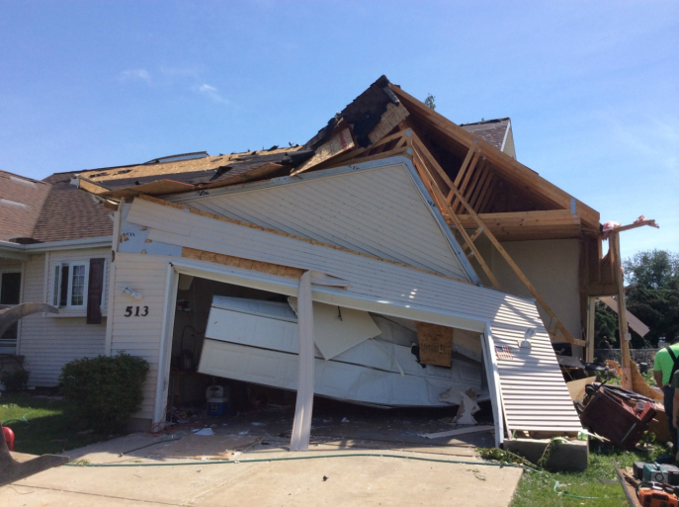
Earlville TDS
Reflectivity 0.5°
0218 UTC
N
NWS Chicago
EF-1 Tornado Track
50 km

Slide 5
Earlville TDS
Range from Radar: ~37 nm/ 68 km
N
Height: ~2900 ft / 0.88 km
2 km

Slide 6
Kankakee County
0.5° Reflectivity
0327 UTC
N
Area of Interest
10 km

Slide 7
Kankakee County Tornadoes
N
TDS associated with these tracks
EF-1 Tornado Track
10 km

Slide 8
Kankakee County (NW of Grant Park)
Velocity (m/s)
0.5°
Reflectivity (dBZ)
0327 UTC
Range from Radar: ~26 nm/ 48 km
N
Height: 1800 ft /
0.55 km
Two tornadoes
35-45 dBZ
ρ_{hv}
Z_{DR} (dB)
ρ_{hv values ~} 0.75 to 0.85
Notes:
CC values generally in the 0.85-0.90 range with one value below 0.80. Confirmed tornado damage.
Two velocity couplets, most of the debris signature is associated with the northern most couplet
Notice the higher reflectivity values where the debris would be located
3) Unfortunately, due to SAILS, vertical continuity was unable to be determined

Slide 9
Warsaw, IN
Reflectivity 0.5°
0456 UTC
N
Area of interest
Mesovortex Track
50 km

Slide 10
Multiple TDSs (SW of Warsaw, IN)
Velocity 0.5°
Reflectivity 0.5°
0456 UTC
2 km
2 km
ρ_{hv} 0.5°
Z_{DR} 0.5°
Range from Radar: ~20 nm/ 37 km
Height: 1400 ft / 0.43 km
2 km
2 km
Notes:
Multiple areas of lowered CC values generally in the 0.85-0.90 range.
No tornadoes were confirmed in this area, but damage occurred
The southern-most signature is the most obvious TDS of the event

Slide 11
Cross-section
N
1 km
Notes:
Cross-section was taken from SW to NE
This shows the correct leaning of the TDS signature with height

Slide 12
“Mesovortex Z” unconfirmed tornado
ρ_{hv} 0.5°
0456 UTC
Likely Tornadic Debris
Notes:
TDS has vertical continuity up to 1.5 km (5,000 ft.)
Damage was observed in this area, but no confirmed tornado
Best TDS of the case. CC values were in the 0.75-0.85 range but not tornado warning was issued.

Slide 13
TDSs Merge (Warsaw, IN)
Velocity 0.5°
Reflectivity 0.5°
0500 UTC
2 km
2 km
ρ_{hv} 0.5°
Z_{DR} 0.5°
Range from Radar: ~17 nm/ 31 km
Height: 1100 ft / 0.34 km
2 km
2 km
Notes:
The three signatures from previous scan have all merged in a “debris wall”
There are two areas of “low” values, but the general signature is merged together
Once again damage was reported, but not tornadoes were confirmed

Slide 14
Vertical Continuity
~1 km
One distinct region
Two distinct regions
Notes:
The signature lasts until the 1.9 degree tilt
The higher the tilt, the better you can see two distinctive areas

Slide 15
Plymouth, IN EF-1
Reflectivity 0.5°
0439 UTC
N
50 km

Slide 16
Plymouth, IN EF-1
0439 UTC
0443 UTC
0448 UTC
0456 UTC
0439 UTC
0443 UTC
0448 UTC
0456 UTC
Notes:
Confirmed tornadoes occur in the first two panels.
TDS weakens and then cycles again
Velocity signature becomes broad and then tightens again

Slide 17
Mesovortex “M” TDS Height
Notes:
This figure is the max height of CC values for each threshold
0443 UTC is when the debris signature first becomes obvious
The signature continues through 0448 UTC where tornado tracks were confirmed
0448 to 0456 UTC, values < 0.85 disappear and max height generally falls
0456 UTC, TDS height rises, velocity couplet/CC signature tightens and 0.85 CC values appear once again

Slide 18
My TDS Criteria
Ryzhkov et al. 2005 | Schultz et al. 2012 (C-band) | WDTD (S-Band) | My TDS Criteria | Poss. TDS Criteria
Velocity Couplet | Velocity Couplet | Velocity Couplet | Velocity Couplet | Velocity Couplet
Reflectivity: 45 ≤ x ≤ 55 dBZ | Reflectivity: ≥ 30 dBZ | Reflectivity:≥ 35 dBZ | Reflectivity: ≥ 30 dBZ (Schultz et al. 2012) | Reflectivity: ≥ 30 dBZ
ρ_{hv} ≤ 0.8 | ρ_{hv} ≤ 0.8 | ρ_{hv} ≤ 0.8 | ρ_{hv} ≤ 0.90 | ρ_{hv} 0.9 ≤ x ≤ 0.95
Z_{DR} ~ 0 dB | Z_{DR} ~ 0 dB | Z_{DR} ~ 0 dB | N/A | N/A
Note: N/A for ZDR because large raindrops contaminate the TDS in rain-wrapped tornadoes, there it is only used to add confidence for the presence of debris

Slide 19
0237 UTC AMDAR Sounding (Midway)

Slide 20
TDS Statistics
 | Mean Height | Median Height | Mean Diameter | Median Diameter
<0.85 | 957 m (3140 ft.) | 1012 m (3320 ft.) | 0.81 km (0.44 n mi) | 0.75 km (0.40 n mi)
<0.90 | 923 m (3028 ft.) | 927 m (3041 ft.) | 1.52 km (0.82 n mi) | 1.01 km (0.55 n mi)
<0.95 | 994 m (3261 ft.) | 1012 m (3320 ft.) | 2.12 km (1.14 n mi) | 1.51 km (0.82 n mi)

Slide 21
Significance of thresholds
Pure rain generally has ρ_{hv} values of > 0.98 (Kumjian 2013)
Rain mixed with hail has ρ_{hv} values < 0.95 (Kumjian 2013)
WBZ height was around 4.7 km while most of the TDSs occurred below 1.5 km, therefore hail is likely not contaminating the TDSs
The “possible” criteria was used to test the < 0.80 threshold that has been documented
Tornadoes in this case featured signatures that generally had 0.85 to 0.90 ρ_{hv} values, likely because the tornadoes were EF-1 or weaker
However, these signatures occurred in areas with known damage and velocity couplets; therefore, confidence is high that these signatures were associated with tornadoes
The thresholds used in this study have shown the importance of the environment in which severe weather is happening

Slide 22
New Criteria for TDS Detection
My criteria for this case changed after analyzing the TDSs
New Criteria:
Velocity Couplet
Reflectivity > 30 dBZ
ρ_{hv} values $≤$ 0.95
Note: Criteria is specifically for THIS event, but WOULD apply to other events with similar environments
If the previous literature criteria had been implemented most of these signatures from this event would not have been realized
TDS criteria should be “loose” in environments where hail is unlikely

Slide 23
Acknowledgements
Partial funding for this work was supplied by the UAH Research and Creative Experience for Undergraduates (RCEU) program, NSF grant number AGS-1359771, NOAA/OAR through agreement number 2586DE-01-UAH from Dauphin Island Sea Lab, NOAA/OAR grant number NA16OAR4590216

Slide 24
Questions?

