Slide 1
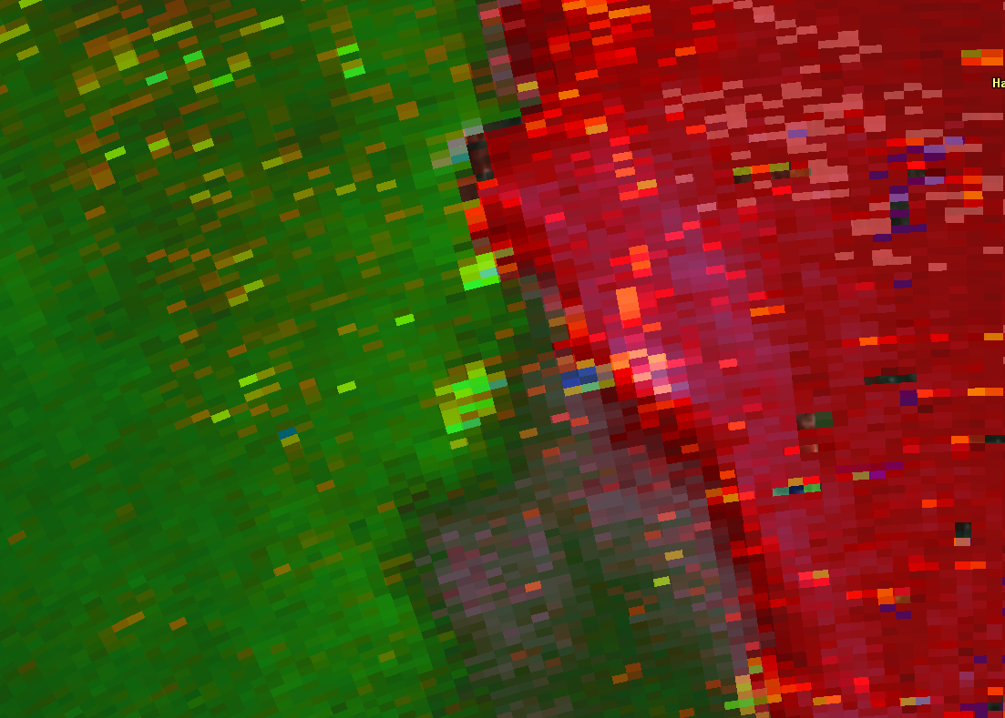


Tornadic Debris Signatures Associated with Quasi-Linear Convective Systems
3rd Midwest Bow Echo Workshop, St. Louis
Rod Donavon, NOAA/NWS Des Moines, IA
Kevin Skow, NOAA/NWS Topeka, KS
The views expressed are those of the author and do not necessarily represent those of the National Weather Service

Slide 2
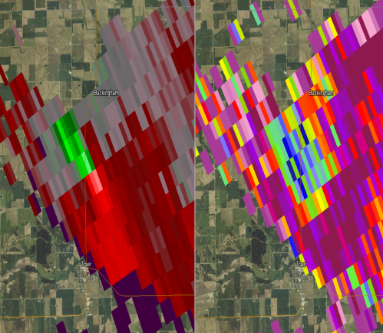
Cross Section of TDS Studies
Background
Criteria in Flux!
Source | Z_{HH} | SRM | ρ_{hv} | Z_{DR}
Ryzhkov et al. (2002) | > 45 dBZ & Hook Echo | Couplet | < 0.80 | < 0.5 dB
Schultz et al. (2012) | > 30 dBZ | Couplet | ≤ 0.70 | Local Minimum when ɸ_{dp} < 15°
NWS Warning Decision Training Division (2013) | > 20 dBZ | Couplet | ≤ 0.95 (0.80) | Local Minimum (Near 0 dB)
Van Den Broeke (2014) | > 20 dBZ | Couplet | ≤ 0.80* | ≤ 0.5 dB
All use product-based thresholds
All require the presence of a radar-resolved couplet
Upper-bound criteria for ρ_{hv} varies; recognition growing that outliers exist
Required
Optional
( ): Two set of criteria
*: Occasional
deviations made

Slide 3
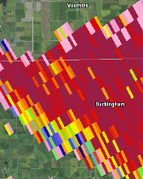
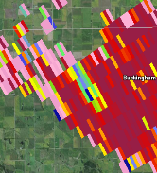
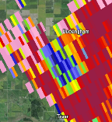
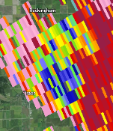
Introducing the “CC Plume”
Background
Relativity: Semi-circular region* of reduced CC** compared to surrounding echoes
Location: Couplet or convergence zone
Continuity: In at least two tilts or scans (SAILS inclusive)
Behavior: Concentrated surface origin, spreads out aloft (a plume!)
Product Criteria: WDTB/Van Den Broeke reflectivity threshold ideal, no other product-based thresholds
T+0 min
T+5 min
T+10 min
T+15 min
* Can start as small as 4 super-resolution range gates, but always grows larger
** Difference of at least 0.04 compared to surrounding data field

Slide 4
Why the CC Plume?
Background
Based on a TDS verification study in the Des Moines CWA from 2013 to 2016.
  Used KDMX WSR-88D radar data to locate possible TDSs, then leveraged all means of surveying to document the associated surface wind patterns (next presentation).
Revealed debris signatures not meeting criteria outlined in multiple studies, especially with QLCS and landspout tornadoes.
CC plume technique was developed to account for these signatures, NOT discredit previous TDS study criteria.
First formalized TDS criteria known to utilize CC behavior trends, easier to assess with SAILS/MESO-SAILS.

Slide 5
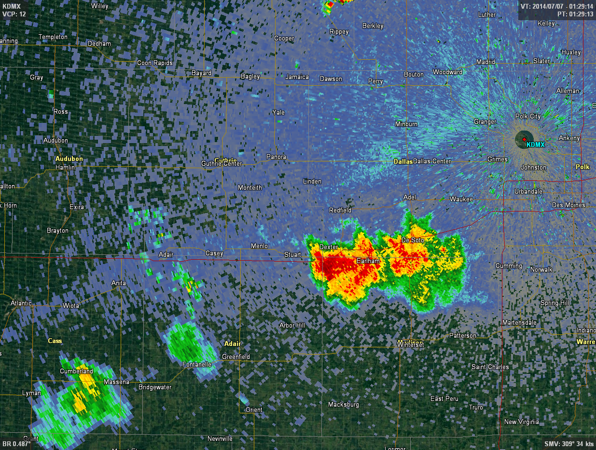
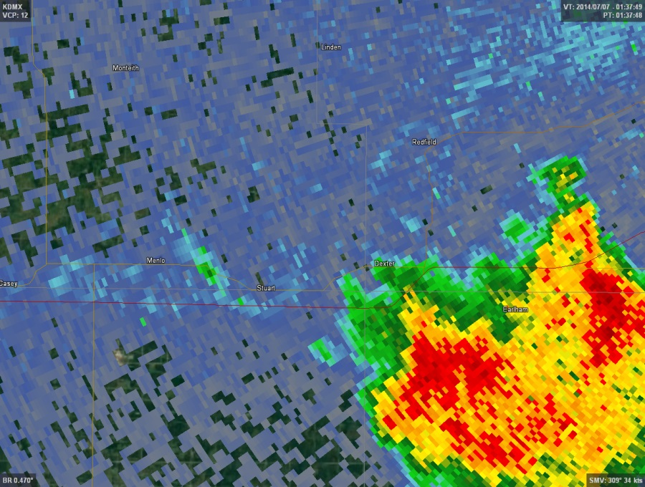
Landspout on Boundary
TDS Example Case - July 6, 2014
Synoptic &
Mesoscale Boundaries
8:29pm CDT
8:37pm CDT
Notes:
Good landspout environment in this area. Extremely unstable with 5,000-6000 J/kg of MLCAPE (150 J/kg of 0-3 km MLCAPE), ample surface vorticity along this cold frontal boundary augmented by several outflow boundaries that had developed in the last hour as older convection dissipated. Low-level (0-1km) shear was a modest 15 kts and 0-6 km shear was about 30 kts. LCLs were around 1000m. The large radar image on the left shows the main cold front pushing in from the northwest, but note how the synoptic boundary is distorted in the middle by a series of outflow boundaries from previous convection. We will be focusing on one particular outflow boundary in the middle of this segment shown by the circle in the second smaller radar image.

Slide 6
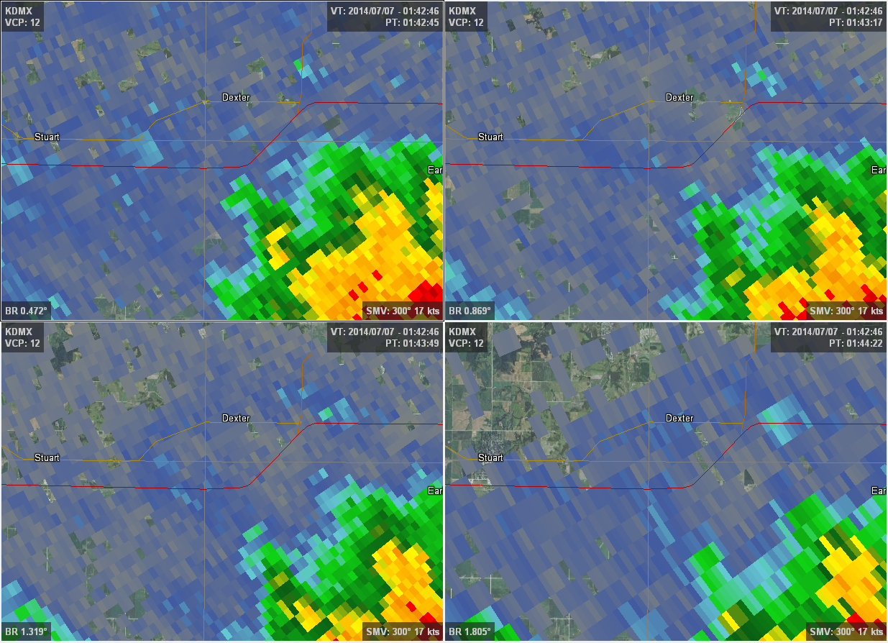
Landspout on Boundary
TDS Example Case - July 6, 2014
0.5°/ 1.9 kft
0.9°/ 3.0 kft
8:42pm CDT
1.3°/ 4.3 kft
1.8°/ 5.6 kft
Notes:
Four panel base reflectivity data at 8:42pm CDT. Nothing to note yet.

Slide 7
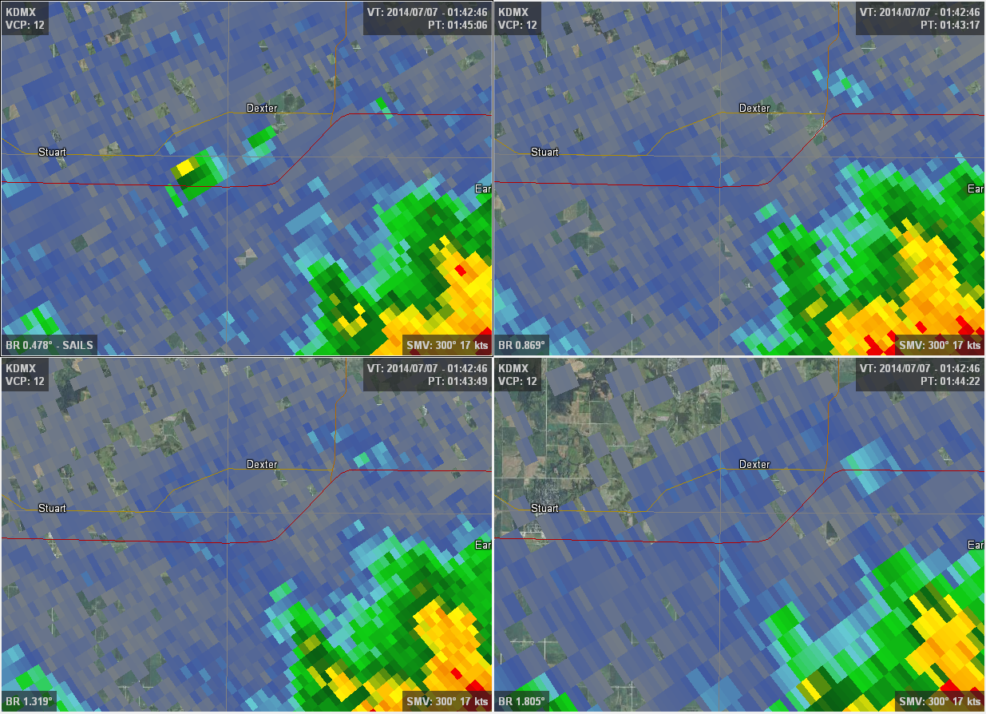
Landspout on Boundary
TDS Example Case - July 6, 2014
0.5°/ 1.9 kft
0.9°/ 3.0 kft
8:45pm CDT
SAILS Cut
TDS in Center
5 km from precip
1.3°/ 4.3 kft
1.8°/ 5.6 kft
Notes:
TDS at onset is 5-6 km away from any precip echoes. Reflectivity values at center of TDS are at about 40 dBZ.

Slide 8
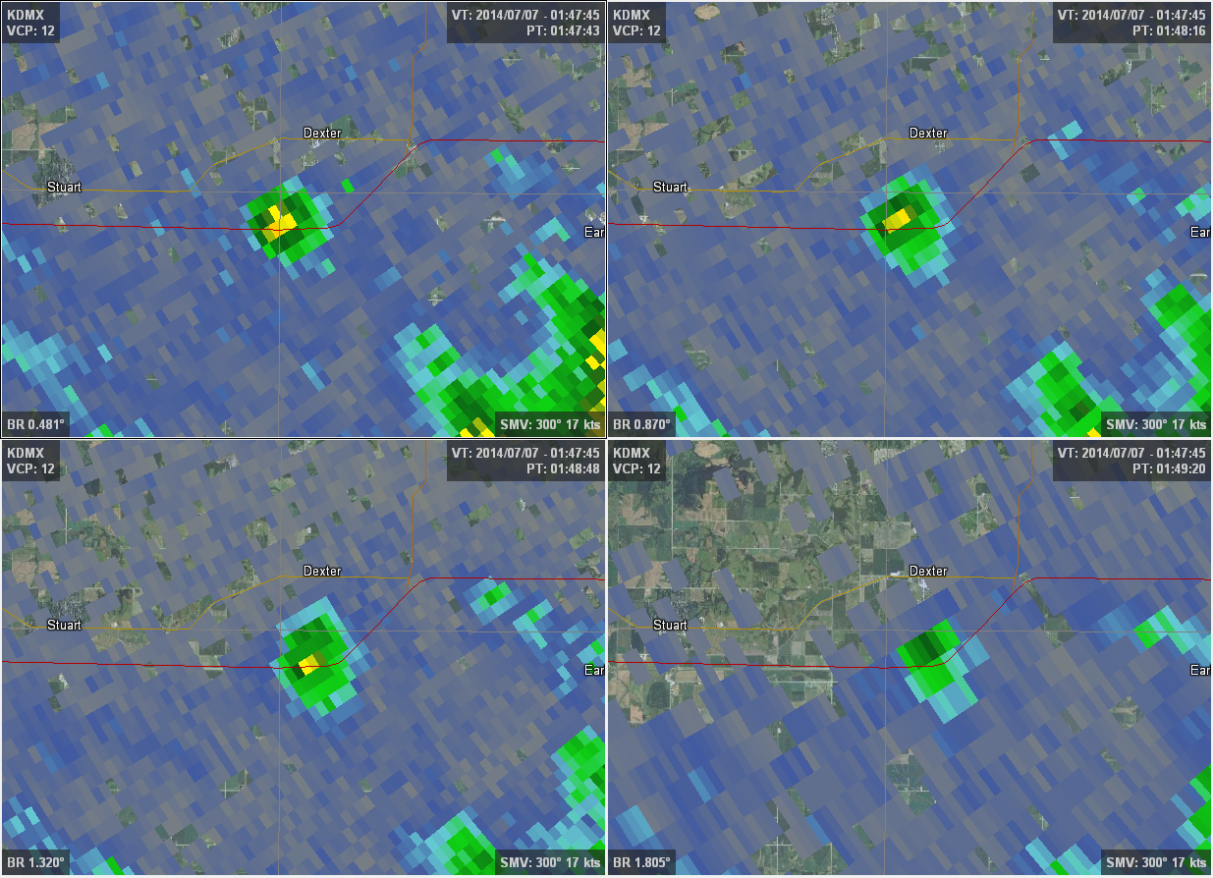
Landspout on Boundary
TDS Example Case - July 6, 2014
0.5°/ 1.9 kft
0.9°/ 3.0 kft
8:47pm CDT
Extends to full height
1.3°/ 4.3 kft
1.8°/ 5.6 kft
Height: 2.8 km
Debris: Crops?
Notes:
By the next full volume scan, the TDS is fully established up to almost 3 km (9,200 ft), with absolutely no evidence of any precip echoes overhead (aka a developing cumulonimbus). This landspout simply developed from an ordinary TCU that never went on to put down any precip.

Slide 9
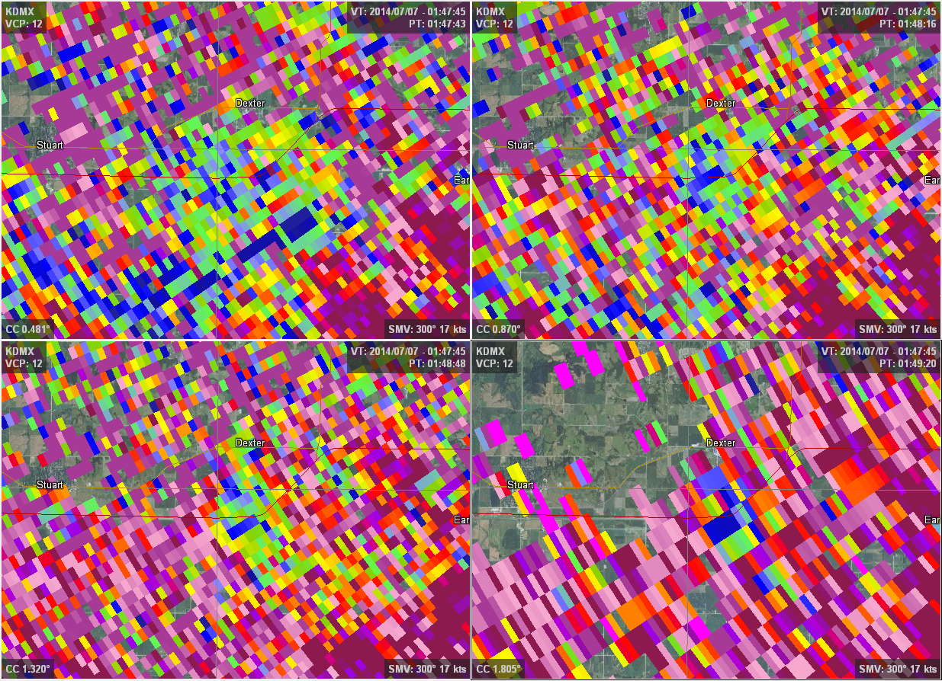
Landspout on Boundary
TDS Example Case - July 6, 2014
0.5°/ 1.9 kft
0.9°/ 3.0 kft
8:47pm CDT
CC shows TDS well
ZDR high (3-4 dB)
1.3°/ 4.3 kft
1.8°/ 5.6 kft
Notes:
Showing CC to validate the notion made with reflectivity that this in indeed a debris plume. CC was noisy at the surface, but the further aloft one goes the better resolved the signal becomes. ZDR (not shown), was on the high side with values of 3-4 dB. Not sure why it was so high. It was still quite a bit lower than with smoke plumes, which are generally in the 5-7 dB range.

Slide 10
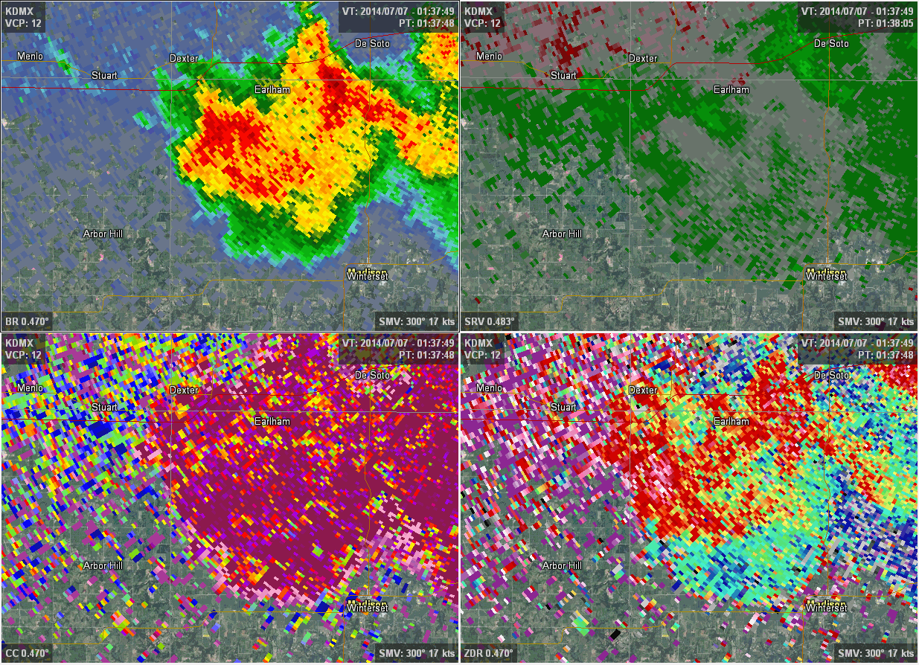
Landspout on Boundary
TDS Example Case - July 6, 2014
8:37pm – 9:13pm CDT
Notes:
Putting everything together in a full Loop. It passes the plume test. Storm Data track does not take it across I-80 since any close up photo/video evidence puts it north of the interstate, but based on the TDS the tornado may have ventured south of I-80. The 0.5 degree CC/ZDR are pretty noisy and SRM yields little clues other than the location of the boundaries. Good old reflectivity is the best product to use here.

Slide 11
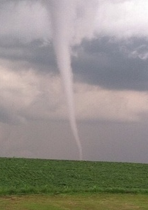
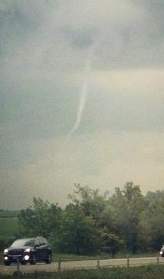
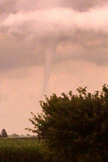
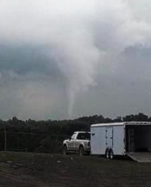
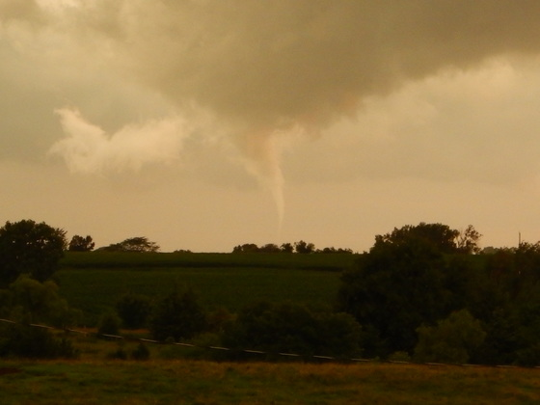
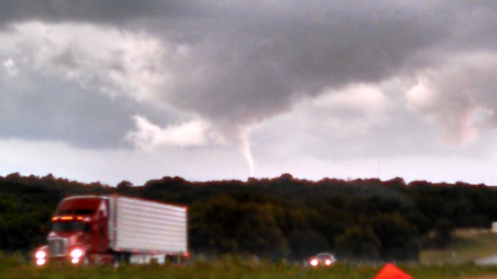
Landspout on Boundary - Photos
TDS Example Case - July 6, 2014
Photos Courtesy
KCCI uLocal
Notes:
High-based ceilings = lots of photos of this tornado.

Slide 12
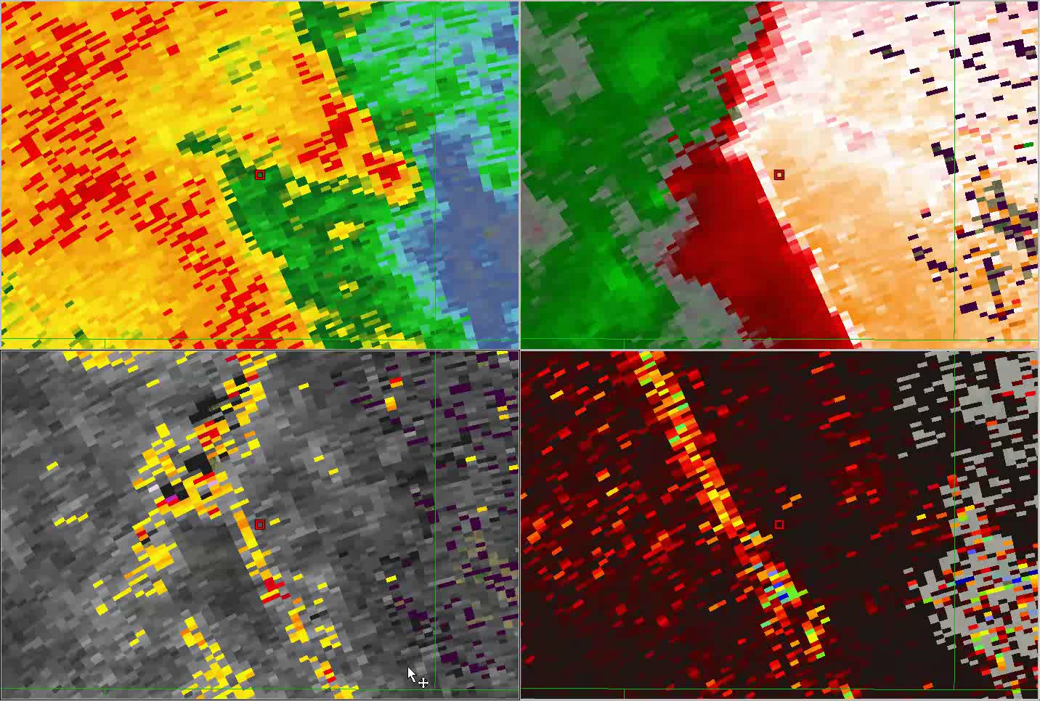
September 1, 2014 00:28-00:44
The Event- August 31, 2014
QLCS TDS That Started the Search
Range: 37 nm Beam Height: 2800 ft ARL

Slide 13
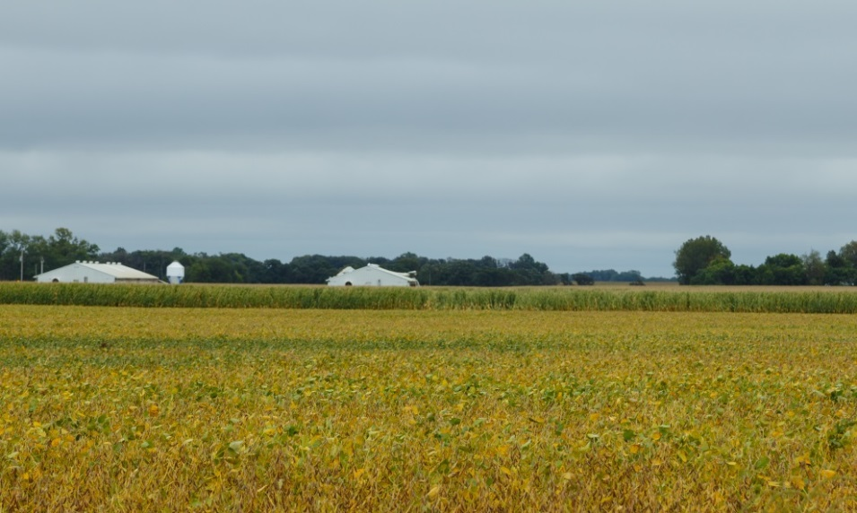
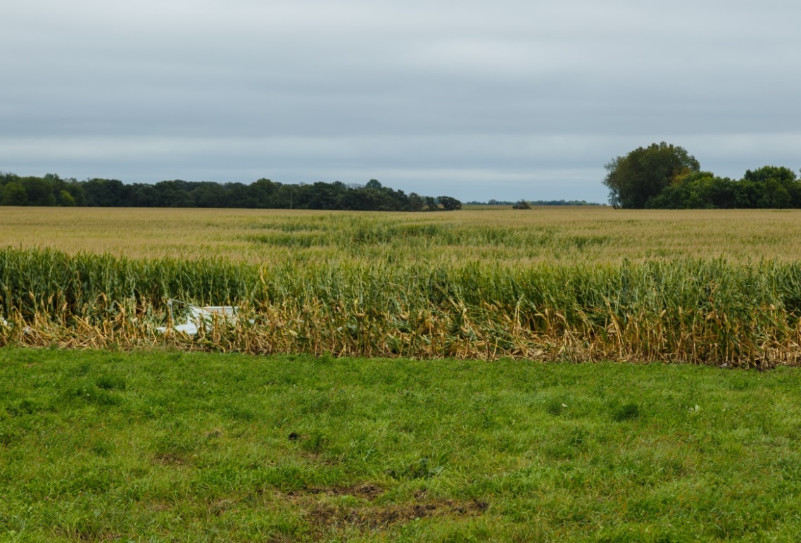
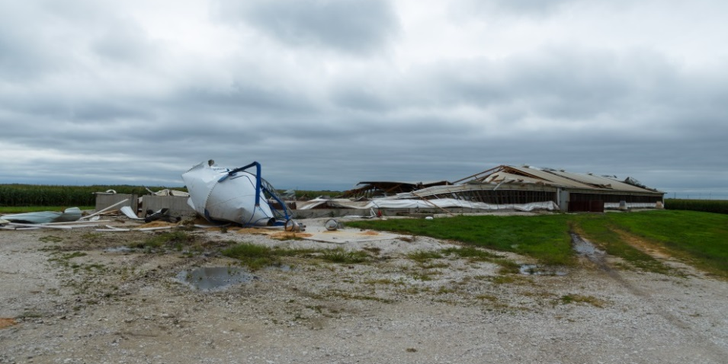
August 31, 2014
The Initial Ground Survey
Photos by Kevin Skow

Slide 14
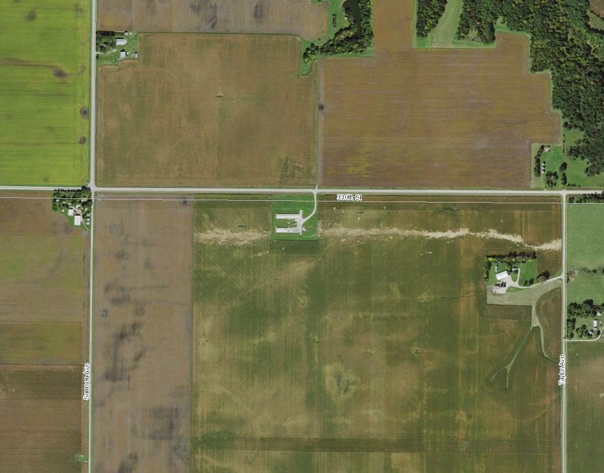
August 31, 2014 Aerial Data
USDA NAIP

Slide 15
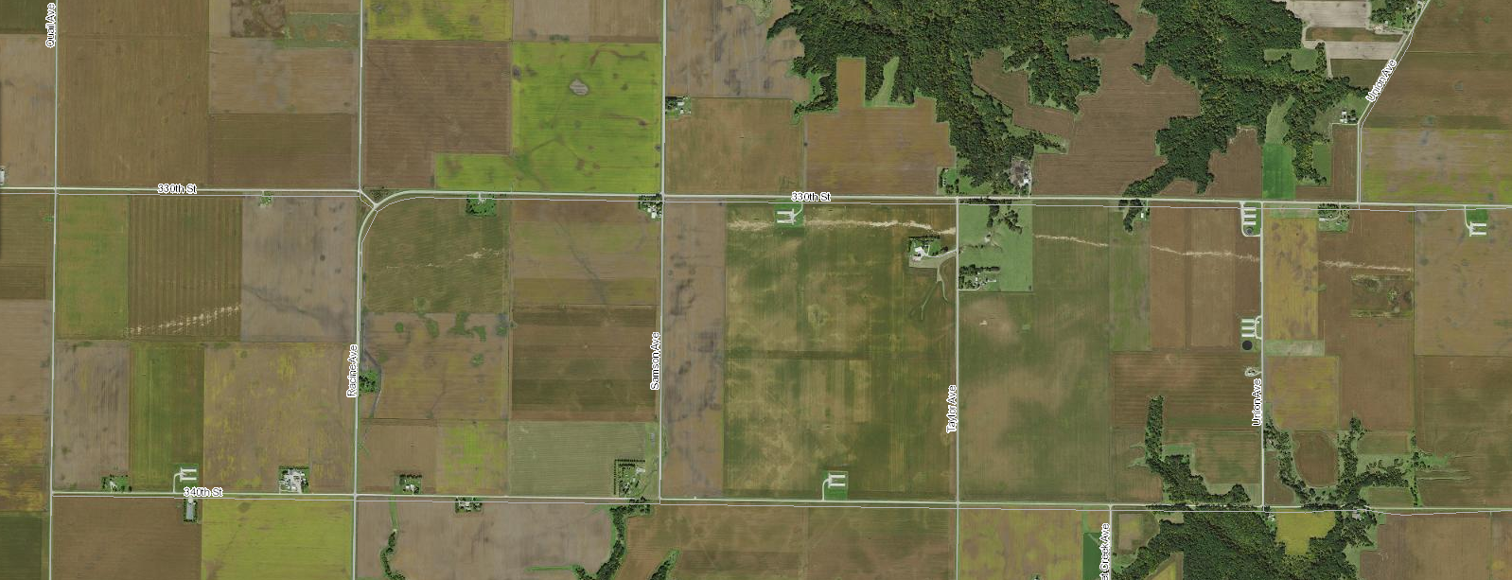
August 31, 2014 Aerial Data
USDA NAIP

Slide 16
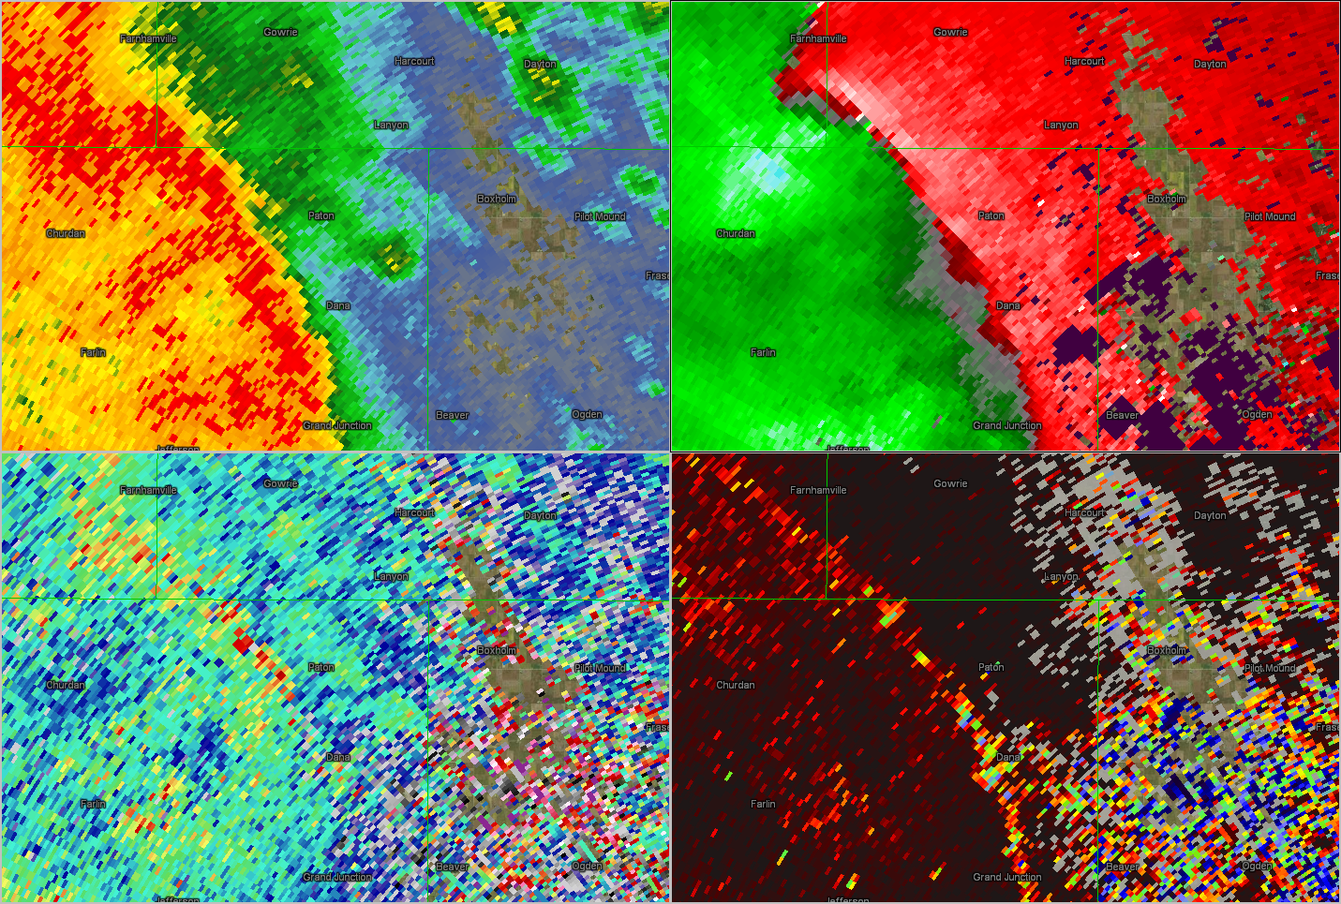
September 1, 2014 01:17z
The Event- August 31, 2014
REF
SRM
ZDR
CC
Where is the TDS?

Slide 17
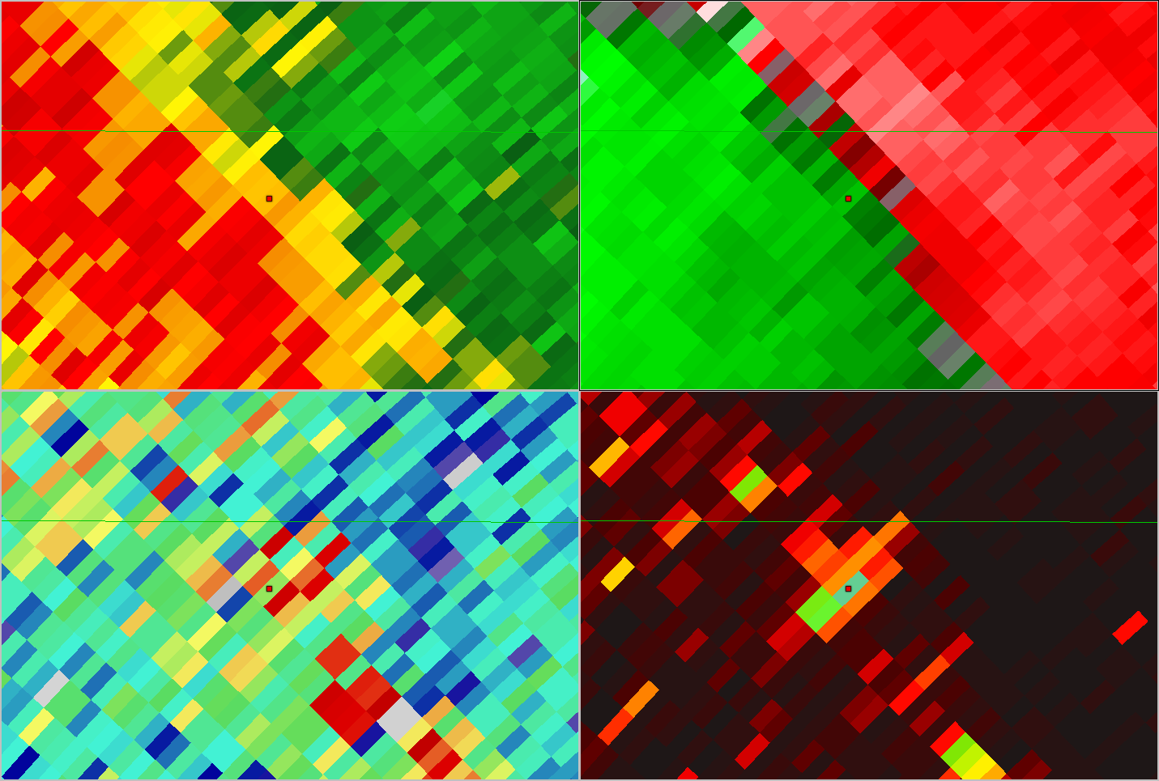
September 1, 2014 01:17z
REF
Vr: 33 kts
SRM
ZDR: 1.75 db
CC: 0.83
ZDR
CC
Where is the TDS?

Slide 18
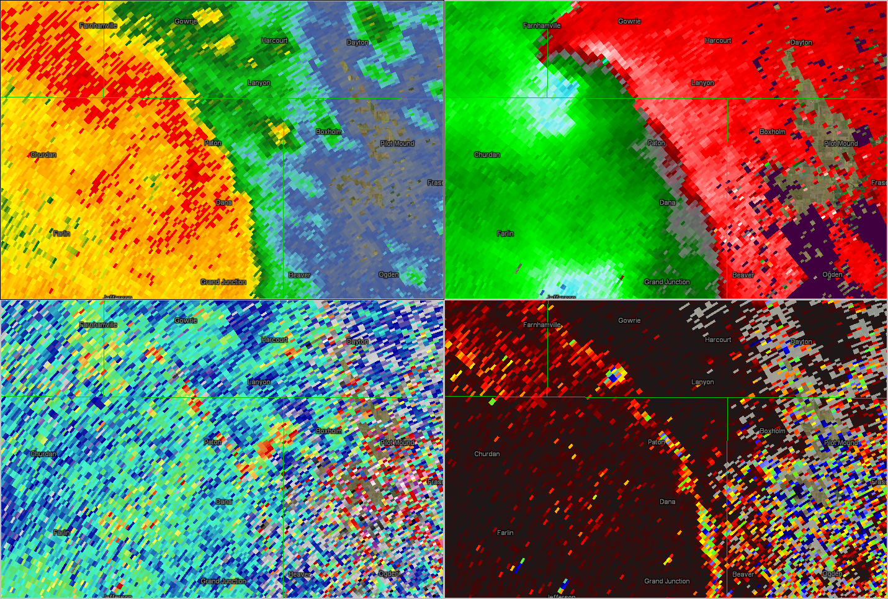
September 1, 2014 01:20z
REF
SRM
ZDR
CC
Where is the TDS?

Slide 19
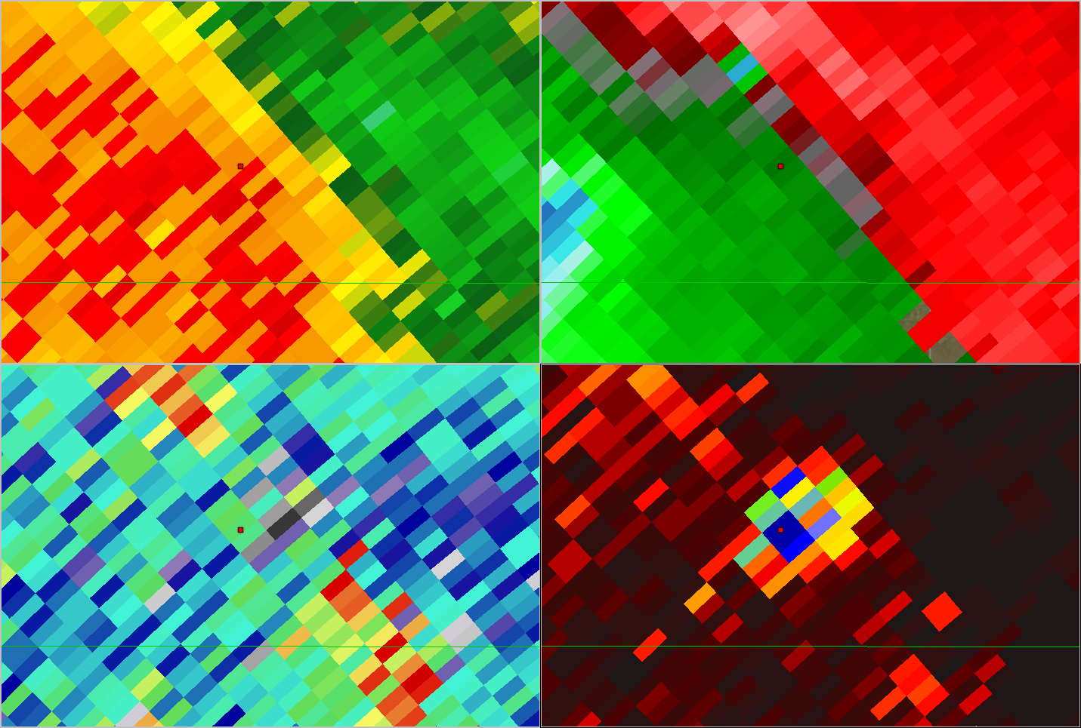
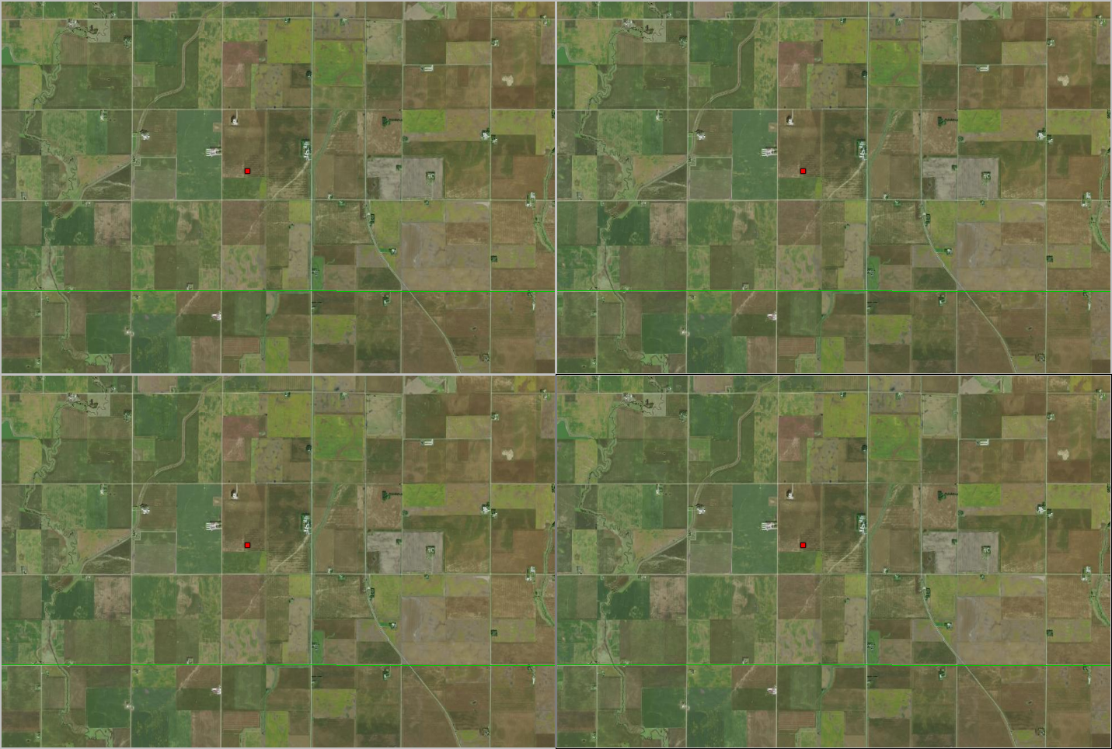
September 1, 2014 01:20z
REF
Vr – 15 kts
SRM
ZDR: -1.5 db
CC: 0.69
ZDR
CC
Where is the TDS?

Slide 20
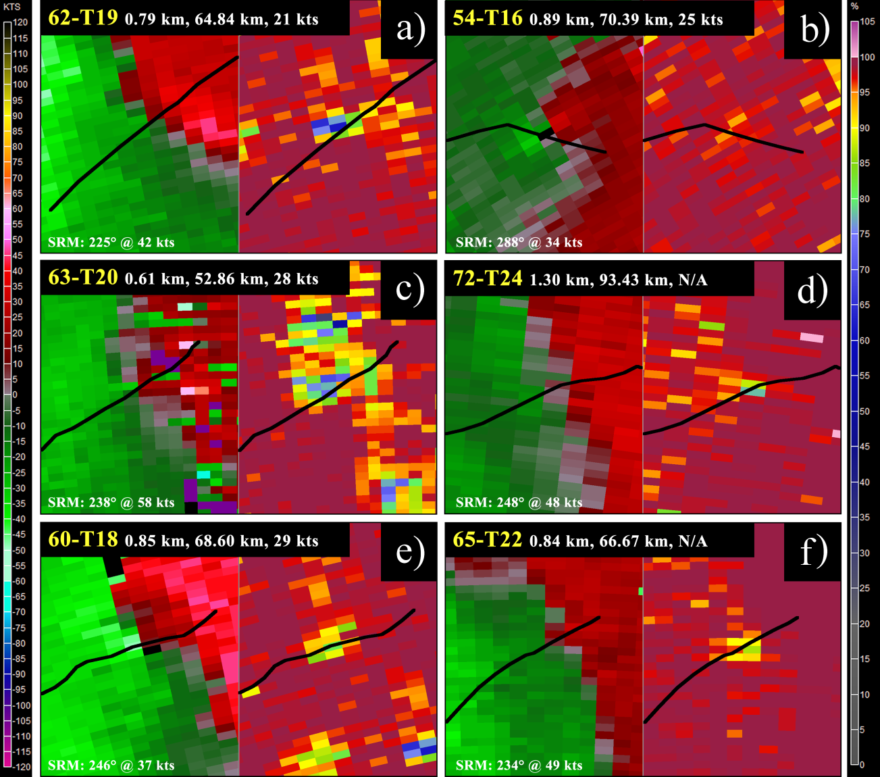
August 31, 2014 TDS Statistics
12 point-source CC minima
11 matched to tracks*
Five minima did NOT have a radar-resolvable couplet. Would not meet
product-based criteria.
Remaining 7 couplets oftentimes weak and difficult to differentiate from the convergence zone
Notes:
So how would August 31, 2014 stand up to the current product-based TDS identification techniques? We identified 12 point-source correlation coefficient minima and tied 11 of them to tracks, with imagery for the twelfth track was compromised due to field harvesting. There was wind damage noted before and after the track area. However, there was not a radar-resolvable couplet visible for five of the 12 CC minima, meaning that they would not have met any of the previous product-based criteria. In some cases, the CC values in the minima were above those proposed in most if not all of the previously listed studies.
Z values for all of these CC depressions were between 40-55 dBz.

Slide 21
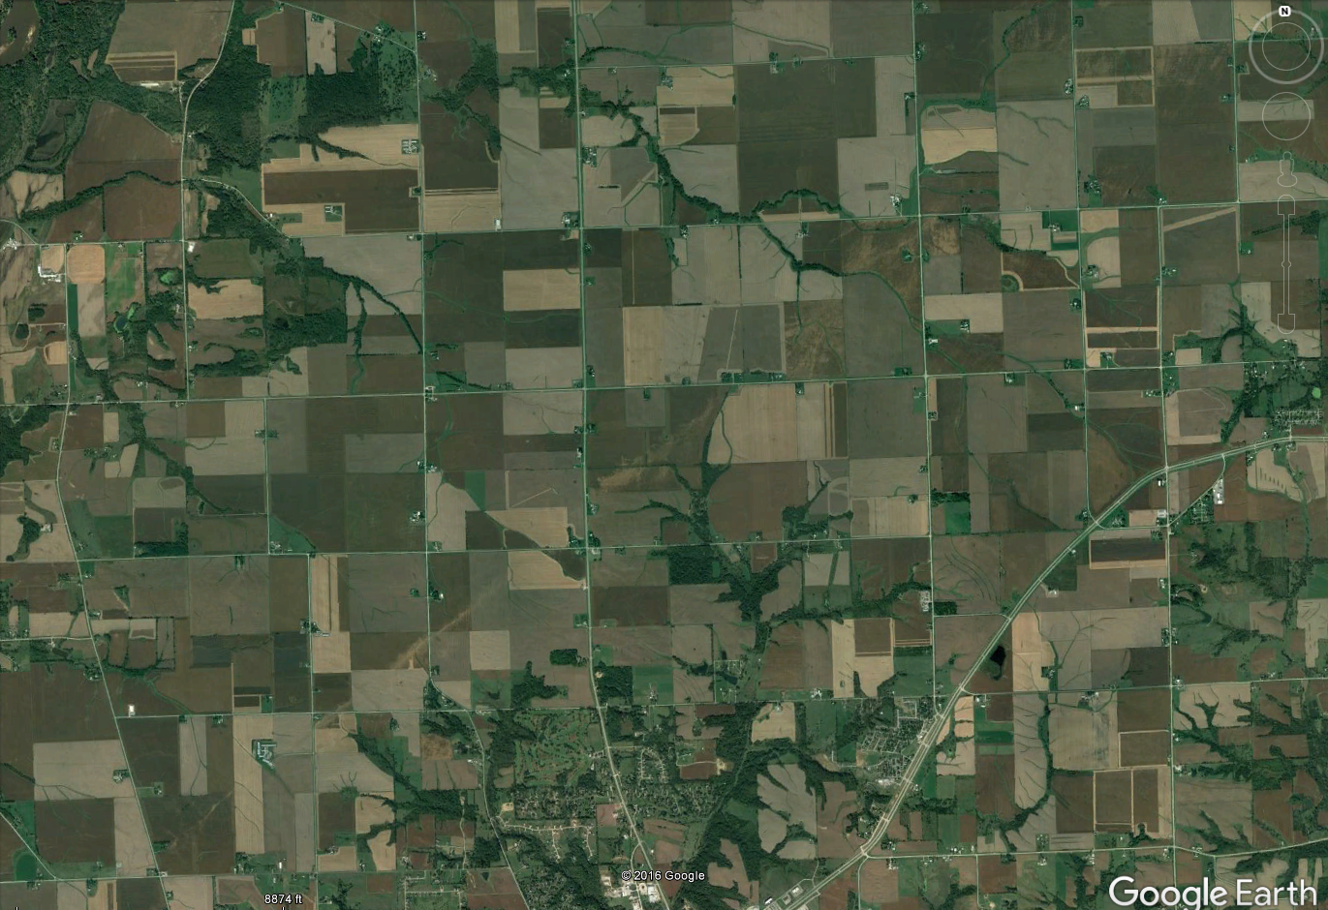
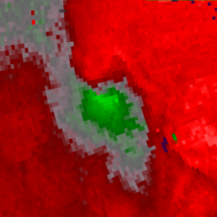
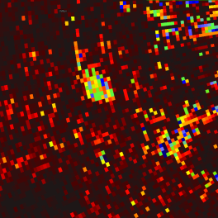
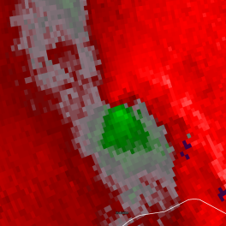
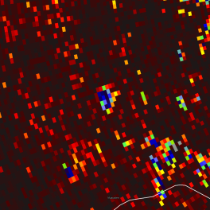
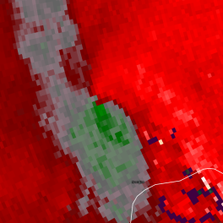
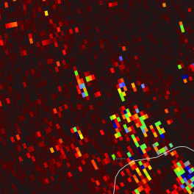
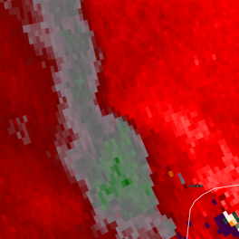
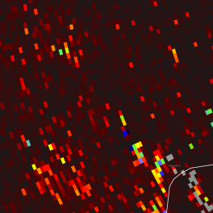
Oct 6, 2016 Near Muscatine, IA

Slide 22
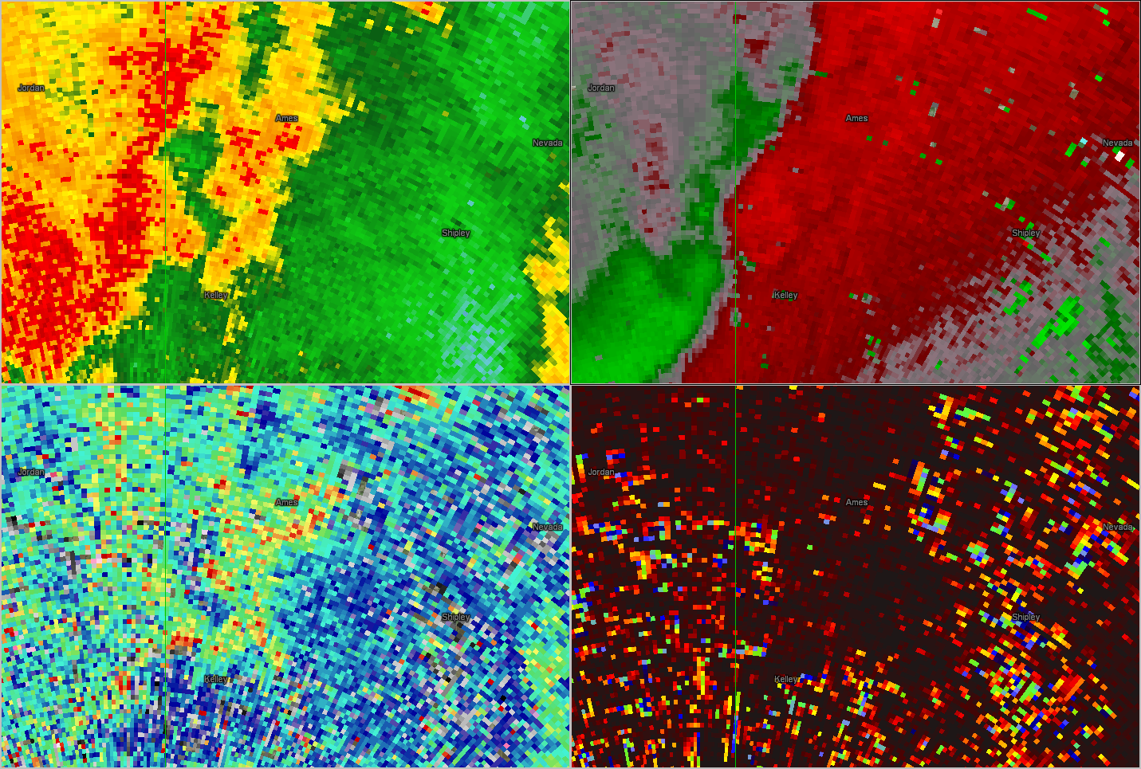
June 7, 2015 06:36z
REF
SRM
ZDR
CC

Slide 23
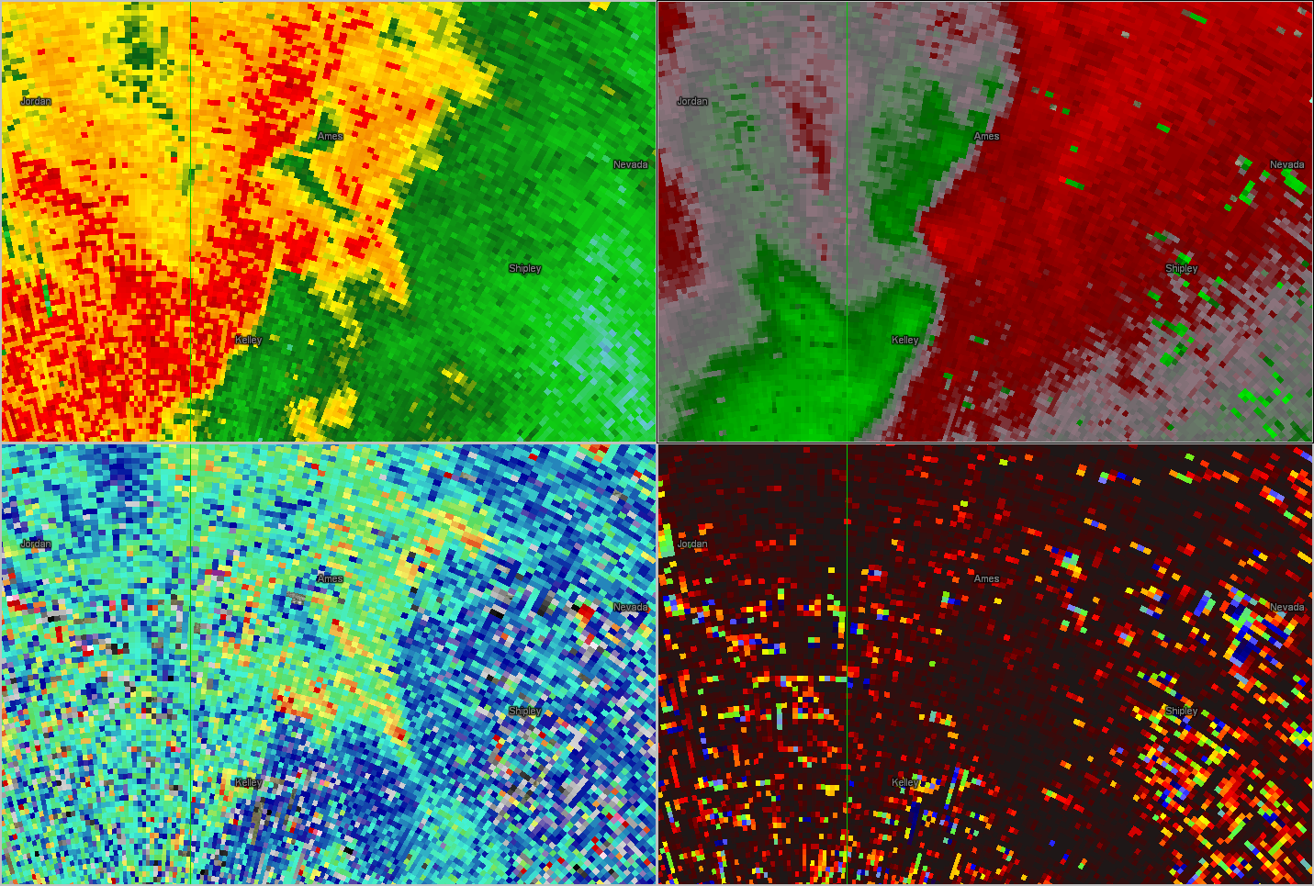
June 7, 2015 06:38z
REF
SRM
ZDR
CC

Slide 24
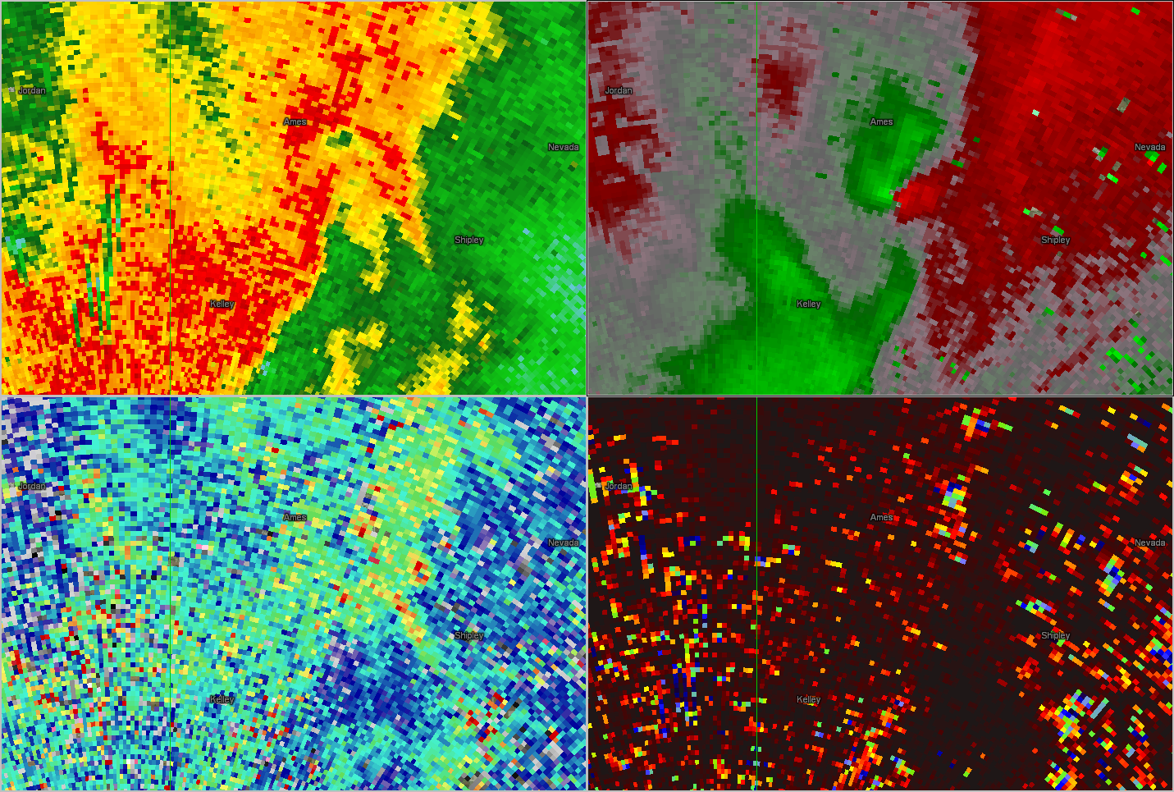
June 7, 2015 06:41z
REF
Vr: 34kts
SRM
ZDR: 1.3 db
CC: 0.95
ZDR
CC

Slide 25
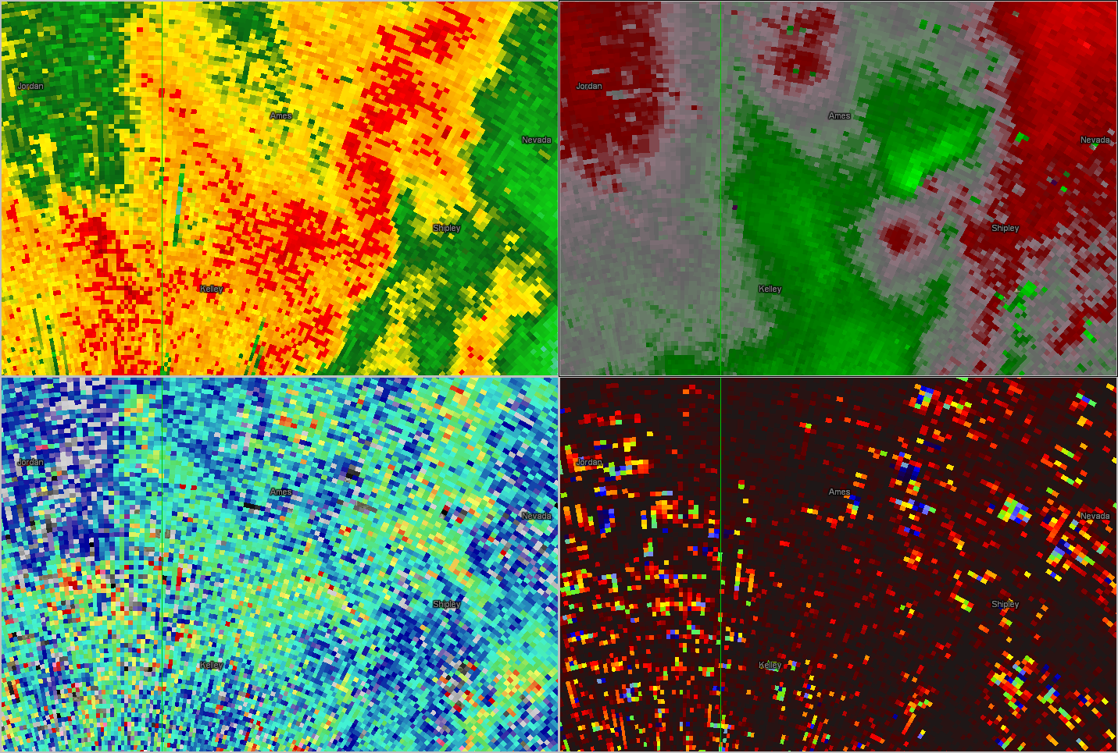
June 7, 2015 06:44z
REF
Vr: 22 kts
SRM
ZDR: 0.3 db
CC: 0.92
ZDR
CC

Slide 26
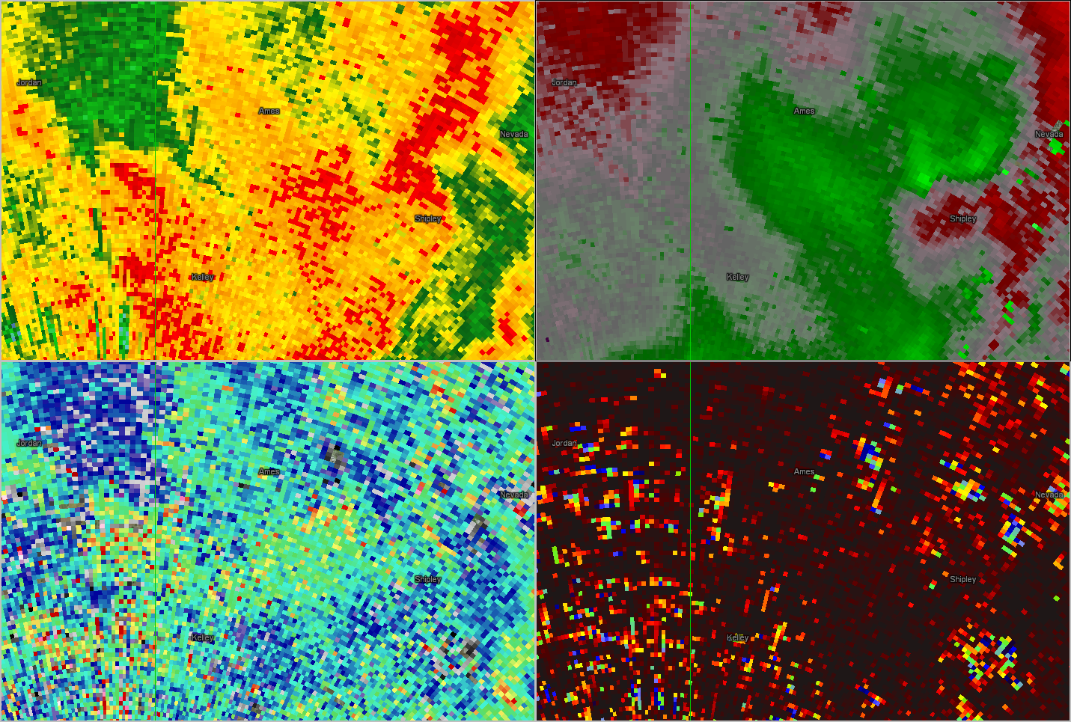
June 7, 2015 06:44z
REF
Vr: 21 kts
SRM
ZDR: 0.5 db
CC: 0.94
ZDR
CC

Slide 27
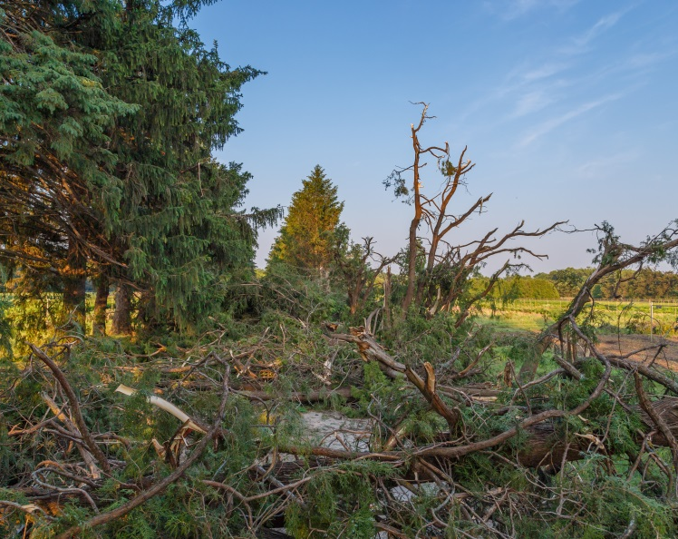
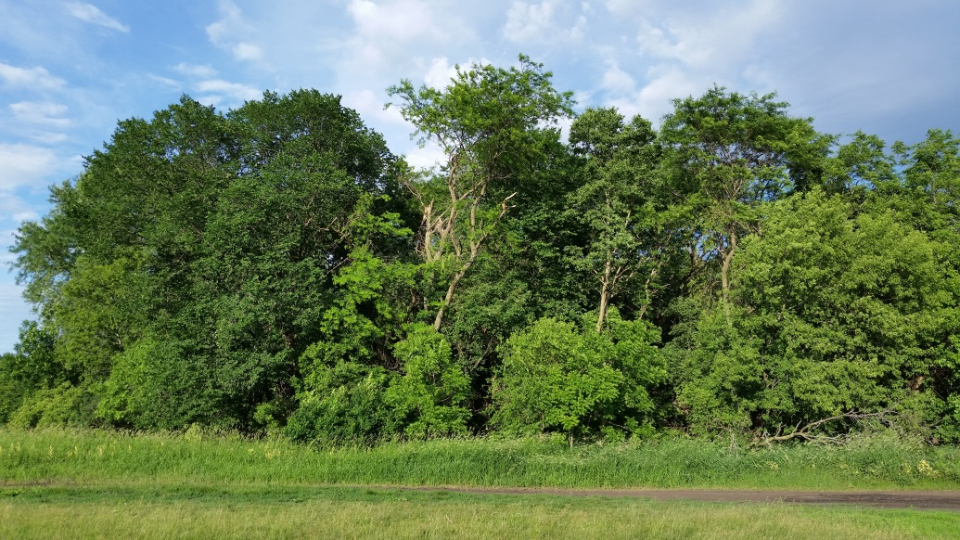
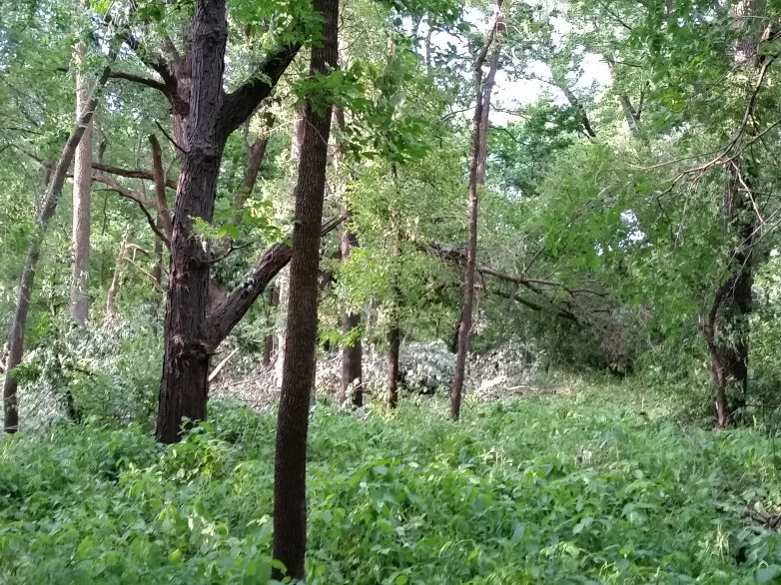
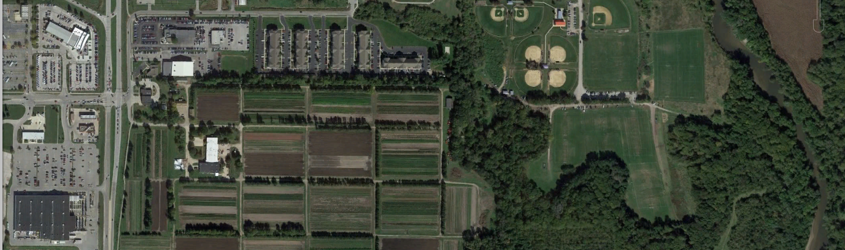
June 7, 2015 Survey

Slide 28


TDS Material Based on Season (Central US)
Jan
Feb
Mar
Apr
May
Jun
Jul
Aug
Sep
Oct
Nov
Dec
Dust
Trees (Leaves)
Maturing Crops
Crop Debris/Plowed Fields
Crop Debris
Crop and leaf debris especially reflective to radar energy, not as attenuated in precipitation as dust

Slide 29
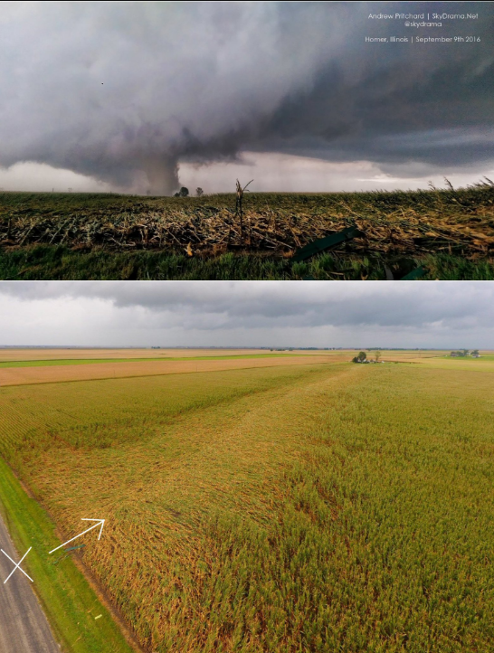

Supercell TDS – Homer, IL Sep 9, 2016
Courtesy Andrew Pritchard – skydrama.photography
Courtesy Jake Wolf

Slide 30

Land use – Homer, IL Sep 9, 2016
Courtesy Jake Wolf

Slide 31


Land use – Homer, IL Sep 9, 2016

Slide 32

TDS False Alarm- Loop
KSGF Case - March 1, 2017

Slide 33

TDS False Alarm
KSGF Case – 0.5º 0540z March 1, 2017

Slide 34

TDS False Alarm
KSGF Case – 0.5º 0542z March 1, 2017

Slide 35

TDS False Alarm
KSGF Case – 0.5º 0543z March 1, 2017

Slide 36

TDS False Alarm
KSGF Case – 0.5º 0545z March 1, 2017

Slide 37

TDS False Alarm
KSGF Case – 0.9º 0546z March 1, 2017

Slide 38

TDS False Alarm
KSGF Case – 1.3º 0547z March 1, 2017

Slide 39

TDS False Alarm
KSGF Case – 1.8º 0548z March 1, 2017

Slide 40

TDS False Alarm
KSGF Case – 2.4º 0549z March 1, 2017

Slide 41

The Search Continues…
KDMX Case – 0.5º 0038z March 7, 2017

Slide 42

The Search Continues…
KDMX Case – 0.5º 0039z March 7, 2017

Slide 43

The Search Continues…
KDMX Case – 0.5º 0041z March 7, 2017

Slide 44
Questions!
rodney.donavon@noaa.gov
kevin.skow@noaa.gov

