Slide 1
Education and Science Sharing to our Core Partners
Doug Cramer
NWS Springfield MO

Slide 2
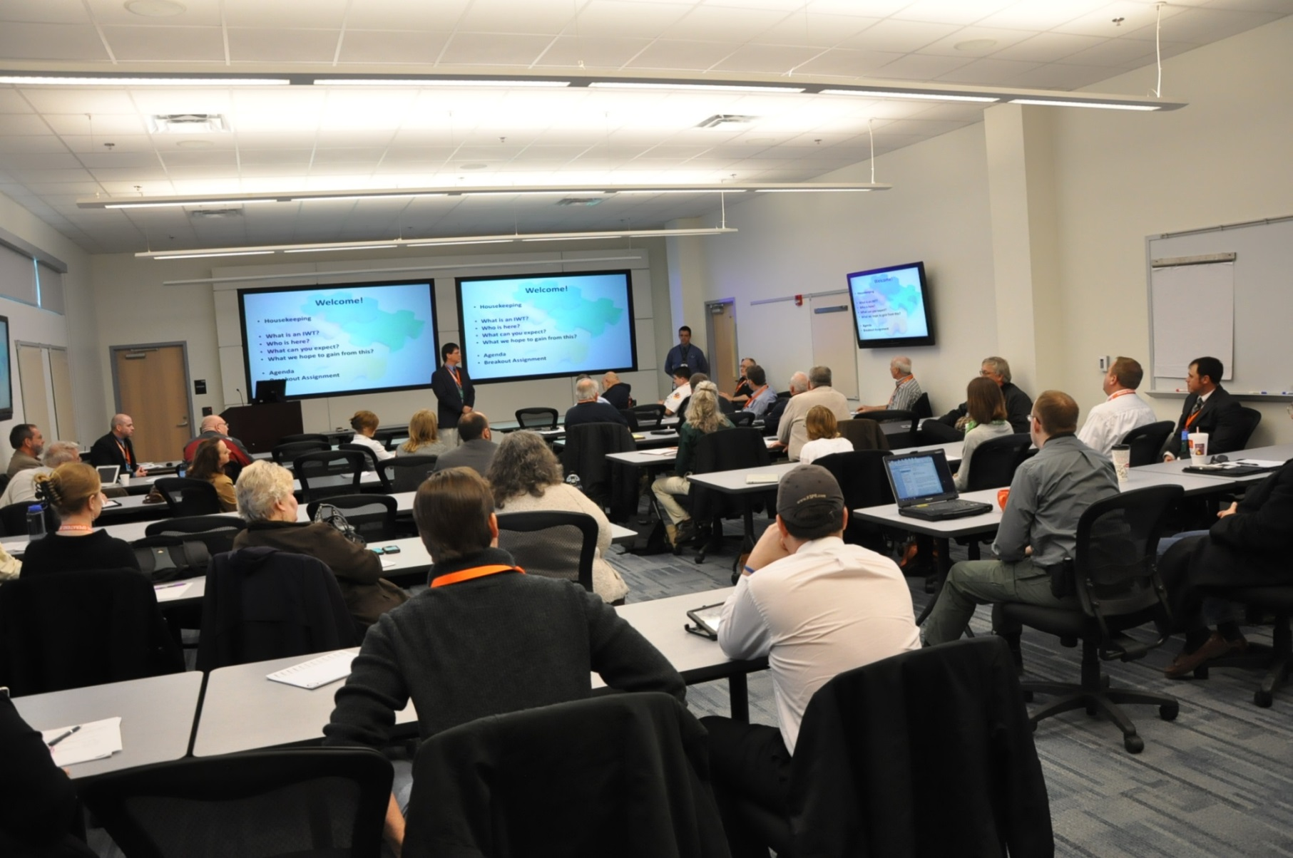
Integrated Warning Team Springfield, Missouri

Slide 3
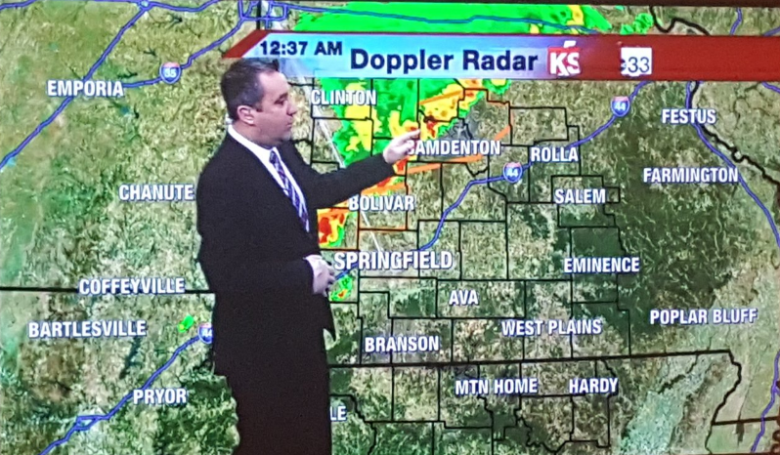
Integrated Warning Team Feedback
TV meteorologists didn’t understand at times why the NWS was issuing tornado warnings for squall lines and line segments.

Slide 4
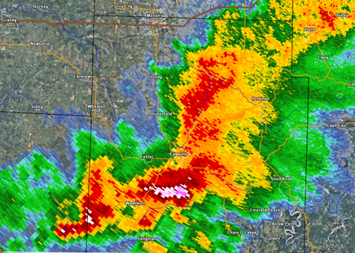
“I’m not sure what part of the storm the NWS is warning on“

Slide 5
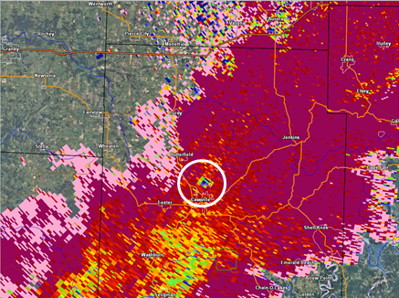
Another Observation
Based off media input given in NWS chat, tornado debris signatures were not properly identified by TV meteorologists.

Slide 6
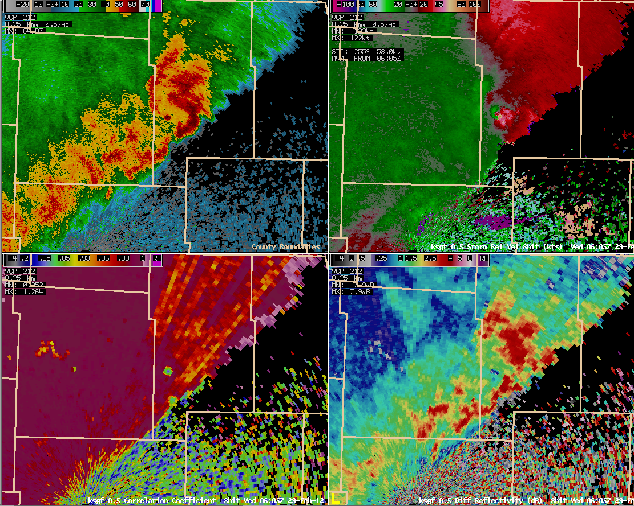
LOW SIGNAL TO NOISE RATIOS

Slide 7
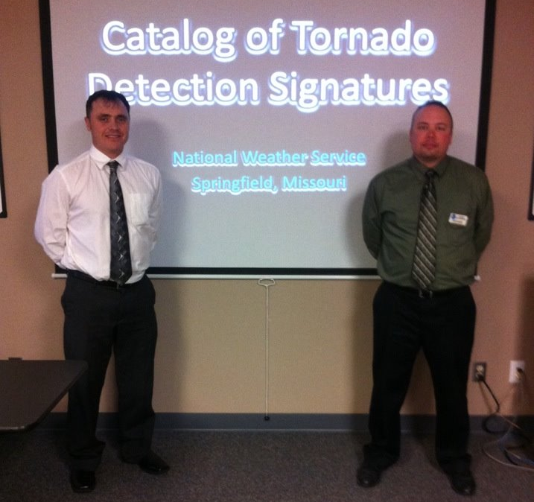
Two Science Sharing Seminars
Springfield TV Market and area EMDs
Joplin TV Market and area EMDs

Slide 8
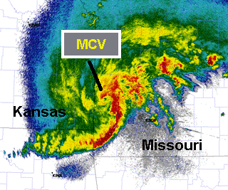
Science Sharing to Core Partners
Tornado Debris Signature Catalog
QLCS Structure and Tornadoes

Slide 9
QLCS Structure and Tornadoes
QLCS Structure and what causes those structures.
Radar signatures that typically lead to QLCS tornadoes
Office strategies for warning types and polygons

Slide 10
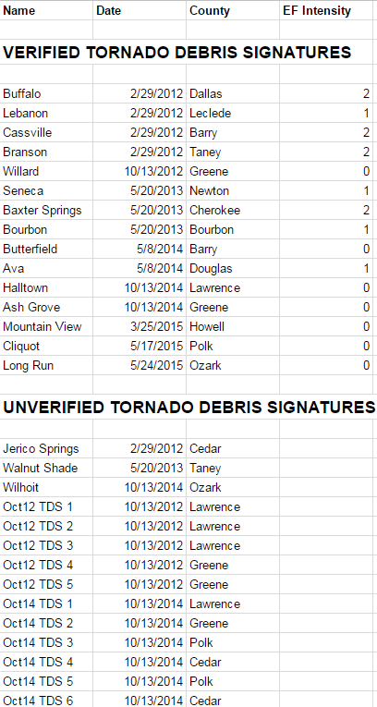
TDS Catalog
A Historical Archive of all Tornado Debris Signatures

Slide 11
BUFFALO, MO
EF -2

Slide 12
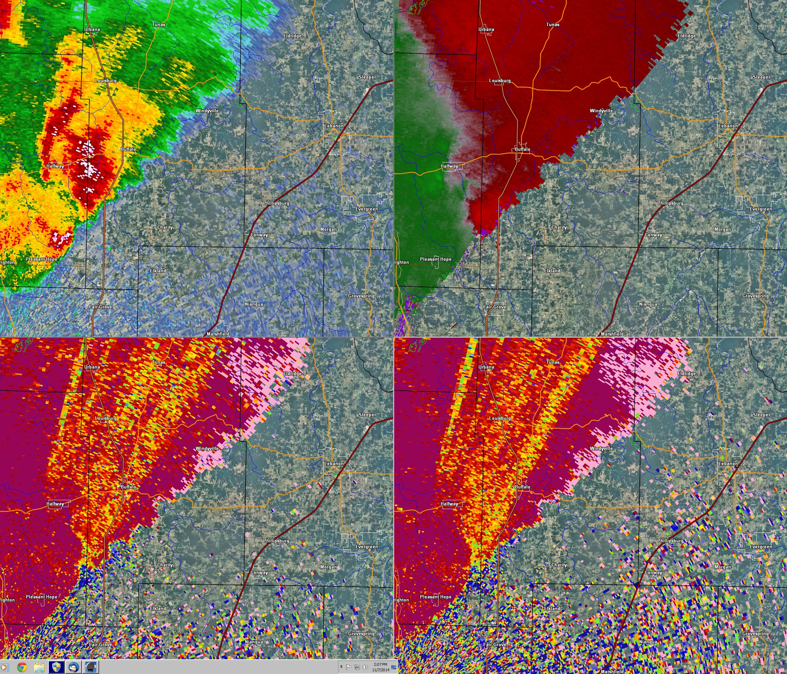
2/29/12
Z / SRM
0.9 / 0.5
CC / CC
CONFIRMED
EF-2

Slide 13
2/29/12
Z / SRM
0.9 / 0.5
CC / CC
CONFIRMED
EF-2

Slide 14
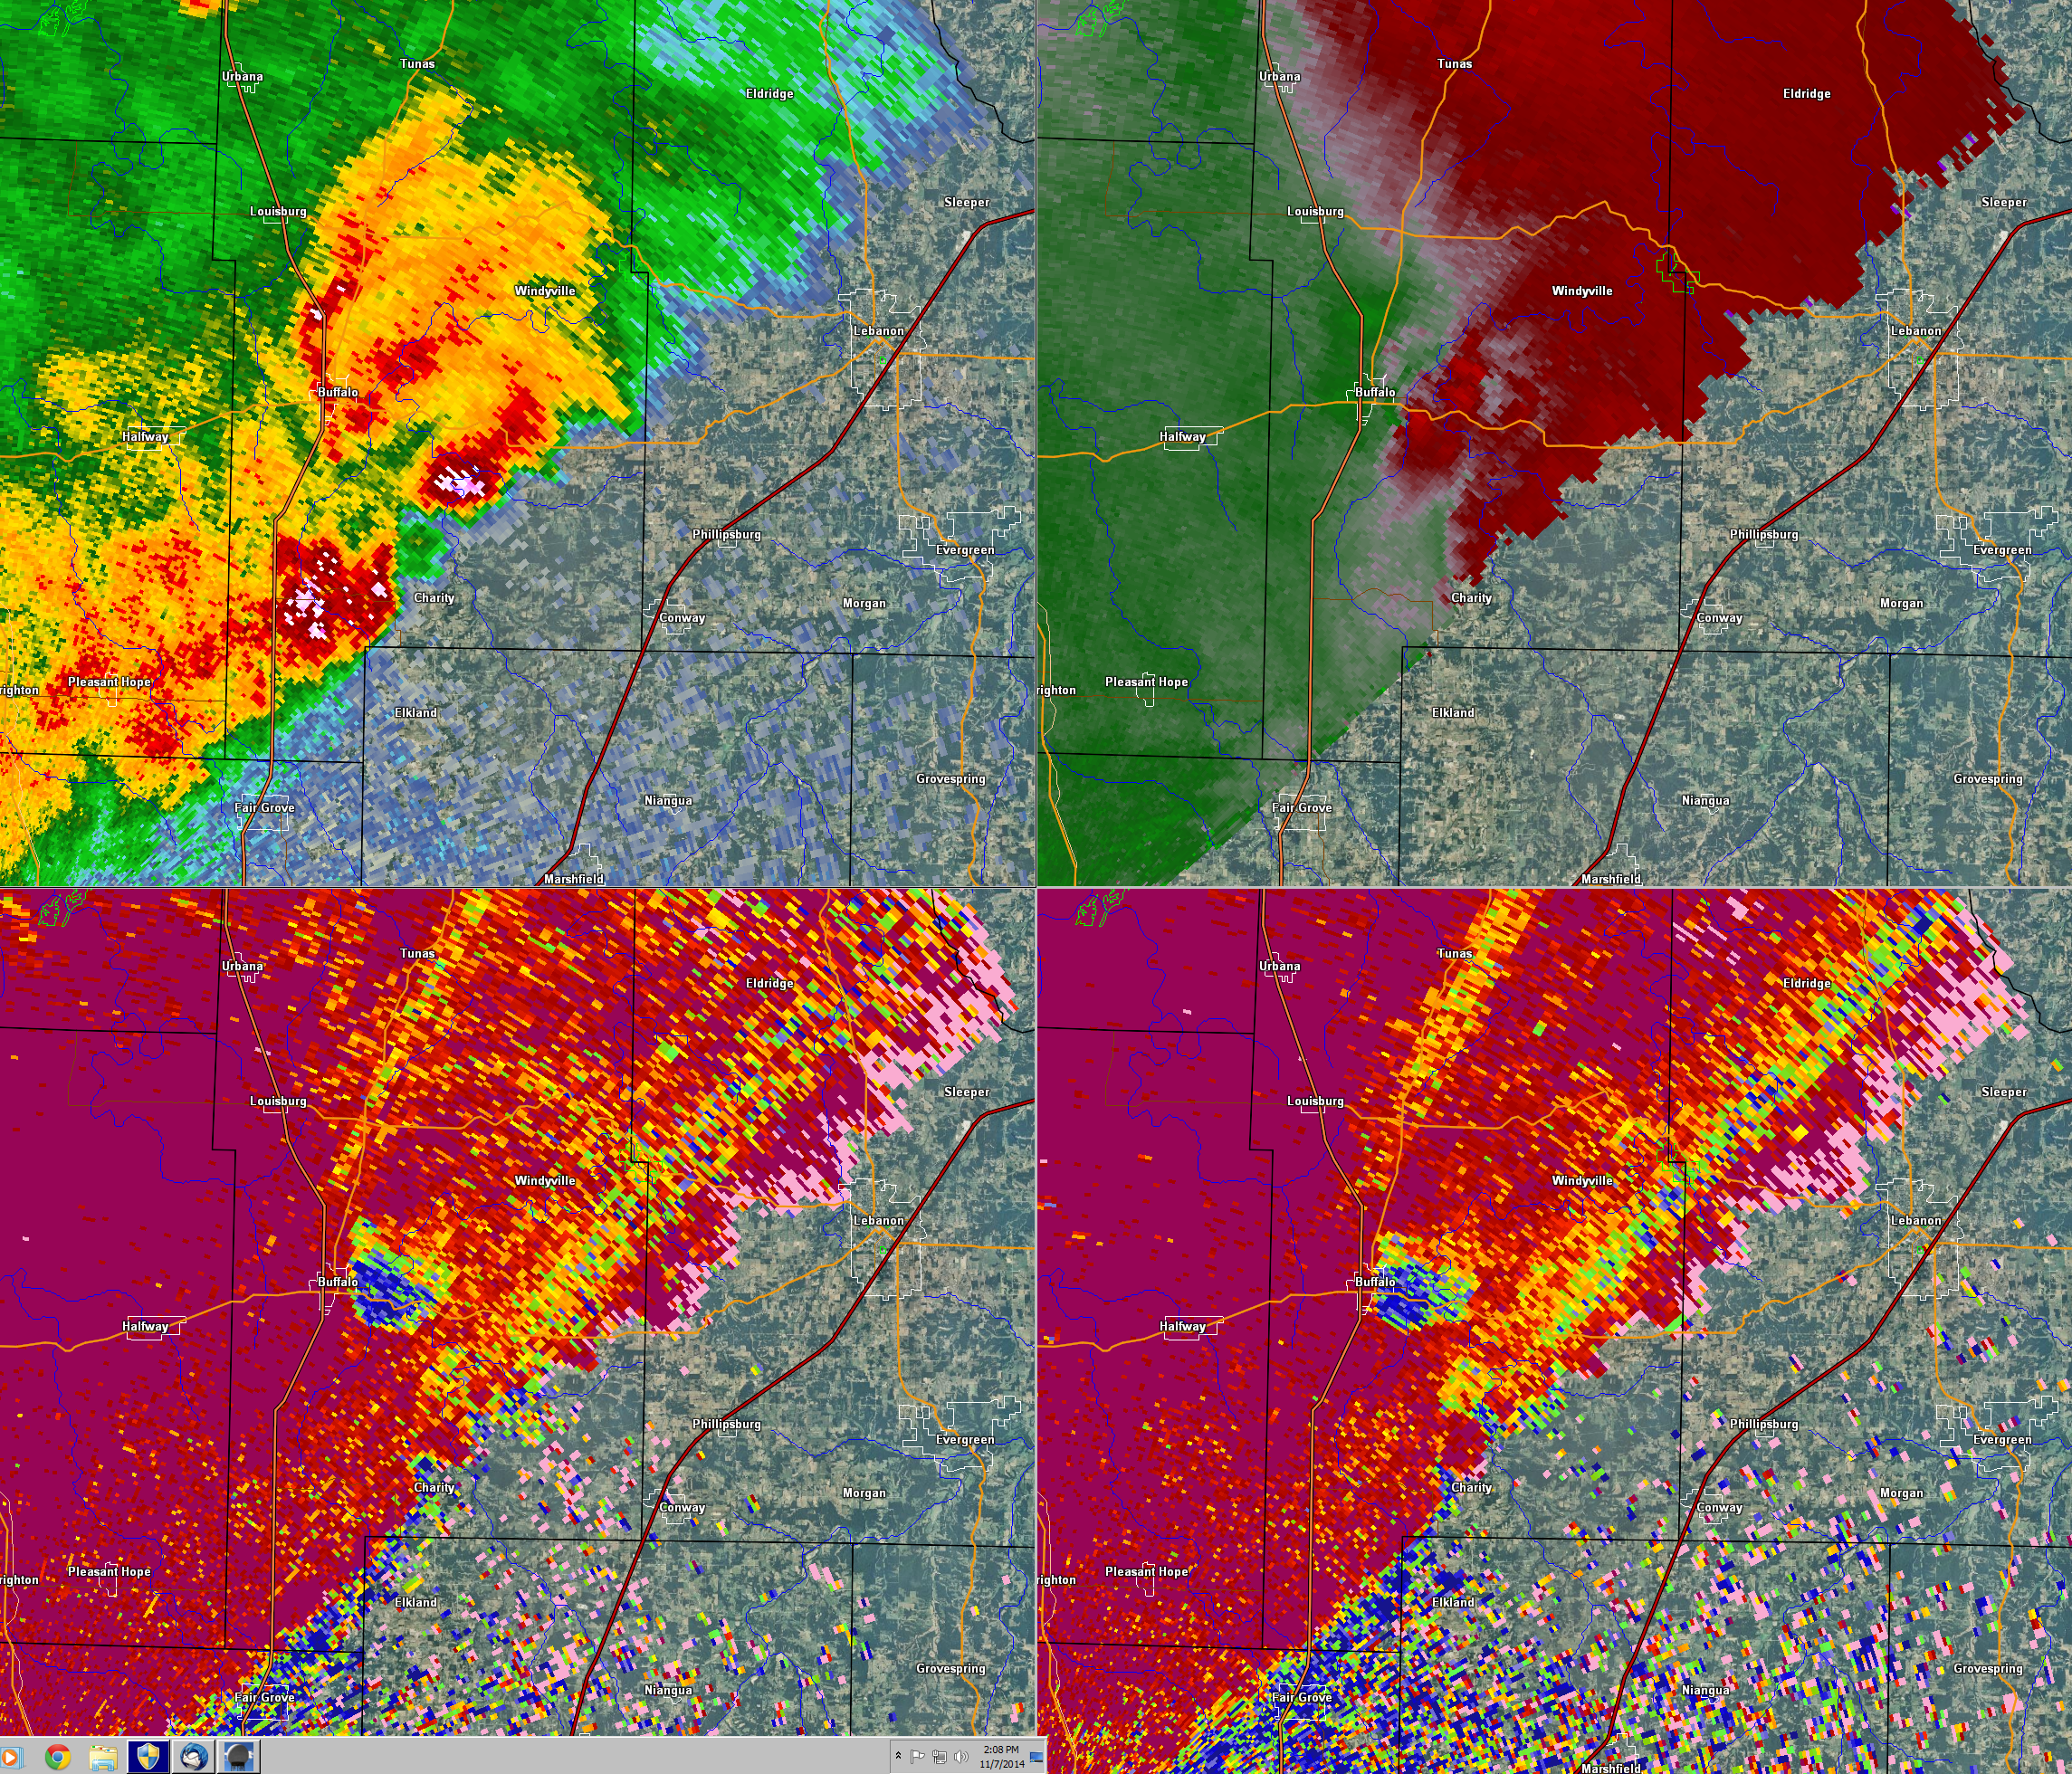
2/29/12
Z / SRM
0.9 / 0.5
CC / CC
CONFIRMED
EF-2

Slide 15
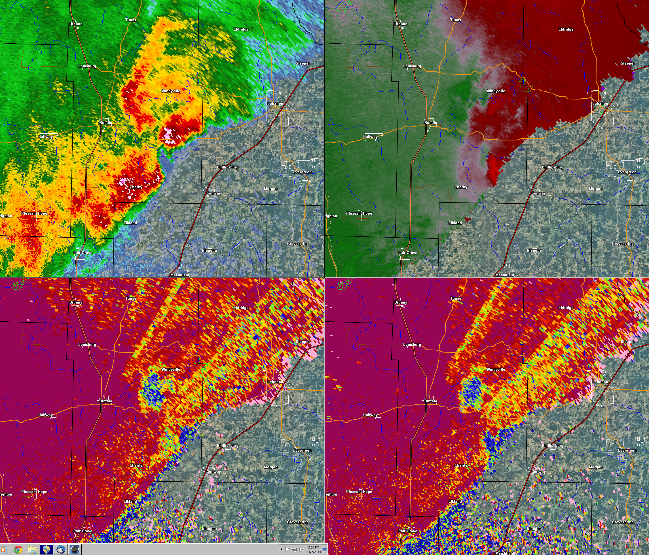
2/29/12
Z / SRM
0.9 / 0.5
CC / CC
CONFIRMED
EF-2

Slide 16
IF A TDS IS IDENTIFIED
The NWS will communicate this on NWS Chat.
If the NWS is not 100% sure it’s a TDS, we will discuss this uncertainty, and tell our partners that damage reports from the area of concern are greatly appreciated.

Slide 17
The NWS in Springfield Missouri will only document tornadoes based off of real damage. A TDS alone does not officially verify a tornado.

Slide 18
We discuss that several tornadoes have been documented without a TDS. So the lack of a TDS does not guarantee a tornado does not exist.

Slide 19
A TDS can and often will appear even after the tornado dissipates.

Slide 20
Springfield Partner Education Course Listing (SPECL)
QLCS Structure and Tornadoes (Jason Schaumann)
Radar (Doug Cramer)
Tactical Spotter Course (Steve Runnels)
Incident/Fire Weather Ozarks Style (Drew Albert)
Flash Flooding in the Ozarks (Doug Cramer, Megan Terry)
Climate in the Ozarks (Gene Hatch)
http://www.weather.gov/sgf/specl

Slide 21
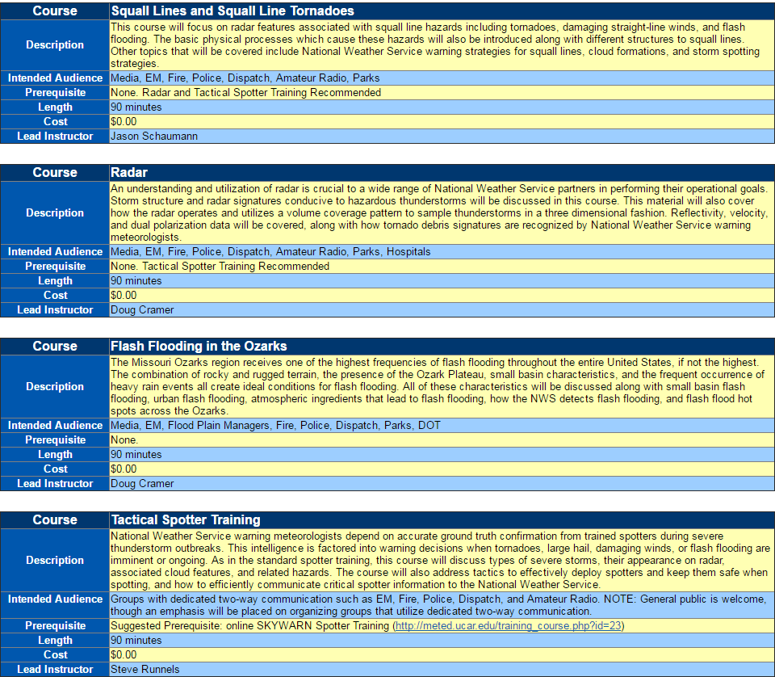

Slide 22
QUESTIONS ?

