Slide 1
PARtners operational wEATHER simulation (POWs)
Ryan Sharp and Ted Funk
NOAA/NWS Louisville

Slide 2
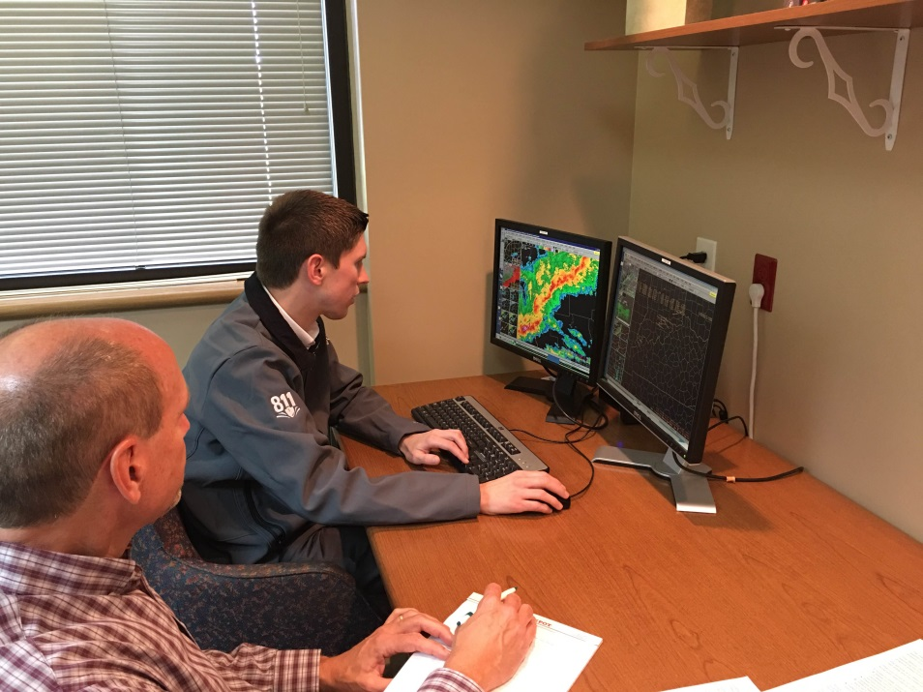
Benefits of POWS Program
Provides training in severe and winter storm structure and the warning decision process. Broadcast mets can get certification program credit
Partners experience firsthand the complexity and strategies faced by NWS radar analysts
Enhances relationships via one-to-one interaction, which facilitates greater consistency in potentially life-saving messages to public
Allows us to determine their level of skill in the warning process
Idea came from WFO St. Louis

Slide 3
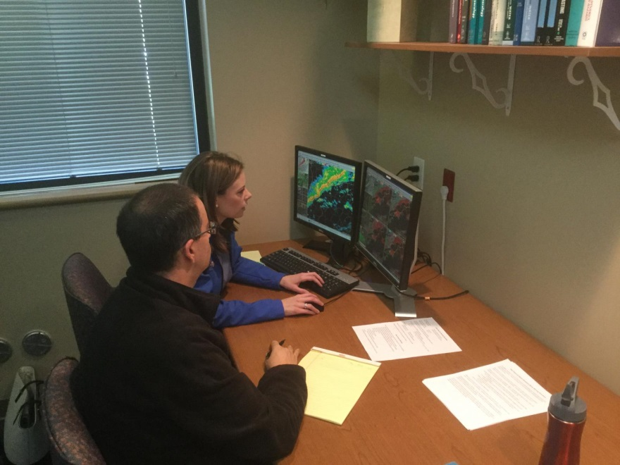
Invitations
Invited all TV Meteorologists who cover parts of our forecast area
Emphasized that simulation would be limited to 2 hours (respect their time)

Slide 4
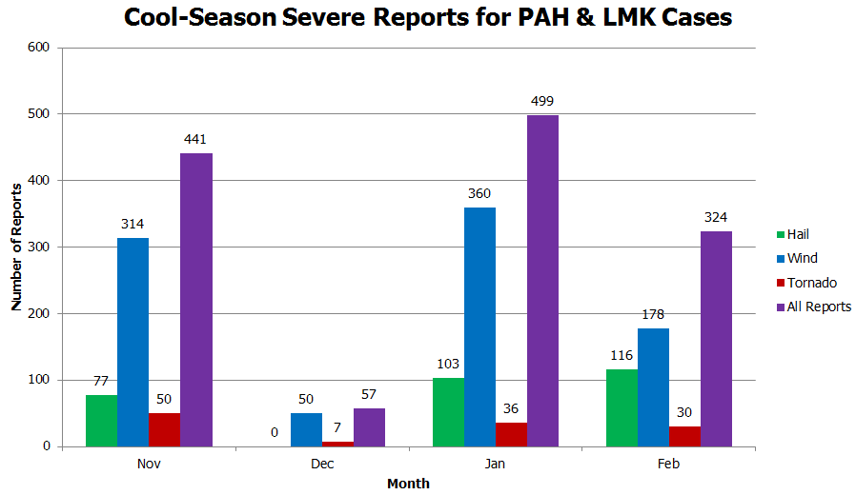
Case Selection
Wanted a case they would not easily remember
Quasi-Linear Convective Systems (QLCS) are common cool-season events in the Ohio Valley
Typically have weak surface-based instability (high shear, low instability)
Produce wind damage and isolated embedded tornadoes (usually EF0-1)
~3 events each season

Slide 5
Case Selection
Wanted a local event so they could relate to the cities/counties where warnings are issued
Needed a quick-hitting event to limit total time of simulation
This one had an EF1 Tornado through Louisville

Slide 6
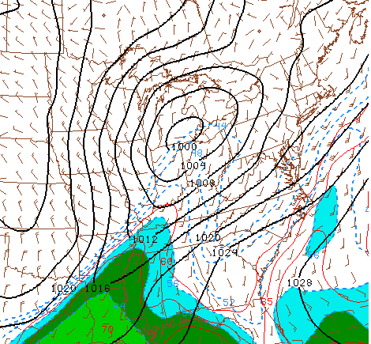
Archived SPC analysis for 15z
MSLP (black), temp (red), dewpoint (light blue and contour)
Observations showed SPC model analysis underestimated the feed of warm, moist air into central KY
RUC analyzed 250 J/Kg CAPE nosing northeast across Paducah’s area

Slide 7
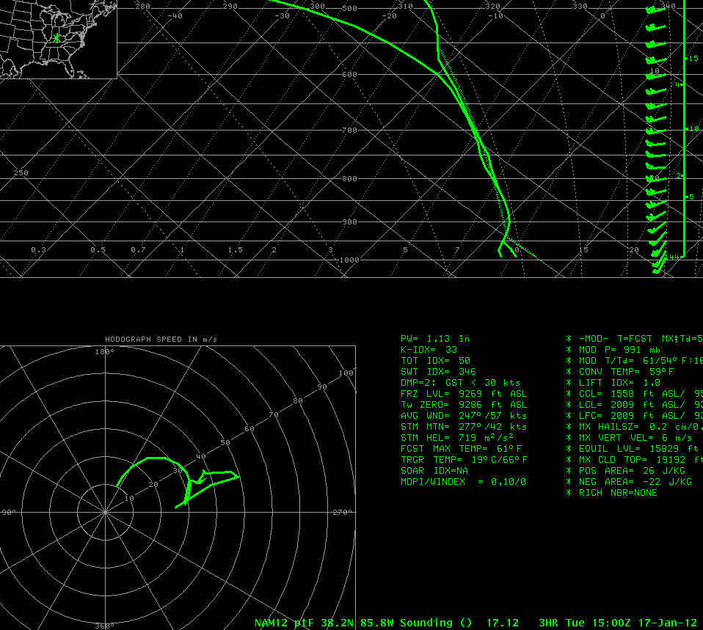
NAM (12 km) 15z forecast sounding
1.8 lifted index
Completely missed actual temps/dewpoints (represented by gray ovals)
Storm-Relative Helicity 719 m²/s²

Slide 8
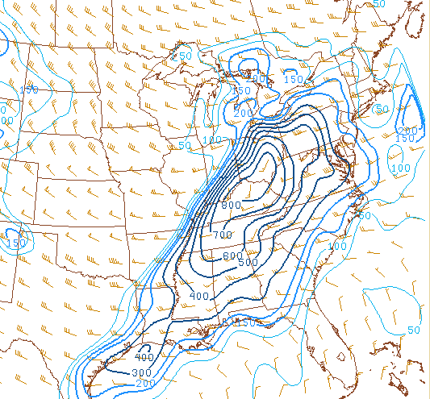
0 to 1 km helicity showed very high values and spin potential for any surface-based storms that developed

Slide 9
Pre-Brief
Sent participants a packet 24 hours before their simulation (mentioned that QLCS was coming)
What to expect with WES
Asked if familiar with a typical cool-season QLCS
Quick primer on SRM/Velocity
Day 1 SPC Outlook
Tornado/Wind/Hail Probabilities
Took all time references off docs
SPC Mesoscale Convective Discussion
SPC Mesoanalysis from 15 Z

Slide 10
QLCS Ahead of Cold Front

Slide 11
QLCS Ahead of Cold Front
QLCS had a couple of line breaks
Cells in this area took better advantage of available shear
Ended up with 9 TORs (3 EF0s, 5 EF1s, 1 EF2)
Also threw in a false report

Slide 12
QLCS Ahead of Cold Front
QLCS had a couple of line breaks
Cells in this area took better advantage of available shear
Ended up with 9 TORs (3 EF0s, 5 EF1s, 1 EF2)
Also threw in a false report

Slide 13
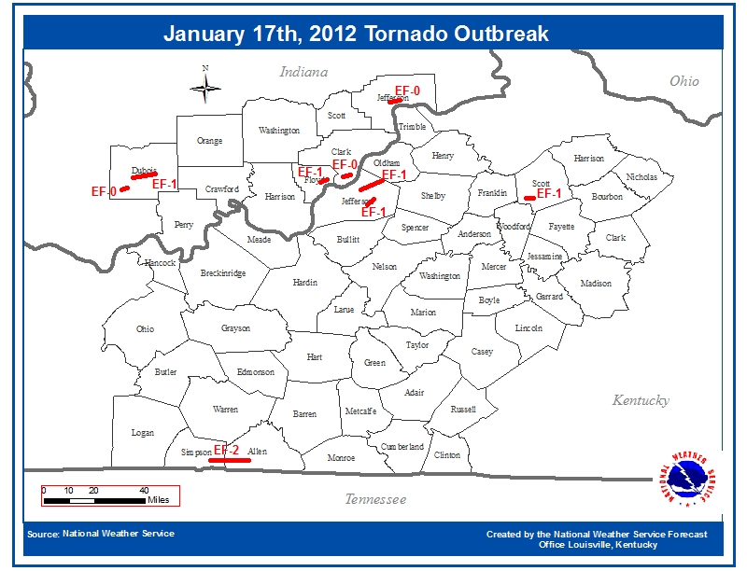
Verification/NWS Warnings

Slide 14
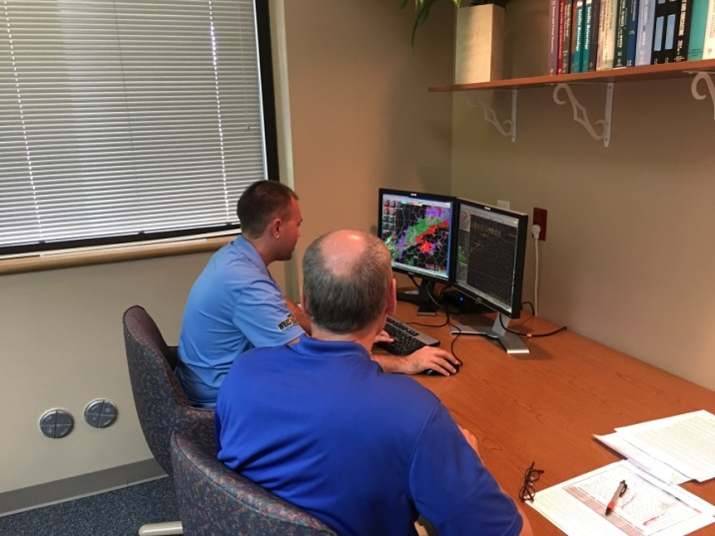
So, How Did They Do?
General trend to issue larger Severe Thunderstorm Warnings with embedded Tornado Warnings
Helped them to see the thought process that must go into warning locations
Some were cognizant of including Louisville at the end of a polygon
Multiple Tornado Warnings in close proximity made for some interesting polygons

Slide 15
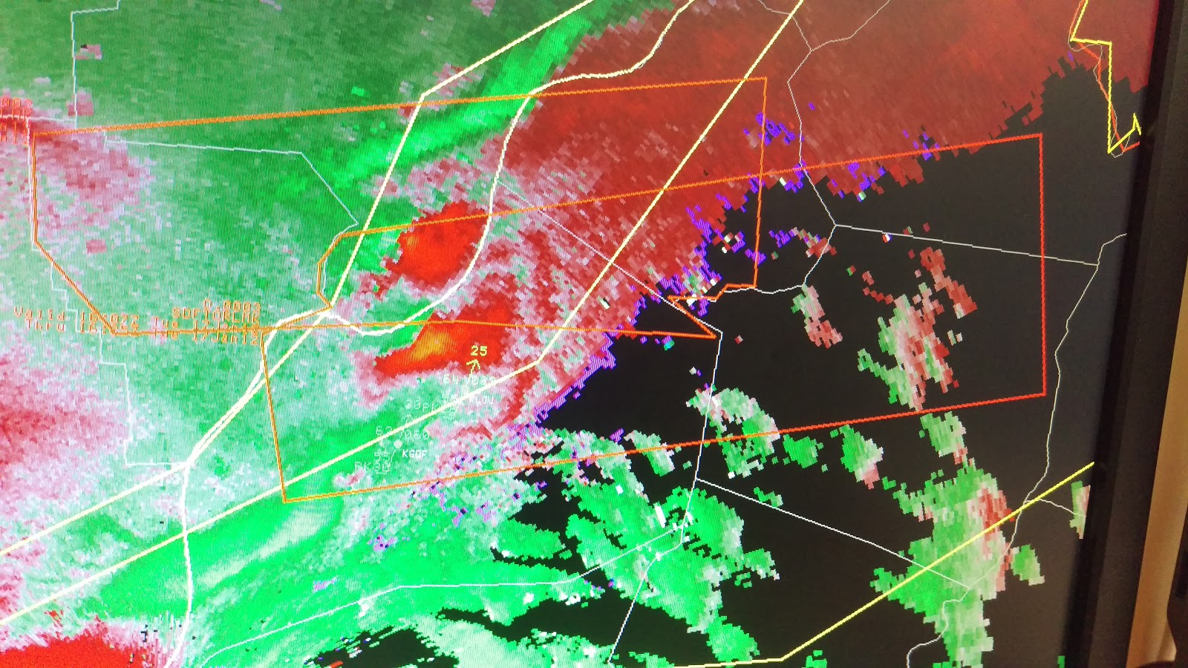
So, How Did They Do?

Slide 16
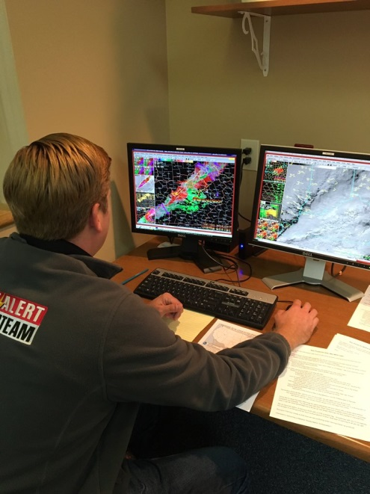
So, How Did They Do?
One made a large Tornado Warning for all of Louisville
“I’m covered for Louisville, unfortunately I just put 500,000 people in their basements.”
Some knobology concerns
Getting used to our system for moving around radar products and clicking through WarnGen procedures
Did go through a practice warning at onset

Slide 17
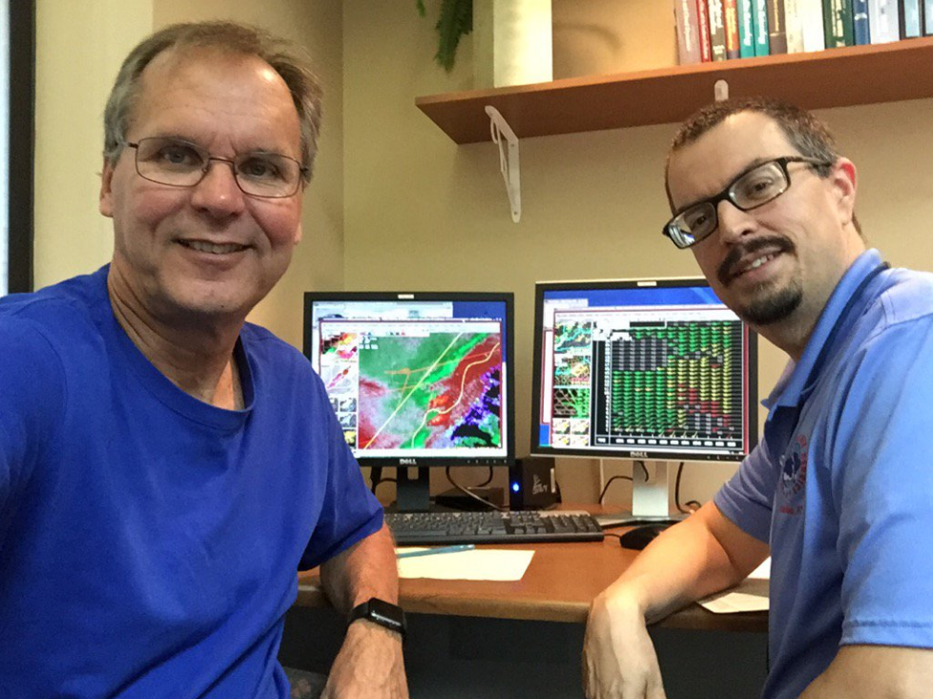
Quotes from TV Mets
“I have much greater respect for the decisions you all have to make. Having good communication on storm reports is really important to help make some of these decisions easier.”
- John Belski, WLKY Louisville
“I’ve always had a lot of respect for what you guys do, but this gives me a greater sense of appreciation. Other TV mets need to do this. I’m just glad I didn’t lay an egg.”
- T.G. Shuck, WHAS Louisville

Slide 18
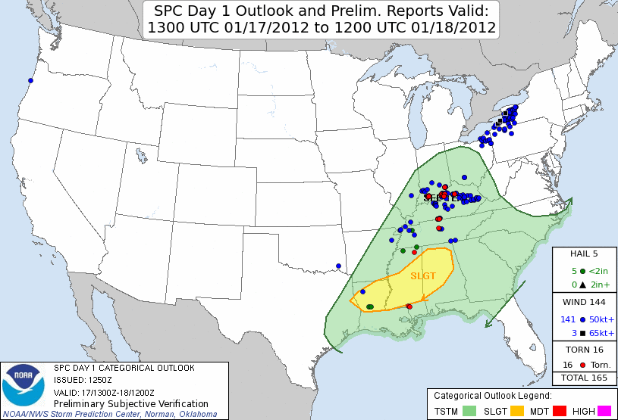
Knowledge of QLCS Hazards
What did they know ahead of time?
Several knew to look for weak, short-lived tornadoes in the line
Recognized that surface-based instability was a big key in getting stronger winds aloft down to the surface as well as rotation

Slide 19
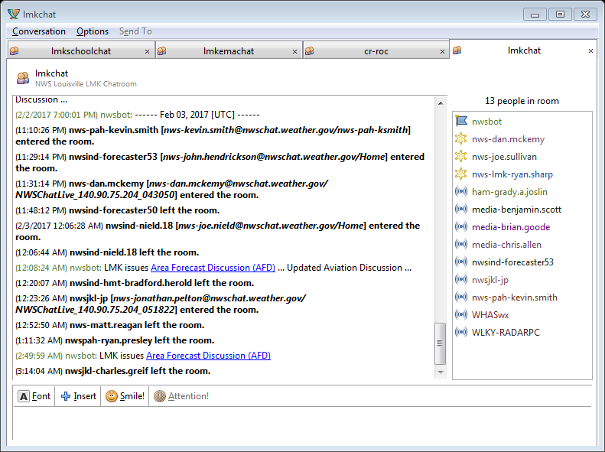
What Have We Learned?
TV Mets like our outgoing communication during a warning situation
We use NWSChat to provide updates in-between our warnings and follow-up statements. MesoAFDs used too.

Slide 20
Warning Challenges
Severe Thunderstorm Warnings do not receive as much attention or coverage in these situations as Tornado Warnings
Unfortunately in these situations, soon after a Tornado Warning is issued, the tornado likely will dissipate
The TV Mets tended to issued more Tornado Warnings once they realized the threat for them was increasing

Slide 21
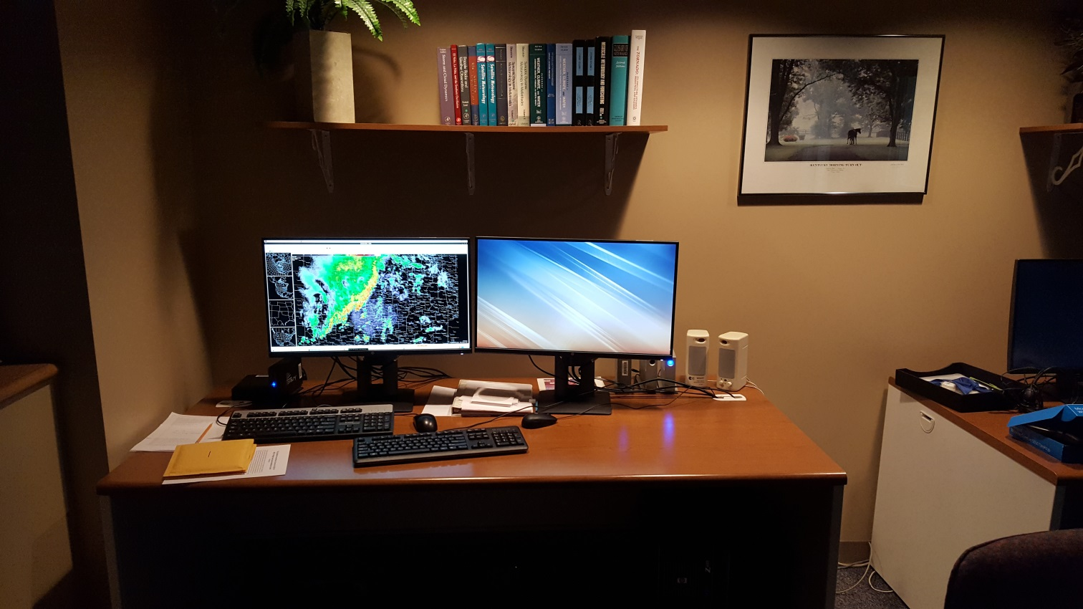
POWS v2.0!
WES2 Upgrade, Larger Screens!
Program will be expanded to other area mets
Academia, Private Sector, Forecast staff

Slide 22
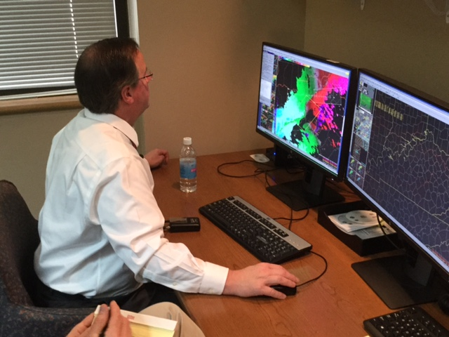
Last Thoughts
Bill Meck, meteorologist from WLEX in Lexington
Have developed a better relationship over past few years
Did a 5-minute segment on evening news about his POWS experience
He called us “Partners”, which he noted was the first time those words had come from him!
“It’s a terrific tool and one that will prove invaluable to countless others as it’s deployed across the nation and become another tool in our arsenal for saving lives and property.”

