Slide 1
Messaging a Nocturnal Tornado Producing QLCS
Learning from the May 16th, 2015 QLCS
Chris Bowman & Jared Leighton
National Weather Service – Pleasant Hill, MO

Slide 2
Messaging a Nocturnal Tornado Producing QLCS
What Happened?
What we’ve learned.
Brief overview of event
Look at some of EAX’s messaging leading up to the event
Things that are good for meteorologist aren’t all that useful for the average person
Examples of action oriented messaging geared for this event
A shift away from what’s most likely to what’s most dangerous event
We want to get the average person to understand they’re at risk

Slide 3
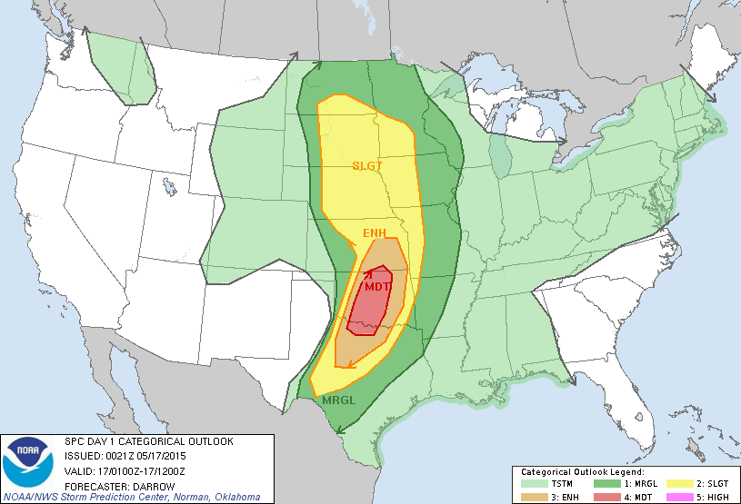
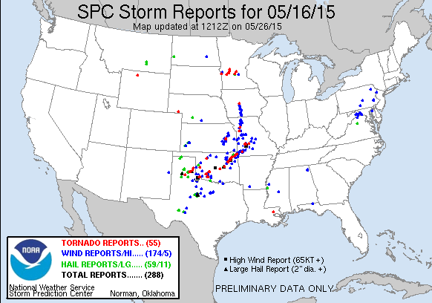
What Happened
Tornado-producing QLCS
At least 2 tornadoes
Max EF-1 rating
Numerous reports of wind damage associated with mesovortices
No tornado warnings issued for QLCS portion of event
Tornadic supercells
Ahead of QLCS
3 tornadoes
EF-2 max rating
Notes:
Not to turn this into a post-mortem but this event wasn’t our best performing event, lower than average lead time and missed events.

Slide 4
What Happened Why it Matters

Slide 5
What Happened Why it Matters
Nocturnal tornadoes account for ~27% of all tornadoes from 1950-2005
Account for ~39% of all fatalities
~42% of deadly tornado events occur at night
Nocturnal tornadoes are 2.5 times as likely to kill compared to daytime tornadoes
~61% of nocturnal tornado fatalities occur in mobile homes
Ashley et al. 2008

Slide 6
What Happened Why it Matters
Nocturnal tornadoes account for ~27% of all tornadoes from 1950-2005
Account for ~39% of all fatalities
~42% of deadly tornado events occur at night
Nocturnal tornadoes are 2.5 times as likely to kill compared to daytime tornadoes
~61% of nocturnal tornado fatalities occur in mobile homes
Ashley et al. 2008
These statistics show the need to raise awareness of potential nocturnal tornadoes, particularly for certain, more vulnerable segments pf society.
Certain portions of the population are especially at risk
Empower the people we’re protecting by giving them actions to prepare/protect themselves
Be aware that these events can and do occur with little or no warning
A slight change in messaging means potentially hundreds of thousands more people become more aware of the forecast

Slide 7
How the Forecast was Messaged
Notes:
Two days out. But no mention of possible threats, vague timing. While meteorologist and higher end users may like the risk categories, they’re difficult for the public to understand. And in this specific case, can lead to sense of it won’t be that bad with the decreasing categories with eastward extent.

Slide 8
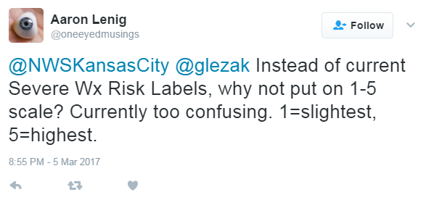
How the Forecast was Messaged
Graphic issued roughly 48 hours from event:
Vague, just a general mention of timing
No mention of possible threats, just “Severe Storms Possible”
Risk categories can be confusing for some
In this specific case, a decreasing risk with eastward extent can lead to a sense of the event not being that bad
As I’m putting finishing touches on this talk
Notes:
Two days out. But no mention of possible threats, vague timing. While meteorologist and higher end users may like the risk categories, they’re difficult for the public to understand. And in this specific case, can lead to sense of it won’t be that bad with the decreasing categories with eastward extent.

Slide 9
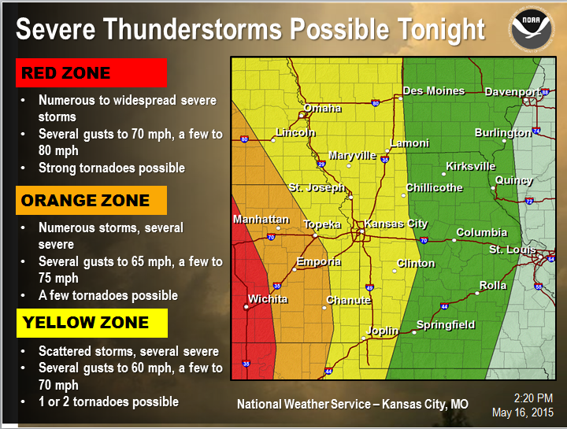
How the Forecast was Messaged

Slide 10
How the Forecast was Messaged
Graphic issued several hours before
event onset:
More detailed hazard information
Using risk categories as zones, decreasing categorical confusion
Still showing most likely vs most dangerous
Most dangerous hazard mentioned last
Notes:
Balancing the anticipated high end activity in central KS with “our area could still be bad” was a challenge.

Slide 11
A Shift Away From Most Likely
to
What’s Most Dangerous?
&
What Actions Can People Take
To Minimize Their Risk?

Slide 12
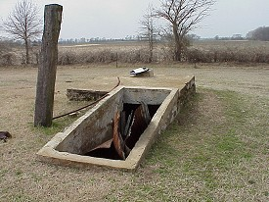
Attention Mobile Home Residents
Thunderstorms are likely Saturday night.
Tornadoes are possible, as well as strong, damaging winds.
Be prepared to move quickly to shelter if severe weather threatens.
Nighttime tornadoes are difficult to see and can occur with little or no warning. Consider spending the night with a friend or relative in more substantial structure
Is your shelter ready if you need it?
Do you know where to take shelter in the event a tornado threatens your home?
Have a plan and know where to shelter.
Have multiple, reliable methods of receiving warnings (weather radio, cell phone apps, etc.)
National Weather Service – Kansas City, MO
www.weather.gov/kc
Notes:
A simple graphic, highlighting one of the most at risk groups. Other groups may be hospitals, nursing homes and in certain times of the year, late spring and summer, campers and lake visitors. This graphic could used the day before or even the morning of as part of an overall strategy throughout the day.

Slide 13
Attention Mobile Home Residents
Thunderstorms are likely tonight, after sunset.
Tornadoes are possible, as well as strong, damaging winds.
Be prepared to move quickly to shelter if severe weather threatens.
Nighttime tornadoes are difficult to see and can occur with little or no warning. Consider spending the night with a friend or relative in more substantial structure
Attention Grabbing Headline
Highlights a portion of the population that is particularly at risk
Is your shelter ready if you need it?
Do you know where to take shelter in the event a tornado threatens your home?
Have a plan and know where to shelter.
Have multiple, reliable methods of receiving warnings (weather radio, cell phone apps, etc.)

Slide 14
Attention Mobile Home Residents
Thunderstorms are likely tonight, after sunset.
Tornadoes are possible, as well as strong, damaging winds.
Be prepared to move quickly to shelter if severe weather threatens.
Nighttime tornadoes are difficult to see and can occur with little or no warning. Consider spending the night with a friend or relative in more substantial structure
Describes What Is Expected
Most dangerous is highlighted, not most likely
General time frame of when to expect bad weather
Is your shelter ready if you need it?
Do you know where to take shelter in the event a tornado threatens your home?
Have a plan and know where to shelter.
Have multiple, reliable methods of receiving warnings (weather radio, cell phone apps, etc.)

Slide 15
Attention Mobile Home Residents
Thunderstorms are likely tonight, after sunset.
Tornadoes are possible, as well as strong, damaging winds.
Be prepared to move quickly to shelter if severe weather threatens.
Nighttime tornadoes are difficult to see and can occur with little or no warning. Consider spending the night with a friend or relative in more substantial structure
Gives Action Items
What can people do to be more weather aware?
Is your shelter ready if you need it?
Do you know where to take shelter in the event a tornado threatens your home?
Have a plan and know where to shelter.
Have multiple, reliable methods of receiving warnings (weather radio, cell phone apps, etc.)

Slide 16
Attention Mobile Home Residents
Thunderstorms are likely tonight, after sunset.
Tornadoes are possible, as well as strong, damaging winds.
Be prepared to move quickly to shelter if severe weather threatens.
Nighttime tornadoes are difficult to see and can occur with little or no warning. Consider spending the night with a friend or relative in more substantial structure
Gives Action Items
What can people do to be more weather aware as a storm approaches?
What can they do now to prepare?
Is your shelter ready if you need it?
Do you know where to take shelter in the event a tornado threatens your home?
Have a plan and know where to shelter.
Have multiple, reliable methods of receiving warnings (weather radio, cell phone apps, etc.)

Slide 17
Attention Mobile Home Residents
Thunderstorms are likely tonight, after sunset.
Tornadoes are possible, as well as strong, damaging winds.
Be prepared to move quickly to shelter if severe weather threatens.
Nighttime tornadoes are difficult to see and can occur with little or no warning. Consider spending the night with a friend or relative in more substantial structure
Is your shelter ready if you need it?
Do you know where to take shelter in the event a tornado threatens your home?
Have a plan and know where to shelter.
Have multiple, reliable methods of receiving warnings (weather radio, cell phone apps, etc.)
Simple Visual Reminder
Is your shelter ready for when you need to use it?

Slide 18
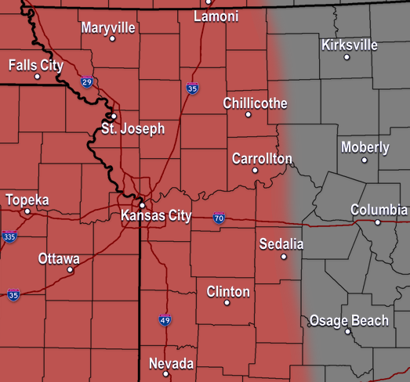
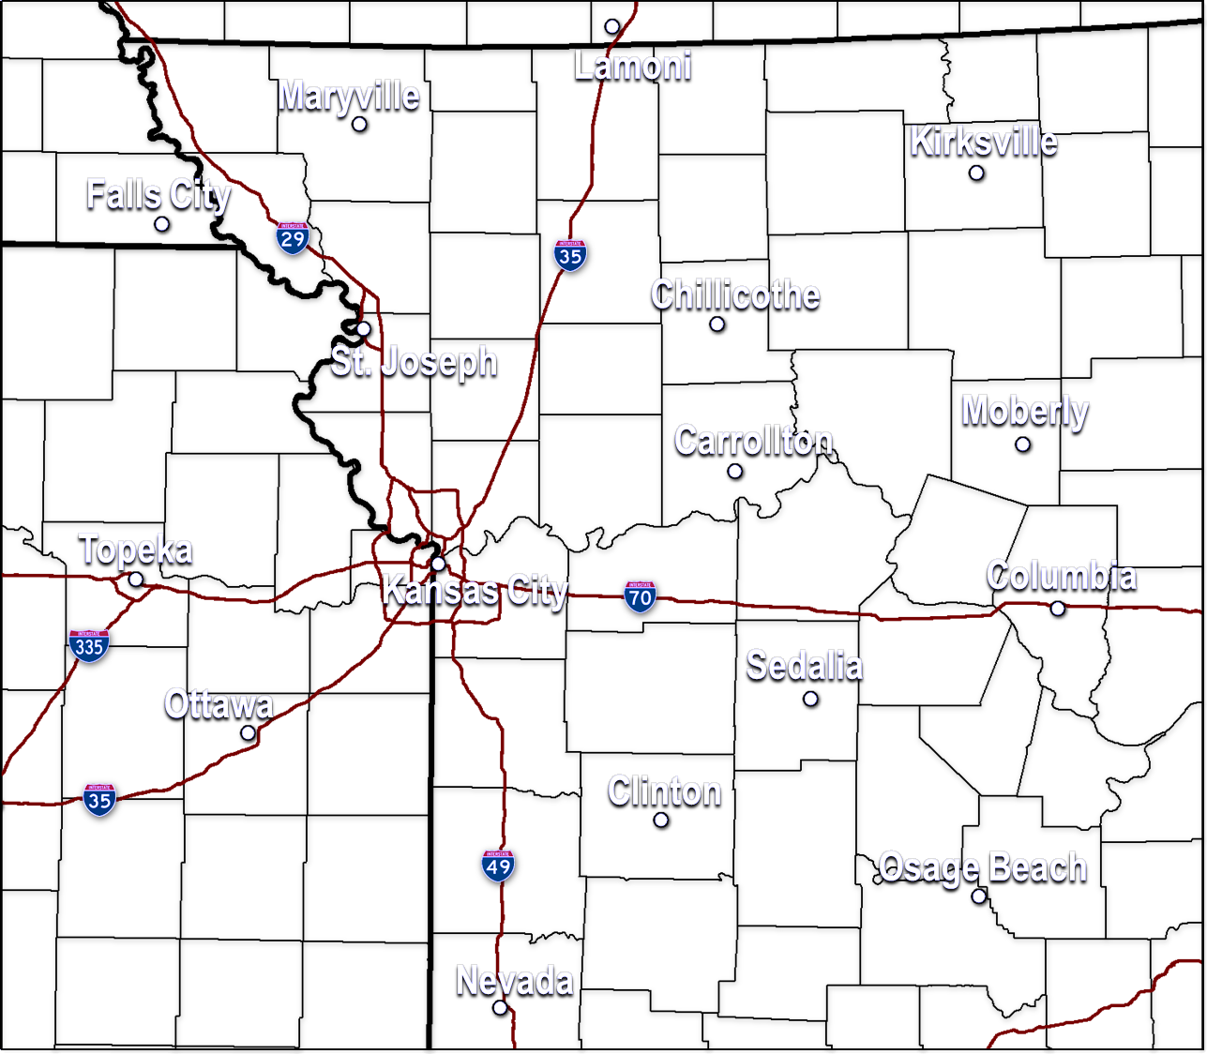
Nighttime Tornadoes Possible
Tornadoes are possible tonight as well as strong, damaging winds.
If you live in or near the SHADED area, be prepared to move quickly to shelter if severe weather threatens.
Nighttime tornadoes are difficult to see and can occur with little or no warning.
Have multiple, reliable methods of receiving warnings (weather radio, cell phone apps, etc.)
Do you know where to take shelter in the event a tornado threatens your home?
Have a plan and know where to shelter.
Notes:
This graphic has many of the same elements as the previous graphic so I won’t go and explain them. The main difference is that the image has been replaced with a map with the threat area shaded. Text highlighting the biggest impact, tornadoes, matches the shading and action items for the shaded area follow. Displaying maps isn’t necessarily the best route as we’ve found people don’t know where they are, but many people do at some point the need for an areal extent of the threat is needed. This graphic could be used during an afternoon update, as confidence in areal extent is likely increased. T-6 to T-12 hours, for example.

Slide 19
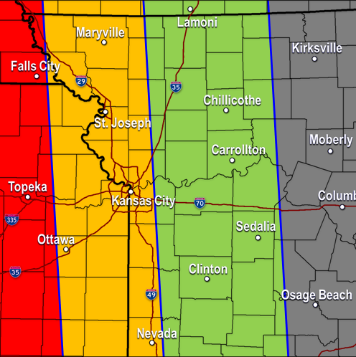
Nighttime Tornadoes Possible
Nighttime tornadoes are difficult to see and can occur with little or no warning. Have multiple methods of receiving warnings
Zone 1:
What?
When?
Where?
How Bad?
Timing : 6pm – 9pm
What to Expect : A few tornadoes, damaging winds, large hail
Zone 2:
Timing : 9pm - Midnight
What to Expect : A few tornadoes, damaging winds, decreasing hail threat, flash flooding
Zone 3:
Timing : Midnight – 3am
What to Expect : A few tornadoes, damaging winds, flash flooding
Actions to take: Have multiple, reliable methods of receiving warnings (weather radio, cell phone apps, etc.) and know where to go in the event a tornado warning is issued for your location
Notes:
Lastly, providing more detailed timing, confidence is high/storms have developed and can be tracked providing a better ability to provide timing. Highly contrasting color zones separated by a contrasting line. The biggest impact/threat, not the most likely, remains highlighted.

Slide 20
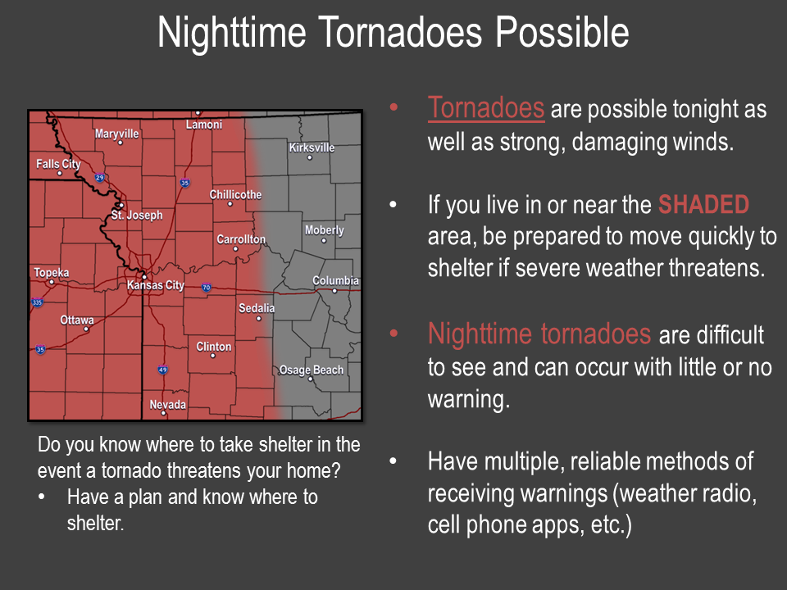
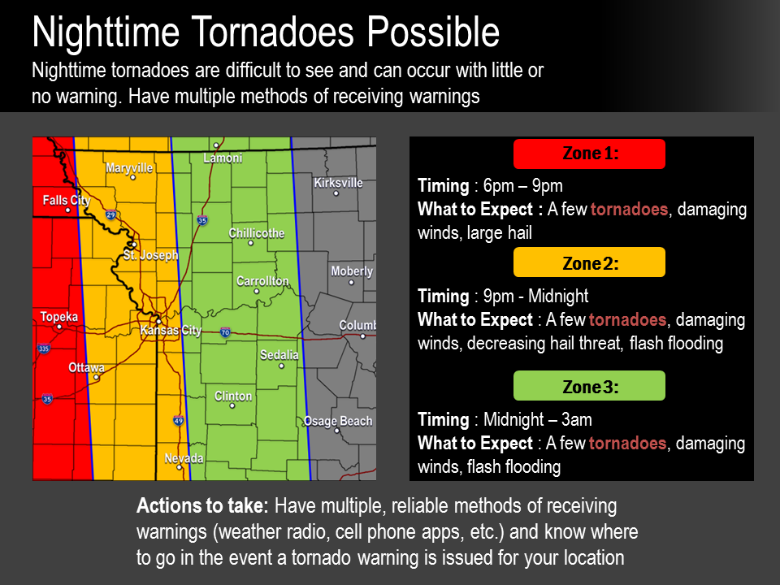
Ready
Set
GO!
Notes:
Building awareness is an ongoing process. A continual campaign that pays dividends with increased numbers of people seeing the information we’re providing.

Slide 21
Continuous Campaign
Taking Actions to
Protect Themselves
Building Trust
More People Seeing
our Information
Notes:
Building awareness is an ongoing process. A continual campaign that pays dividends with increased numbers of people seeing the information we’re providing.

Slide 22
Summary
Shifting away from most likely to most dangerous
Provide action items people can take to prepare/protect themselves
Different methods of communicating risk/vulnerability can greatly enhance public awareness & response
Continual campaign, building trust & increasing awareness

