Slide 1
Motivating Protective Action in Advance of Severe QLCS Events
Dan Hawblitzel
NOAA/NWS Kansas City, MO

Slide 2

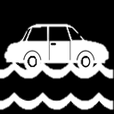
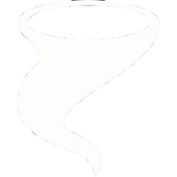
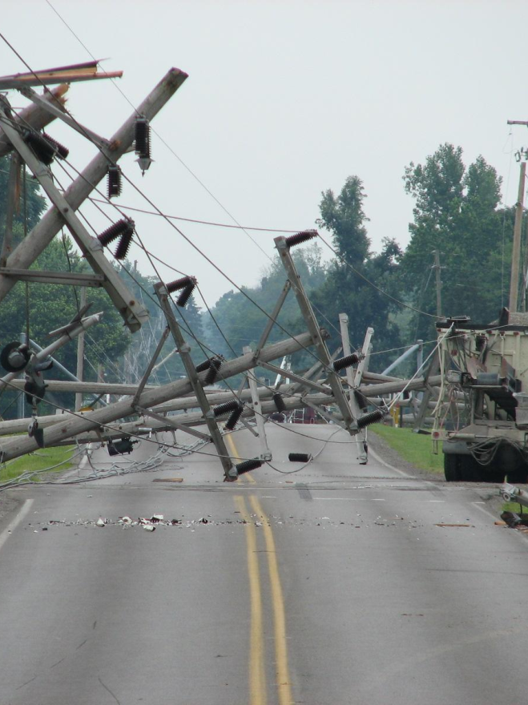
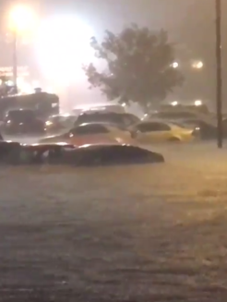
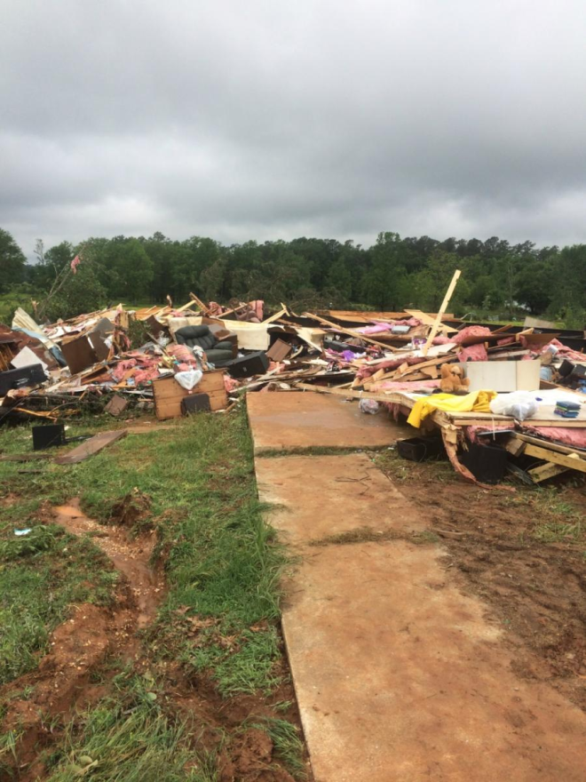
QLCS Hazards

Slide 3

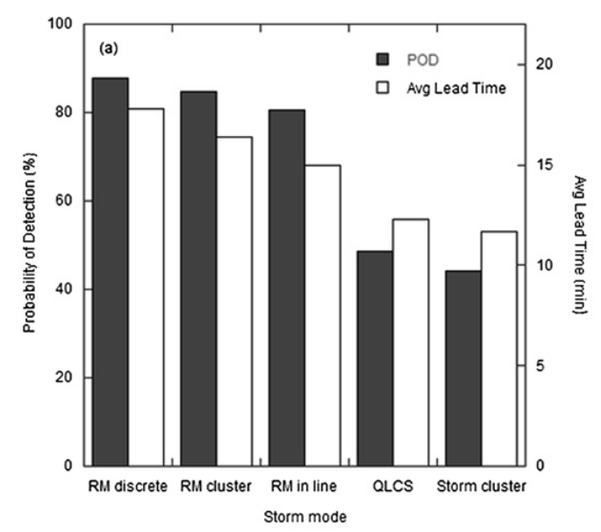
QLCS Tornadoes: Poorer POD and LT
Brotzge et al 2013

Slide 4






Populations Vulnerable to Short Lead Time
Mobile home residents
Large venues
Outdoor events
Schools
Outdoor recreation
Limited mobility

Slide 5
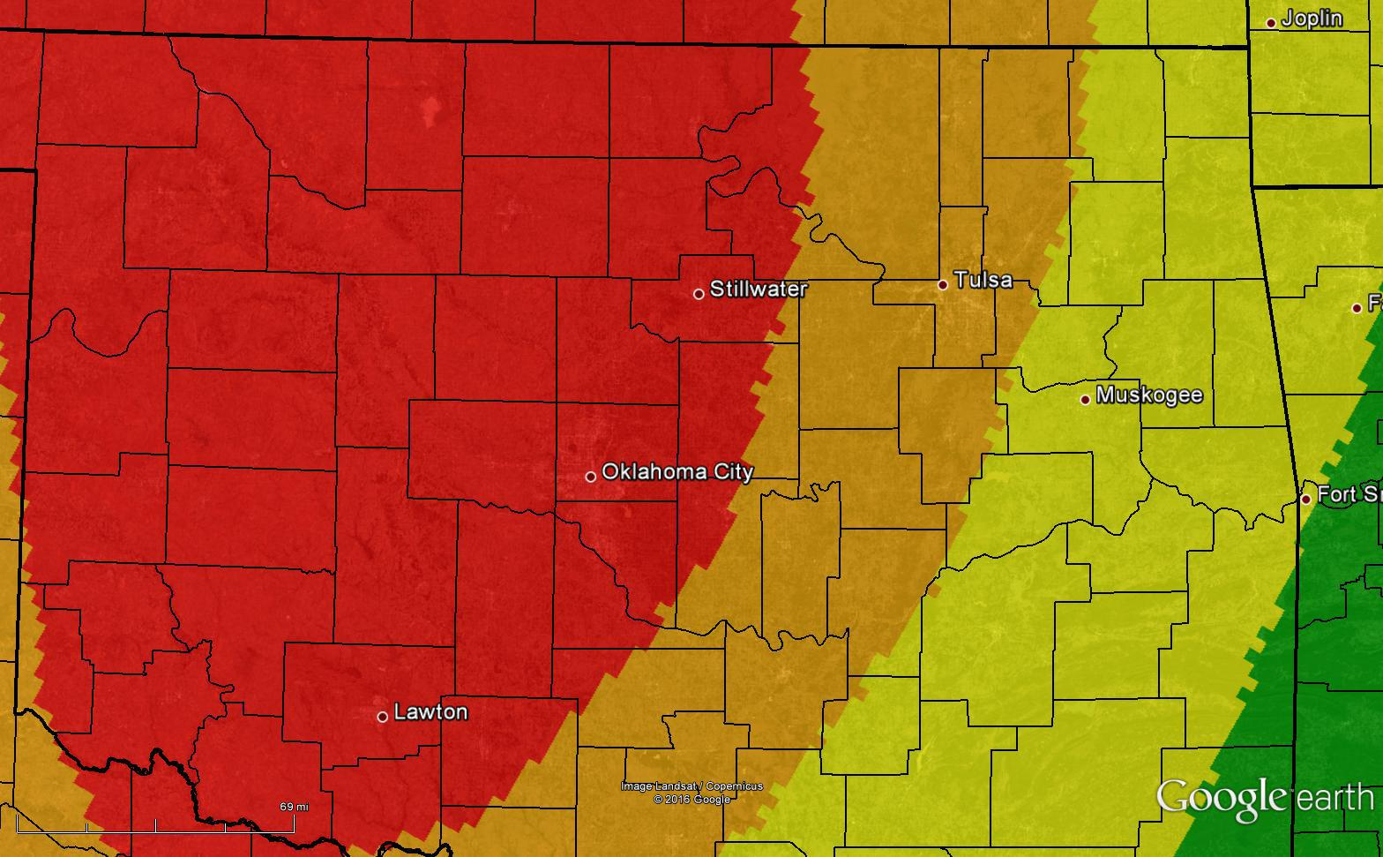
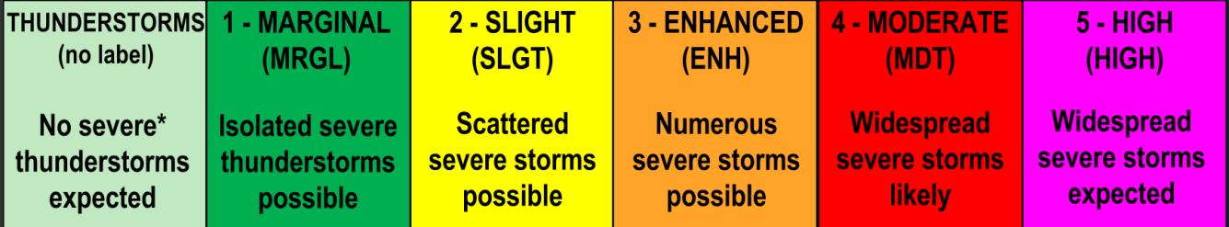
Current Ways of Communicating Storm Risk
SPC Convective Outlooks
Moderate
Enhanced
Slight

Slide 6
Current Ways of Communicating Storm Risk
SPC Convective Outlooks
Decaying line
SUPERCELLS → → QLCS →

Slide 7
Current Ways of Communicating Storm Risk
SPC Convective Outlooks
Based on anticipated coverage and severity
Graphic alone doesn’t address threat to life or property.
No way to infer necessary protective action.
Tornado vs hail vs wind?

Slide 8

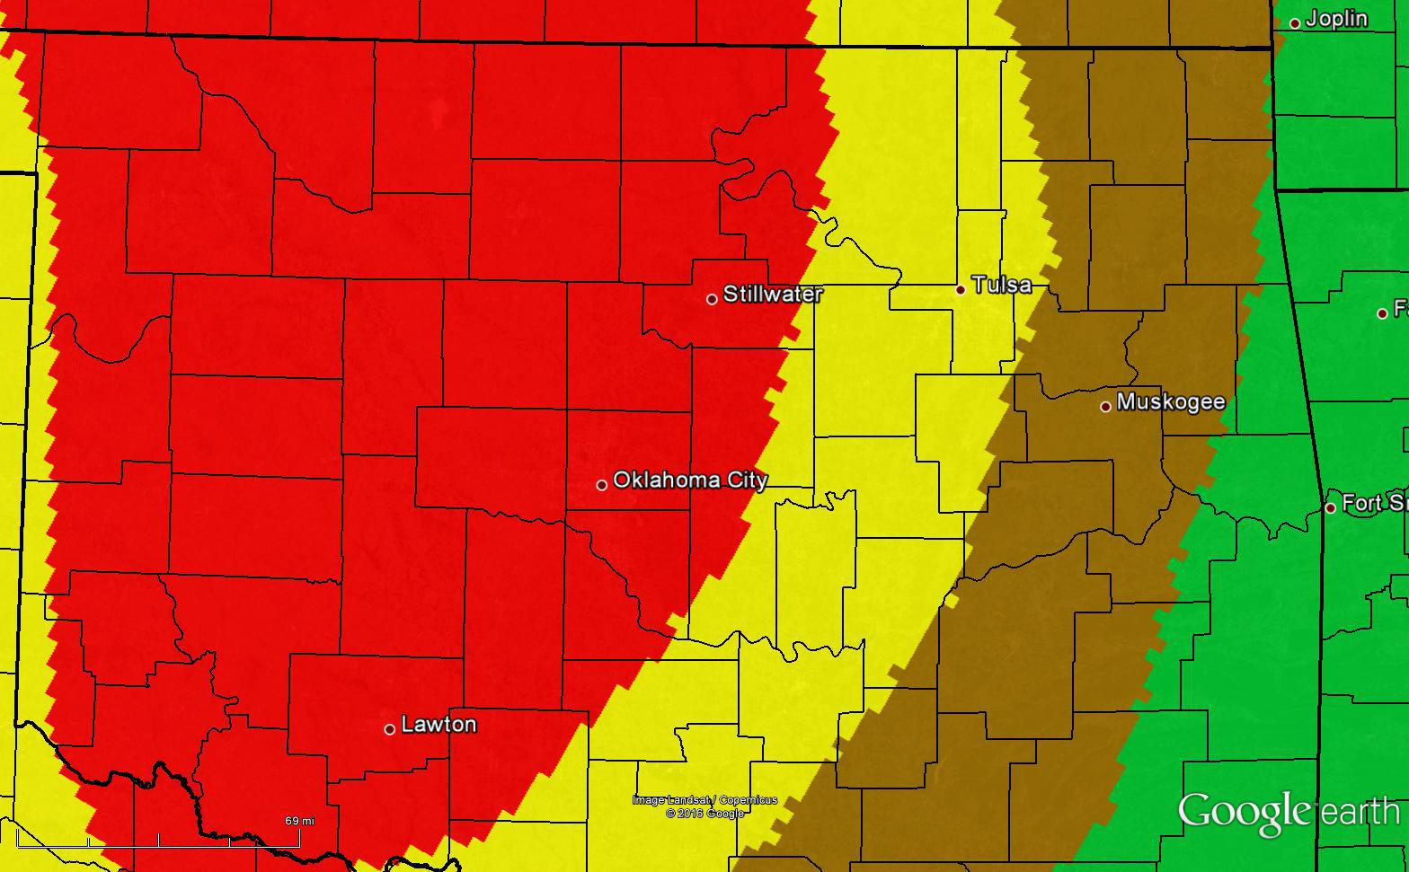
Current Ways of Communicating Storm Risk
SPC Tornado Probabilities
2%
5%
10%
15%

Slide 9
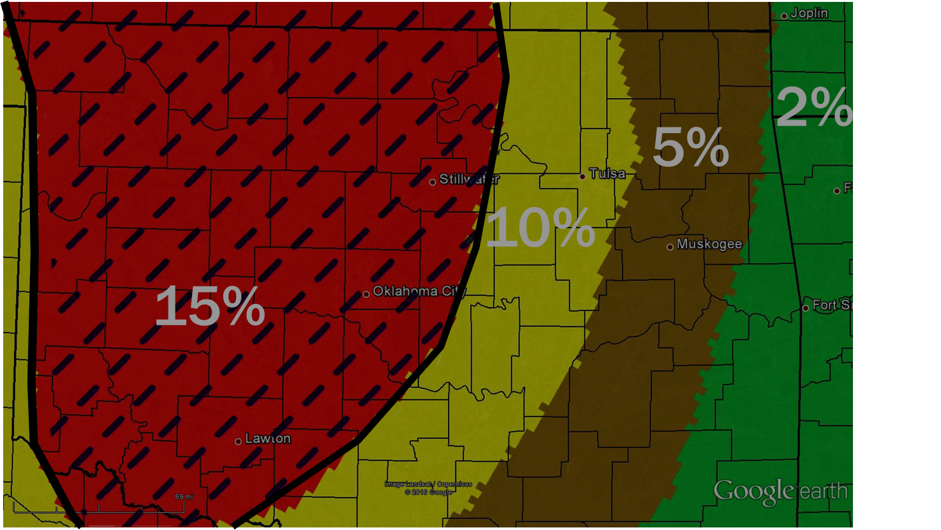
Current Ways of Communicating Storm Risk
SPC Tornado Probabilities
QLCS tornadoes
Supercell tornadoes
Numerous/long-lived
Possibly strong
Potentially deadly.

Slide 10
Current Ways of Communicating Storm Risk
SPC Tornado Probabilities
QLCS tornadoes
Supercell tornadoes
Not as numerous
Not as long-lived
Weaker
Numerous/long-lived
Possibly strong
Potentially deadly.
Less lead time?
No warning?
Nighttime?
POTENTIALLY DEADLY.

Slide 11
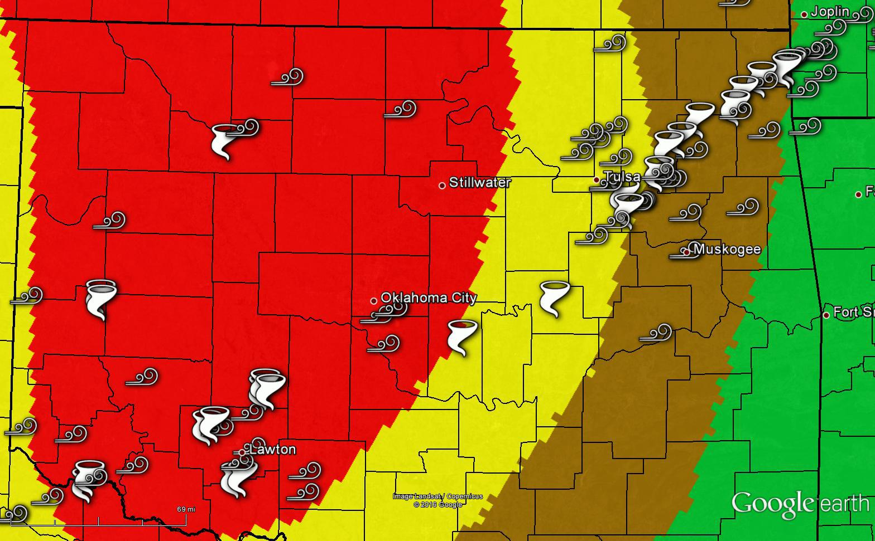
Average tornado lead time 11 minutes
120 homes damaged, up to EF2
2%
10%
5%
15%

Slide 12
Transition to QLCS may imply lesser severe threat
(fewer tornadoes, threat for EF3+ much lower).
However the risk for low-lead time and/or nocturnal tornadoes may be INCREASING. This may be critical info for some users.
This may change action from “Wait for warning” to “Go ahead and take action now” if lead time won’t be adequate enough.

Slide 13



How do we communicate the unique risk of QLCS tornadoes to those most vulnerable?
Large events: NWS may have dedicated DSS meteorologist telling them the potential for low-lead time tornadoes.
May weigh into their decision to cancel an event or have extra staffing.
What about other vulnerable parts of the population?

Slide 14
Social Science:
Single out one vulnerable segment of population, those who aren’t included will still get the message.
Miletti 2006
Evidence suggests people are more likely to act when specific protective action is communicated to them. Risk is inferred.
Bourque et al. 2012

Slide 15
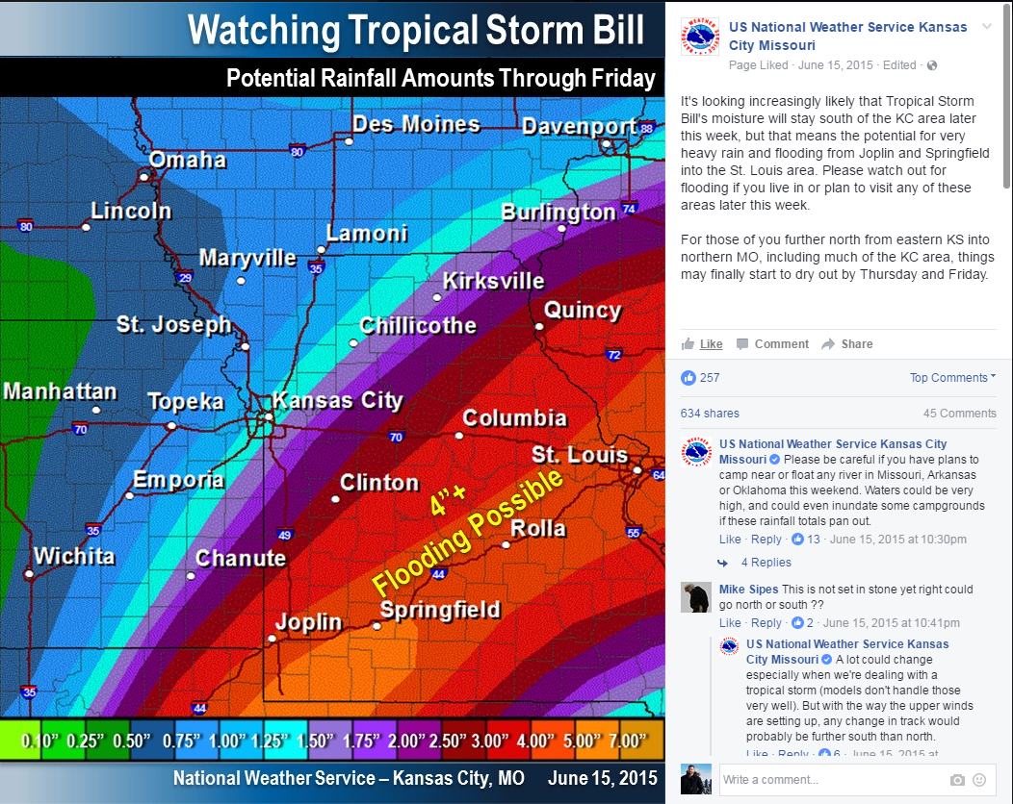

Slide 16
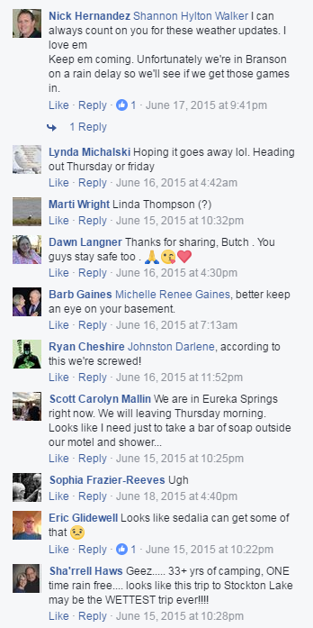

Slide 17
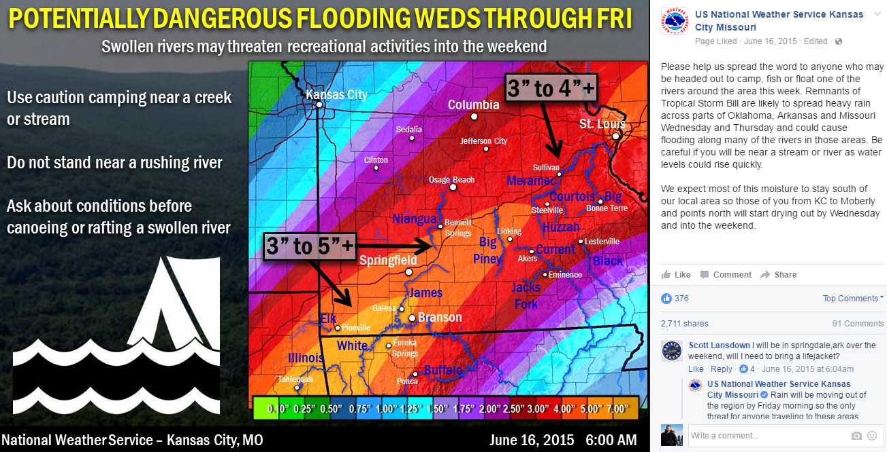
Post singles out specific rivers at risk.
Mentions activities that may become dangerous.
Shared 4x’s more than first graphic.
Reached over 325,000 people.

Slide 18

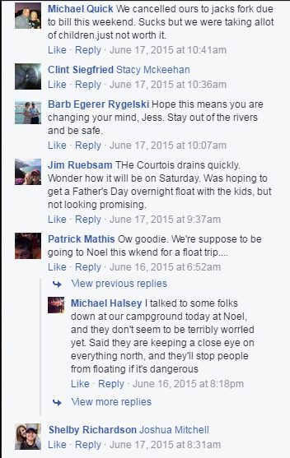
Post singles out specific rivers at risk.
Mentions activities that may become dangerous.
Canceled
plans
Canceled
plans
Alerting others
Called campground
Shared 4x’s more than first graphic.
Reached over 250,000 people.
Alerting others

Slide 19
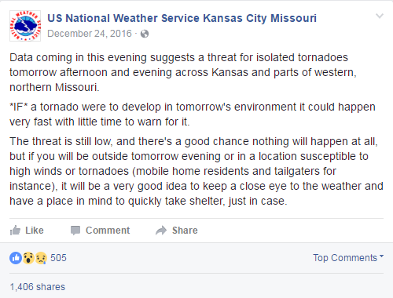
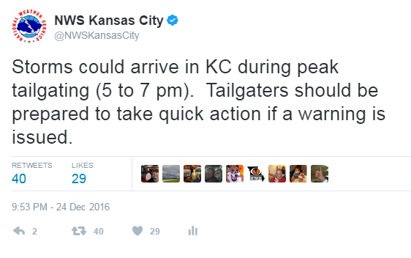
Christmas Day 2016
Similar conditions to 12/31/2010 in STL
BIG Chiefs game!

Slide 20
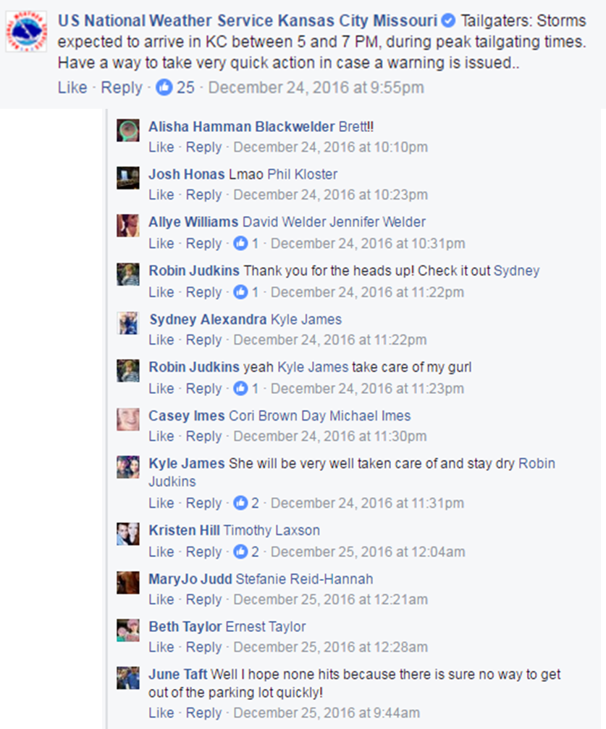

Slide 21
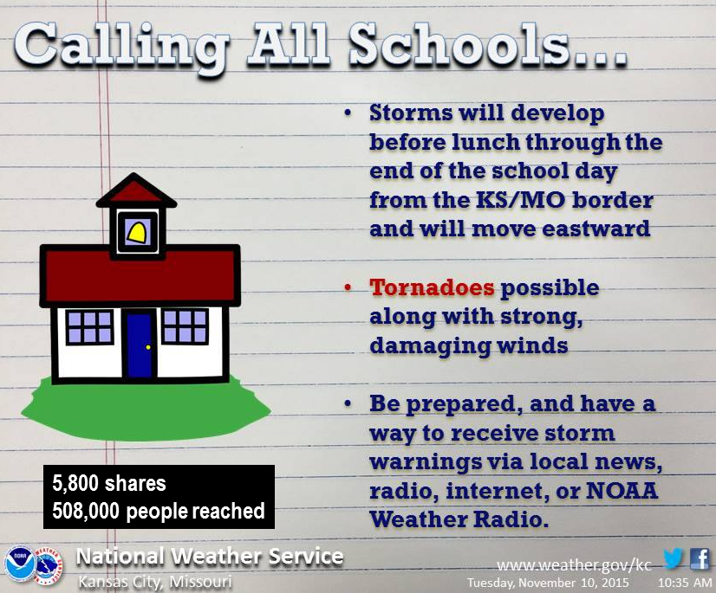

Slide 22

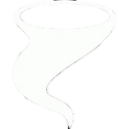
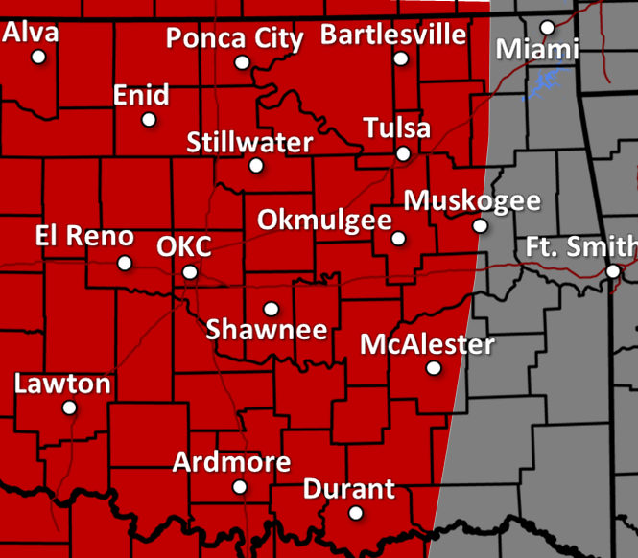


Attention campers:
Dangerous storms may develop rapidly tonight.
Prepare to act quickly.
Areas most at risk:
Storms expected. A few tornadoes possible.
Have shelter available within 5 minutes.
Consider changing outdoor plans if shelter is not readily available.
Visit www.weather.gov/CWA for information on tonight’s storms.

Slide 23


Attention Fair Goers:
Dangerous storms may develop rapidly tonight.
Know where your shelter options are.
Areas most at risk:
Storms expected. A few tornadoes possible.
Keep an eye on weather conditions before storms hit.
Stay within 5 minutes of shelter as storms approach.
Visit www.weather.gov/CWA for information on tonight’s storms.

Slide 24


Attention Mobile Home Residents:
Dangerous storms may develop rapidly tonight.
Be prepared to act quickly.
Areas most at risk:
Storms expected. A few tornadoes possible.
Have shelter available within 5 minutes.
Consider spending the evening in a sturdy structure.
Visit www.weather.gov/CWA for information on tonight’s storms.

Slide 25
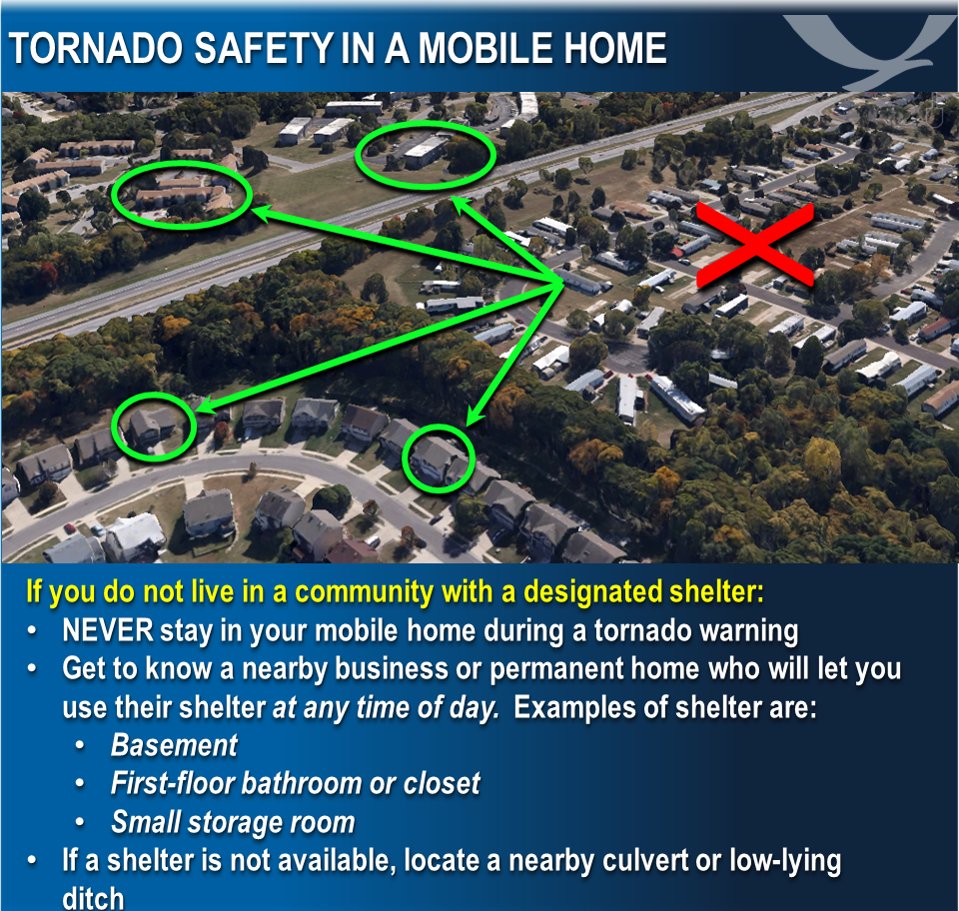
If you know anyone in a mobile home, please be sure they know of a safe place nearby. Dangerous storms could develop rapidly tonight with little time to prepare.

Slide 26
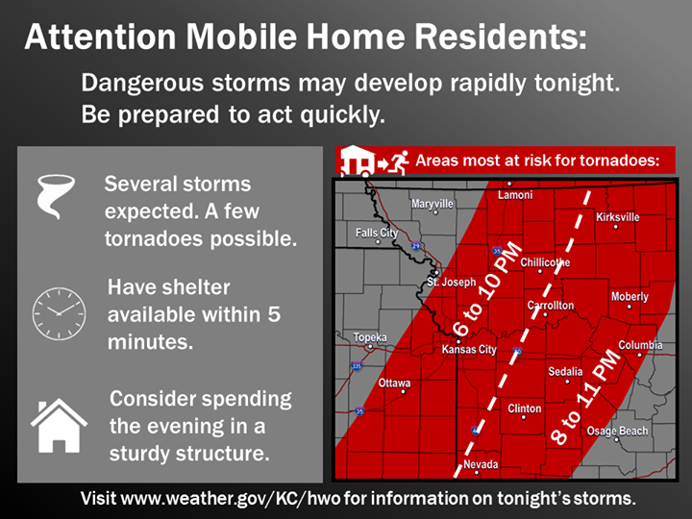

Slide 27
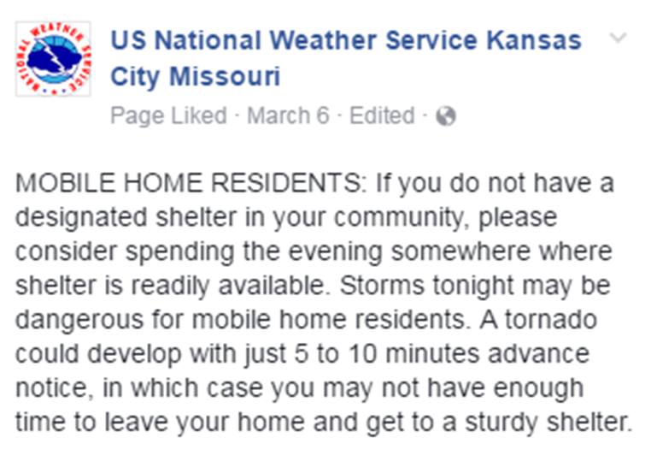


Slide 28


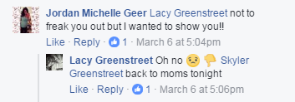
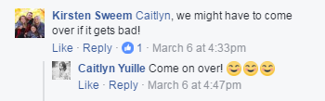


Slide 29
SUMMARY
QLCS tornadoes can be particularly dangerous to some. Singling out those most at risk and providing explicit action to take may make the message much more effective.
Call-to-action messaging should inspire users to seek more information.
This is not the only way to message the risk, just one potentially effective method to SUPPLEMENT your message.
Keep a steady flow of information throughout all stages of the event.

Slide 30
SUMMARY
Make sure all IWT partners are on the same page with potential for low-lead time tornadoes.
Choose wording CAREFULLY. Ensure users they can still trust you to be on top of the situation.
Use this approach selectively – don’t exhaust an effective communication method.

Slide 31
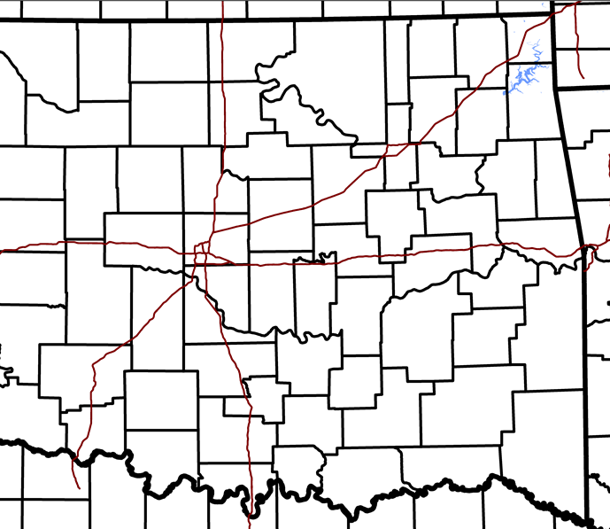
Alva
Ponca City
Bartlesville
Miami
Enid
Stillwater
Tulsa
Okmulgee
Muskogee
El Reno
OKC
Ft. Smith
Shawnee
McAlester
Lawton
Ardmore
Durant

