Slide 1
The Northern Illinois/Indiana QLCS Tornadoes of June 30th, 2014
Todd Holsten, Evan Bentley, Jeff Logsdon, Kyle Brown

Slide 2
Several Studies/Presentations on this Event
23rd Great Lakes Operational Meteorology Workshop
Eric Lenning et al. (synoptic, mesoscale, storm scale processes)
Todd Holsten et al. (damage survey techniques)
AMS 27th Conference on Weather Analysis and Forecasting
Eric Lenning and Matt Friedlein
AMS 37th Conference on Radar Meteorology
Tony Lyza (mesovortex analysis)
NC State – CSTAR HSLC Webinar
Jason Schaumann (3 ingredients approach)

Slide 3
Past recent QLCS tornado events
06/30/14 – 11 tornadoes
11/17/13 – 17 tornadoes *
* 2nd (38) highest IN statewide tornado count
04/19/11 – 6 tornadoes
10/26/10 – 13 tornadoes *
Ranks 1st (37) in total calendar year tornadoes for IWX
06/05/10 – 8 tornadoes
06/23/10 – 7 tornadoes
Notes:
Cool season events dominate the database and typically yield stronger tornadoes. Non-tornado QLCS events not listed yet can be even more damaging with significant winds damage from strong mesovorticies.

Slide 4
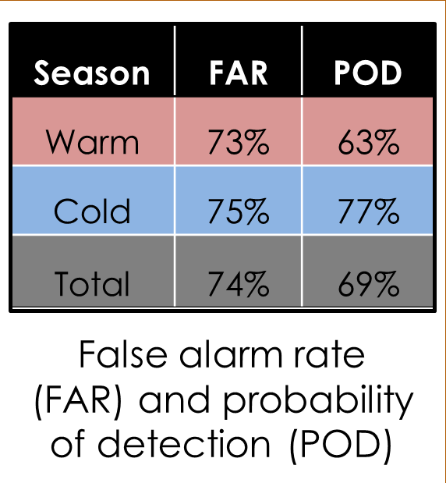
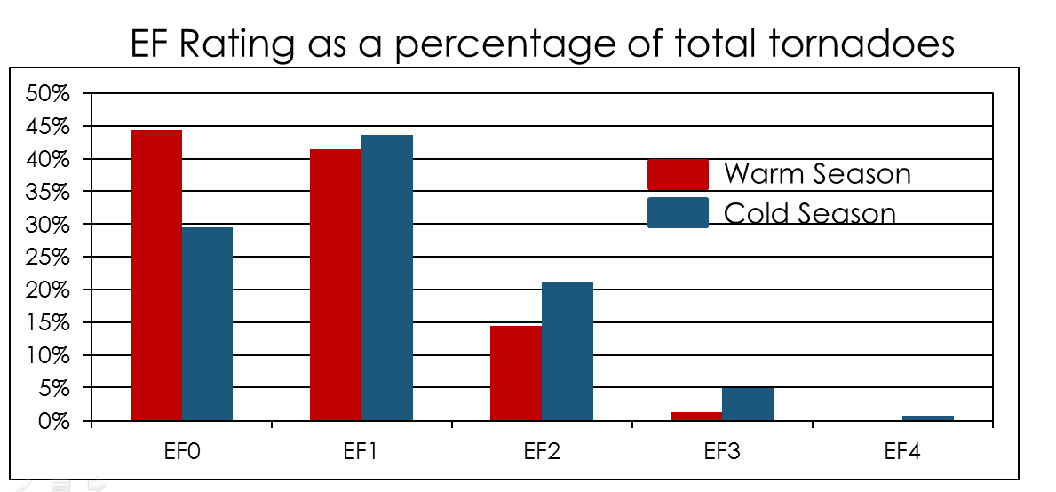
Central US QLCS Study
Notes:
2013 study from Williams et al University of Missouri – Columbia. Study area included much of the midwest from MN to MO yet did not include IWX, GRR, or DTX. However, we expect similar results here based on our 2000-2014 tornado climatology study.

Slide 5
Our Primary Problem
Notes:
Over 95% of our tornadoes are associated with QLCS events

Slide 6
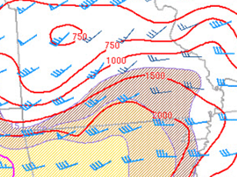
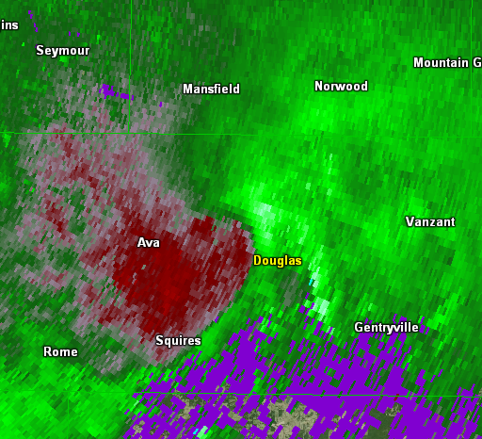
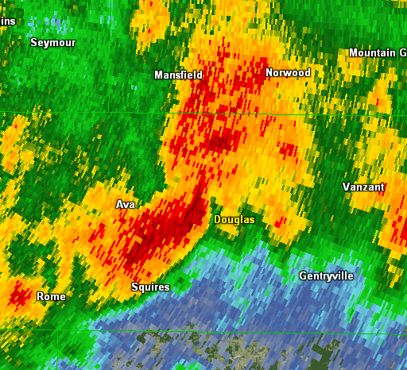
Three Ingredients Method (Schaumann and Przybylinski 2012)
0-3 km Bulk Shear/MLCAPE
0.5° SRM
0.5° Z
Favored Region for
Mesovortex Genesis
UDCZ
SPC Meso Page
0-3 km line-normal bulk shear magnitude ≥ 30 knots
Balanced or slightly shear dominant convective line
RIJ or enhanced outflow causing surge or bow in the line
Notes:
Slide from 2015 NWA Annual Meeting…John Gagan and Jason Schaumann. Focus of this presentation/study is to apply 3 ingredients to this event and re-issue warnings and see how verification stats compare…use it as justification for implementing this methodology at our office.

Slide 7
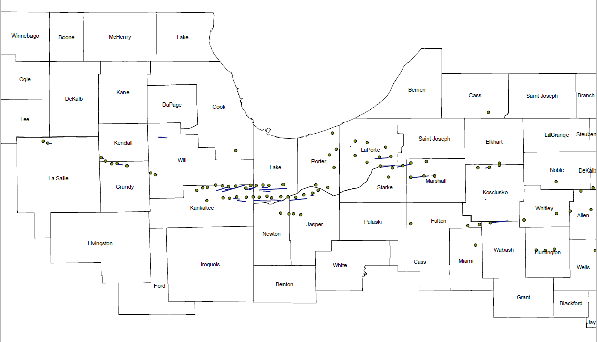
Data Plots of 3 Ingredients
Notes:
Kyle Brown used GIS to plot out data points where ingredients were met with overlay of tornado tracks. Green dots: 3 of 3 ingredients met

Slide 8
Event Overview
Notes:
Lead portion of 1st “Derecho” split and lifted through NW IL/S WI. Split SW flank reorganized, following east through N IL yet outran better shear and became outflow dominant and quickly died over NW IN leaving behind an wsw-ene oriented outflow. New intense convection rapidly developed and intensified back west along prefrontal trough over nrn IL and organized into 2nd “Derecho” which then blasted east through ne IL and nrn IN/srn MI late evening.

Slide 9
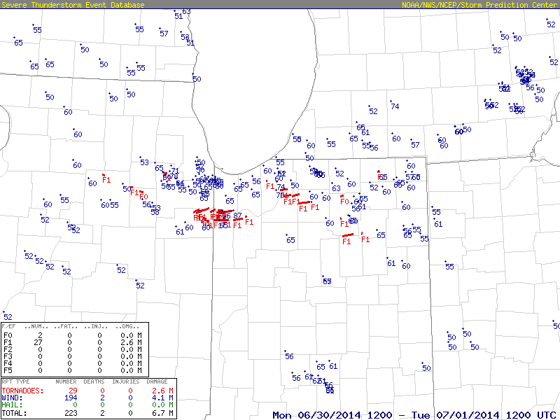
Aftermath
Notes:
18 tornadoes occurred in KLOT CWA. 11 tornadoes in KIWX CWA. All were embedded in strong damaging wind swaths.

Slide 10
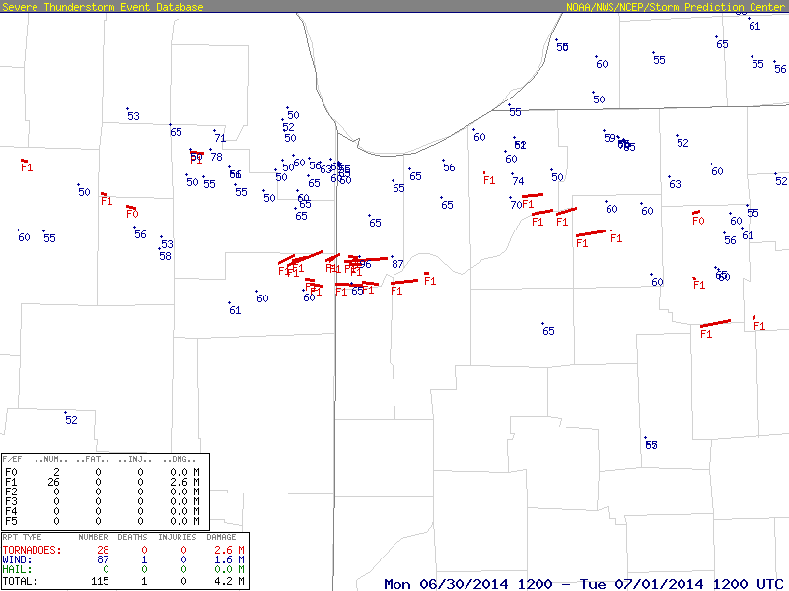
Aftermath
Notes:
18 tornadoes occurred in KLOT CWA. 11 tornadoes in KIWX CWA. Most were coincident with or embedded in strong damaging wind swaths.

Slide 11
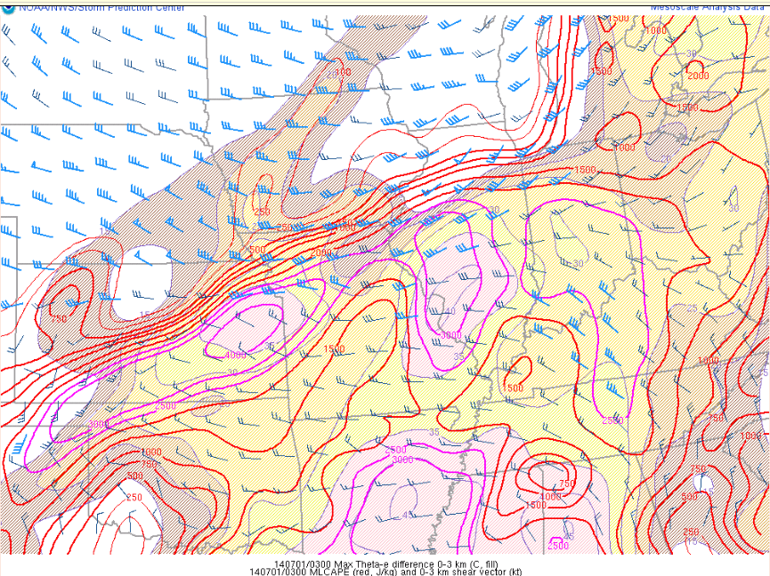
3 Ingredients…Line Normal Shear is Key MLCAPE and 0-3 km Bulk Shear
MLCAPE/0-3 km Bulk Shear
UDCZ Orientation Favoring 0-3 km Bulk Shear Magnitudes ≥ 30 knots
Notes:
Wind vectors aligned NE at 35-40 knots
Notice the CAPE gradient over nrn IL/IN
0-3 km MLCAPE 50-75 J/kg (not shown)

Slide 12
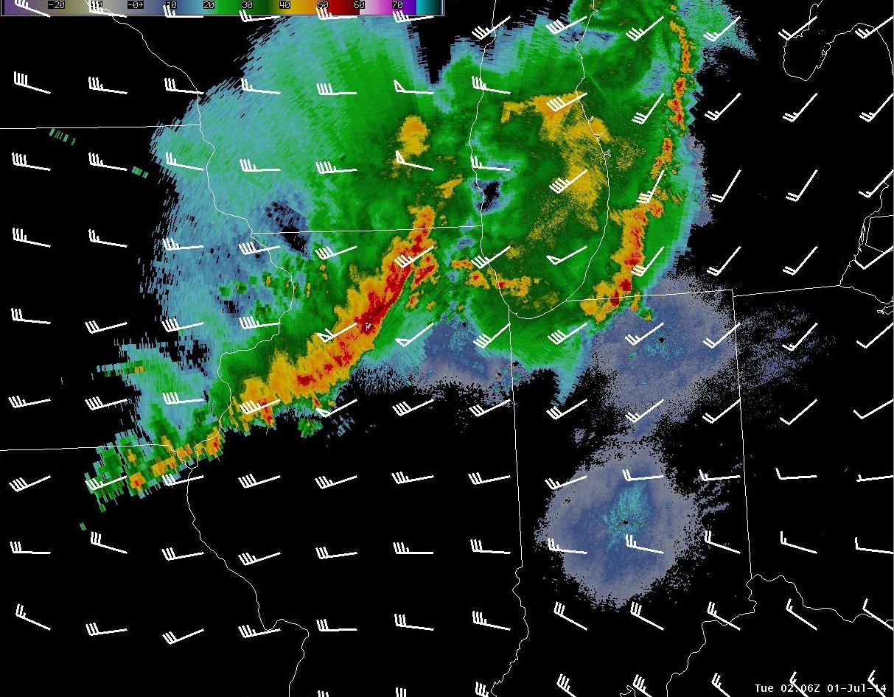
Mesoanalysis
02Z Radar and RUC 03km Bulk Shear
Notes:
0-3km bulk shear vectors w/ radar overlay…notice orientation of vectors which are not favorable with NE/SW oriented line of convection…so will be looking for features along the line that will result in a more line normal orientation NW/SE with respect to bulk shear vectors.

Slide 13
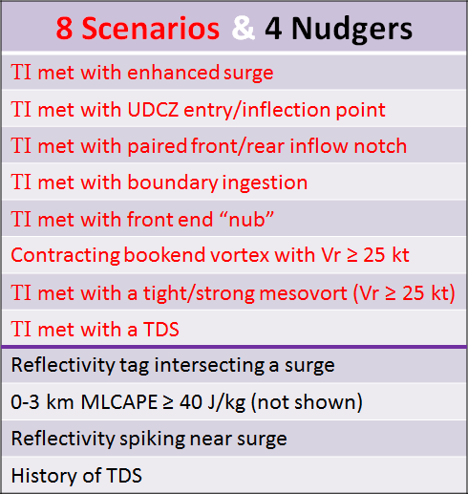
Radar Signatures and Mesoscale Features
Courtesy of Jason Schaumann
Notes:
Radar signatures and mesoscale parameters that increase mesovortex tornado potential. From Jason Schaumann

Slide 14
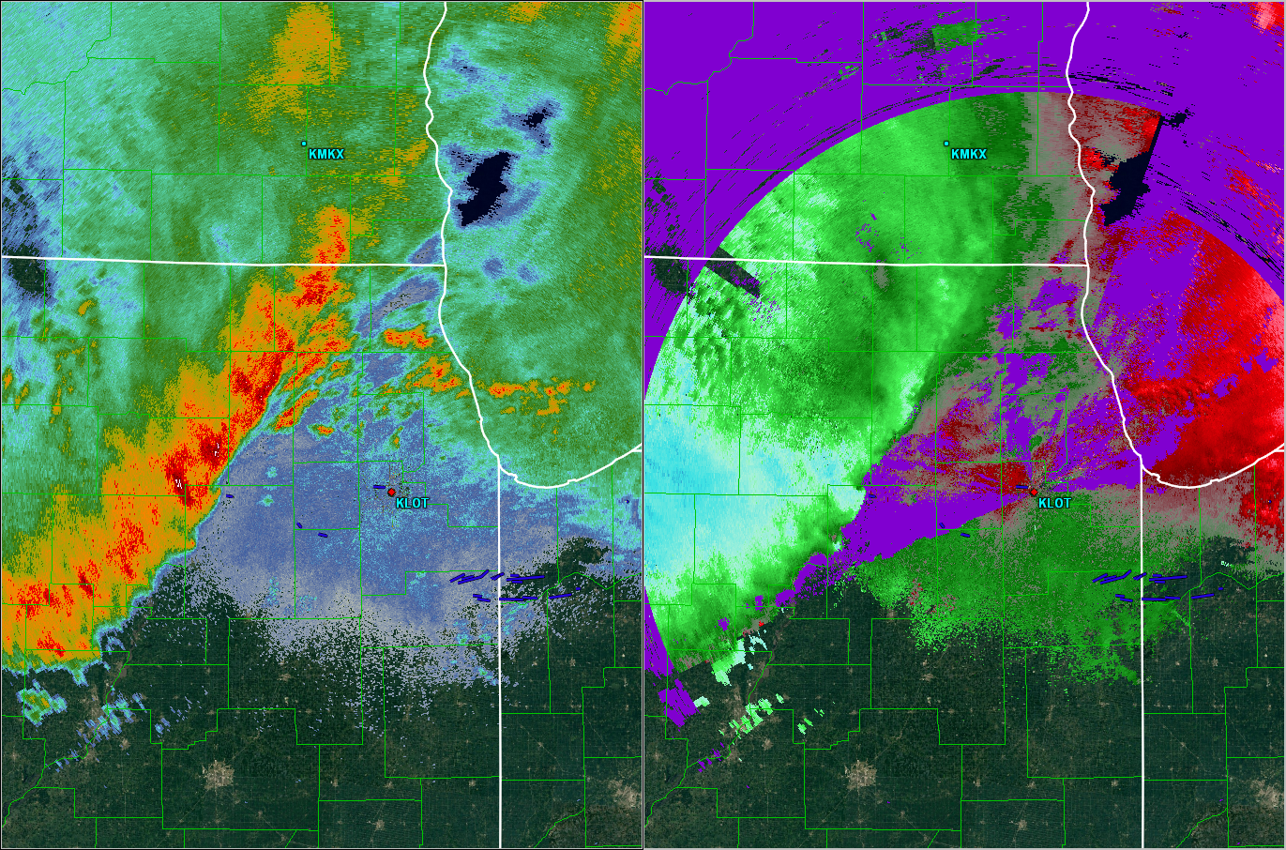
Notes:
Zoomed out KLOT radar with identification of a “front end nub” that is key feature west of KLOT. As with any method, no silver bullet here as other features along the line can lead to potential tornado false alarms.

Slide 15
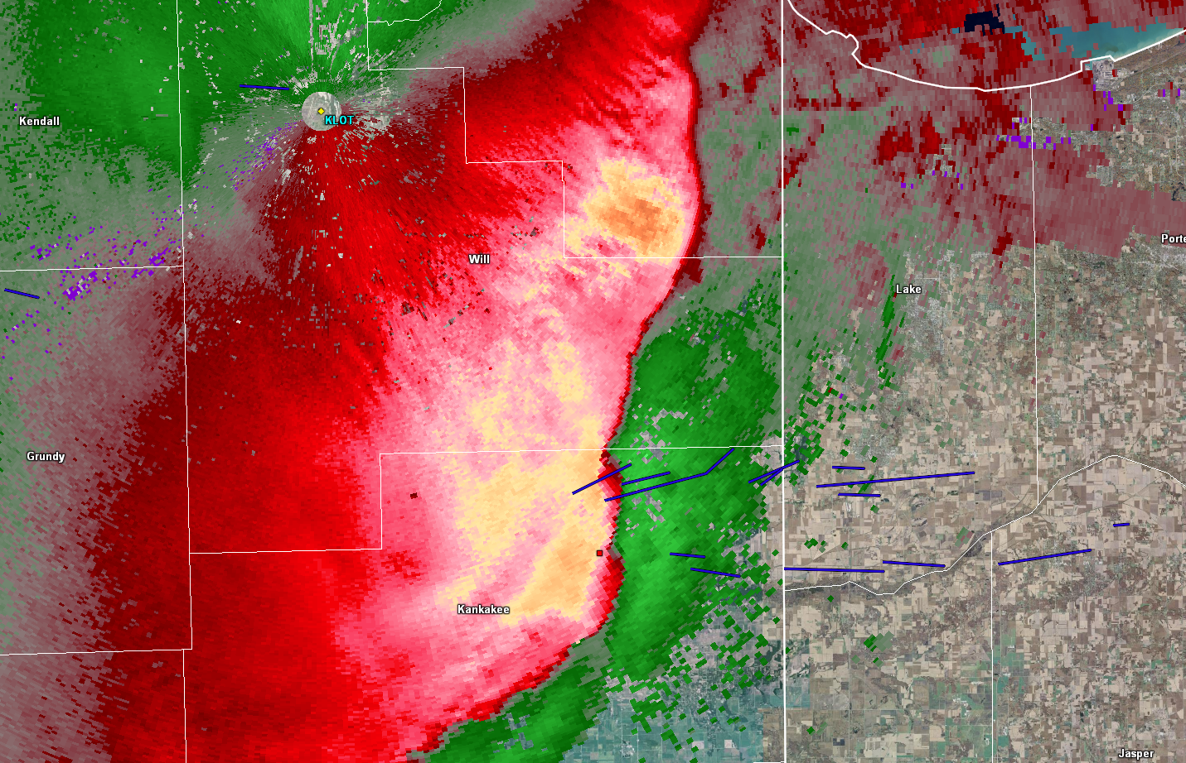
Notes:
2 distinct mesovortices that resulted in the tornado “family” in E IL/NW IN. Note that these 2 mesovorts had favorable orientation wrt 0-3km bulk shear while the KLOT storm continues to surge out while orientation of that feature is not line normal to the bulk shear vector.

Slide 16
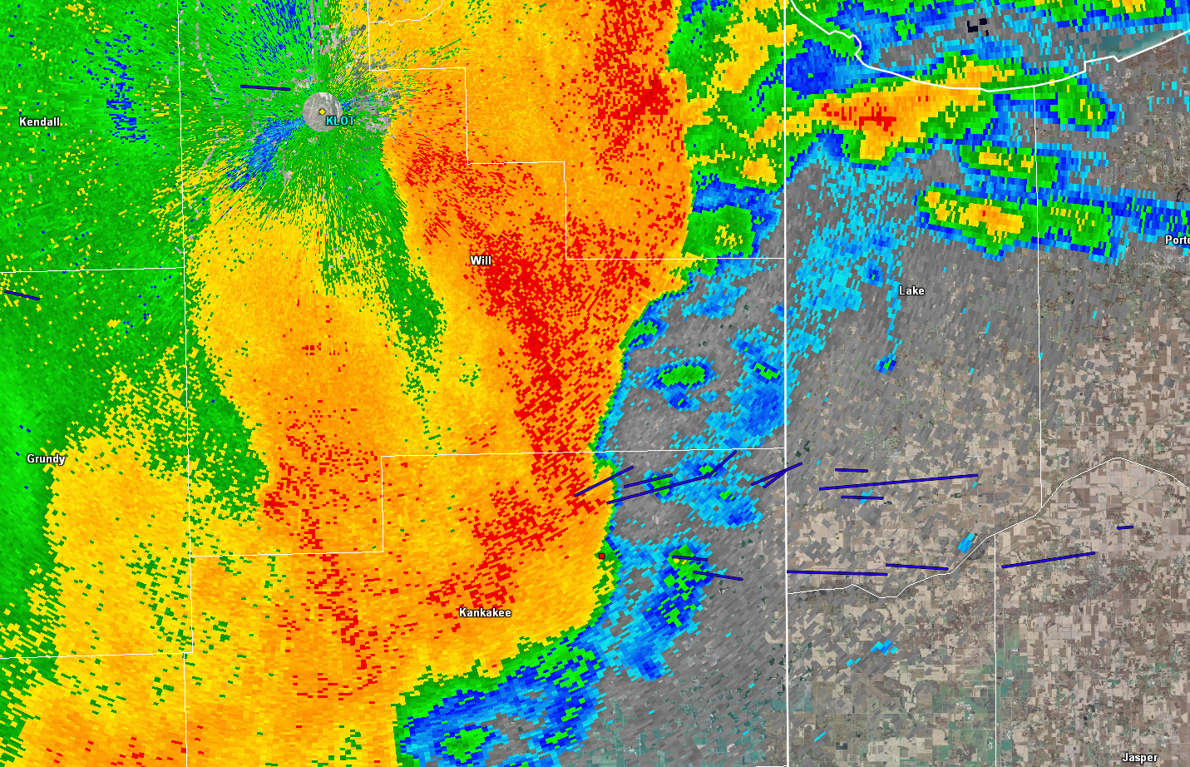
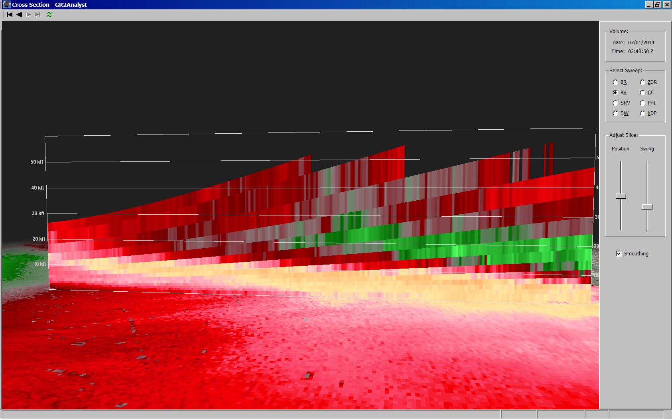
Notes:
Scouring out of reflectivities evident…indicating descending RIJ. Also of note are the new cells going up ahead of the UDCZ…indicating increased convergence via RIJ.

Slide 17
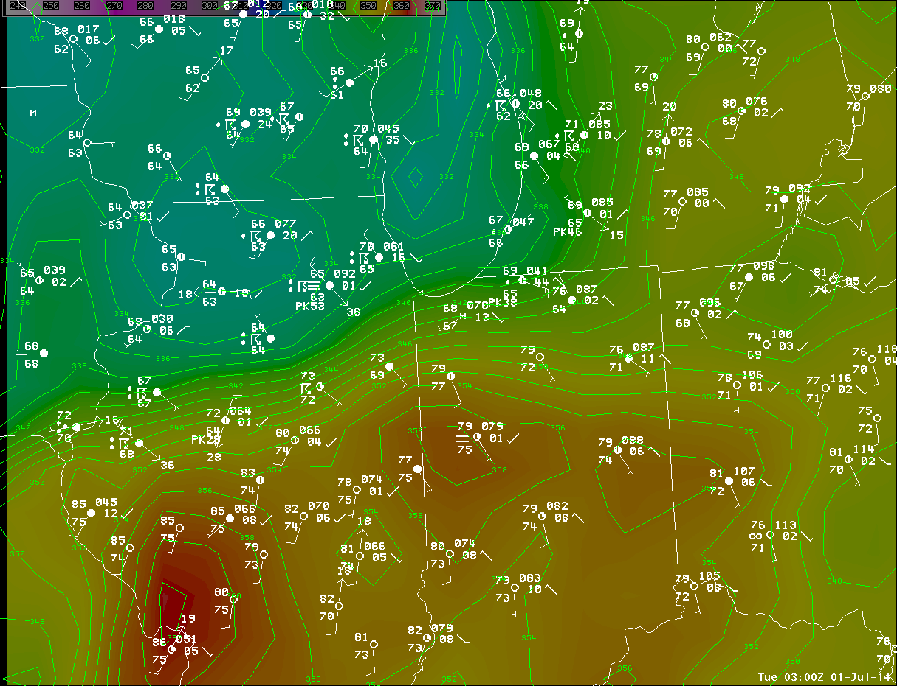
Notes:
Surface obs and Theta-E showing approximate position of mesoscale boundary leftover from outflow of 1st convective line across northeast IL and northwest IN.

Slide 18
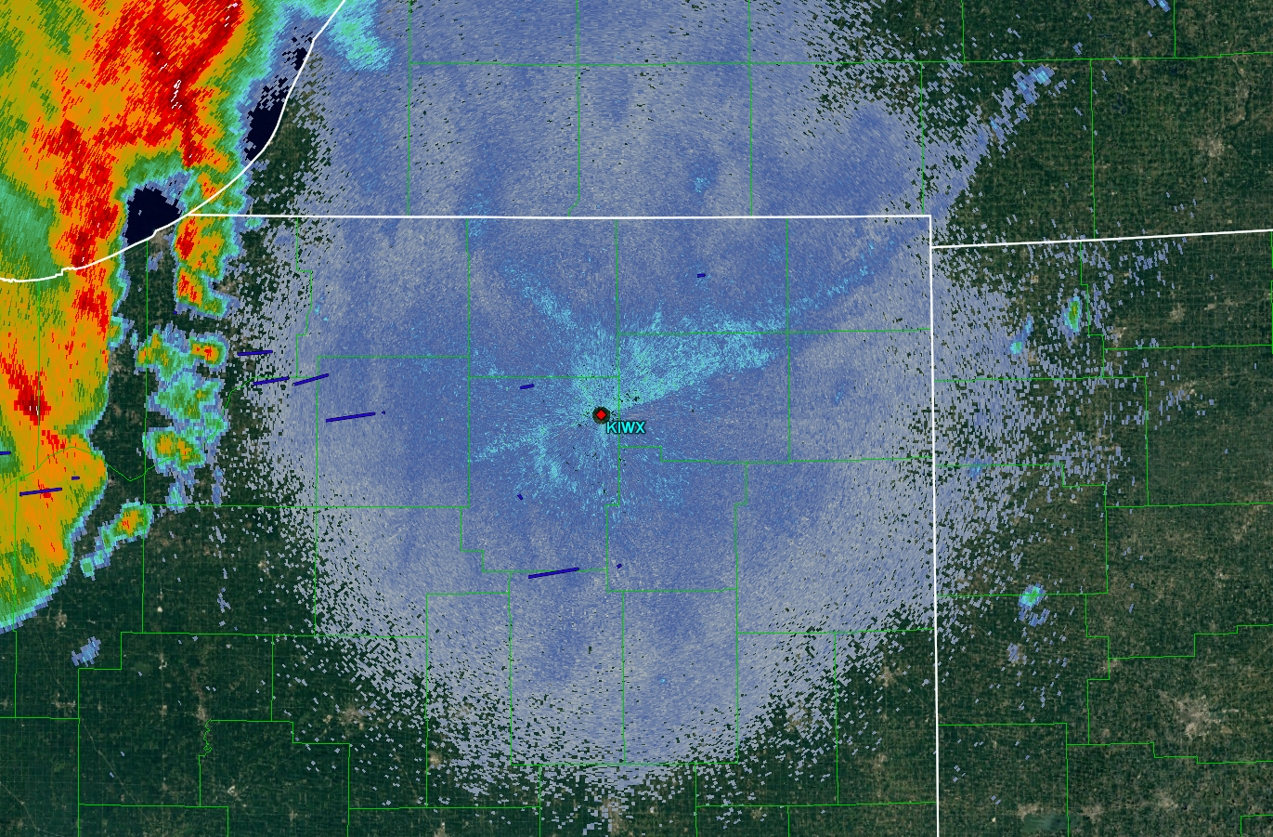
Notes:
Now LOT hands it off to IWX…multiple points of concern to contend with along the line. Note the left over fine line demarcating the outflow boundary which at this time had mixed out to the west.

Slide 19
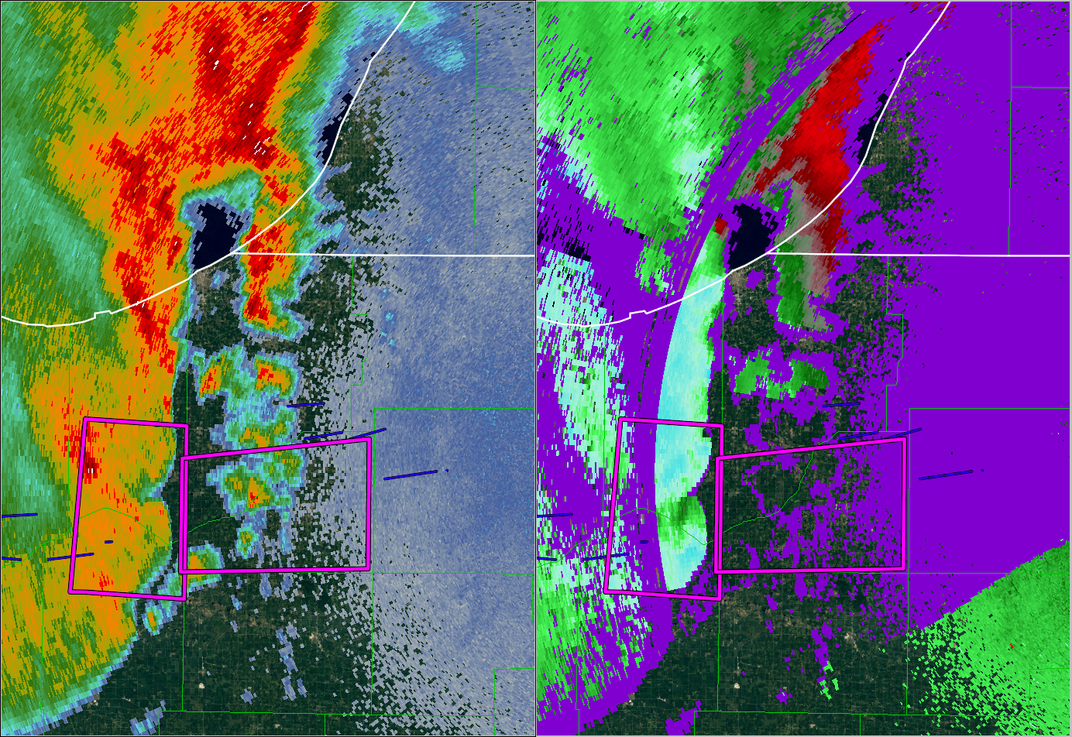
Notes:
Actual TOR polygons issued that night. First one focused on the well-defined inflow notch associated with upstream mesovortex.

Slide 20
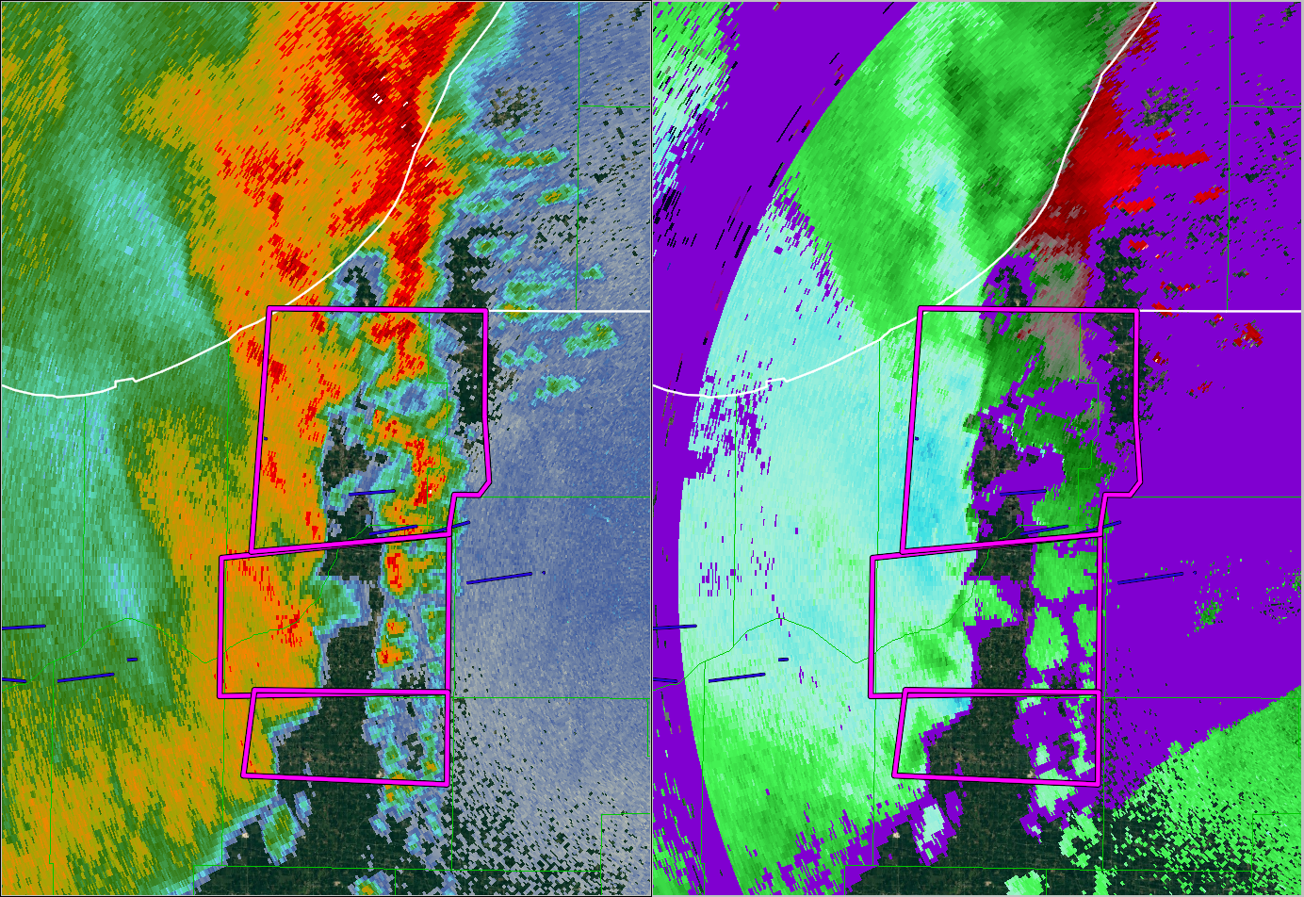
Notes:
Subsequent tornado warning issuances in quick succession. Difficult workload to manage as multiple features/mesovorts to contend with along with fast eastward storm motions. Sectorized warning operations (N/S) employed. Leading storms are non-severe yet featured reflectivity tags indicating presence of a undular bore.

Slide 21
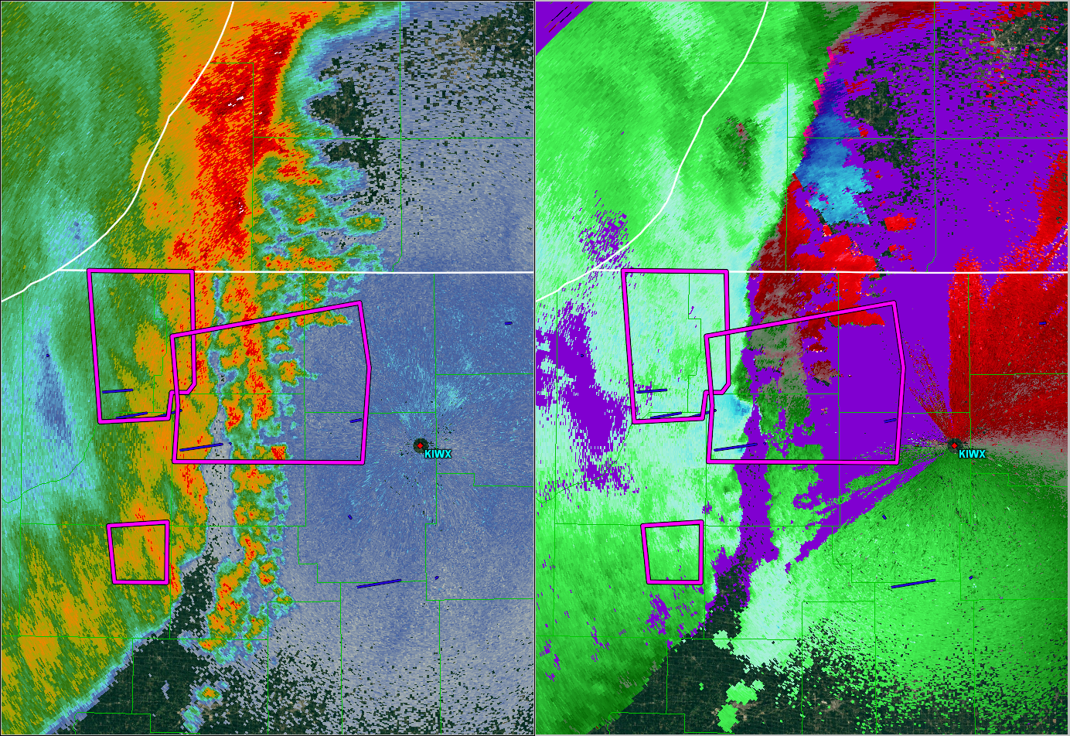
Notes:
Continue warning downstream on strongest mesovortex which did not produce any more tornadoes but did produce a large swath of intense damage down highway 6.

Slide 22
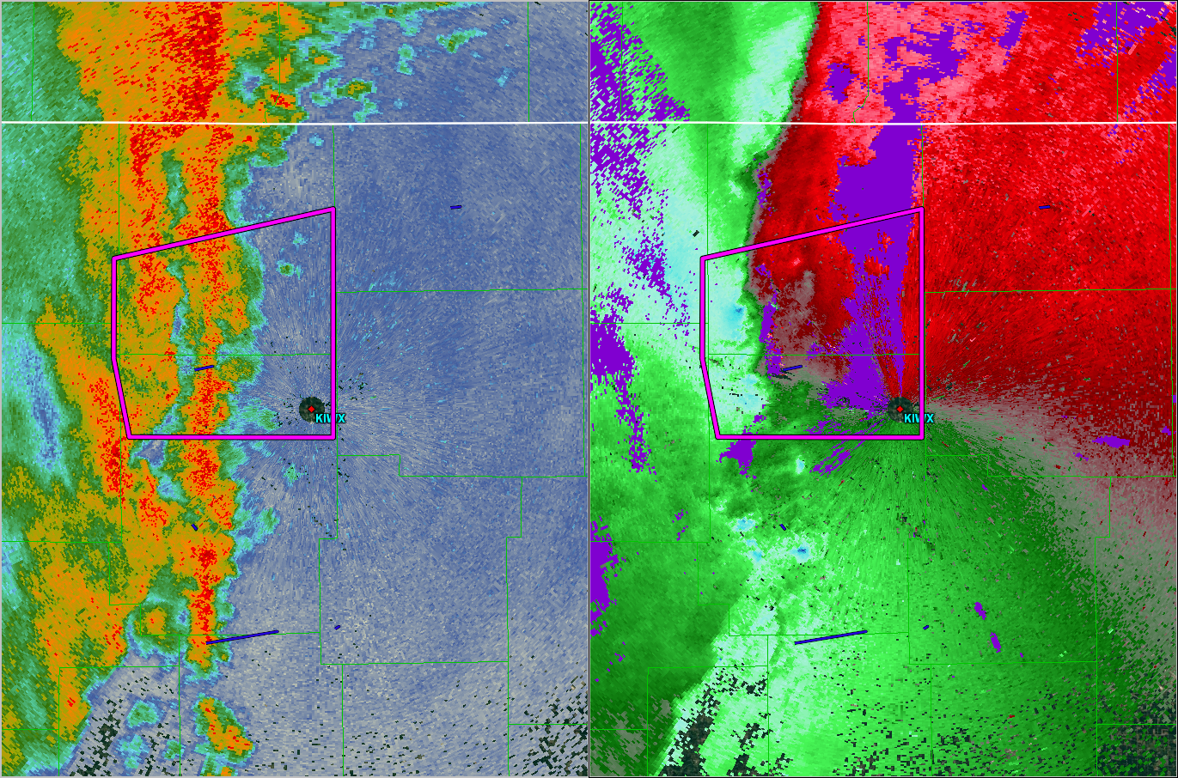
Notes:
Numerous small scale features to interrogate south of the current polygon.

Slide 23
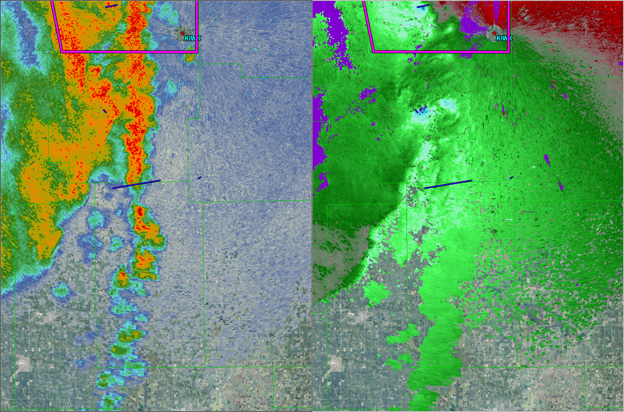
Notes:
Entire area south of the TOR polygon was covered with SVR w/ TOR possible tag which is a good practice in these type of events. No sails at the time and with storm motions in excess of 45kts, you must act fast and anticipate.

Slide 24
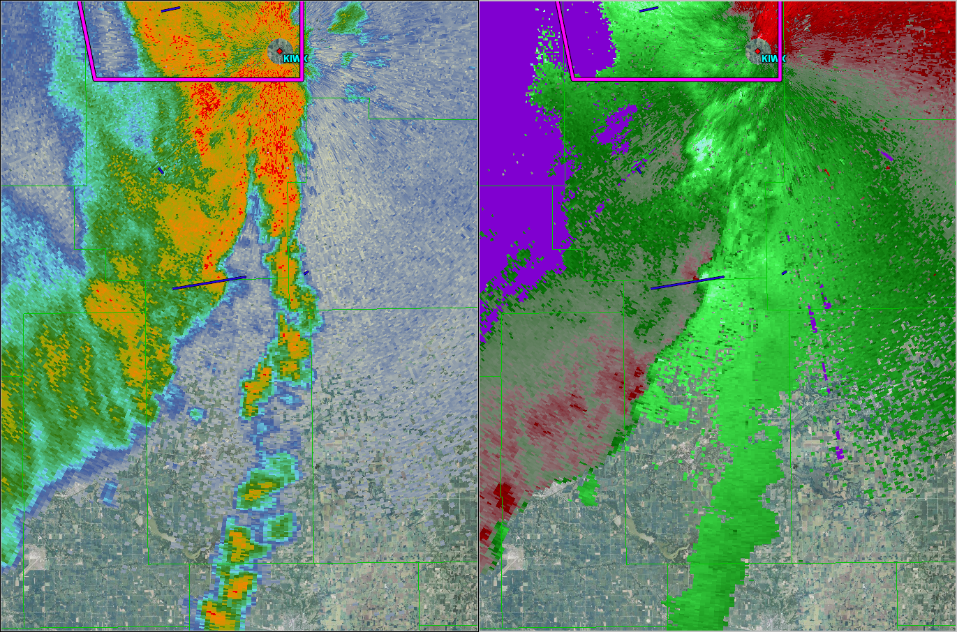
Notes:
Shows the advantage of 3 ingredients method of anticipating mesovortex development, rather than waiting for that “oh crap” moment ;-).

Slide 25
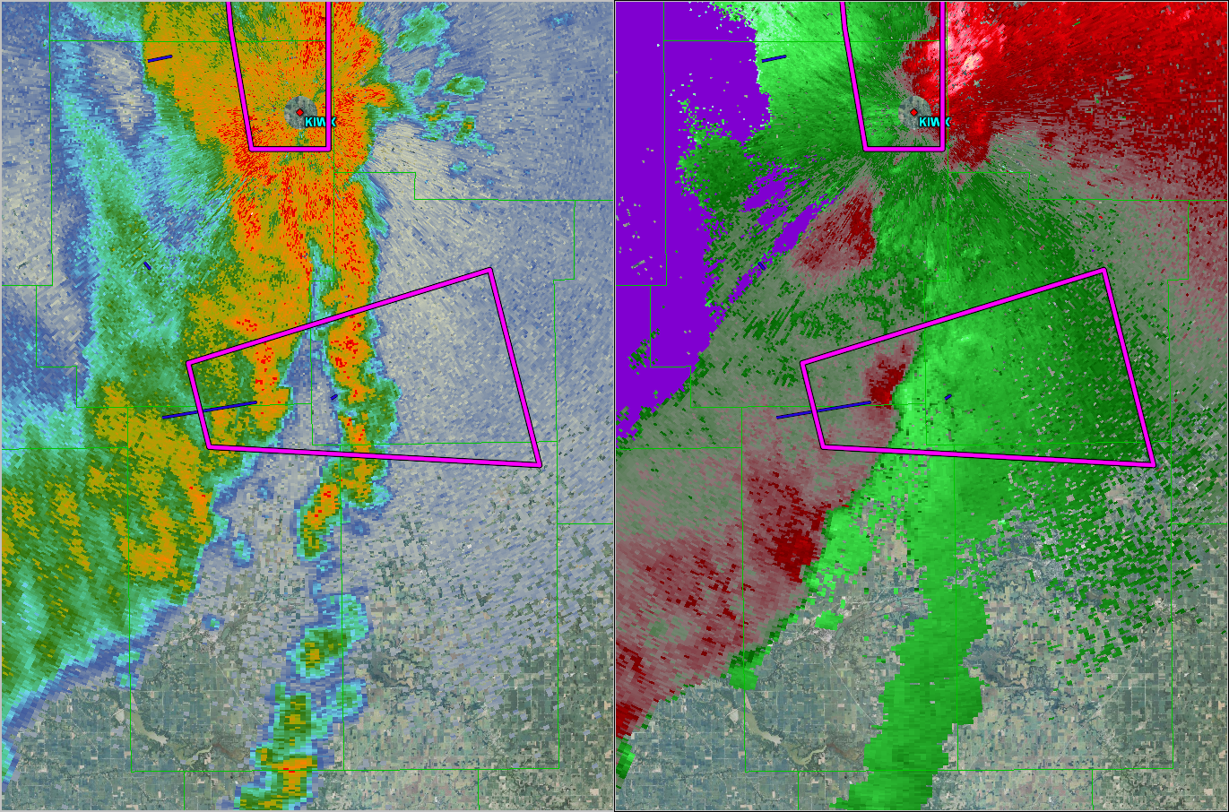
Notes:
Again…numerous possibilities using 3 ingredients method for false alarms as well as hits.

Slide 26
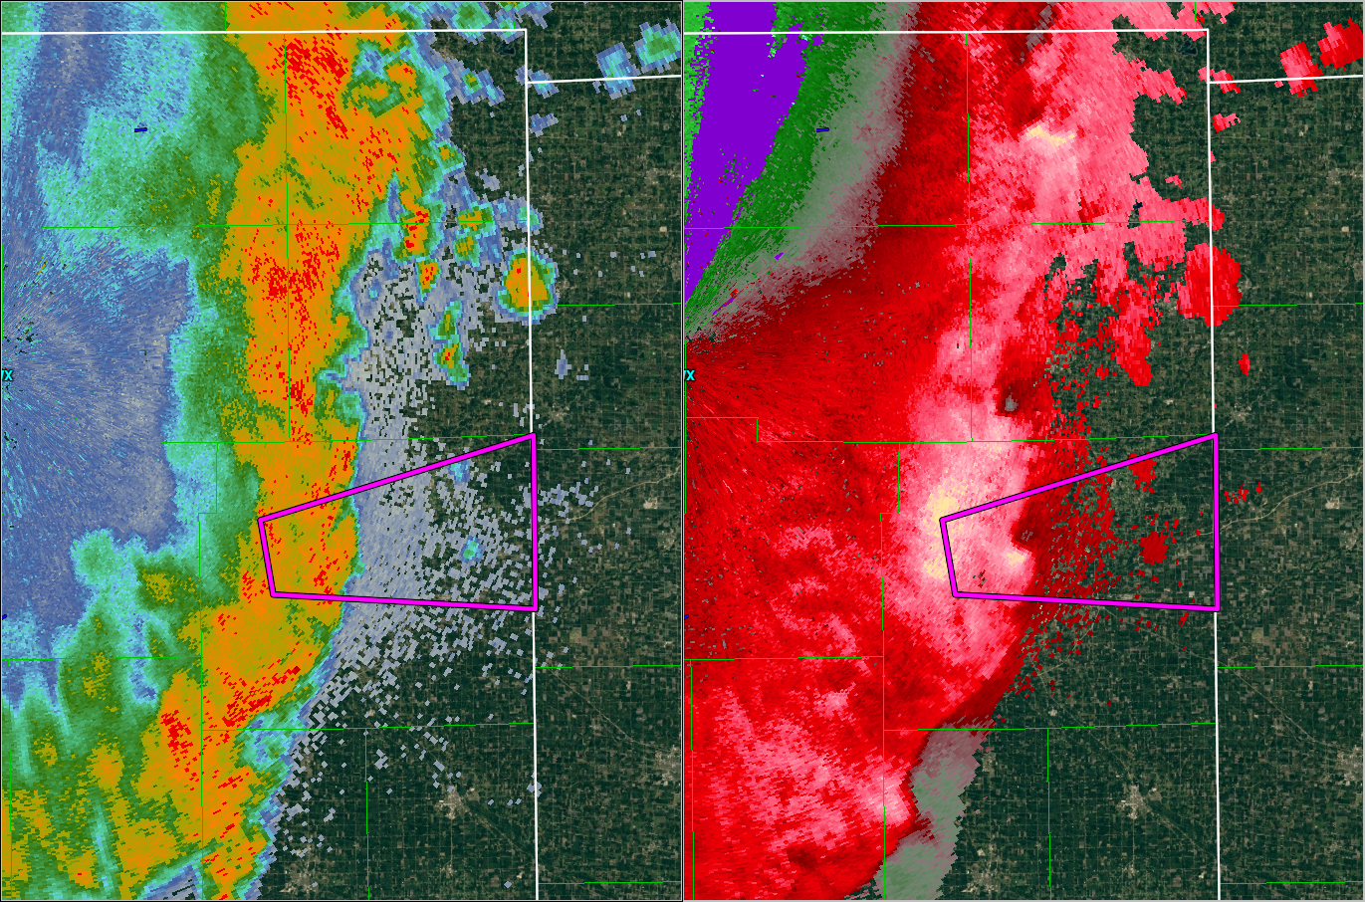
Notes:
Line continued east with multiple mesovortices noted…however none of these resulted in additional tornadoes. Many did however produce wind damage.
Contrast our subtle signatures with LOT’s textbook signatures.

Slide 27
So how did TI do?
Notes:
Simulated event stats out performed real-time events stats based on meeting all 3 ingredients. Note though that while simu FAR is still fairly high, it is better than real event. Leadtime for simulated warnings was expected to be lower given warnings were not issued until 3 ingredients were met. Otherwise event was favorably anticipated in real-time. Addition of meso-sails will yield additional leadtime in future events.

Slide 28
Lessons Learned
Anticipation
Lead convective line modified boundary layer
Outflow boundary interaction with mesovorticies
Communication and Damage Surveys
EM’s in most affected counties were overwhelmed
Many were unaware of significant damage outside local area
Post event liaison (incident commander) needed
Media interviews, EM contact, Direct survey effort
Difficult Damage Surveys
Complicated by widespread wind damage swaths
Tornado tracks were embedded in or just north
Lack of DI’s as most tracks were over rural farmground
Notes:
Don’t wait for EM confirmations for events such as this one as they were overwhelmed from the extensive, widespread wind damage that occurred to population centers. Most were unaware of tornadoes in their respective counties…

Slide 29
Storm Surveys
NSSL rotational tracks are used as a first guess to potential tornadic track damage areas
GR2 data loaded on laptop is then used in the field to precisely locate potential damage tracks
Criss-cross suspect couplet paths for damage
Can be a tiring process for long track features
However significant damage can be missed which can otherwise affect final EF scale rating and tornado count
Tornado paths most often begin proximal to beginning or ending of microburst/macroburst wind damage swaths
Additional surveys may be needed
Notes:
Don’t wait for EM confirmations for events such as this one as they were overwhelmed from the extensive, widespread wind damage that occurred to population centers. Most were unaware of tornadoes in their respective counties…

Slide 30
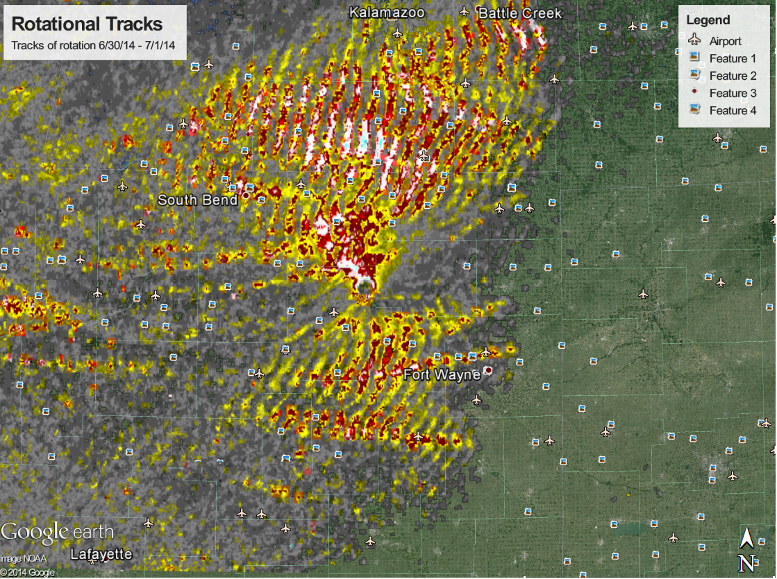
Where do we start?
Notes:
NSSL rotational tracks are generally too messy in QLCS events to be of much use. Instead use GR2 and archived data on a laptop in the field to criss-cross the rotational couplet tracks.

Slide 31
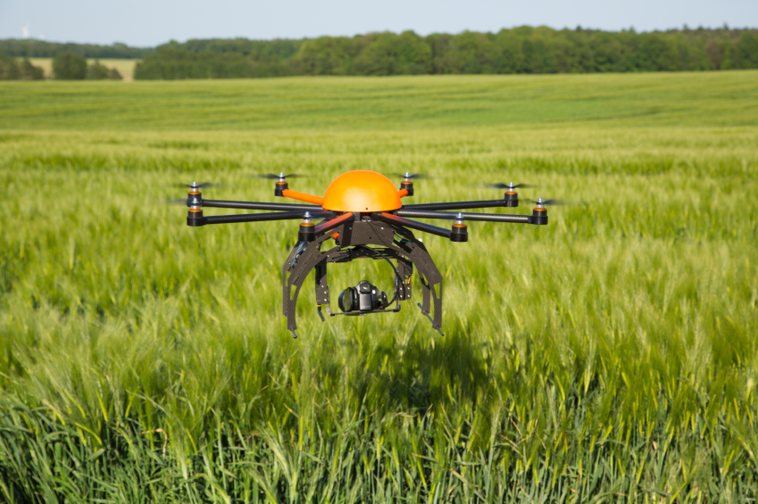
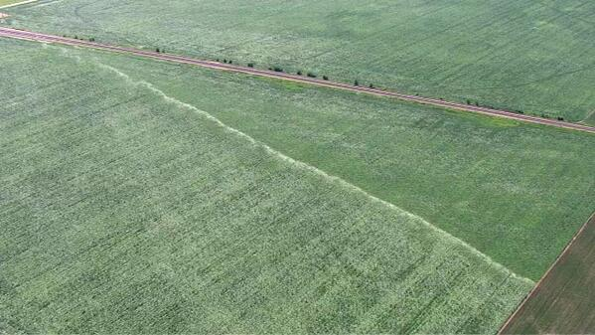
“The Future”
Notes:
Drone imagery will give us an “eye in the sky” ability to quickly discern wind versus tornado damage at ground level in both forest and crop land. In addition, drones will allow us to go into areas that are inaccessible by vehicle or on foot.

Slide 32
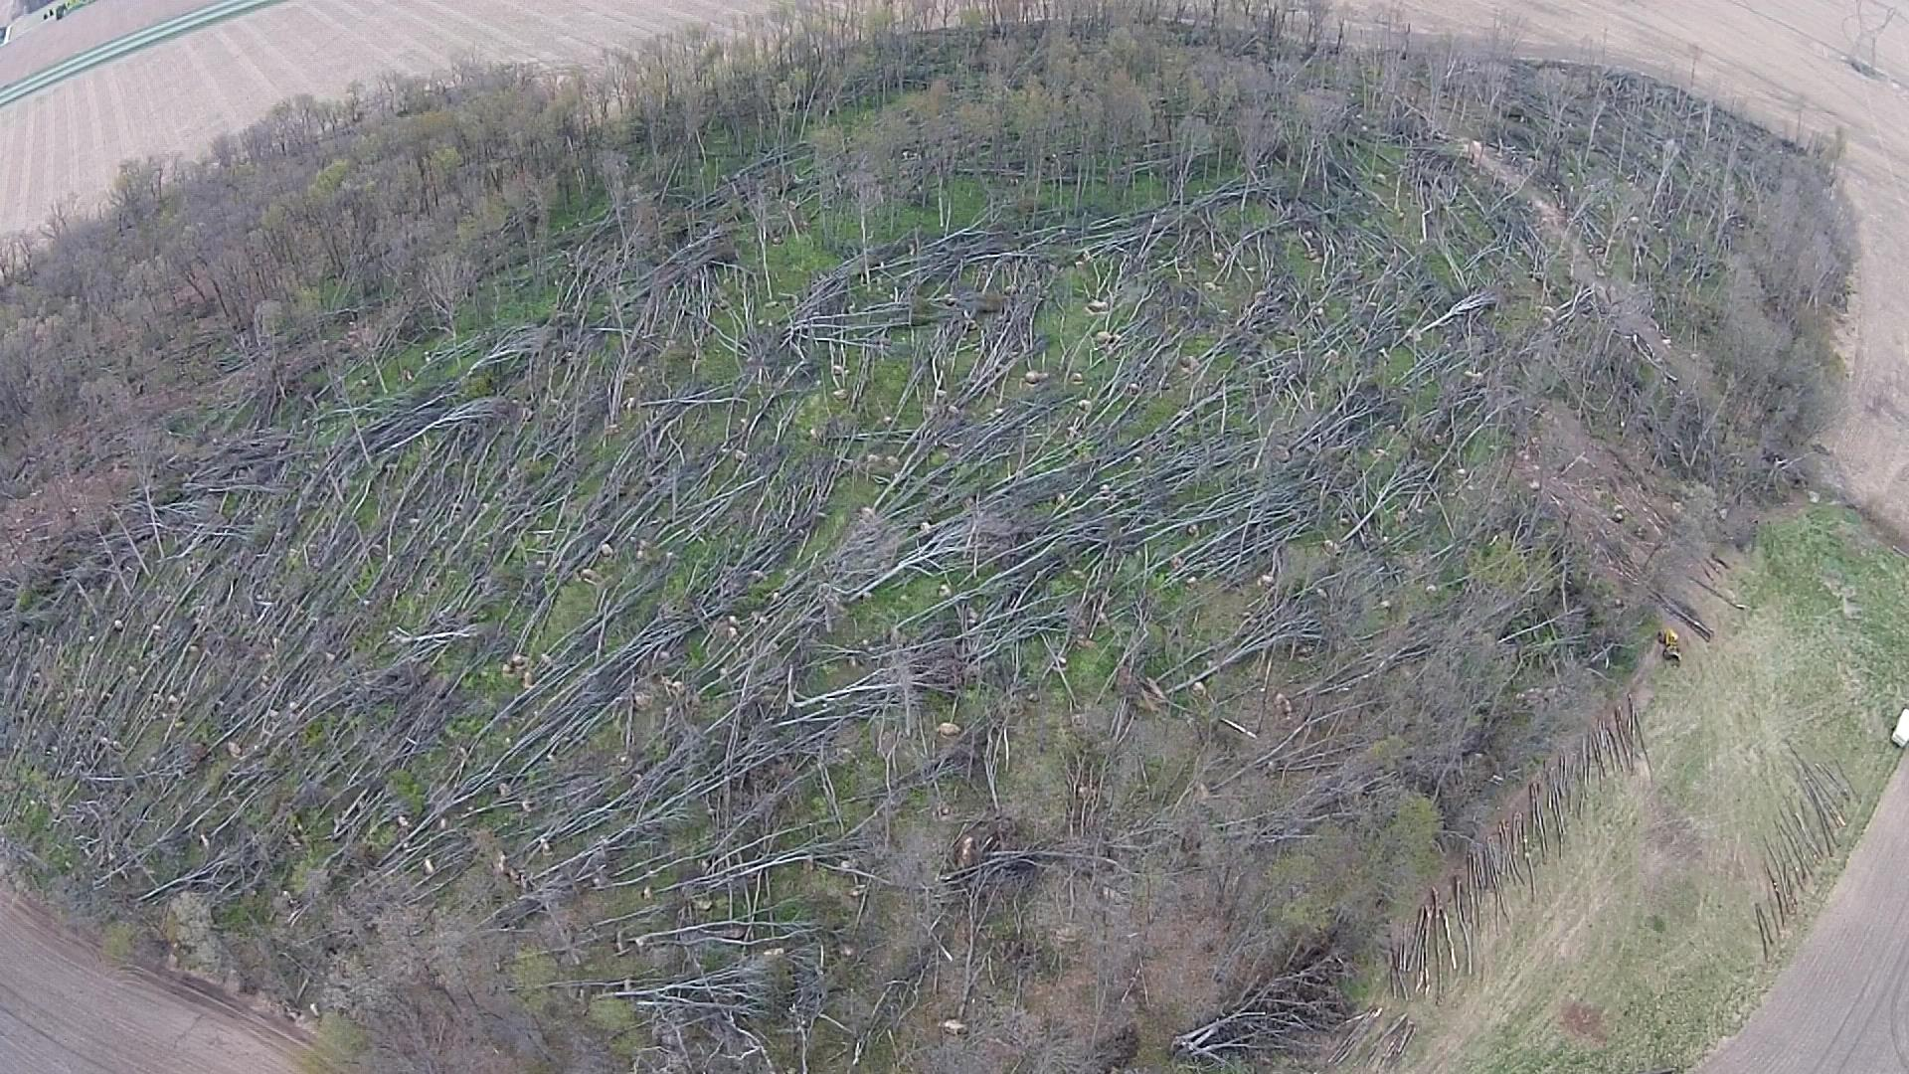
“We could have seen this…”
Notes:
Just northwest of Hanna in Laporte county. Note US 30 in top left corner. Damage was not seen as it lay in middle of section nor discovered until the following spring (April 2015).

Slide 33
Improvements/Future Work
Incorporated training on 3 Ingredients methodology which has been implemented operationally
Provide feedback and verification to CR Tornado Warning Improvement Project
FAR reduction and Improved IBW science
Modify verification methods?
Meso-SAILS
Even more temporal resolution: 75-95 sec update time with SAILSx3
Critical in detecting rapidly evolving low level signatures embedded within QLCS
Reconfigured Operations Area
Side by side warning desks for sectorized warning operations
Double the eyes!
Foster what if scenarios
Shared workload
Notes:
TWIP notes here with modified verification methods concerning EF0-1 tornadoes. If you want FAR reduced, let us issue severe with tor possible tag warnings. Meso-sails will improve the 3 ingredients based approach and yield additional leadtime in future events.

Slide 34
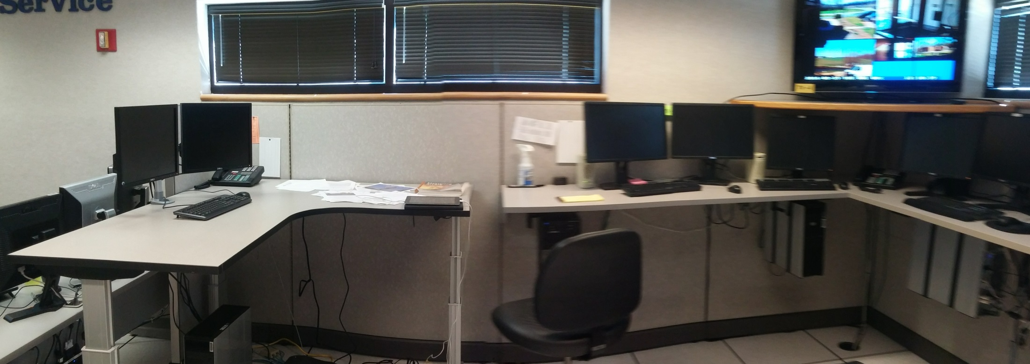
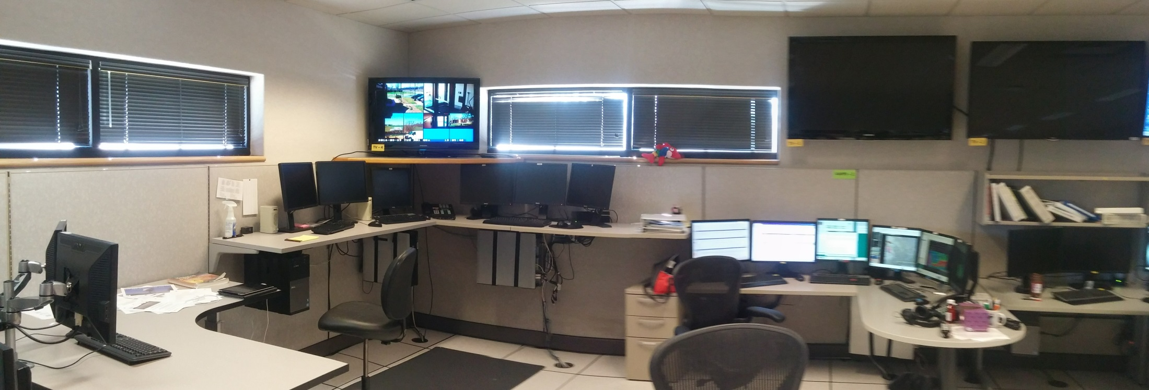
Notes:
Take new picture!

Slide 35
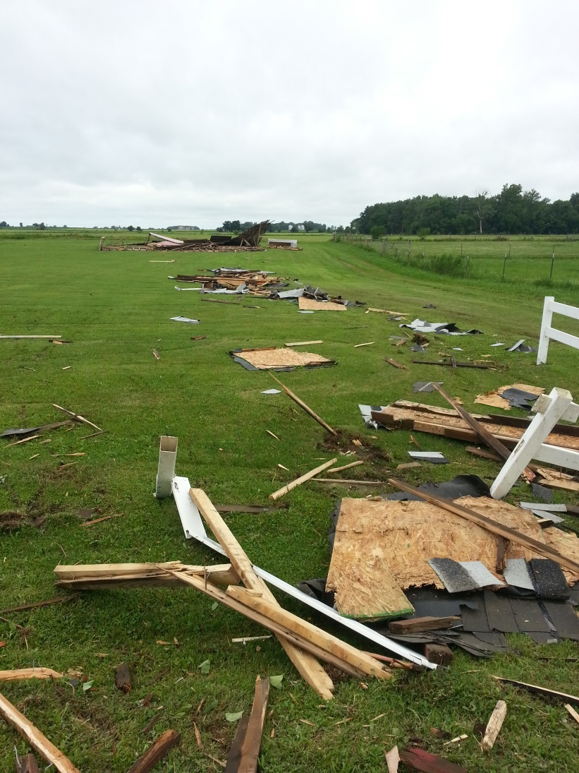
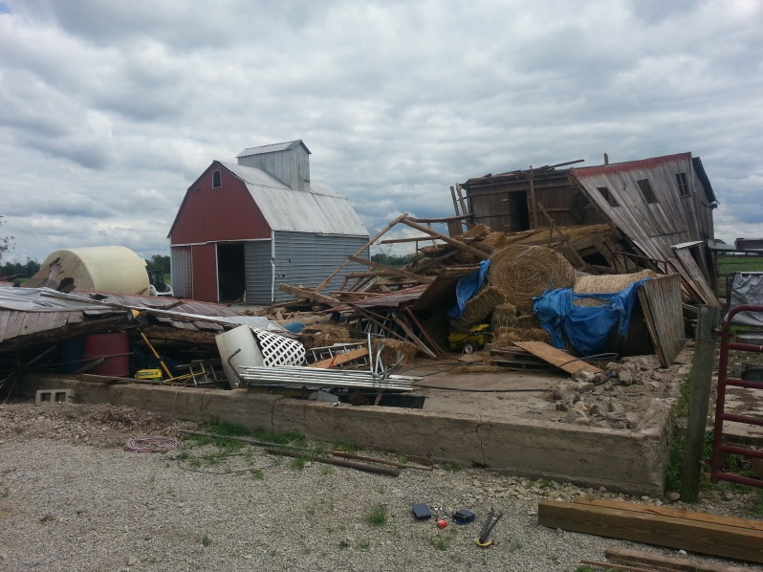
Questions?
Todd.holsten@noaa.gov

