Slide 1
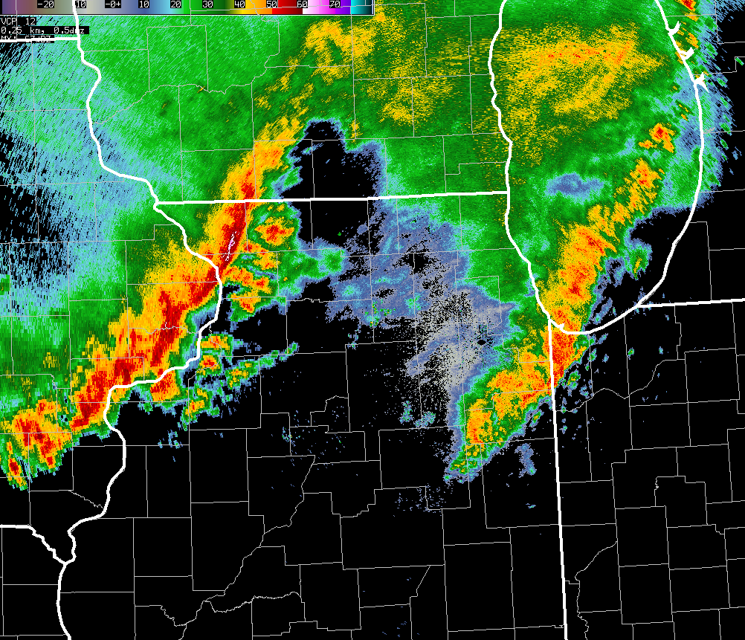
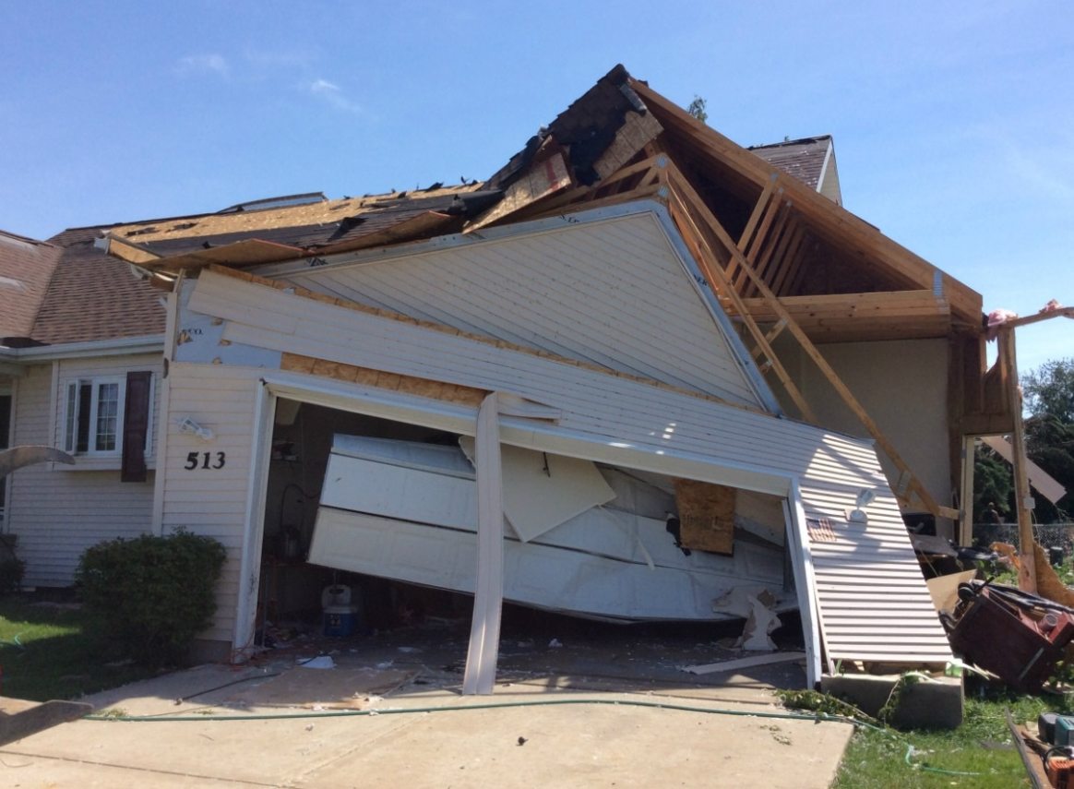
Evolution of the
30 June 2014
Double Derecho Event
in Northern Illinois & Northwest Indiana
Matthew Friedlein,
Richard Castro, & Eric Lenning
National Weather Service – Chicago, IL
Anthony Lyza & Kevin Knupp
Atmospheric Sciences Department, University of Alabama in Huntsville
3rd Bow Echo Workshop: March 9-10, 2017

Slide 2
June 30th - What happened: Storm reports and tornado count per derecho on a regional level.
The close proximity in time.
The second derecho clearly more prolific tornado producer in IL/IN.
Derecho and QLCS climatology
Not a surprise where this occurred
Such rapid succession not observed before though
Synoptic pattern and ingredients of the event
Multiple SPC mesoanalysis images and composite graphics
Prior to first derecho, in-between, during second
Observed 00Z sounding and RAP sounding a few hours later
The effect of the first derecho on the second
Start a transition to mesoscale here with some focus on the outflow modulated theta-e boundary (LOT CWA emphasis)
Operational notes - ability to recognize this enhanced tornado threat. (LOT CWA emphasis)
Outline
Event overview
Two derechos in close proximity and time
What climatology says
Synoptic environment of the event
Mesoscale modulation in-between
How the first derecho helped the second
Takeaways
Detecting storm scale factors and assessing impacts to convection

Slide 3
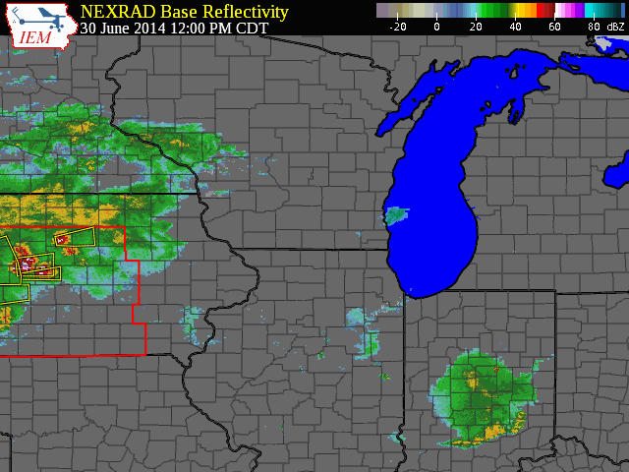

Slide 4
30 June 2014: Severe Weather Reports
First Derecho
Time: 1:45 pm – 7:30 pm CDT
Wind: 112
Tornadoes: 2
Hail: 28
Second Derecho
Time: 8 pm – 2 am CDT
Wind: 119
Tornadoes: 29
Hail: 3
3 documented tornadoes and dozens of hail reports prior to derecho initiation in Iowa.

Slide 5
30 June 2014: Severe Weather Reports
Proposed Revision
Forward propagating MCS
Bow echo(es) with mesoscale vortices and/or rear-inflow jets
Consistent damage t least 100 km wide (~60 miles) and 650 km (400 miles) long
Wind damage occurring once organized cold pool has developed
(Corfidi et al. 2016)
Derecho Definition:
Swath of wind damage for more than 400 km (250 miles)
Wind gusts of 50 kt (58 mph)+ along its path
Gusts of 64 kt (75 mph) or greater regularly along its path
(Johns & Hirt 1987)

Slide 6
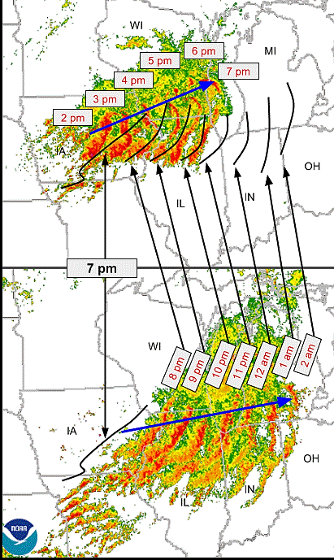
30 June 2014: Another View
Courtesy of Greg Carbin (WPC)

Slide 7
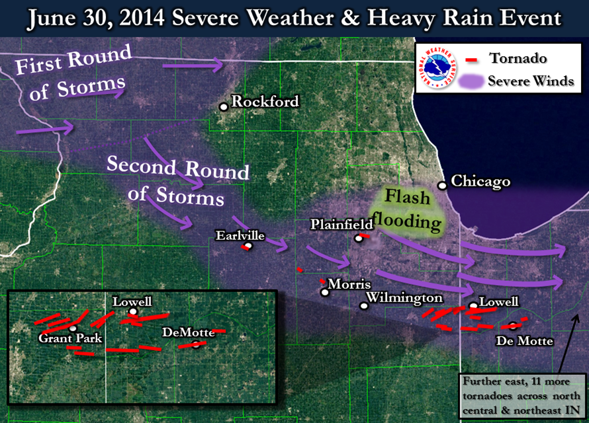
30 June 2014: Northern Illinois & Northwest Indiana Impacts

Slide 8
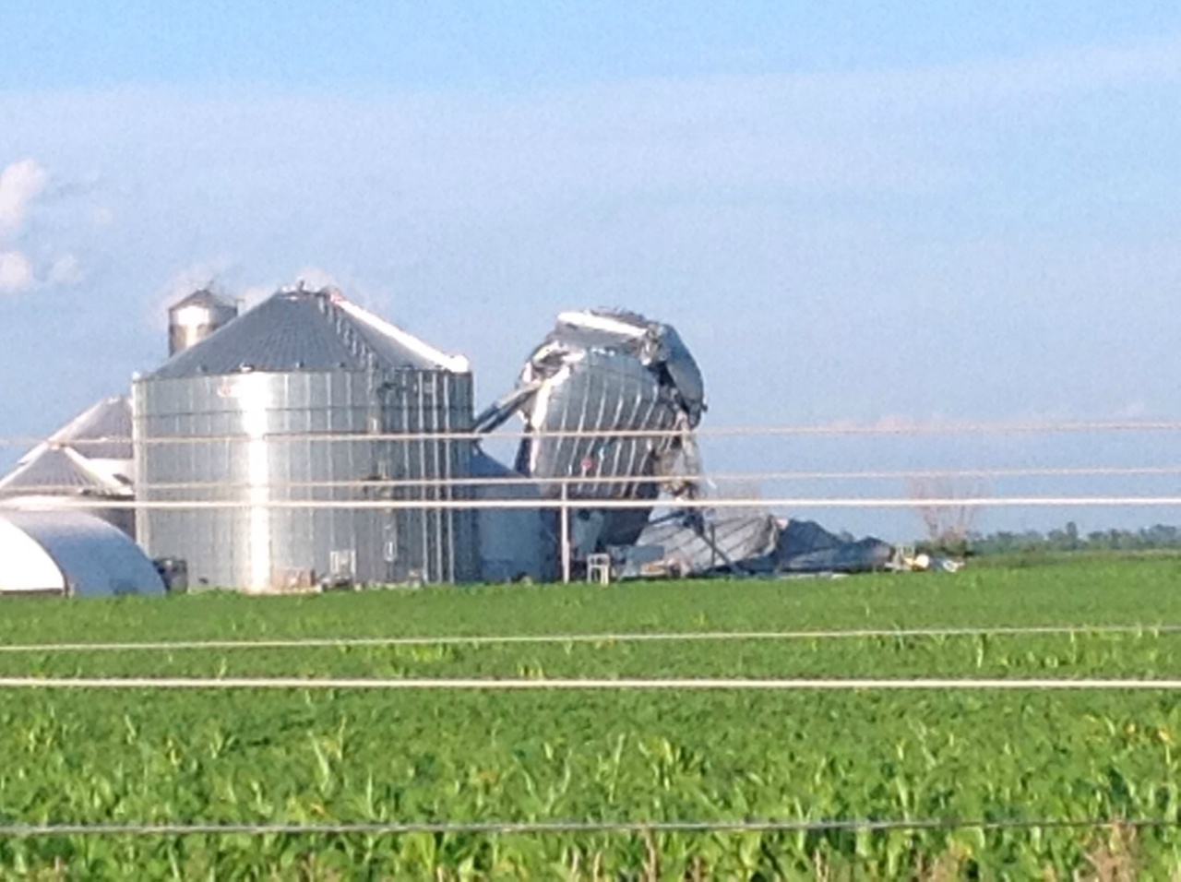
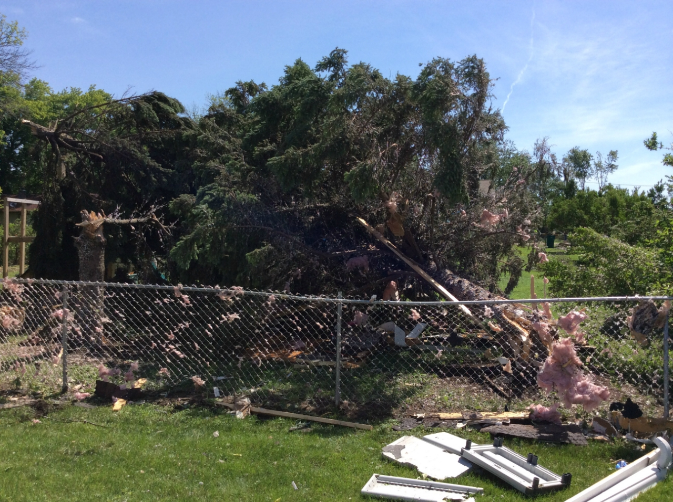
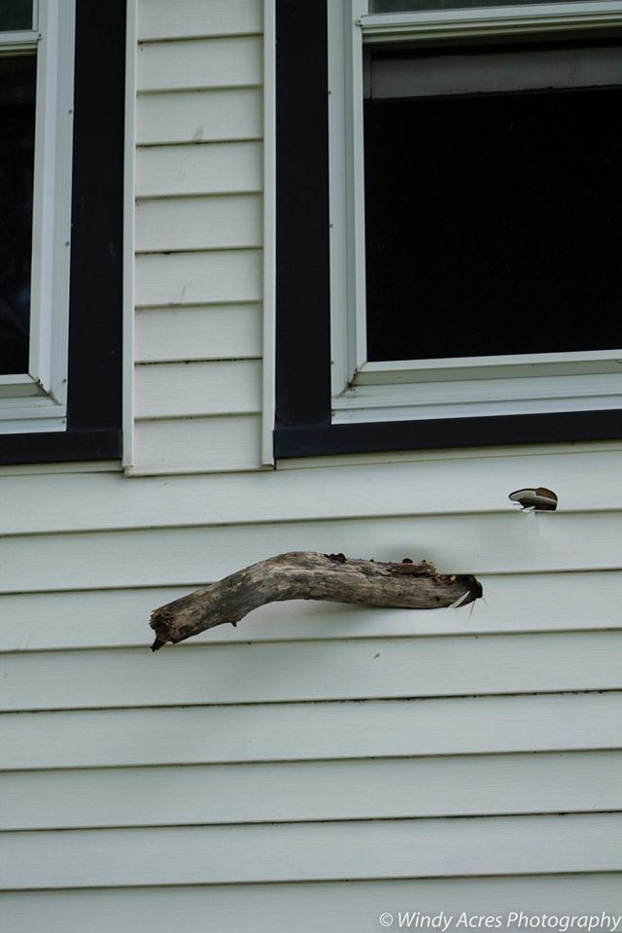
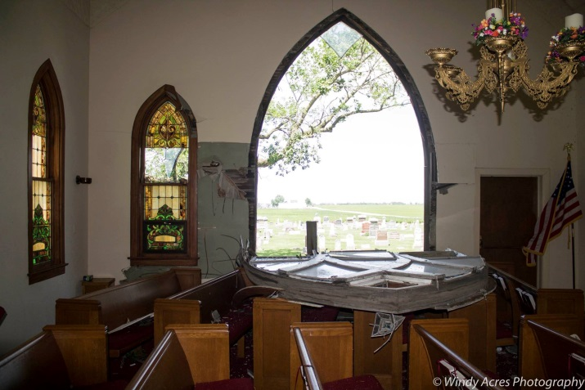
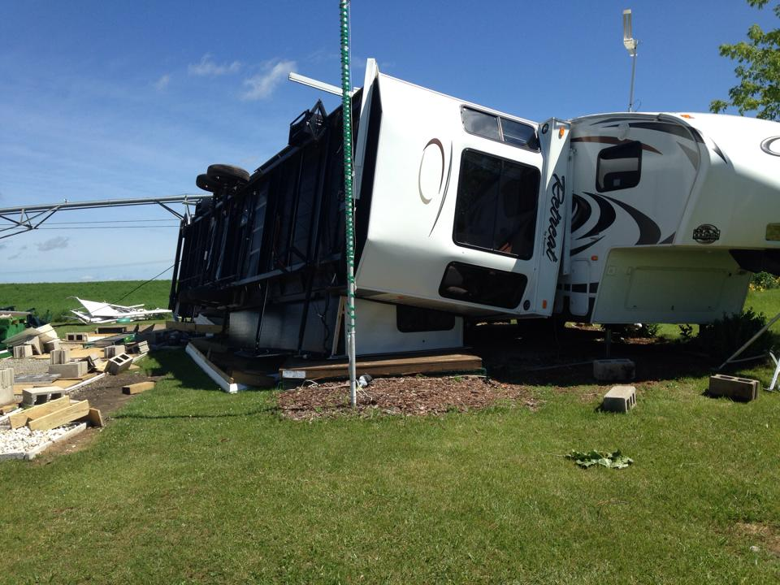
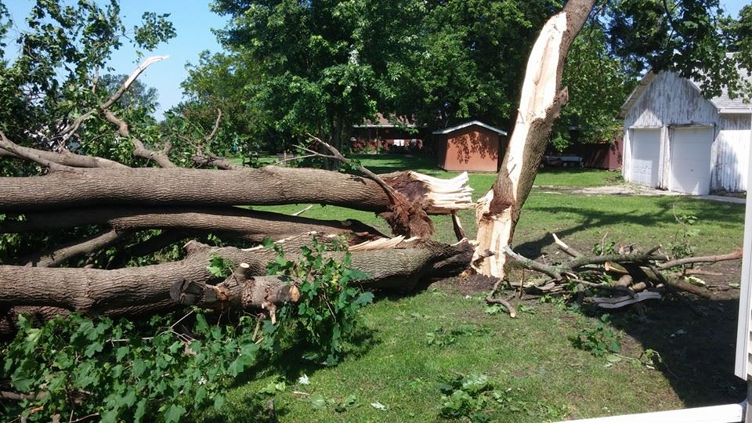

Slide 10
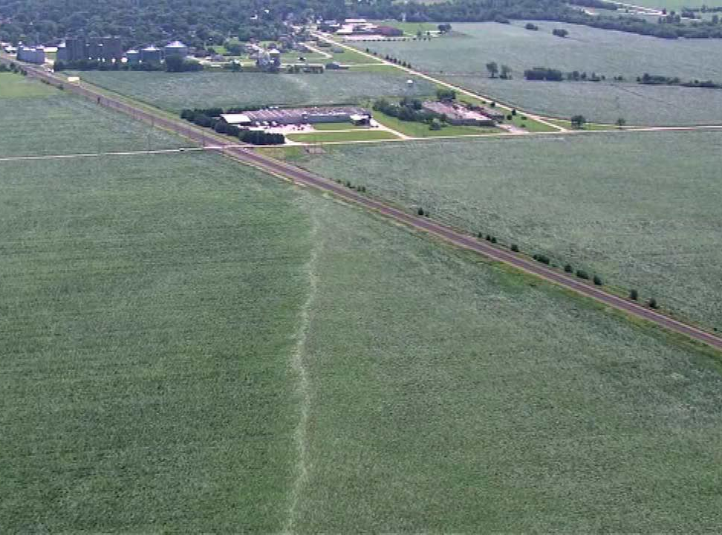
Courtesy of ABC7 Chicago
Earlville, IL
First Tornado of Second Derecho

Slide 11
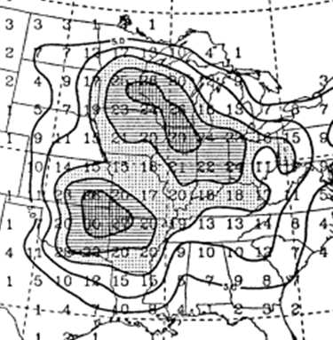
Warm Season Derechos and QLCS Tornadoes
in Northern Illinois & Northern Indiana
Progressive Derecho Climatology
Relative Frequency of Summer QLCS Tornadoes to All Summer Tornadoes
Warm Season Derecho Climatology
1996-2013
2003-2009
1986-2001
Coniglio & Strensrud 2004
Smith et al. 2012
(Guastini & Bosart 2016)

Slide 12
June 30th - What happened: Storm reports and tornado count per derecho on a regional level.
The close proximity in time.
The second derecho clearly more prolific tornado producer in IL/IN.
Derecho and QLCS climatology
Not a surprise where this occurred
Such rapid succession not observed before though
Synoptic pattern and ingredients of the event
Multiple SPC mesoanalysis images and composite graphics
Prior to first derecho, in-between, during second
Observed 00Z sounding and RAP sounding a few hours later
The effect of the first derecho on the second
Start a transition to mesoscale here with some focus on the outflow modulated theta-e boundary (LOT CWA emphasis)
Operational notes - ability to recognize this enhanced tornado threat. (LOT CWA emphasis)
Back to Back Derechos – Rare, Right?
Guastini 2016 Data
From 1996-2013, nearest in time over northern IL was 14 hours apart
In the nation, the closest in time that overlapped the same area was five hours apart (only one other under 10 hours)
It is rare!
Detecting storm scale factors and assessing impacts to convection

Slide 13
The Synoptic Environment of 30 June 2014: 500 mb
NWS SPC RAP Mesoanalysis
2 pm
http://www.spc.noaa.gov/exper/mesoanalysis/

Slide 14
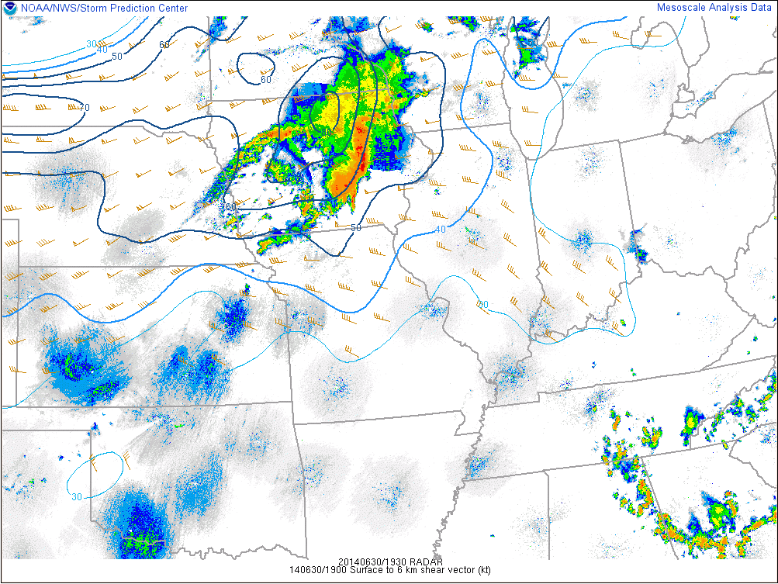
The Synoptic Environment of 30 June 2014: 0-6km Shear
2 pm

Slide 15
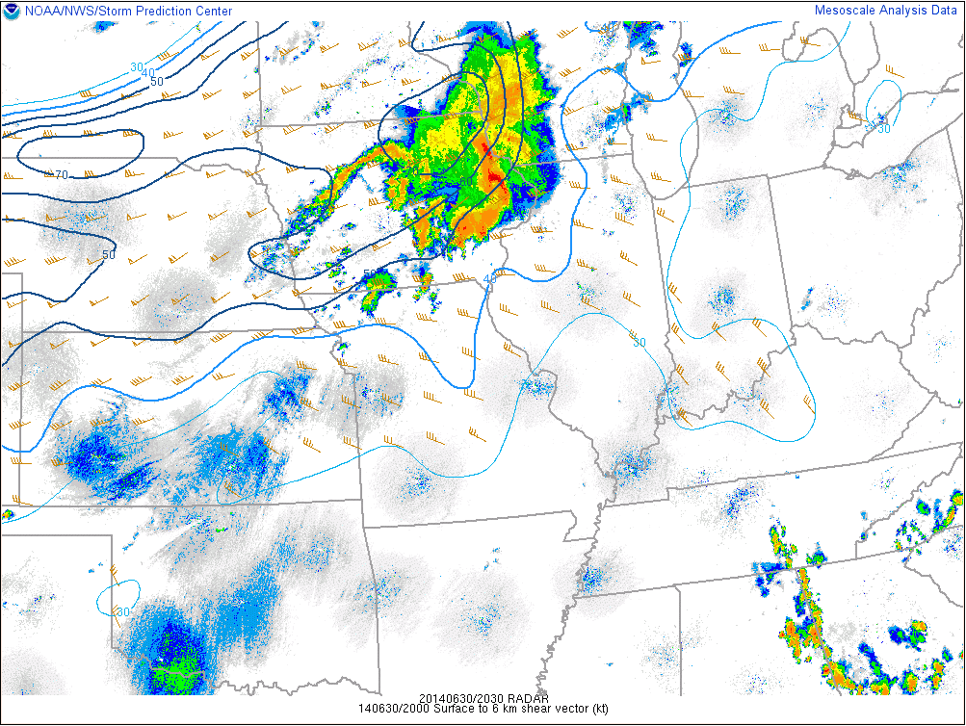
The Synoptic Environment of 30 June 2014: 0-6km Shear
3 pm

Slide 16
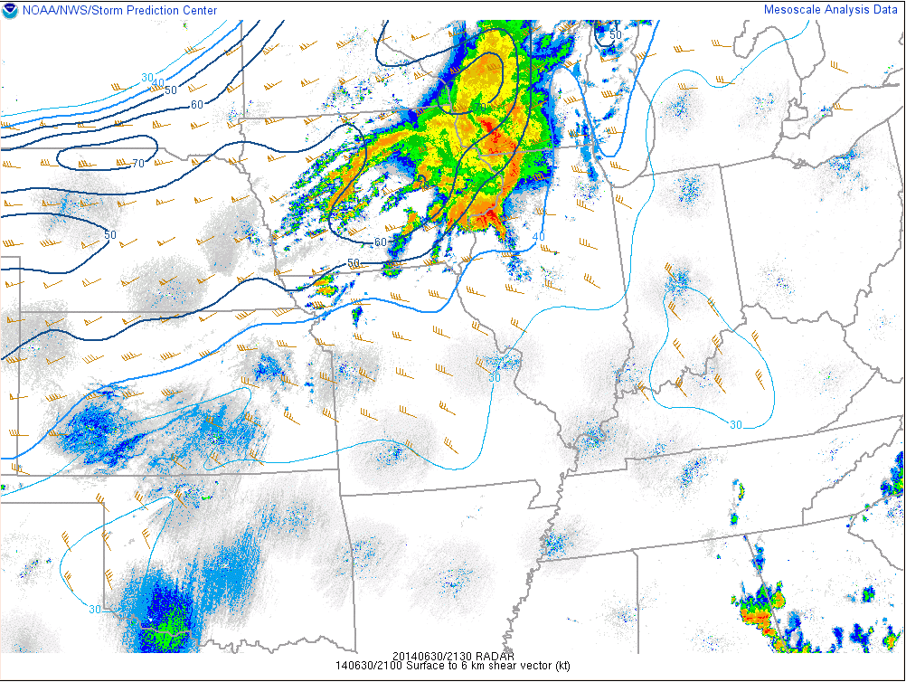
The Synoptic Environment of 30 June 2014: 0-6km Shear
4 pm

Slide 17
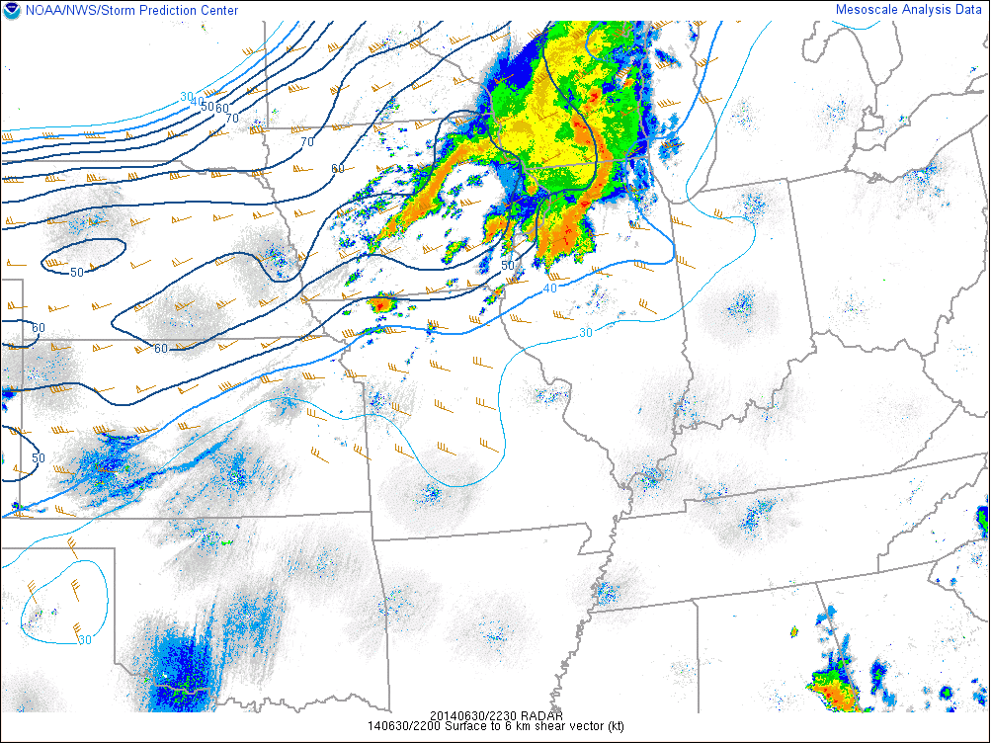
The Synoptic Environment of 30 June 2014: 0-6km Shear
5 pm

Slide 18
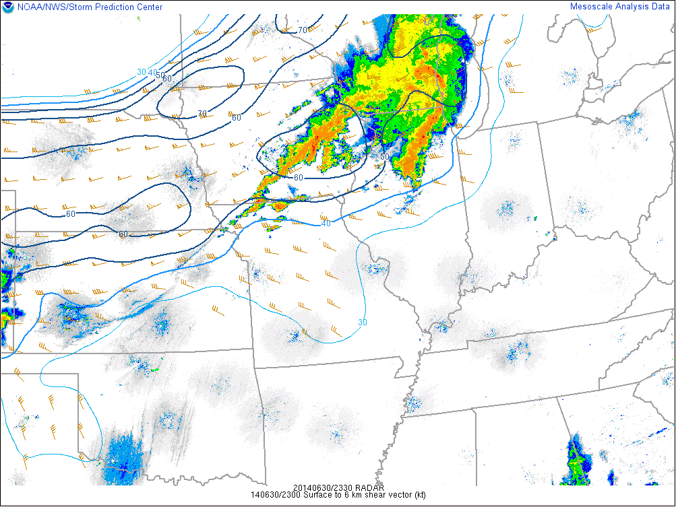
The Synoptic Environment of 30 June 2014: 0-6km Shear
6 pm

Slide 19
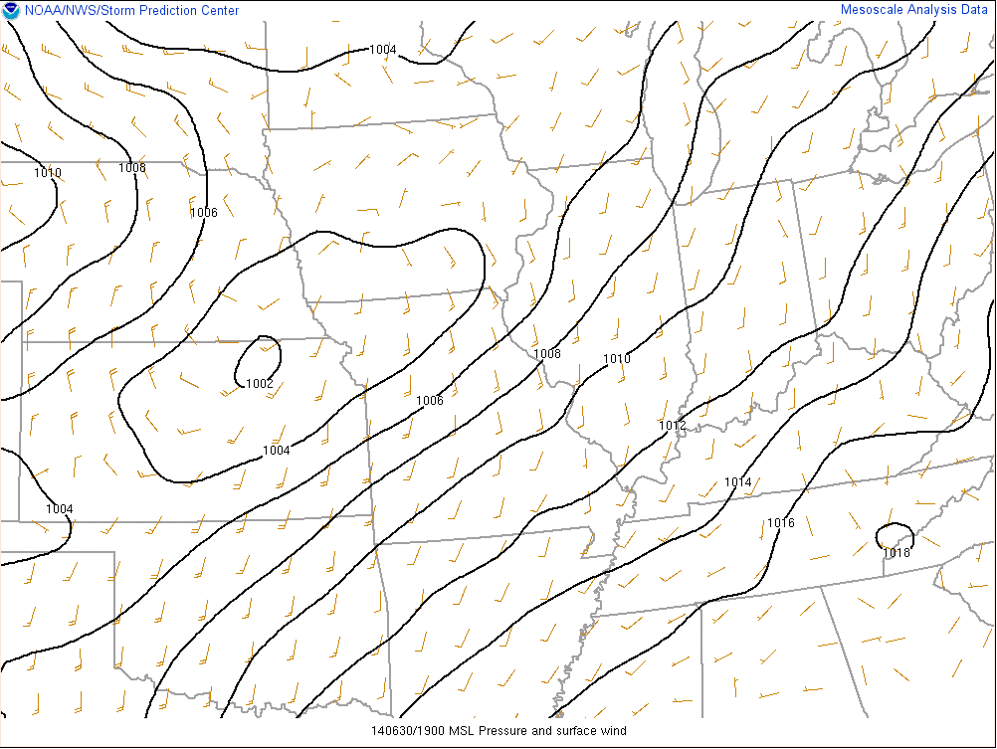
The Synoptic Environment of 30 June 2014: MSLP
L
L
2 pm

Slide 20
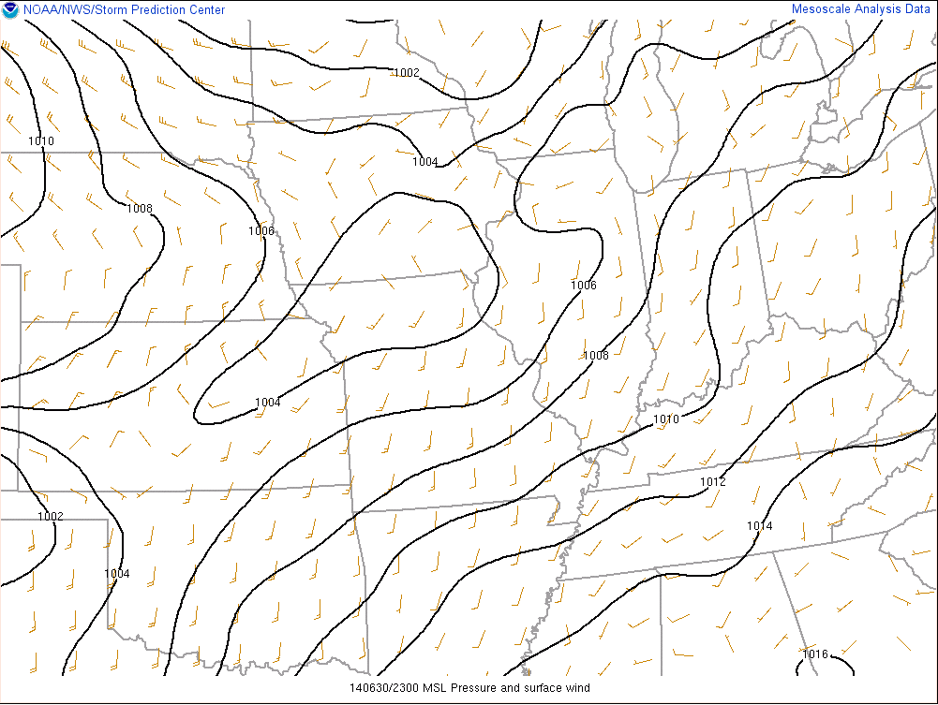
The Synoptic Environment of 30 June 2014: MSLP
L
6 pm

Slide 21
The Synoptic Environment of 30 June 2014: MSLP & 2h Change
L
6 pm

Slide 22
The Synoptic Environment of 30 June 2014: MSLP & 2h Change
L
Weak, shallow cold pool
Strengthening pressure falls
6 pm

Slide 23
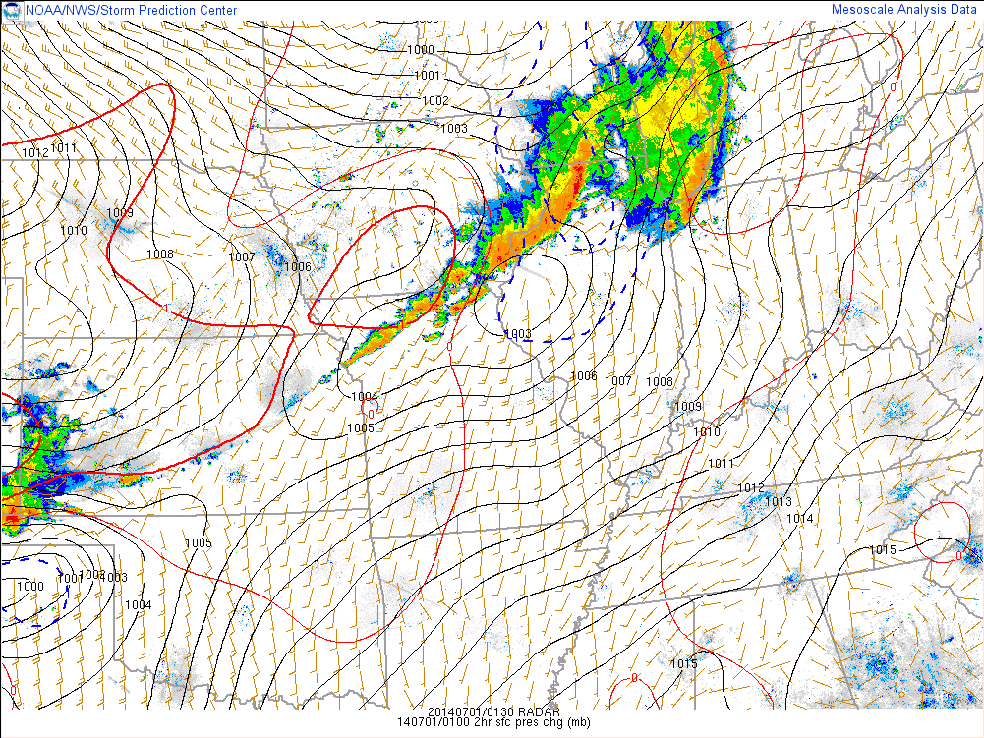
The Synoptic Environment of 30 June 2014: MSLP & 2h Change
01z 07/01
L
8 pm

Slide 24
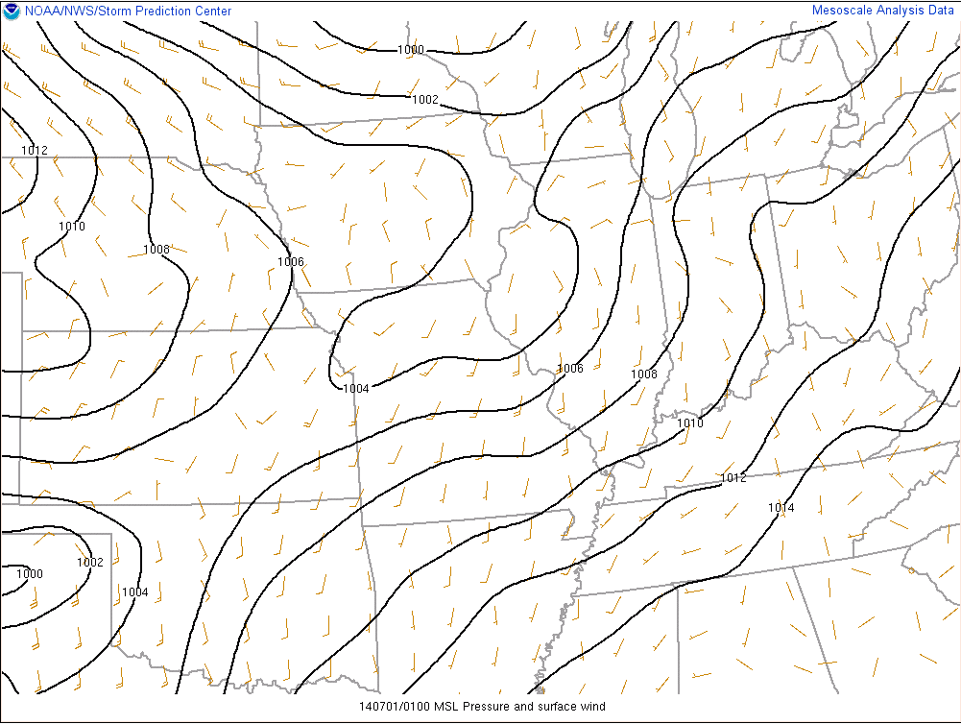
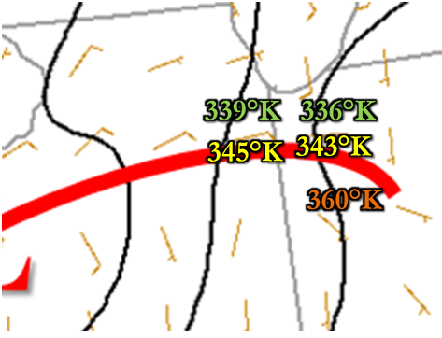
The Synoptic Environment of 30 June 2014: MSLP & Theta-E
L
8 pm
9 pm

Slide 25
The Synoptic Environment of 30 June 2014: MSLP & Theta-E
L
L
8 pm
9 pm

Slide 26
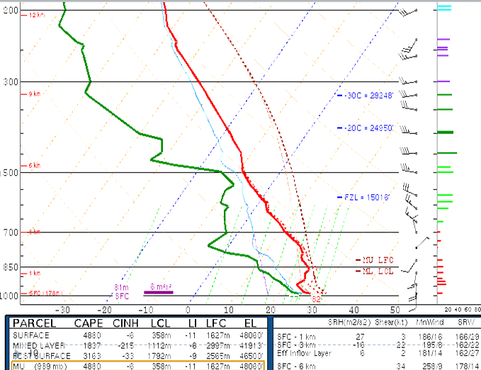
The Synoptic Environment of 30 June 2014: ILX Sounding
7 pm (00Z)
50 Miles South
of Boundary

Slide 27
Mesoscale Environment of 30 June 2014: Effective SRH
9 pm

Slide 28
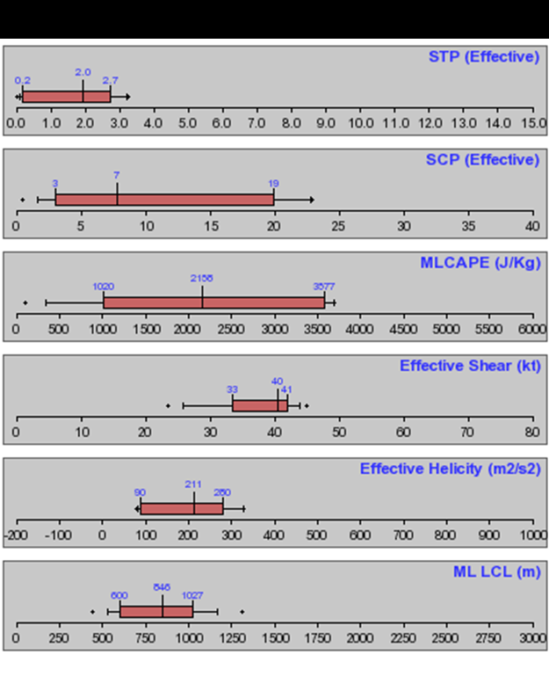
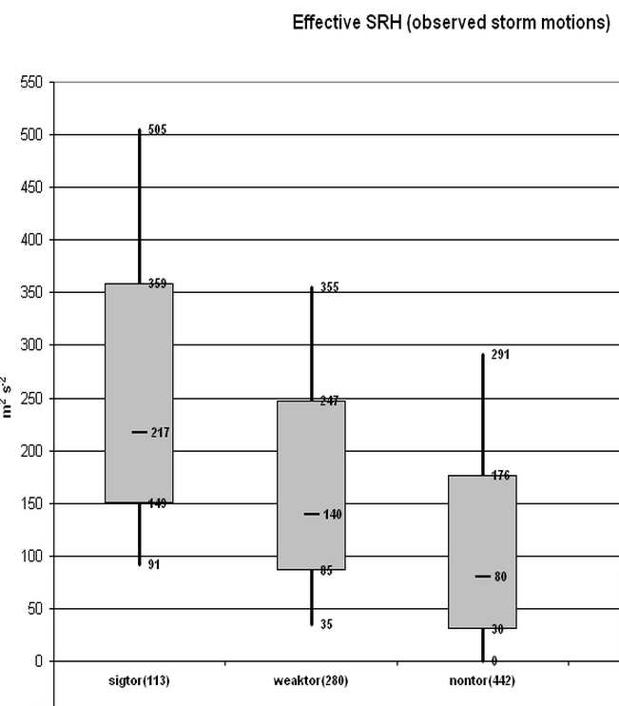
The Synoptic Environment of 30 June 2014: Effective SRH
02z 07/01
NWS Chicago Radar Area: QLCS Tornadoes (2003-2009)
Thompson et al. (2003)
15 tornado cases
9 pm

Slide 29
The Mesoscale Environment of 30 June 2014: QLCS Parameters
9 pm

Slide 30
The Mesoscale Environment of 30 June 2014: QLCS Parameters
02z 07/01
MDW
KLOT
9 pm

Slide 31
The Mesoscale Environment of 30 June 2014: QLCS Parameters
02z 07/01
Schaumann & Przybylinski
9 pm

Slide 32
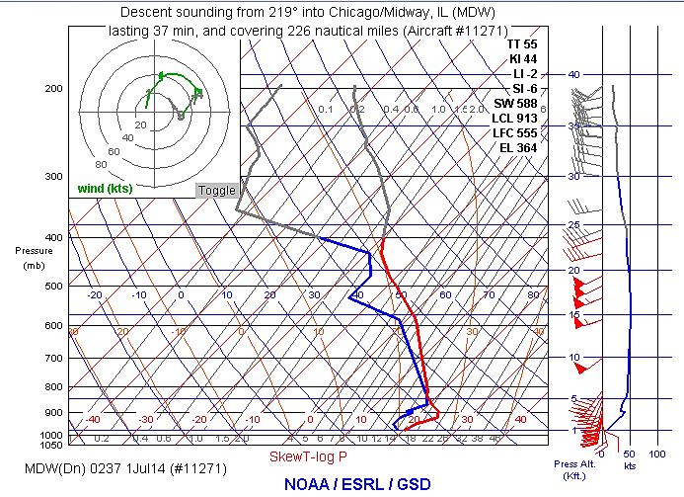
30 June 2014: Aircraft Sounding Data Finished at 9:37 pm

Slide 33
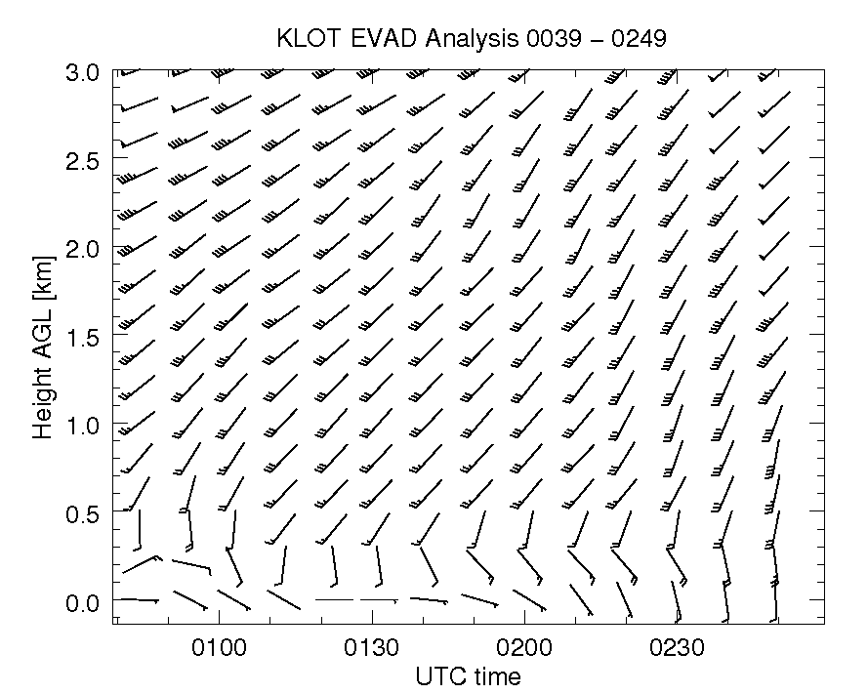

Slide 34
June 30th - What happened: Storm reports and tornado count per derecho on a regional level.
The close proximity in time.
The second derecho clearly more prolific tornado producer in IL/IN.
Derecho and QLCS climatology
Not a surprise where this occurred
Such rapid succession not observed before though
Synoptic pattern and ingredients of the event
Multiple SPC mesoanalysis images and composite graphics
Prior to first derecho, in-between, during second
Observed 00Z sounding and RAP sounding a few hours later
The effect of the first derecho on the second
Start a transition to mesoscale here with some focus on the outflow modulated theta-e boundary (LOT CWA emphasis)
Operational notes - ability to recognize this enhanced tornado threat. (LOT CWA emphasis)
Takeaways
Double derecho
Unique in some respects, but the synoptic to mesoscale environmental characteristics are common in MCS environments
Modulation of boundaries, higher theta-e air
Importance of a mesoscale analyst
Know your MCS climatology
Set the stage to understand the storm scale
Detecting storm scale factors and assessing impacts to convection

Slide 35
Thanks To:
NWS Chicago co-authors Richard Castro and Eric Lenning
UAH co-authors Anthony Lyza and Kevin Knupp
Ariel Cohen (SPC)
Steve Corfidi (SPC ret.)
Corey Guastini (EMC)
http://www.spc.noaa.gov/misc/AbtDerechos/papers/Coniglio_2004a.pdf
http://www.spc.noaa.gov/publications/smith/modeclim.pdf
http://www.spc.noaa.gov/misc/AbtDerechos/papers/Trappetal_2005.pdf

Slide 36
References:
Coniglio, M.C., and D. J. Stensrud. (2004): Interpreting the Climatology of Derechos. Wea. Forecasting, 19, 595-605.
Corfidi, S. F., A. E. Cohen, M. C. Coniglio, and C. M. Mead, (2016): A Proposed Revision to the Definition of "Derecho". Bull. Amer. Meteor. Soc., 96. (and direct communication)
Guastini, C. T., and L. F. Bosart, 2016: Analysis of a Progressive Derecho Climatology and Associated Formation Environments. Mon. Wea. Rev., 144, 1363–1382 (and direct communication).
Johns, R. H., and W. D. Hirt, 1987: Derechos: Widespread Convectively Induced Windstorms. Wea. Forecasting, 2, 32-49.
Schaumann, J.S., R.W. Przybylinski: Operational Application of 0-3 km Bulk Shear Vectors in Assessing QLCS Mesovortex and Tornado Potential. Preprints, 27th Conf. Severe Local Storms, Madison WI, P9.10.
Smith, B.T., R. L. Thompson, J. S. Grams, C. Broyles, and H. E. Brooks, (2012): Convective Modes for Significant Severe Thunderstorms in the Contiguous United States Part I: Storm Classification and Climatology. Wea. Forecasting, 27, 1114 – 1135.
http://www.spc.noaa.gov/misc/AbtDerechos/papers/Coniglio_2004a.pdf
http://www.spc.noaa.gov/publications/smith/modeclim.pdf
http://www.spc.noaa.gov/misc/AbtDerechos/papers/Trappetal_2005.pdf

Slide 37
References:
Smith, B.T., R. L. Thompson, J. S. Grams, C. Broyles, and H. E. Brooks, (2012): Convective Modes for Significant Severe Thunderstorms in the Contiguous United States Part I: Storm Classification and Climatology. Wea. Forecasting, 27, 1114–1135.
Storm Prediction Center. (accessed 2015) Mesoanalysis and Tornado Environment Browser
Thompson, Richard L., Corey M. Mead, and Roger Edwards. (2007): Effective Storm-Relative Helicity and Bulk Shear in Supercell Thunderstorm Environments. Wea. Forecasting, 22, 102–115.
Thompson, R. L., R. Edwards, J. A. Hart, K. L. Elmore, and P. Markowski, 2003: Close proximity soundings within supercell environments obtained from the Rapid Update Cycle. Wea. Forecasting, 18, 1253.
Trapp, R.J., S. A. Tessendorf, E.S. Godfrey, and H.E. Brooks, 2005: Tornadoes from Squall Lines and Bow Echoes. Part I: Climatological Distributions. Wea. Forecasting, 131, 2779-2803.
Wakimoto, R. M. 2001: Convectively driven high wind events. Severe Convective Storms, Meteor. Monogr., No. 50, Amer. Meteor. Soc., 257-258
http://www.spc.noaa.gov/misc/AbtDerechos/papers/Coniglio_2004a.pdf
http://www.spc.noaa.gov/publications/smith/modeclim.pdf
http://www.spc.noaa.gov/misc/AbtDerechos/papers/Trappetal_2005.pdf

Slide 38
Evolution of the
30 June 2014
Double Derecho Event
in Northern Illinois & Northwest Indiana
Matthew Friedlein,
Richard Castro, & Eric Lenning
National Weather Service – Chicago, IL
Thank You!
Anthony Lyza & Kevin Knupp
Atmospheric Sciences Department, University of Alabama in Huntsville
3rd Bow Echo Workshop: March 9-10, 2017

Slide 39
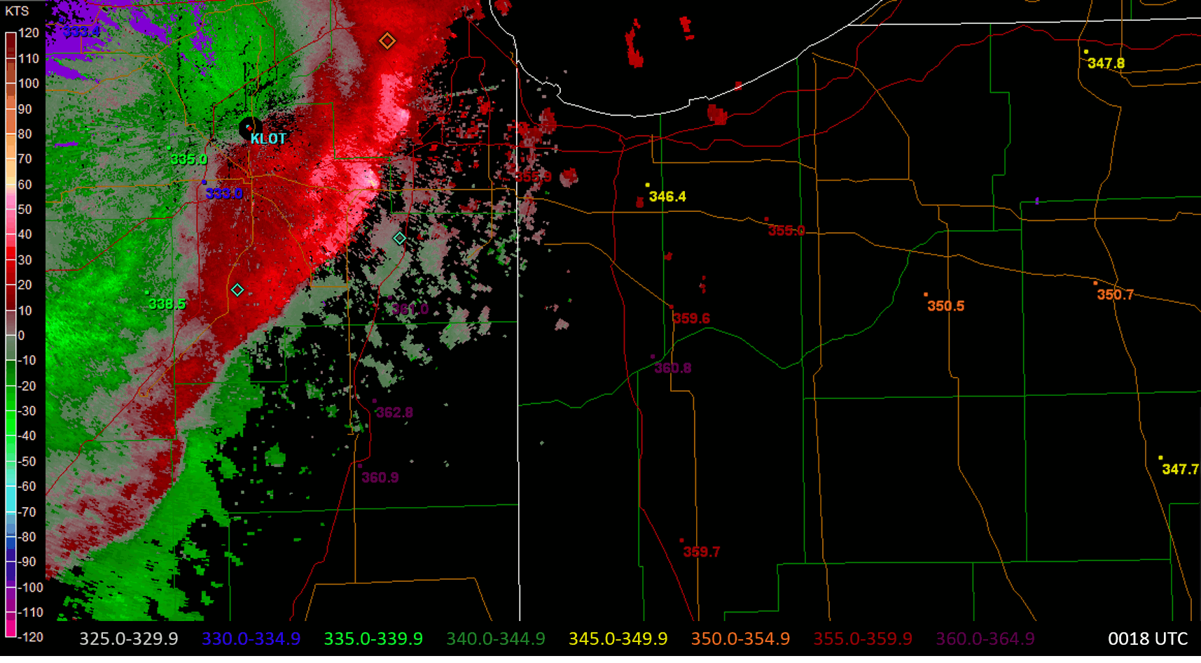
The Synoptic Environment of 30 June 2014: QLCS Parameters

