Slide 1
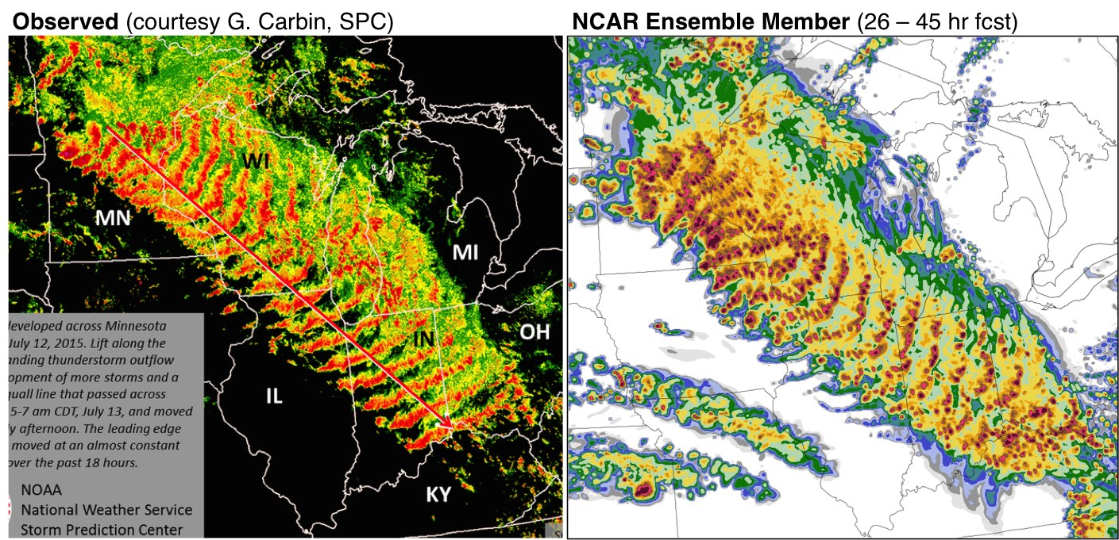
“Progress in Predicting Derechoes using Convection-Allowing Forecast Models”
Morris Weisman, Glen Romine, Craig Schwartz, Ryan Sobash
3rd Midwest Bow Echo Workshop 2017
July 12 2015 Derecho

Slide 2
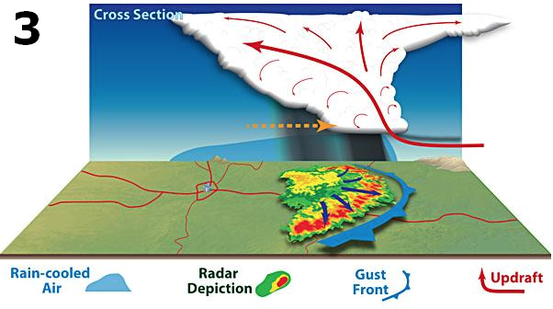
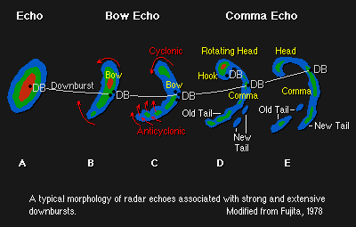
Derechos: Severe Lines of Thunderstorms Hinrichs (1888), Johns and Hirt (1987)
Straight-line winds
Long swaths (> 400 km), long duration (> 6 h)
Wide damage swaths (100-500 km)
Rapid movement: 20-30 m/s
NOAA Storm Prediction Center
OR, see Corfidi et al. BAMS, 2016
The key structural component is often a bow echoes (e.g., Fujita 1978)

Slide 3
Part I:
Part II:

Slide 4
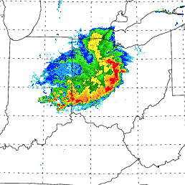
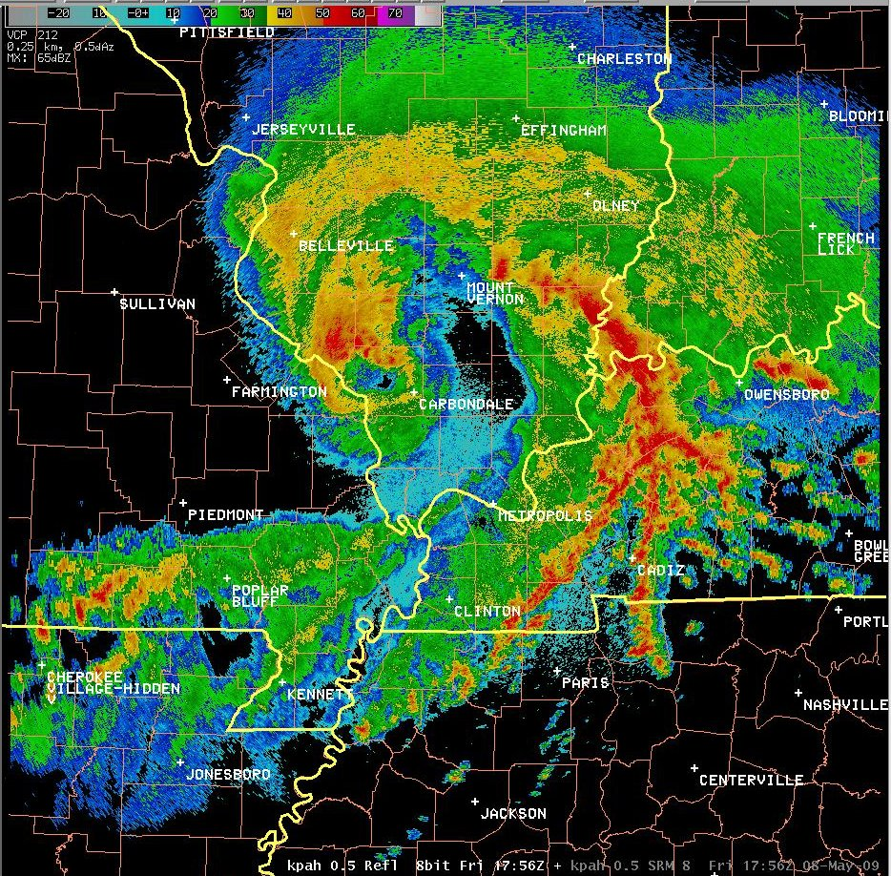
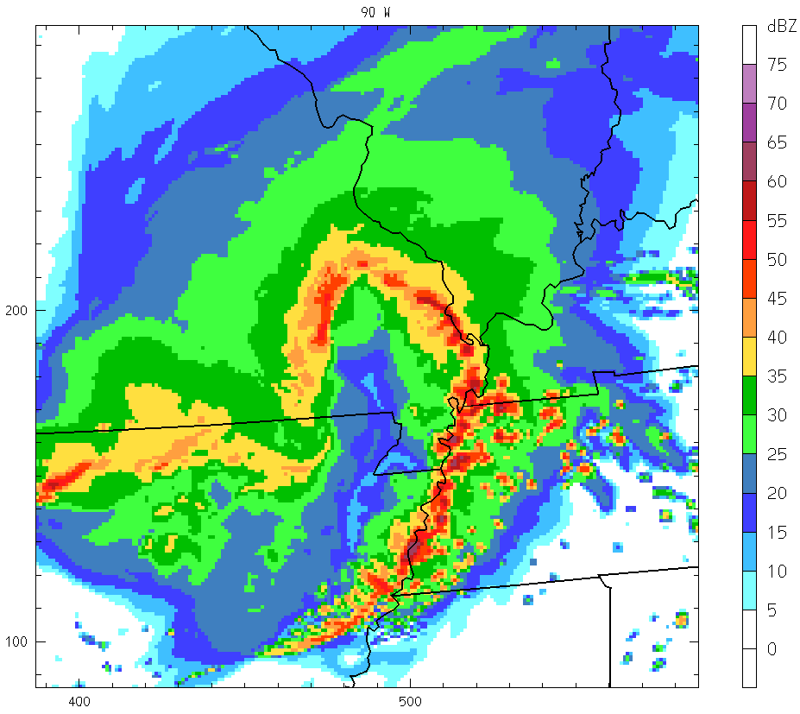
“Super” Derecho Archetypes:
29 June 2012
Radar Reflectivity
3 km Model Reflectivity
08 May 2009

Slide 5
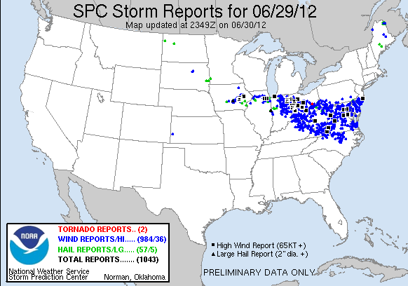
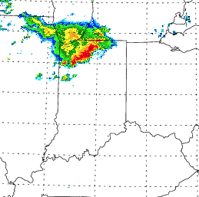
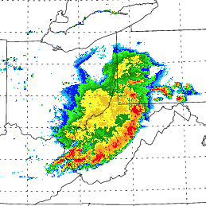
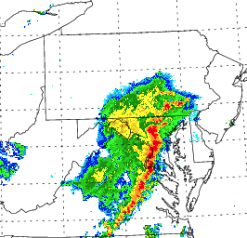
29 June 2012 Derecho:
..massive tree damage, power losses, comparable to hurricane damage
18 UTC
21 UTC
00 UTC
03 UTC

Slide 6
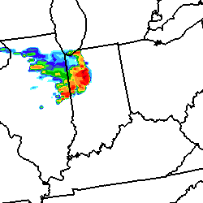
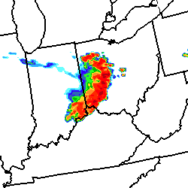
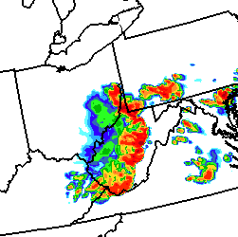
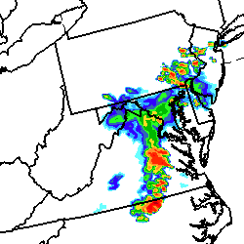
Derecho Predictability: 29 June 2012
3 km WRF-ARW Forecast
18 UTC (6 h)
21 UTC (9 h)
00 UTC (12 h)
03 UTC (15 h)
Composite Radar
18 UTC
21 UTC
00 UTC
03 UTC

Slide 7
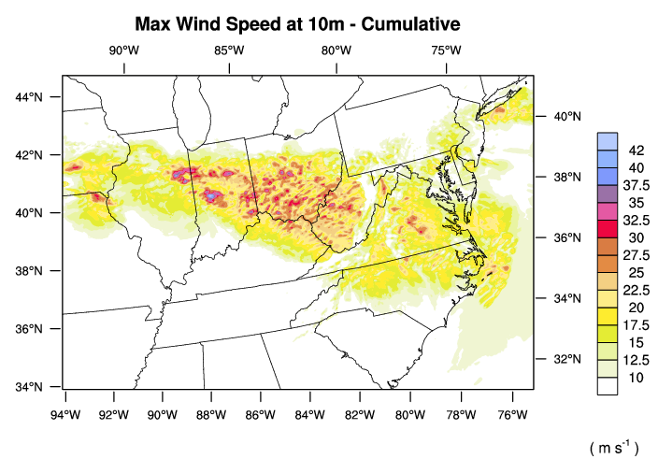
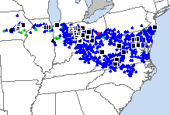
Derecho Predictability: 29 June 2012
SPC Storm Reports
3 km WRF-ARW Forecast
Why did the Derecho cross the Appalacians?

Slide 8
29 June 2012 21 UTC
Reflectivity, Sfc winds
*Cold Pool : -14 to -16 C
*Strong Rear Inflow Jet
*No cyclonic vorticity along leading line
975 hPa Theta
850 hPa Theta

Slide 9
29 June 2012 Derecho: 22 UTC
~ 30 Deg F Cold Pool

Slide 10
29 June 2012 21 UTC
Vertical X-sections
*Cold Pool : 4 km deep, -14 to -16 C
*Descending Rear Inflow Jet
8 km
4 km
0 km
Reflectivity, Theta
Winds, Theta-E

Slide 11
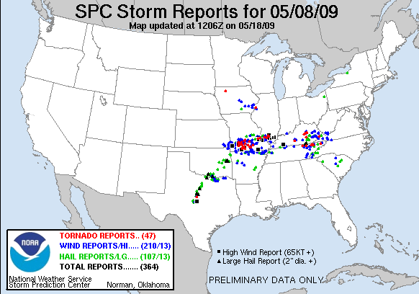
The 8 May 2009 “Super Derecho”:
8-10 h of Hurricane-Force Winds, Extensive Damage…
Radar 17:56 UTC 05/08/09 (Paducah)

Slide 12
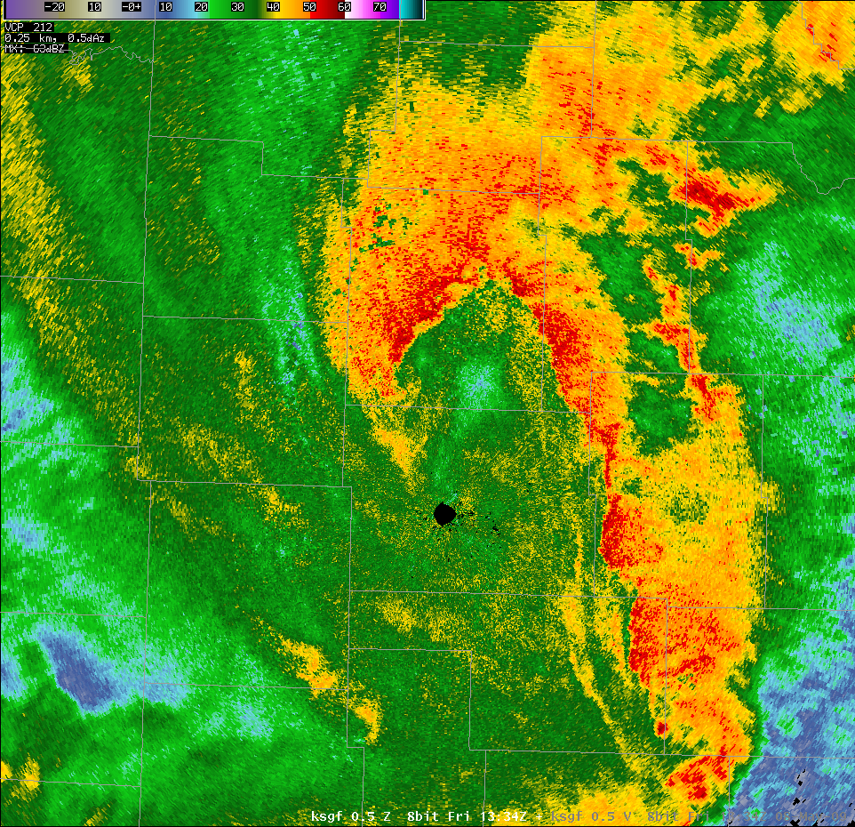
100-110KT winds at ~1kft
Base Reflectivity 1334z KSGF
Notes:
Here is the corresponding reflectivity image.

Slide 13
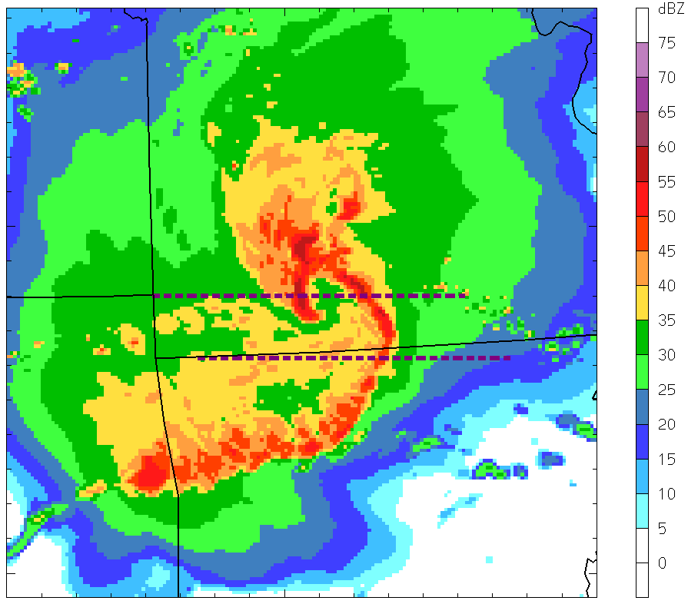
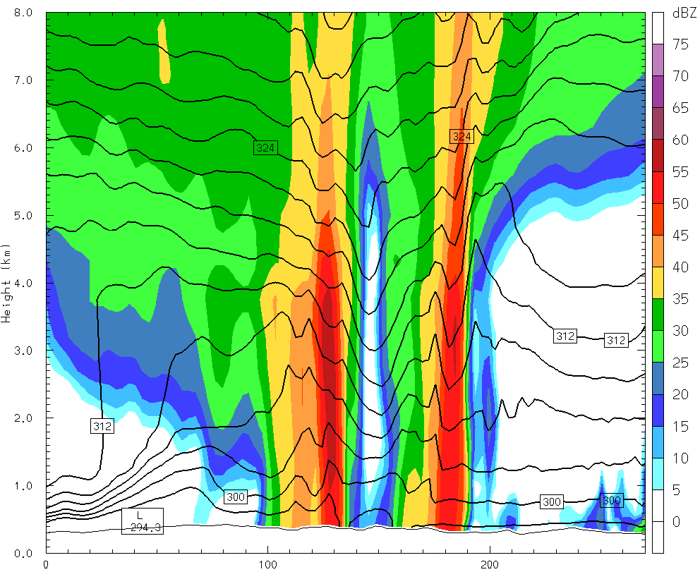
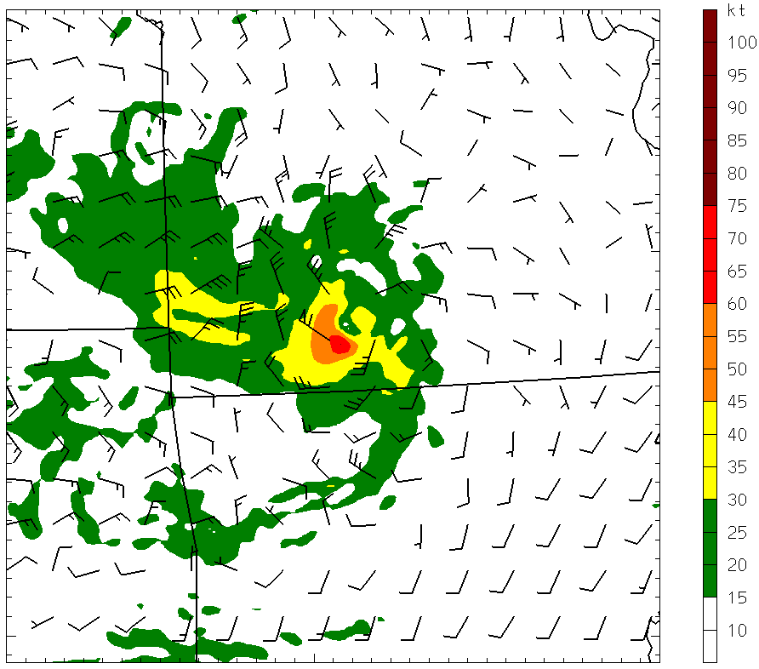
Why did the 08 May 2009 derecho act like an inland Hurricane?
It was!!
Surface Wind Speed (shaded)

Slide 14
Derecho Predictability:
29 June 2012
Cold-pool
dominant
(-16 C, 4 km)
Radar Reflectivity
3 km Model Reflectivity
08 May 2009
Mesovortex
dominant
(warm core)

Slide 15
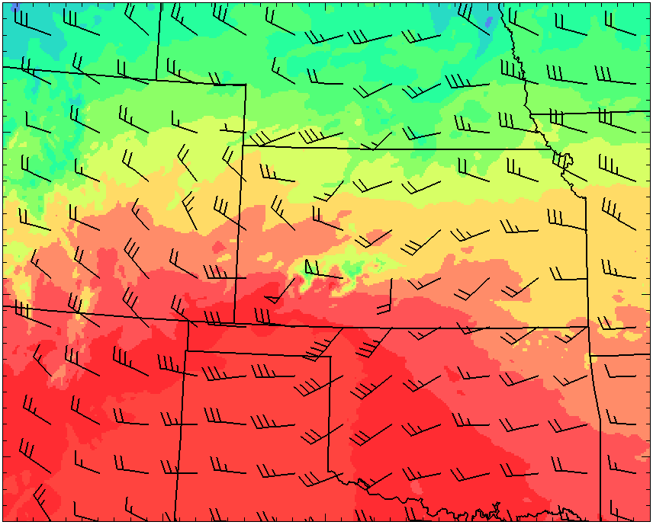
700 hPa Intercomparison:
29 June 2012
08 May 2009


Weaker mid-tropospheric baroclinicity
Mid-tropospheric baroclinicity, Lee trough

Slide 16
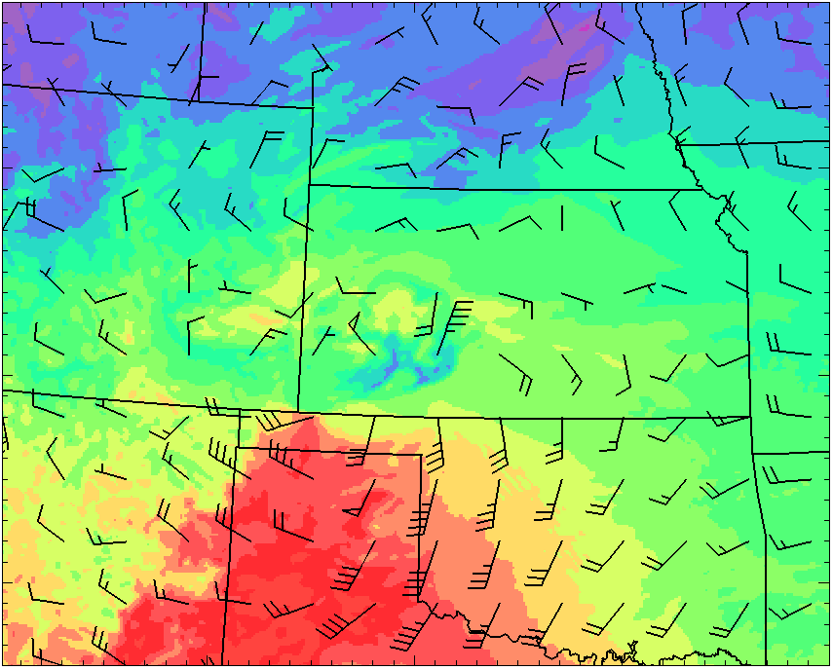
850 hPa Intercomparison:
29 June 2012
08 May 2009


NO Low-Level Jet, NO west-east boundary
Low-Level Jet, west-east boundary, Lee trough

Slide 17
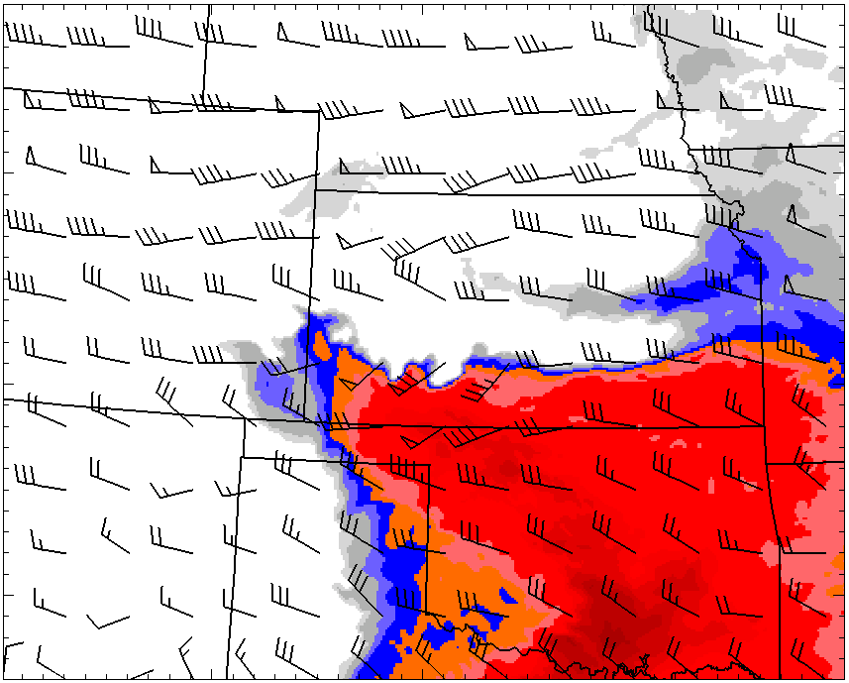
Cape/Shear Intercomparison:
29 June 2012
08 May 2009
CAPE: 5000-6000 j/kg
Shear: 20-30 kts (10-15 ms-1)
CAPE: 2500-3500 j/kg
Shear: 30-50 kts (15-25 ms-1)

Slide 18
Part I Summary:
….3 km WRF-ARW was capable of not only predicting the potential for two high-end Derecho events, but also was capable of distinguishing the differing mechanisms…
29 June 2012: Cold Pool dominant
08 May 2009: Mesovortex dominant
….These two cases may help clarify the differing environmental characteristics that contribute to these two archetypes:
29 June 2012: Extreme instability, modest
unidirectional low-level shear
08 May 2009: Mid-trop baroclinicity, low-level
jet, strong directional shear
(streamwise at low-levels)

Slide 19
Part II: NCAR Ensemble

Slide 20
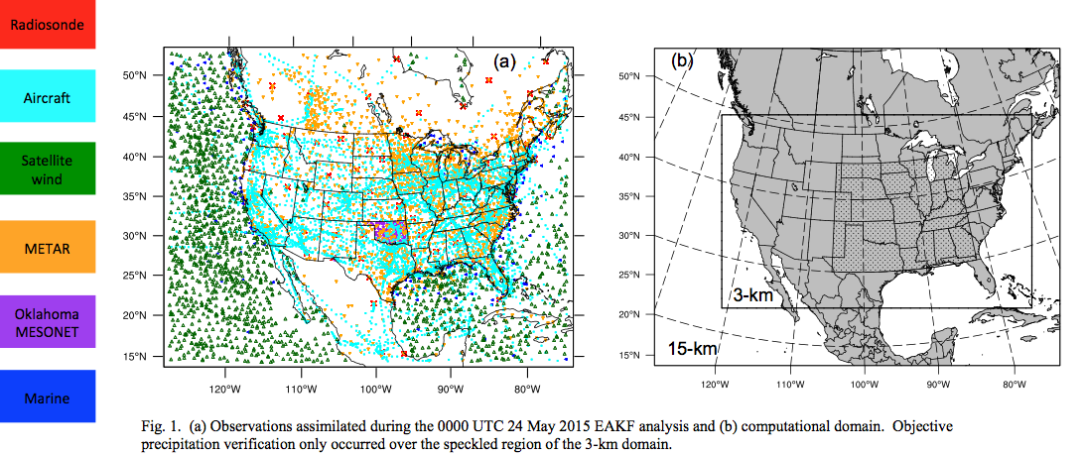
Data Assimilation Research Testbed toolkit (Lanai)
Continuously cycled (initialized mid-March 2015)
Ensemble Adjustment Kalman Filter
50-member analysis
Updated every 6 hours
Assimilate conventional observations:

Slide 21
CAM products for prediction of severe convection
*Convective-scale ensembles offer unique guidance for significant weather hazards: tornadoes, high winds,
hail, flash flooding….
VIA:
Convective mode: – supercells, squall lines, bow echoes/
derechoes, training echoes
Model surrogates – derived from simulated convection
- updraft speed/helicity
- surface wind speeds
- low-level vorticity
- maximum hail size
Accumulated precipitation – flash flooding
Probabilistic Guidance!!

Slide 22
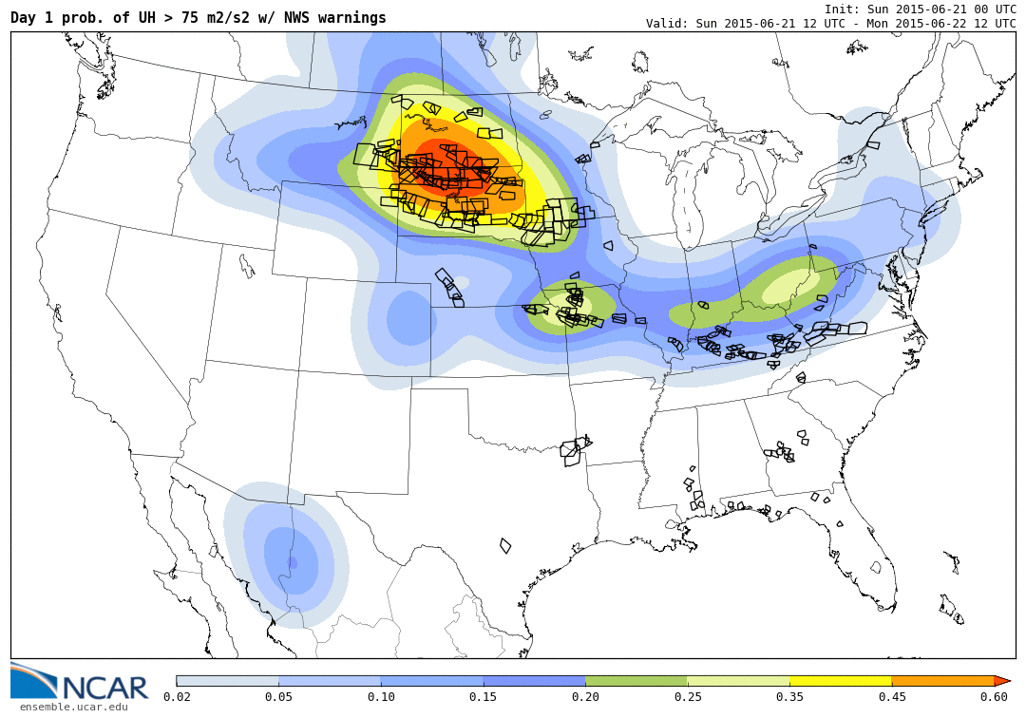
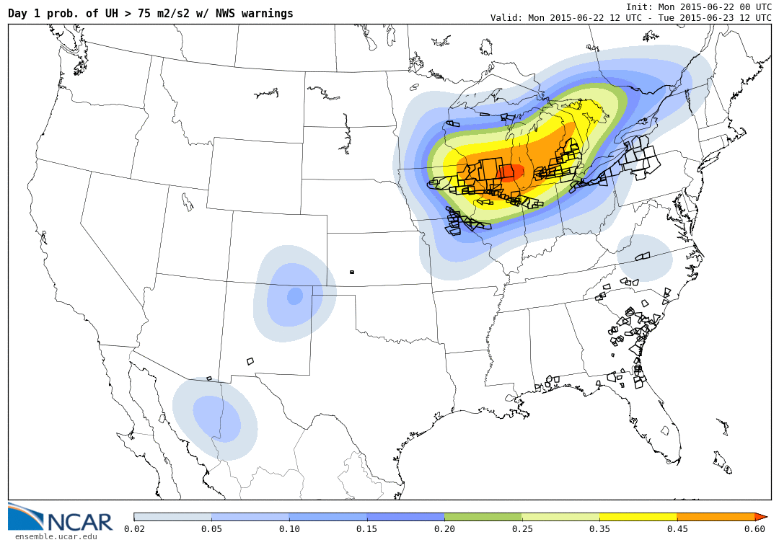
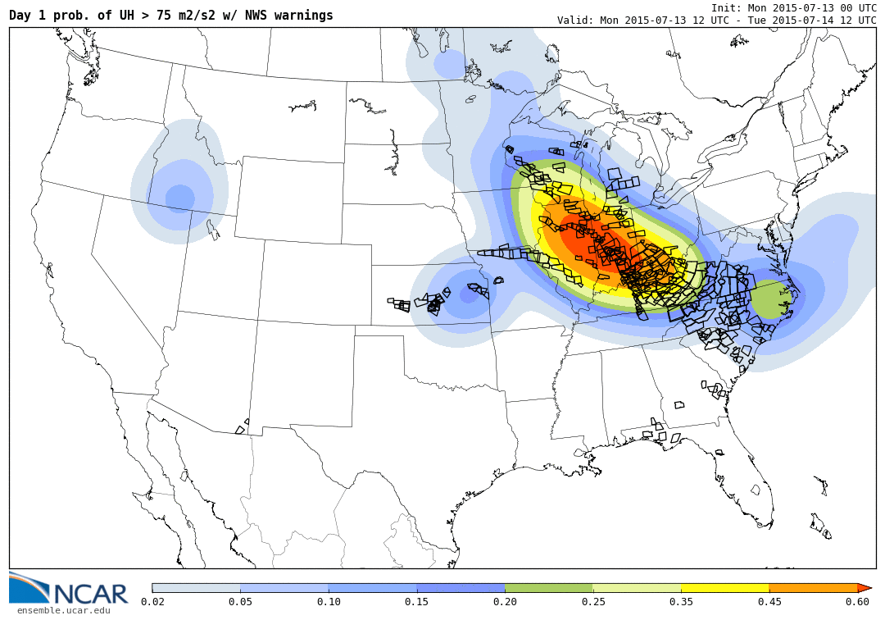
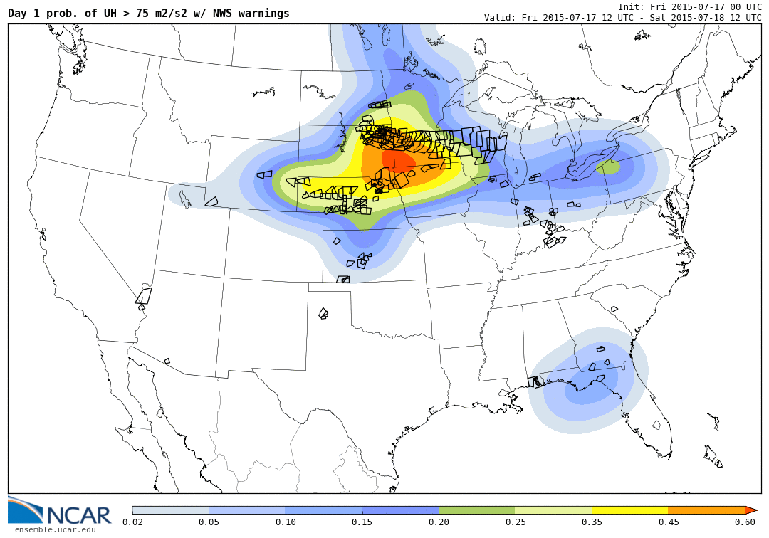
Ensemble Probability of Severe: Updraft Helicity > 75
06/21/15
06/22/15
07/13/15
07/17/15

Slide 23
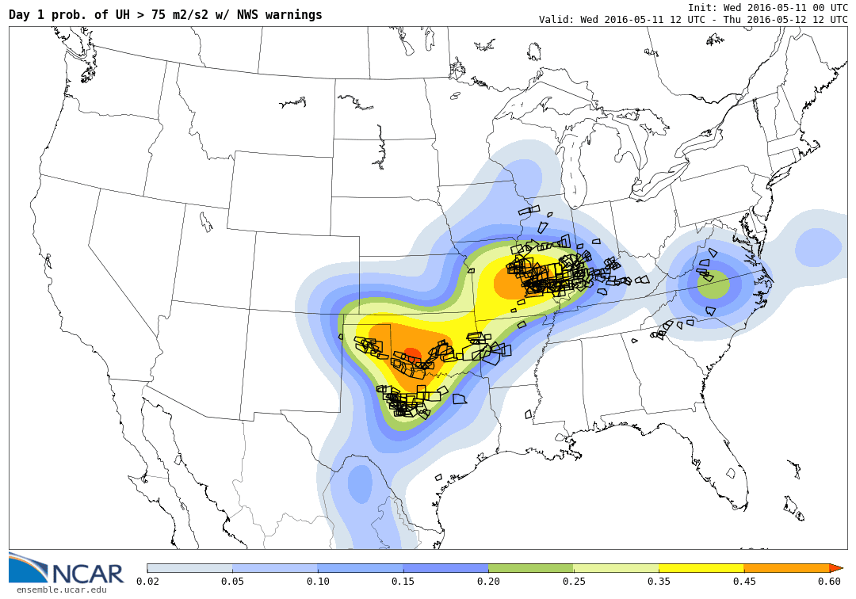
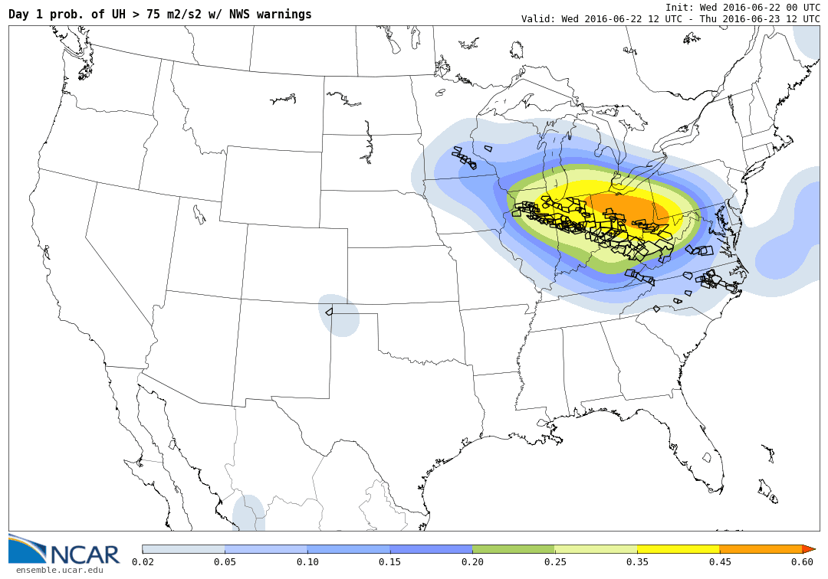
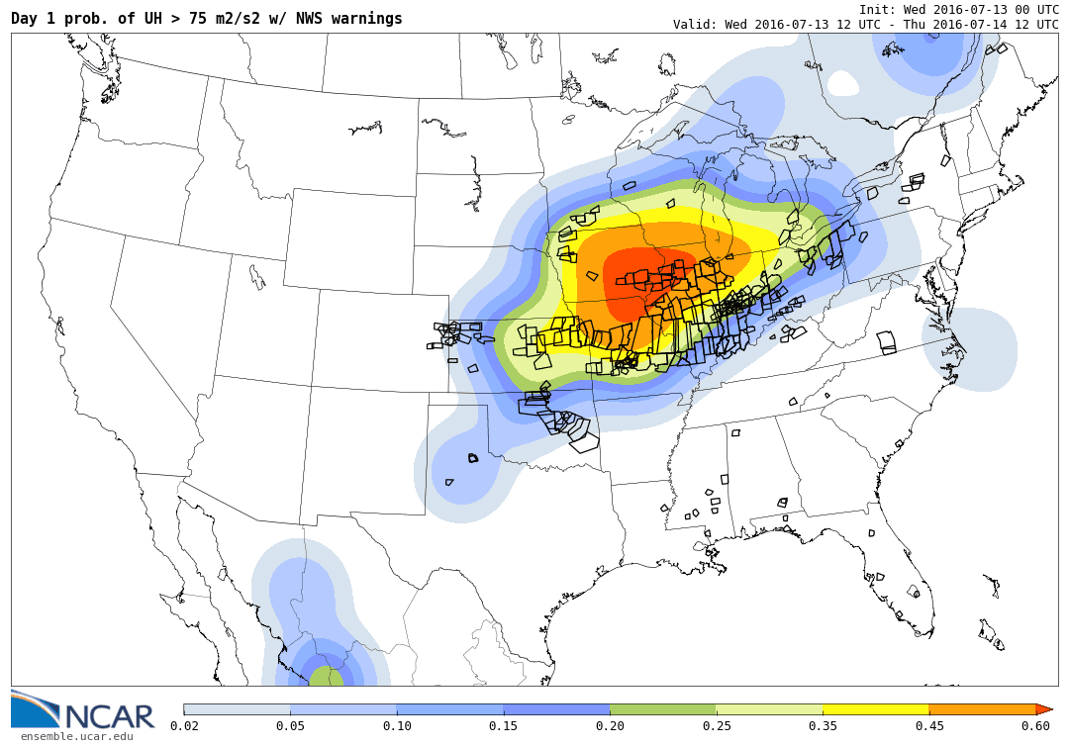
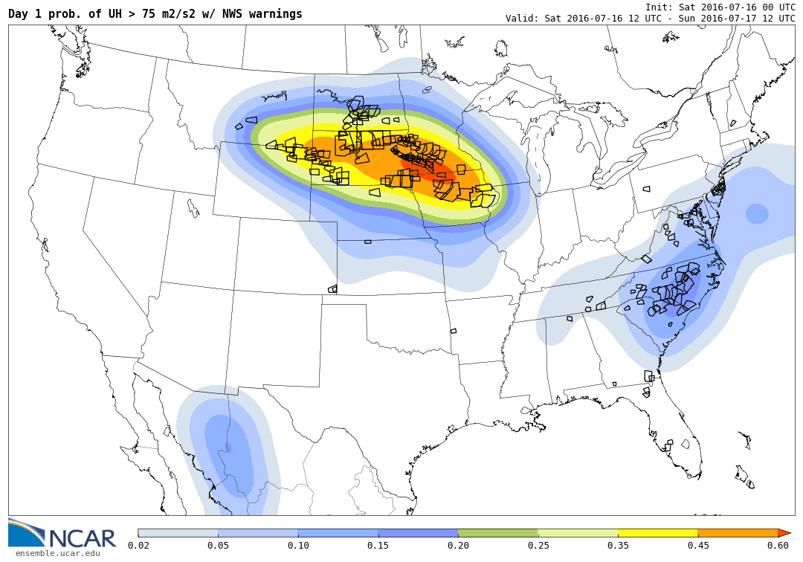
Ensemble Probability of Severe: Updraft Helicity > 75
05/11/16
06/22/16
07/13/16
07/16/16

Slide 24
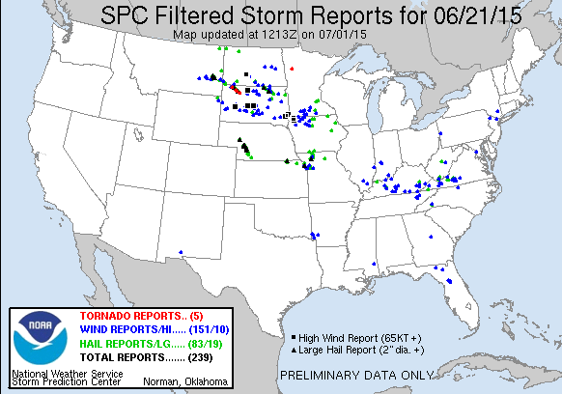
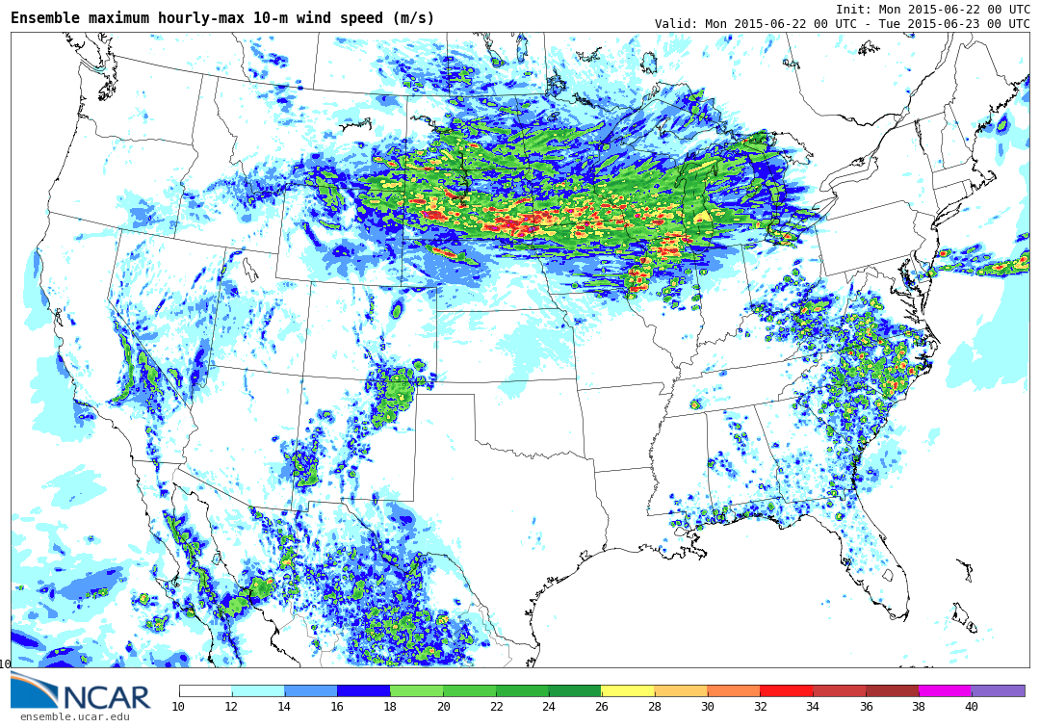
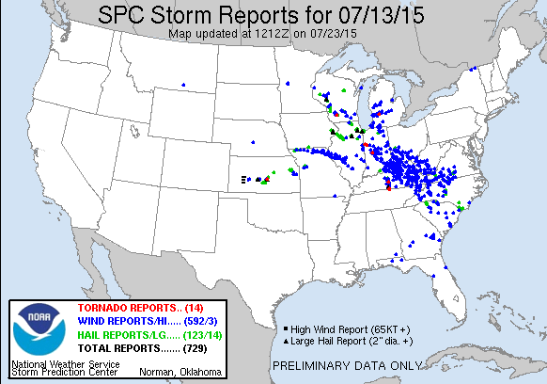
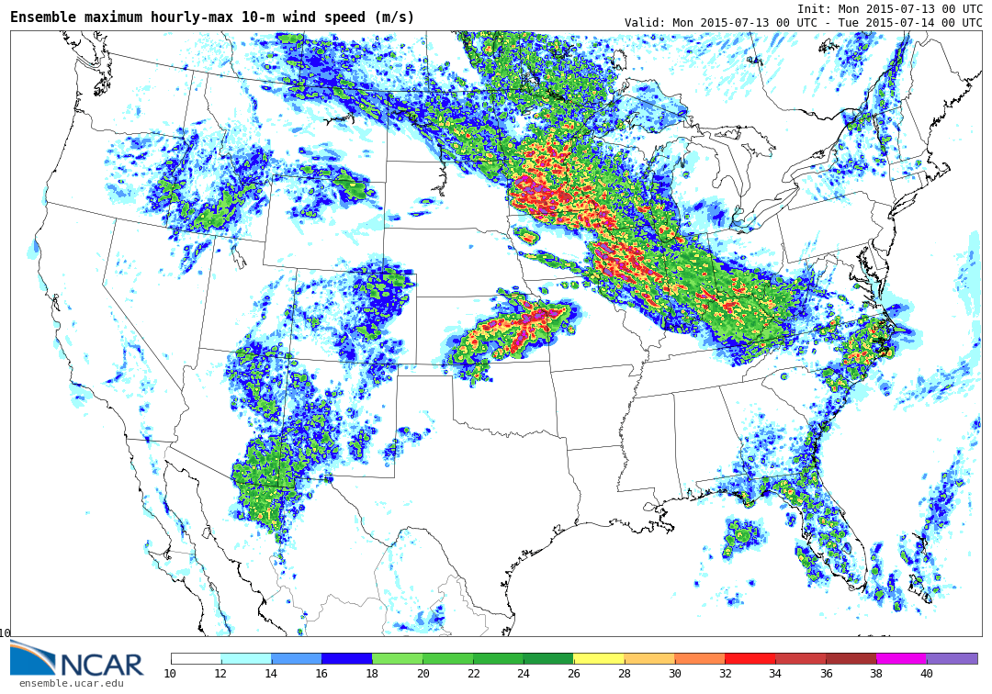
Ensemble Maximum Surface Winds:

Slide 25
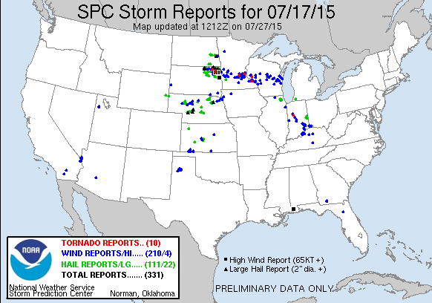
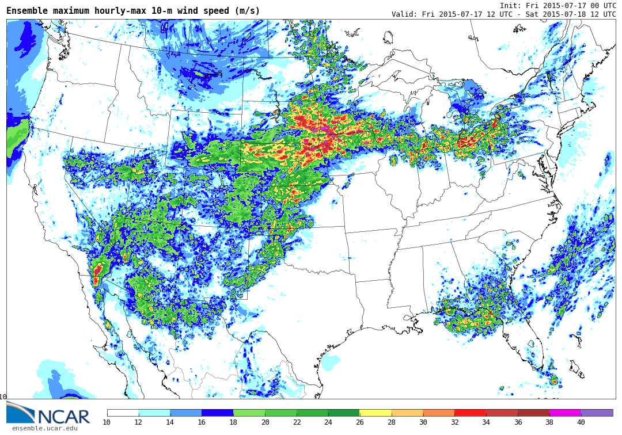
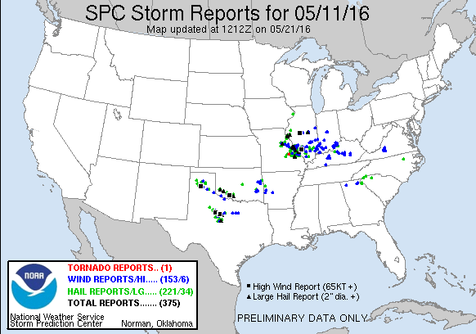
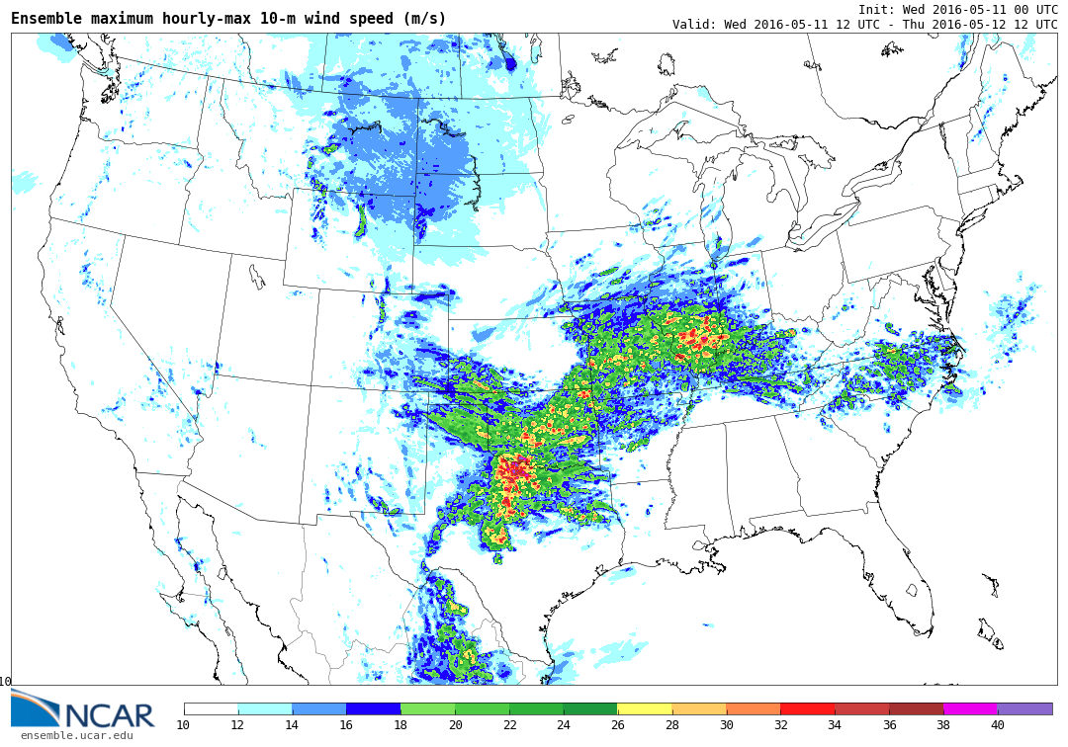
Ensemble Maximum Surface Winds:

Slide 26
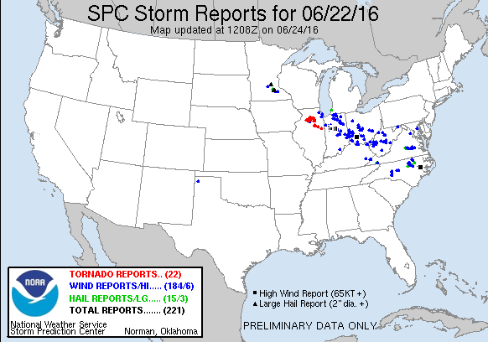
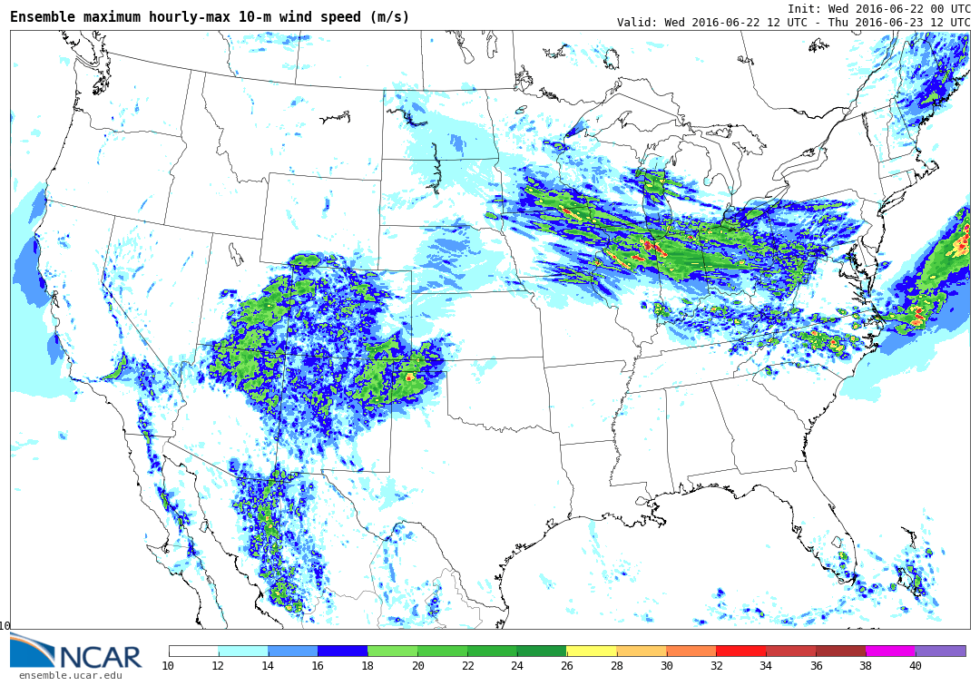
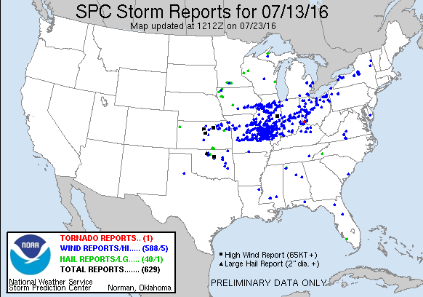
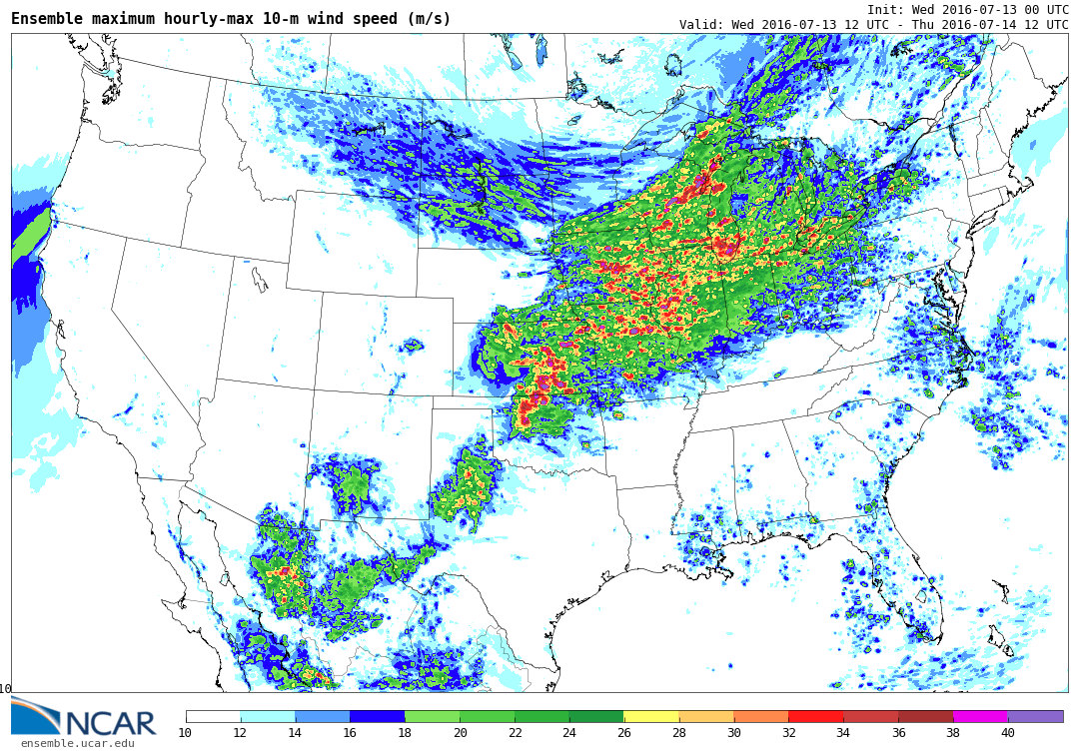
Ensemble Maximum Surface Winds:

Slide 27
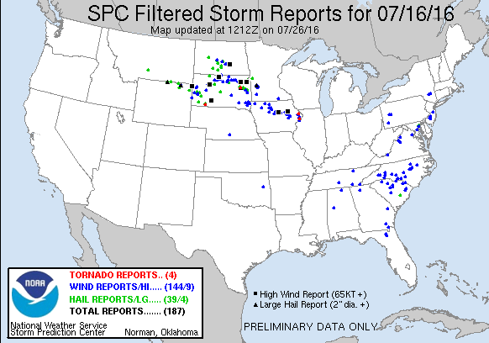
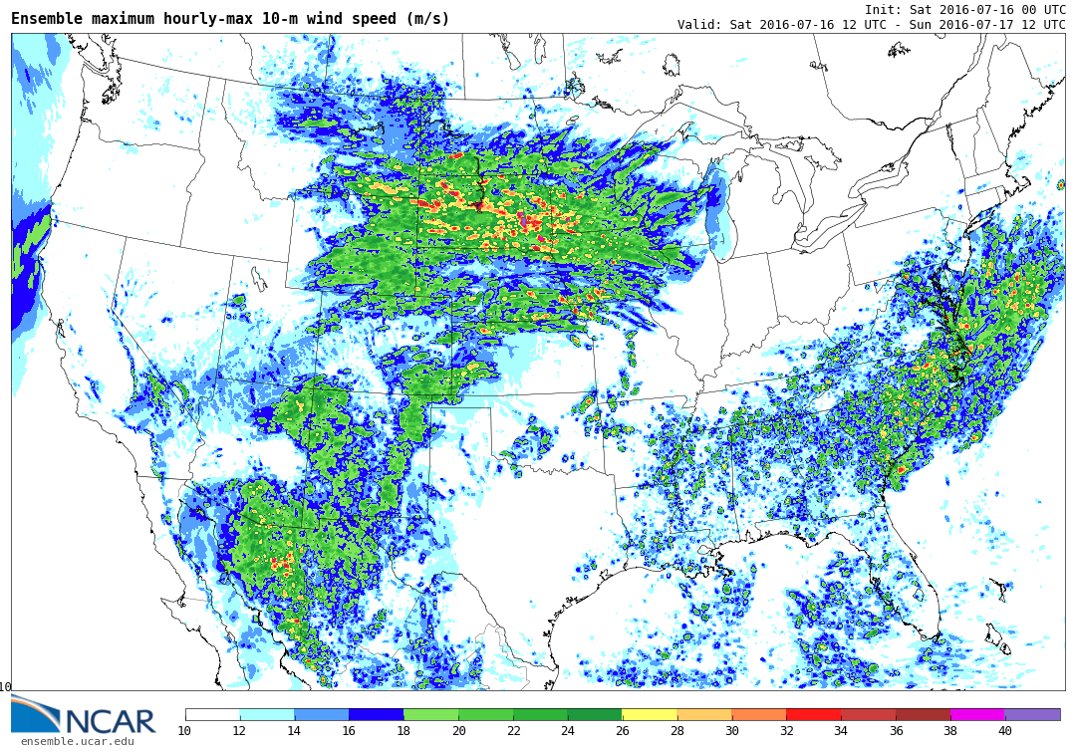
Ensemble Maximum Surface Winds:

Slide 28
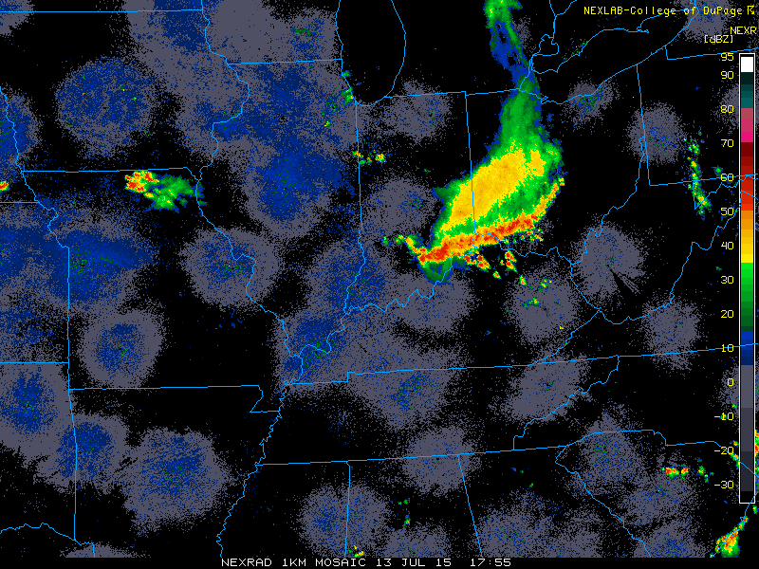
07/13/15
18:00 UTC

Slide 29
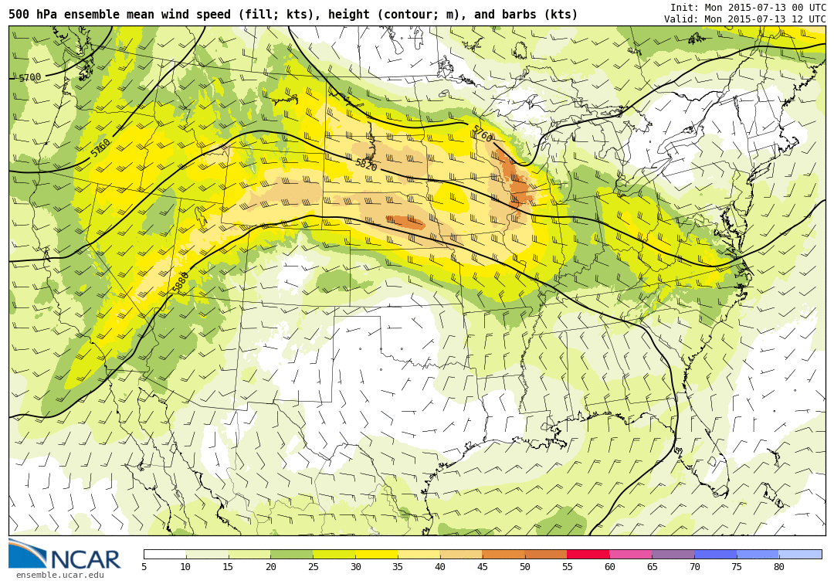
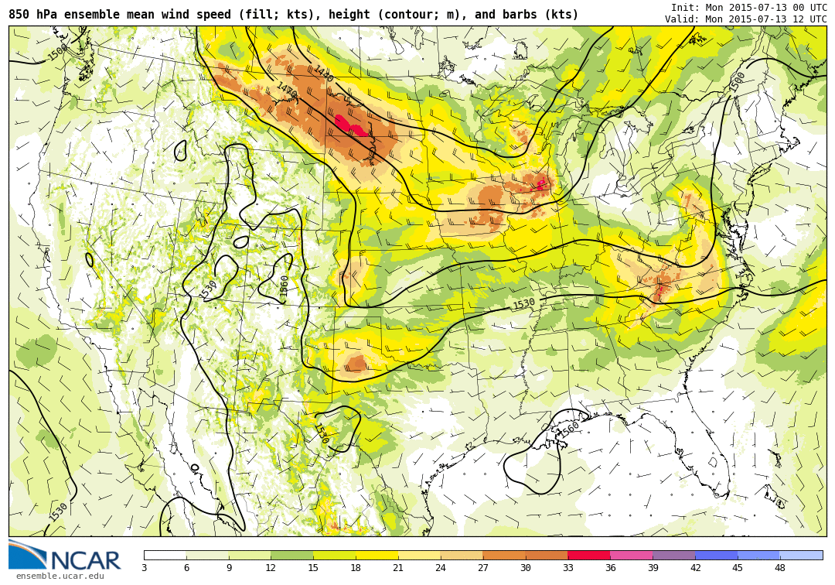
07/13/15
12 UTC
500 hPa
850 hPa

Slide 30
07/13/15
Ensemble Mean MUCAPE and 6 km shear

Slide 31
07/13/15
Ensemble Mean MUCAPE and 6 km shear

Slide 32
13 July 2015
Radar
Model Reflectivity 12h
12:00 UTC

Slide 33
13 July 2015
Radar
Model Reflectivity 15h
15:00 UTC

Slide 34
13 July 2015
Radar
Model Reflectivity 18h
18:00 UTC

Slide 35
13 July 2015
Radar
Model Reflectivity 21h
21:00 UTC

Slide 36
13 July 2015
Radar
Model Reflectivity 24h
00:00 UTC

Slide 37
13 July 2015
18 h forecast 6 Ensemble Members

Slide 38
07/13/15
15 UTC
Ensemble probability of surface winds > 20 ms-1
18 UTC
21 UTC

Slide 39
13 July 2015
18 h forecast Surface T 6 Ensemble Members

Slide 40
13 July 2015 18 UTC
~ 15-20 F Cold Pool

Slide 41
06/22/16
06:00 UTC

Slide 42
06/22/16
00 UTC
500 hPa
850 hPa

Slide 43
06/22/16
Ensemble Mean MUCAPE and 6 km shear

Slide 44
23 June 2016
Derecho/training echoes/flash flooding...
Radar
Model Reflectivity 27h
03:00 UTC

Slide 45
23 June 2016
Derecho/training echoes/flash flooding...
Radar
Model Reflectivity 30h
06:00 UTC

Slide 46
23 June 2016
Derecho/training echoes/flash flooding...
Radar
Model Reflectivity 33h
09:00 UTC

Slide 47
23 June 2016
Derecho/training echoes/flash flooding...
Radar
Model Reflectivity 36h
12:00 UTC

Slide 48
23 June 2016
Derecho/training echoes/flash flooding...
Radar
Model Reflectivity 39h
15:00 UTC

Slide 49
22 June 2016
30 h forecast 6 Ensemble Members

Slide 50
06/22/16
Ensemble probability of surface winds > 20 ms-1
06 UTC
09 UTC
12 UTC

Slide 51
22 June 2016
30 h forecast Surface T 6 Ensemble Members

Slide 52
23 June 2016 06 UTC
~ 5 F Cold Pool

Slide 53
06/22/15
12 UTC

Slide 54
22 June 2015
12 h forecast 6 Ensemble Members

Slide 55
06/22/15
09 UTC
Ensemble probability of surface winds > 20 ms-1
12 UTC
15 UTC

Slide 56
07/17/15
06 UTC

Slide 57
17 July 2015
30 h forecast 6 Ensemble Members

Slide 58
07/17/15
Ensemble probability of surface
winds > 20 ms-1
03 UTC
06 UTC
09 UTC

Slide 59
07/13/16
00 UTC

Slide 60
13 July 2016
24 h forecast 6 Ensemble Members

Slide 61
07/13/16
Ensemble probability of surface winds > 20 ms-1

Slide 62
07/16/16
06 UTC

Slide 63
16 July 2015
30 h forecast 6 Ensemble Members

Slide 64
07/16/16
03 UTC
Ensemble probability of surface winds > 20 ms-1
06 UTC
09 UTC

Slide 65
05/11/16
00 UTC

Slide 66
11 May 2015
24 h forecast 6 Ensemble Members

Slide 67
Finally!

Slide 68
30 June 2014

Slide 69
30 June 2014
Radar
Model Reflectivity 15h
15:00 UTC

Slide 70
30 June 2014
Radar
Model Reflectivity 18h
18:00 UTC

Slide 71
30 June 2014
Radar
Model Reflectivity 21 h
21:00 UTC

Slide 72
01 July 2014
Radar
Model Reflectivity 24 h
00:00 UTC

Slide 73
01 July 2014
Radar
Model Reflectivity 27 h
03:00 UTC

Slide 74
01 July 2014
Radar
Model Reflectivity 30 h
06:00 UTC

Slide 75
Summary:
*Convective allowing (3 km) ensemble(s) not that bad at forecasting Derechoes
*Ensemble reasonably good at forecasting cold pool strength and subsequent surface wind potential
*HOWEVER, 1-4 h timing errors and/or 100-300 km location errors still need to be considered

Slide 76
Extras:

Slide 77
06/22/15
500 hPa
850 hPa

Slide 78
06/22/15
Ensemble Mean MUCAPE and 6 km shear

Slide 79
07/17/15
500 hPa
850 hPa

Slide 80
07/17/15
Ensemble Mean MUCAPE and 6 km shear

Slide 81
07/13/16
18 UTC
500 hPa
850 hPa
18 UTC

Slide 82
07/13/16
Ensemble Mean MUCAPE and 6 km shear

Slide 83
07/16/16
500 hPa
850 hPa

Slide 84
07/16/16
Ensemble Mean MUCAPE and 6 km shear

Slide 85
05/11/16
500 hPa
850 hPa

Slide 86
05/11/16
Ensemble Mean MUCAPE and 6 km shear

