Slide 1
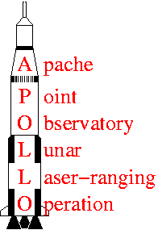
Processing SG data according to the requirements of the IGETS database, with Apache Point as an example
Goals of the AP SG project
David Crossley¹ and Tom Murphy²
¹Earth and Atmospheric Sciences, Saint Louis University,
²Astrophysics and Space Sciences, University of California San Diego
Thanks to: Mark Klaene, APOLLO Site Manager, New Mexico State University
R. David Wheeler (National Geospatial-Intelligence Agency, Holloman AFB) for AG measurements in the cone room
Bernard Ducarme, for discussions and results on tidal processing

Slide 2
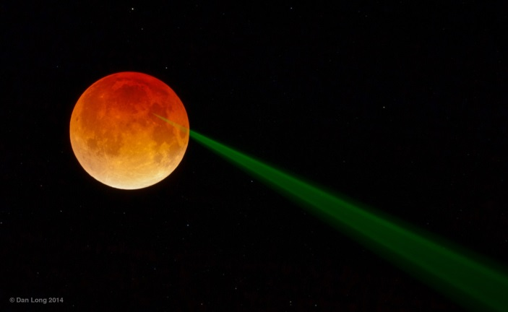
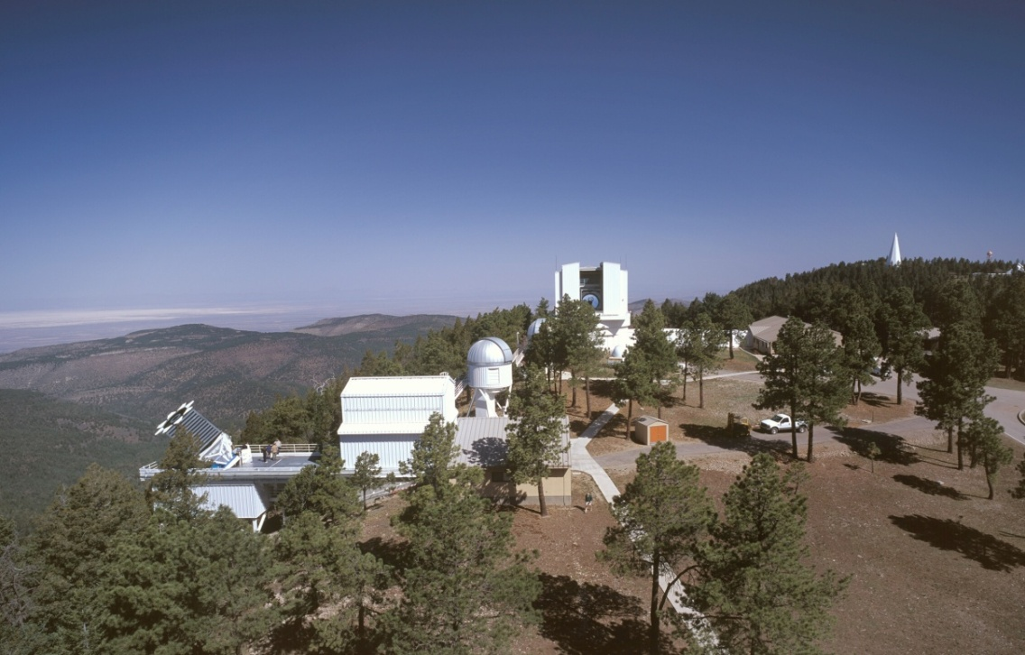
The APOLLO program at Apache Point
uses lunar laser ranging (Earth-Moon orbital separation) for various tests of general relativity
Apache Point 3 m LLR telescope with OSG-046 in cone room
SUNSPOT solar telescope and GPS
the SG (installed early 2009) is intended to improve the determination of local crustal elastic parameters and telescope motion, especially vertical displacements
tidal models get elastic parameters and we infer vertical displacements from residual gravity time series combined with GPS data

Slide 3
Processing for IGETS users
correcting function (new)
tidal analysis
calibration files
loading options (IGETS)
local hydrology model (IGETS / local)
assessing drift and trends

Slide 4
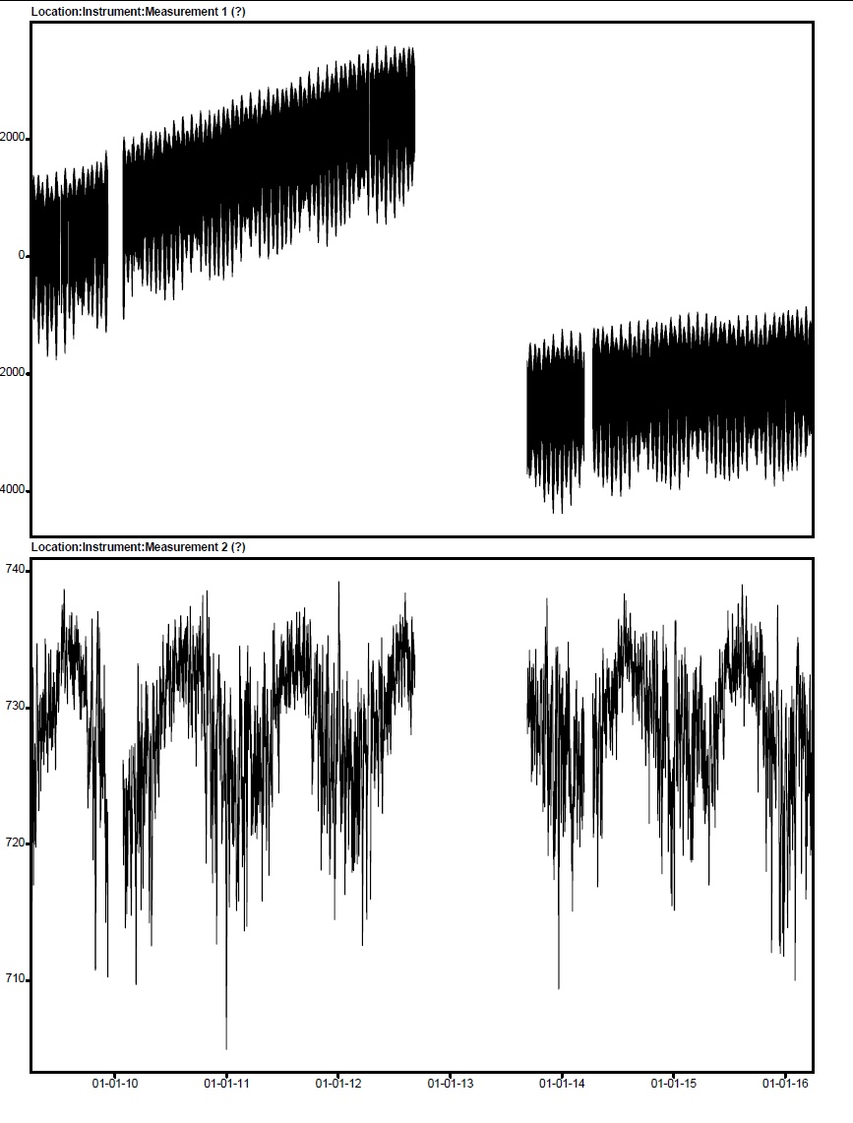
AP OSG 046
corrected 1 hr data - ICET
sensor replacement at GWR - 1 year
+12 μGal/yr
+70 μGal/yr
annual pressure high in summer
+10 hPa or
- 3 μGal/yr

Slide 5
Apache Point SG corrected residuals and AG values
drift removed 70 μGal/y
drift removed 12 μGal/y
servicing at GWR

Slide 6
The ICET 1 min corrected data is helpful for stations without significant manpower
corrections have removed spikes and disturbances, replaced with linear interpolation
but step removal may have been too aggressive and touched the long-term evolution of the signal
maybe can use ICET 1 min corrected data and restore offsets of specific sizes (e. g. > 1 mGal), retaining the obvious large step corrections
this is easiest when done by ICET, but optionally can be done by the user when the cormin files become available through GFZ (a 2-step process)

Slide 7
ICET-style cormin file with added correcting function
DATA CORRECTED AT ICET (bf.ducarme@gmail.com)
Filename : APDATA CORRECTED AT ICET (bf.ducarme@gmail.com)
Filename : AP090422.ggp
Station : Apache Point, New Mexico, USA
Instrument : GWR OSG 046
Time Delay (sec) : 8.2000 0.0100 nominal
N Latitude (deg) : 32.78036 0.0010 measured
E Longitude (deg) :-105.82042 0.0010 measured
Elevation MSL (m) : 2788.0000 5.0000 measured
Gravity Cal (uGal/V) : -79.328 0.1410 AG
Pressure Cal (hPa/V) : 1.0000 0.0001 nominal
Author : Tom Murphy (tmurphy@physics.ucsd.edu)
yyyymmdd hhmmss gravity(V) pressure(V) correct-func(V)
C**********************************************************
INSTR 1.0000 1.0000 0.000 0
77777777 0.000 0.000 0.000
20090401 000000 0.912988 721.4880 0.000001
20090401 000100 0.908741 721.4850 0.000001
20090401 000200 0.904532 721.4890 -0.000001
20090401 000300 0.900598 721.4950 -0.000001
20090401 000400 0.896731 721.5020 -0.000000
20090401 000500 0.892715 721.5030 -0.000002
gcf = g00 – g22/gcal
advantages:
all in volt to be used in conjunction with new calibration file
preterna format so as to be compatible with raw data
(requires extra step to prepare for ETERNA34)
gcf

Slide 8
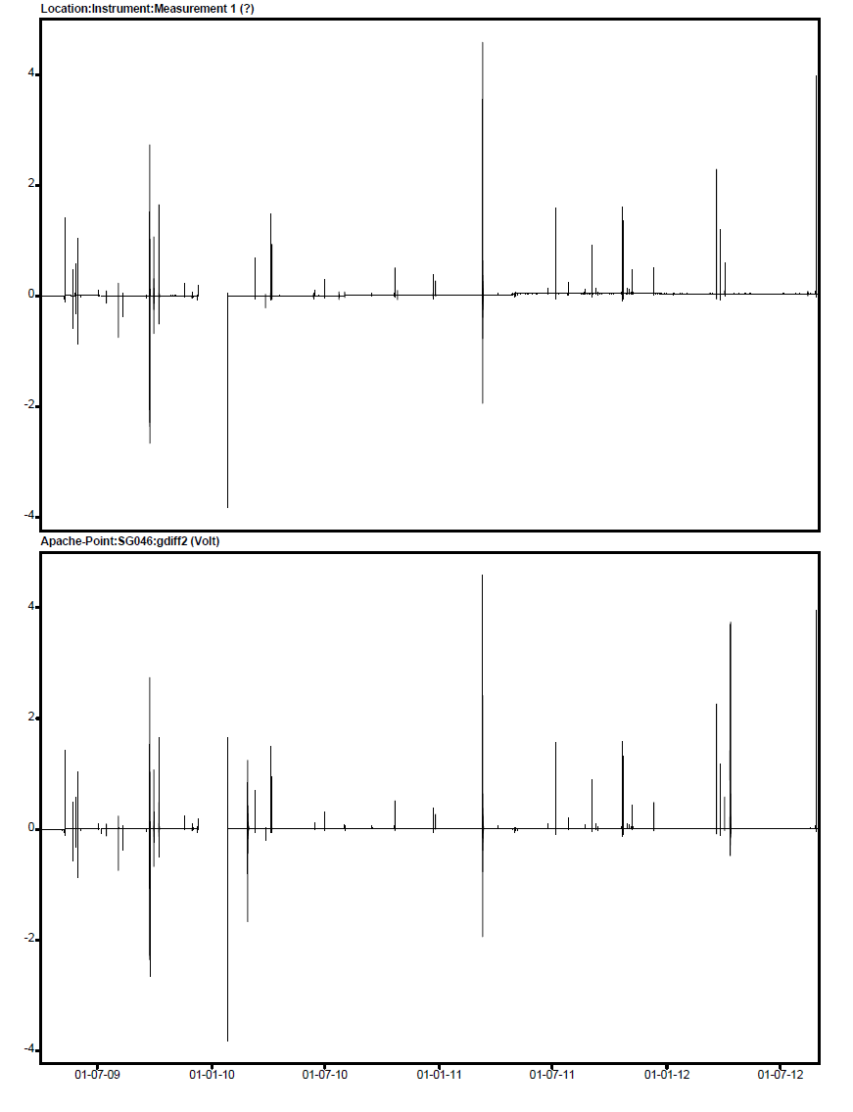
GCF extracted from ICET files 2009-2012 (Verschelle)
GCF processed locally (Crossley)

Slide 9
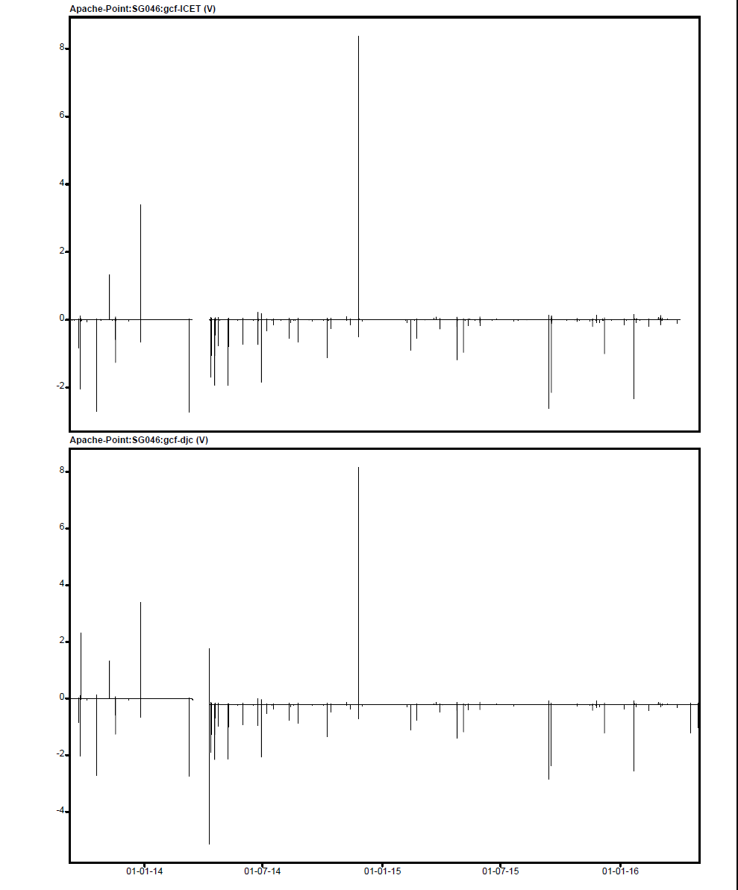
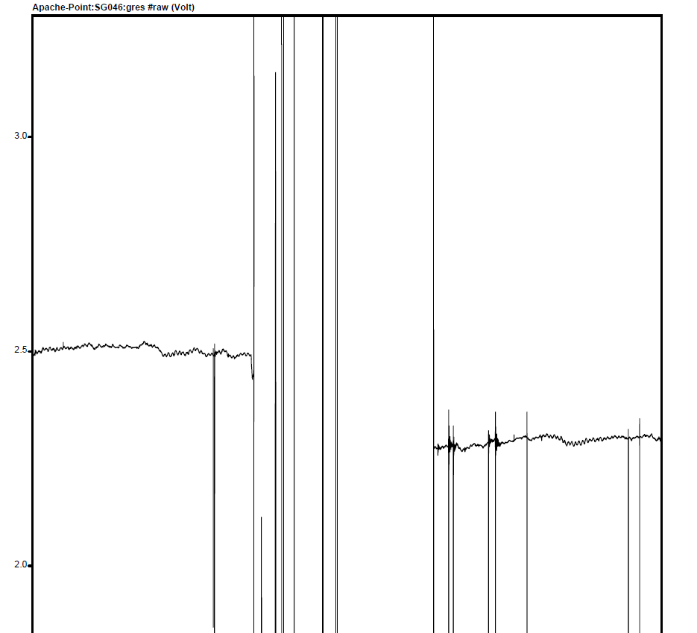
some discrepancies in 2013-2016 data
GCF extracted from ICET files 2009-2012 (Verschelle)
- 0.218 V
or 20.5 mGal
GCF processed locally (Crossley)

Slide 10
choices here:
Tamura potential
Matthews non-hydro elastic parameters
46 tidal groups
ANALYZE, PREDICT, and TWAVE
mean of 9 recent tidal models (as used by Ducarme),
Scherneck’s loading phasors (seems most reliable)
Conventional tidal analysis, following Ducarme’s many papers
options available:
tidal potential – Tamura 1200 / HW95 1900 waves
earth model – WD hydro, WD Zschau, WDD non-hydro, Matthews non-hydro
number of tide groups – 22 for 1 yr, 46 for 3 yr or more, etc.
programs for synthetic tides, tidal analysis
ocean tide loading models and computations
numerous studies have dealt with the various factors, most users will not test all combinations for their stations

Slide 11
time domain fit, following Goodkind (1991) to determine primarily A (volt /μGal)
gobs(t) = A*solid(t) + B*gotl(t) + C*p(t) + D*pm(t) + E*t + F
(V) (μGal) (μGal) (hPa) (μGal) (V) (V)
case | combine | solve for
1 | tide = (solid+otl+press+pm) | tide, offset
2 | tide = (solid+otl+p+pm) | tide, drift, offset
3 | tide = (solid+otl+pm) | tide, p, drift, offset
4 | tide (solid+pm) | tide, otl, p, drift, offset
5 | tide = (solid) | tide, otl, p, pm, drift, offset
6 | tide = (local+pm) | p, drift, offset
7 | tide = (local) | p, pm, drift, offset
the constants are converted to usual units
A’ = 1/A μGal / V
B’ = B/A factor
C’ = C/A factor (admit)
D’ = D/A factor
E’ = E/A μGal /yr
F’ = F/A μGal

Slide 12
Solution for 2 different data segments work with mixed success
gcal errors similar to AG errors, drifts are as expected; other factors poorly determined
2009/04 - 2012/09 segment
chisq | gcal | err | otl | pcal | pm | drift | offset
8704.11 | -78.86 | 0.64 |  |  |  |  | 177.07
23.72 | -78.53 | 0.64 |  |  |  | 64.76 | 92.33
22.72 | -78.56 | 0.64 |  | -0.41 |  | 64.92 | 93.10
18.02 | -78.89 | 0.66 | 0.13 | -0.41 |  | 65.18 | 93.50
16.39 | -78.86 | 0.66 | 0.13 | -0.33 | 0.45 | 65.04 | 95.90
12.43 | -79.30 | 0.64 |  | -0.42 |  | 65.52 | 94.09
10.96 | -79.27 | 0.64 |  | -0.35 | 0.47 | 65.02 | 96.39
2013/08 - 2016/04 segment
chisq | gcal | err | otl | pcal | pm | drift | offset
146.17 | -93.32 | 1.05 |  |  |  |  | -228.86
28.96 | -93.36 | 1.05 |  |  |  | 12.72 | -242.01
27.04 | -93.43 | 1.06 |  | -0.52 |  | 12.31 | -239.84
16.80 | -94.46 | 1.13 | -1.04 | -0.52 |  | 12.44 | -242.52
15.62 | -94.43 | 1.13 | -1.03 | -0.52 | 0.39 | 12.39 | -239.09
16.50 | -94.03 | 1.06 |  | -0.53 |  | 12.38 | -241.33
15.33 | -94.01 | 1.06 |  | -0.52 | 0.39 | 12.34 | -237.94

Slide 13
2009-2012
solutions 2-5 depending on the theoretical values all have a significant tidal residual,
whereas the local delta factors 6-7 (based on ETERNA analysis) are clearly better

Slide 14
Time domain tidal fitting 2009-2012
calibration constant probably smaller than AG value,
about -78.90

Slide 15
2013-2016
solutions 2-5 depending on the theoretical values all have a significant tidal residual,
whereas the local delta factors 6-7 (based on ETERNA analysis) are clearly better

Slide 16
Time domain tidal fitting 2013-2016
calibration constant maybe larger than AG value,
about -94.50

Slide 17
There are 12 possible combinations of 3 atmospheric and 4 hydrological loadings
- here an example of my worksheet to see which ones are current for the data
iECMWF op IB and GLDAS / Noah are usually most up to date

Slide 18
local air pressure varies somewhat with the model, but significant differences exist with the local pressure loading, depending of course on the admittance

Slide 19
some models seem quite coherent
e.g. ECMWF op vs MOG2D and ECMW ERA-I

Slide 20
... but they have quite a wide scatter

Slide 21
local hydrology has by far the largest additional loading / attraction to be corrected in the residual gravity

Slide 22
relative sizes of the various corrections, only the local P and PM is corrected for in most AG data
(except when part of a calibration)

Slide 23
simultaneous fit of a drift function to fully corrected SG and AG data

Slide 24
residual and AG
local hydrology model not yet applied

Slide 25
Questions arising ...
Which AG values should we send to the AGRAV database?
everyone says just send the results of the microG software, but those values have no corrections for hydrology, and can be off by 5-10 microgal depending on the season.
If we know this, should there not be a way of recording this in AGRAV?
also, if the AG value comes from a calibration experiment one cannot use the microG output files

Slide 26
Questions arising ...
(2) A related question concerns instrument drift.
I have been fitting a drift function that consists of an initial exponential + linear function to both the SG series and to the available AG data (experimenting with weighting the AG values differently to the SG values).
But the inclusion of hydrology corrections will also influence the SG instrument drift assessment if one is fitting a fully corrected SG series (including hydrology) to uncorrected AG values.
In this case I think one should apply all the same loading corrections to the AG data as the SG data.

Slide 27

End

Slide 28
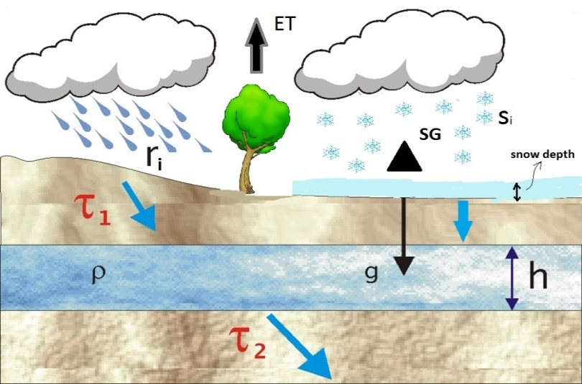
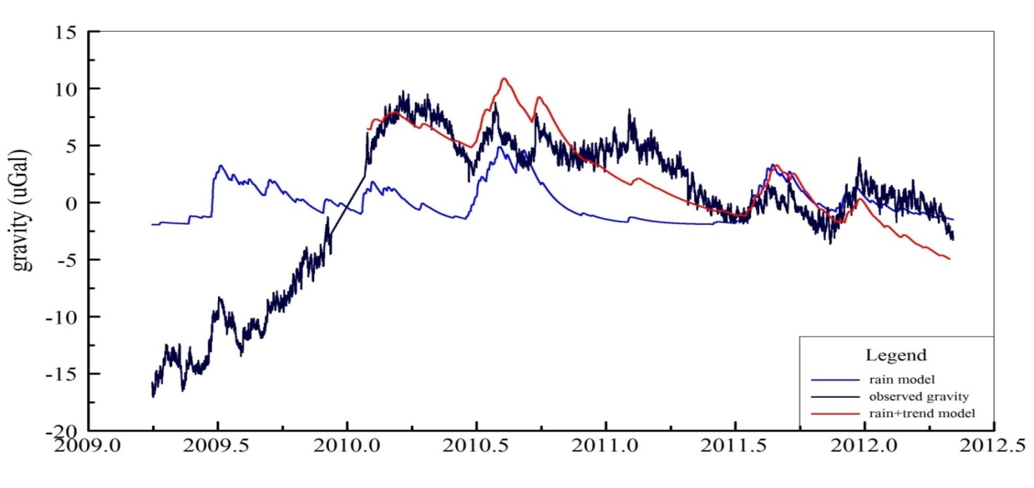
Fit the new model parameters to the gravity residuals
use Monte-Carlo simulation to start followed by Levenberg-Marquardt inversion
Model parameters:
recharge τ₁ (d)
discharge τ₂ (d)
offset (μGal)
Slope (μGal/d)
A_{sw}
melting factor K
ET factor β

Slide 29
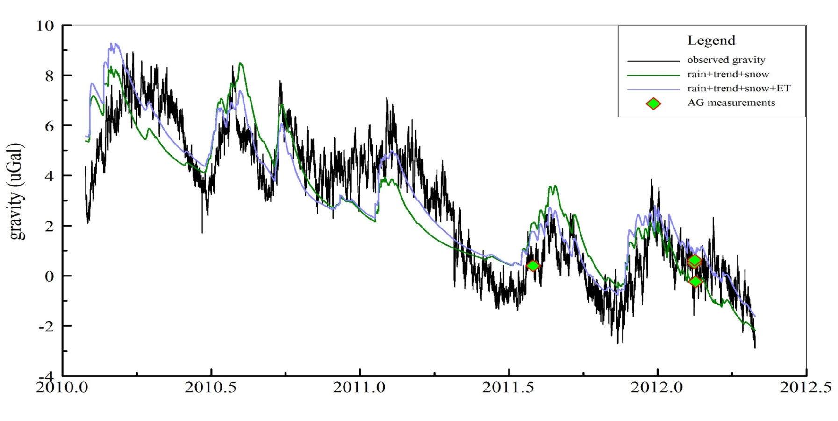
Add snow effect (green) and ET effect (purple) to the model

