Slide 1
Applying the Three-Ingredients Method to the QLCS Warning Process: An Interactive Case Study
John P. Gagan – NWS Milwaukee, WI
Jason Schaumann – NWS Springfield, MO

Slide 2
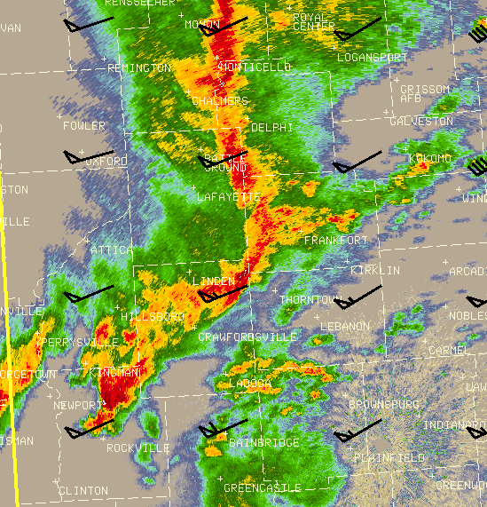
Three Ingredients Method Schaumann and Przybylinski 2012
QLCS mesovortex genesis and strong intensification is favored where the following three criteria are co-located:
A portion of the QLCS in which the system cold pool and ambient low-level shear are nearly balanced or slightly shear-dominant
Where 0-3 km line-normal bulk shear magnitudes are equal to or greater than 30 knots
Where a rear-inflow jet (RIJ) or enhanced outflow causes a surge or bow in the line
17 Nov 2013 Central Indiana
Keep in mind that mesovortex genesis and strong intensification does not necessarily mean a tornado!
Notes:
2012 Severe Local Storm conference (manuscript and poster)
Mesovortex genesis and strong intensification does not necessarily mean a tornado!

Slide 3
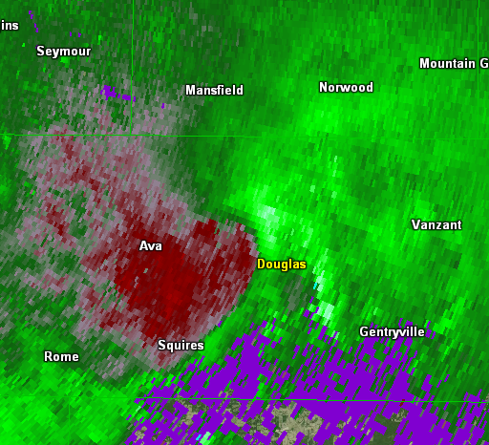
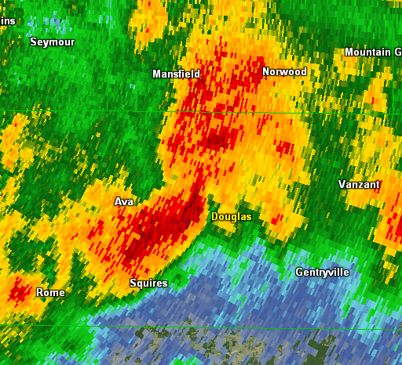
Shear/Cold Pool Balance Locating Balanced/Slightly Shear Dominant Regions
0.5° SRM
0.5° Z
Slightly Shear
Dominant
UDCZ
Entry
Point
Balanced
Slightly Cold
Pool Dominant
3 Apr 2015 Southern Missouri
Locate updraft/downdraft convergence zone (UDCZ) using 0.5° V/SRM products.
Compare location of UDCZ to 0.5° reflectivity field.
Notes:
Determining ingredient #1
Worst is not always first!
Point out inflection point
Mesovortices remain tethered to the UDCZ

Slide 4
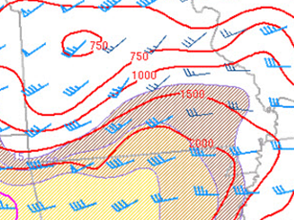
Three Ingredients Method Application
0-3 km Bulk Shear/MLCAPE
0.5° SRM
0.5° Z
Favored Region for
Mesovortex Genesis
UDCZ
SPC Meso Page
0-3 km line-normal bulk shear magnitude ≥ 30 knots
Balanced or slightly shear dominant
RIJ or enhanced outflow causing surge or bow in the line

Slide 5
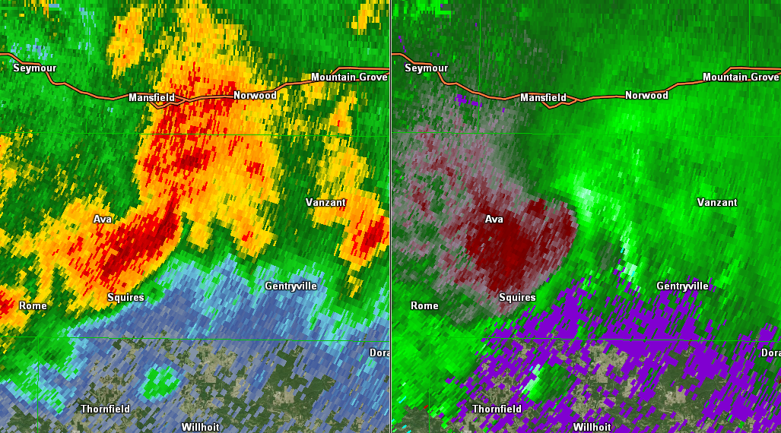
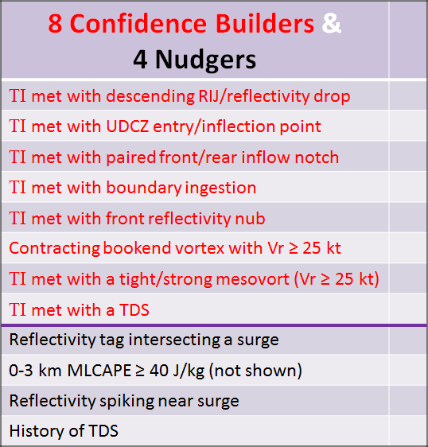
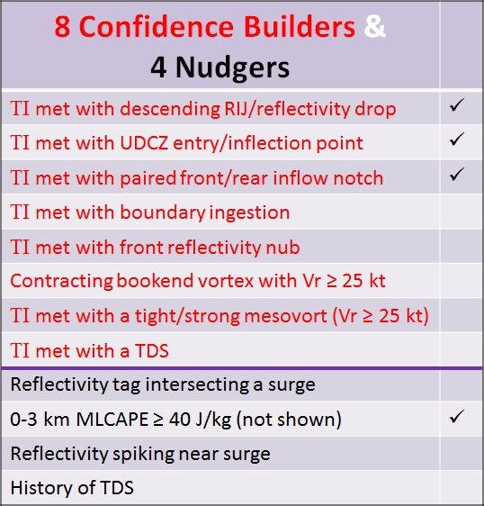
Warning Decision Guidance Scenarios for Considering a Tornado Warning
Reflectivity Drop
Entry Point
RIN
EF-1
FIN
Enhanced Surge
from Descending RIJ
UDCZ
0.5° Z
0.5° SRM
While a few confidence builders being present is often worthy of considering a Tornado Warning, confidence should further increase as confidence builders and/or “nudgers” continue to increase.
Notes:
Using the three ingredients method as a foundation, we have identified additional radar features and mesoscale parameters which indicate an increased likelihood for tornadoes
EF-1 tornado near Vanzant, MO
Don’t want to wait until the last two scenarios if at all possible
Poster session this afternoon and again on Wednesday

Slide 6
Case Study: Northeast Oklahoma
16-17 May 2015
Quick Meso-Review

Slide 7
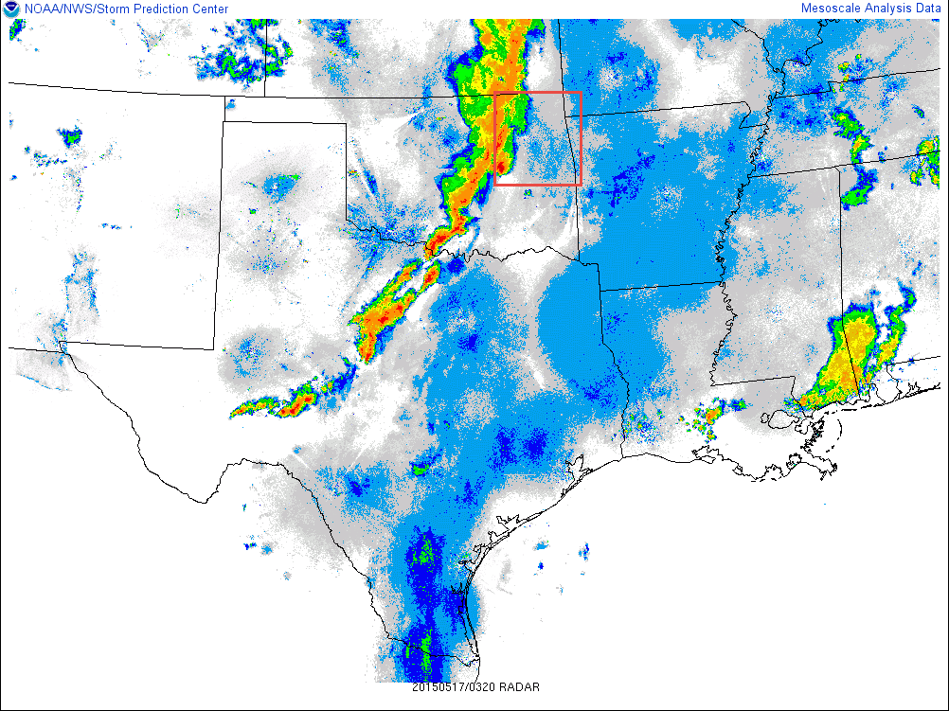
0320 UTC

Slide 8
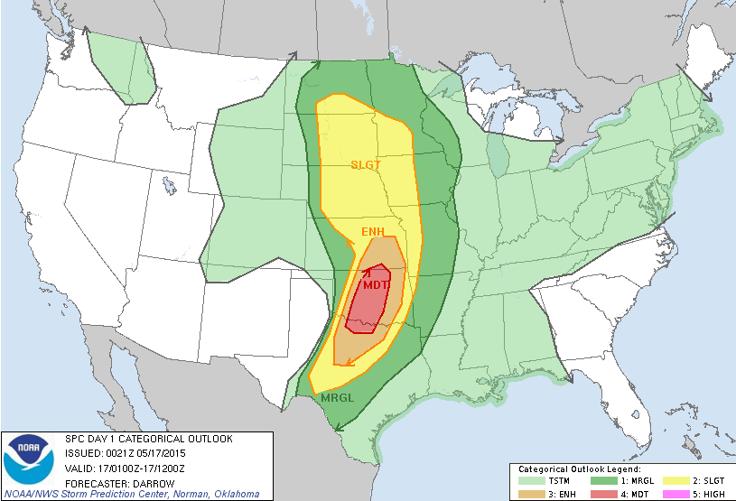
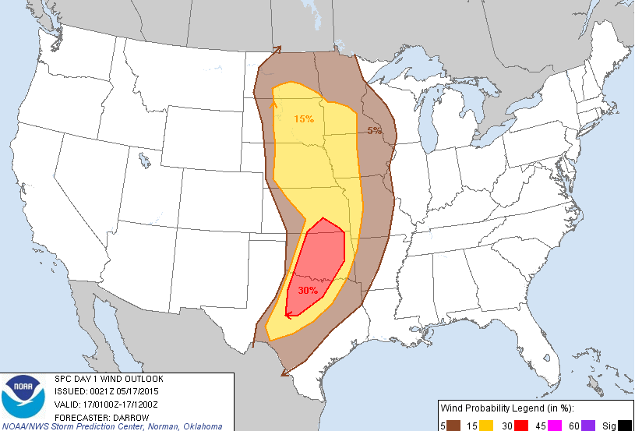
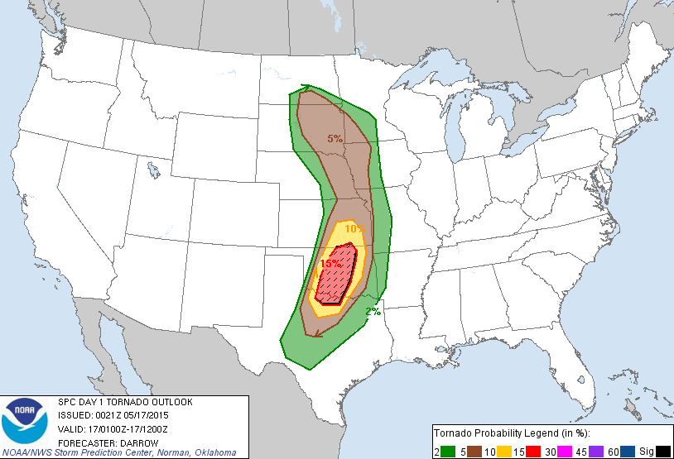
Categorical
Wind
Tornado

Slide 9
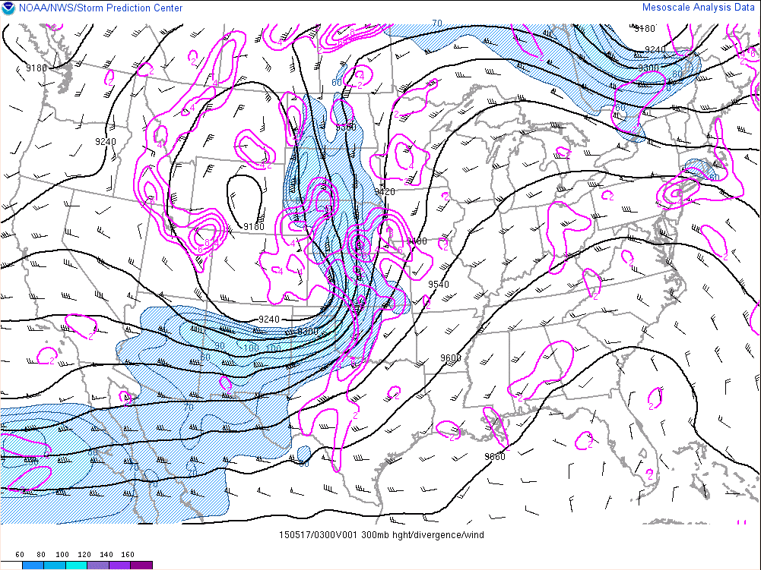
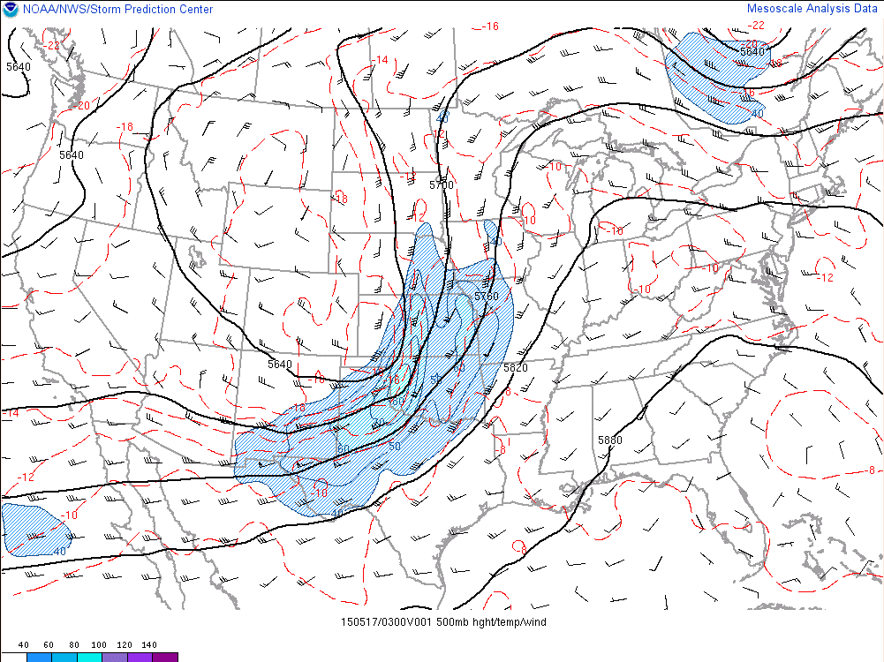
300mb
300mb
Cyclonic Upper Jet
100kt core
500mb
500mb
Shortwave – negative tilt
80kt core
Broad 40-50kt spreading over warm sector

Slide 10
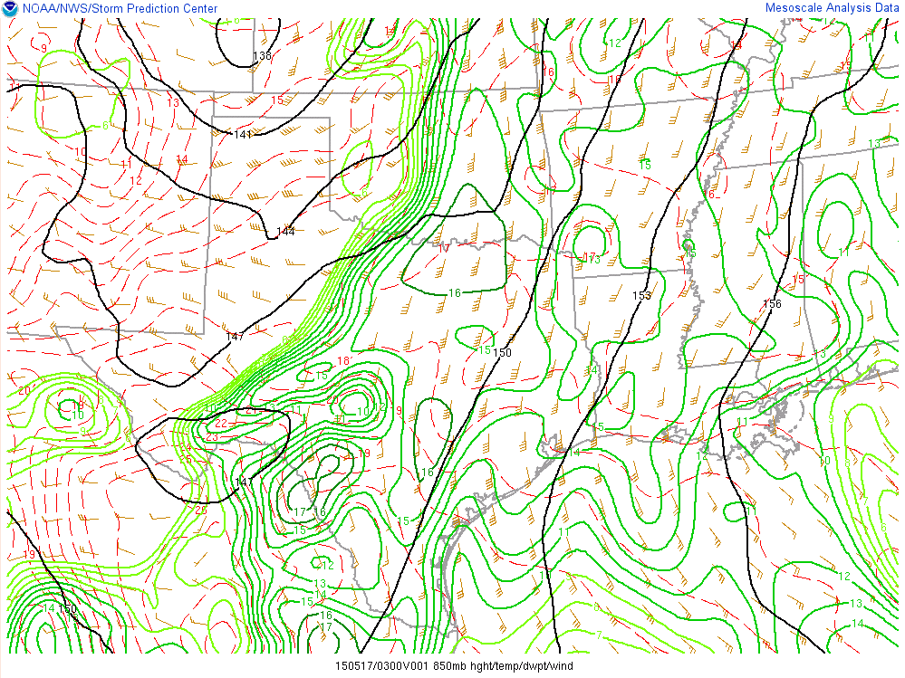
0300 UTC 850mb
Notes:
Very moist
40-50kt LLJ – due south to north

Slide 11
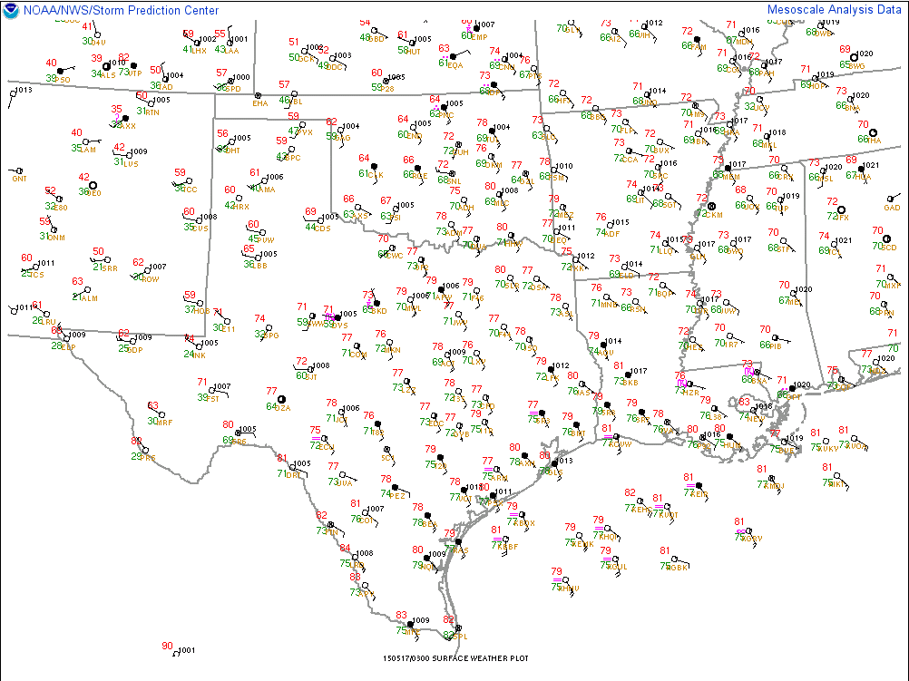
0300 UTC
Notes:
Surface winds are backed.
Tds well into the 60s.

Slide 12
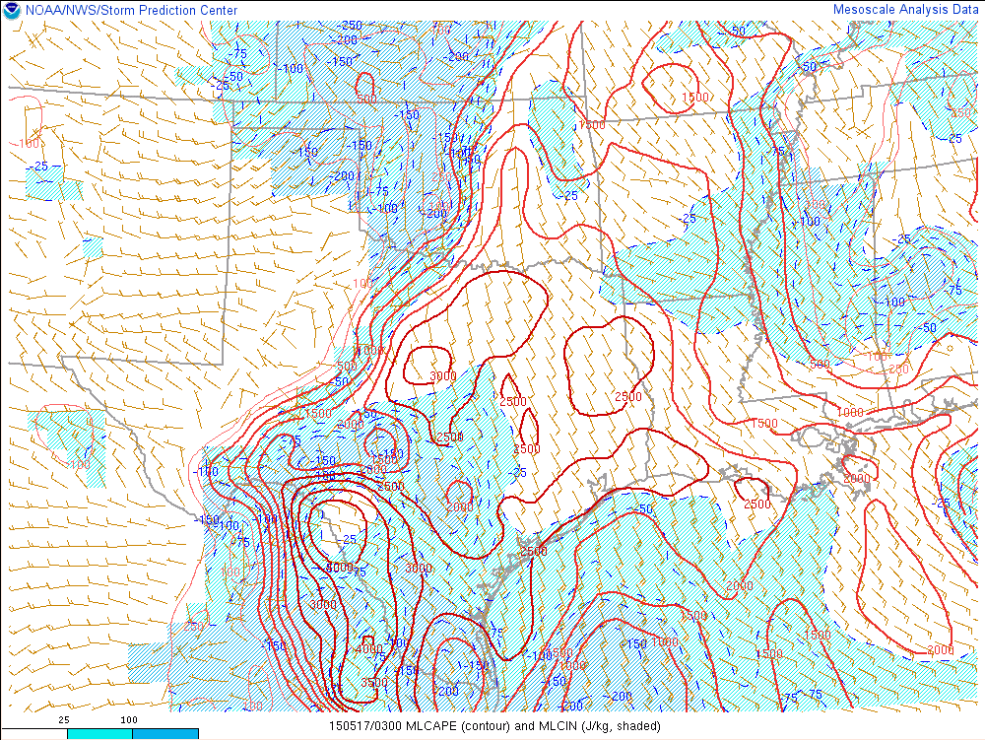
0300 UTC MLCAPE/CIN
Notes:
Uncapped.
Ridge of 2000-3000 J/kg nosing into the region.

Slide 13
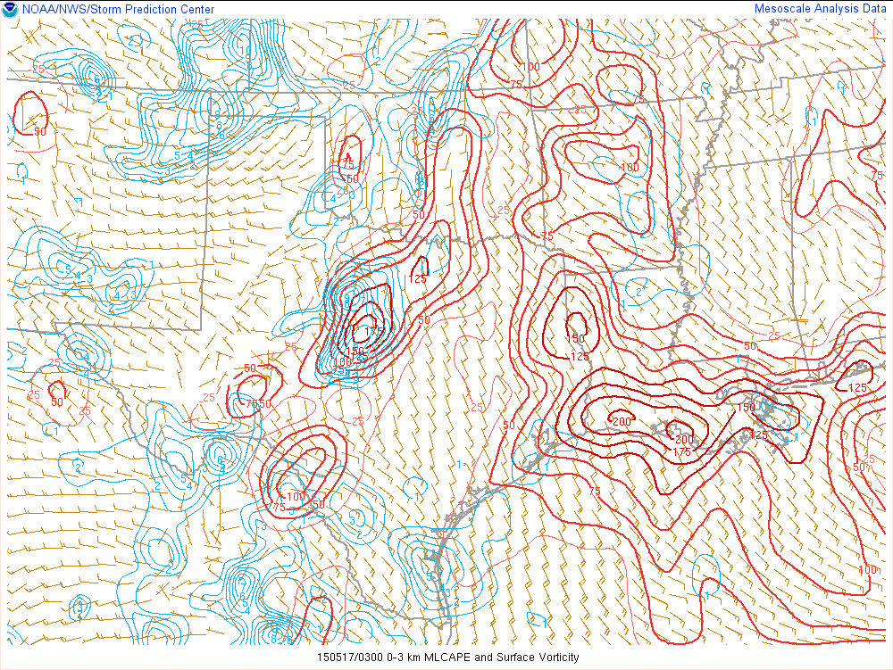
0300 UTC Low Level CAPE
Notes:
Are these low level CAPE values trustworthy?

Slide 14
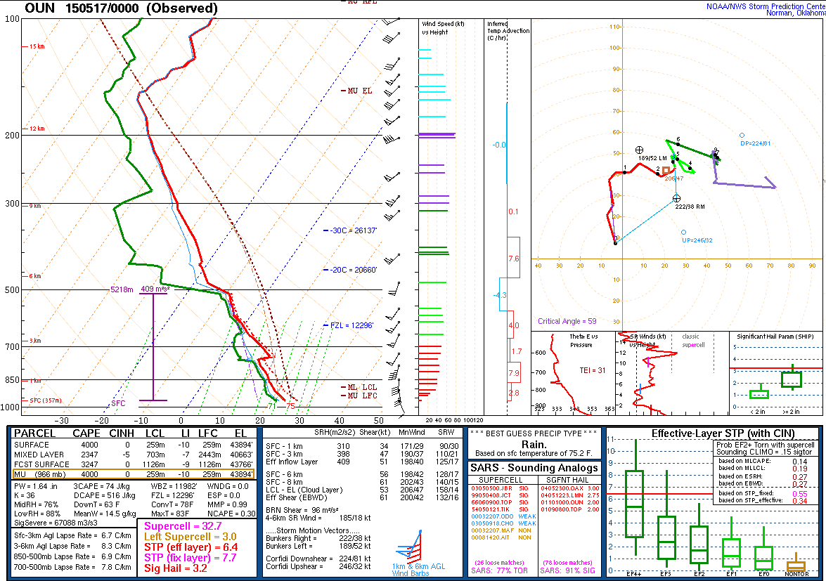

Slide 15
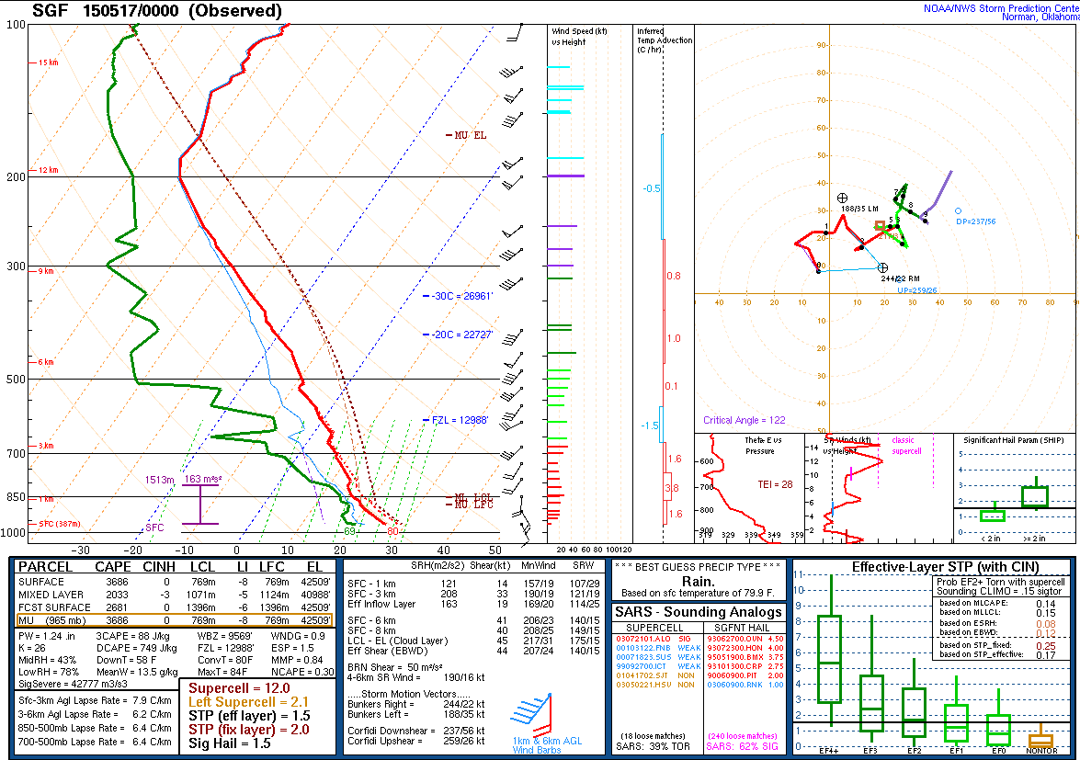

Slide 16
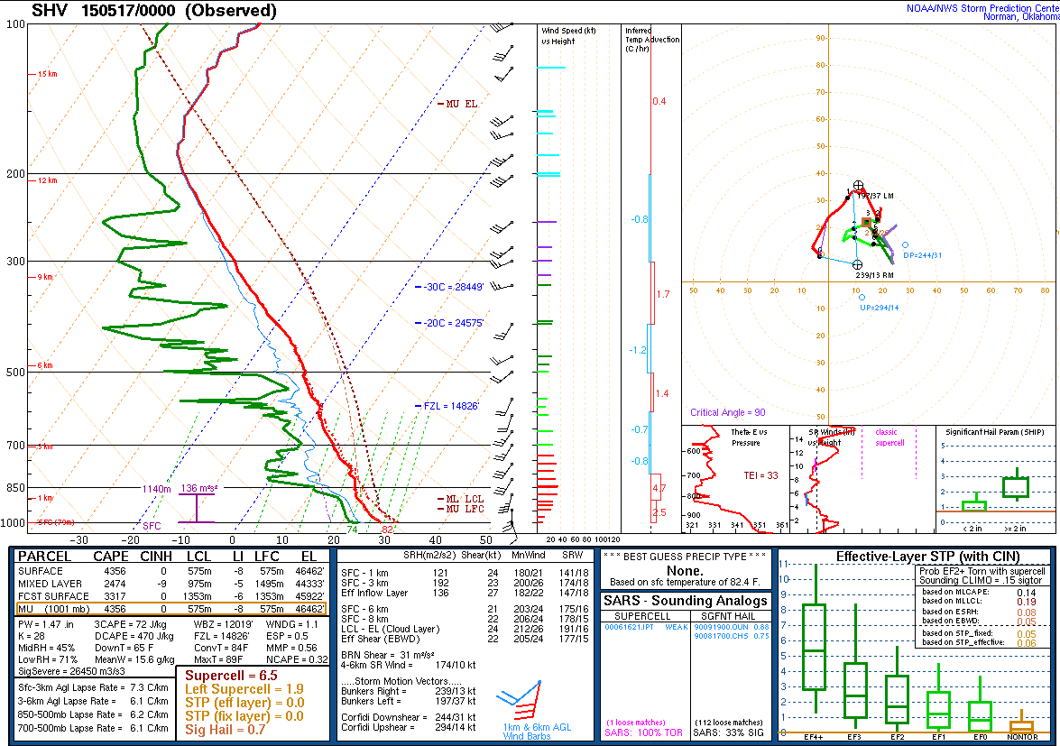

Slide 17
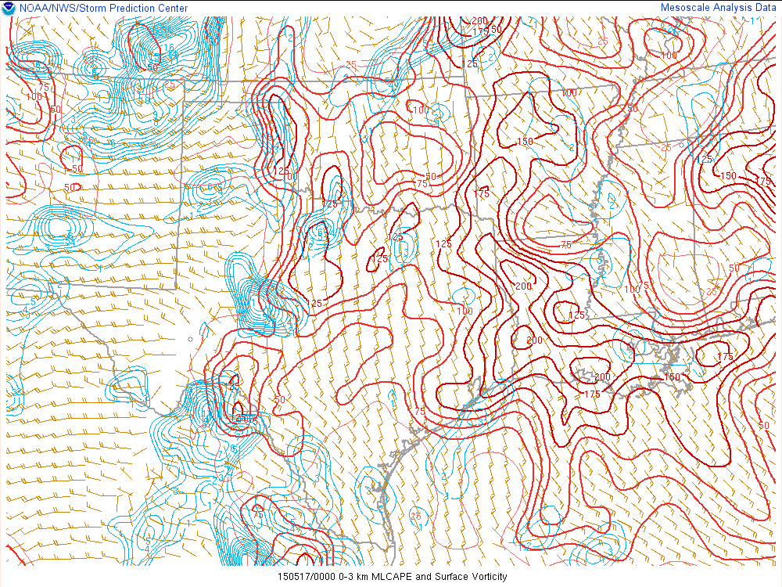
0000 UTC Low Level CAPE
88
Pro Tip
74
72
Notes:
Beware to compare objective analysis to raobs:
OUN raob to OA – 74 J/kg vs. 50-75 J/kg
SGF raob to OA – 88 J/kg vs. 100 to 125 J/kg
SHV raob to OA – 72 vs. ~175 J/kg

Slide 18
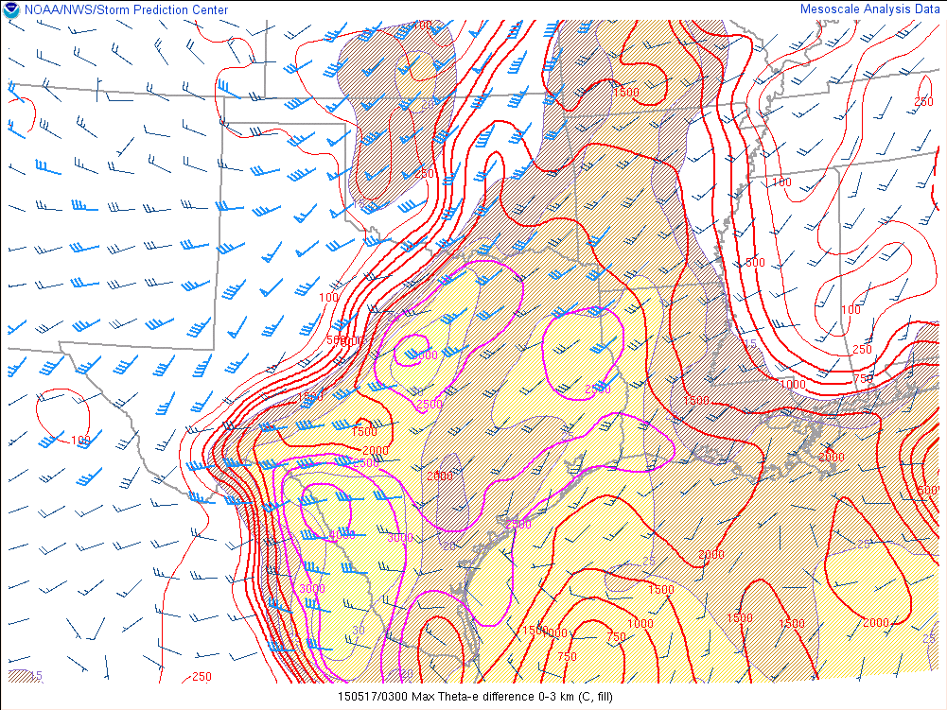
0300 UTC
0-3km Shear
0-3km ϴe
MLCAPE
Notes:
0-3km Shear oriented southwest-to-northeast ~30kt to as much as 40kt.
0-3km Theta-E is 15-20K
What orientations to the UDCZ would give you a 30 knot line-normal component?

Slide 19
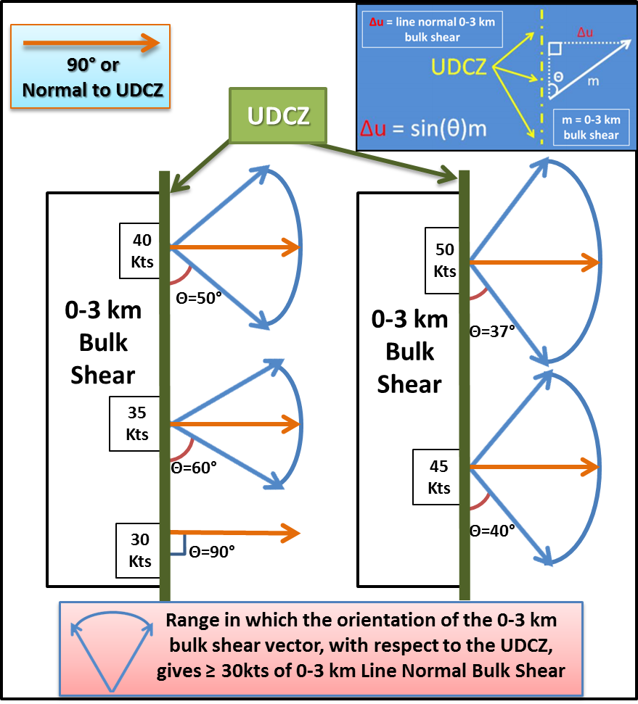
Line Normal Component

Slide 20
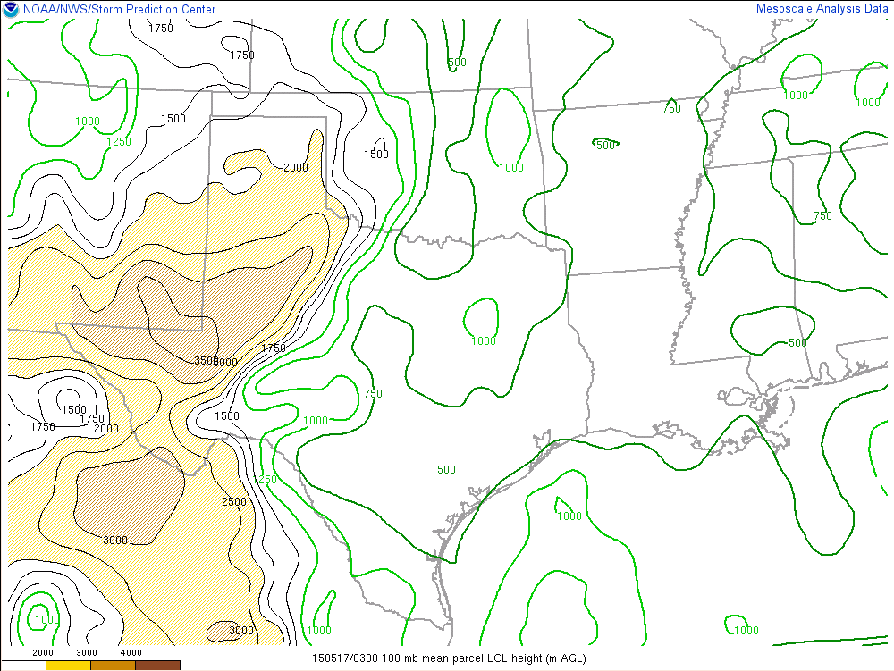
0300 UTC
LCL
Notes:
LCLs 500-1000m
Or ~1600-3200ft

Slide 21
Case Study: Northeast Oklahoma
16-17 May 2015
Warning Application
Radar - KINX

Slide 22
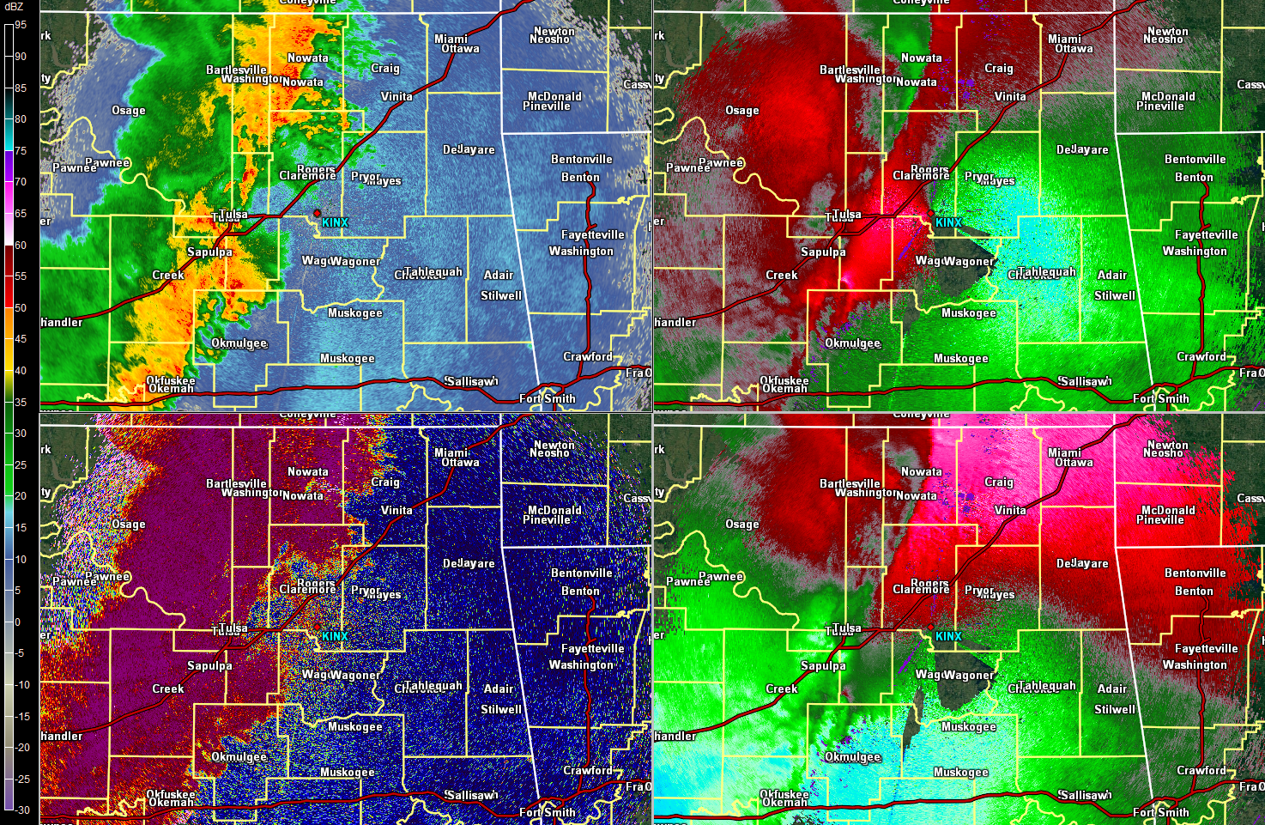
KINX 0.5° – 0359 UTC

Slide 23
What Radar Settings Would Be Optimal At This Point?
VCP12 as there are no RF issues.
AVSET should be enabled.
MESO-SAILS 2 or 3 are recommended.
CMD should be turned OFF if there is potential for tornadoes within 30 miles of the RDA.
Pro Tip

Slide 24
0408 UTC What Is the Typical Level for Mesovortex Genesis?
Around or just above 1km AGL.

Slide 25
0408 UTC
How Would This Impact Your Radar Interrogation Strategies as This System Approaches the RDA
Pro Tip
The 0.5° tilt will likely not be optimal as you get inside of 30nm.
Pro Tip
Begin looking at other lower to mid-level tilts to interrogate for mesovorticies.
Mid-Level Rescan of Low-Elevations (MRLE) will be a big help!

Slide 26
0421 UTC – Apply the Three Ingredients
UDCZ is provided for you
Determine which areas of lines are balanced or slightly shear dominant
Determine where 0-3 km line normal magnitudes are ≥ 30 knots
Determine where a surge or bow is present
Where do all three of these ingredients exist?
This is your area where mesovortex genesis is favored!

Slide 27
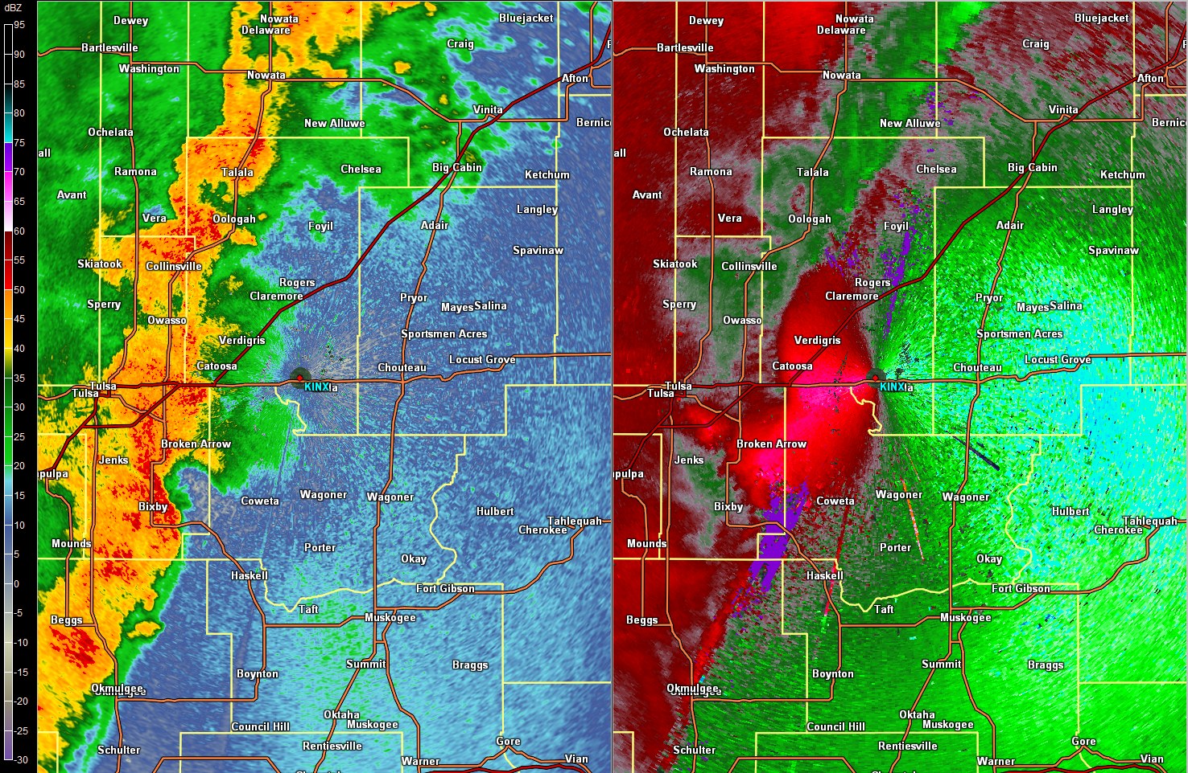
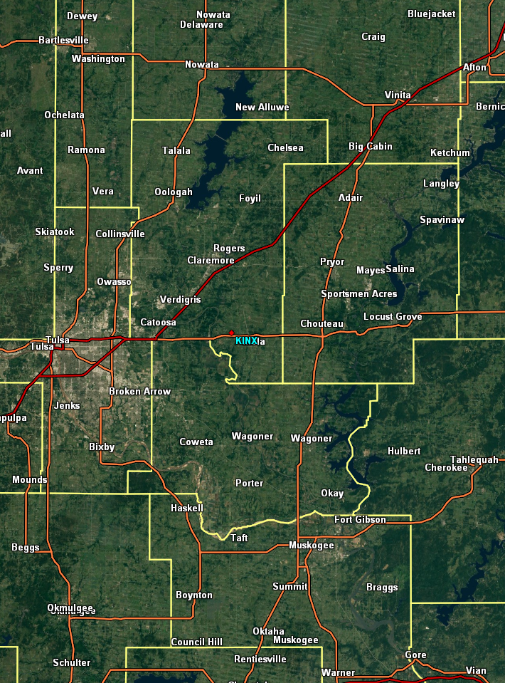
KINX 0.5° – 0421 UTC – UDCZ
Slightly Shear
Dominant
Slightly Shear
Dominant
Balanced
Balanced
Slightly Cold
Pool Dominant
Slightly Cold
Pool Dominant

Slide 28
KINX 0.5° – 0421 UTC
Three Ingredients
Favored Region for
Mesovortex Genesis
Favored Region for
Mesovortex Genesis
Favored Region for
Mesovortex Genesis
What type of warning would you consider issuing?

Slide 29
Bow Echo Color Curve
Pro Tip
Color curves matter
Central Region Tornado Warning Improvement Project has developed situation-specific color curves
The Bow Echo Color Curve “brings out” more features between +/- 10 to 40 knots

Slide 30
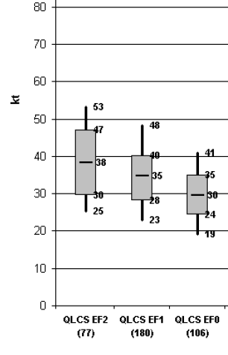
Why Focus in the +/- 10 to 40kt Range?
Smith et. al 2012

Slide 31
0429 UTC – Confidence Builder & Nudger Checklist
8 Confidence Builders & 4 Nudgers
TI met with descending RIJ/reflectivity drop
TI met with UDCZ entry/inflection point
TI met with paired front/rear inflow notch
TI met with boundary ingestion
TI met with front reflectivity nub
Contracting bookend vortex with Vr ≥ 25 kt
TI met with a tight/strong mesovort (Vr ≥ 25 kt)
TI met with a TDS
Reflectivity tag intersecting a surge
0-3 km MLCAPE ≥ 40 J/kg (not shown)
Reflectivity spiking near surge
History of TDS

Slide 32
KINX 0.5° – 0429 UTC – Checklist
Reflectivity Drop
Entry Point
FIN
RIN
Enhanced Surge
from Descending RIJ

Slide 33
0451 UTC What Are The Chances of a Spotter Seeing a Mesovortex Tornado and Getting Real-Time Tornado Reports?
Very low.
Only shot is with a mesovort in a balanced region (i.e. not rain wrapped).
This is why TDSs are your best friend!

Slide 34
0456 UTC
Pro Tip
All mesovorticies develop and remain tethered to the UDCZ!

Slide 35
0507 to 0518 UTC Why Did Mesovortex Genesis NOT Materialize near Muskogee and Wagoner?
The UDCZ never pivots enough to meet the 30kt+ line normal magnitude threshold for the three ingredients method.
Once the cells out ahead of the main line (developing due to increased convergence owing to a descending RIJ) merge back in with the line, the UDCZ is still oriented from about 20° to 200°.

Slide 36
Line Normal Component

Slide 37
0512 UTC Sketch a Tornado Warning
Pro Tip
When drawing a polygon consider:
Track of surges
Balanced/slightly shear dominate regions
Account for potential migration of mesovorticies to the north
Avoid multiple warnings over small areas which can create confusion

Slide 38
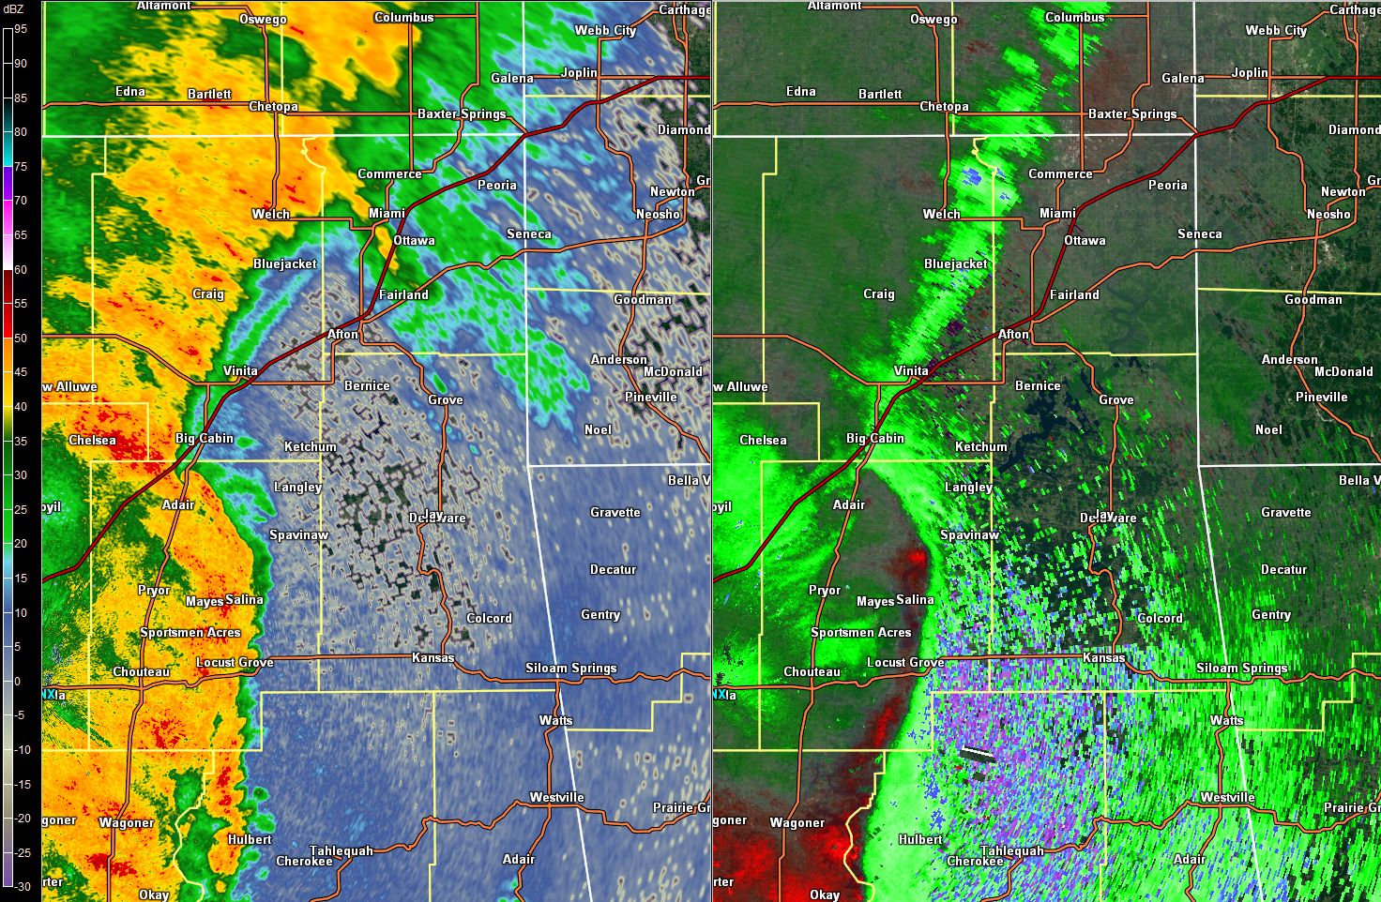
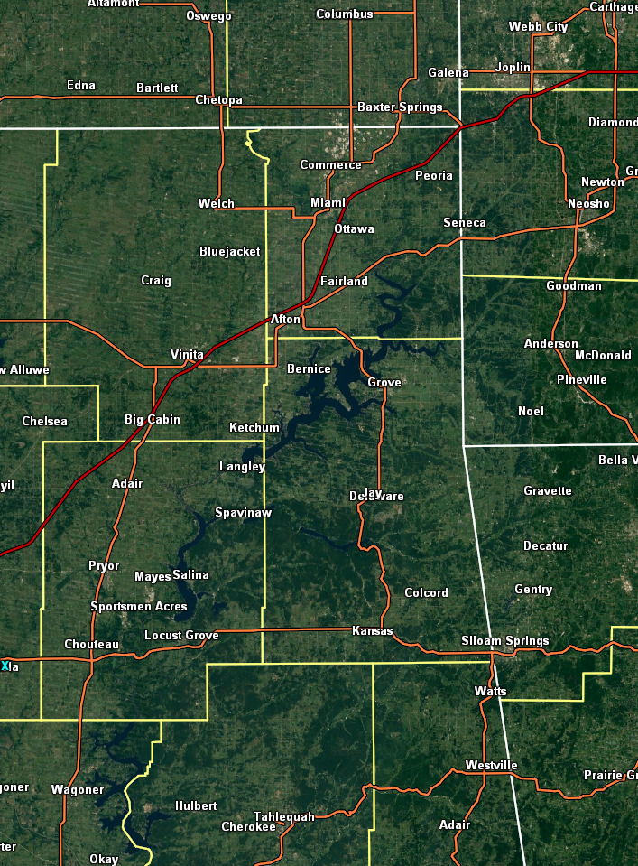
KINX 0.5° – 0512 UTC – Our Polygon
Tornado Warning – Craig, Mayes, Ottawa and Delaware
Until 0600 UTC (45 minutes)

Slide 40
Tornadic Debris Signatures
Pro Tip
If possible, have multiple people looking for TDSs during an event.
Have at least one person look again after an event.
Additionally, make sure you are using raw CC data within AWIPS. This is not the default!
The CR TWIP team will be sending out a memo on this shortly.

Slide 41
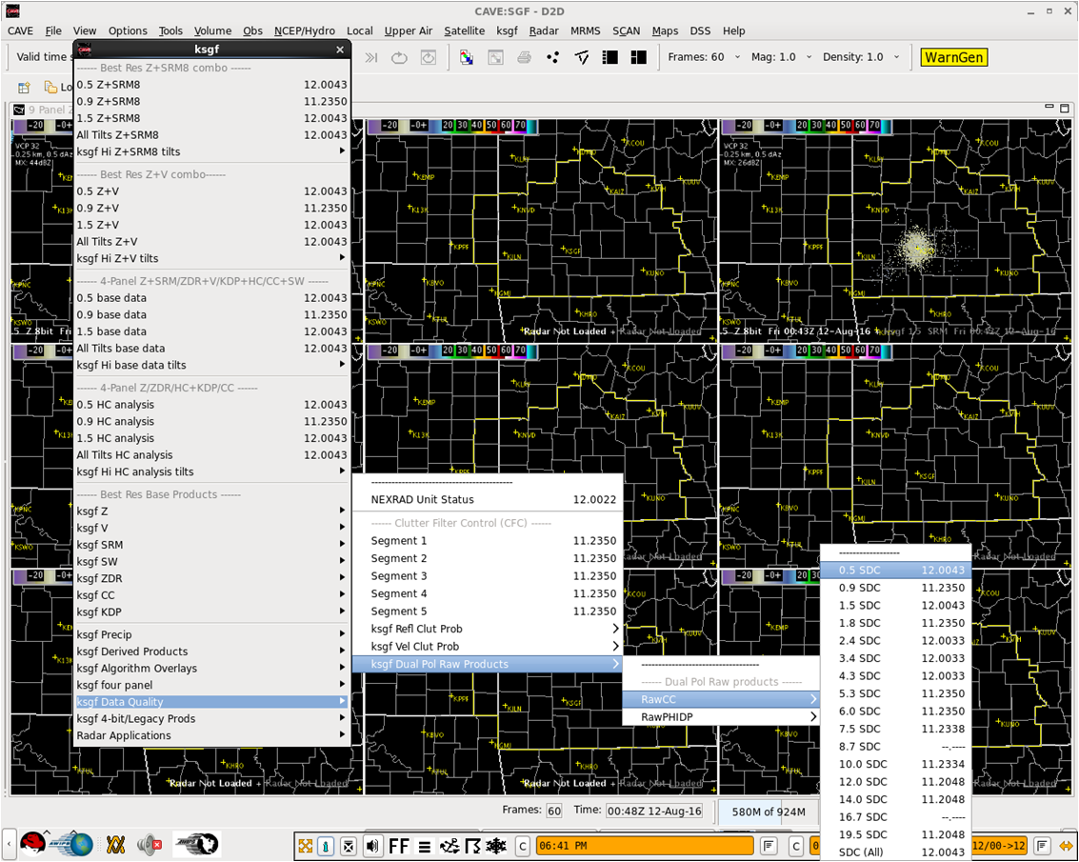
Finding Raw CC in AWIPS

Slide 42
0505 to 0523 UTC What Might The SRM Inbounds Represent on the 1.8° to 2.4° Tilts Between Big Cabin and Vinita?
This appears to match the 2009 Atkins/Laurent research.
Recall the conceptual model where the parcels descend right along or just behind the UDCZ.

Slide 43
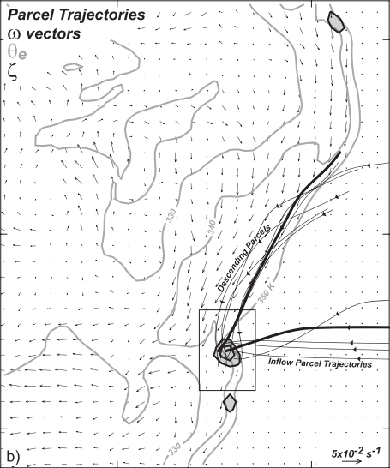
Atkins Conceptual Model

Slide 44
0524 UTC Where Is The Mesovort/Possible TDS In Relation To The Precipitation/Updraft Cores?
Back into the reflectivity.

Slide 45
0524 UTC
Is This Immediate Portion of the Line Balanced or Slightly Shear Dominant?
Probably slightly shear dominant.

Slide 46
0550 UTC What Are The Odds of “Seeing” Mesovortex Genesis At This Point Along The Bow Echo?
Odds are not good
Beyond 40nm, the radar beam is beginning to overshoot the typical mesovortex genesis region
You may see mature mesovorticies beyond 40nm – they oftentimes rapidly grow upwards

Slide 47
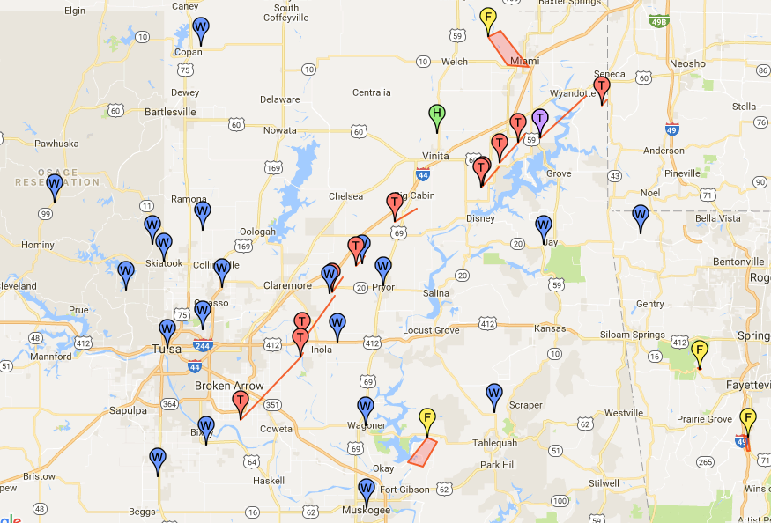

Slide 48
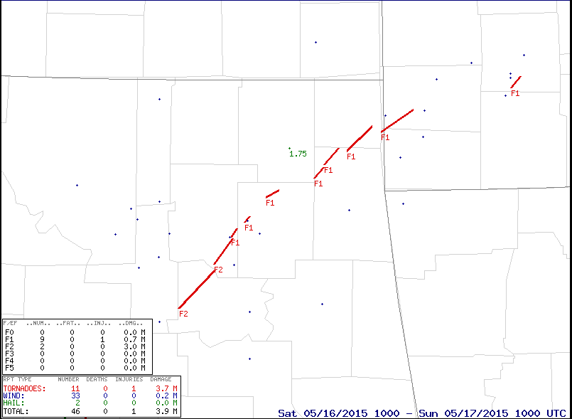

Slide 49
Closing Comments & Questions
Materials will be available on SLU web site
Case will be available to bring back to your respective offices

