Slide 1
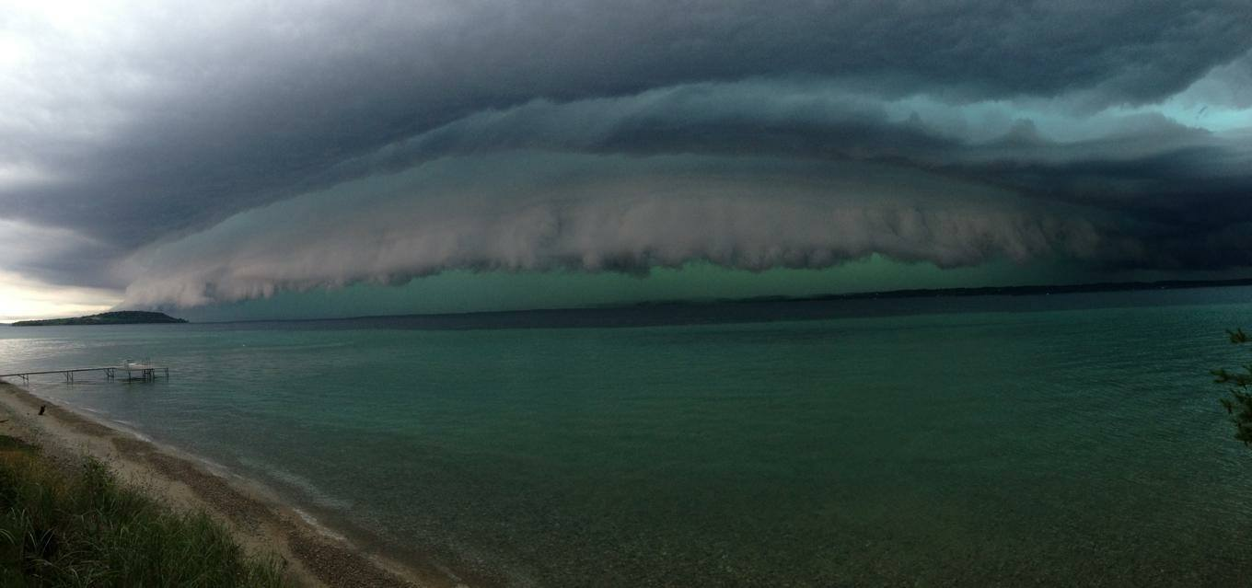
Overview of the 2 August 2015 Northern Michigan Severe Weather Outbreak
Aaron Mayhew/Matt Gillen/John Boris
National Weather Service
Gaylord MI

Slide 2
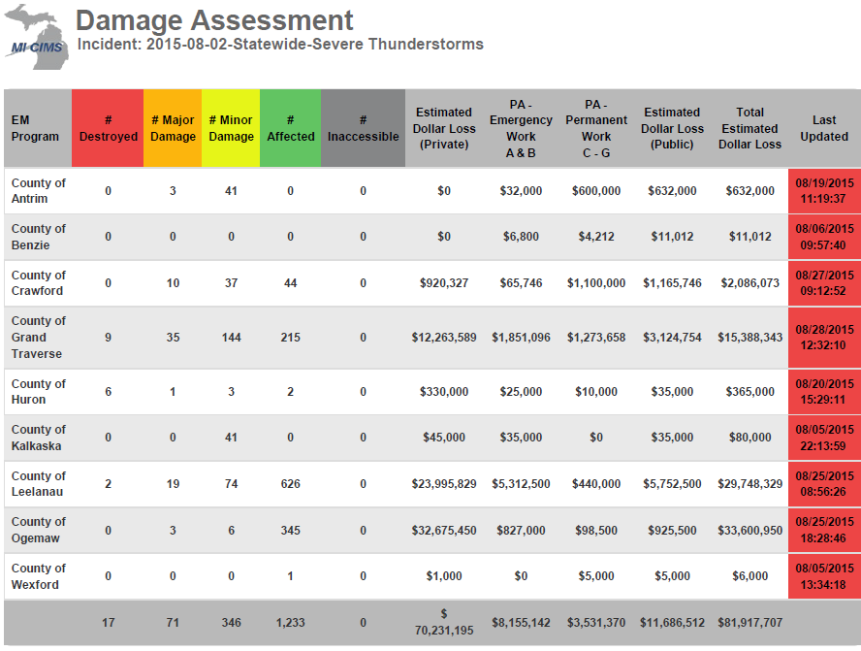
Overview
Notes:
Most expensive severe weather event in our CWA. Focus will be on Leelenau with the bow echo, but Ogemaw had the most damage associated with the large hail there. This included 4.25” hail north of West Branch, the largest documented hail stone in northern Michigan since records began in 1950.

Slide 3
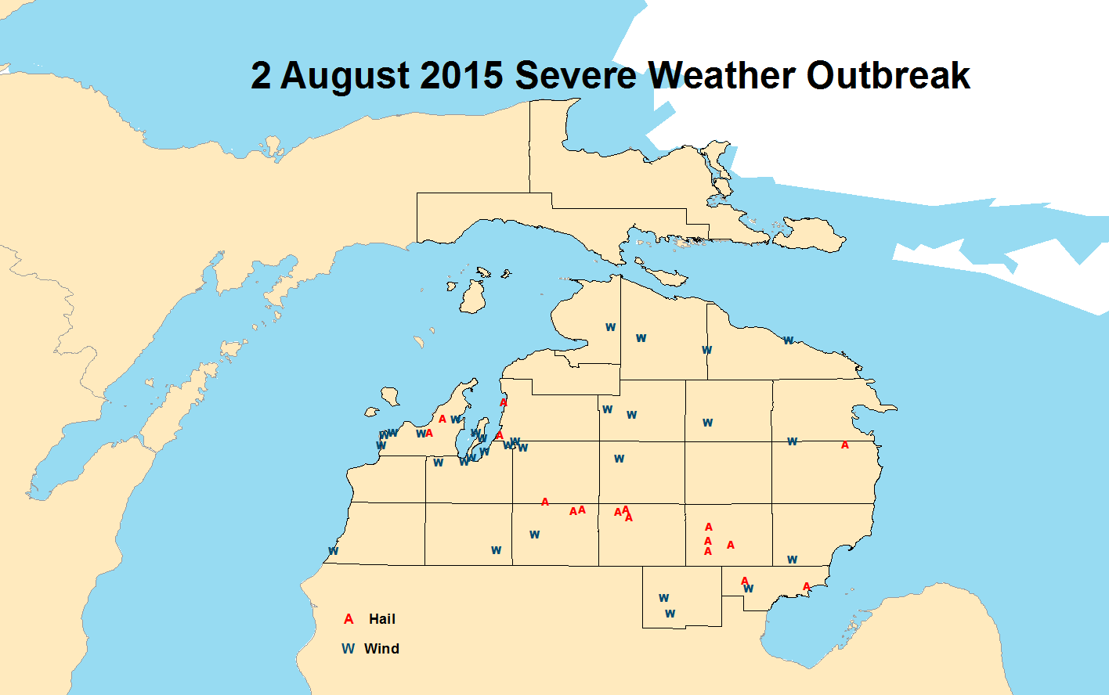
Overview: Storm Reports
Multiple rounds of severe thunderstorms raked northern Michigan throughout the day.
Four main “waves” of severe thunderstorms...with impacts gradually moving south across northern Lower Michigan as the day progressed.
Storm morphology dominated by linear/bowing segments...but some supercells were also evident during the afternoon hours.
Hail/wind damage in excess of $80 million.
Main wind damage around the Grand Traverse Bay region with estimated winds of 80-100mph. Thousands of downed trees... agricultural losses for fruit growers.
Largest hailstone on record for the WFO APX County Warning Area (4.25 inch diameter in Ogemaw County).
Round 1 (1355z-1530z)
Round 3 (1900z-2245z)
Round 4 (2200z-0000z)
Round 2 (1540z-1815z)
Notes:
Event overview with map showing storm reports and approximate temporal evolution of those events. Event evolved over an 11 hour period with four rounds of severe thunderstorms. Wind damage with bowing segments (QLCS) were the dominated severe weather type. Some supercells developed during the afternoon south of M-72 with prolific hail production.

Slide 4
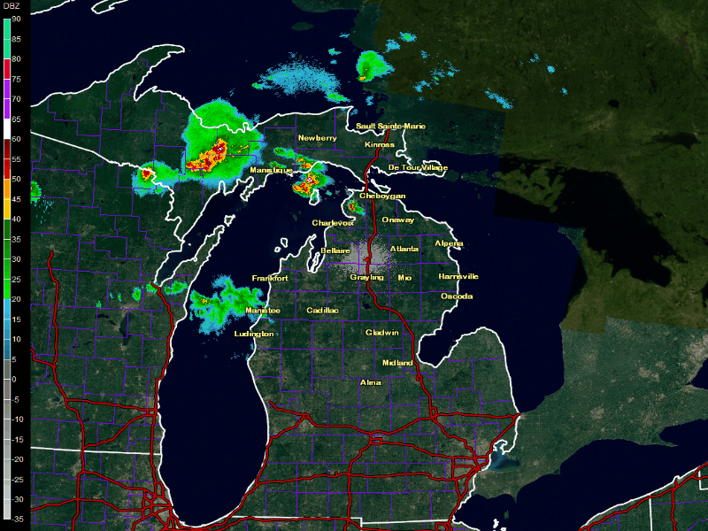
Overview: Radar Mosaic 1350Z 2 Aug – 0000Z 3 Aug
Notes:
Radar overview of entire event, which impacted the CWA from ~1350Z through 0Z. Shows how the initial convective line across the Tip of the Mitt setup the outflow boundary that moved south through the day, helping to focus upstream convection from WI.

Slide 5
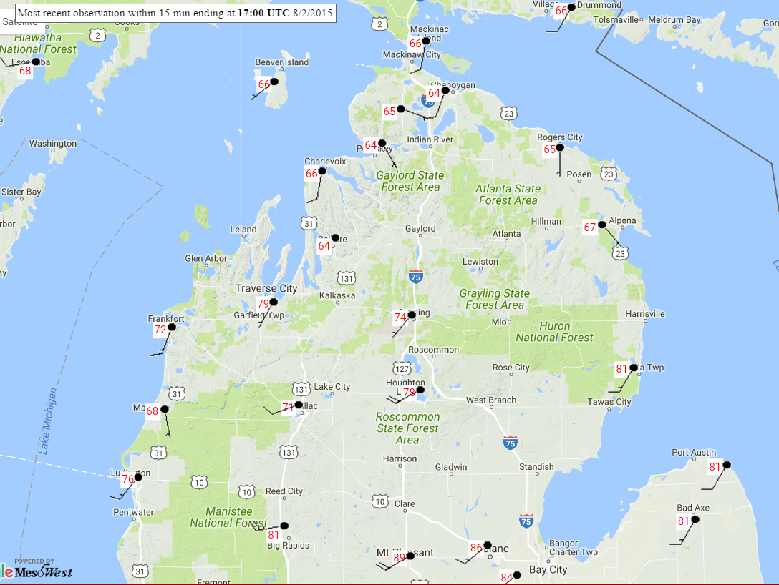
Setup: Outflow Boundary Progression
1700Z

Slide 6
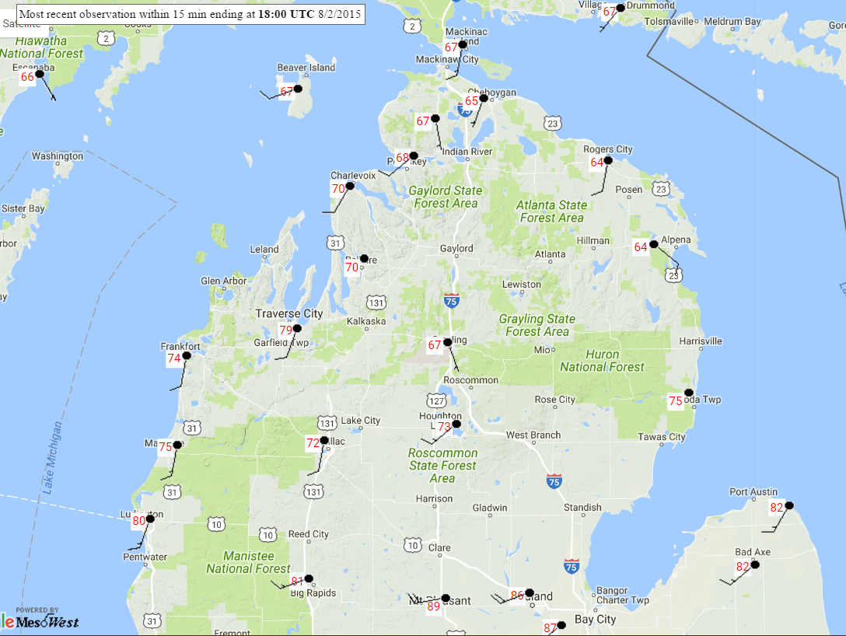
Setup: Outflow Boundary Progression
1800Z

Slide 7
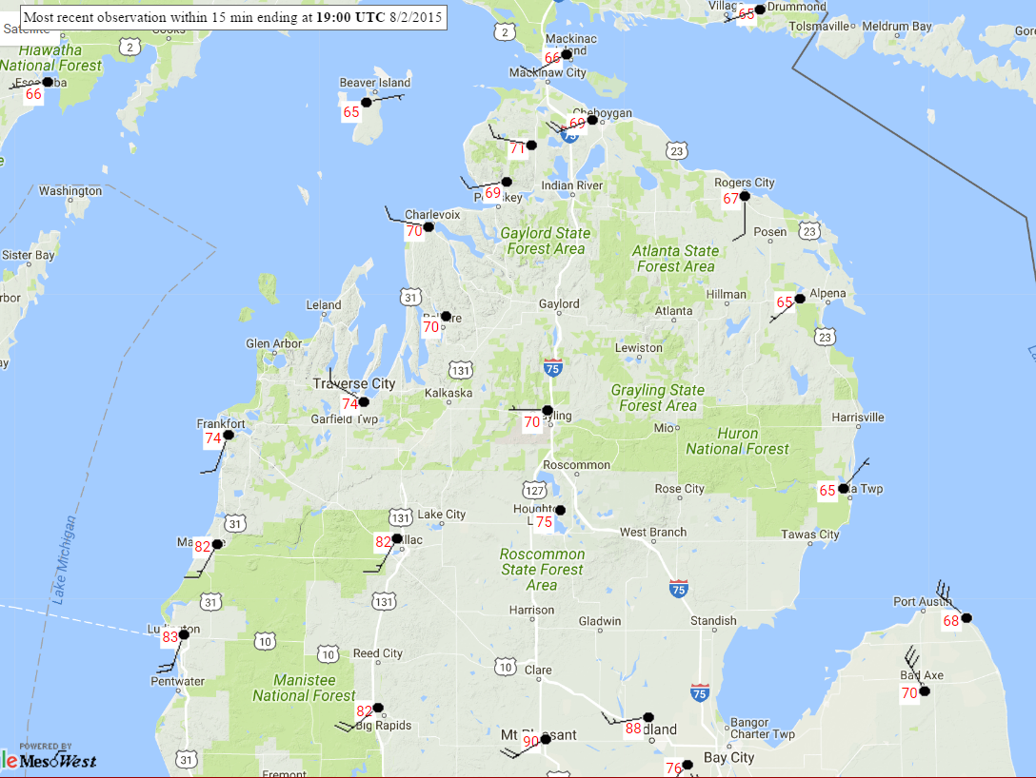
Setup: Outflow Boundary Progression
1900Z

Slide 8
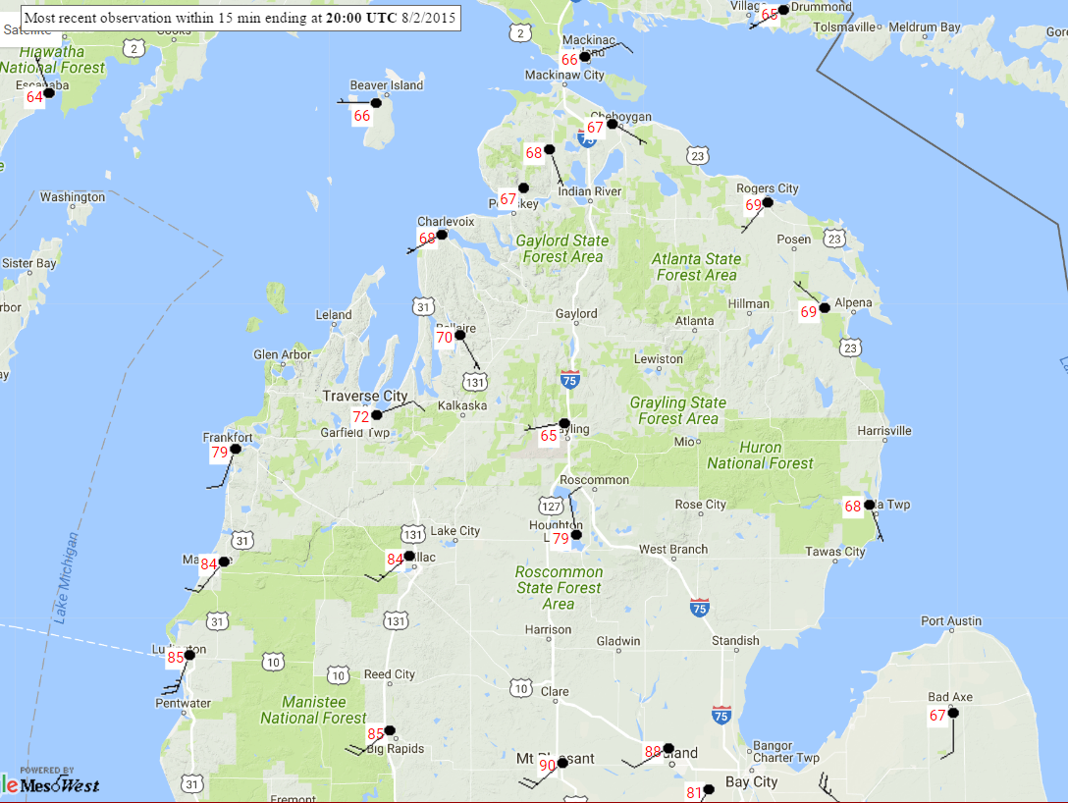
Setup: Outflow Boundary Progression
2000Z

Slide 9
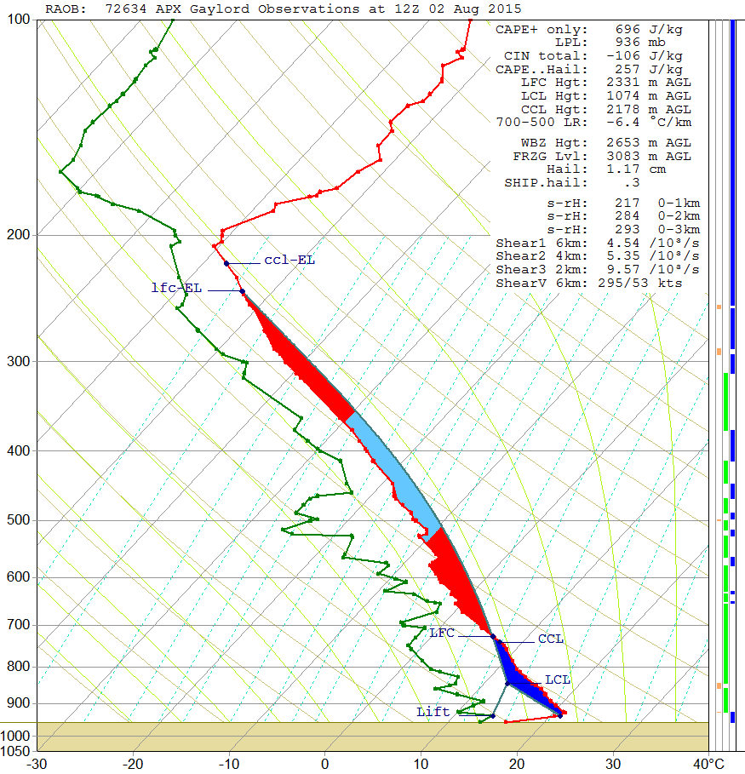
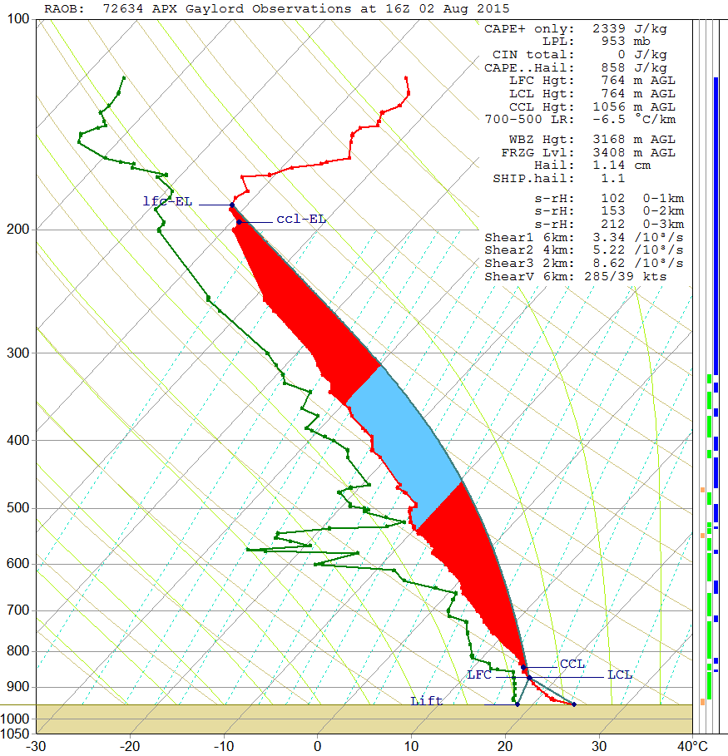
Setup: APX Soundings
1600Z 2 Aug 2015
1200Z 2 Aug 2015

Slide 10
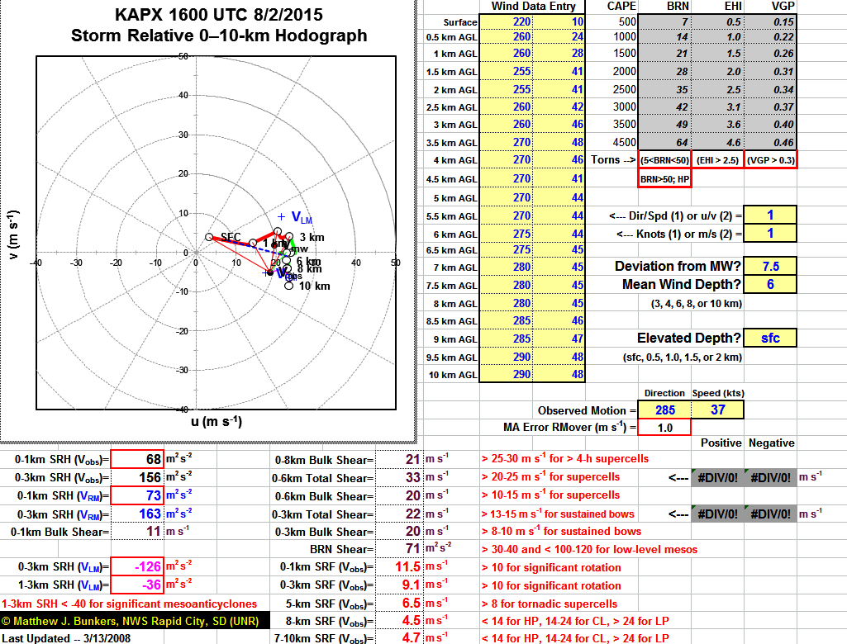
Setup: 16Z 2 Aug 2015 APX Hodograph
Notes:
Low level shear

Slide 11
Setup: 20Z Surface T_{d} (Green)/700-500mb LR >7 C/km
Sfc T_{d} 64 – 68 °F across the area.
Conditional instability 700-500 LR (7 – 7.5 °C/km)
Notes:
High Td (64°F – 68°F) and conditional instability shown in mid level lapse rates, with more warm moist air being advected through the day

Slide 12
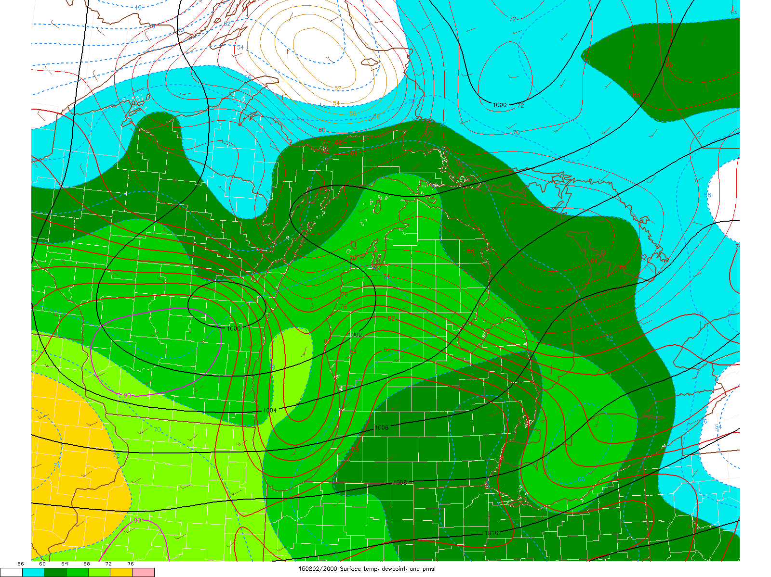
Setup: 20Z Surface T (Red)/T_{d} (Shaded)/MSLP/Wind
Notes:
20Z surface T, Td, and MSLP. Showing Td in the 64-68 °F range and a warm front just south of the CWA. SW flow through the day continued to advect warm, moist air into the area in between waves of storms. Also help to tighten the thermal gradient through the day.

Slide 13
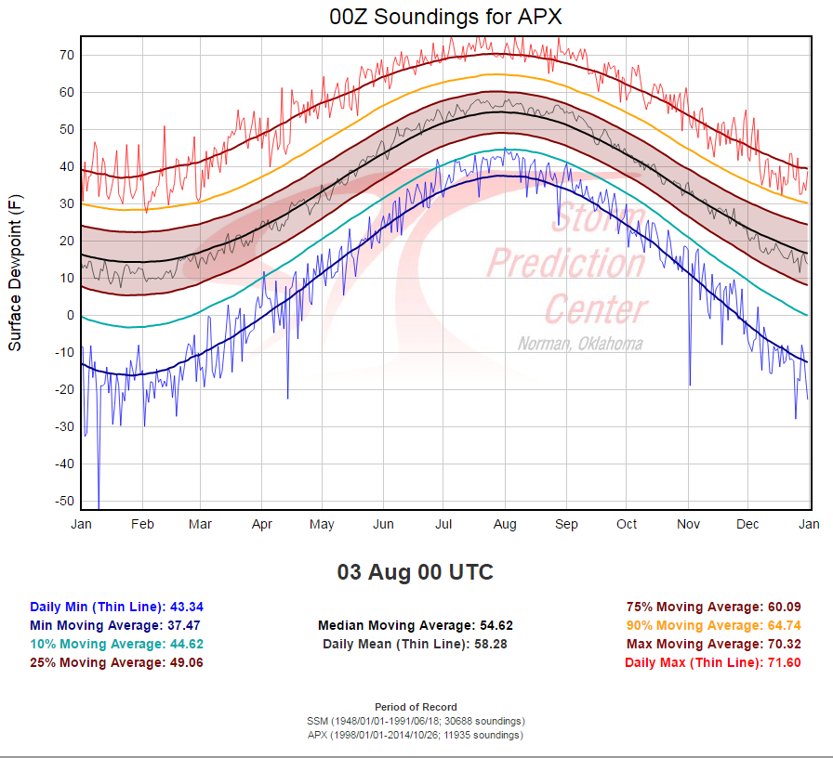
Setup: 00Z APX Surface T_{d} Climatology

Slide 14
Setup: 20Z MUCAPE (Red)/Lifted Parcel Level (Shaded)
Notes:
MUCAPE and lifted parcel level. Shows MUCAPE values of 1000 – 3000 J/kg over northern MI, with a good, slightly NW to SE oriented gradient from Leelenau to Saginaw Bay

Slide 15
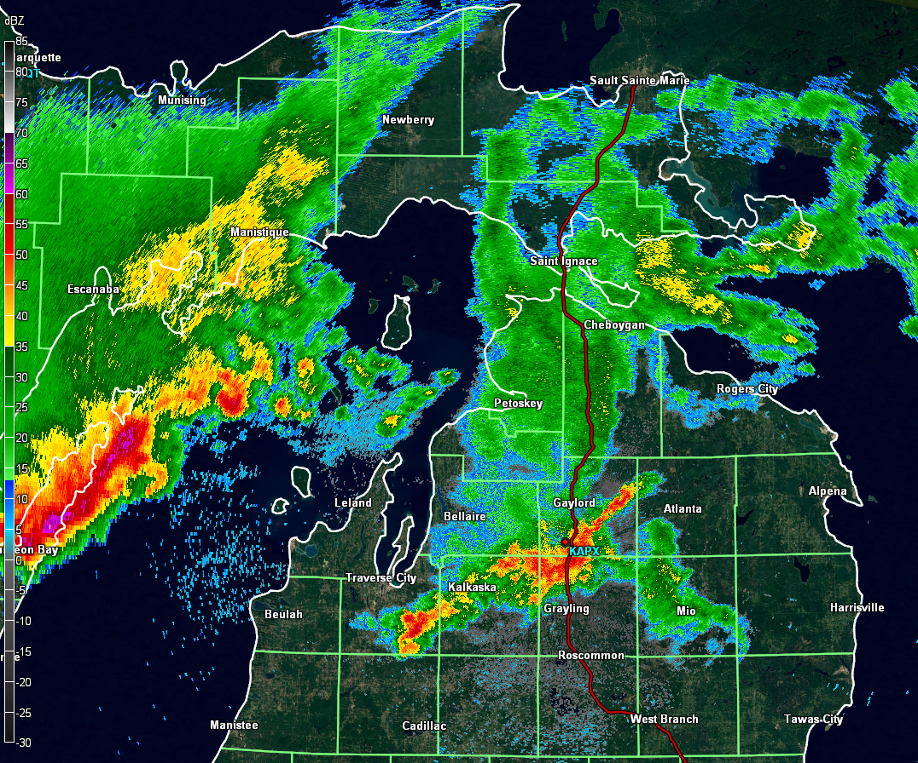
Grand Traverse Bay QLCS: KAPX Z 1919Z 2 Aug 2015

Slide 16
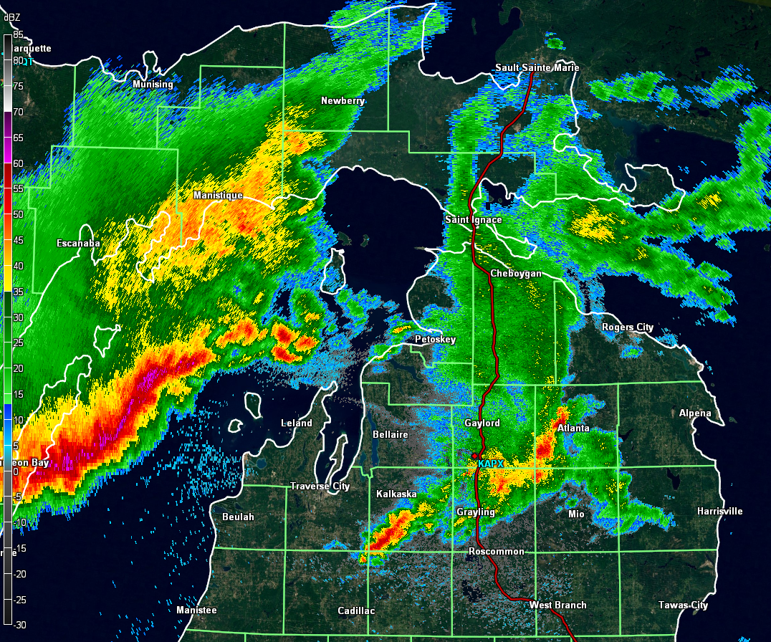
Grand Traverse Bay QLCS: KAPX Z 1934Z 2 Aug 2015

Slide 17
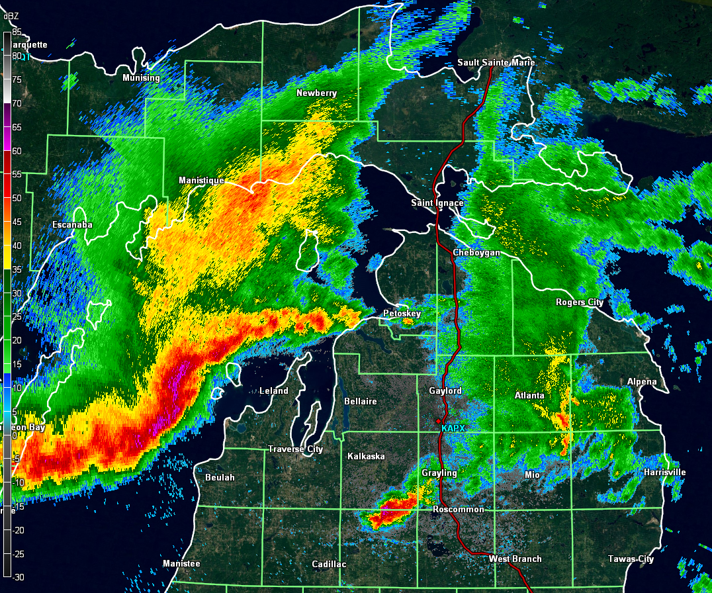
Grand Traverse Bay QLCS: KAPX Z 1953Z 2 Aug 2015

Slide 18
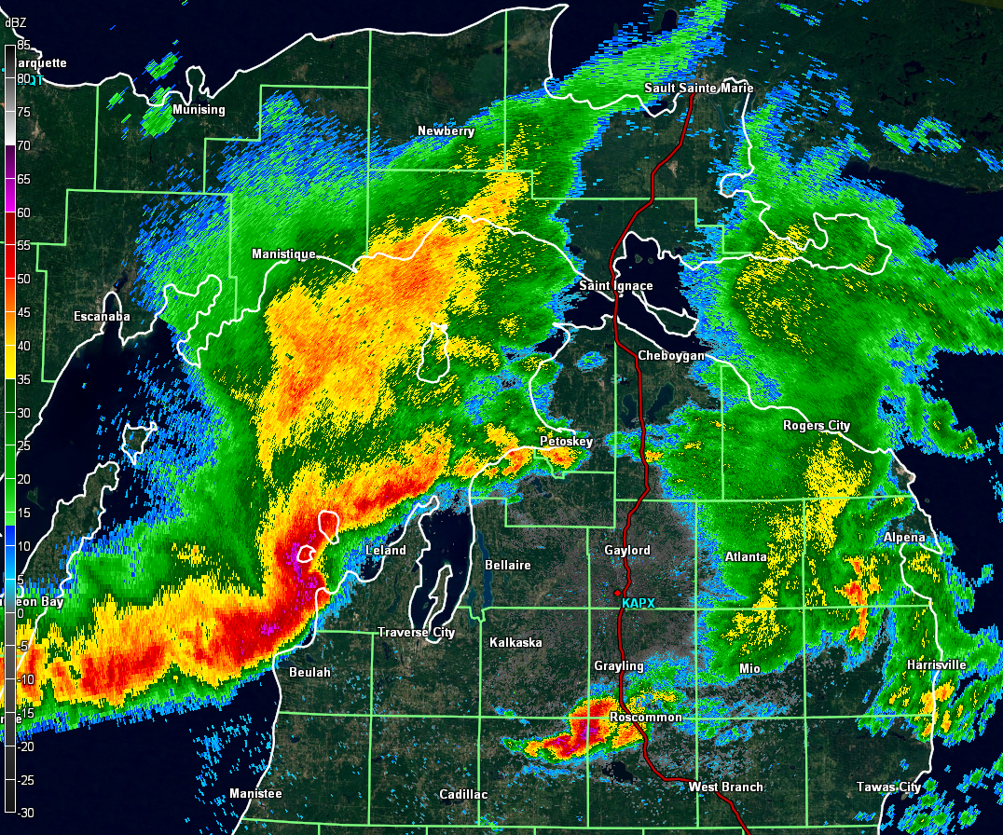
Grand Traverse Bay QLCS: KAPX Z 2008Z 2 Aug 2015

Slide 19
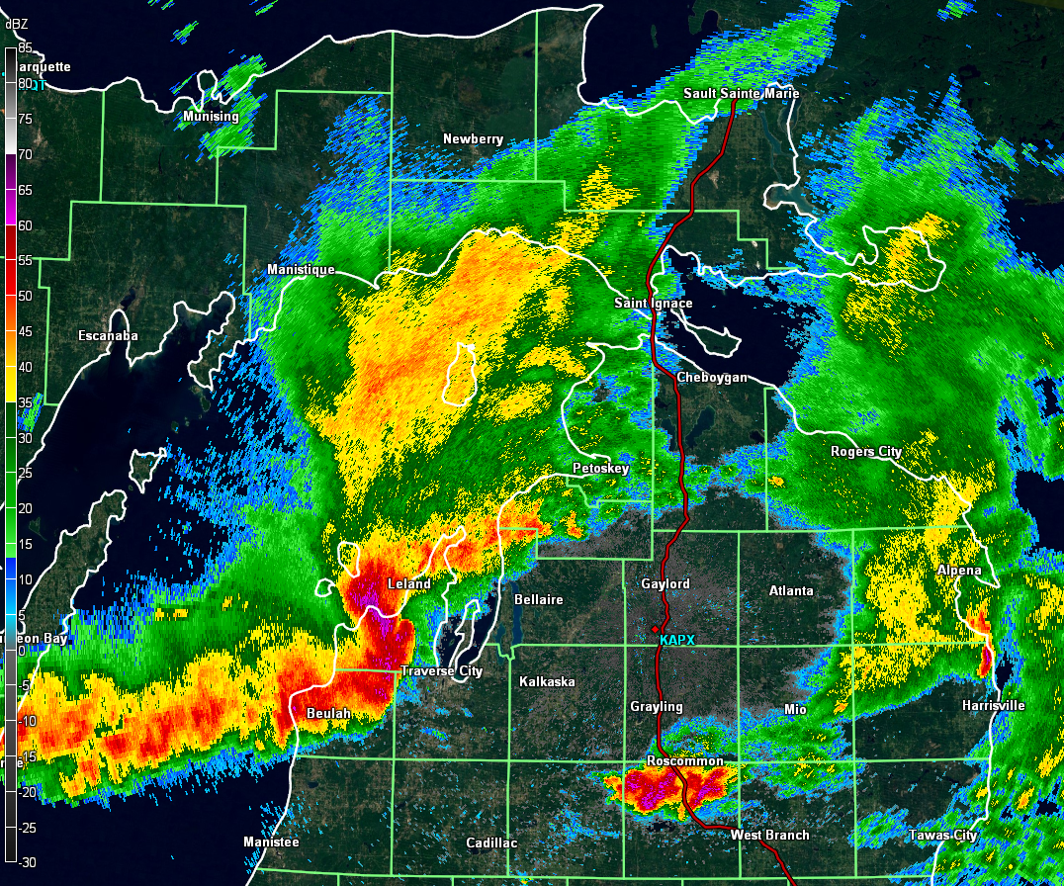
Grand Traverse Bay QLCS: KAPX Z 2023Z 2 Aug 2015

Slide 20
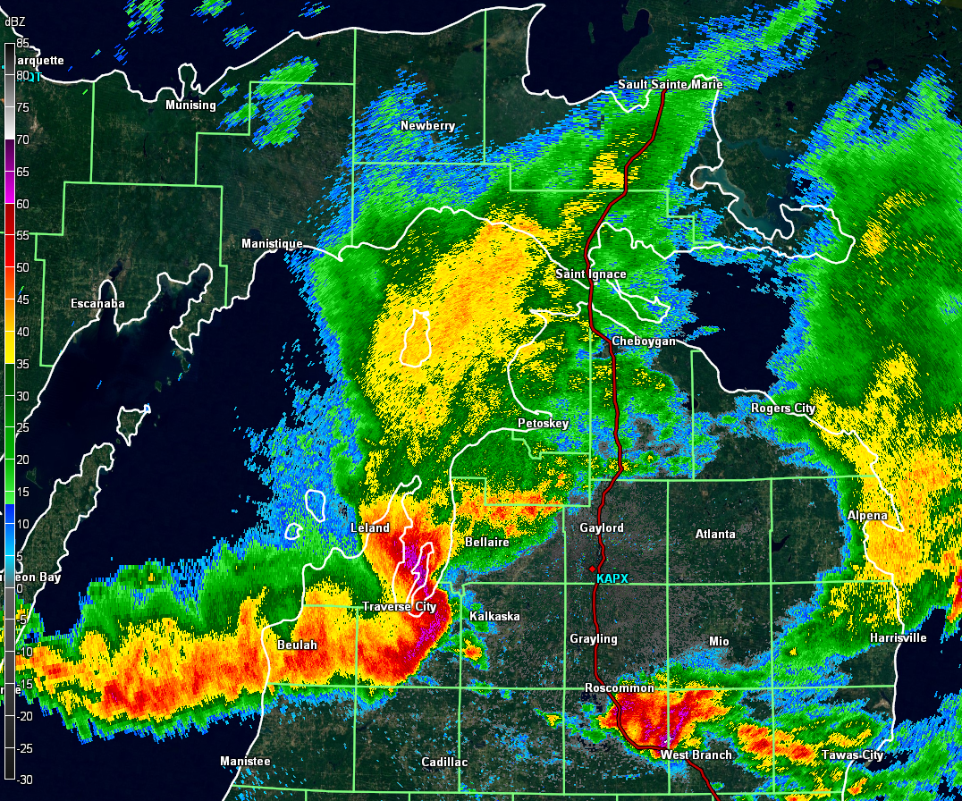
Grand Traverse Bay QLCS: KAPX Z 2039Z 2 Aug 2015

Slide 21
3 Ingredients for QLCS Mesovortex Genesis
From Schaumann and Przybylinski 2012:
A portion of a QLCS in which the system cold pool and ambient low-level shear are nearly balanced or slightly shear dominant.
2)Where 0-3 km line-normal bulk shear magnitudes are equal to or greater than 15 m s⁻¹ (30 knots).
3)Where a rear inflow jet (RIJ) or enhanced outflow causes a surge or bow in the line.

Slide 22
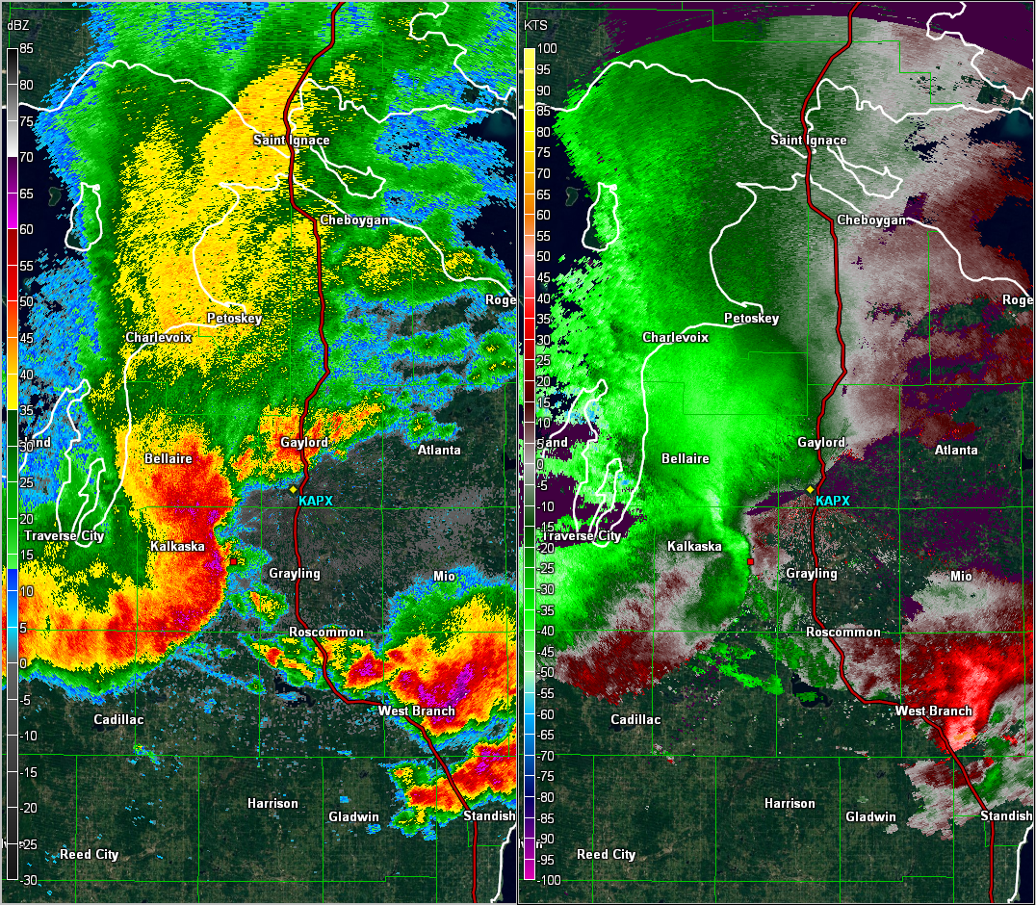
Ingredient 1: Cold Pool-Low Level Shear Balance
KAPX Z 2058Z
KAPX V 2058Z
Notes:
Reflectivity and velocity when the line is closer to APX. Shows the proximity of convergence zone to updraft. Not in perfect balance, but the outflow is not greatly outrunning the updraft.

Slide 23
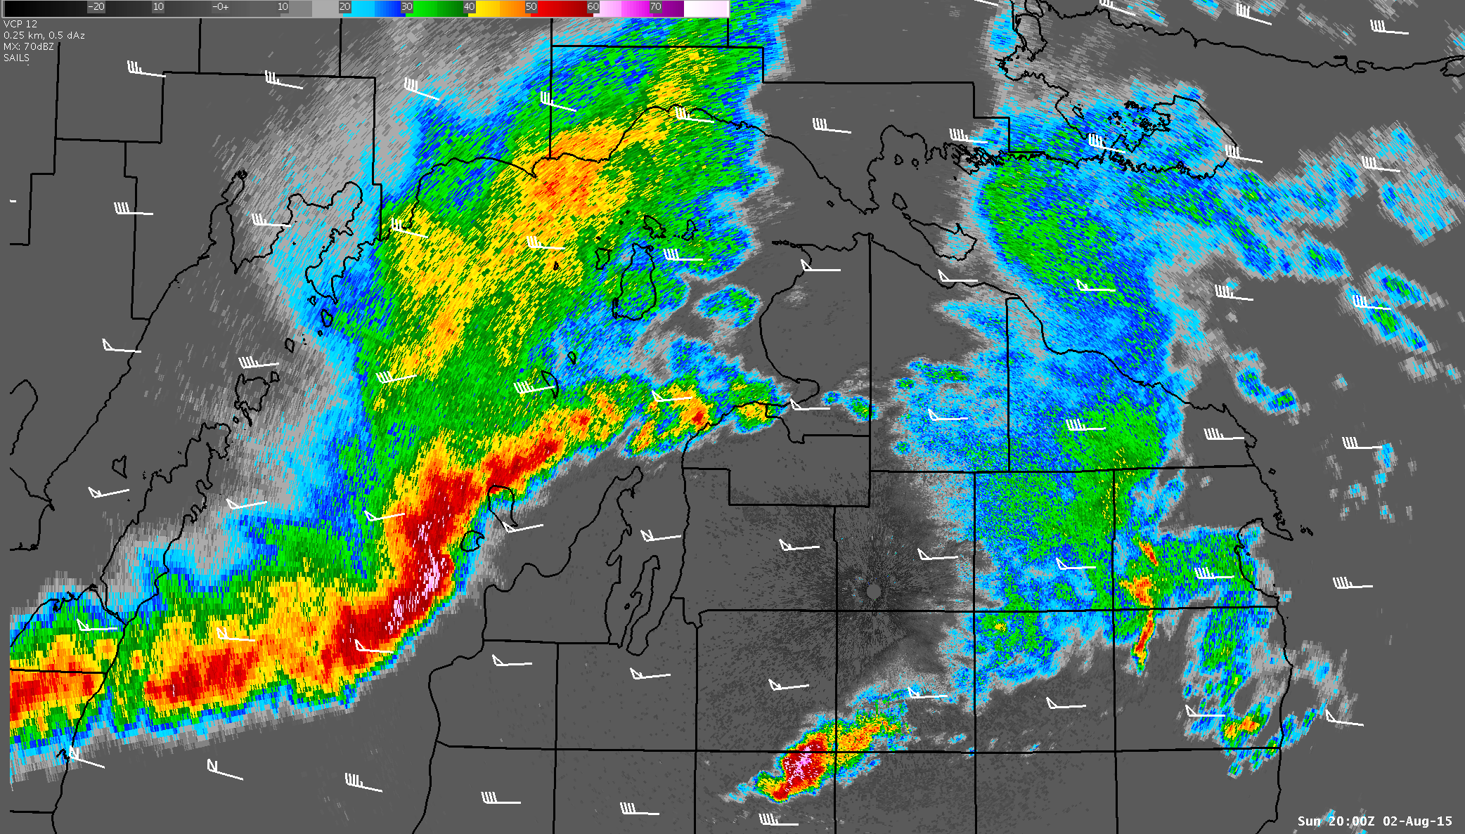
RAP 0-3km Shear and APX Reflectivity
Ingredient 2: 0-3km Line Normal Shear > 15 m s⁻¹
KAPX Z/0-3km Shear Vectors 2000Z 2 Aug

Slide 24
Ingredient 2: 0-3km Line Normal Shear > 15 m s⁻¹
KAPX VAD Wind Profile 1938Z – 2027Z
Notes:
APX VAD winds to gauge representativeness of RAP 0-3km shear, since RAP was producing precip. Done with regards to the section in Schaumann paper that says: “When calculating line-normal magnitudes, one must ensure that the vectors are representative of the ambient atmosphere ahead of the convective line. Model output will likely be unrepresentative if the convective scheme is generating precipitation. Radar operators should look downstream of the model generated precipitation to gauge the orientation and magnitude of true ambient vectors. “

Slide 25
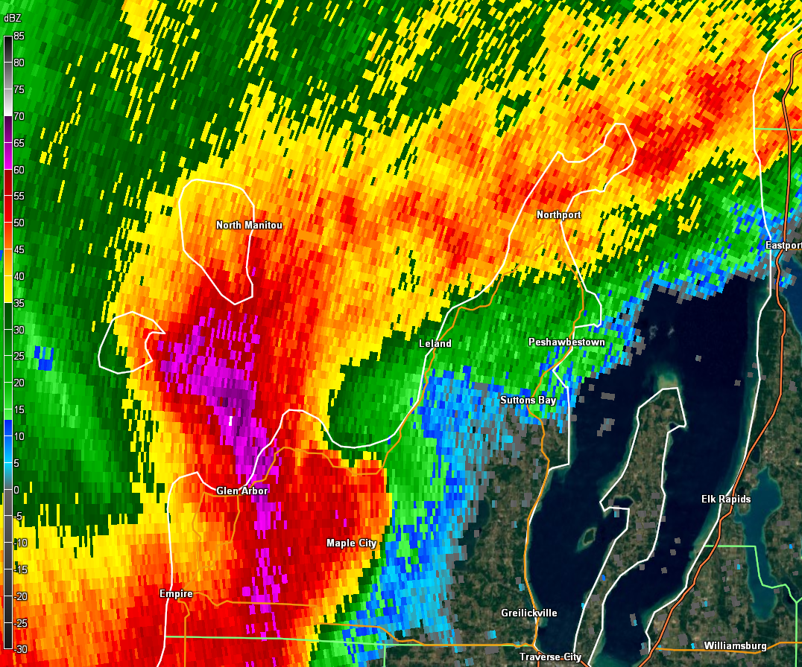
Ingredient 3: Forward Surge in Line
KAPX Z 2017Z 2 Aug

Slide 26
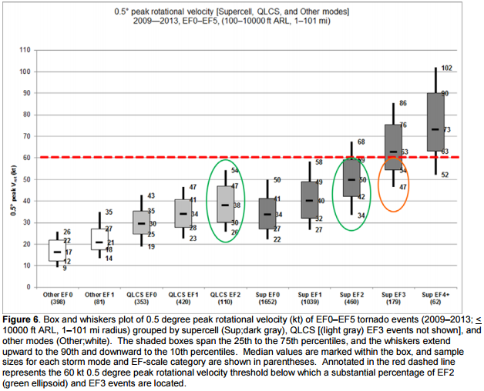
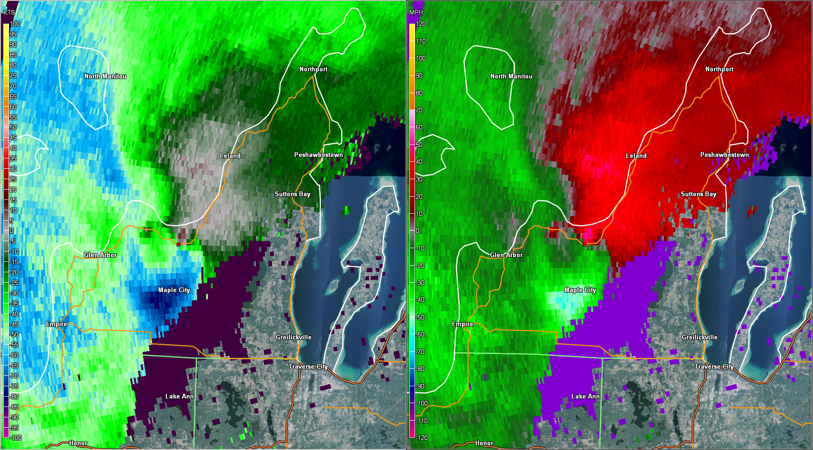
Ingredient 3: Forward Surge in Line (RIJ)
KAPX V 2017Z
KAPX SRV 2017Z
V_{ROT} 30 kts
at ~4000 ft AGL
80 to 85 kts
at ~4000 ft AGL
Notes:
BV and SRV from APX at 2017Z. BV nicely shows a core of 80-85 kts winds at about 4kft. VROT in both velocities is 30kts. This is at 4kt and 48 nm from the radar. This VROT would fall in the 50th percentile for QLCS EF-0 tornado intensity. VROT values line up with QLCS EF0 from Smith et. al paper.

Slide 27
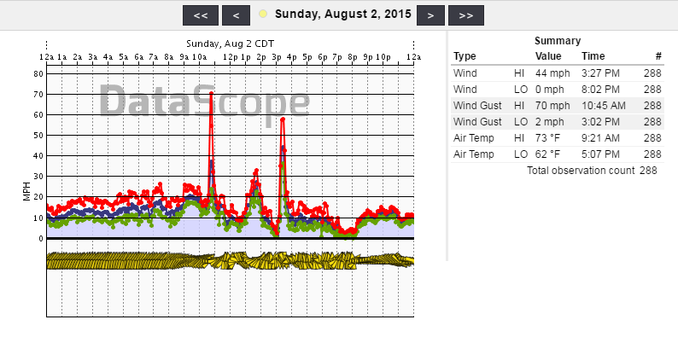
Leelanau County Damage
Damage from Morning Convection (70mph gust Leland Harbor 1545Z)
Primary Straight Line Wind Damage
Notes:
Leelenau County damage map. Main corridor of damage from Glen Arbor to Elmwood. Damage map from Leelenau County, Cleveland Township. Circle denotes location where possible tornado indicated on radar at 2017Z

Slide 28
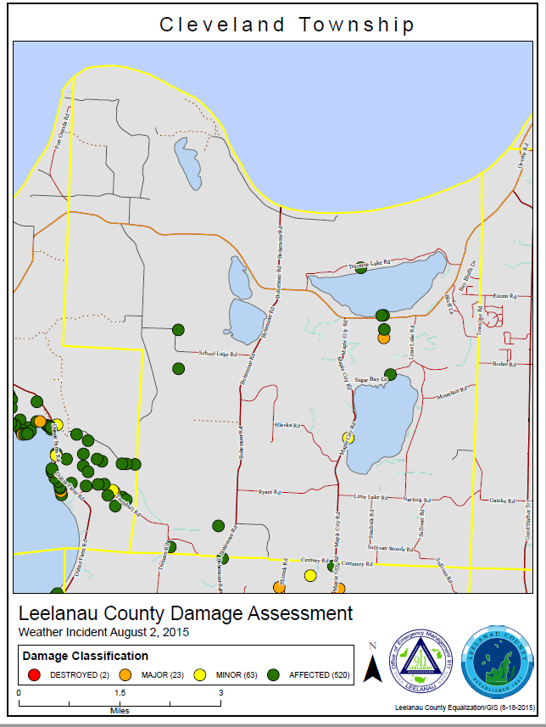
Leelanau County Damage: Little Traverse Lake Area
Possible Tornado
Notes:
Damage map from Leelenau County, Cleveland Township. Circle denotes location where possible tornado indicated on radar at 2017Z

Slide 29
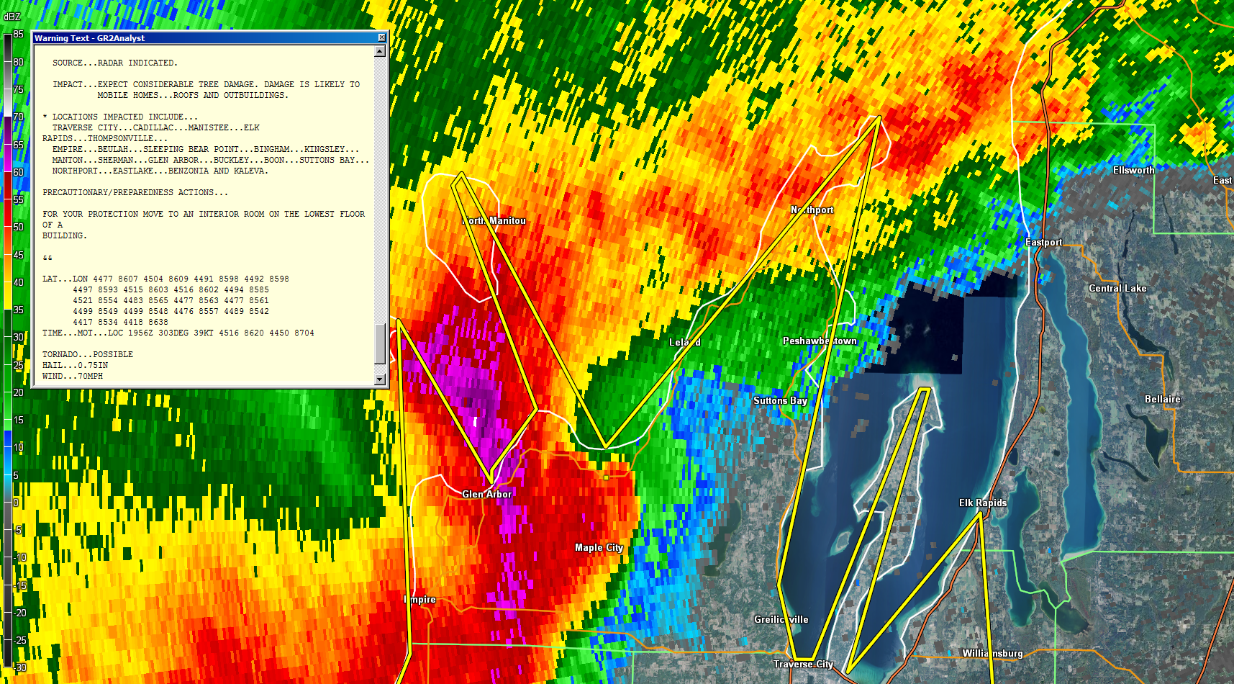
KAPX Z 2017Z/Severe Thunderstorm Warning
Notes:
Radar at the 2017Z scan, with warning turned out and text callout box open. Shows the SVR with the tornado possible tag that was used. Warning was issued at 1957Z.

Slide 30
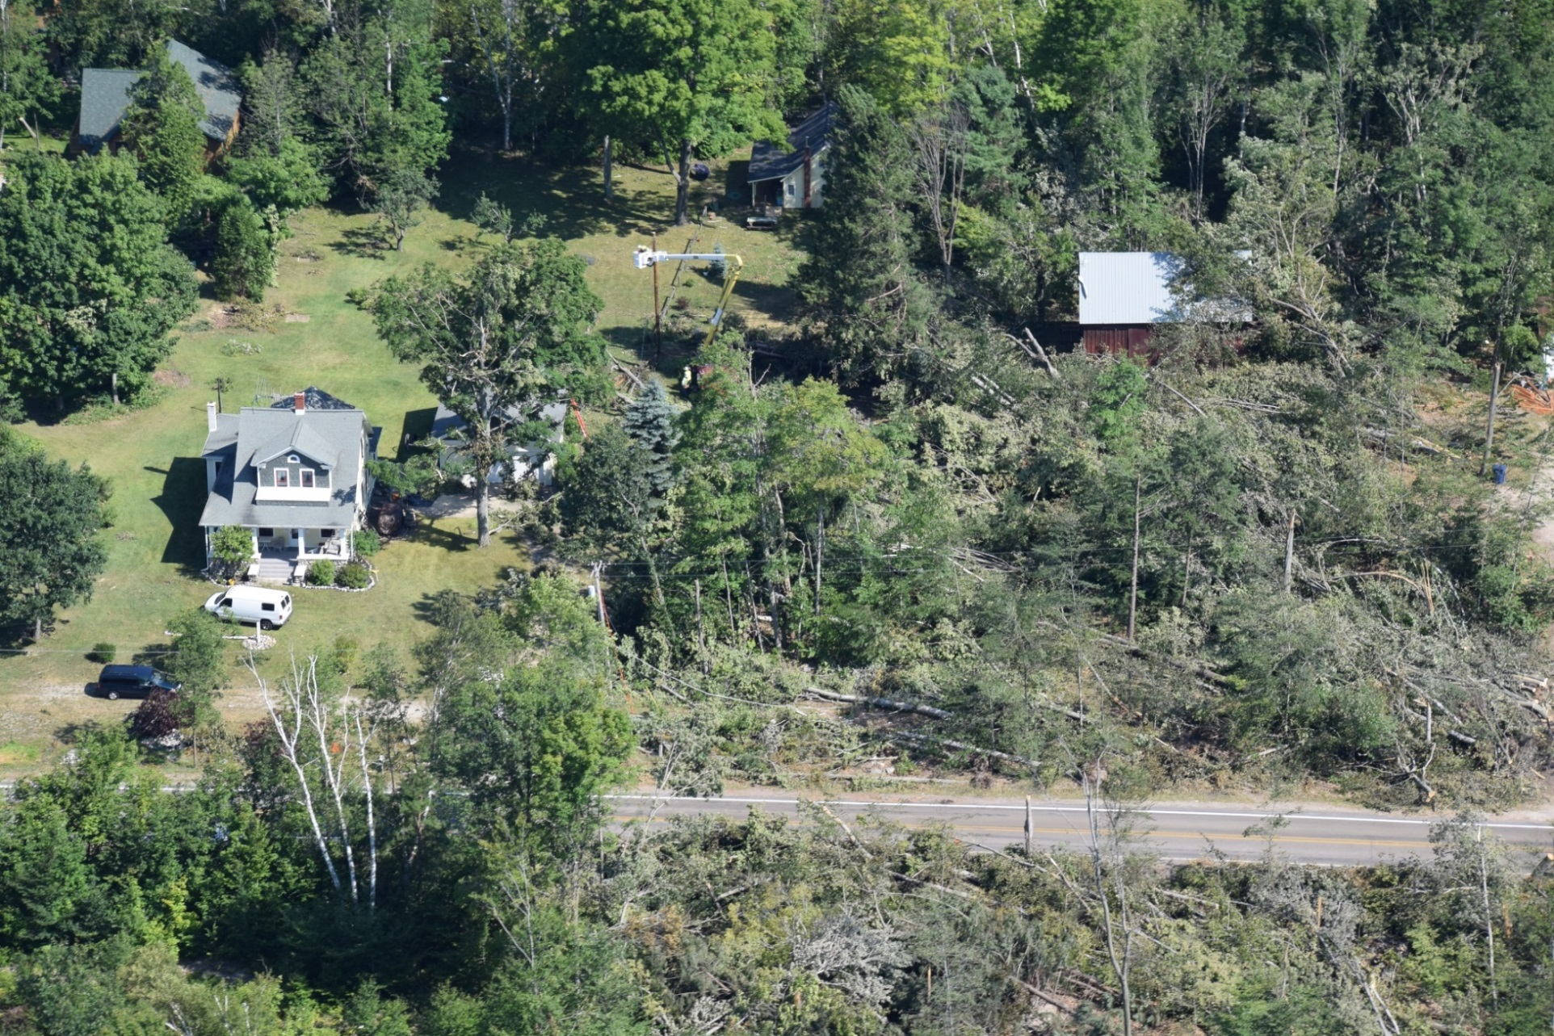
Event Pictures
Notes:
Photo near Little Traverse Lake. Sent by the EM who mentioned “Photos around that area aren’t the best. Mainly we had M22 clogged up as a result of the storm, very little residential damage.”

Slide 31
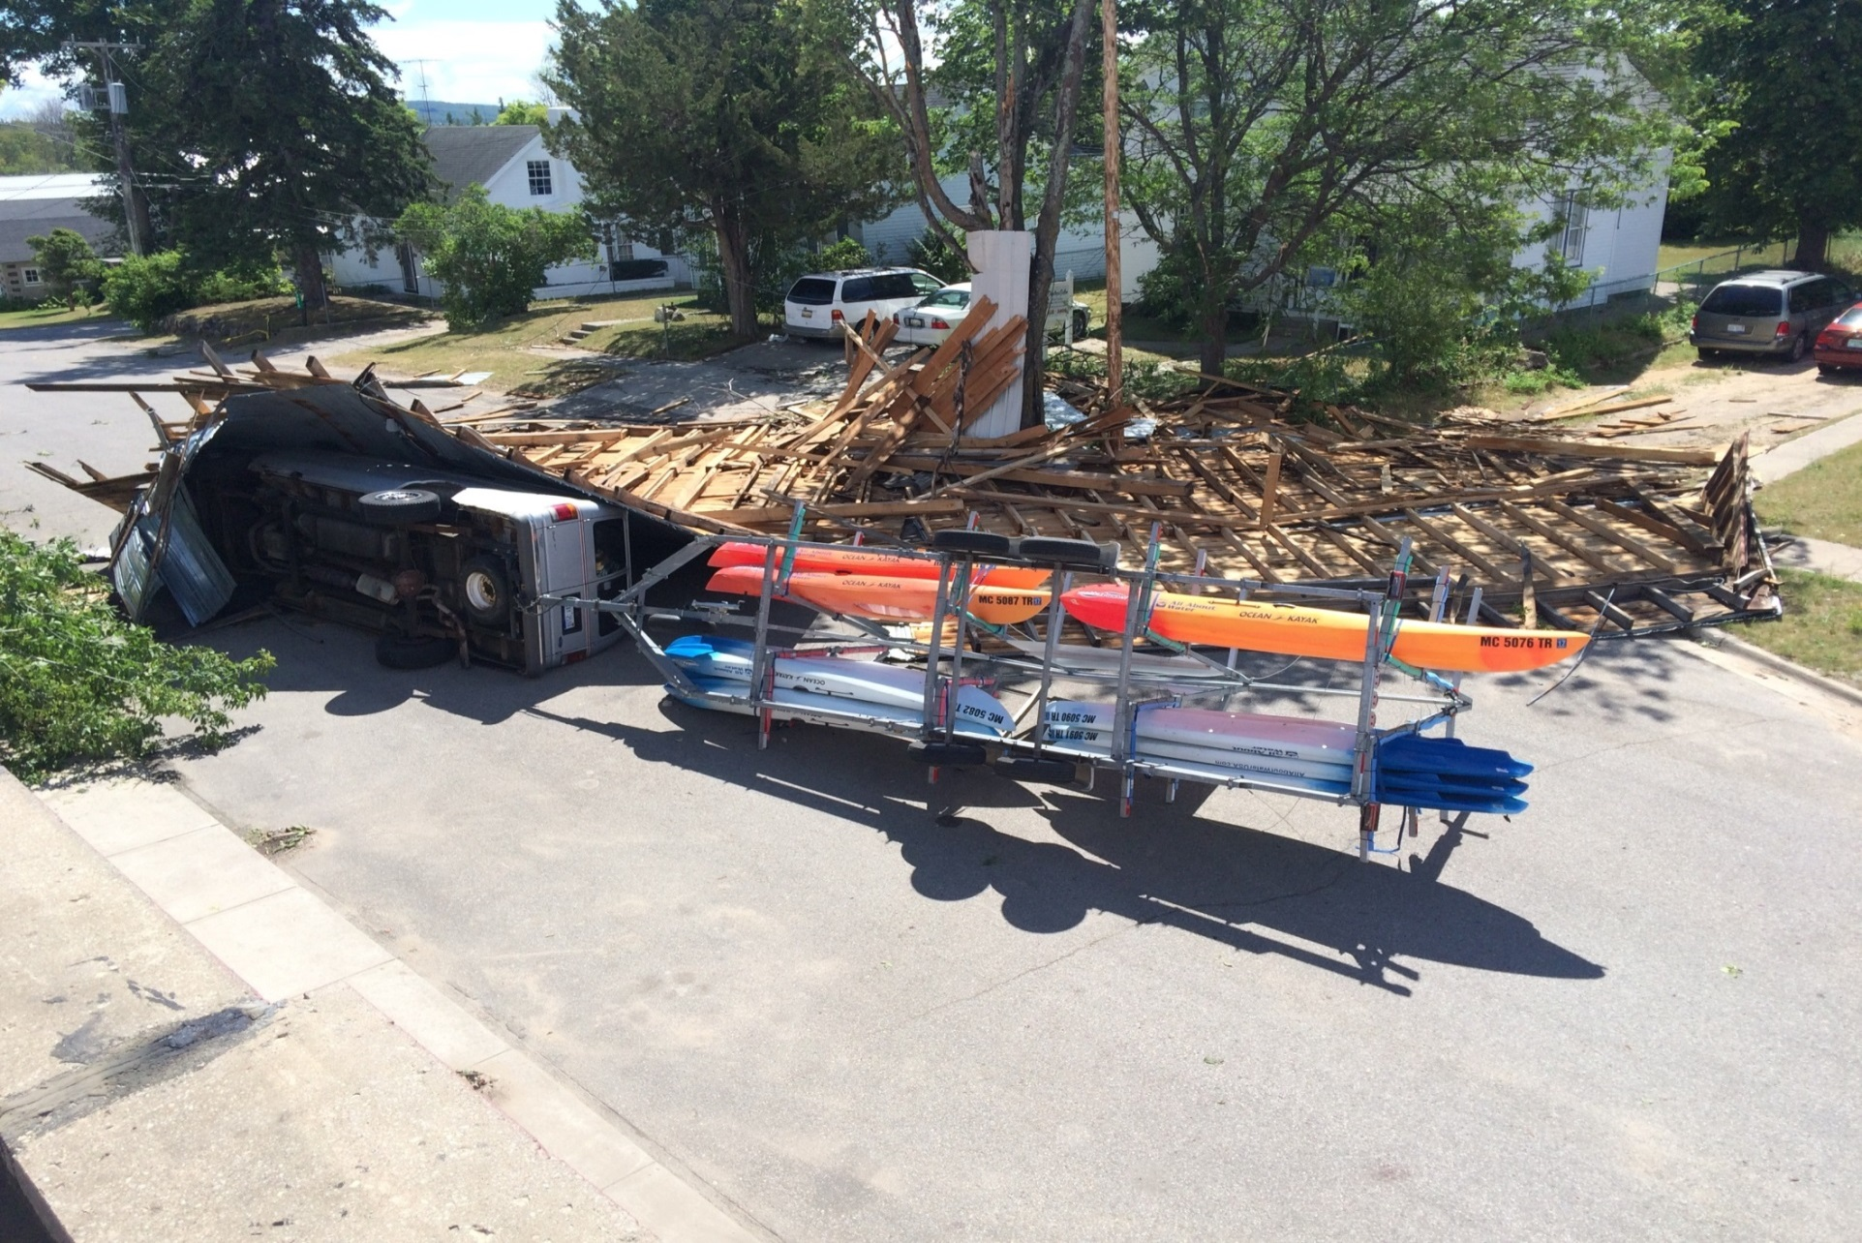
Event Pictures
Notes:
Carport and van blown over

Slide 32
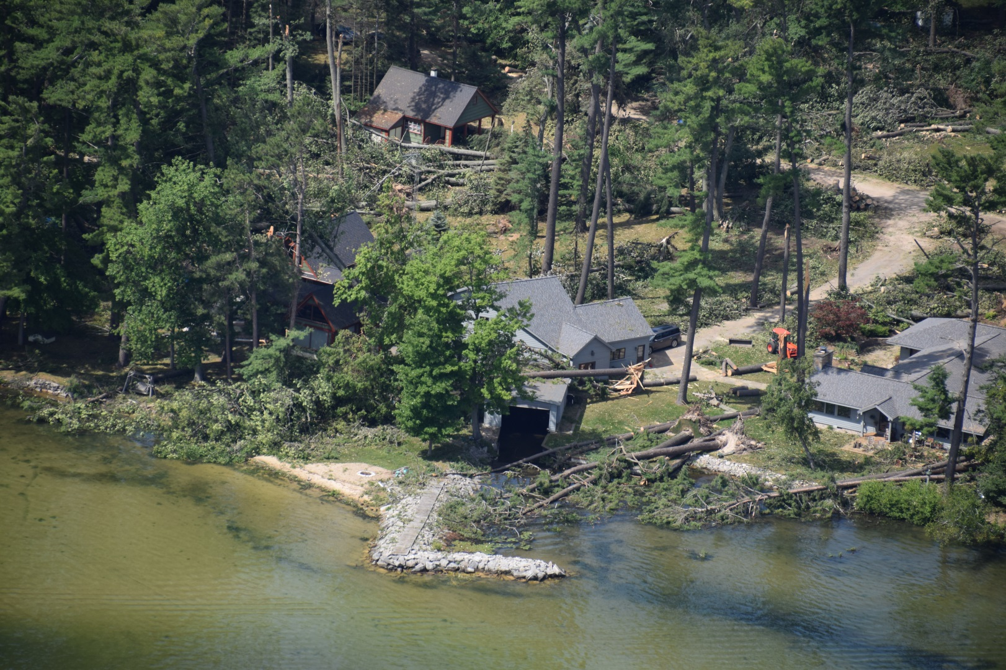
Event Pictures
Notes:
Damage from Skegemog Point Rd in Grand Traverse County

Slide 33
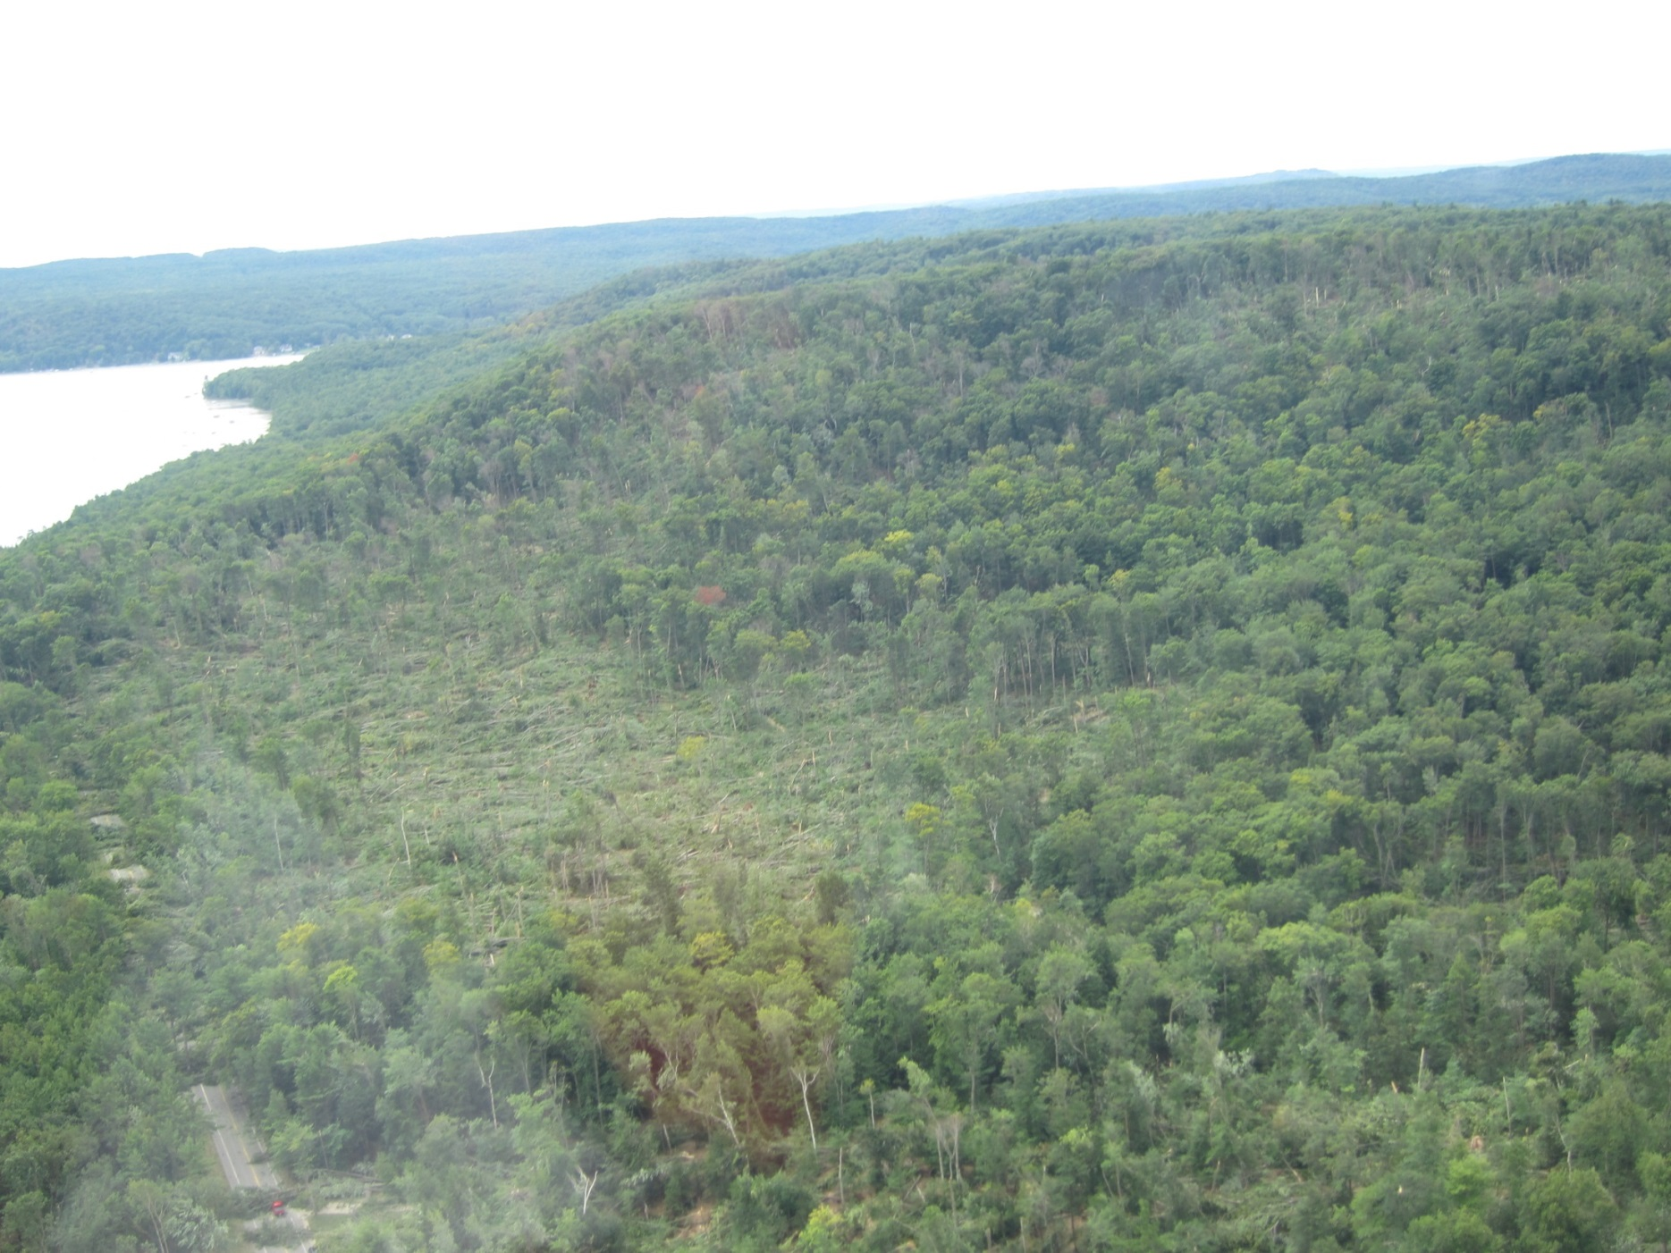
Event Pictures
Notes:
Road into Glen Arbor

Slide 34
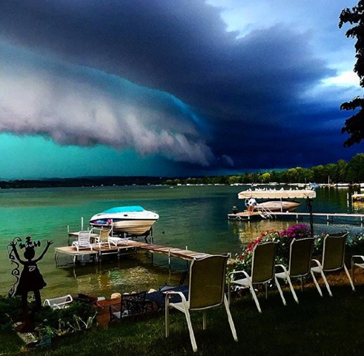
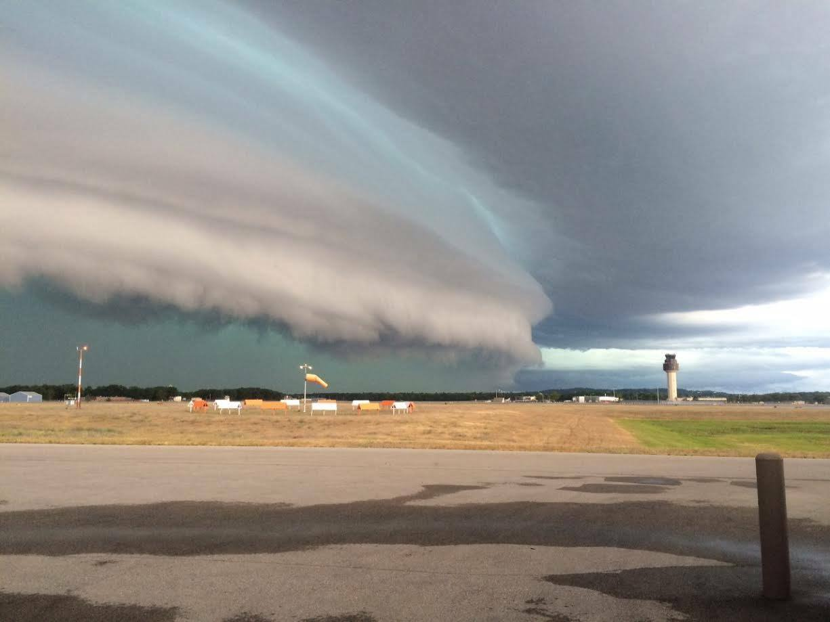
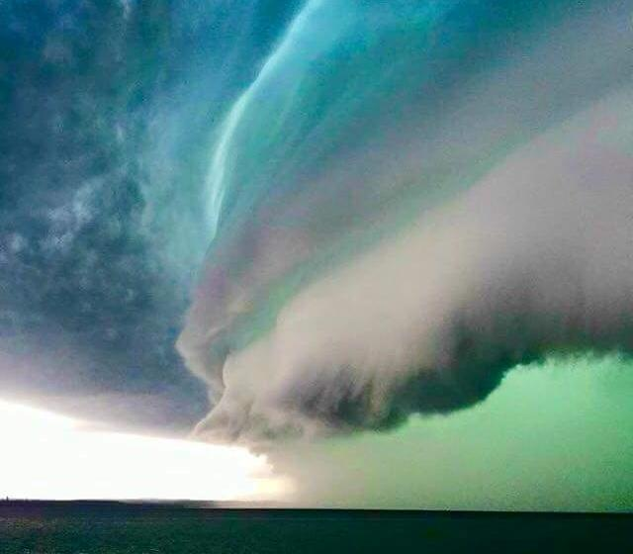
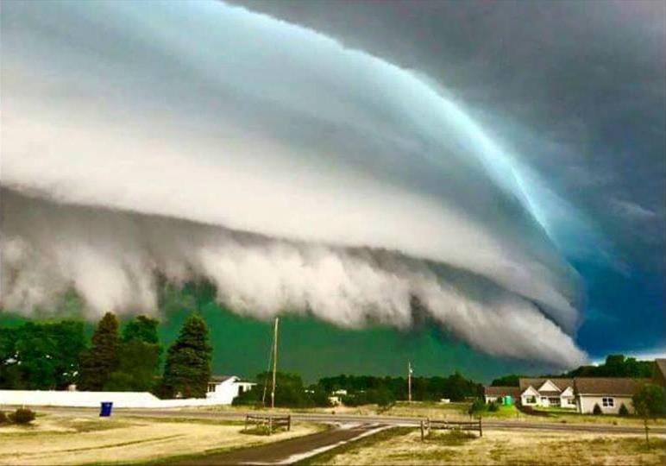
Event Pictures
Notes:
Nice shots of the shelf cloud

Slide 35
Questions?

Slide 36
References
Schaumann, J. S., and R. W. Przybylinski. "Operational application of 0–3 km bulk shear vectors in assessing QLCS mesovortex and tornado potential." Preprints, 26th Conf. on Severe Local Storms, Nashville, TN, Amer. Meteor. Soc. Vol. 9. 2012.
Smith, Bryan T., et al. "Demonstrating the utility of conditional probabilities of tornado damage rating in the impact-based warning era." 27th Conf. on Severe Local Storms. 2014.

