Slide 1
Dual Doppler Observations of a Tornadic Quasi-Linear Convective System on 04 January 2015
Dustin Conrad, Kevin Knupp
University of Alabama-Huntsville

Slide 2
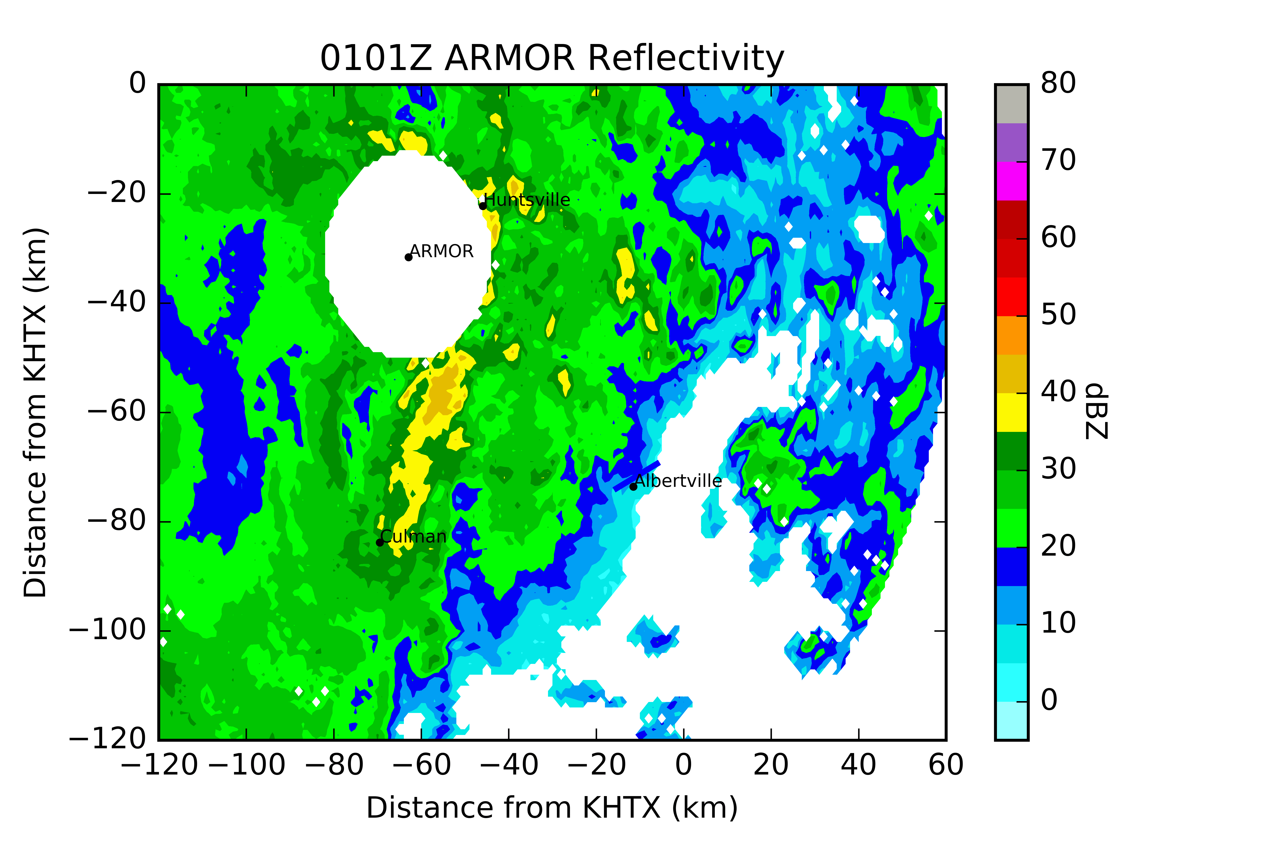
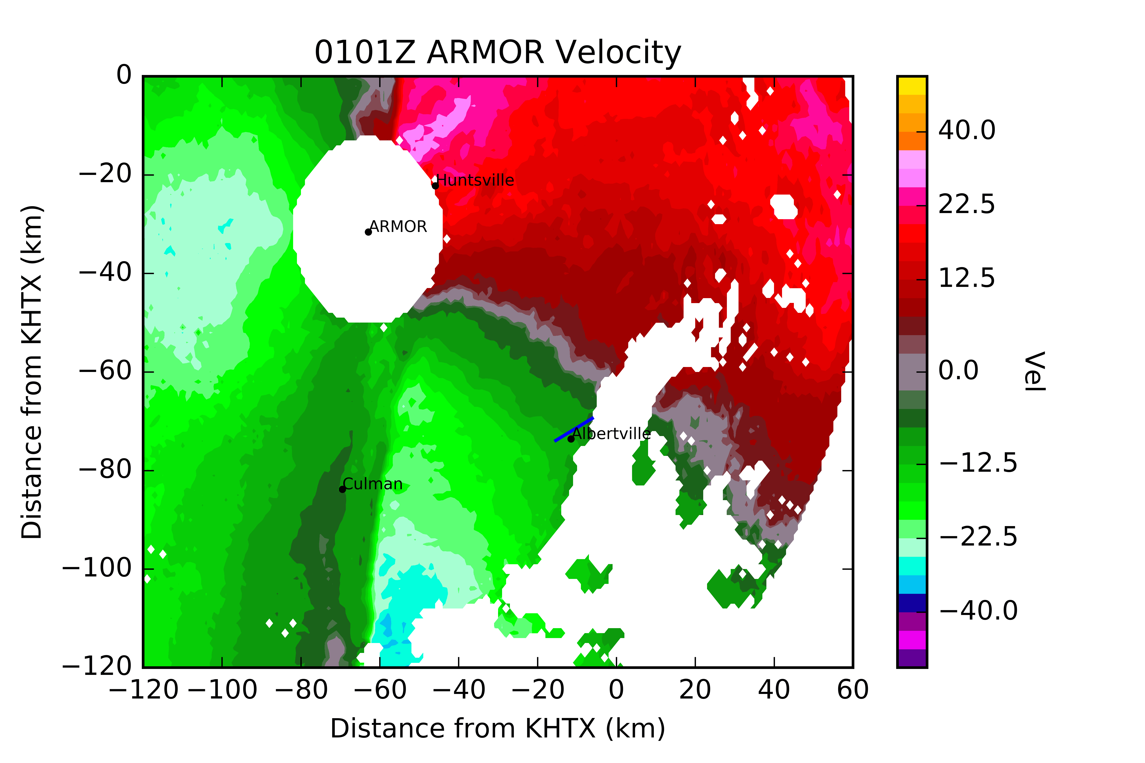

Slide 3
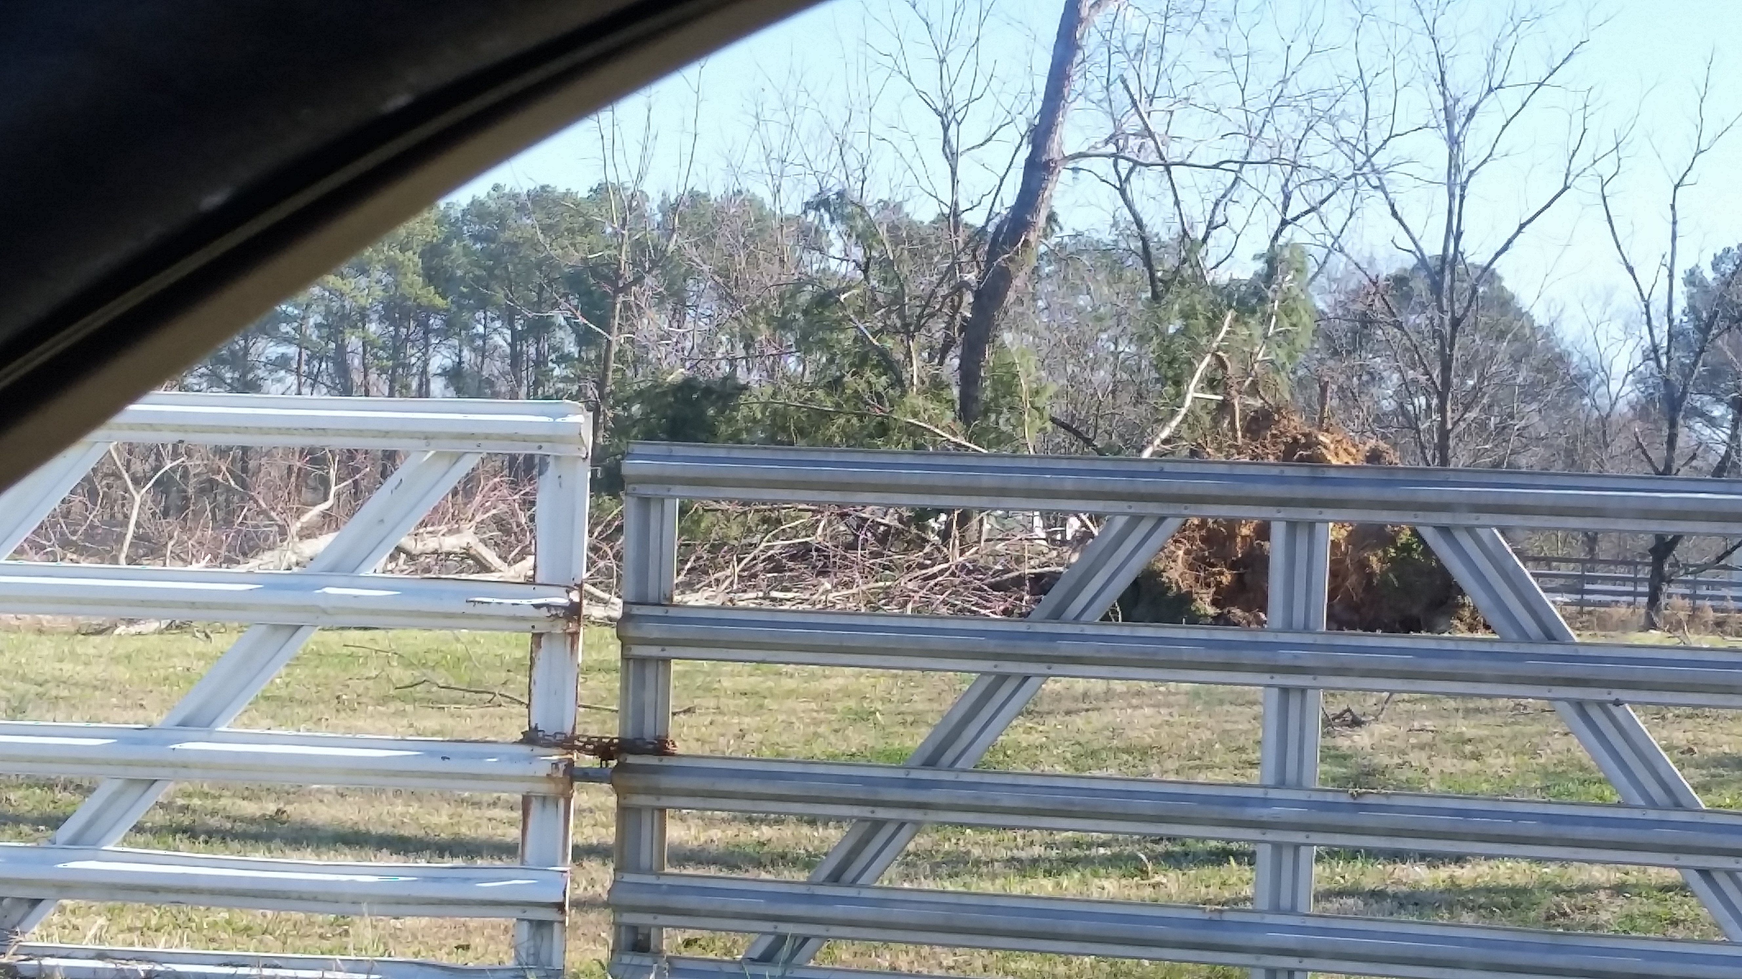
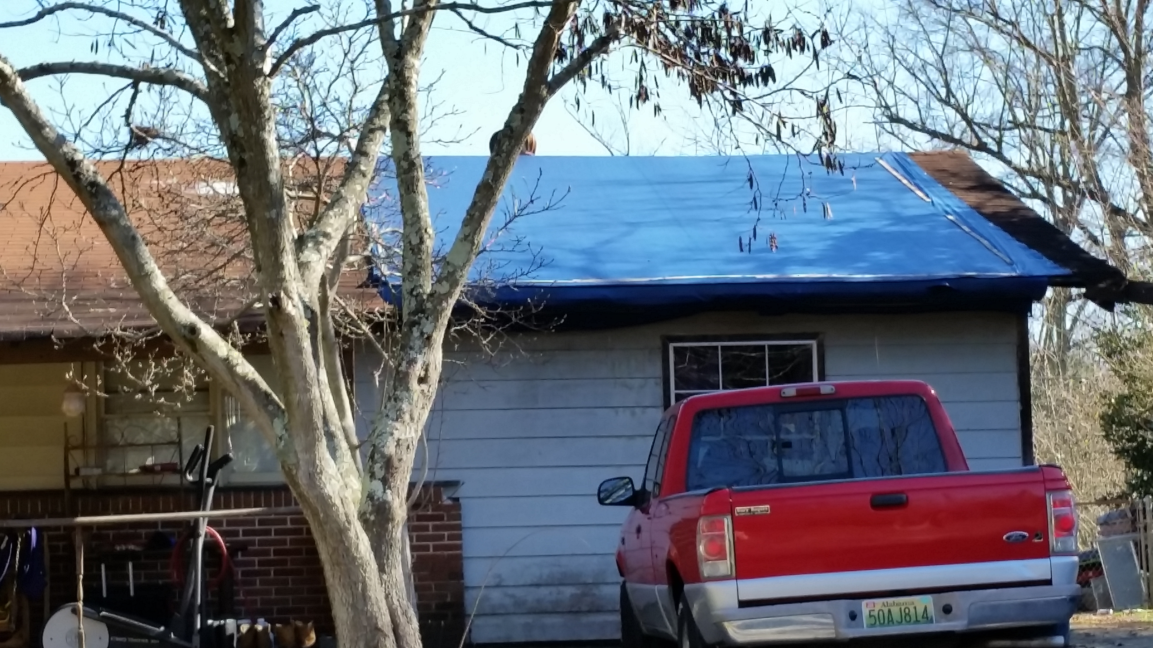
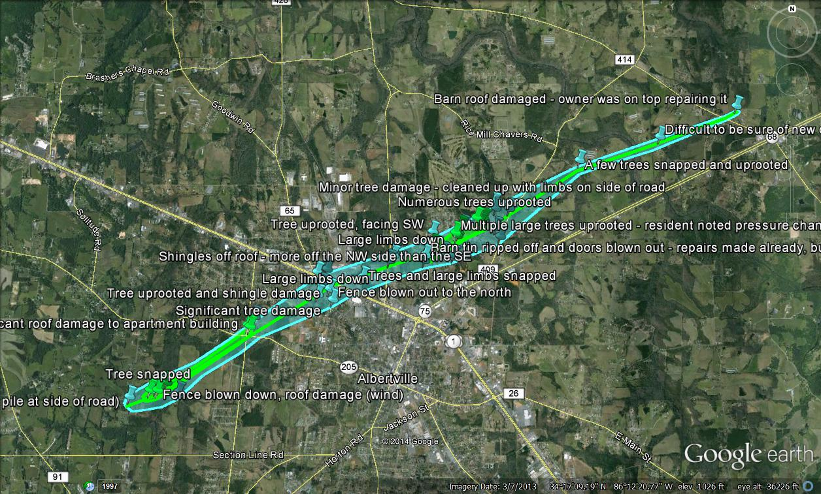
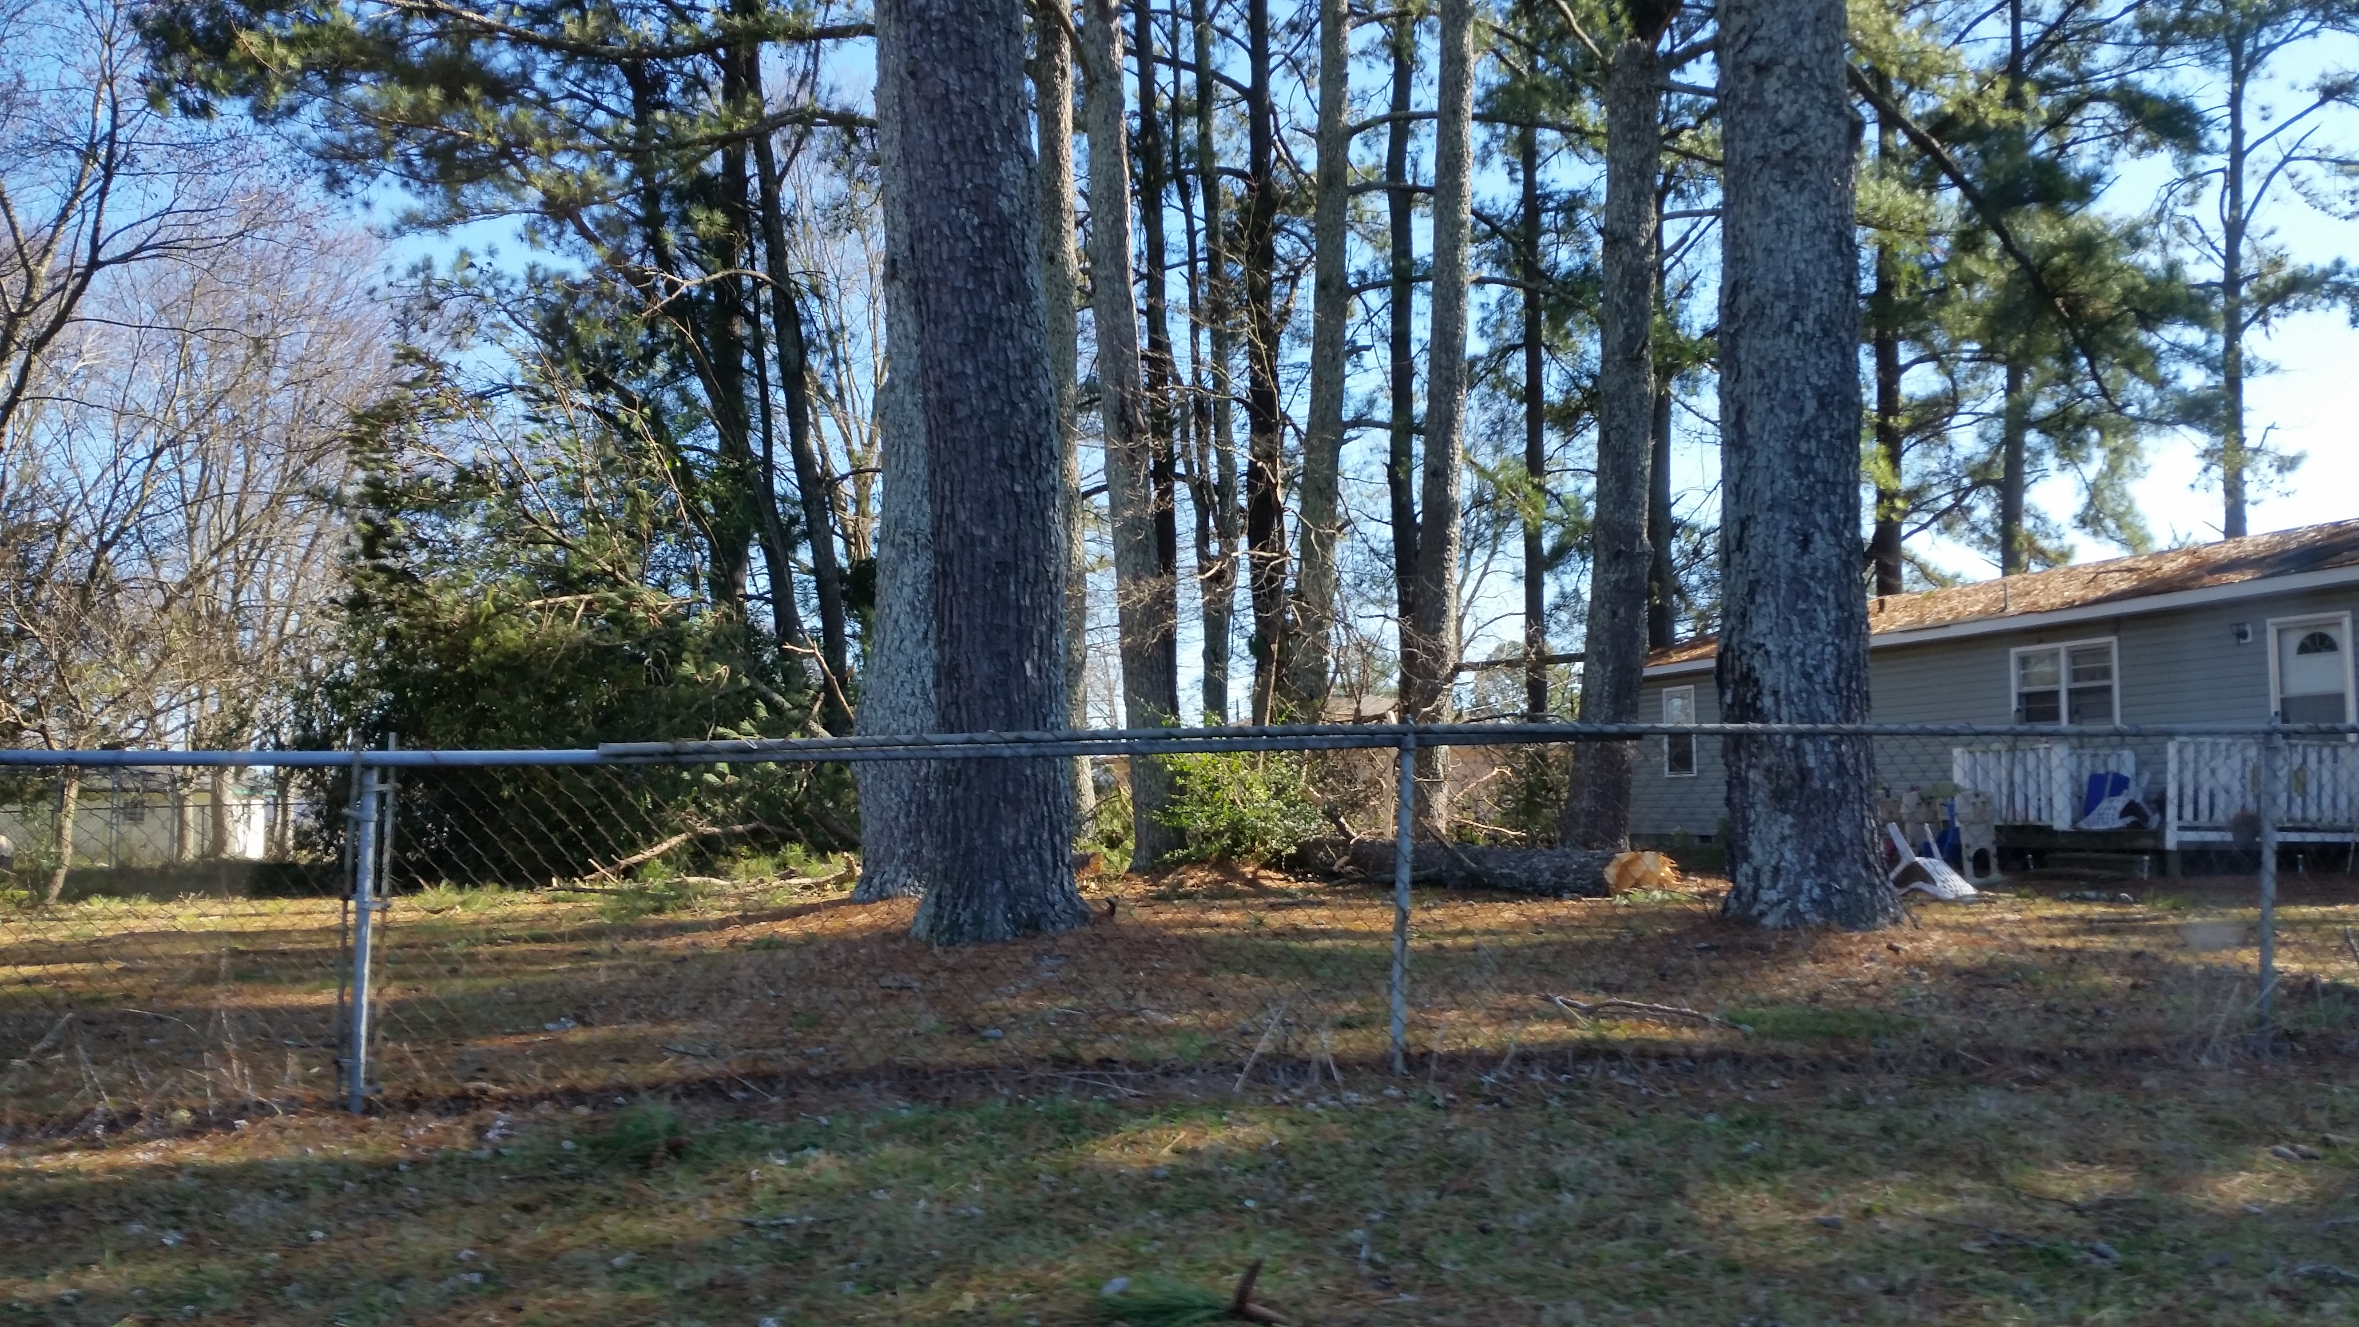
Damage/tornado track
EF 1 damage on the north side of Albertville
Track length about 10.3 km
Survey data courtesy of Tony Lyza

Slide 4
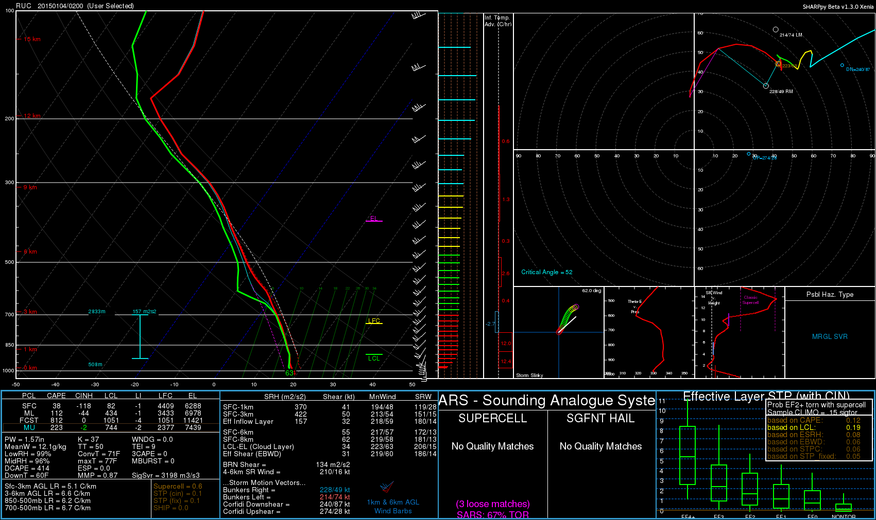
Environment

Slide 5
Dual Doppler Analysis
UAH ARMOR (C-band) and KHTX (S-band) radars
Data manually edited and unfolded using solo3
Data were gridded to a Cartesian grid using Radx
180 km x 120 km x 15 km grid
Horizontal grid spacing of 1000 m and vertical grid spacing of 500 m
Cressman weighting scheme
Dual Doppler Analysis performed using CEDRIC
Since ARMOR was in low levels only, only ARMOR volume scans that were fully within a KHTX volume were selected to reduce error in the dual Doppler analysis
70 km baseline

Slide 6
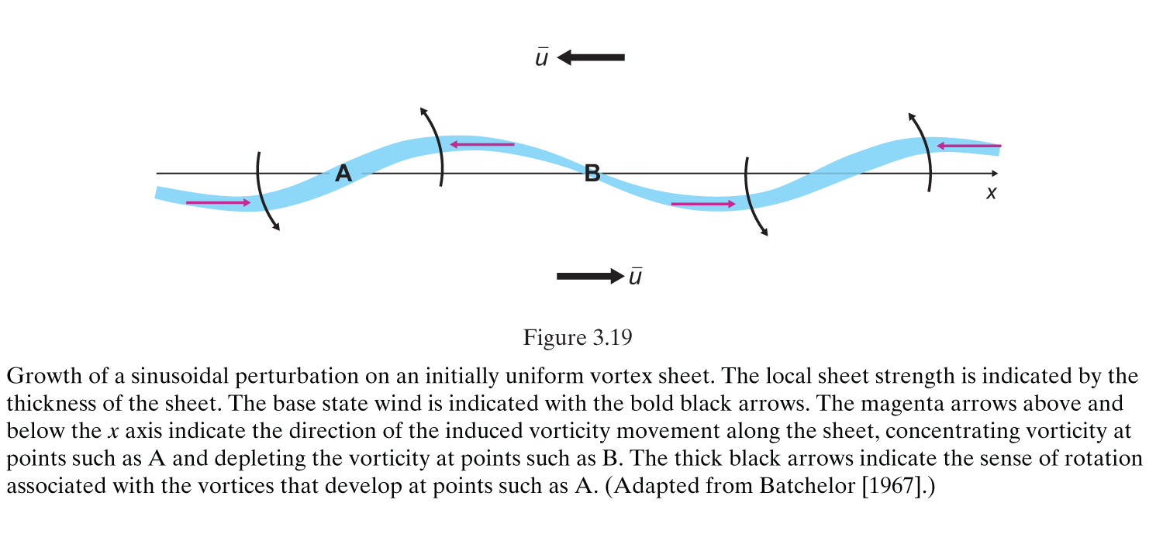
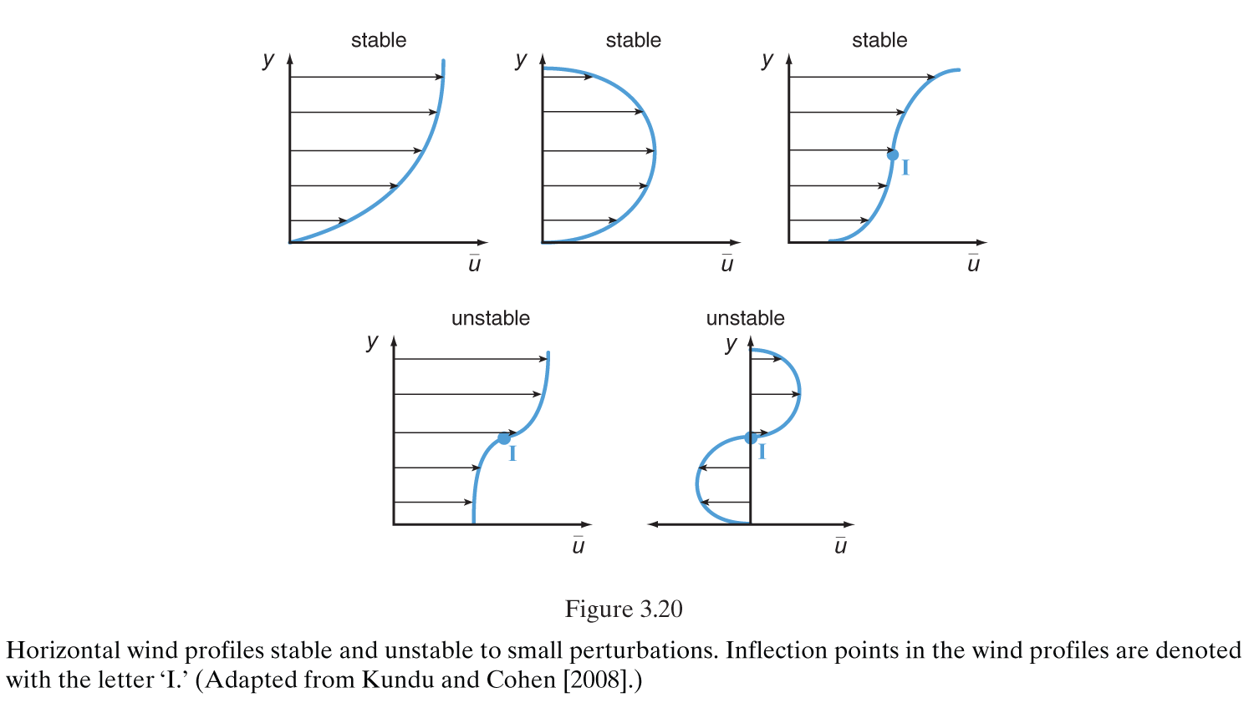
Horizontal Shearing Instability Criteria
Rayleigh Instability Criterion
Change in sign of $\frac{∂^{2}u}{∂y^{2}}$ shows inflection point in flow where u is line parallel wind component
Necessary but not sufficient for HSI
Fjortoft Instability Criterion
Fjortoft derived a more stringent condition
$\frac{∂^{2}u}{∂y^{2}}(u−u_{I}$) must be less than zero in the flow, where $u_{I}$ is the flow at the inflection point
Also necessary but not sufficient for HSI
From Markowski and Richardson 2010

Slide 7
Clark and Parker 2014
Used high resolution surface data to obtain winds, temperature, and pressure in the UK
Studied 15 cold fronts crossing the UK, 7 of them producing tornadoes
Lists HSI as the formation mechanism
Lack of anticyclonic misovortices and variability in reflectivity suggests absence of updraft/downdrafts (Trapp & Weisman 03)
Does not rule out tilting mechanism due to lack of high resolution observations
Found 3 general thresholds
Large-veer (>>45°), strong post frontal winds usually tornadic
Small-veer (<45°), strong post frontal winds not conducive for tornadoes
Weak post frontal winds not conducive for tornadoes
Vorticity stretching found with progressive veering of winds or increase in speed
Possibility of conditional instability in prefrontal environment as a necessary condition

Slide 8
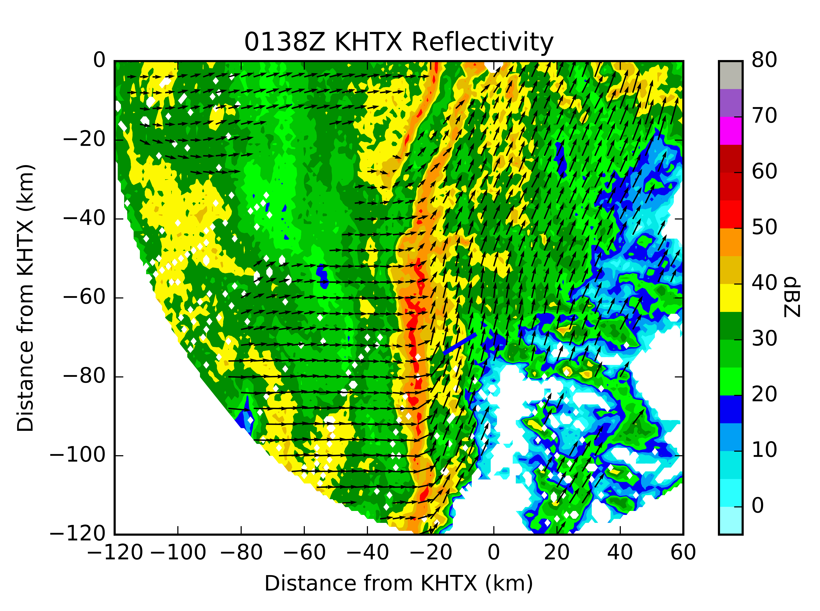
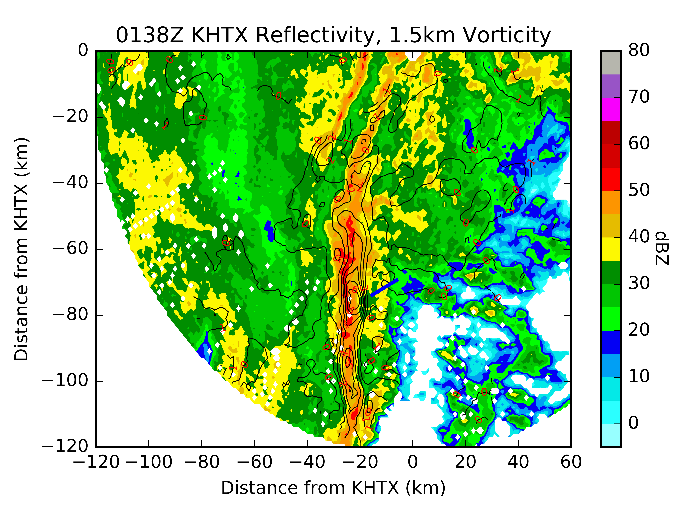
Tornadic Vortex
Objectively-analyzed radar reflectivity from KHTX at 0138 UTC at 1500 m above ground level (AGL).
Objectively-analyzed radar reflectivity and vorticity (10⁻³ s⁻¹) from KHTX at 0138 UTC at 1500 m above ground level (AGL).

Slide 9
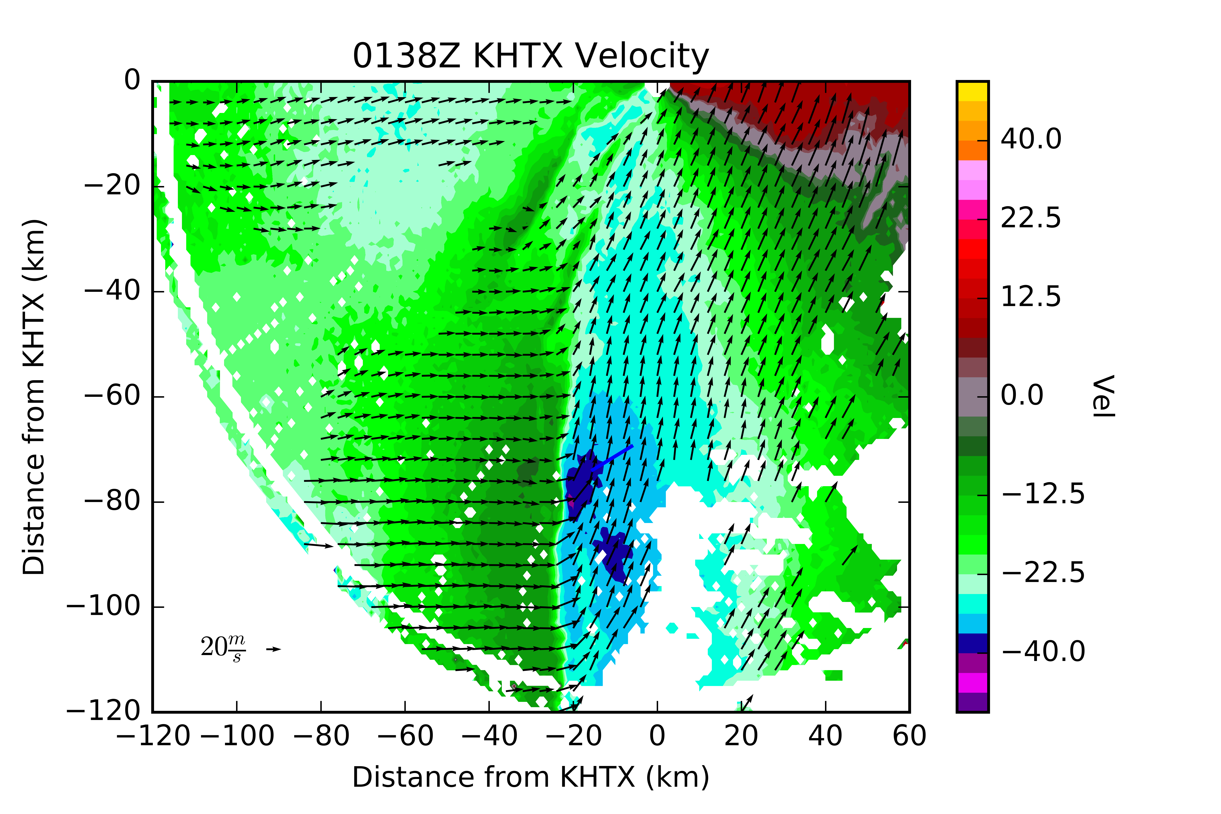
Tornadic Vortex
Rayleigh stability parameter at 0138 UTC at 1500 m AGL. Greatest change of sign located near location of tornadic vortex.
Objectively-analyzed velocity (m s⁻¹) from KHTX at 0138 UTC at 1500 m AGL.

Slide 10
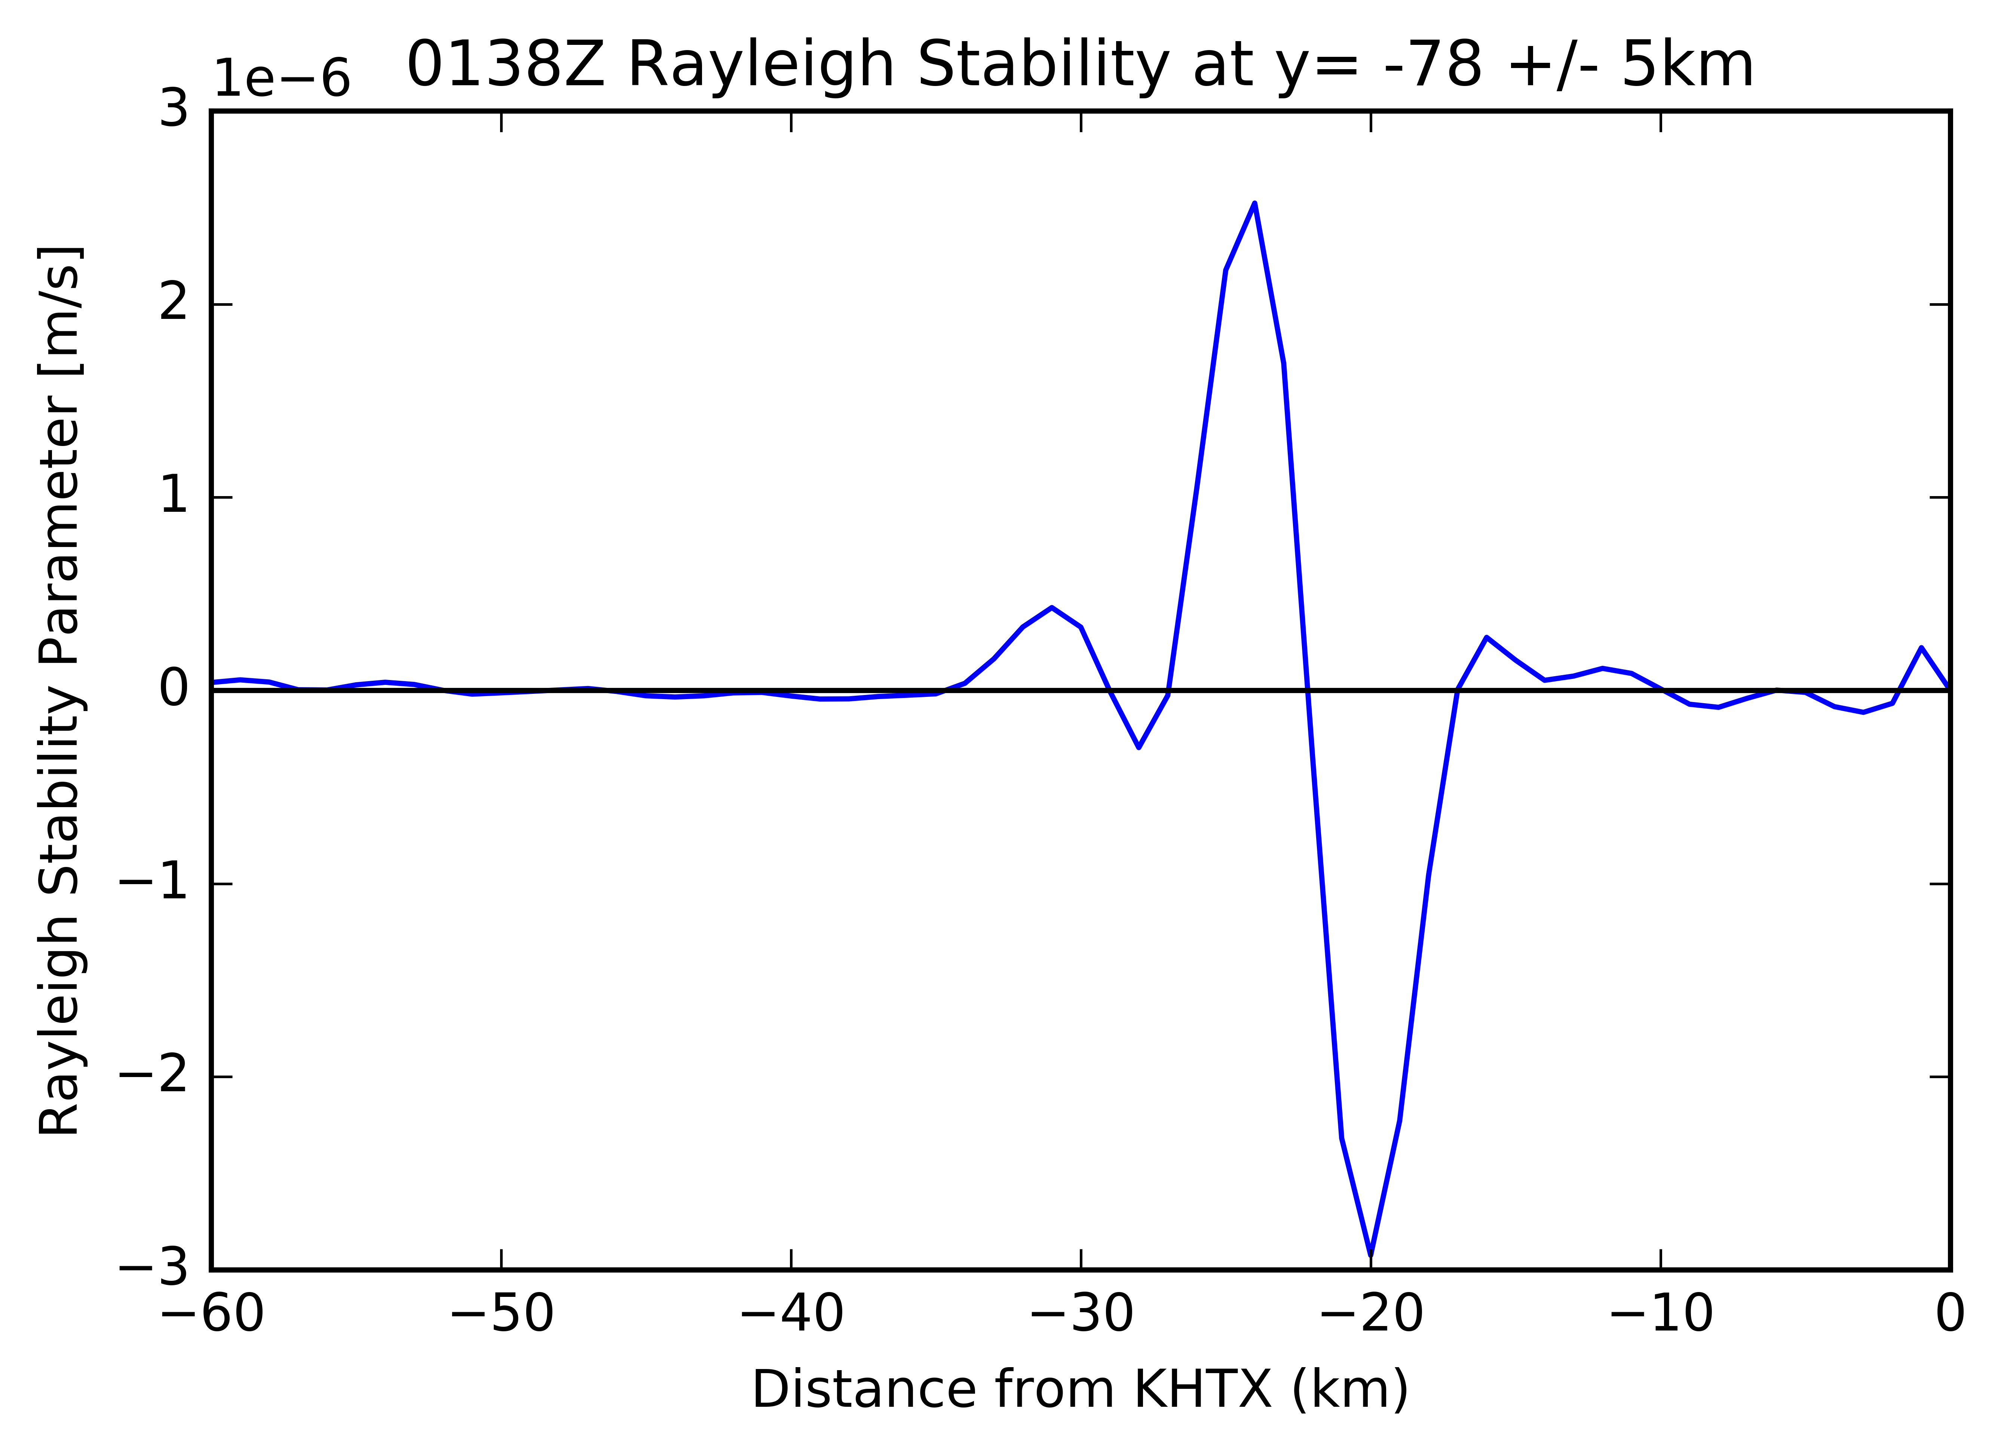
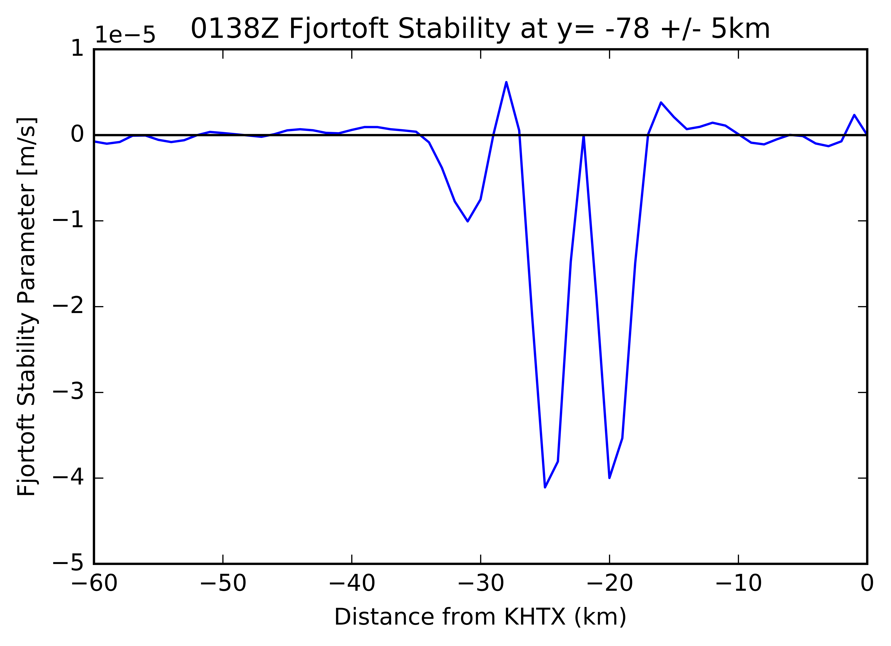
Tornadic Vortex
Rayleigh stability parameter at 0138 UTC at 1500 m AGL through tornadic vortex. Change in sign of Rayleigh parameter indicates the presence of an inflection point, necessary but insufficient for HSI.
Fjortoft stability parameter at 0138 UTC at 1500 m AGL. Negative Fjortoft parameter reveals that the vortex is not near the boundaries, which is necessary but insufficient for HSI.

Slide 11
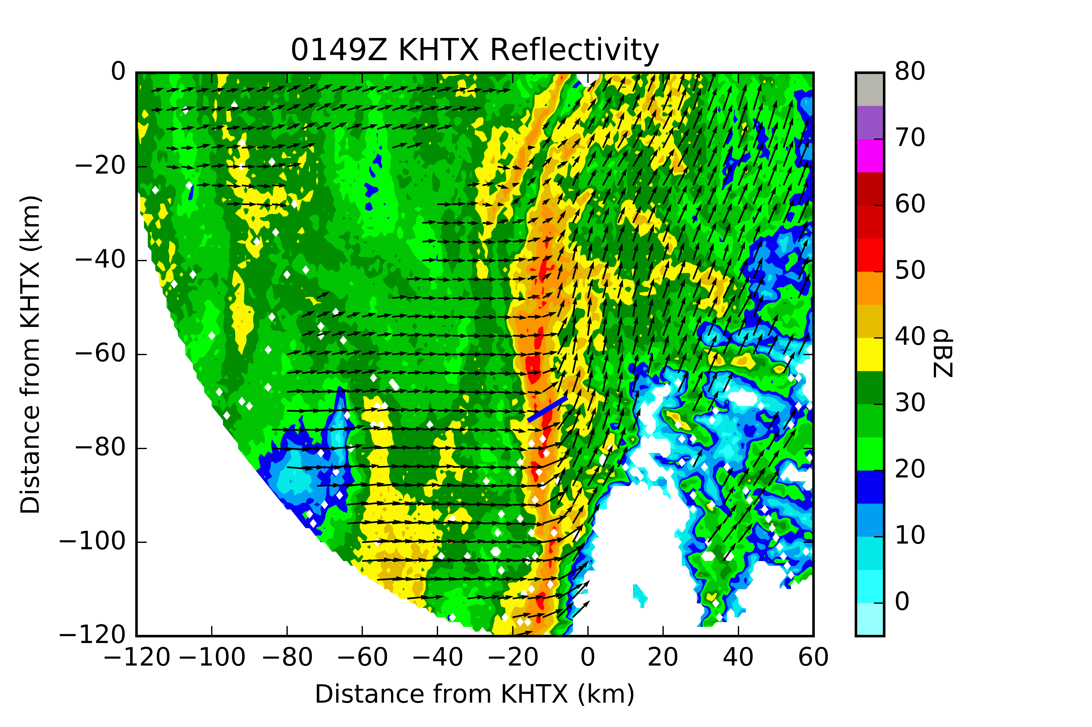
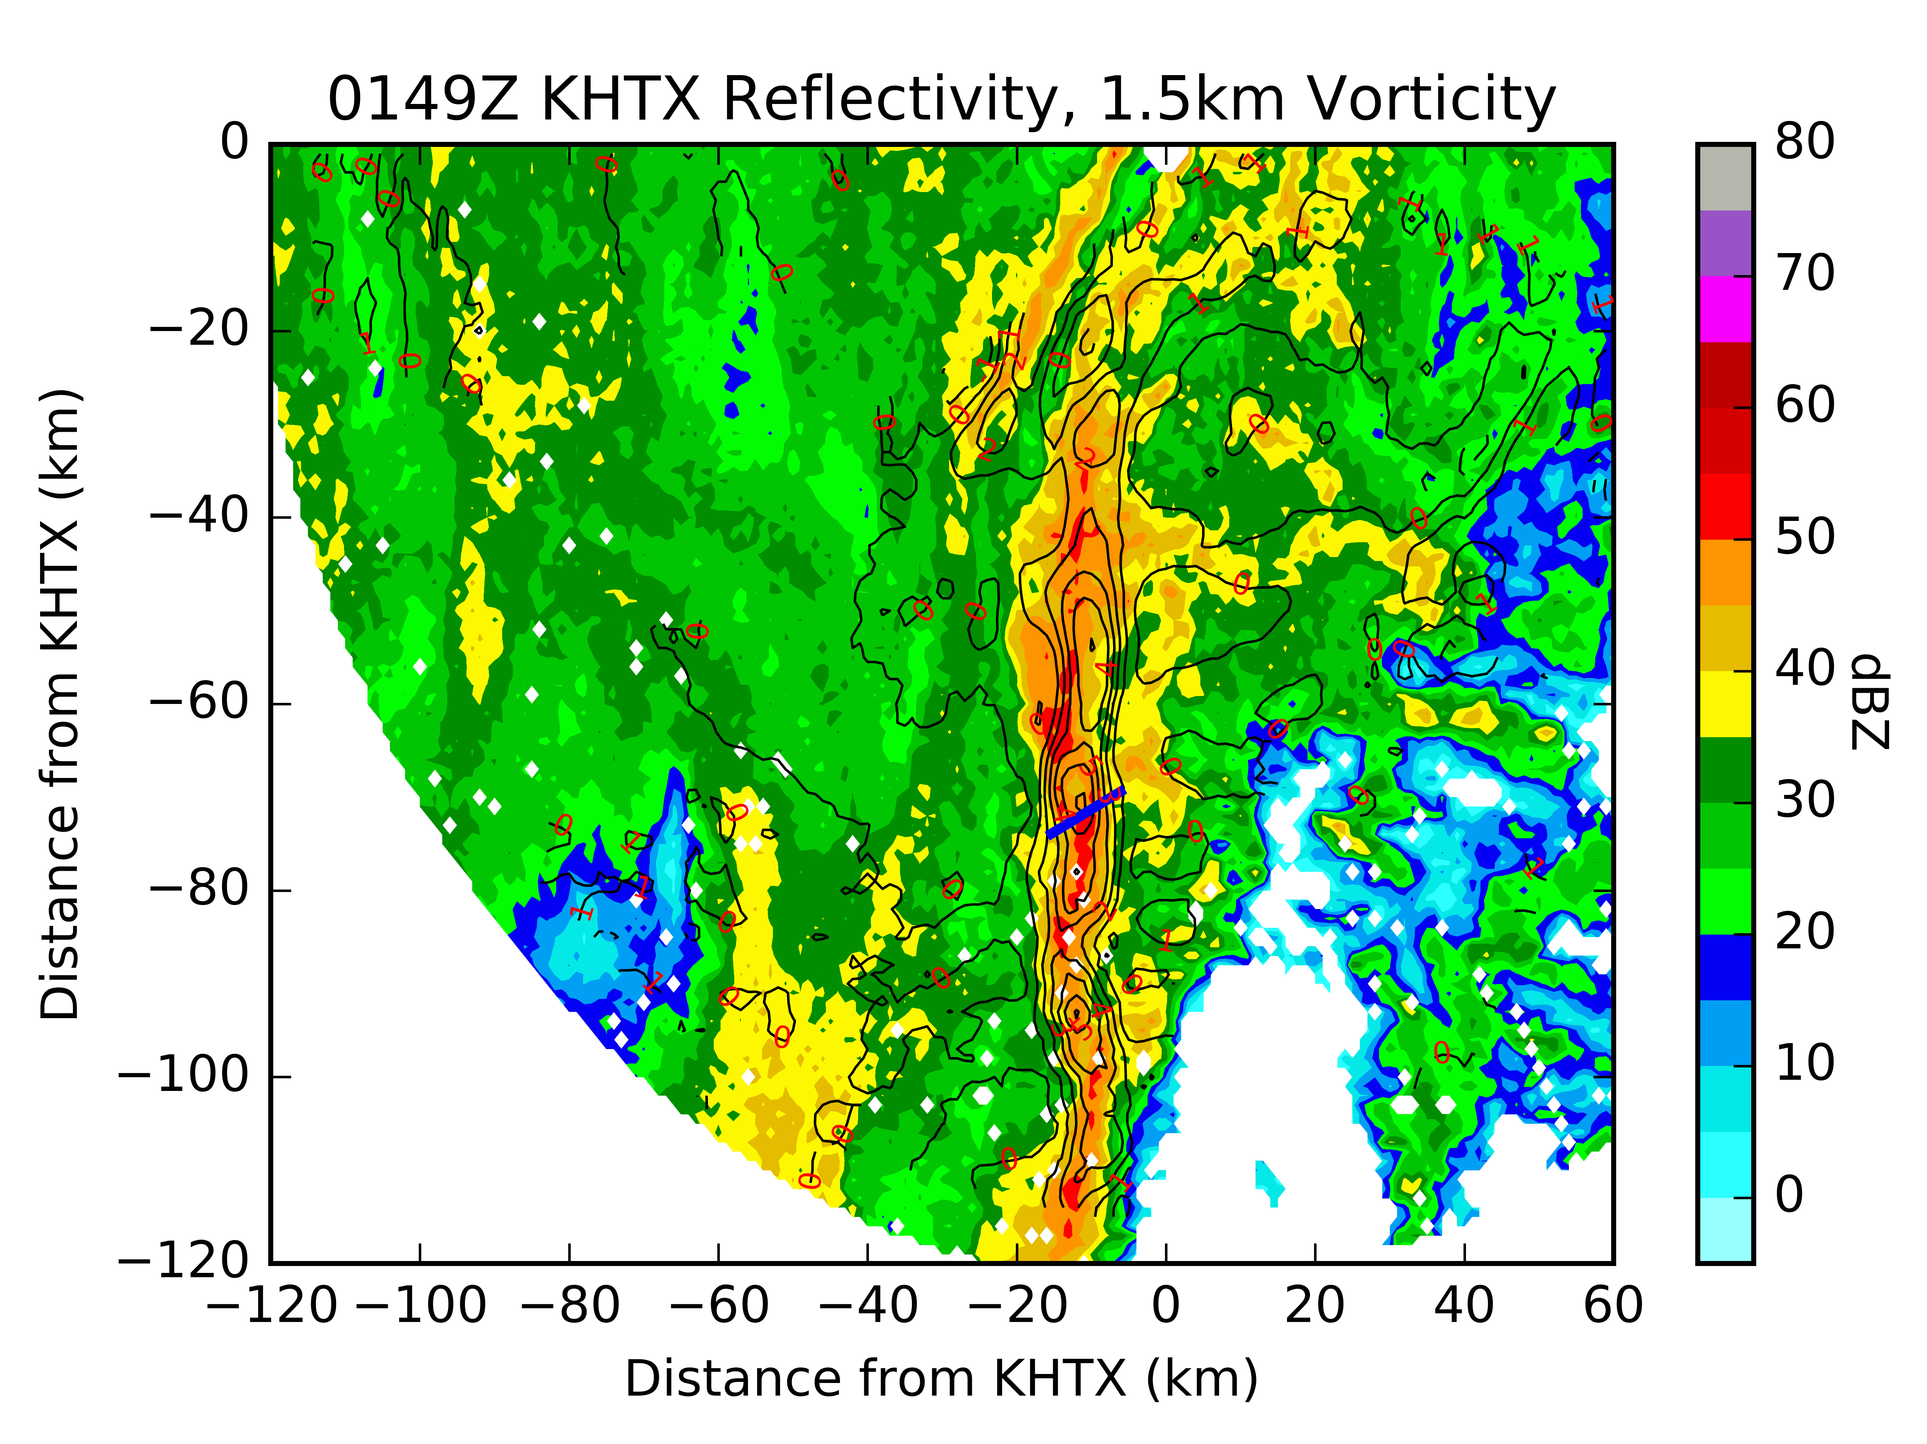
NonTornadic Vortex
Objectively-analyzed radar reflectivity from KHTX at 0149 UTC at 1500 m AGL.
Objectively-analyzed radar reflectivity and vorticity (10⁻³ s⁻¹) from KHTX at 0149 UTC at 1500 m AGL.

Slide 12
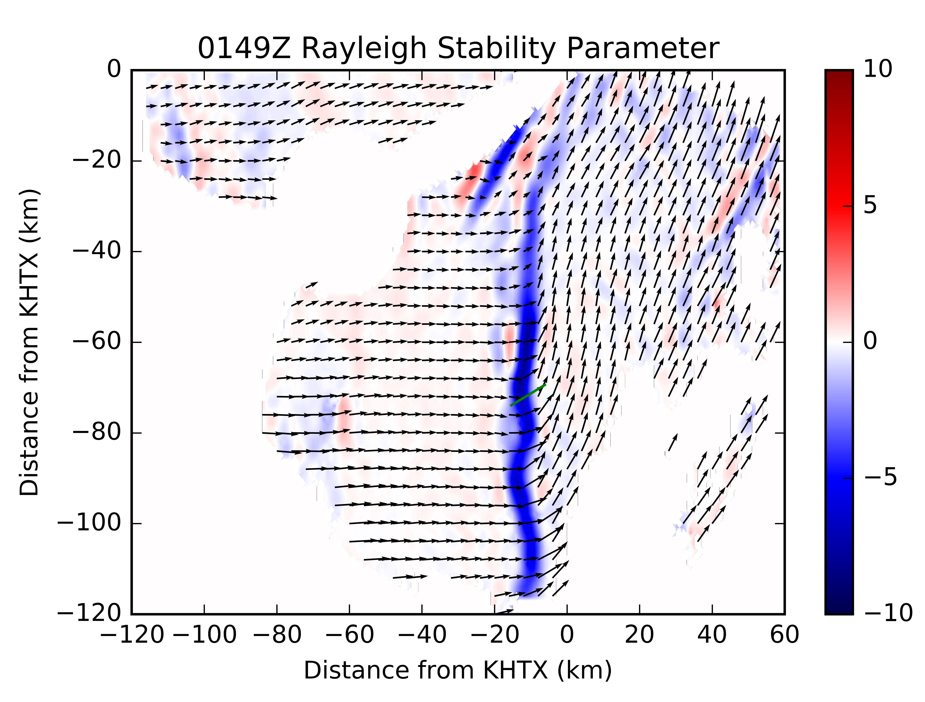
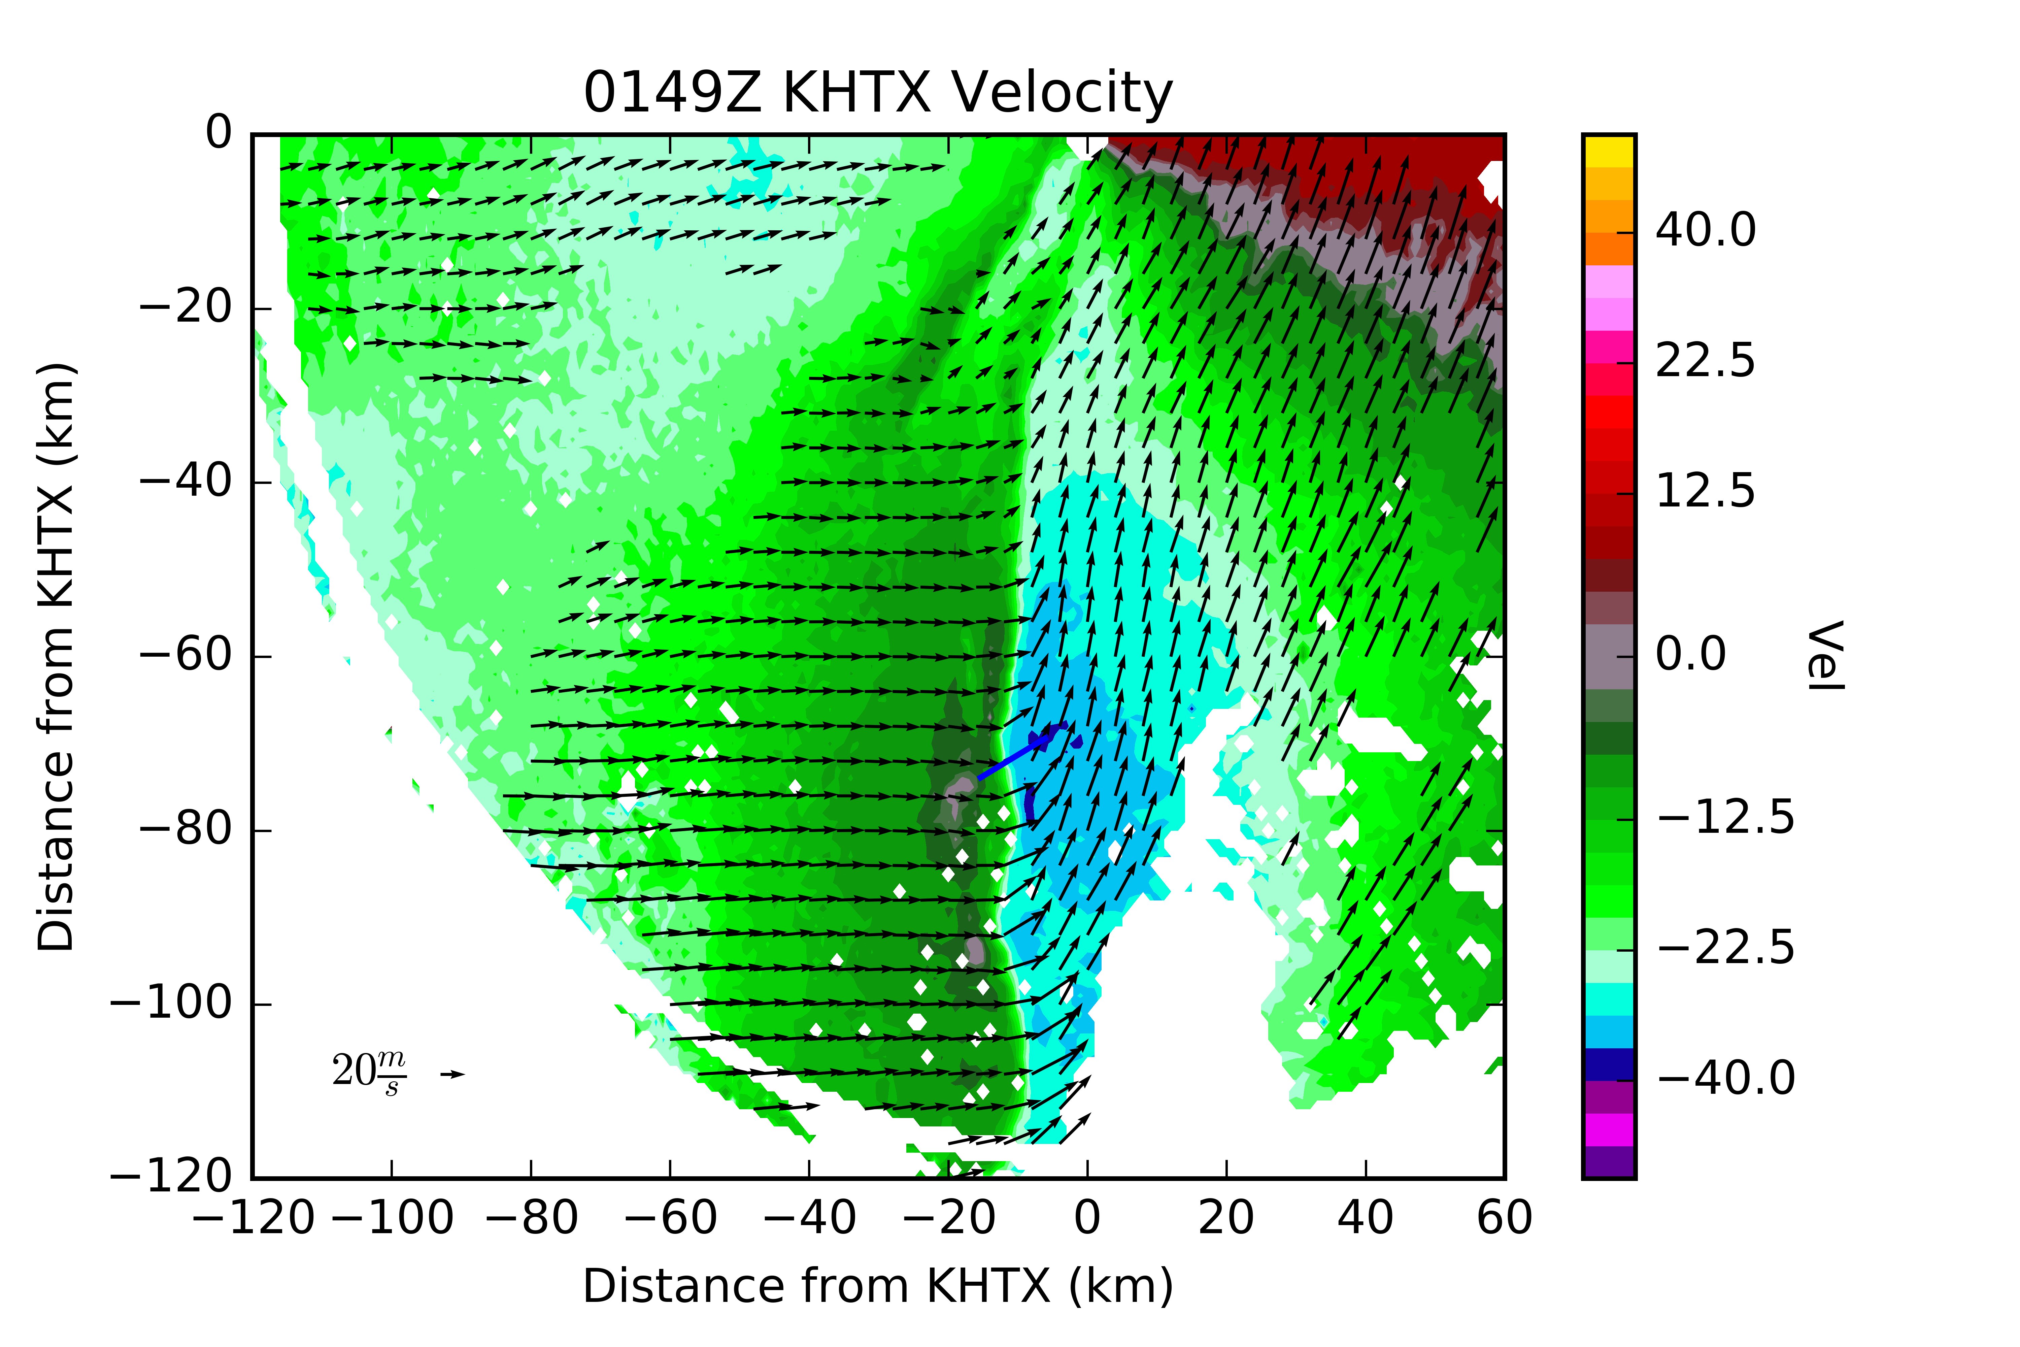
NonTornadic Vortex
Rayleigh stability parameter at 0149 UTC at 1500 m AGL. Over change in sign is of lower magnitude than what was seen at 0138 UTC.
Objectively-analyzed velocity (m s⁻¹) from KHTX at 0149 UTC at 1500 m AGL.

Slide 13
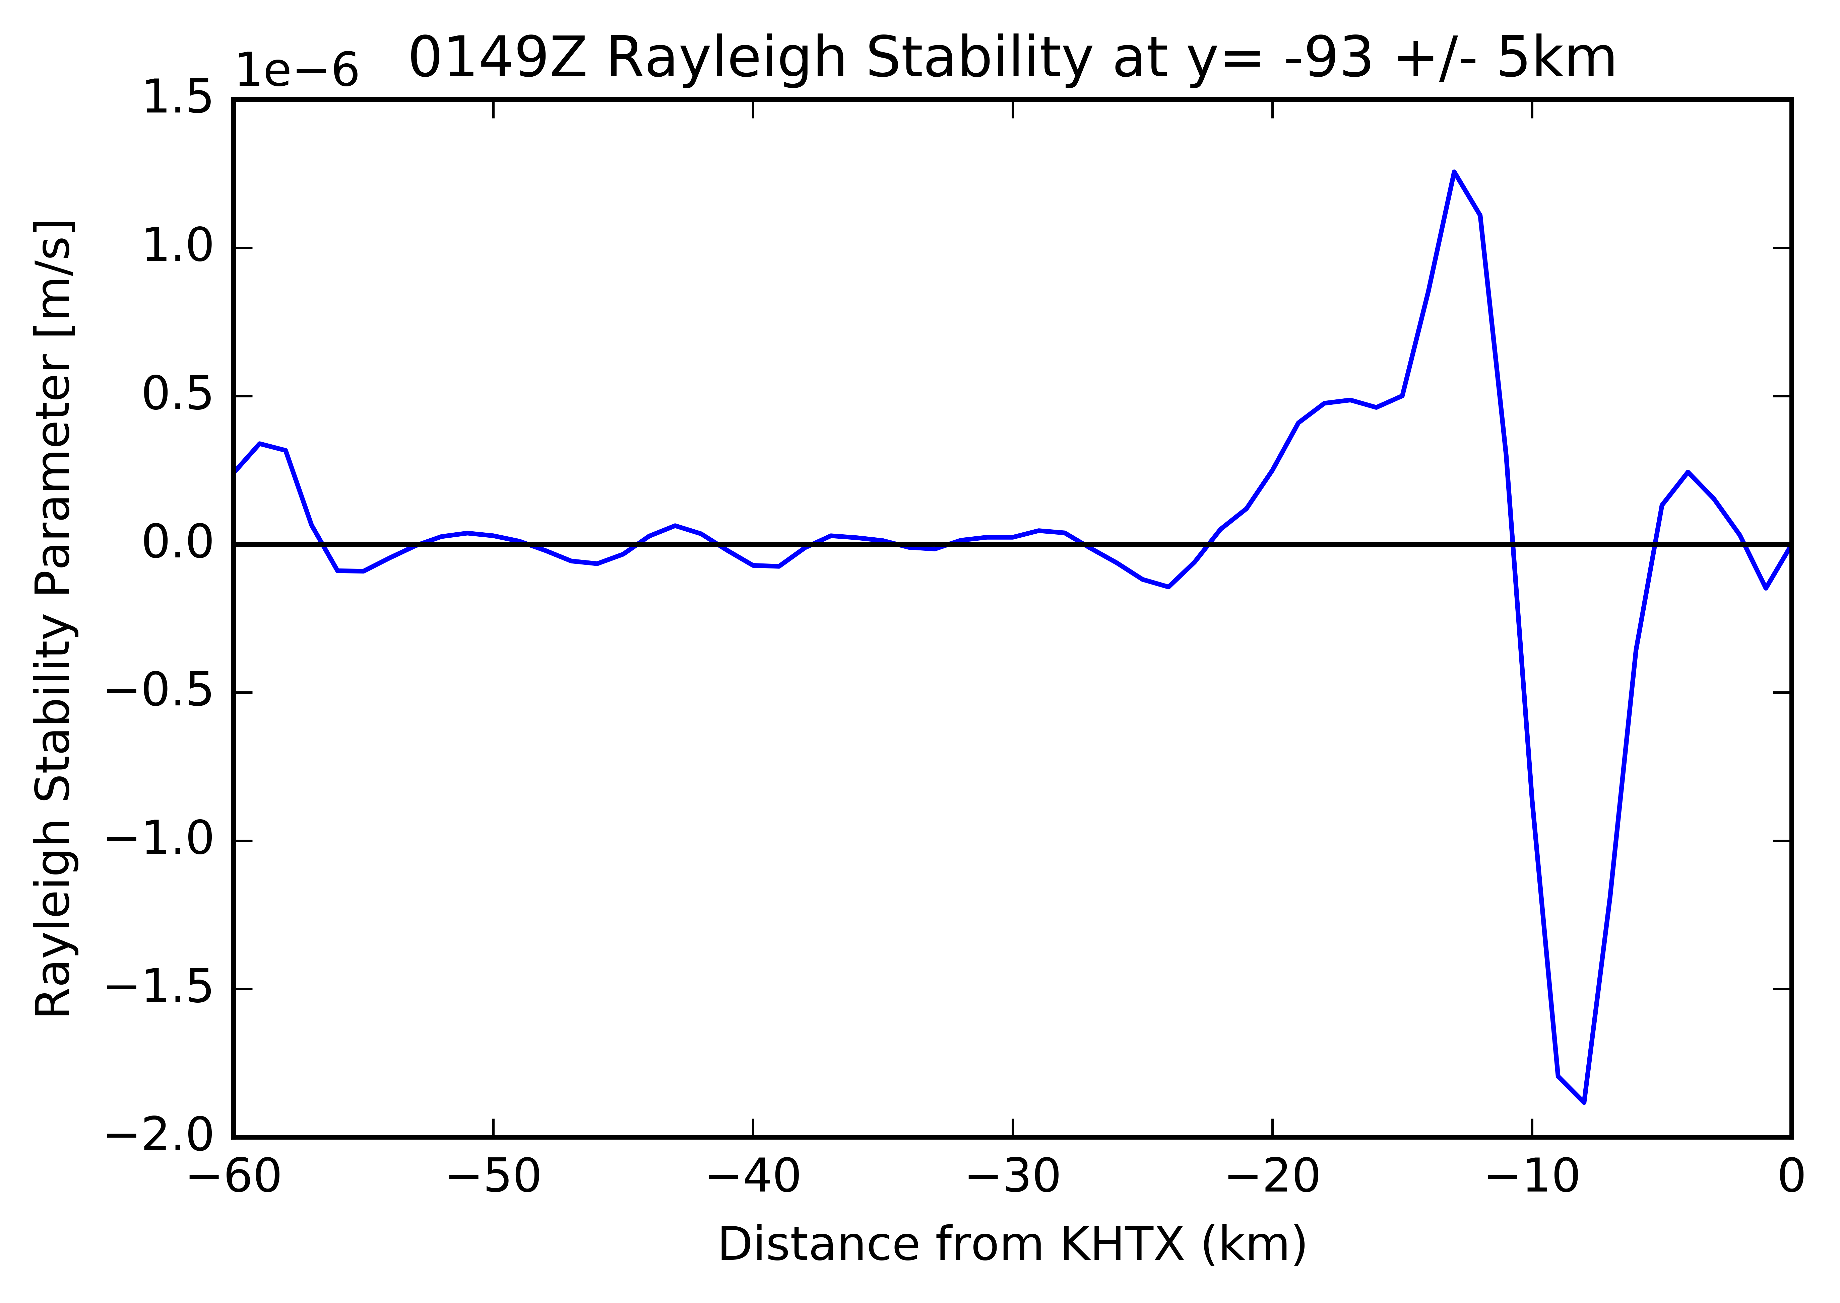
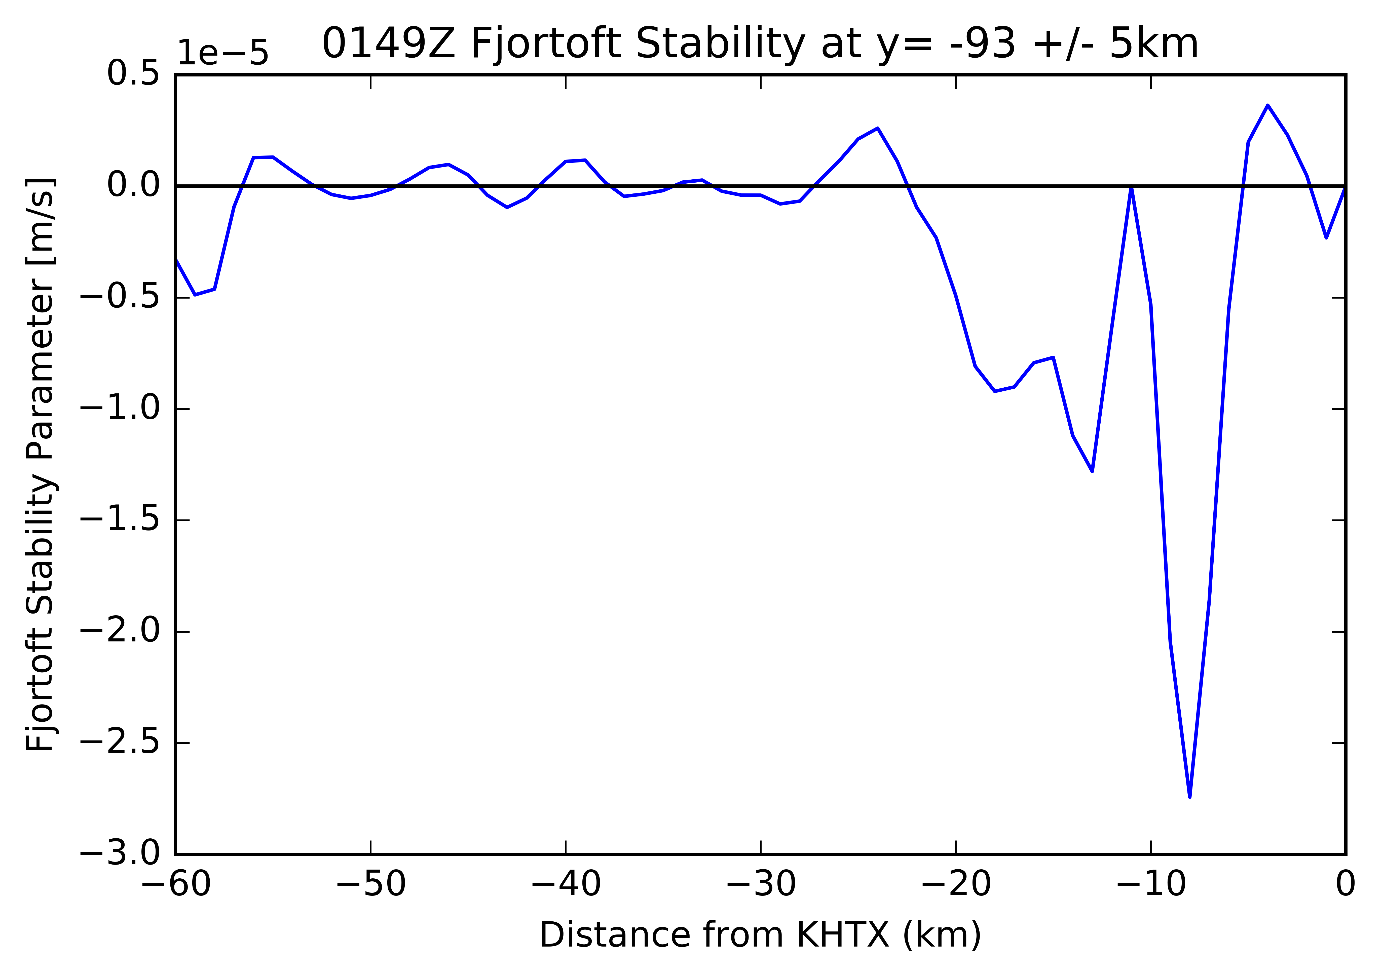
NonTornadic Vortex
Rayleigh stability parameter at 0149 UTC at 1500 m AGL through tornadic vortex. Change in sign of Rayleigh parameter indicates the presence of an inflection point, necessary but insufficient for HSI. Magnitude of change in sign is less than at 0138 UTC by 3x10⁻⁶.
Fjortoft stability parameter at 0149 UTC at 1500 m AGL. Negative Fjortoft parameter reveals that the vortex is not near the boundaries, which is necessary but insufficient for HSI. Magnitude of negative max is less negative than at 0138 UTC by 1.5x10⁻⁶.

Slide 14
So why is one tornadic and the other is not?
Both mesovortices likely formed from HSI, however northern vortex becomes tornadic while southern vortex does not
Wave interaction with northern vortex but not with southern vortex
Cannot provide definitive proof of wave passage
Lack of surface stations in region of passage
Is the environment supportive of waves?

Slide 15
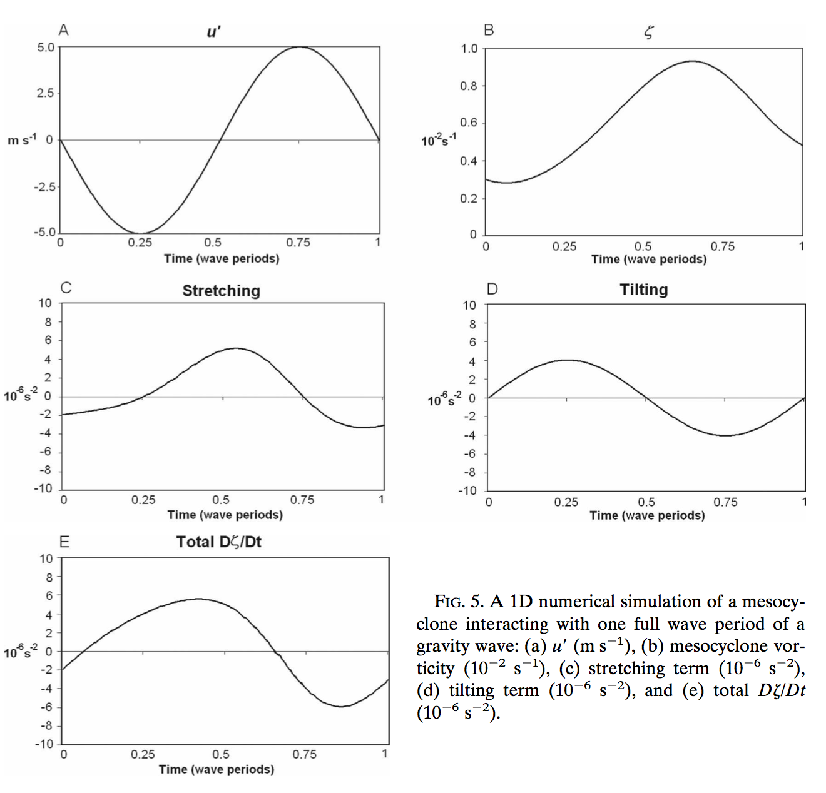
Wave Interaction
Holton 2013 states that Kelvin-Helmholtz waves can be generated (maintained) in environments with Richardson Number less than .25 (1.0)
$$N^{2}=\frac{g}{θ}\frac{∂θ}{∂z} Ns^{2}=\frac{g}{θz_{0}}\left[\frac{θe(z_{0})−θes(z_{1})}{hz_{0}−hz_{1}}\right] Ri=\frac{N^{2}}{{\left(\frac{du}{dz}\right)}^{2}}$$
Lindzen and Tung (1976) stated that internal gravity waves can be ducted by layers of decreasing vertical wave number (m²) and the ground
$$m^{2}= \frac{N^{2}}{{\left(c−u\right)}^{2}}+ \frac{\frac{∂^{2}u}{∂z^{2}}}{(c−u)} −k^{2} k^{2}={\left(\frac{2π}{λ_{h}}\right)}^{2}$$
Coleman and Knupp 08 showed how interactions between internal gravity waves and mesocyclones can lead to an overall intensification of vorticity
From Coleman and Knupp 2008

Slide 16
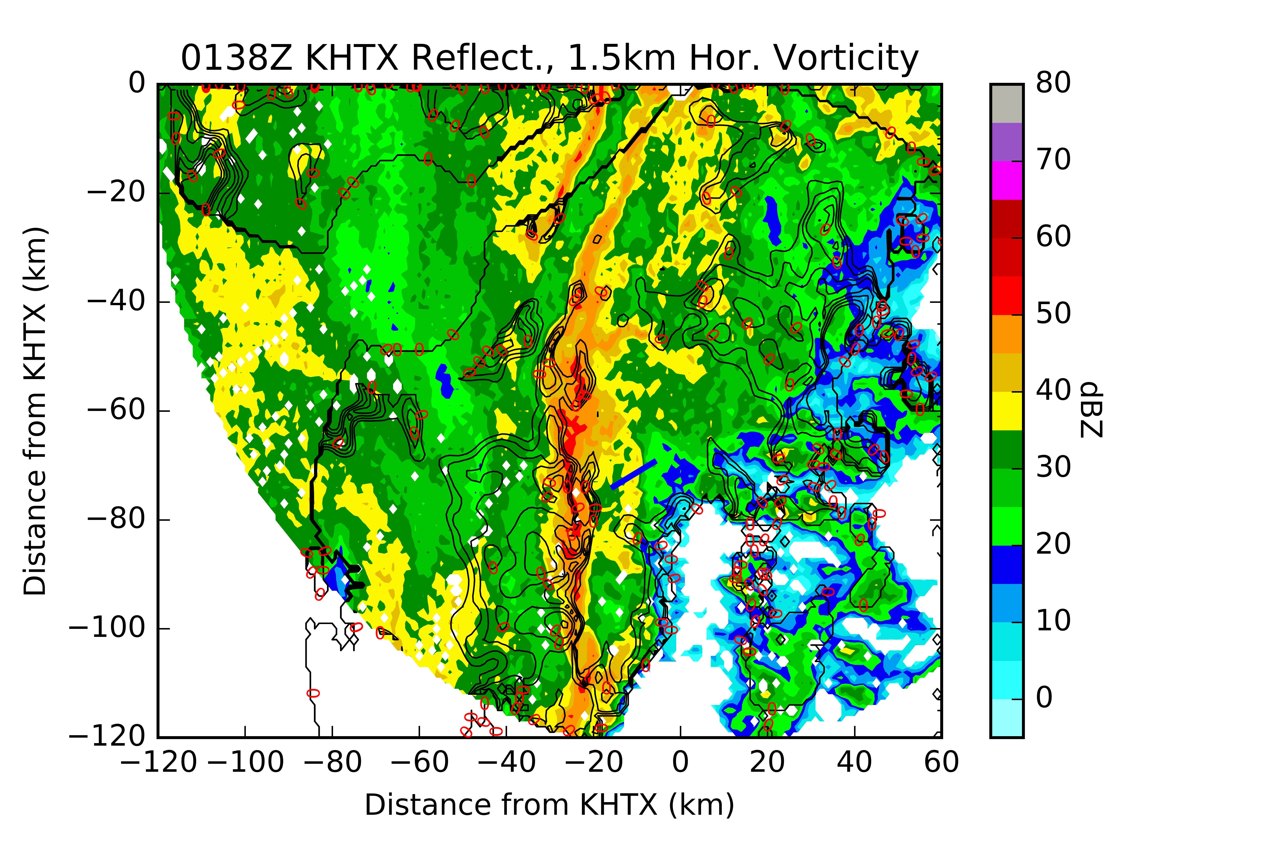
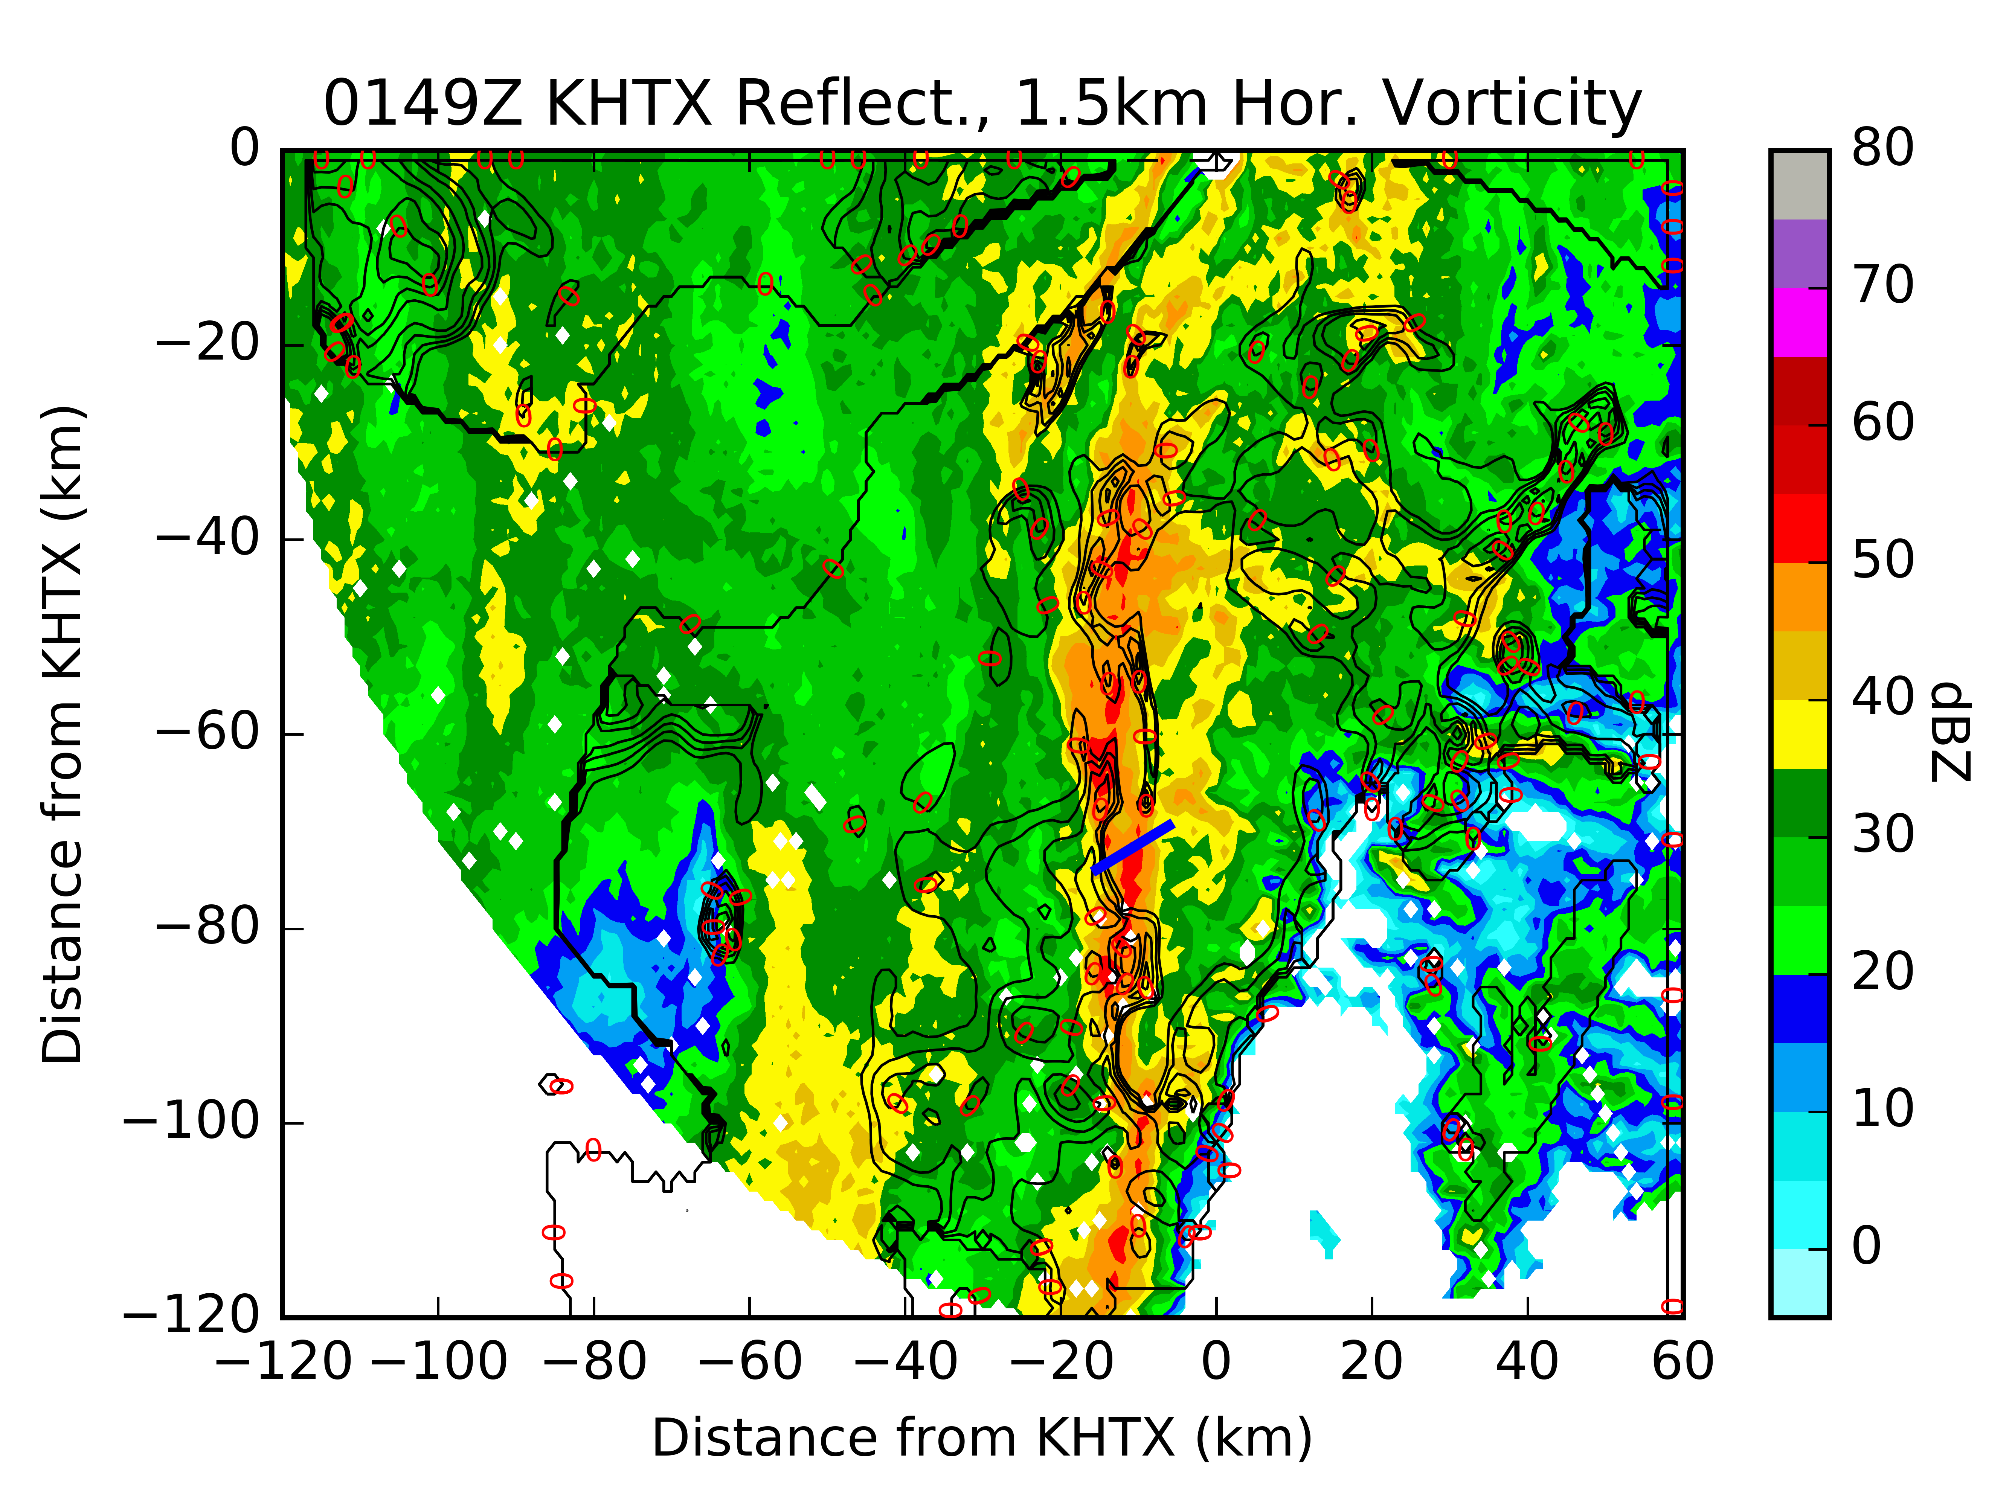
Wave Interaction
Objectively-analyzed radar reflectivity and horizontal vorticity (10⁻³ s⁻¹) from KHTX at 0138 UTC at 1500 m AGL. Some hint of horizontal vorticity along leading edge of possible wave.
Objectively-analyzed radar reflectivity and horizontal vorticity (10⁻³ s⁻¹) from KHTX at 0149 UTC at 1500 m AGL. Unlike 0138 UTC, no horizontal vorticity interacts with southern vortex.

Slide 17
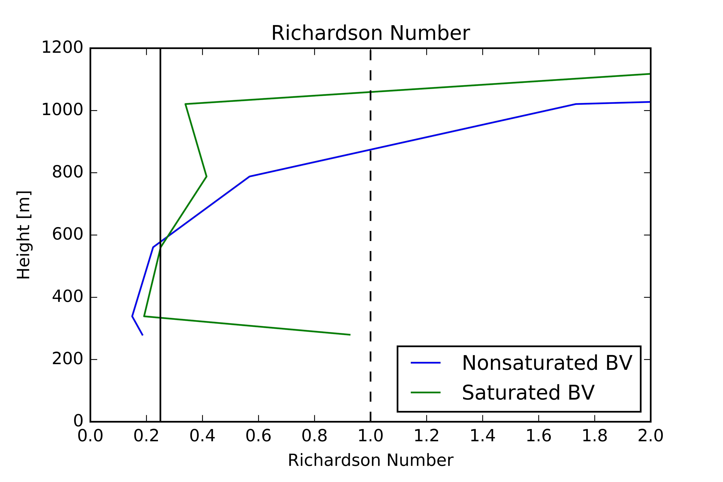
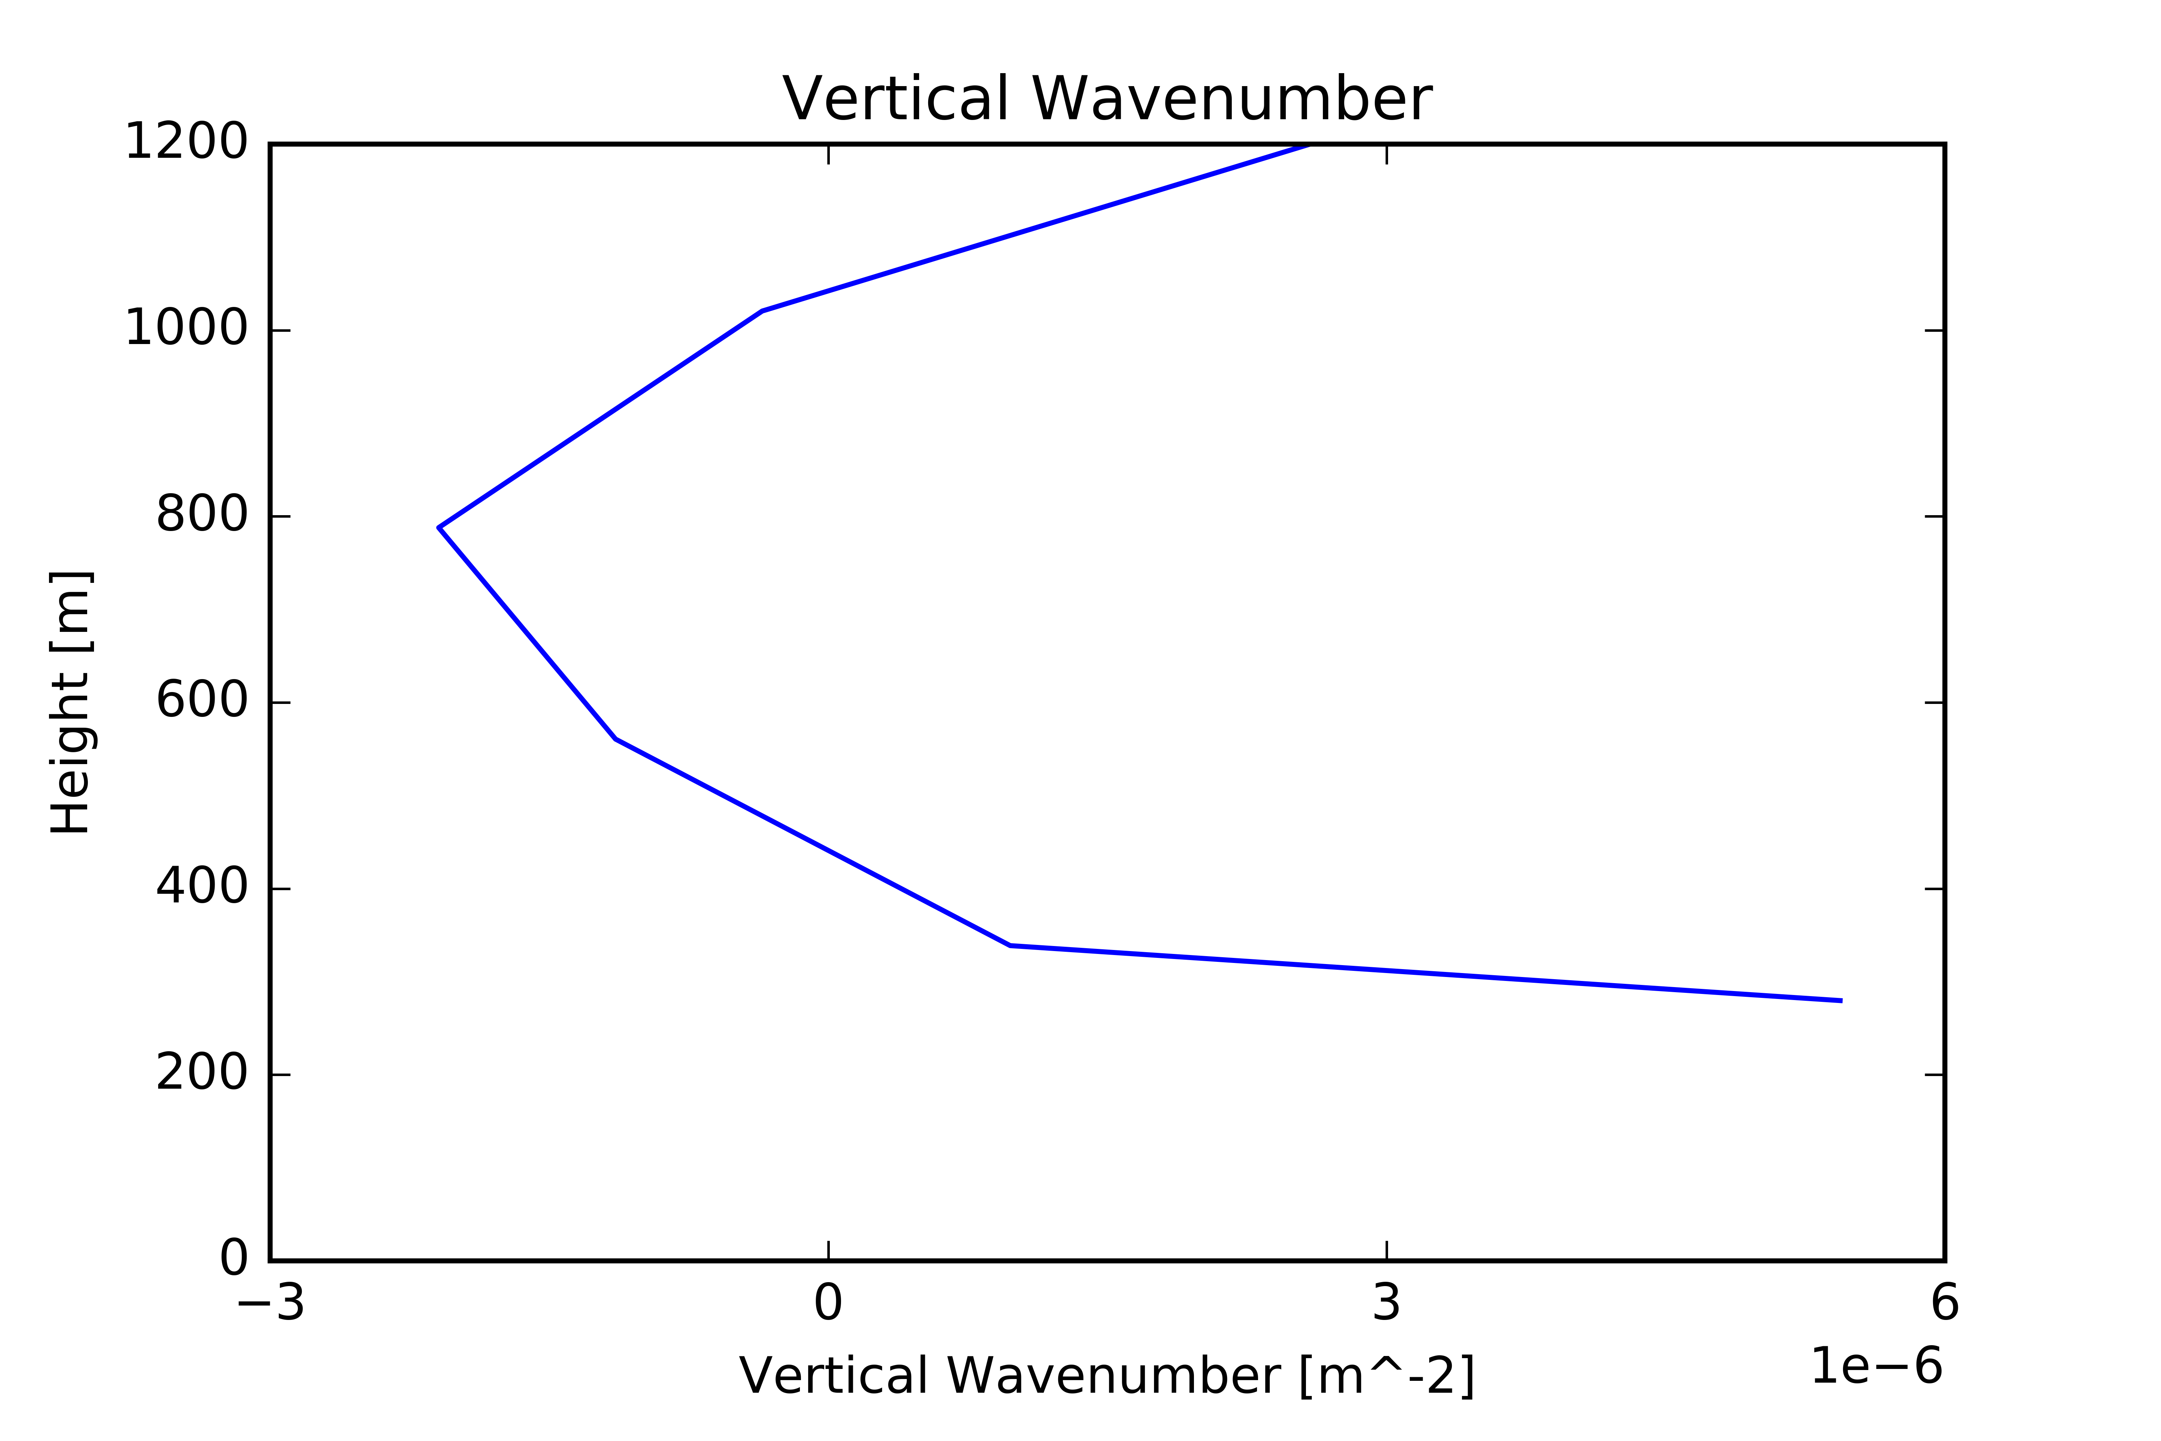
Wave Interaction
Profile of Richardson Number calculated from the RAP sounding using saturated and non-saturated Brunt-Vaisala frequency. Values below 0.25 (1.0) are supportive for generation (maintenance) of Kelvin-Helmholtz waves.
Profile of vertical wavenumber determined from equation below using RAP sounding. Gravity waves can be reflected by the ground and by layers of decreasing m² .

Slide 18
Summary
Dual Doppler analysis of a tornadic QLCS was performed
A stout wind shift with strong pre- and post-QLCS winds existed with tornadic vortex
Agrees with results shown in Clark and Parker 2014
Southern vortex depicts are more drawn out wind shift than northern vortex
Both vortices satisfied Rayleigh and Fjortoft stability criteria, which are necessary but insufficient for HSI. Thus, it is likely that HSI is the main formation mechanism of these vortices
A possible wave interaction is what caused northern vortex to become tornadic
Environment was favorable for Kelvin-Helmholtz and internal gravity wavesDual Doppler analysis shows horizontal vorticity along leading edge of the wave
Cannot definitively say wave was present though due to lack of surface observations and low resolution of dual Doppler

Slide 19
Future Work
Similar analysis to be performed on other events with improved radar coverage
Further investigation into the role of tilting and stretching in mesovortex formation and wave interaction
Assimilation into the Weather Research and Forecasting model for trajectory analysis
Dual polarization analysis near the vortex

Slide 20
Acknowlegments
Dr. Kevin Knupp, Dr. Tim Coleman – UAH
Dr. Jeff Frame – UIUC
Dr. Todd Murphy - ULM
Barrett Goudeau, Carter Hulsey, Tony Lyza, Austin Vacek, Ryan Wade – UAH
Support from Northern Gulf Institute Grant 191001.363513.04A

Slide 21
Questions?
Contact: dconrad@nsstc.uah.edu
Twitter: @WxDcon

