Slide 1
Comparison of Spectrum Width, Normalized Rotation, and Correlation Coefficient in Tornadic QLCS and Supercell Circulations
Brian Greene
University of Oklahoma
Ted Funk and Zack Taylor
NOAA/NWS Louisville KY
Kevin Deitsch
NOAA/NWS St. Louis MO

Slide 2
Objectives
Define values, spreads, and trends in SW, NROT, and CC associated with tornadic QLCS and supercell circulations, and develop operational recommendations
Can such values be used to estimate tornado strength?
How valuable is SW in assessing/predicting tornadogenesis?

Slide 3
Methodology
GR2 used to analyze tornadoes by mode and intensity over OH, TN, and mid-MS Valley
30 TOR events and 158 total tornadoes
QLCS | Count | Supercell | Count
EF0 | 15 | EF0 | 11
EF1 | 52 | EF1 | 29
EF2 | 20 | EF2 | 17
EF3+ | 2 | EF3+ | 12
TOTAL | 89 | TOTAL | 69
Parameters recorded for each tornado
Min CC, max TDS depth – Each scan during and after TOR
Max SW, height AGL – Each scan before, during, and after TOR
Max NROT, height of max, depth – Each scan before, during, and after TOR
Avg SW, avg NROT – Max value for each scan ÷ by total # of scans during TOR

Slide 4
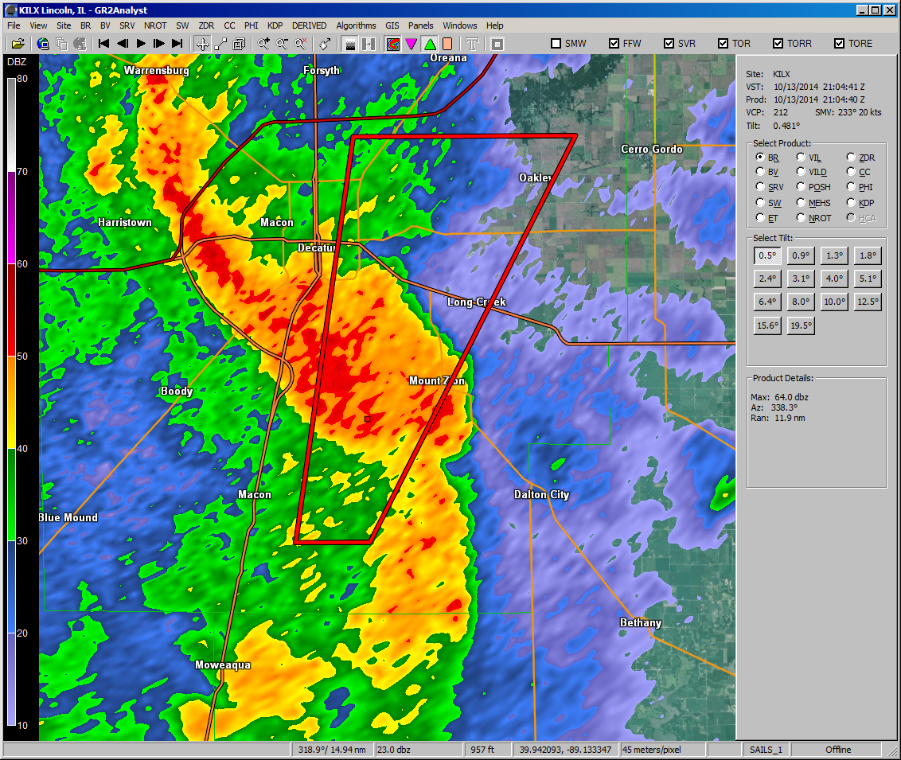
The Process
REFL

Slide 5
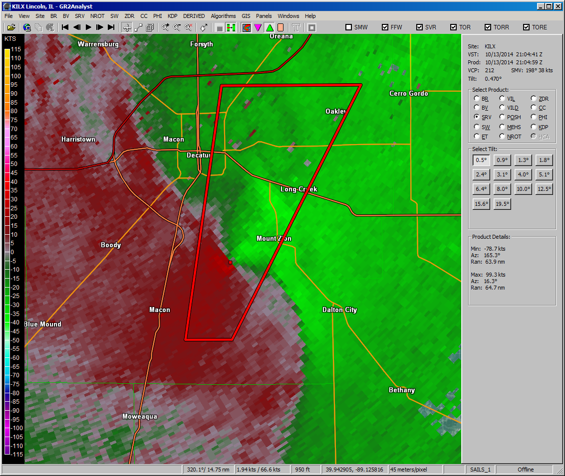
The Process
SRM

Slide 6
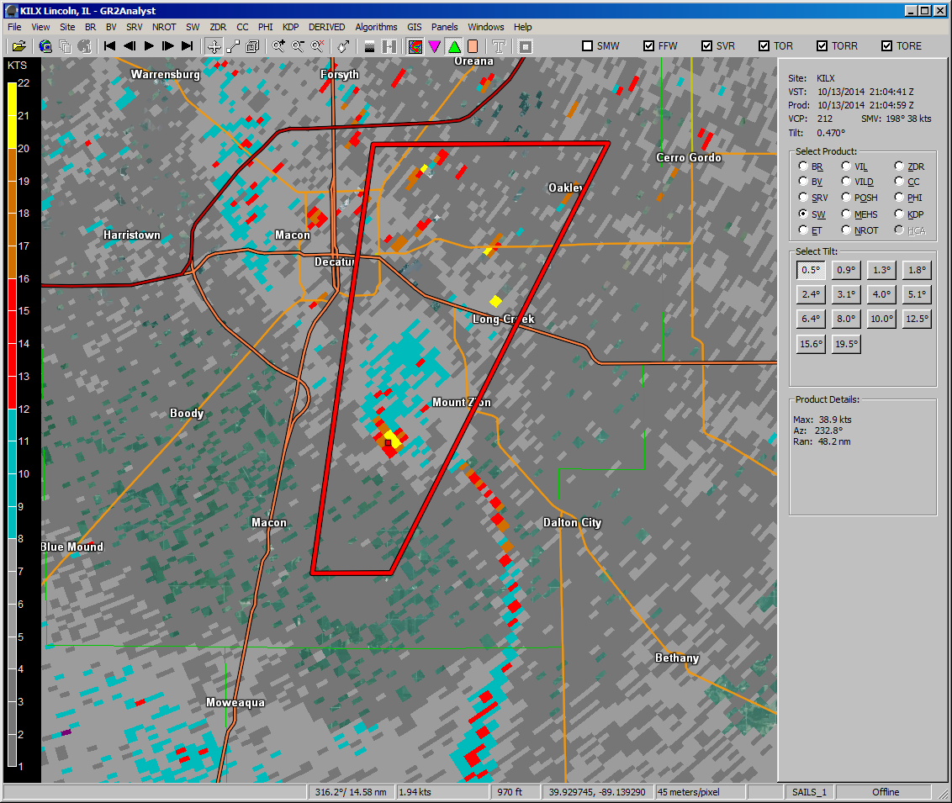
The Process
SW

Slide 7
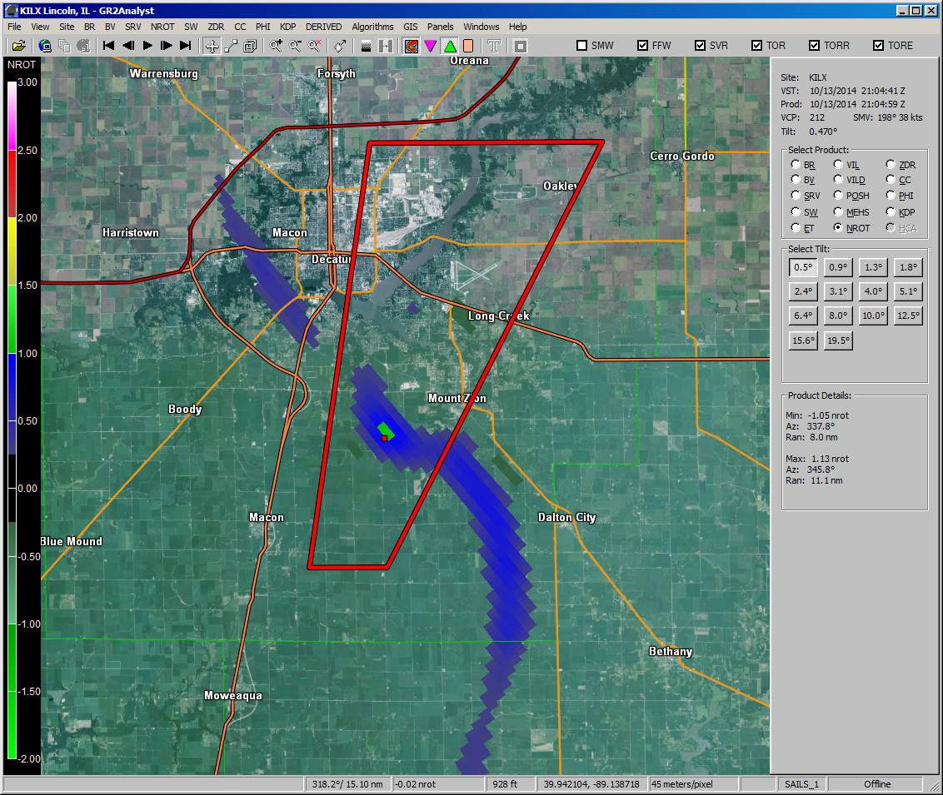
The Process
NROT

Slide 8
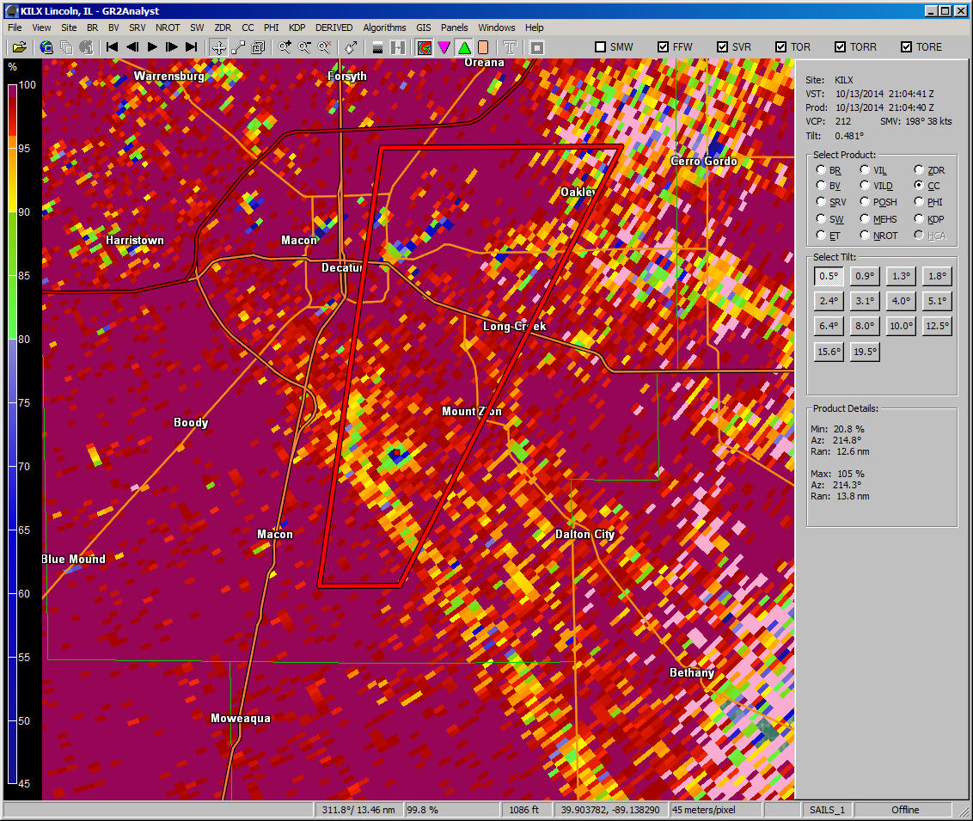
The Process
CC

Slide 9
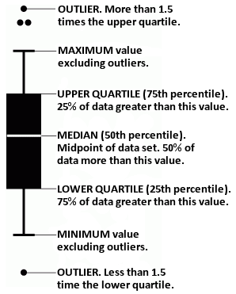
Box and Whisker Charts
Box
Bottom = 1st quartile (25th percentile); 75% above value
Top = 3rd quartile (75th percentile); 25% above value
Middle band = 2nd quartile (median); 50% above value
Height of box = interquartile range (IQR) = Q₃ – Q₁
IQR = measure of how spread out values are
Whiskers
Indicates variability outside upper and lower quartiles
Max and min values of data excluding outliers
Outliers
Data point that’s too far from a central value; doesn’t seem to fit; lies outside expected range of values
May be due to variability in measurement or error
Value that lies > 1.5 times outside height of box, i.e., outlier is below Q₁ – 1.5 × IQR or above Q₃ + 1.5 × IQR

Slide 10
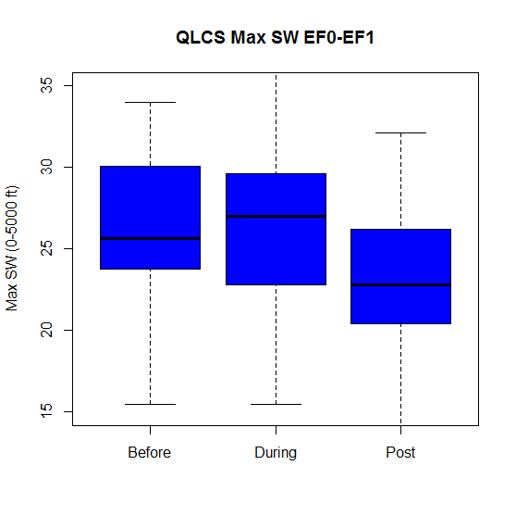
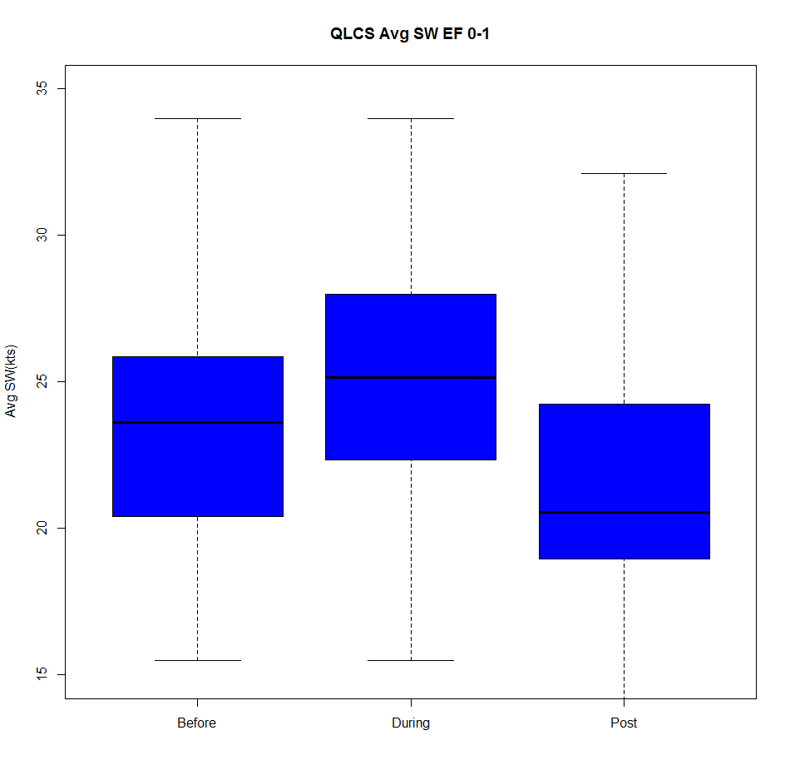
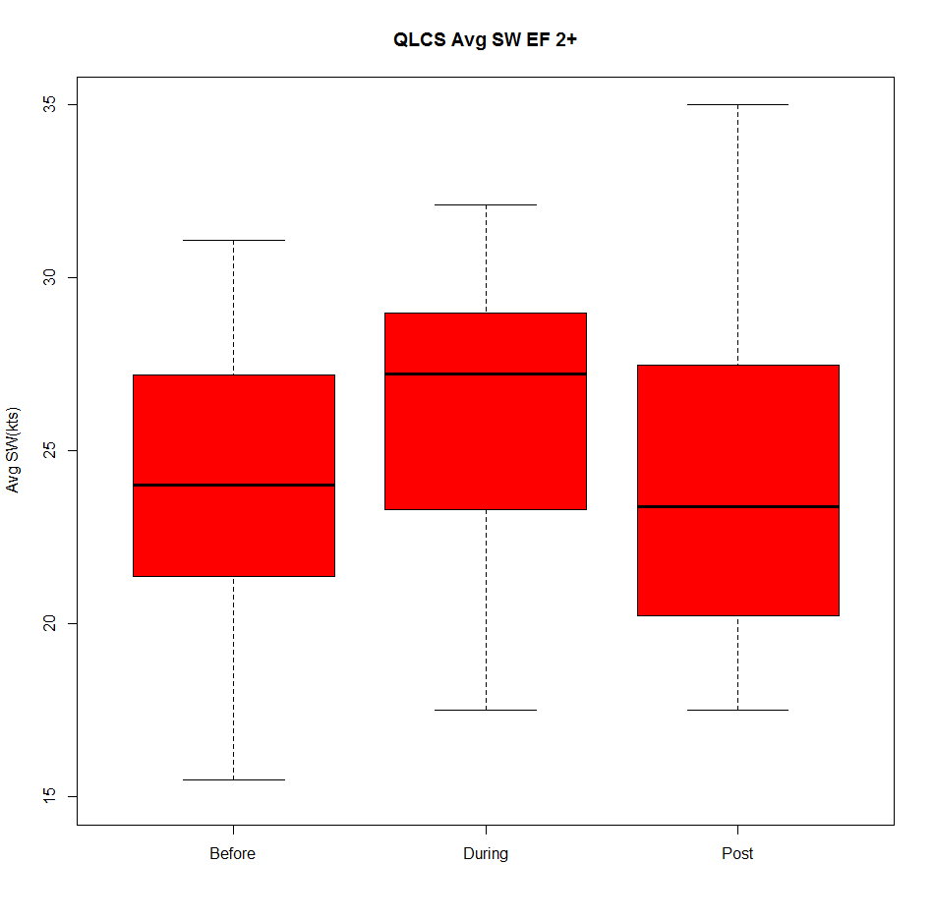
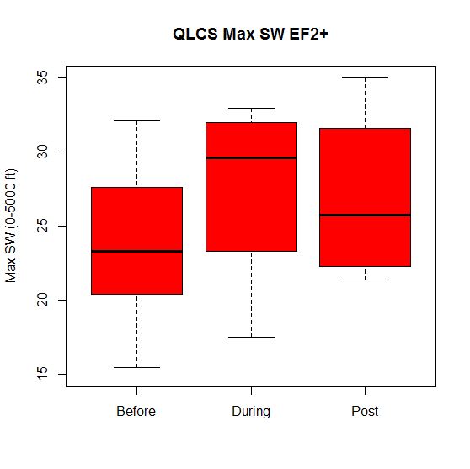
QLCS Max Spectrum Width
QLCS Avg SW EF 0-1
QLCS Avg SW EF 2+
QLCS Max SW EF 0-1
QLCS Max SW EF 2+
35
35
30
30
25
25
Avg SW Value
Avg SW Value
Max SW Value
Max SW Value
20
20
15
Before
During
After
15
Before
During
After
Before
During
After
Before
During
After
Little difference before vs. during for EF0-1 but ↑ for EF2+; some ↓ after
Baseline during: > 24 kts
Median during: 27 (EF0-1), 29-30 (EF2+)

Slide 11
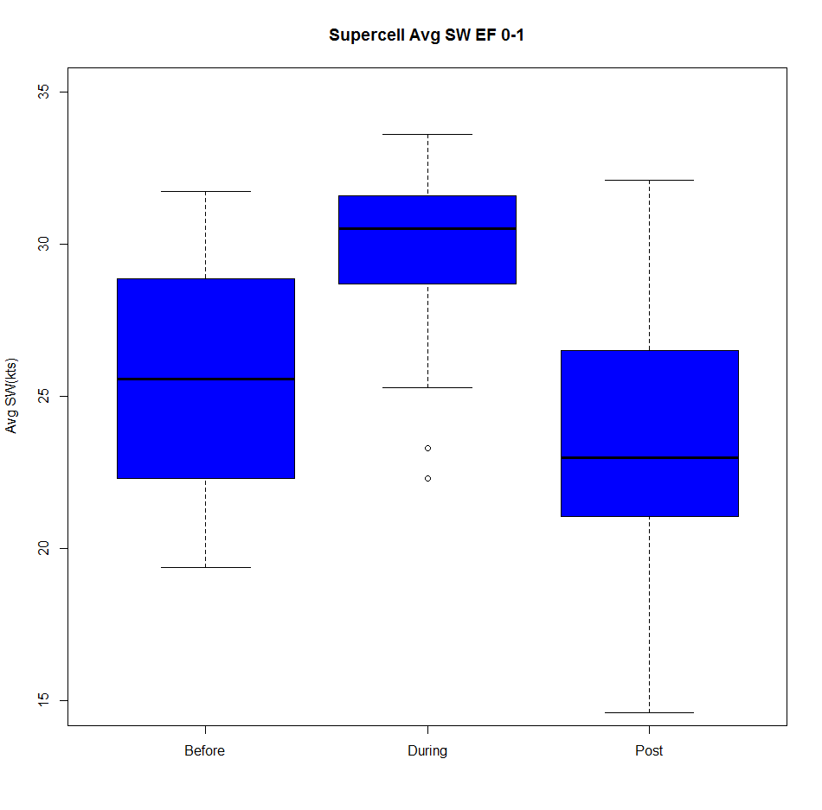
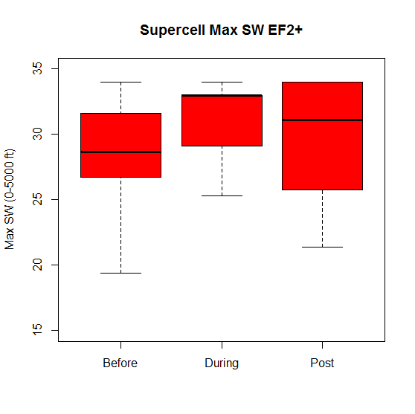
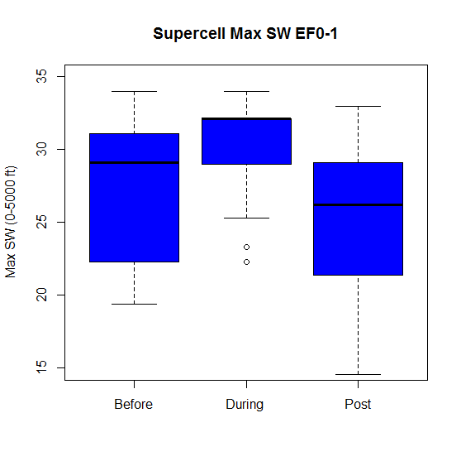
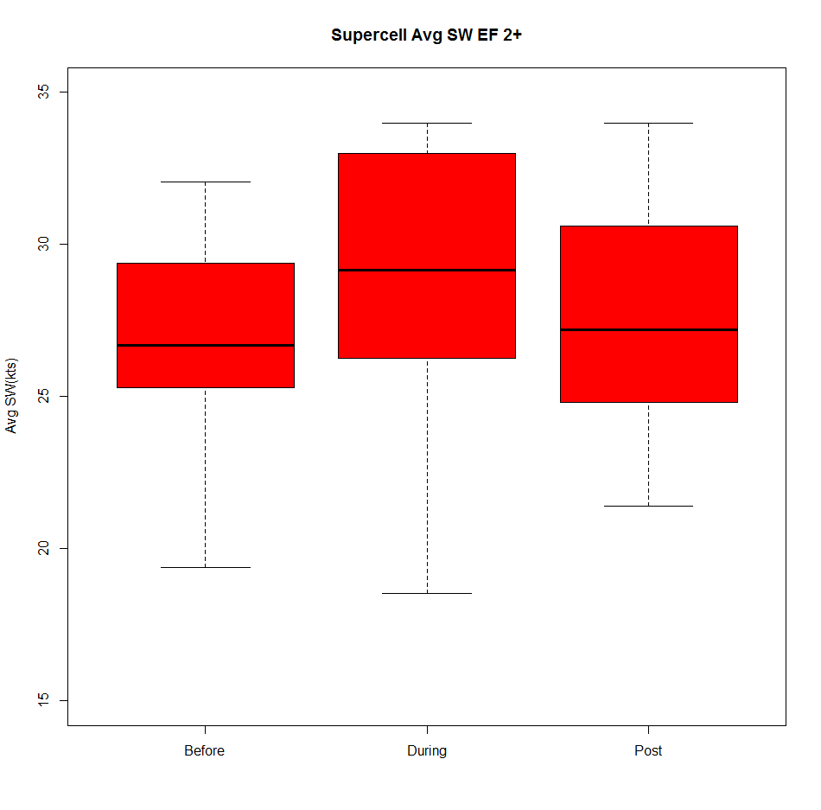
Supercell Max Spectrum Width
Supercell Avg SW EF 0-1
Supercell Avg SW EF 2+
Supercell Max SW EF 0-1
Supercell Max SW EF 2+
35
35
30
30
25
25
Avg SW Value
Avg SW Value
Max SW Value
Max SW Value
20
20
15
Before
During
After
15
Before
During
After
Before
During
After
Before
During
After
Values ↑ from before to during, then ↓ after tornado
Tighter spread on high end than QLCSs (very high values truncated in GR2)
Baseline during: > 29 kts
Median during: 32 (EF0-1), 32-33 (EF2+)

Slide 12
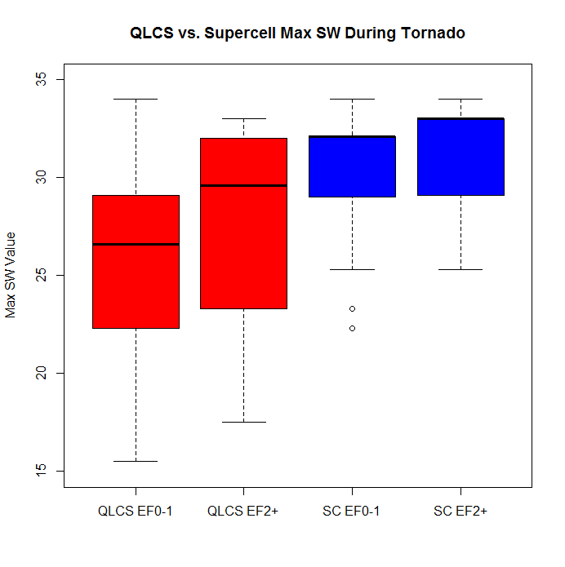
QLCS vs. Supercell: Max SW Value During Tornado
QLCS vs. Supercell Max SW During Tornado
Max SW Value
QLCS EF0-1
QLCS EF2+
SC EF0-1
SC EF2+
Values generally higher for supercells; wider range for QLCSs
EF0-1 median: 27 (QLCS), 32 (supercell)
EF2+ median: 29-30 (QLCS), 32-33 (supercell)

Slide 13
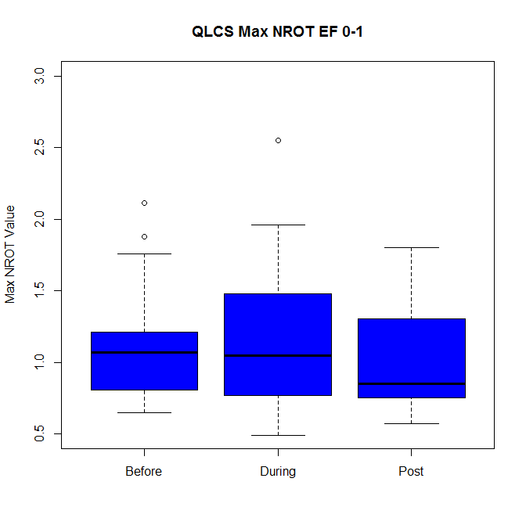
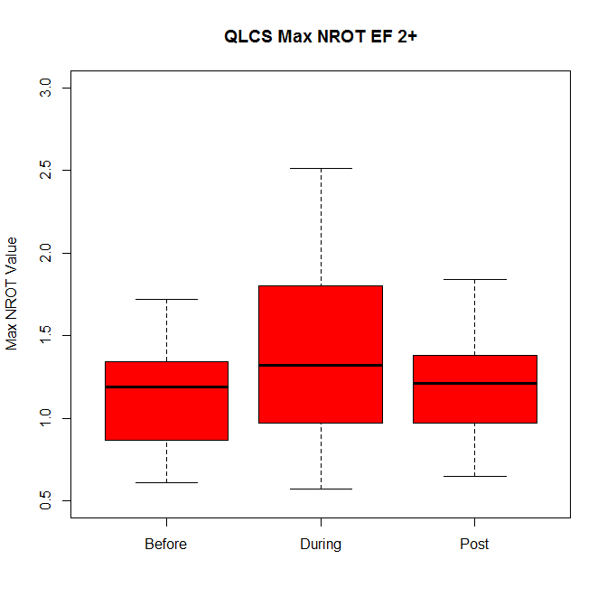
QLCS Max NROT Value
QLCS Max NROT EF 0-1
QLCS Max NROT EF 2+
3.0
3.0
2.5
2.5
2.0
2.0
Max NROT Value
Max NROT Value
1.5
1.5
1.0
1.0
0.5
0.5
Before
During
After
Before
During
After
Little diff before, during, and after, although several higher values during tornado
Baseline during: ≥ 0.8 (EF0-1), ≥ 1.0 (EF2+)
Median during: 1.0 (EF0-1), 1.3 (EF2+)

Slide 14
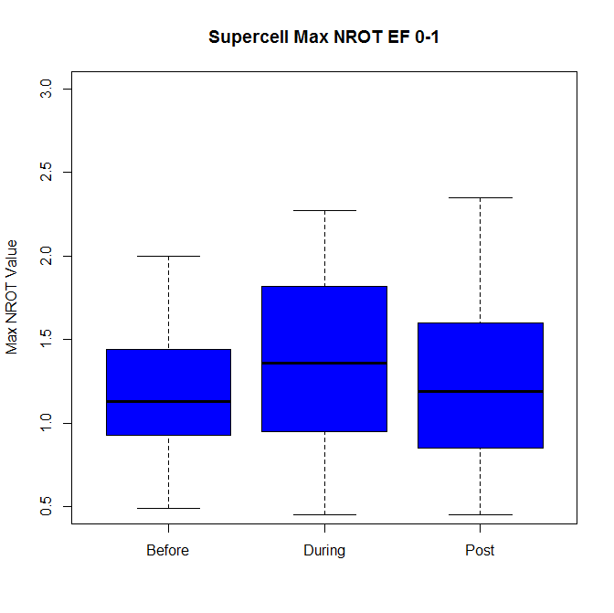
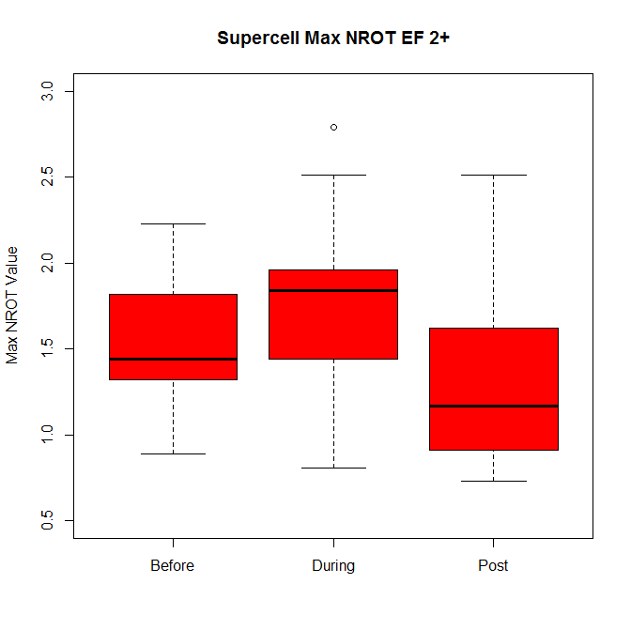
Supercell Max NROT Value
Supercell Max NROT EF 0-1
Supercell Max NROT EF 2+
3.0
3.0
2.5
2.5
2.0
2.0
Max NROT Value
Max NROT Value
1.5
1.5
1.0
1.0
0.5
0.5
Before
During
After
Before
During
After
Modest ↑ from before to during; modest ↓ after, esp. EF 2+
Baseline during: ≥ 1.0 (EF0-1), ≥ 1.5 (EF2+)
Median during: 1.3 (EF0-1), 1.8 (EF2+)

Slide 15
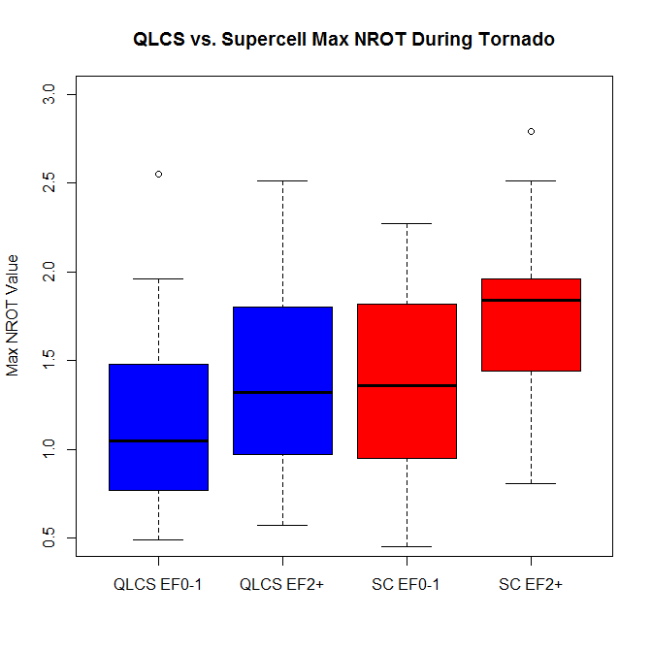
QLCS vs. Supercell: Max NROT During Tornado
QLCS vs. Supercell Max NROT During Tornado
3.0
2.5
2.0
Max NROT Value
1.5
1.0
0.5
QLCS EF0-1
QLCS EF2+
SC EF0-1
SC EF2+
Median max ↑ as EF scale ↑ for both modes, but much overlap
EF0-1 median: 1.0 (QLCS), 1.3 (supercell)
EF2+ median: 1.3 (QLCS), 1.8 (supercell)

Slide 16
QLCS: Max NROT vs. Max SW (0-10 kft)
During Tornado
Min TOR criteria: NROT > 0.5, SW > 15 (clustered > 23)
No sig EF0-1 scale diffs, but EF2+ clustered at higher values
Axes: Max NROT (SW) found for event, but SW (NROT) unidentifiable (set = 0)

Slide 17
Avg of Max NROT vs. Avg of Max SW per EF Scale
During Tornado
Supercell
QLCS
Supercell values higher for each EF rating
QLCS: NROT > 1.0, SW > 22 (> 26 for EF1+)
Supercell: NROT > 1.3, SW > 29

Slide 18
Median NROT Value vs. Median Height of Max NROT
After
After
Higher values and altitude for supercells than QLCSs
Values ↑ from before to during (esp. supercells), and ↓ afterward
Height of max NROT ↓ from before to during tornado

Slide 19
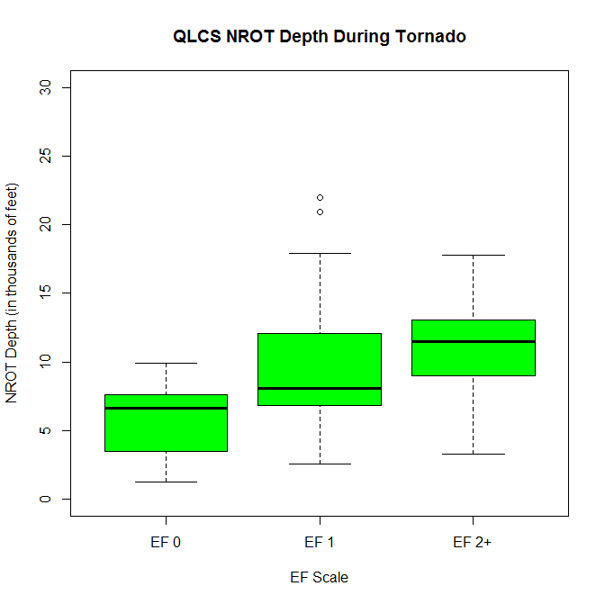
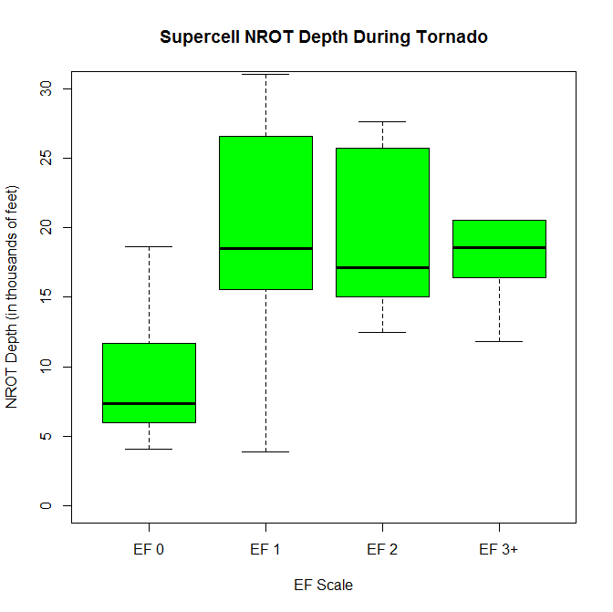
NROT Depth (≥ 1.0) During Tornado by EF Scale
QLCS NROT Depth During Tornado
Supercell NROT Depth During Tornado
30
30
25
25
20
20
NROT Depth (kft)
NROT Depth (kft)
15
15
10
10
5
5
0
0
EF 0
EF 1
EF 2+
EF 0
EF 1
EF 2
EF 3+
EF Scale
EF Scale
QLCS: Median depth ↑ slightly as EF scale ↑
Supercell: Median depth ↑ from EF0 to EF1, then similar for EF1+
Median depth doesn’t differentiate potential tornado strength that well

Slide 20
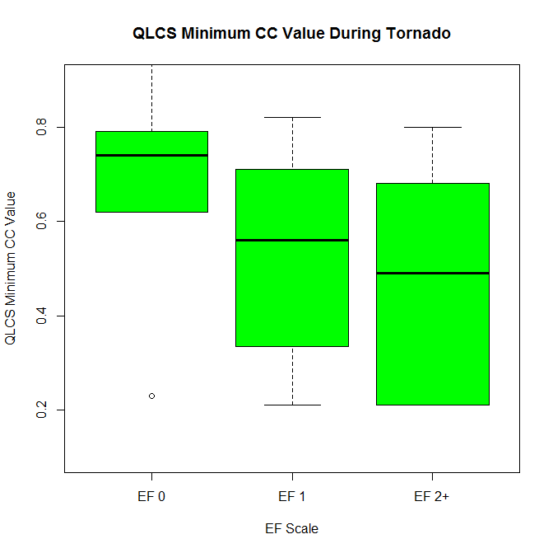
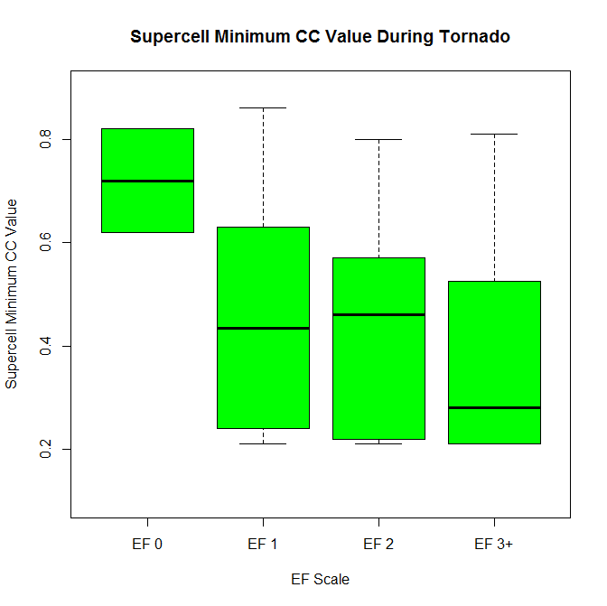
Min CC Value (≤ 0.9) in TDS During Tornado by EF Scale
QLCS Min CC During Tornado
Supercell Min CC During Tornado
0.8
0.8
0.6
0.6
Min CC Value
Min CC Value
0.4
0.4
0.2
0.2
EF 0
EF 1
EF 2+
EF 0
EF 1
EF 2
EF 3+
EF Scale
EF Scale
Generally lower for supercell vs. QLCS tornadoes
QLCS: Values ↓ from EF0 to EF2 (much overlap in EF1 and EF2+)
Lower CC moderately associated with stronger tornadoes

Slide 21
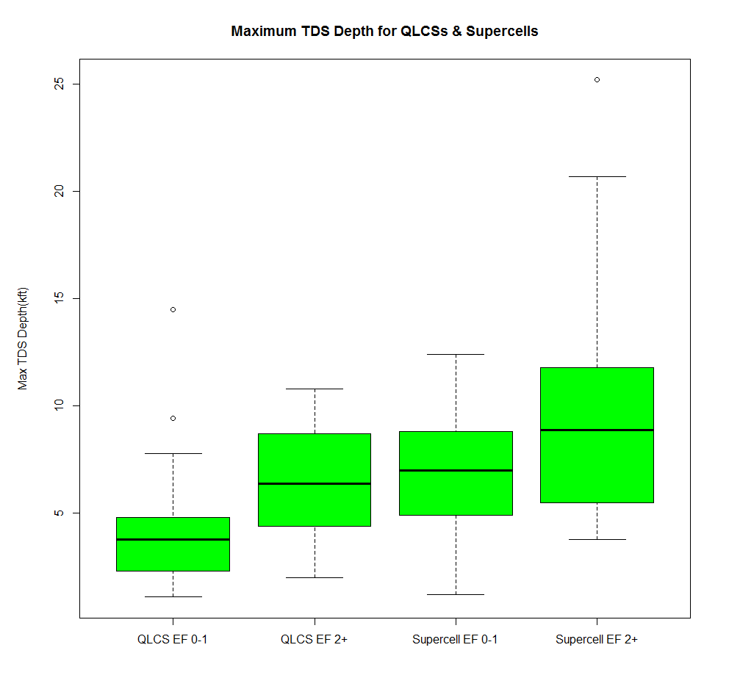
Max TDS Depth (CC ≤ 0.9) for QLCS and Supercells
Maximum TDS Depth for QLCSs & Supercells
25
20
15
Max TDS Depth (kft)
10
5
QLCS EF 0-1
QLCS EF 2+
Supercell EF 0-1
Supercell EF 2+
Depth ↑ from EF0-1 to EF2+ for both modes
Deeper depth for supercells than QLCSs for all EF ratings
Are shallow QLCS EF0-1 depths truly tornado debris or convergence of particles?

Slide 22
Summary
Mode | Max SW (median) | Max NROT (median) | Max NROT and Depth | Min CC (median) | TDS Depth (median)
Base QLCS | ≥ 24 (25%) | ≥ 0.8 (25%) | N/A
Base SC | ≥ 29 (25%) | ≥ 1.0 (25%) | N/A
QLCS EF0-1 | 27 | 1.0 | 0-5-2.0; 3-22 kft | 0.75 (EF0), 0.55 (EF1) | 4 kft
QLCS EF2+ | 29-30 | 1.3 |  | 0.5 | 6-7 kft
SC EF0-1 | 32 | 1.3 | 0.5-2.5 (3 for EF4); 5-30 kft (35 for EF4) | 0.7 (EF0), 0.45 (EF1) | 7 kft
SC EF2+ | 32-33 | 1.8 |  | 0.45 (EF2), 0.3 (EF3) | 9 kft

