Slide 1
Differences and Inconsistencies in the QLCS Tornado Warning Paradigm
Fred H. Glass, NOAA/NWS St. Louis, MO
Jacob Beitlich, NOAA/NWS Chanhassen, MN
Rod Donavon, NOAA/NWS Des Moines, IA
Ted Funk, NOAA/NWS Louisville, KY
Aaron Johnson, NOAA/NWS Dodge City, KS
Jason Schaumann, NOAA/NWS Springfield, MO
John Stoppkotte, NOAA/NWS North Platte, NE
Ray Wolf, NOAA/NWS Davenport, IA

Slide 2
Tornado Warning Improvement Project Team
Created by NWS CR Consistency Team
Address significant differences in tornado warning POD/FAR rates due to inconsistencies in warning methodologies, knowledge, human factors, etc.
Mission is to develop a consistent, scientific approach to the tornado warning process, and a corresponding expert-level continuation education curriculum
Focused on the tornado warning process

Slide 3
Tornado Warning Improvement Project Team
Since our inception, we have been actively engaged in examining the root causes of tornado warning inconsistencies in CR WFOs:
Review of select events
Results of a detailed forecaster and management survey
Research on unwarned and partially warned events
Discussion with SMEs and other NWS colleagues examining the same issue in other NWS regions
Focused on the tornado warning process

Slide 4
Tornado Warning Improvement Project Team
Our findings indicate that perhaps the most challenging issue is differences and inconsistencies in the QLCS tornado warning paradigm
This presentation will review some of the contributing factors to this problem
One illustrative case
Focused on the tornado warning process

Slide 5
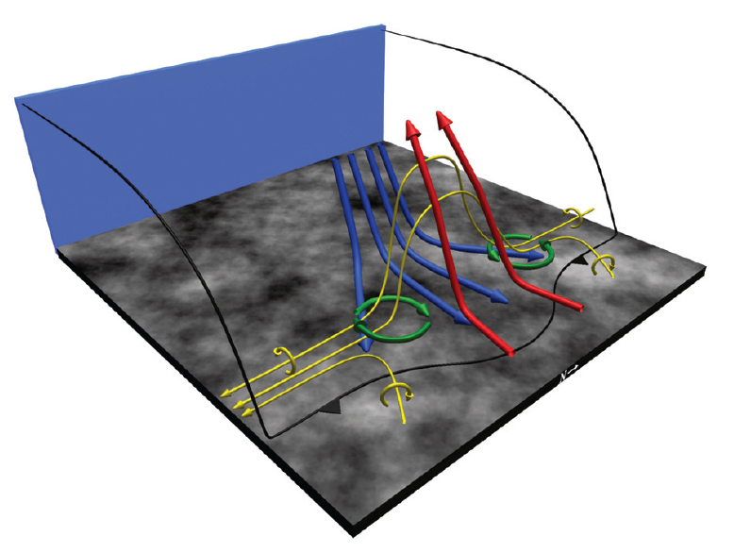
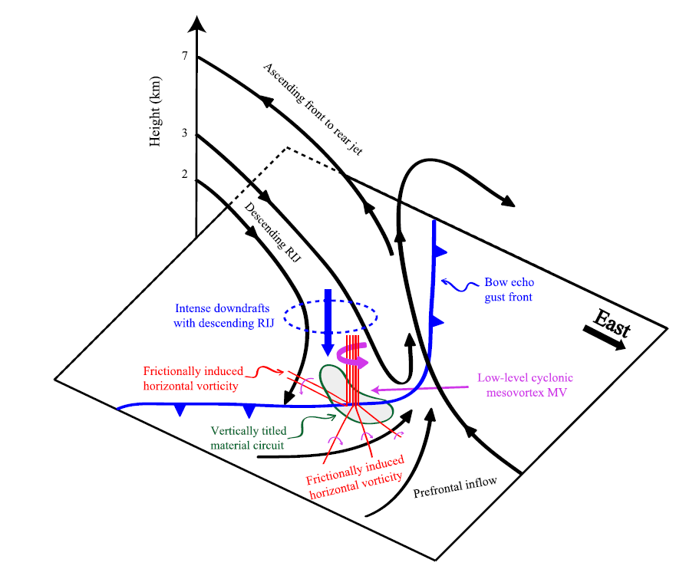
Wide-ranging knowledge of QLCS conceptual models, mesovortex dynamics, and favorable environmental conditions
Several theories of mesovortex formation mechanisms including Trapp and Weisman (2003), Wakimoto et al. (2006), Atkins and St. Laurent (2009), and Xu et al. 2015
Commonality – tilting and stretching of low-level horizontal vorticity
Mesovortex development occurs in association with an enhanced updraft along the leading edge/bulge in the convective outflow/gust front surge which can be associated with a descending RIJ
Atkins and St. Laurent (2008)
Contributing Factors
Xu et al. (2015)

Slide 6
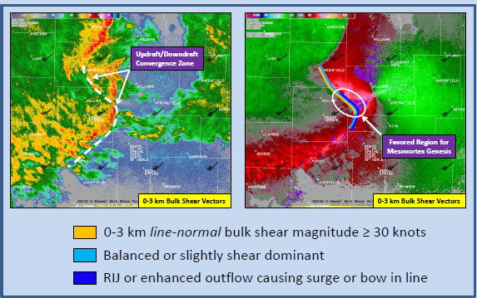
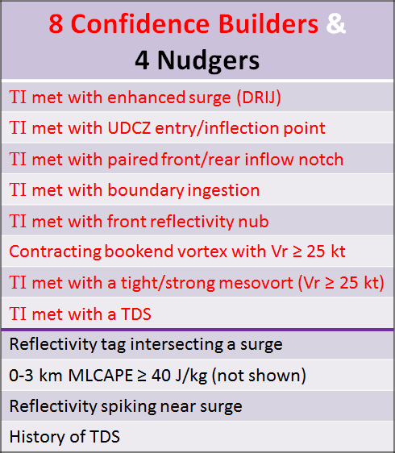
Wide-ranging knowledge of some of the latest QLCS WDM techniques
Application of the three ingredients method to anticipate mesovortex genesis and intensification region
Interrogation of radar data for distinctive reflectivity signatures and velocity trends/mesoscale features suggesting heightened tornado potential
Added confidence - mesoanalysis data that is also favorable for supercell tornadoes: mesoscale boundaries, large low-level CAPE but low LCL heights, large 0-1 km bulk shear and 0-1 km SRH
Contributing Factors

Slide 7
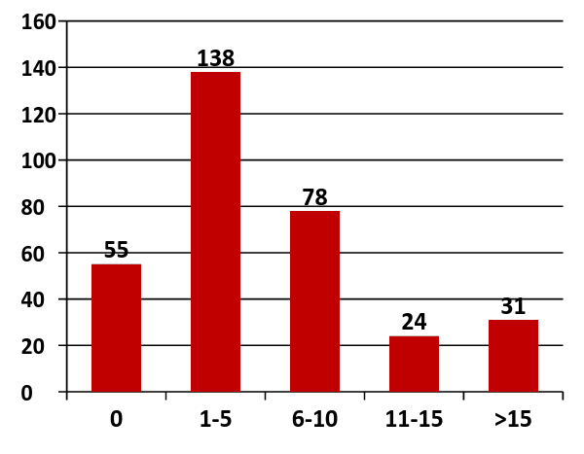
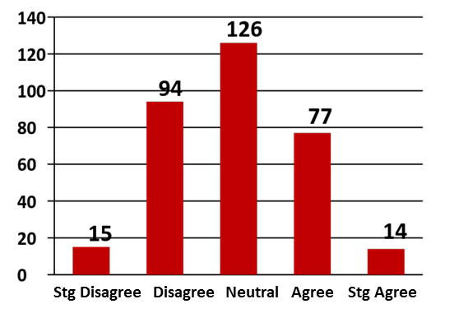
TWIP Survey- How Many TOR warnings have you issued in last 3 years?
Actual, functional experience with the QLCS tornado WDM process
Almost 60% have issued ≤ 5 TORs in last 3 years (83% ≤ 10)
Little practical experience - Not much chance to practice
Forecasters have limited confidence warning for QLCS tornadoes
I’m confident issuing TOR warning for QLCS
Contributing Factors

Slide 8
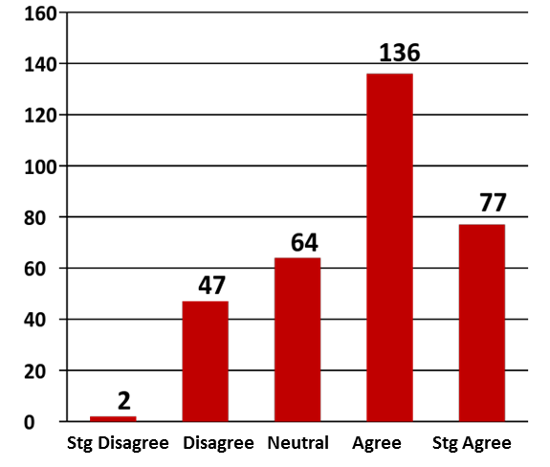
Subjective interpretation and evaluation of radar data, including varied individual warning thresholds
Human Factors x Infinity
Warning Decision Making process must be more consistent and scientific with less human bias
NWS Warning Decision Workshop (2001)
TWIP Survey - TOR warning process varies considerably amongst forecasters in my office
Contributing Factors

Slide 9
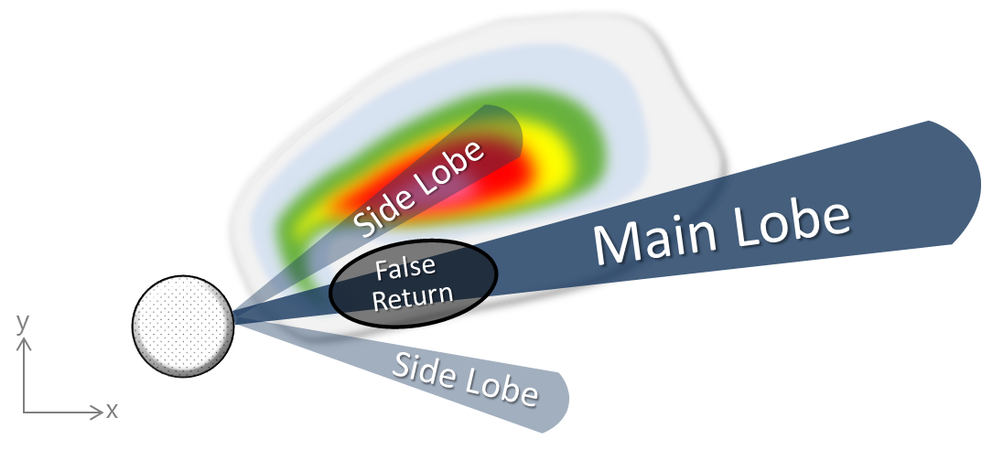
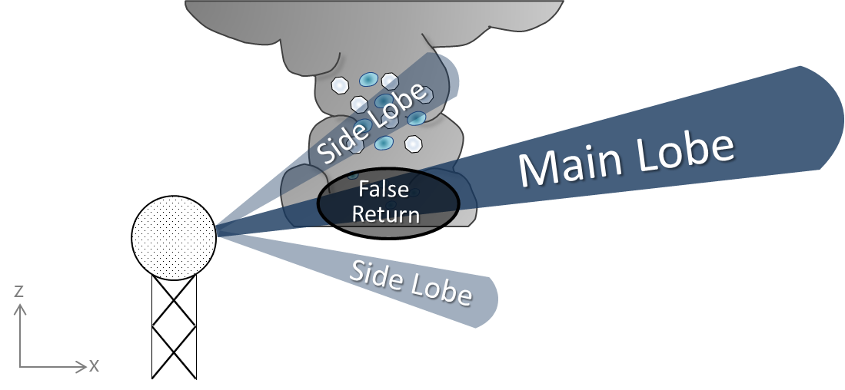
Incomplete understanding of radar sampling/limitations
Side lobes can result in incorrectly displayed velocity data
TBSS’s can contaminate velocity data
Scan-to-scan variability of velocity data in MesoSAILS
QLCS mesovortices develop low with peak magnitude in the lowest 2 km (really 1 km)
Viewing angle and beam height – understanding sampling both close range and distant ranges
Contributing Factors

Slide 10
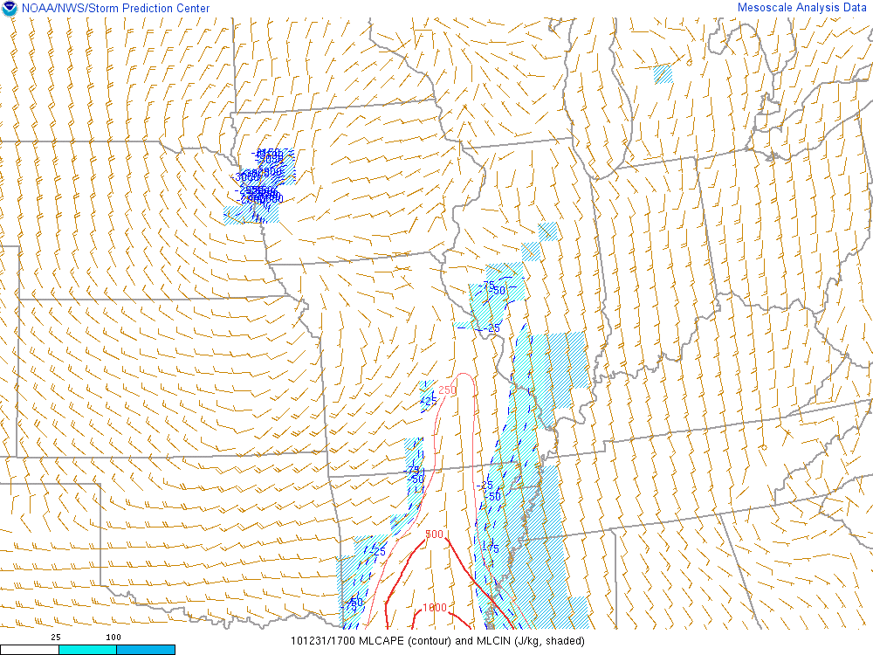
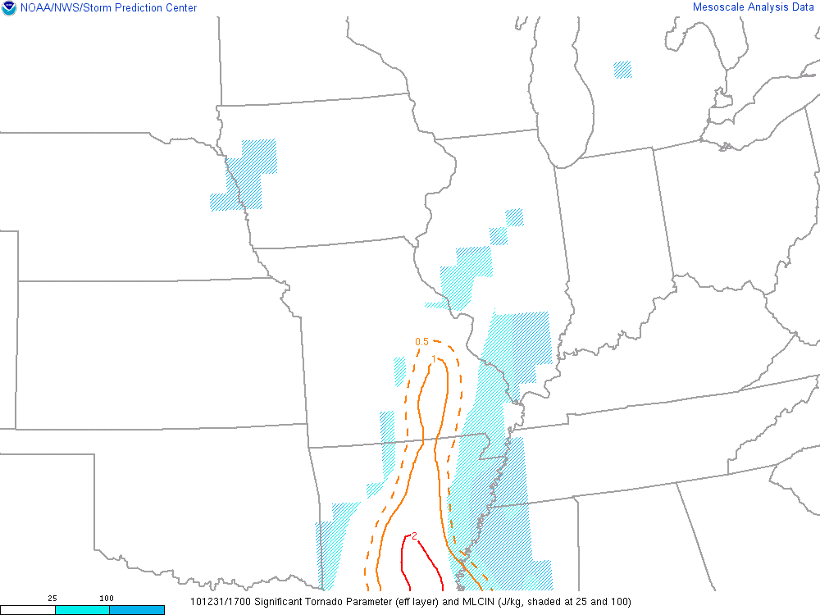
Improper application of near storm environment data and threat assessment in the Warning Decision Making (WDM) process
Strengths/limitations of SPC mesoanalysis
40 km grid and hourly updates at ~20 min. after the hour
Potential for large temporal & spatial variability
We utilize often with great success, but not really designed to support WDM
Weight of inputs in combined parameters
Contributing Factors

Slide 11
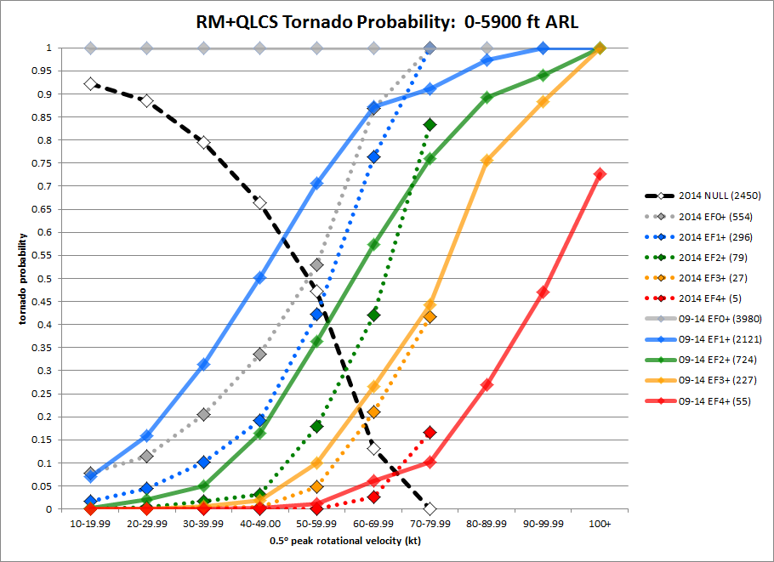
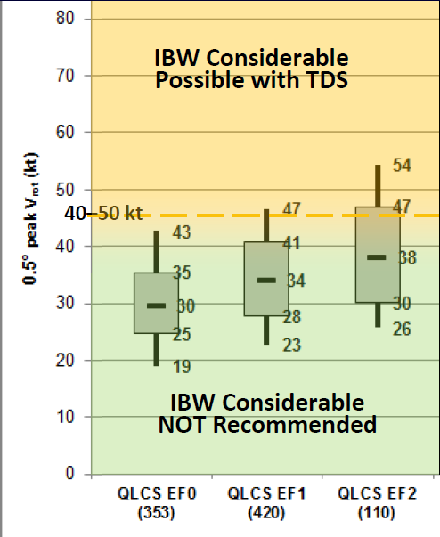
Incomplete understanding of the advantages and limitations of Conditional Tornado Probability Guidance
Can be helpful, but MUST understand the limitations of the underlying science
Limitations of Vr/EF scale intensity relationship
Climatology - Great Plains tornadoes often underrated due to lack of DI’s
Peak tornado Vr not always directly related to instantaneous tornado intensity
Not originally designed for yes/no WDM
Contributing Factors

Slide 12
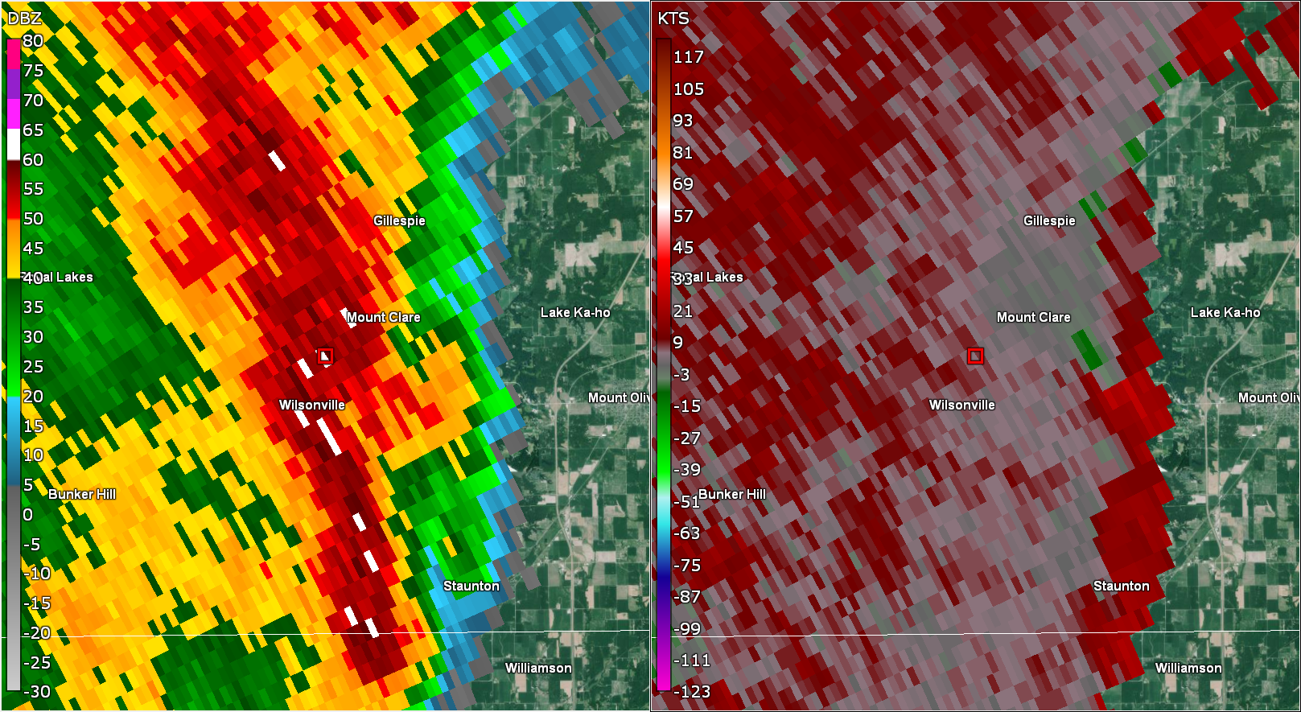
Complexities and challenges in the QLCS tornado WDM process
Range = 47 nm
Beam height = ~4100 ft. ARL
SM = 260/55 kts
Vr = 19 kts
* SM at significant angle to beam
Overshooting the peak mesovortex at distant ranges
Weak circulations in radar presentation
Many circulations that all look roughly the same
Fast-moving storms (can be 60+ mph)
Nocturnal component limits real-time information - spotter reports/reliability
Example
Contributing Factors

Slide 13
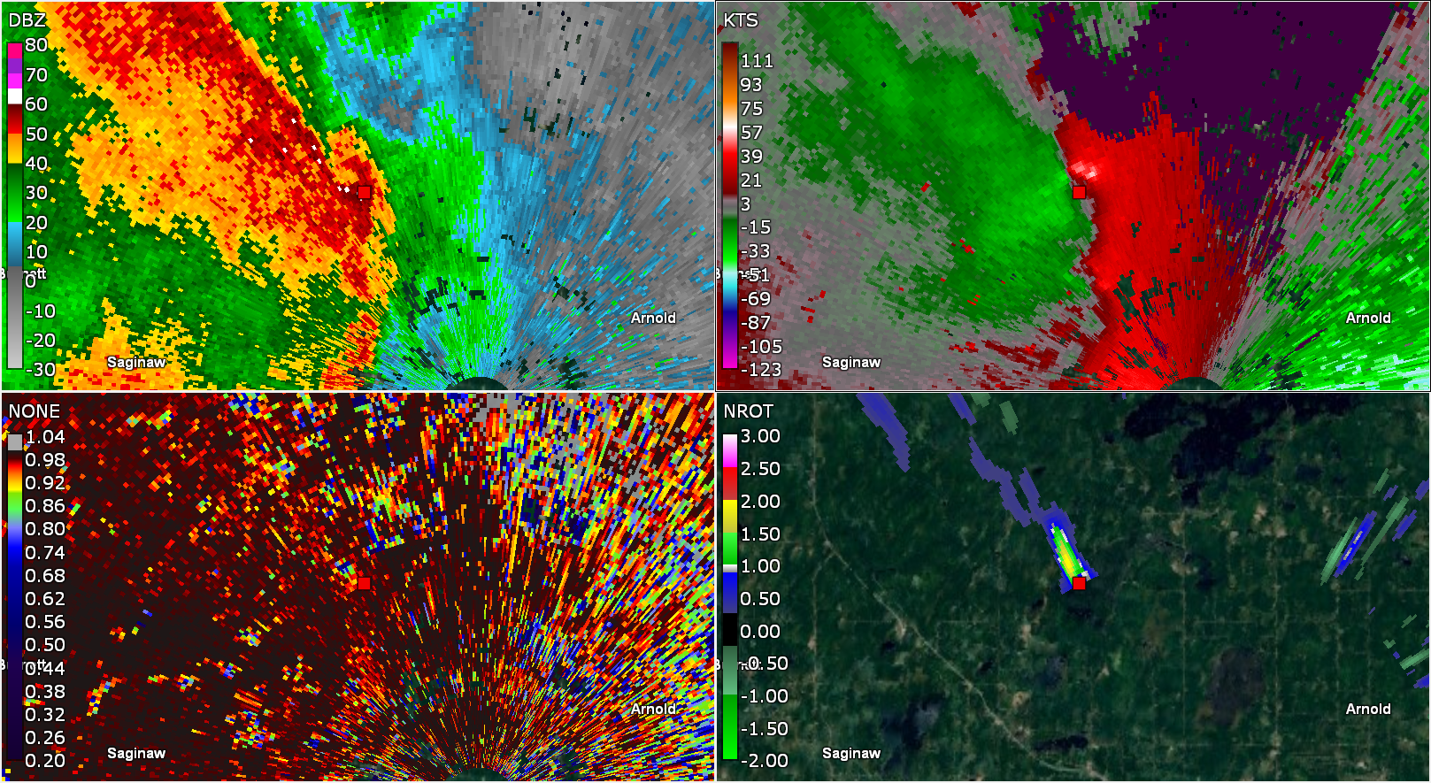
Real-time TDS identification, interpretation, and threat acceptance
Subjectivity – another human factor
Can be challenging → non-uniform beam filling, mixed phase hydrometers/ice, melting layer, NUBF, ground clutter/bad data, strong gust fronts
Land use impacts
Many not identified in real-time
Some identified are not accepted as a true TDS and thus subsequent tornado threat
At least one instance where politics of a storm survey and damage identification has found its way into published TDS science
Lack of TDS does not discount a tornado (distance, time of year)
Wind Damage
No Survey
Contributing Factors

Slide 14
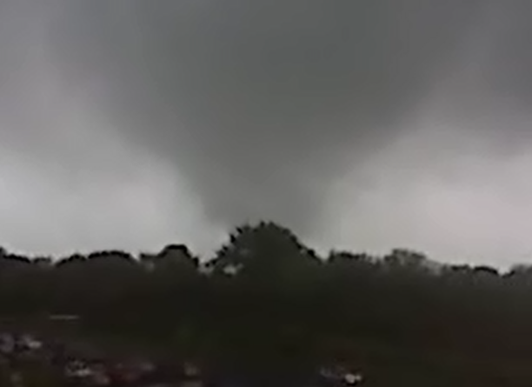
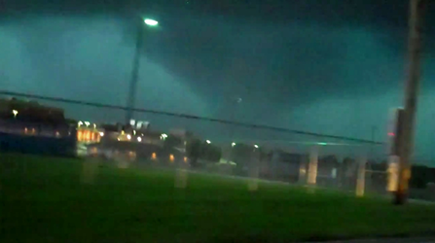
Damage from QLCS is from shear vortices, not bonafide tornadoes
Contributing Factors

Slide 15
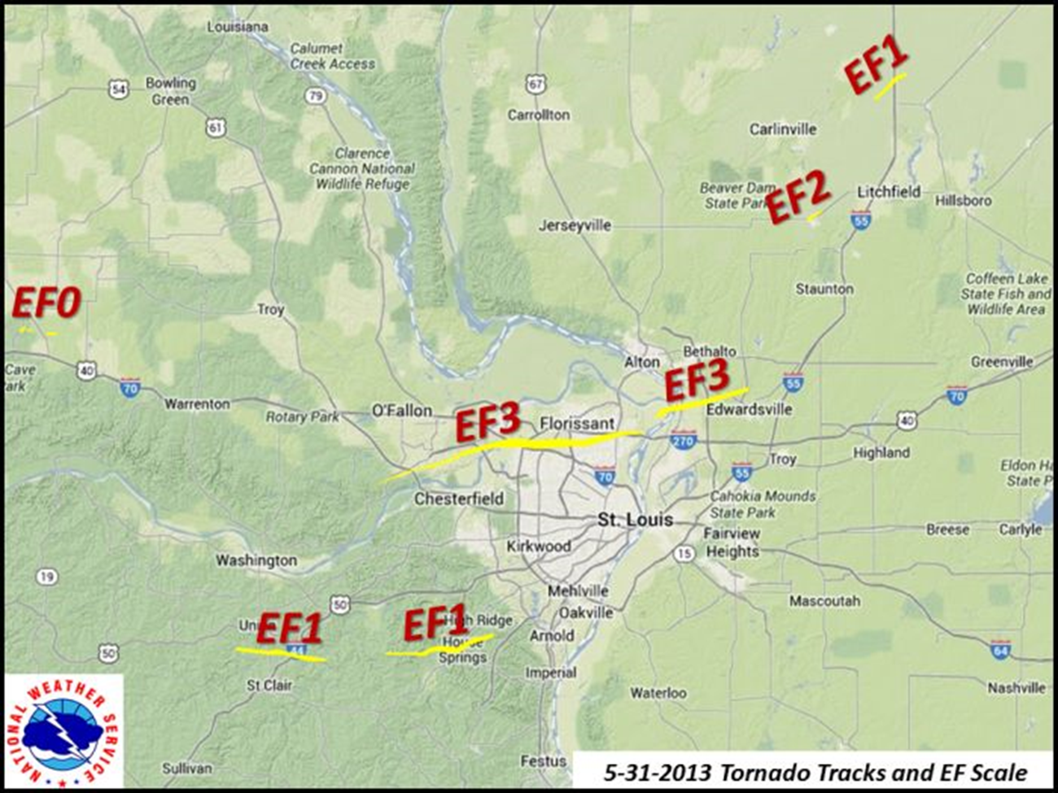
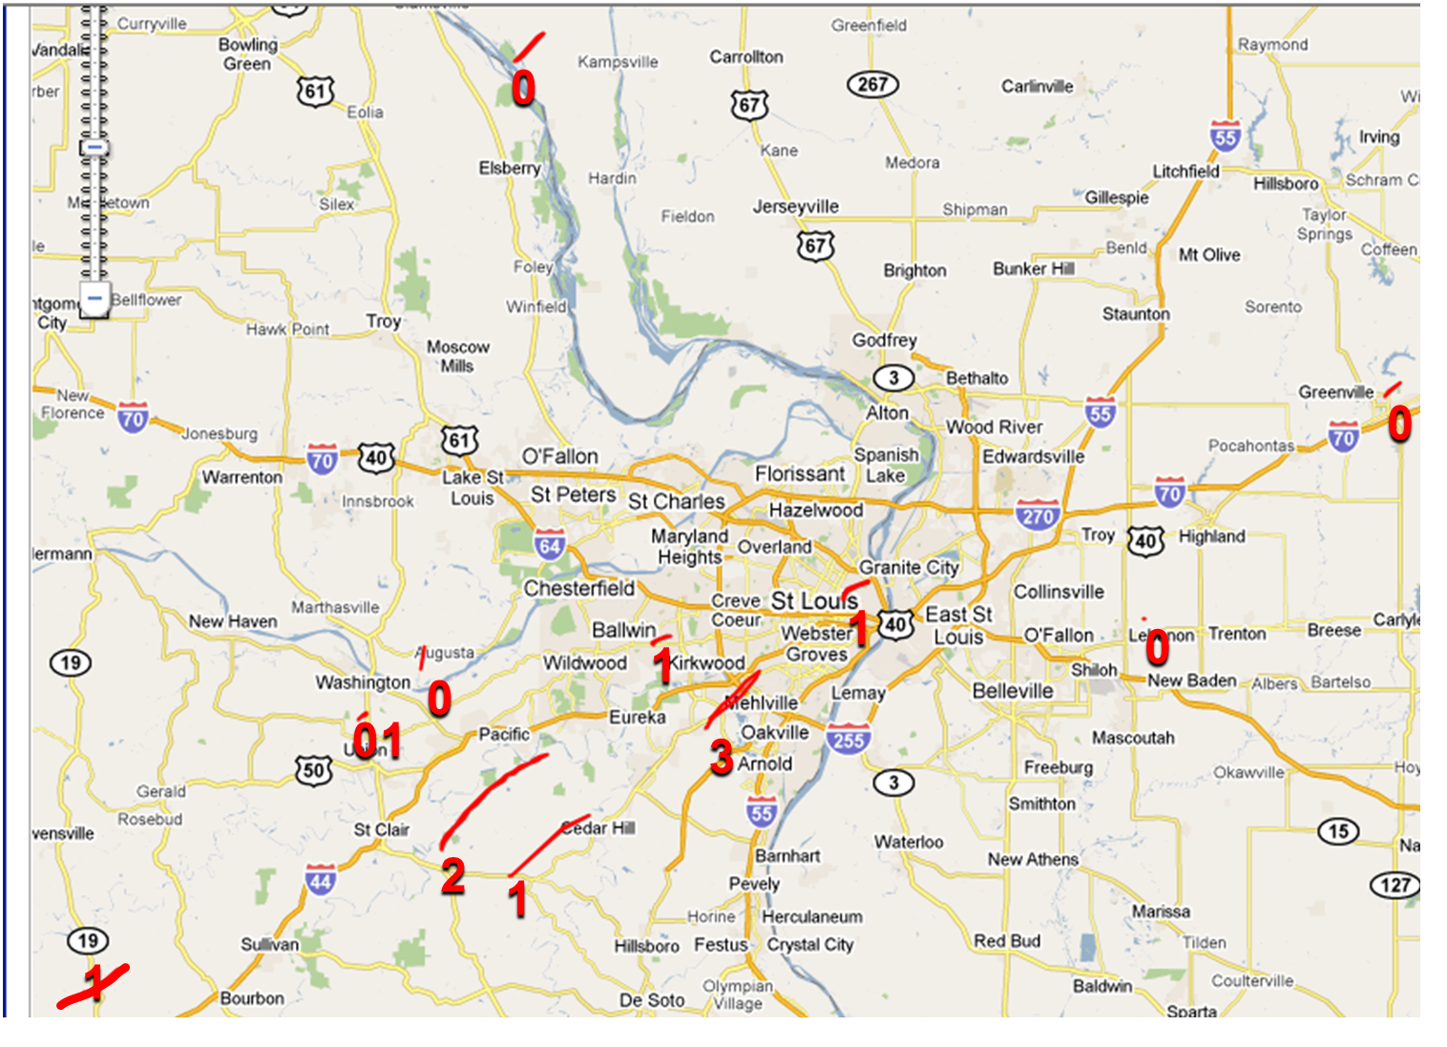
Philosophical differences including misconceptions that all QLCS tornadoes are weak, short-lived and thus are not worthy of tornado warnings
2010 NYE Outbreak
Contributing Factors

Slide 16
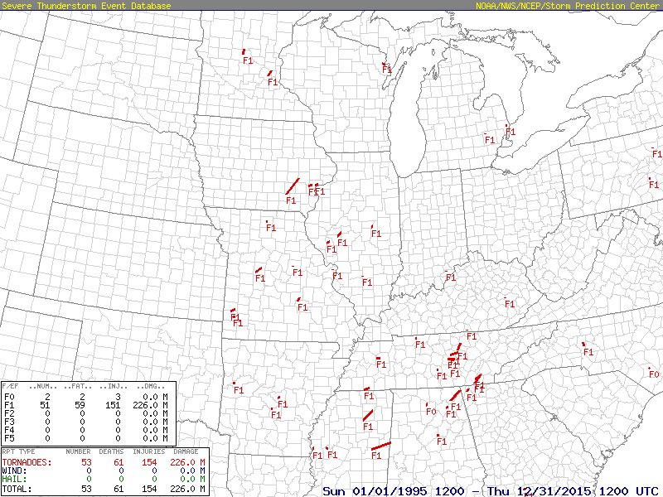
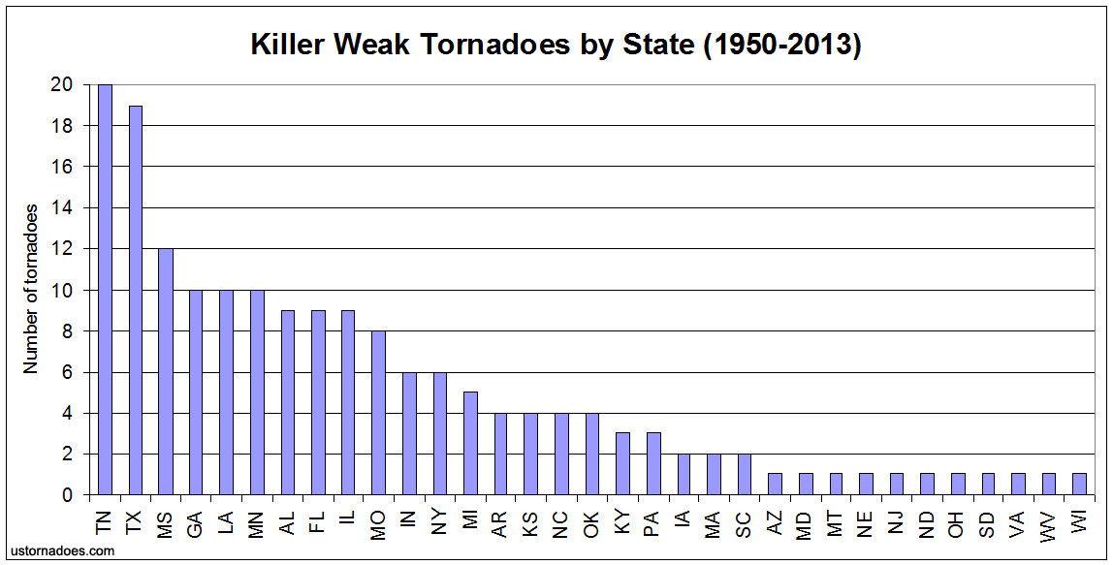
Philosophical differences including misconceptions that all QLCS tornadoes are weak, short-lived and thus are not worthy of tornado warnings
Since 1995 in the LSX CWA, there have been a total of 11 fatalities from tornadoes: 6 from QLCS tornadoes and 4 from weak tornadoes
Contributing Factors

Slide 17
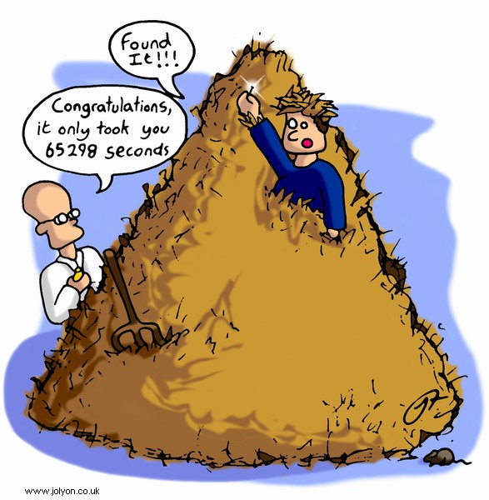
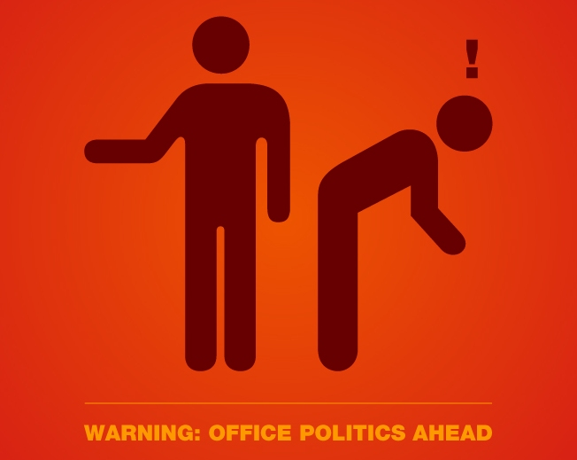
Inconsistent damage survey policies and inconsistencies in damage identification
Many issues -- When do we or should we survey?
Bias depending on presence or type of warning
Confirmation bias
Politics – Management doesn’t believe in QLCS tornadoes
Damage surveying experience – training?
Resources – available staffing
Experience with fast-moving (weak) tornadoes debris pattern
Inconsistency will impact the science!
Contributing Factors

Slide 18
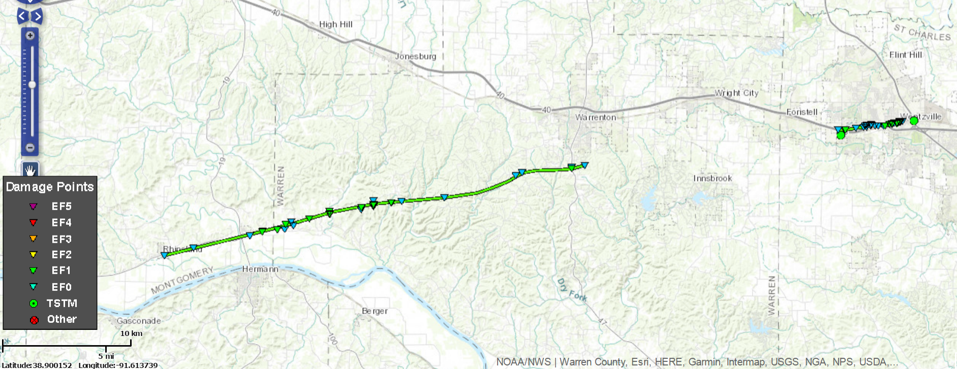
06 March 2017 – East Central MO
Unwarned Tornadoes
EF-1
3 miles
551-554 UTC
EF-1
21 miles
517-538 UTC
Illustrative Case

Slide 19
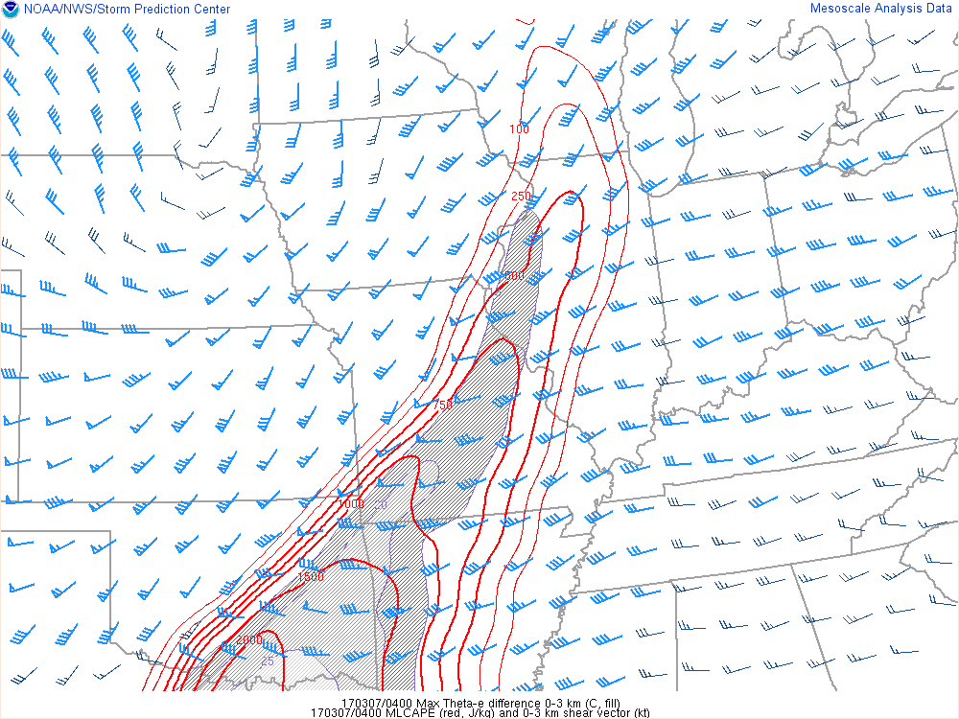
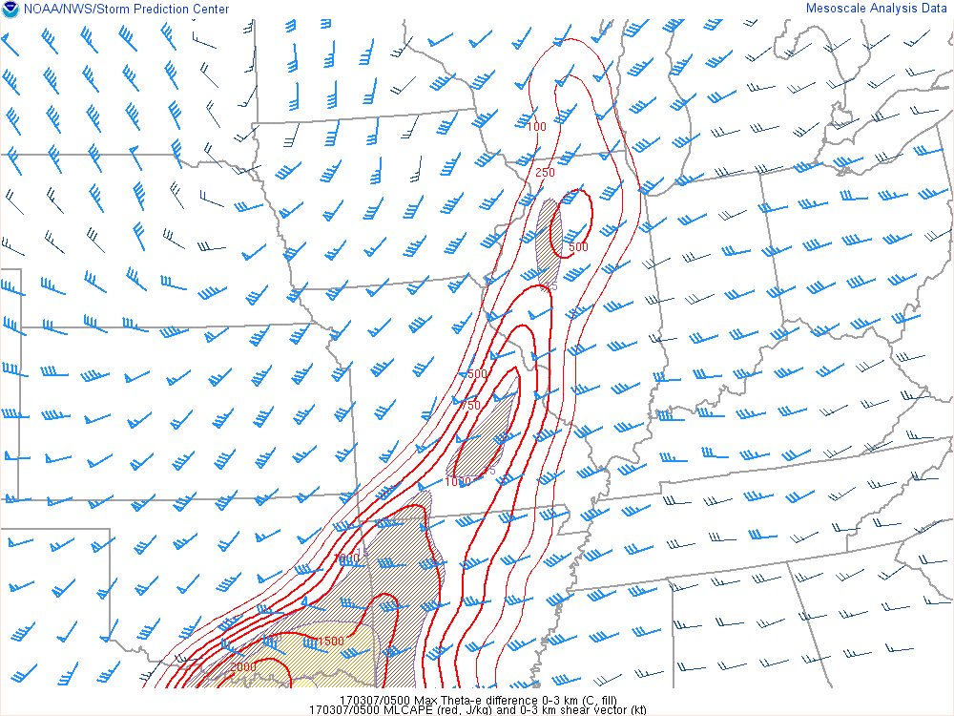
MLCAPE and 0-3 km Bulk Shear Vectors
0400 0500
Illustrative Case

Slide 20
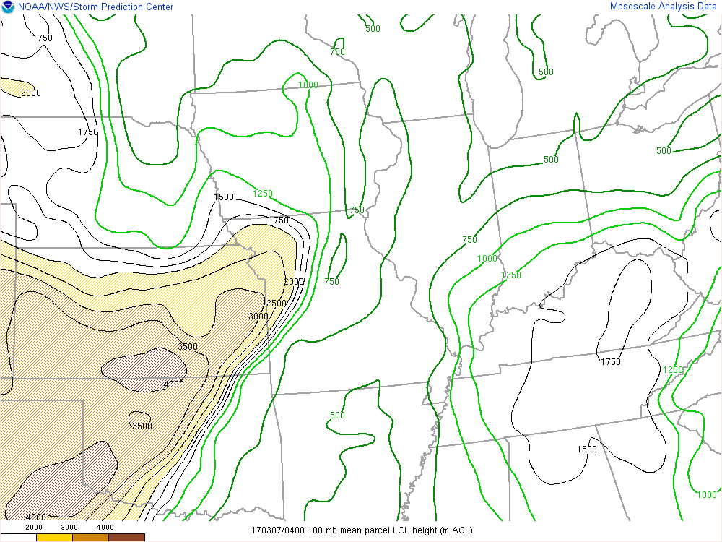
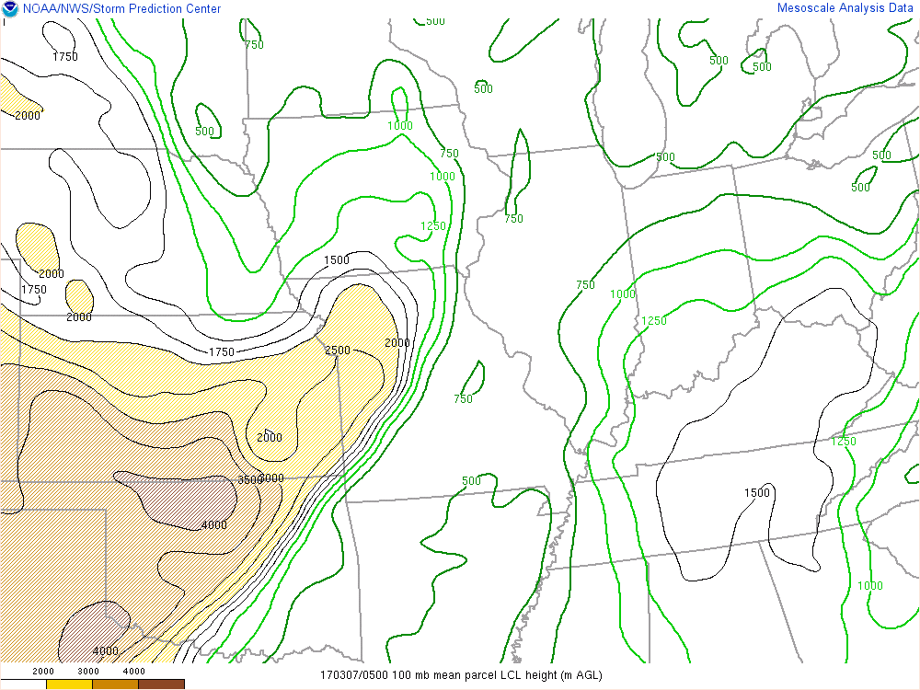
Mean LCL Height
0400 0500
Illustrative Case

Slide 21
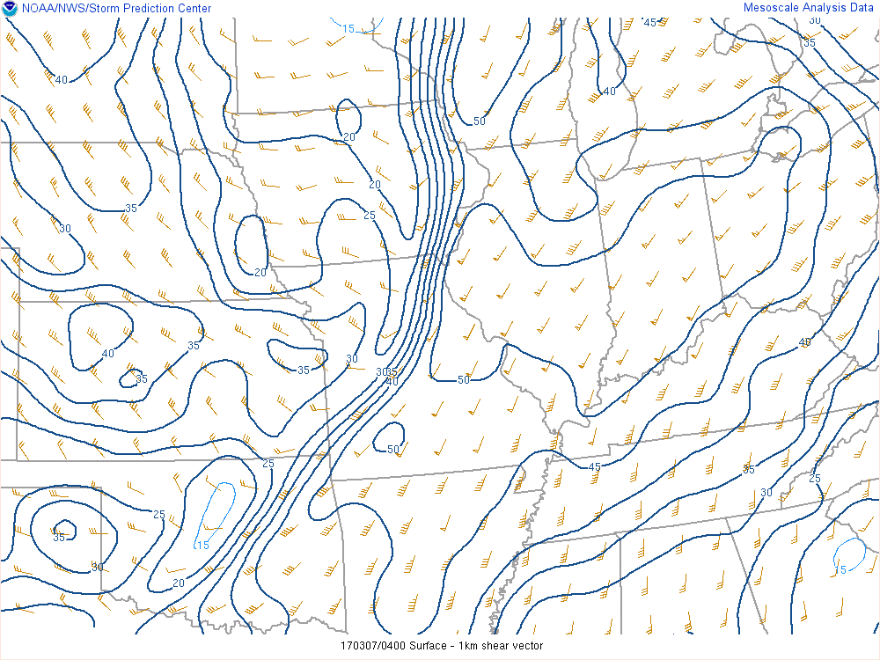
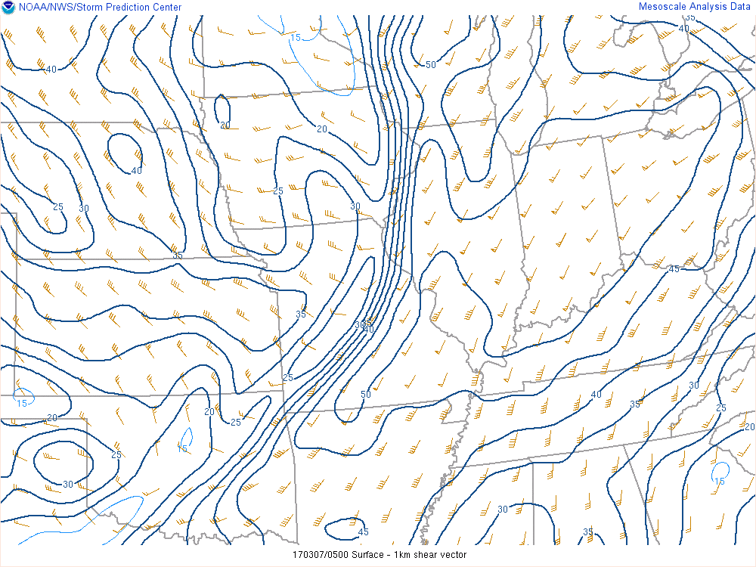
0-1 km Bulk Shear Vectors
0400 0500
Illustrative Case

Slide 22
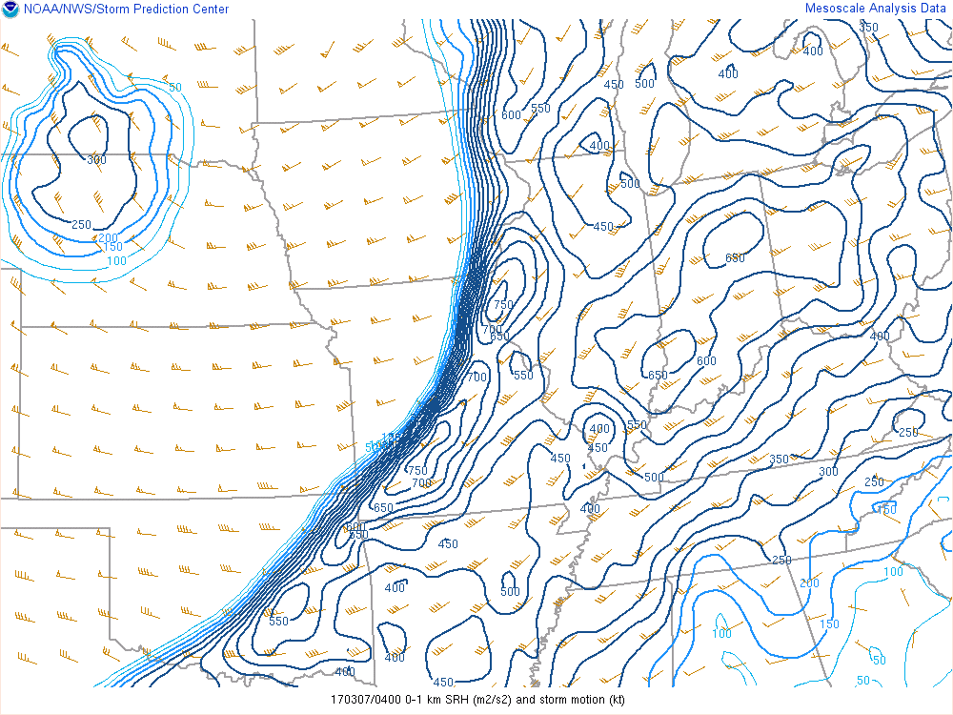
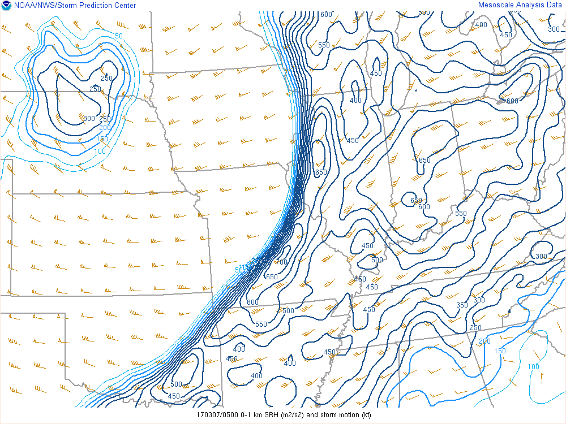
0-1 km SRH
0400 0500
Illustrative Case

Slide 23
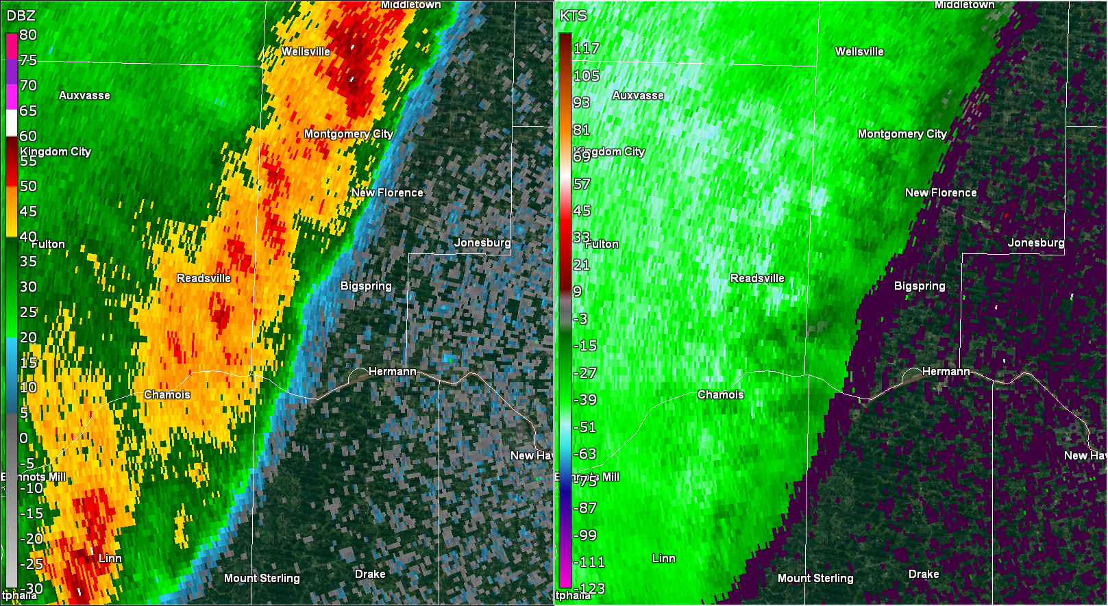
0514

Slide 24
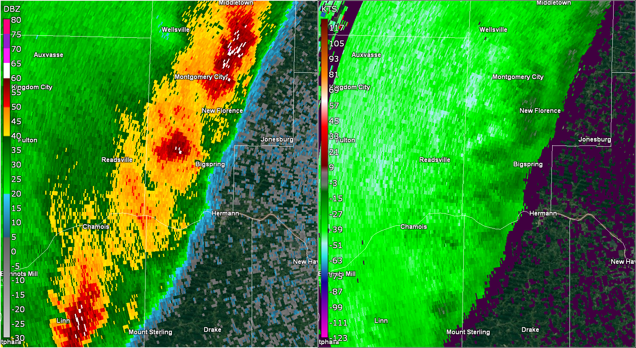
0519

Slide 25
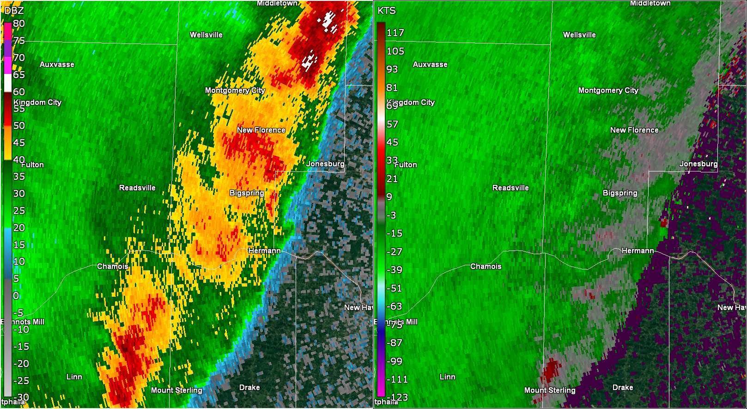
0524

Slide 26
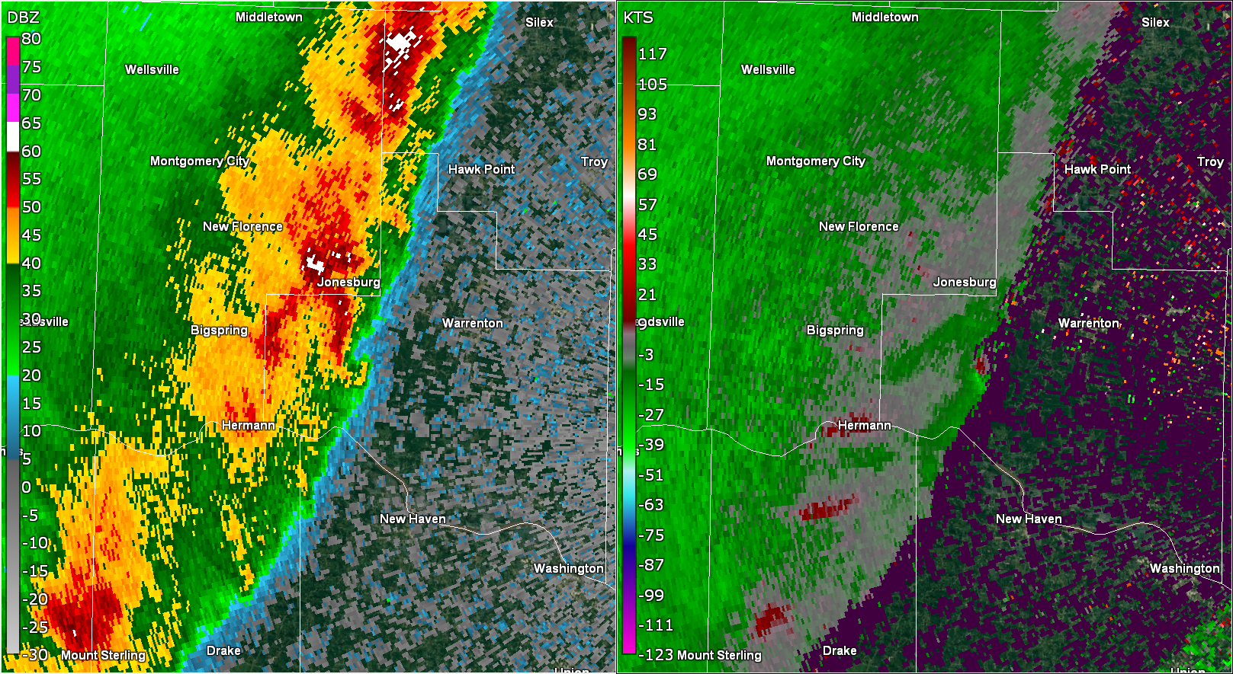
0530
Vr=26 kts @ 2136 ft ARL

Slide 27
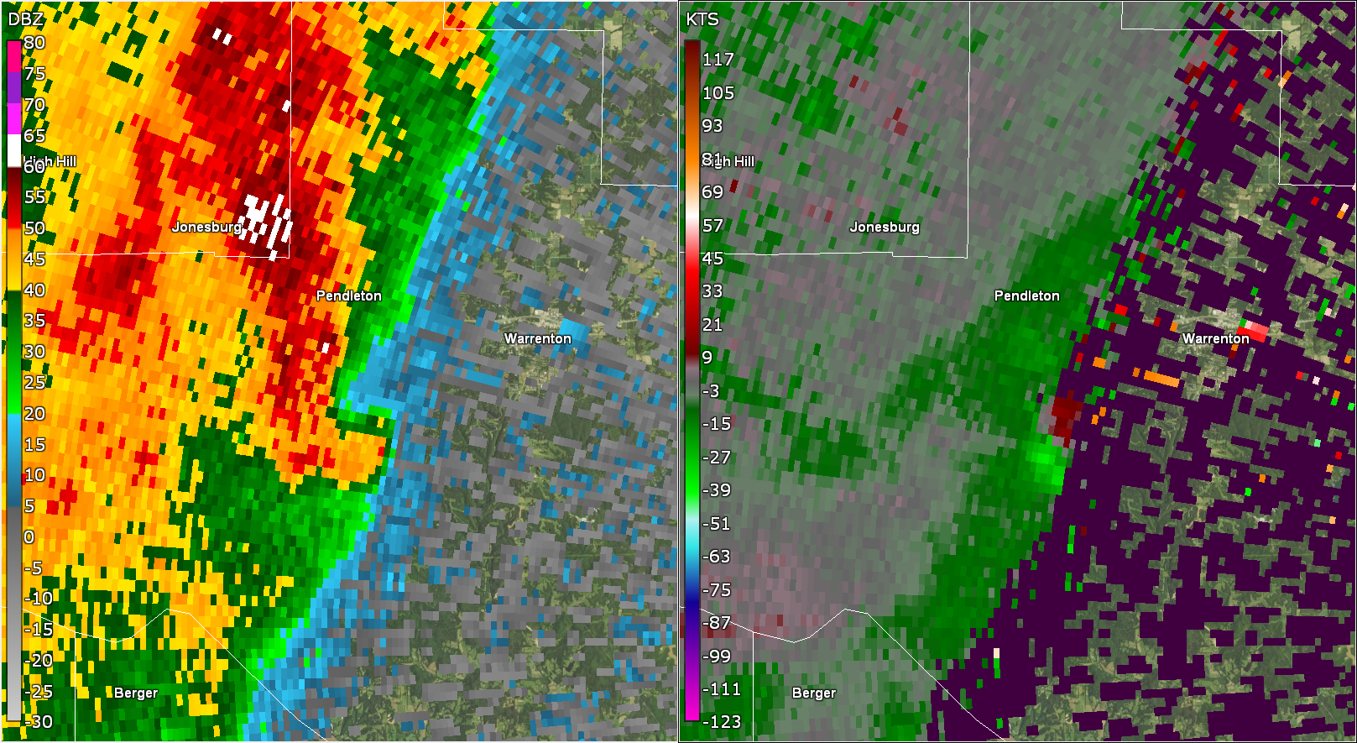
0533
Vr=27 kts @ 1842 ft ARL

Slide 28
Synopsis
Very rapid evolution, very little time from mesovortex development to tornado
Initially more subtle
Met TI with balanced line, line normal 0-3 km shear > 30 kts, line surge
Prominent RIN/FF concavity
Mesovortex with Vr ≥ 25 kts
Front Reflectivity Nub → Hook
Very favorable environment
Initial lead-time unlikely, but cumulative support for tornado warning
Illustrative Case

