Slide 1
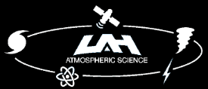
Observations of Complex Mesovortex Interactions and Behaviors during the Second 30 June - 1 July 2014 Midwestern Derecho Event
Anthony W. Lyza¹, Adam W. Clayton¹, Kevin R. Knupp¹, Eric Lenning², Matthew T. Friedlein², Richard Castro², and Evan Bentley³
¹Severe Weather Institute and Radar & Lightning Laboratories (SWIRLL), University of Alabama in Huntsville, Huntsville, AL
²NOAA/National Weather Service, Chicago, IL
³NOAA/National Weather Service, Portland, OR
3rd Midwestern Bow Echo Workshop
9 March 2017
SEVERE WEATHER INSTITUTE AND
RADAR AND LIGHTNING LABORATORIES

Slide 2
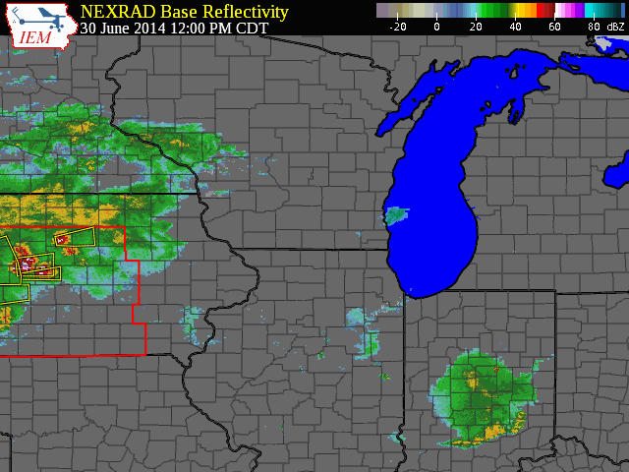

Slide 3
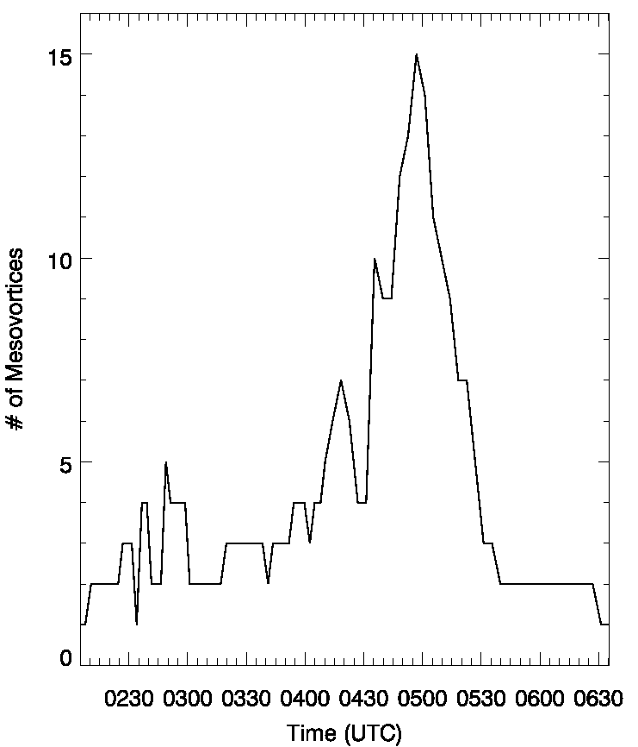
The Many Mesovortices of the 2nd QLCS
39 mesovortices detected across northern Illinois, northern Indiana, and far northwestern Ohio
As many as 15 ongoing simultaneously
29 tornadoes confirmed in surveys; numerous others suspected
High number of mesovortices and proximity to three radar sites afforded unique observations of several mesovortex behaviors

Slide 4
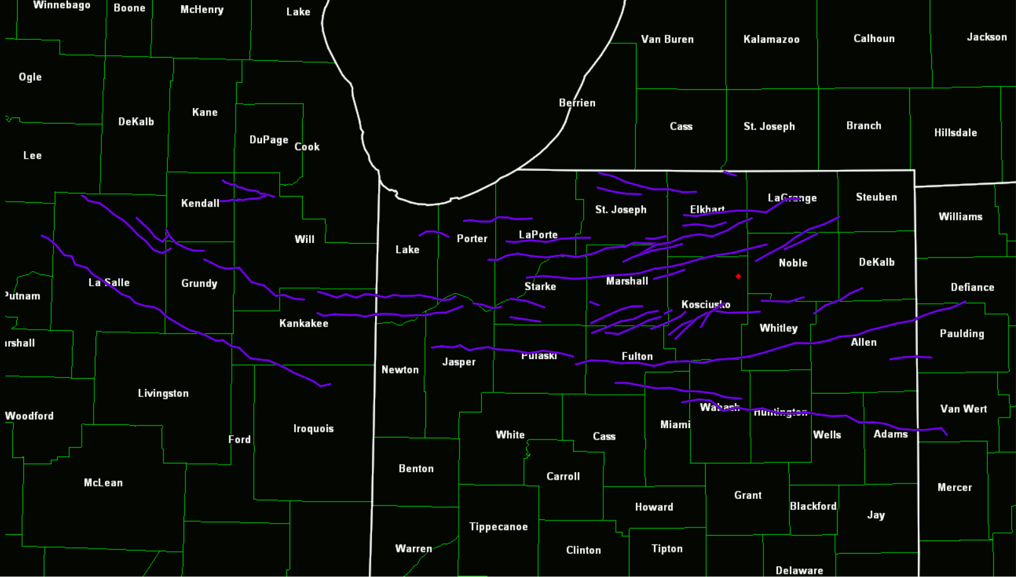
Mesovortex and Confirmed Tornado Tracks
N
MV Tracks
EF0 Tornadoes
EF1 Tornadoes
55 km

Slide 5
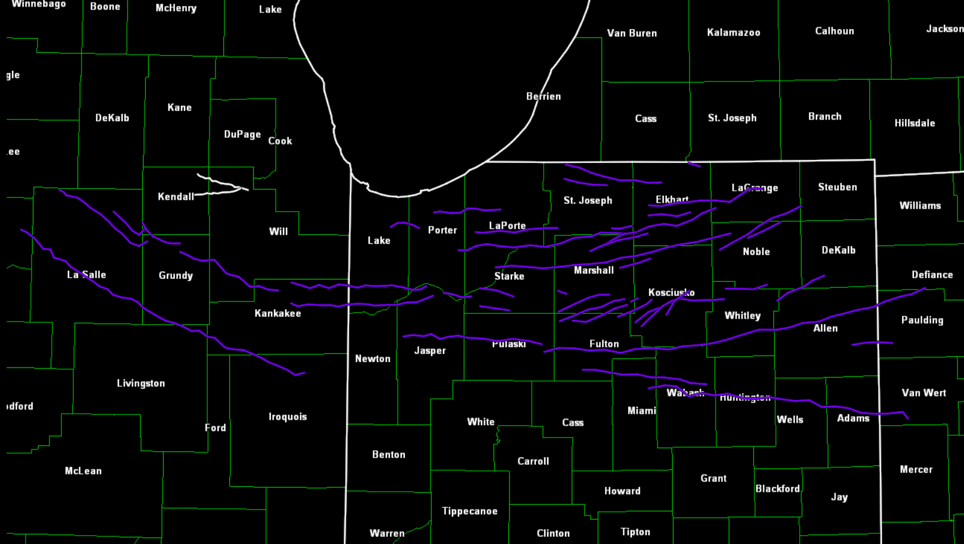
Fujiwhara Interaction between MVs ‘E’ and ‘F’
N
E
F
55 km

Slide 6
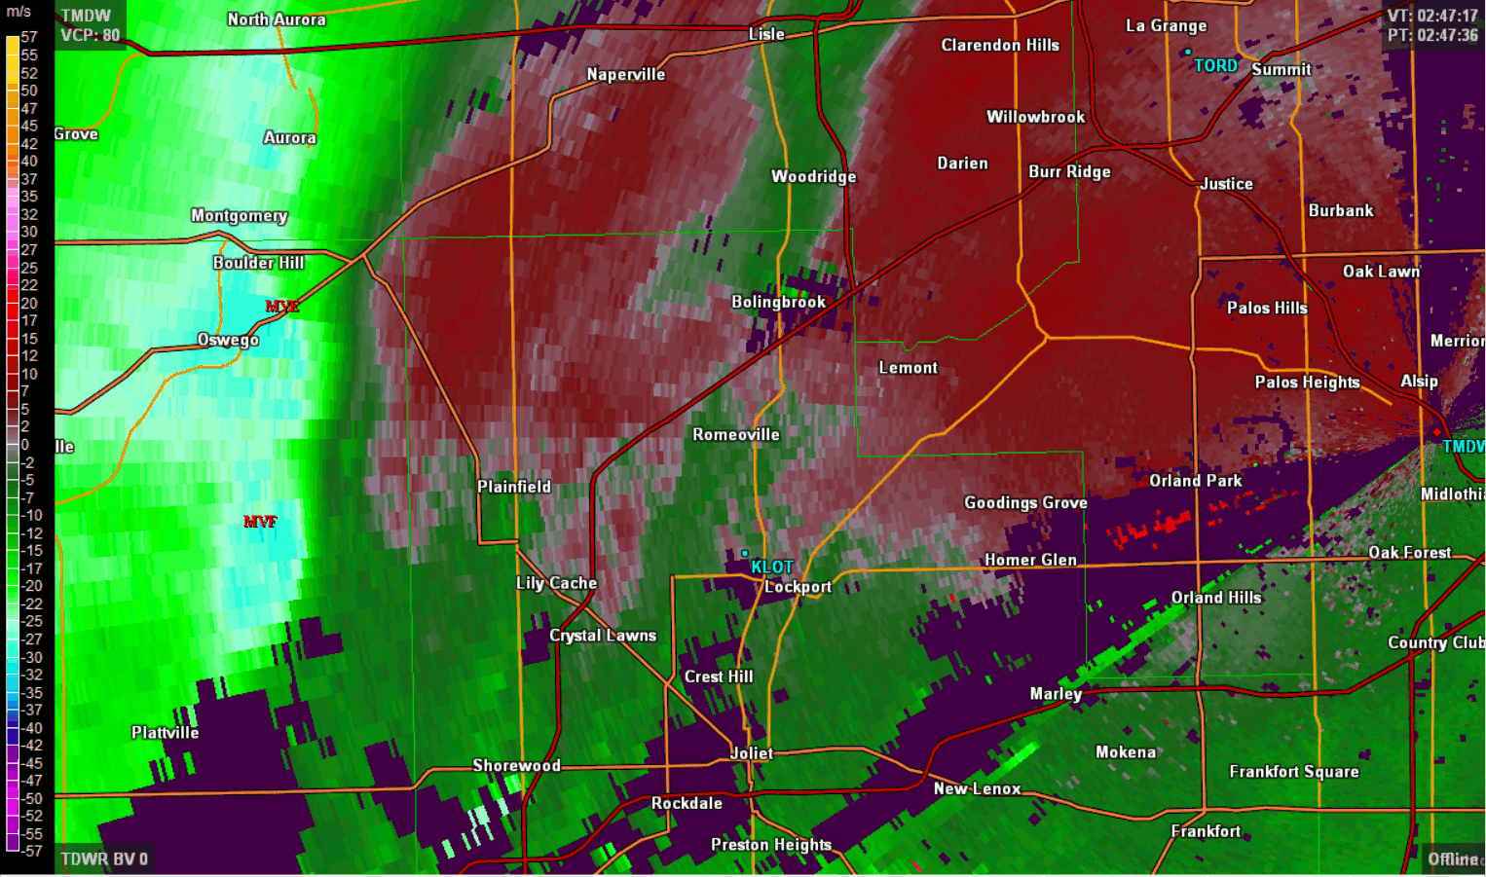
Fujiwhara Interaction between MVs ‘E’ and ‘F’
N
5 km

Slide 7
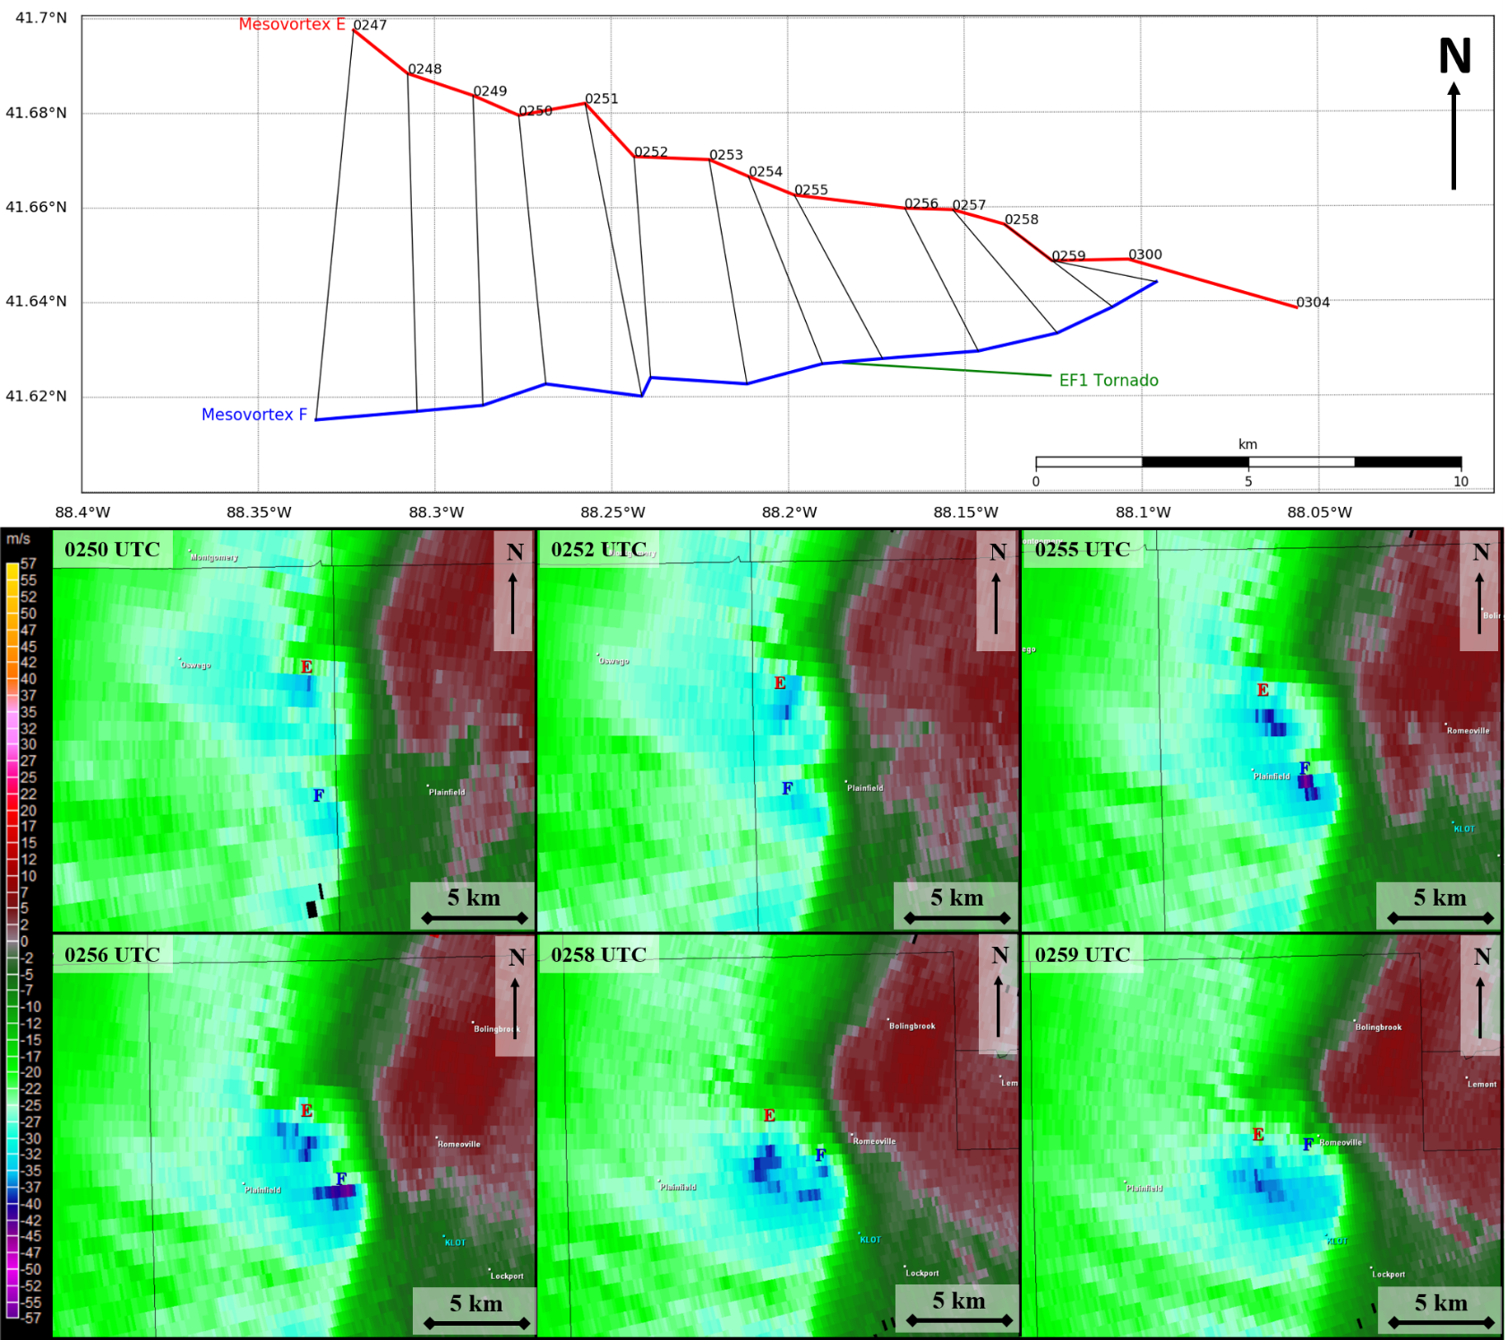
Fujiwhara Interaction between MVs ‘E’ and ‘F’

Slide 8
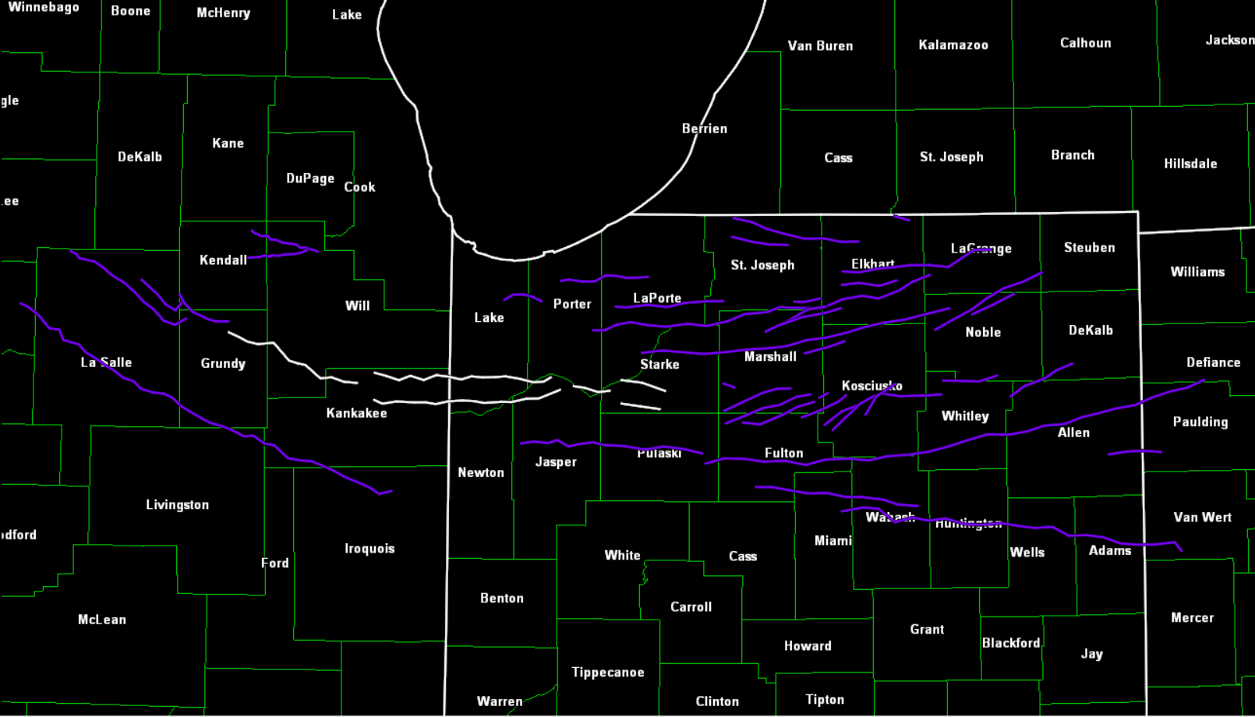
Evolution of MV ‘G’
N
G
G1
G3
G2
G4
55 km

Slide 9
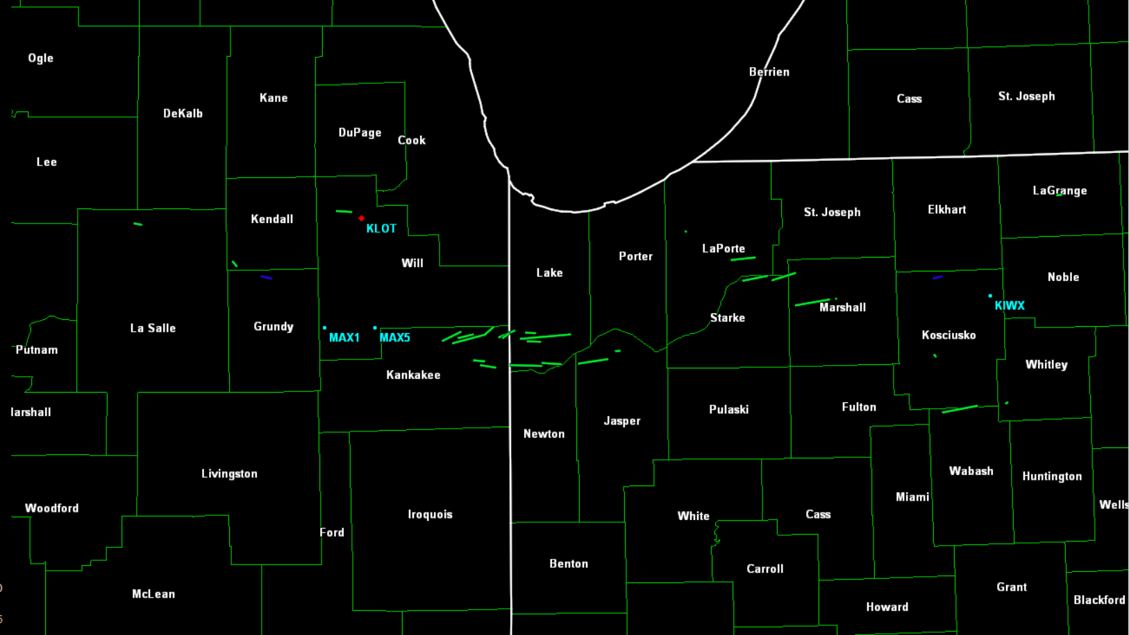
Evolution of MV ‘G’
N
25 km
Tornadoes associated with MV G
EF0
EF1

Slide 10
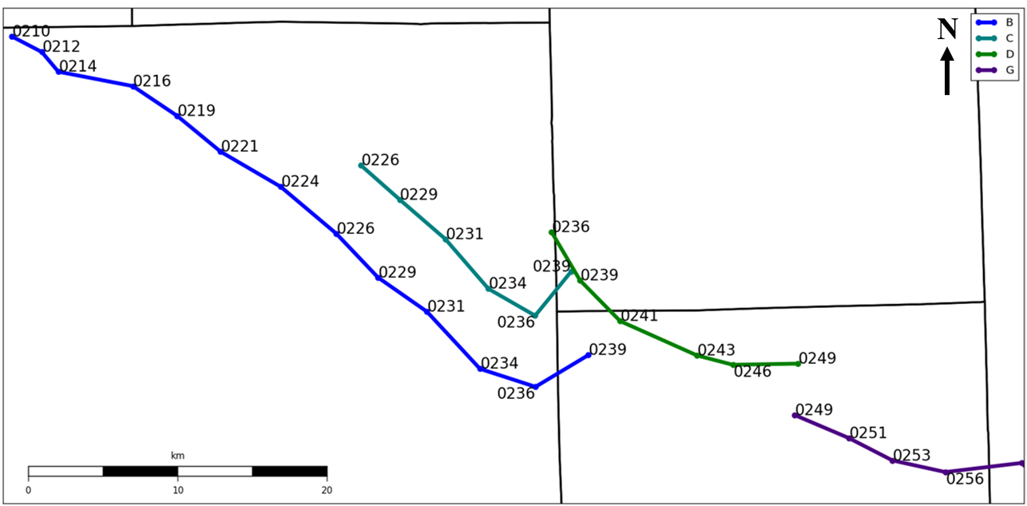
Evolution of MV ‘G’

Slide 11
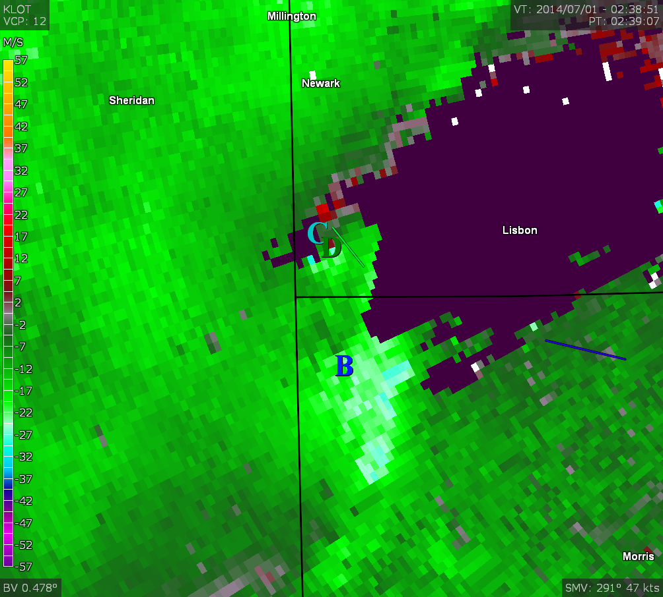
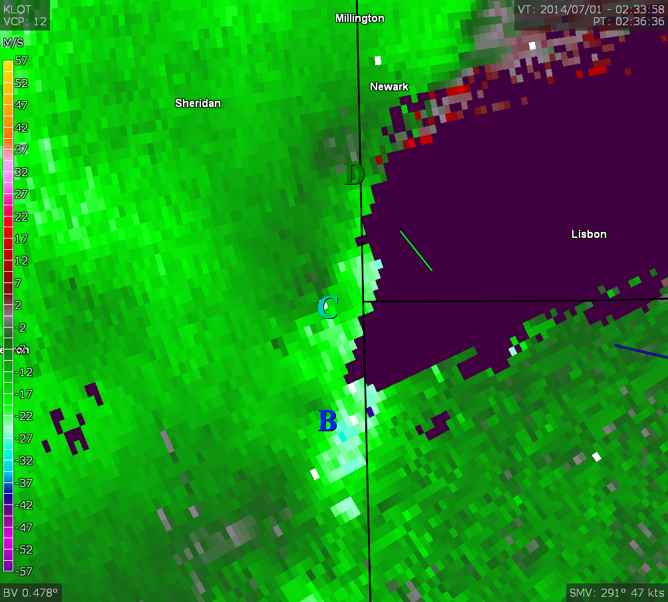
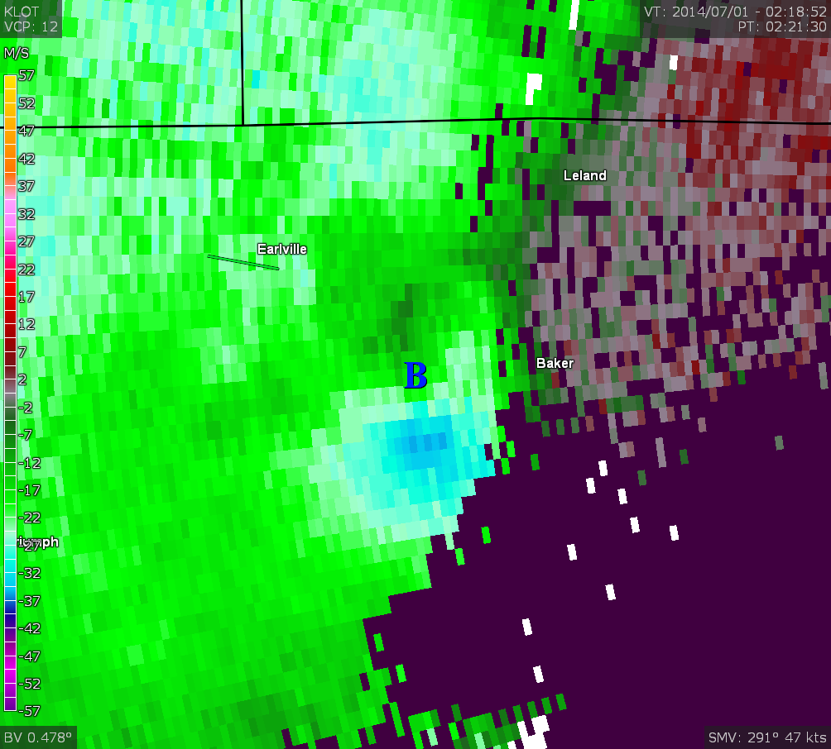
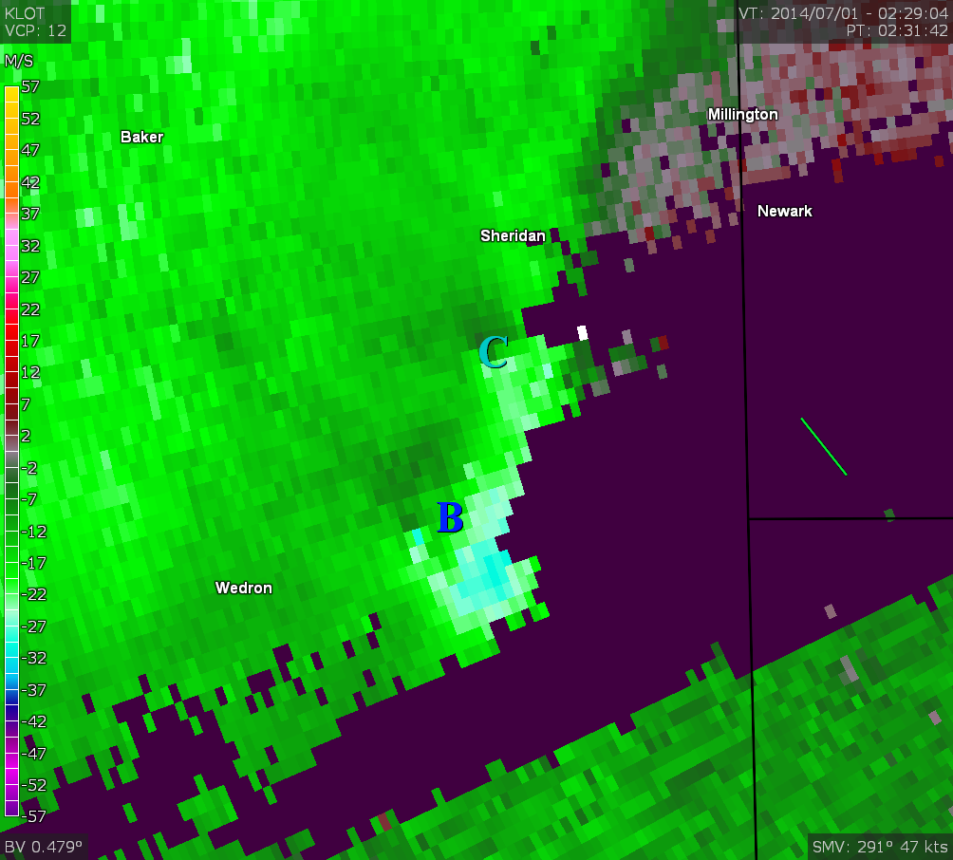
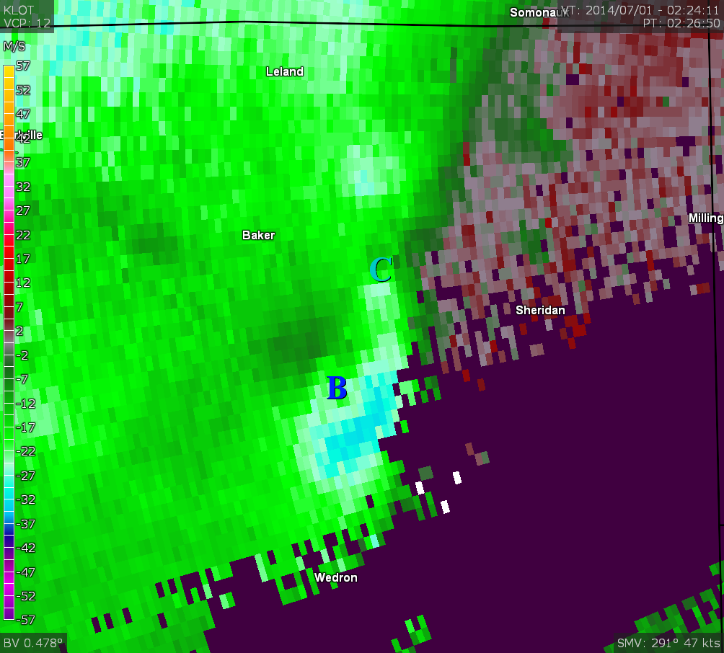
Evolution of MV ‘G’
5 km

Slide 12
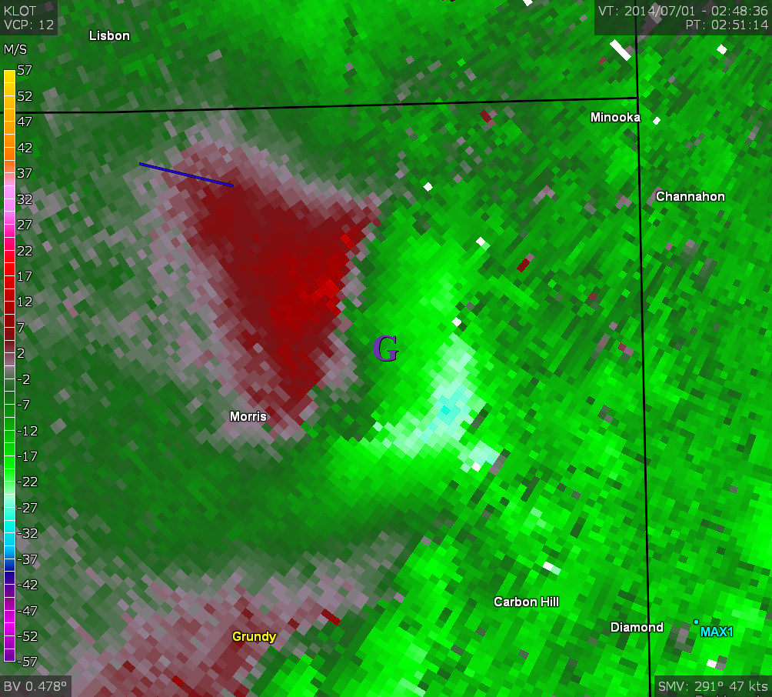
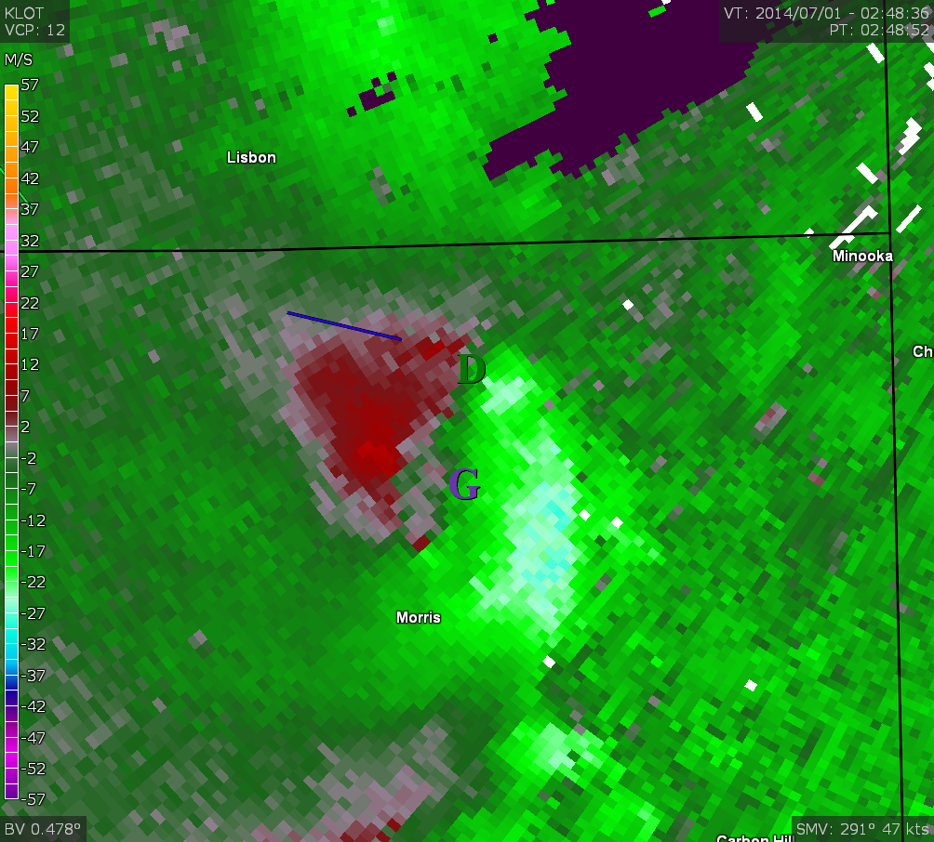
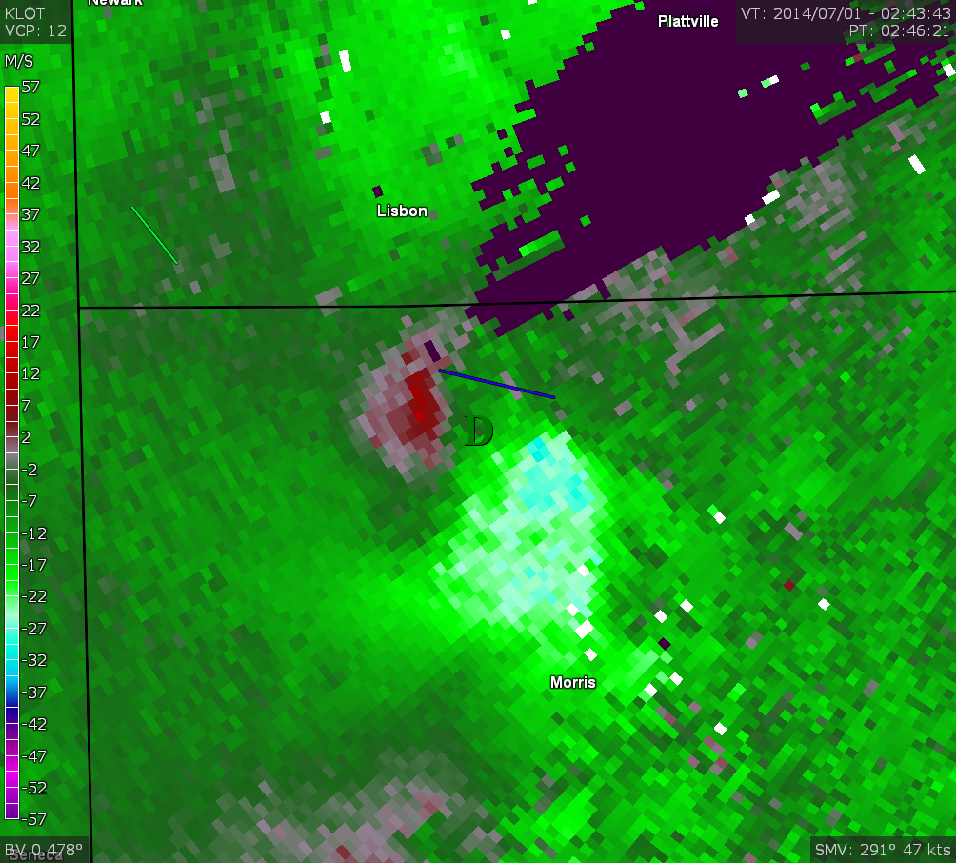
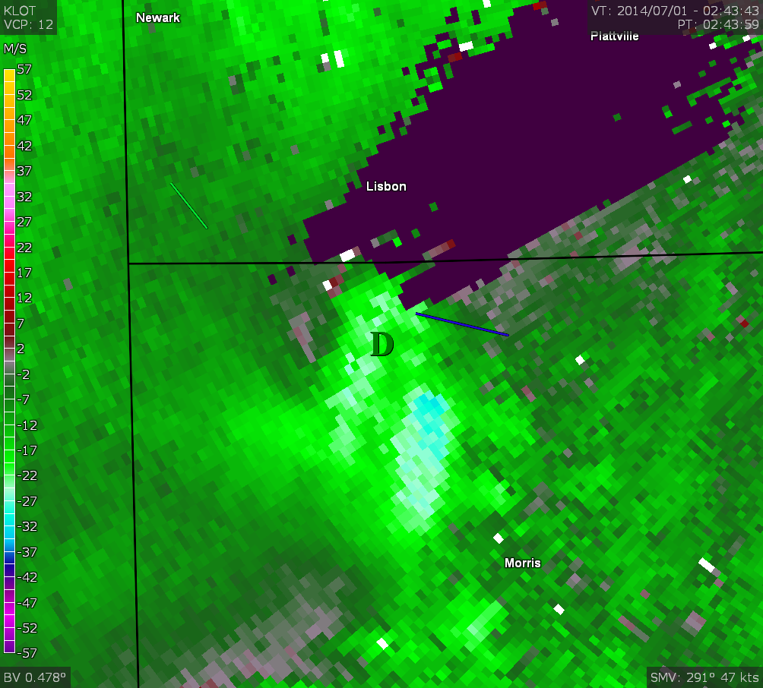
Evolution of MV ‘G’
5 km

Slide 13
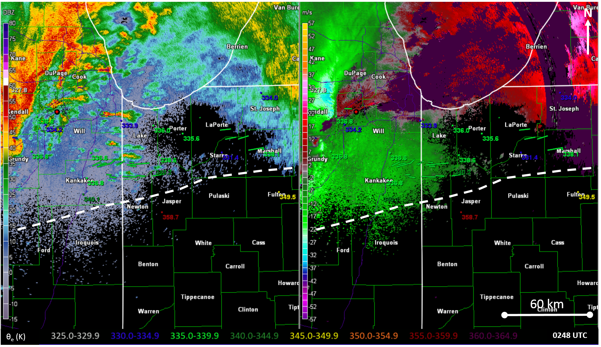
Evolution of MV ‘G’
327.8
334.0
327.8
334.0
336.8
333.9
336.8
333.9
334.2
336.0
335.6
334.2
336.0
335.6
MV G
MV G
336.8
336.6
338.6
331.4
338.1
336.8
336.6
338.6
331.4
338.1
340.2
340.2
336.8
336.8
340.1
349.5
340.1
349.5
358.7
358.7

Slide 14
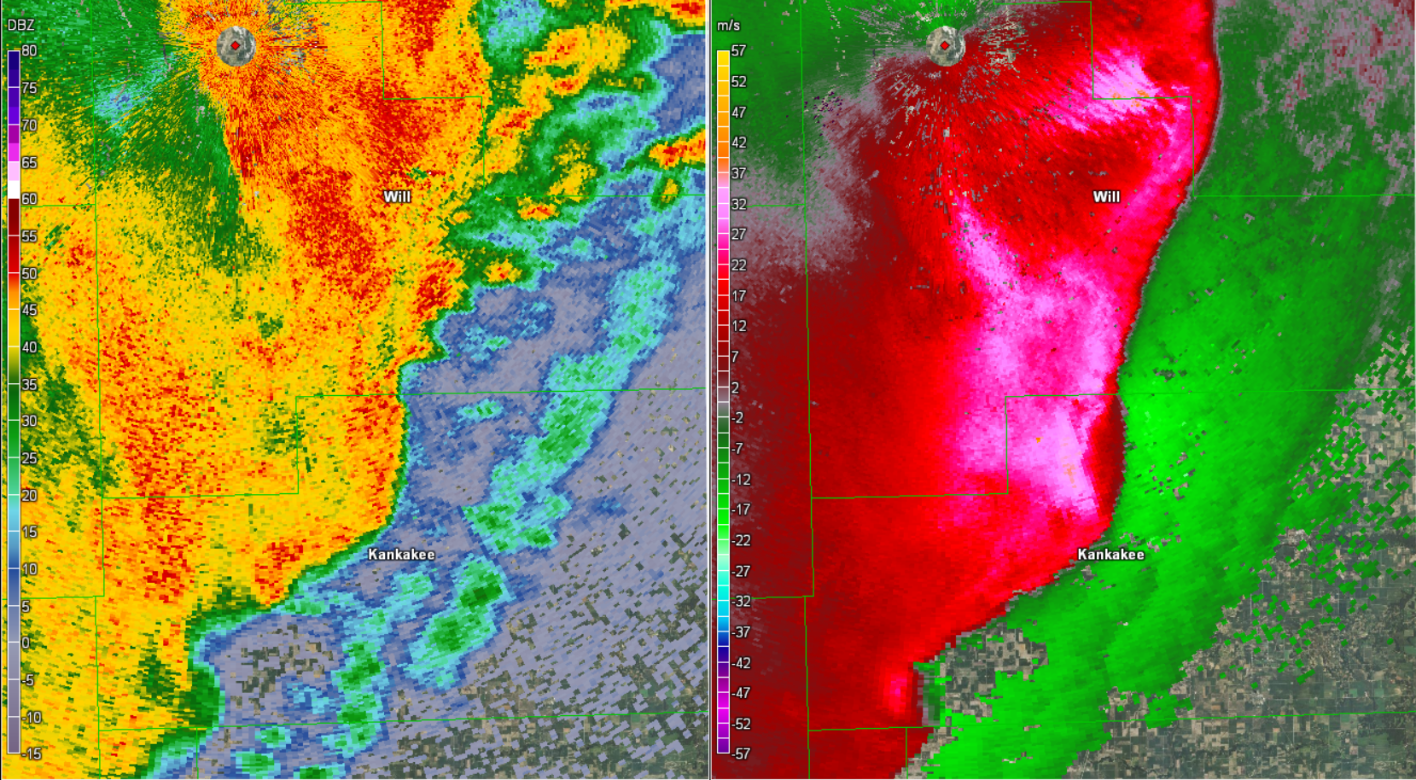
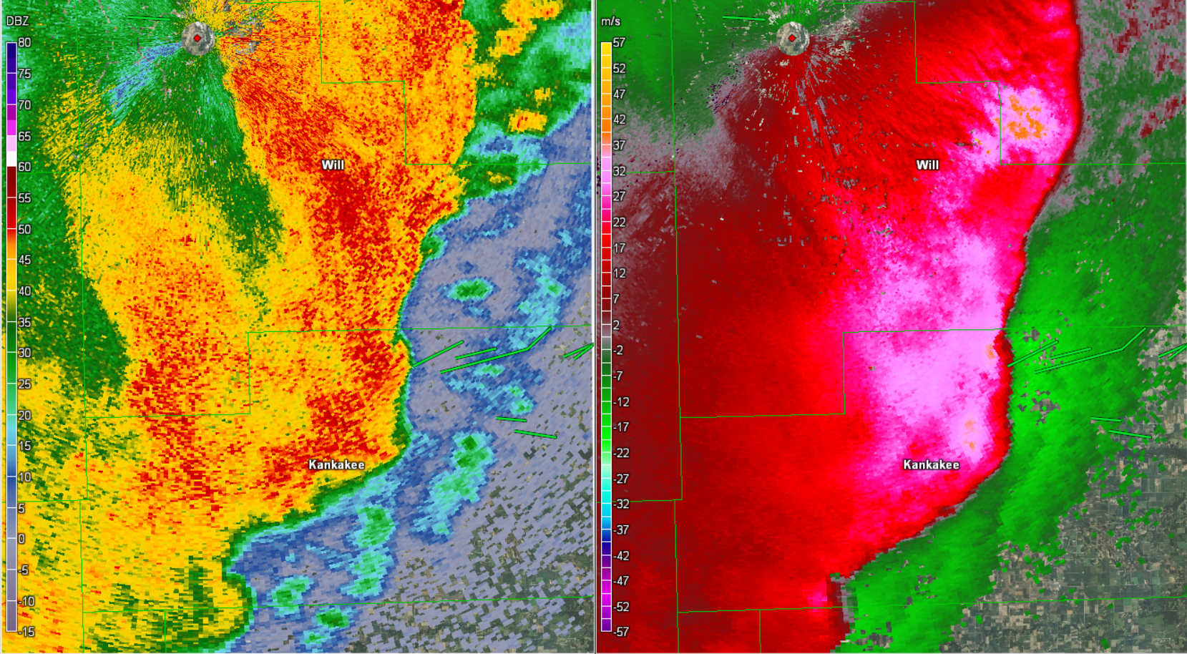
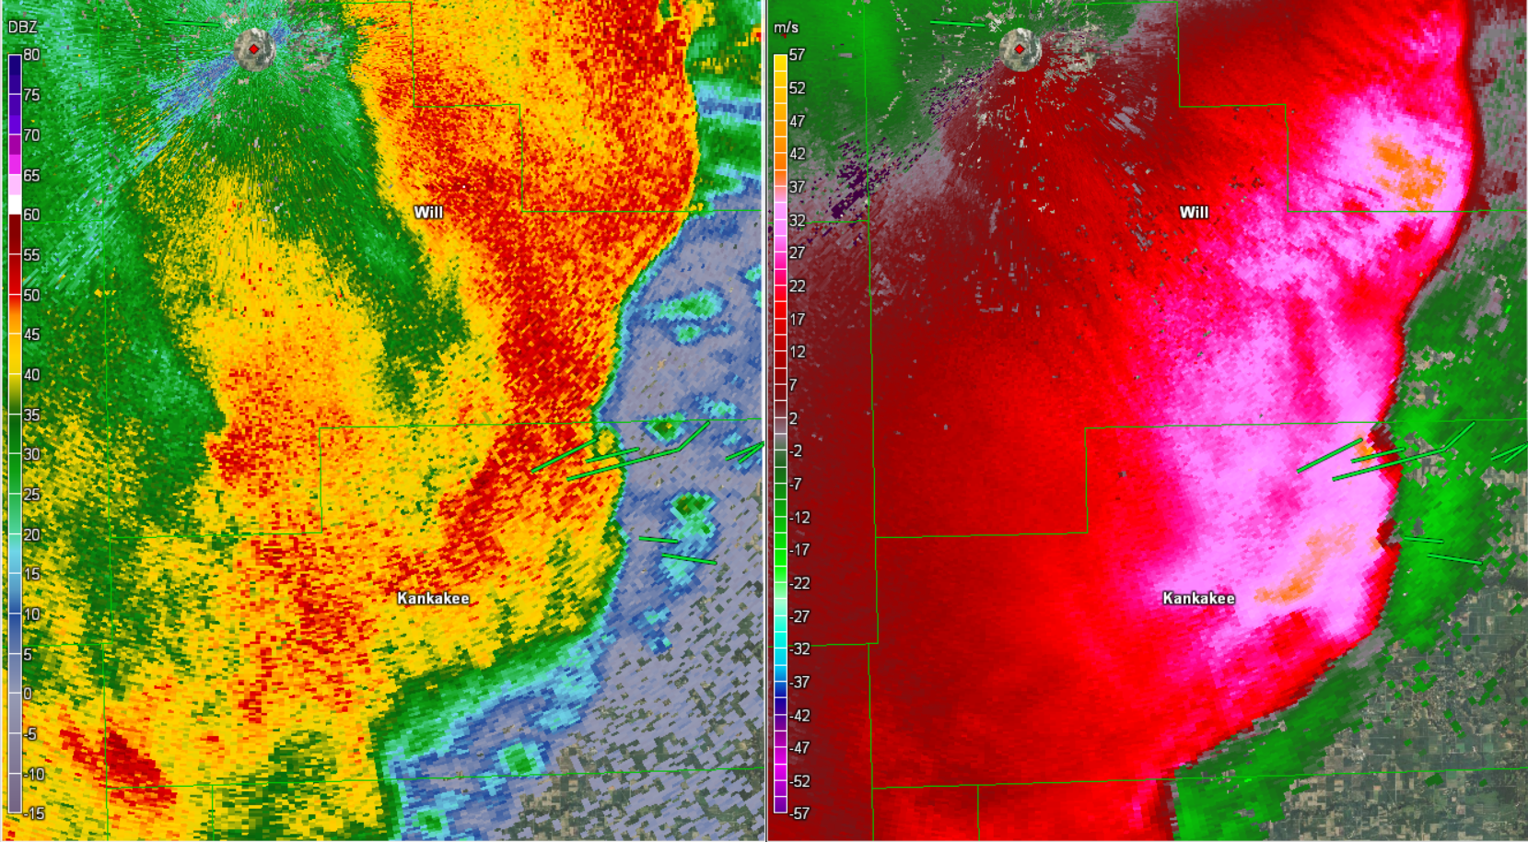
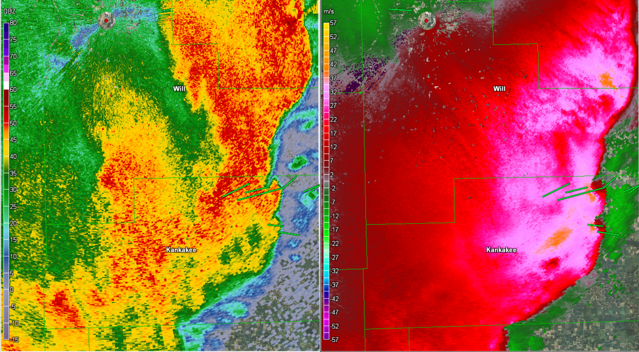
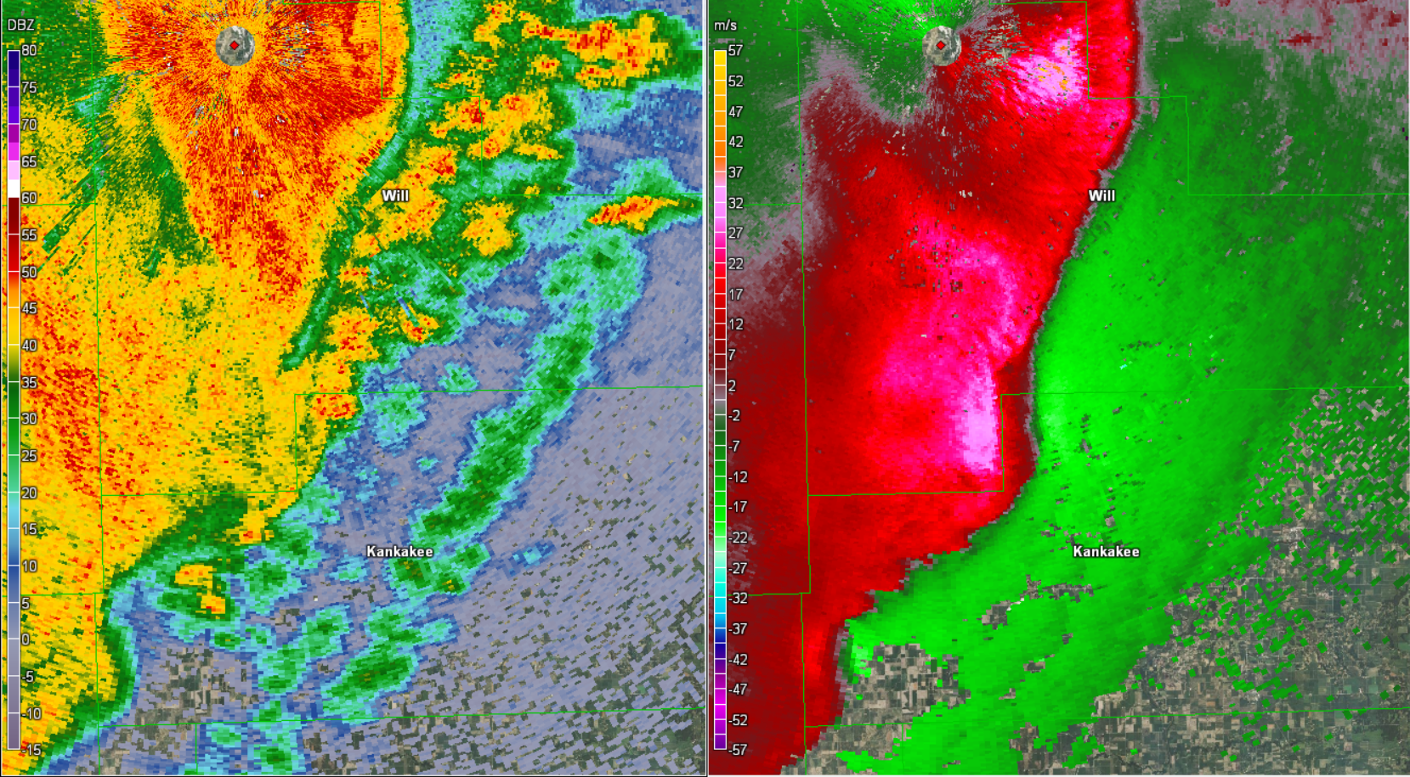
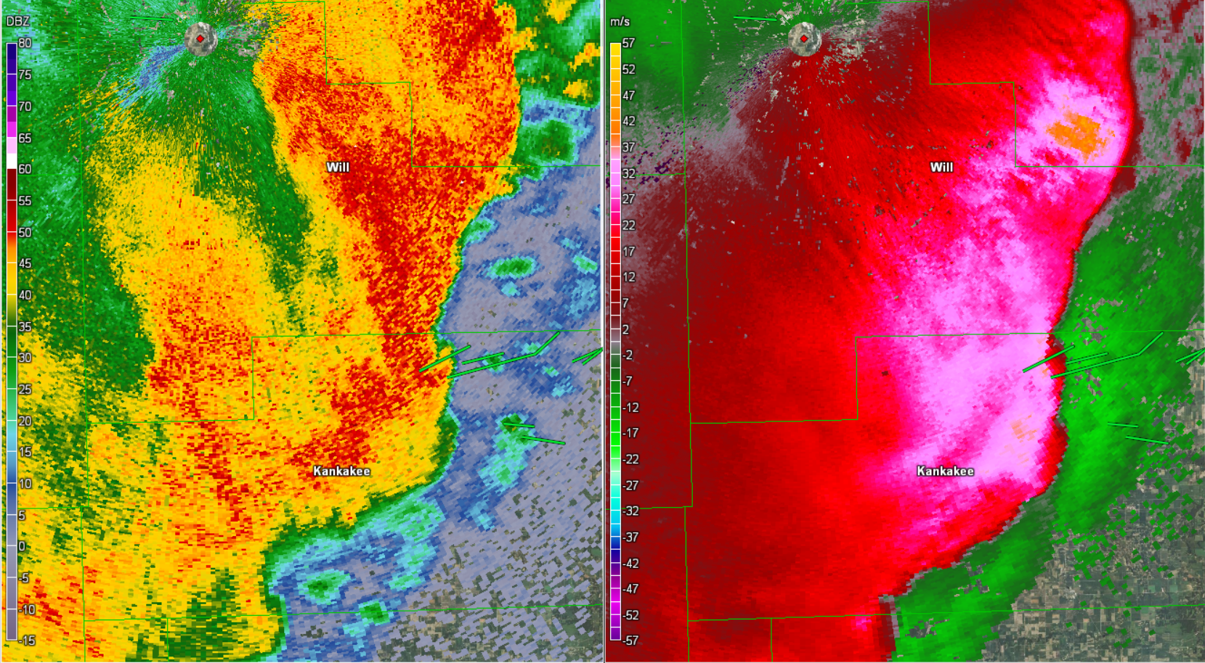
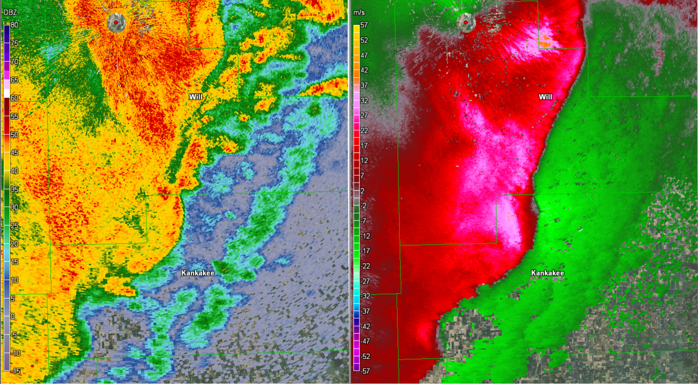
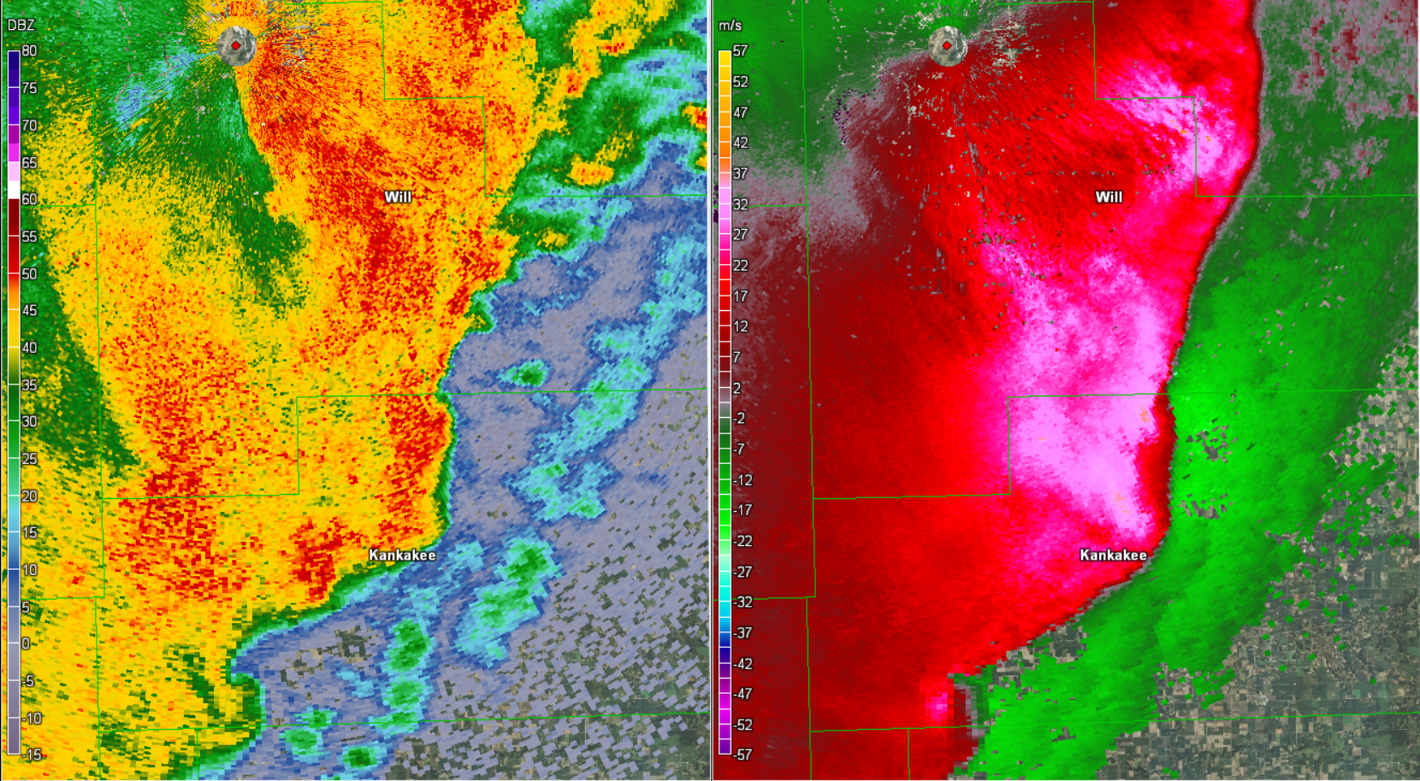
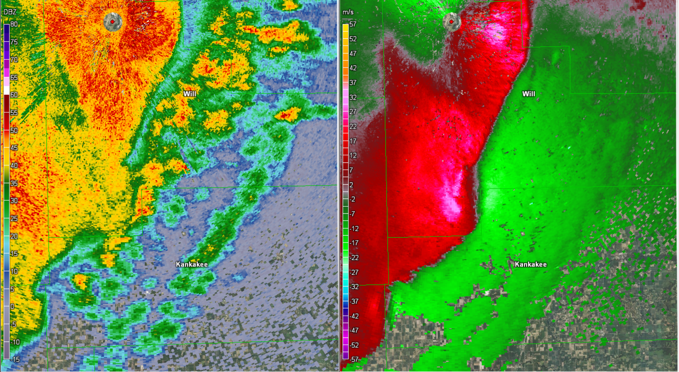
Evolution of MV ‘G’
N
N
N
N
N
N
N
N
0316 UTC
N
0322 UTC
0327 UTC
0330 UTC
0325 UTC
0308 UTC
0311 UTC
0314 UTC
0319 UTC
MV G
MV G becoming larger
Northern shear zone becomes tornadic
Two distinct circulations out of one broader vortex
Two concentrated shear zones appear
G1
G2
Southern shear zone becomes tornadic
16 km
16 km
16 km
16 km
16 km
16 km
16 km
16 km
16 km

Slide 15
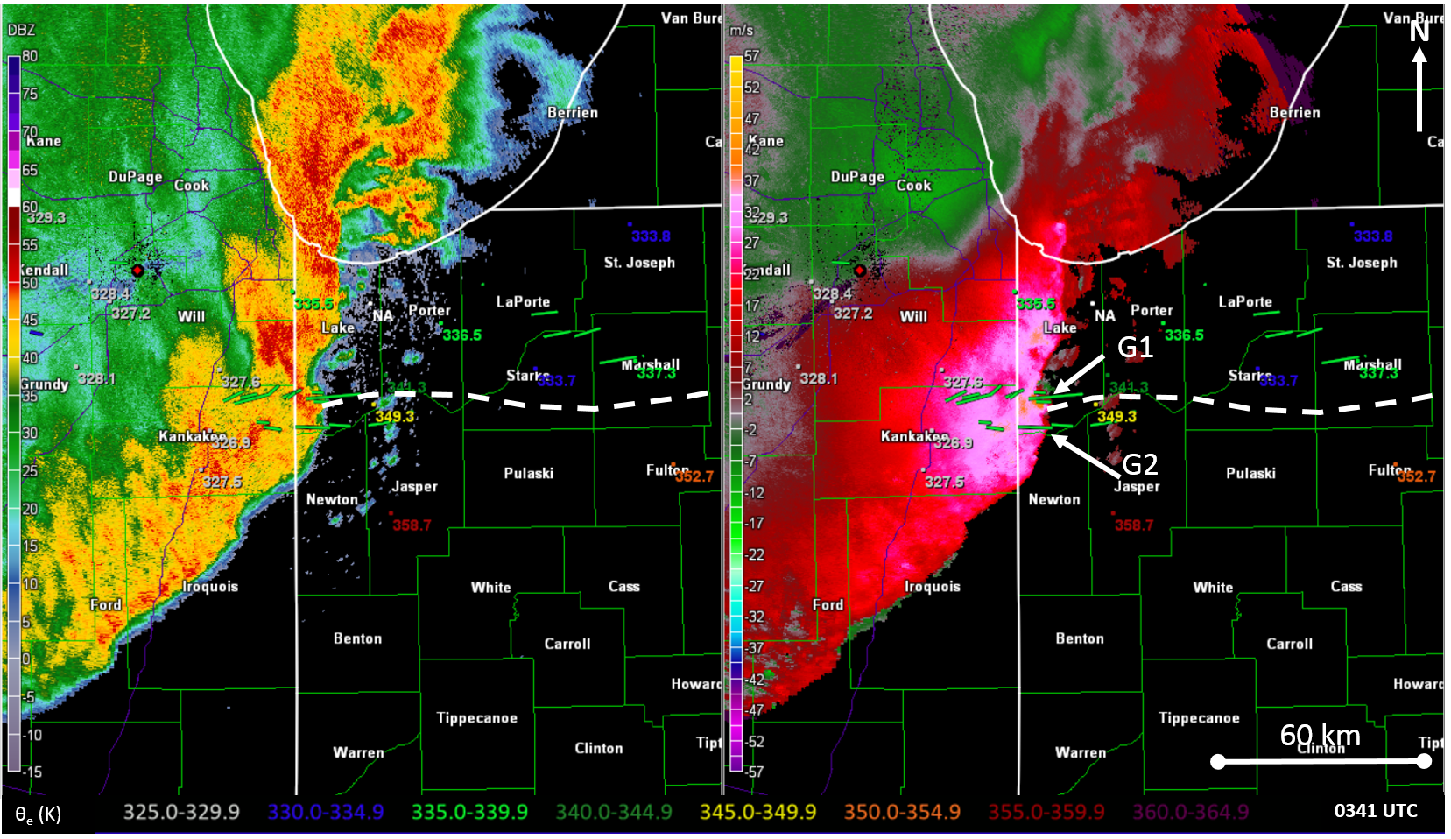
Evolution of MV ‘G’
329.3
333.8
329.3
333.8
328.4
335.5
328.4
335.5
327.2
NA
336.5
327.2
NA
336.5
328.1
327.6
341.3
333.7
337.3
328.1
327.6
341.3
333.7
337.3
349.3
349.3
326.9
326.9
327.5
352.7
327.5
352.7
358.7
358.7

Slide 16
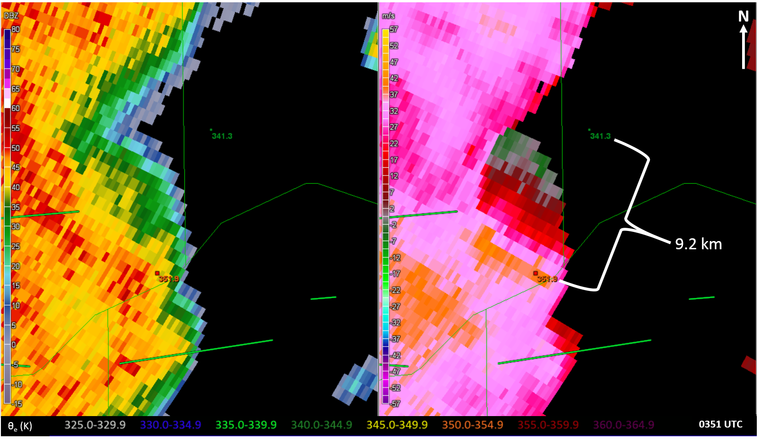
Evolution of MV ‘G’
341.3
341.3
G1
351.9
351.9
G2

Slide 17
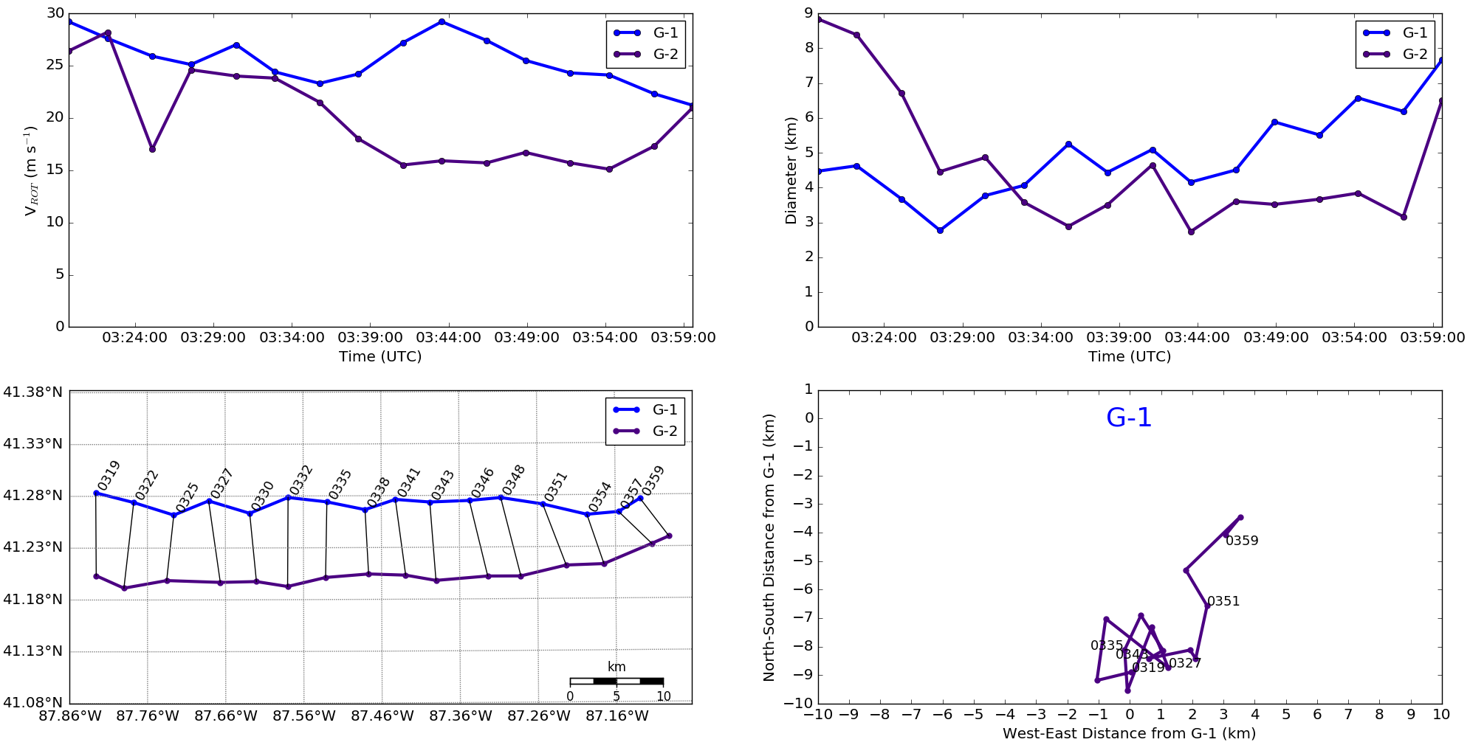
Evolution of MV ‘G’
Acceleration of G2 from 0343 UTC to merger after 0359 UTC

Slide 18
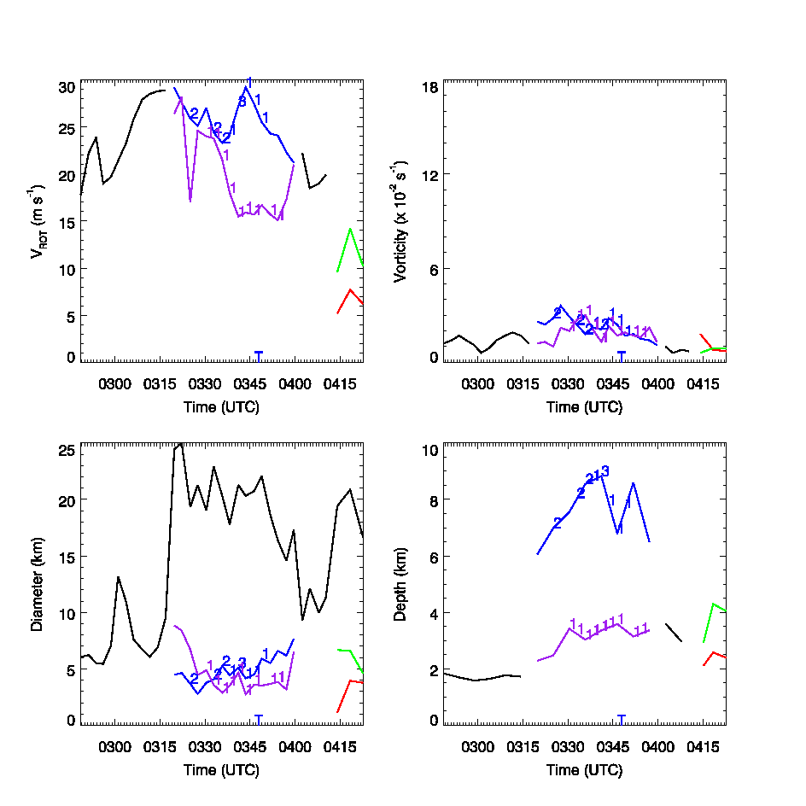
Evolution of MV ‘G’
G-1
G-2
G-3
G-4
Is this realistic?
Numbers: # of tors ongoing at sweep time
T: TDS detected

Slide 19
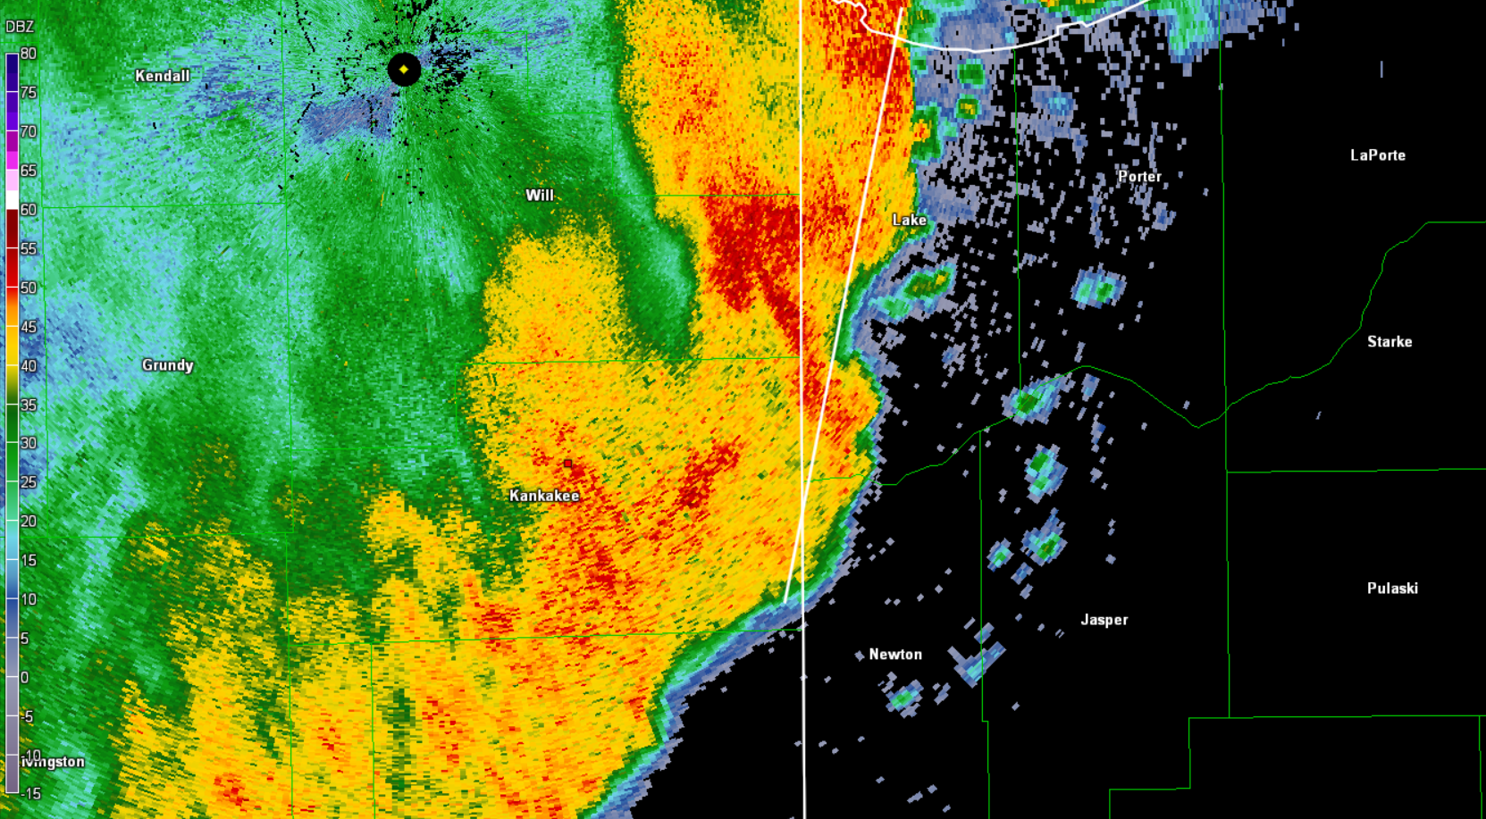
Evolution of MV ‘G’
0341 UTC
71.4 km
Cell assoc. w/G1

Slide 20
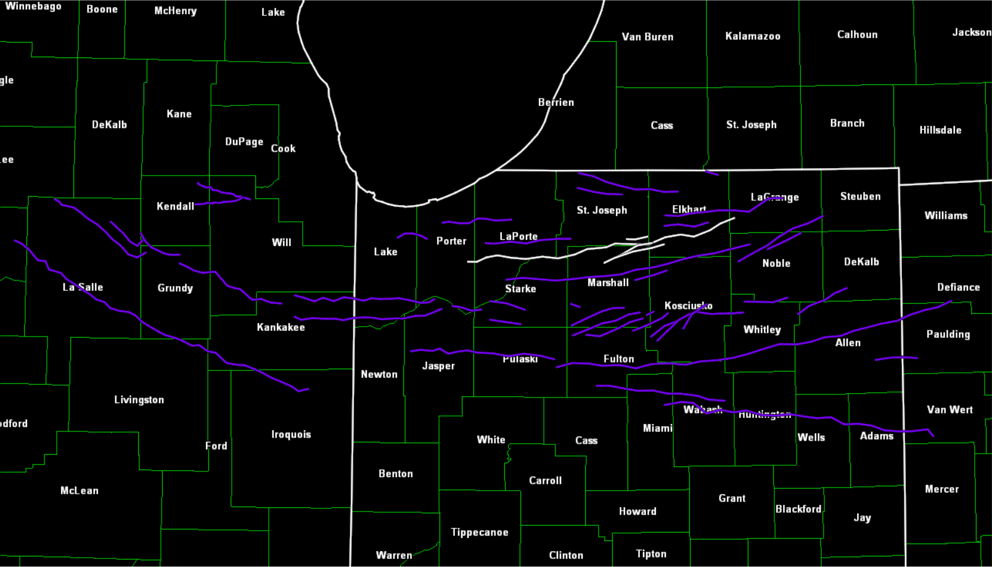
Interaction between MVs ‘K’, ‘U’, ‘V’, and ‘W’
N
V
U
K
W
55 km

Slide 21
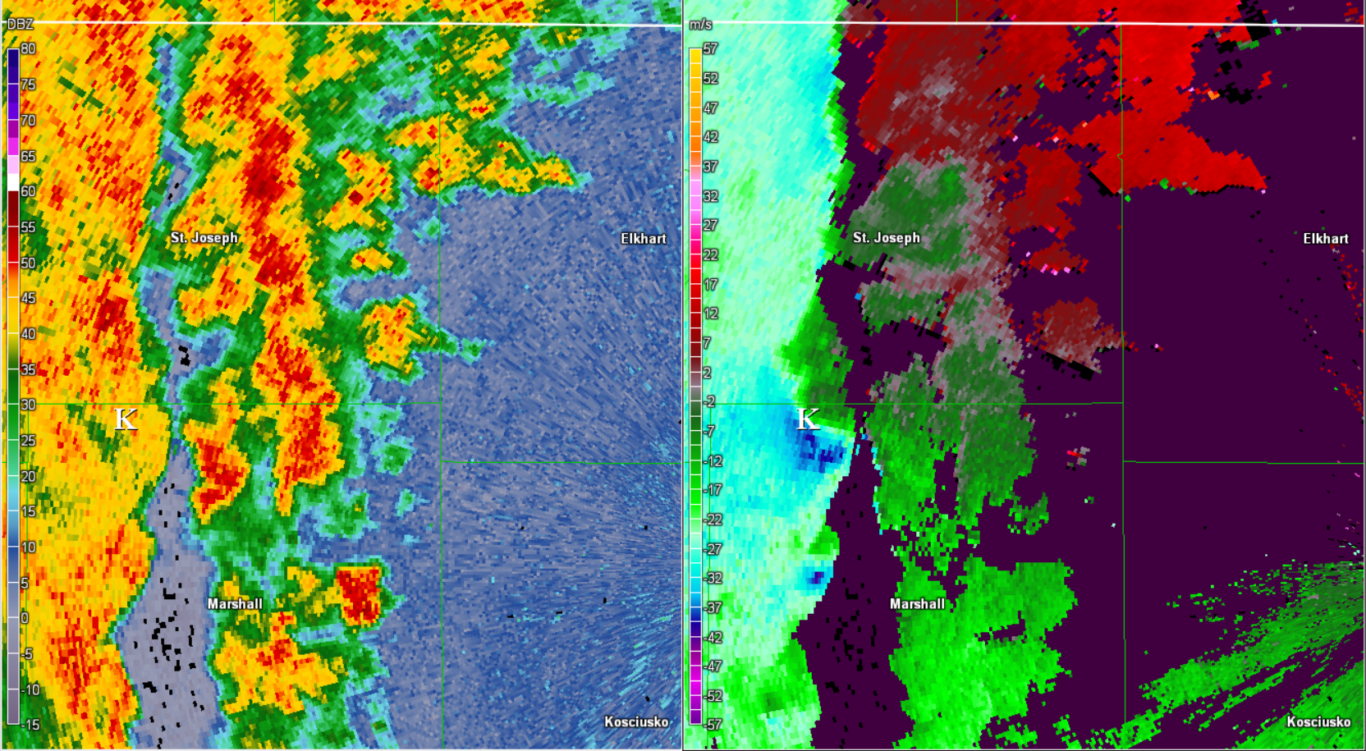
Interaction between MVs ‘K’, ‘U’, ‘V’, and ‘W’
0439 UTC
N
20 km

Slide 22
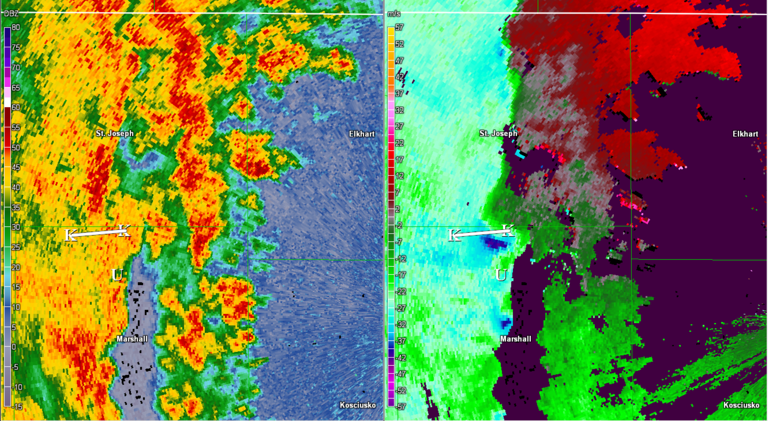
Interaction between MVs ‘K’, ‘U’, ‘V’, and ‘W’
0444 UTC
N
20 km

Slide 23
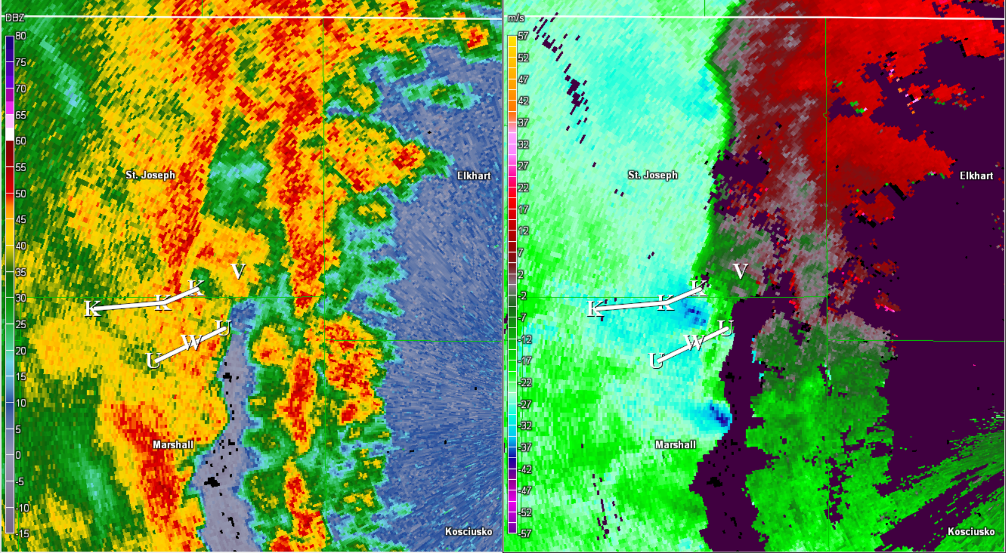
Interaction between MVs ‘K’, ‘U’, ‘V’, and ‘W’
0448 UTC
N
20 km

Slide 24
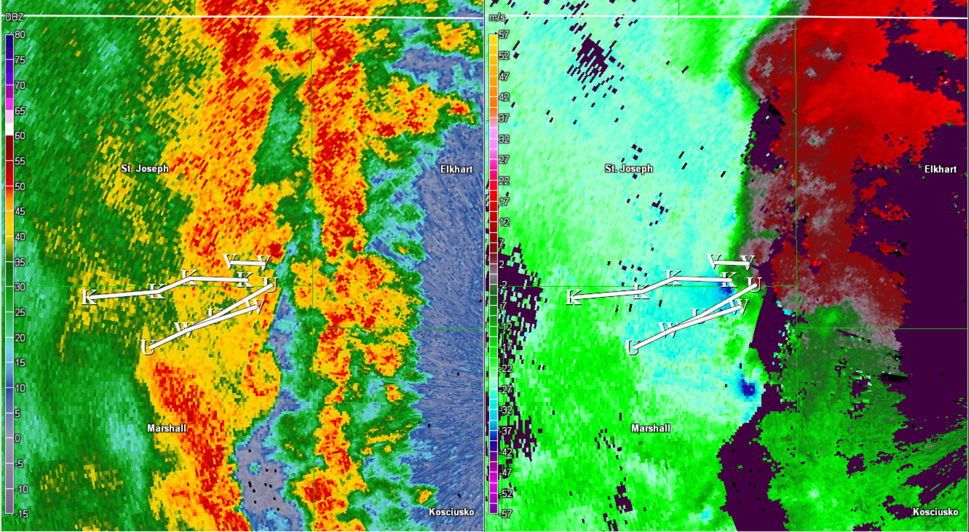
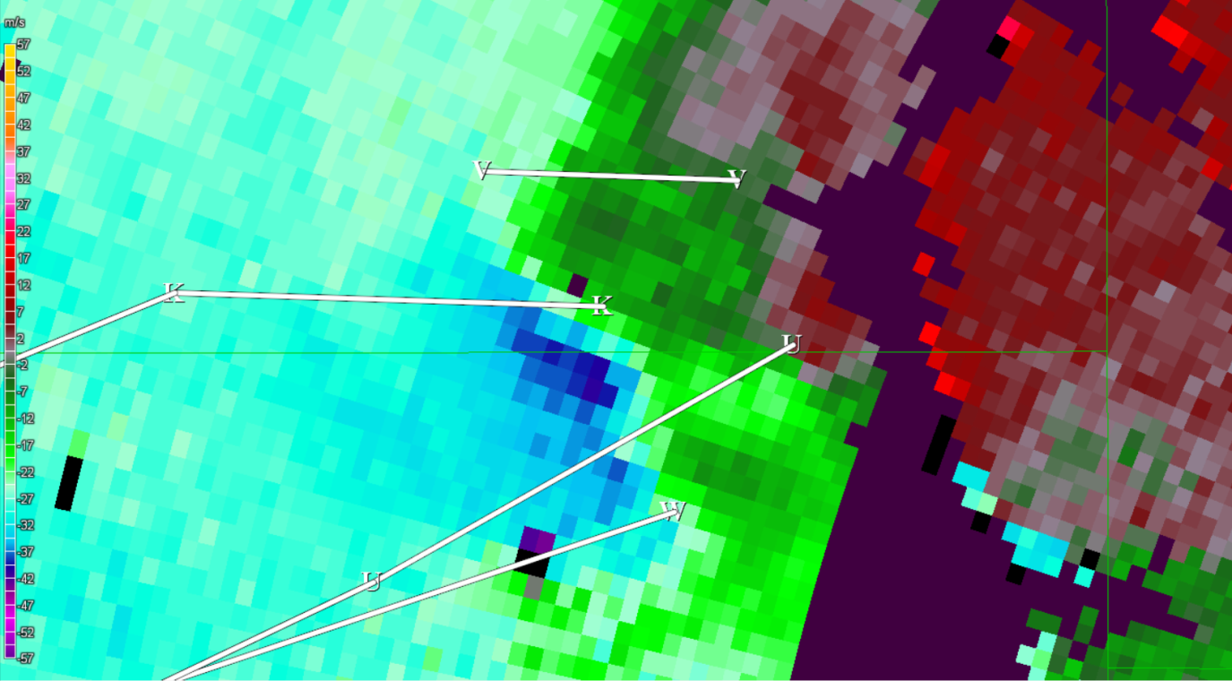
Interaction between MVs ‘K’, ‘U’, ‘V’, and ‘W’
0452 UTC
N
5 km
20 km

Slide 25
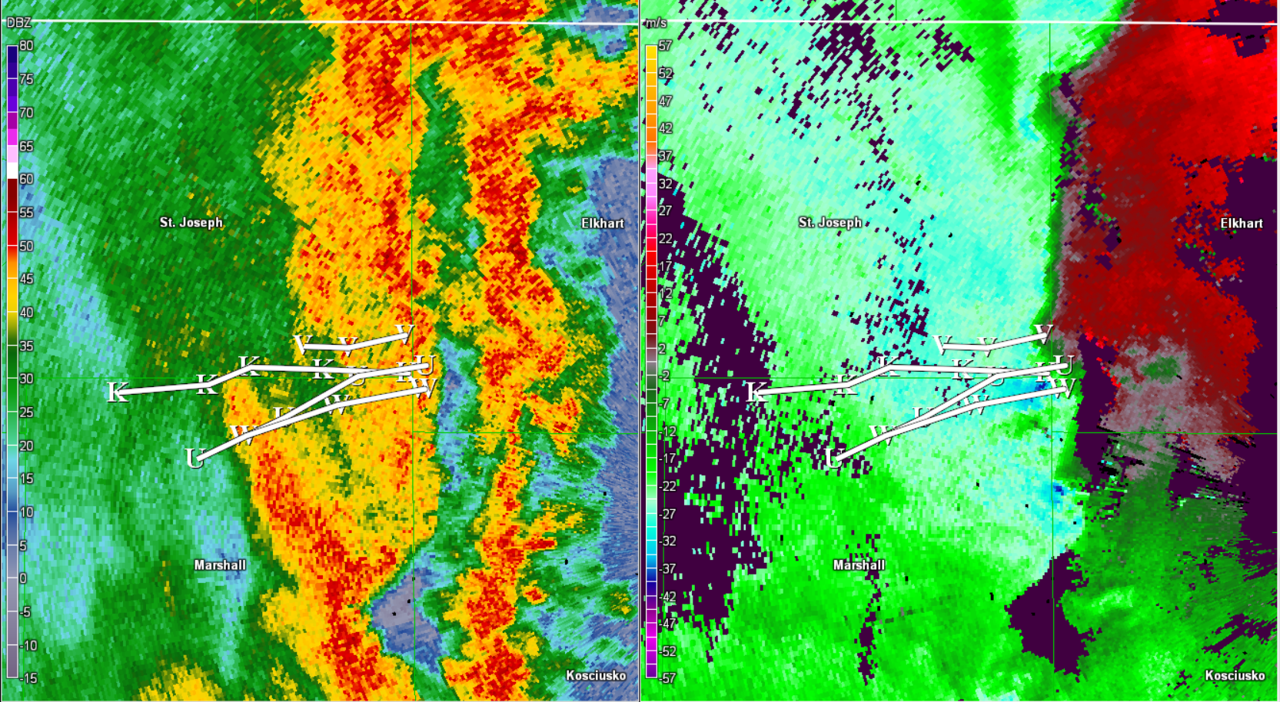
Interaction between MVs ‘K’, ‘U’, ‘V’, and ‘W’
0456 UTC
N
20 km

Slide 26
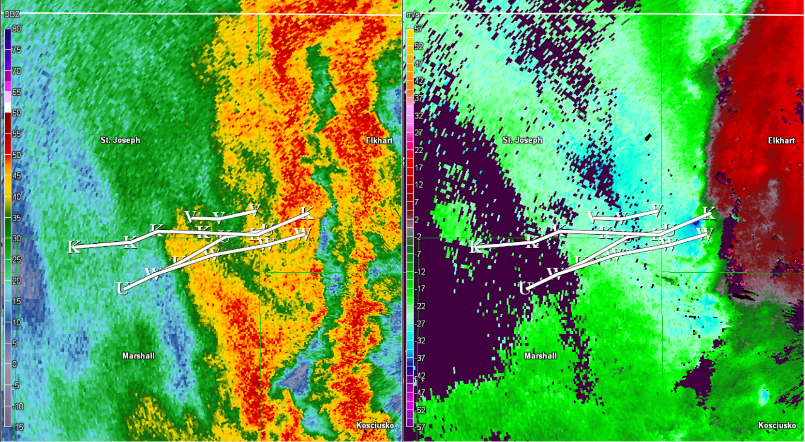
Interaction between MVs ‘K’, ‘U’, ‘V’, and ‘W’
0501 UTC
N
20 km

Slide 27
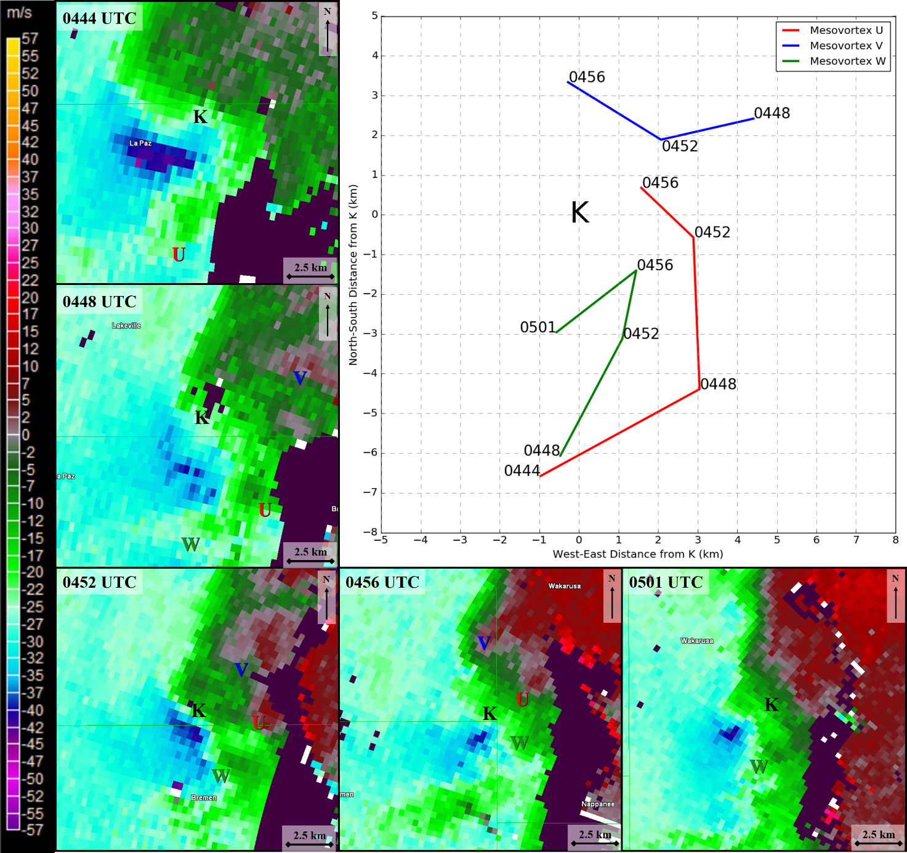
Interaction between MVs ‘K’, ‘U’, ‘V’, and ‘W’

Slide 28
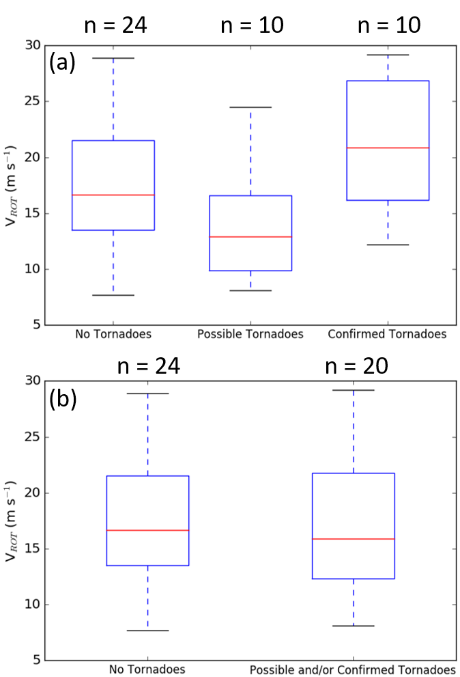
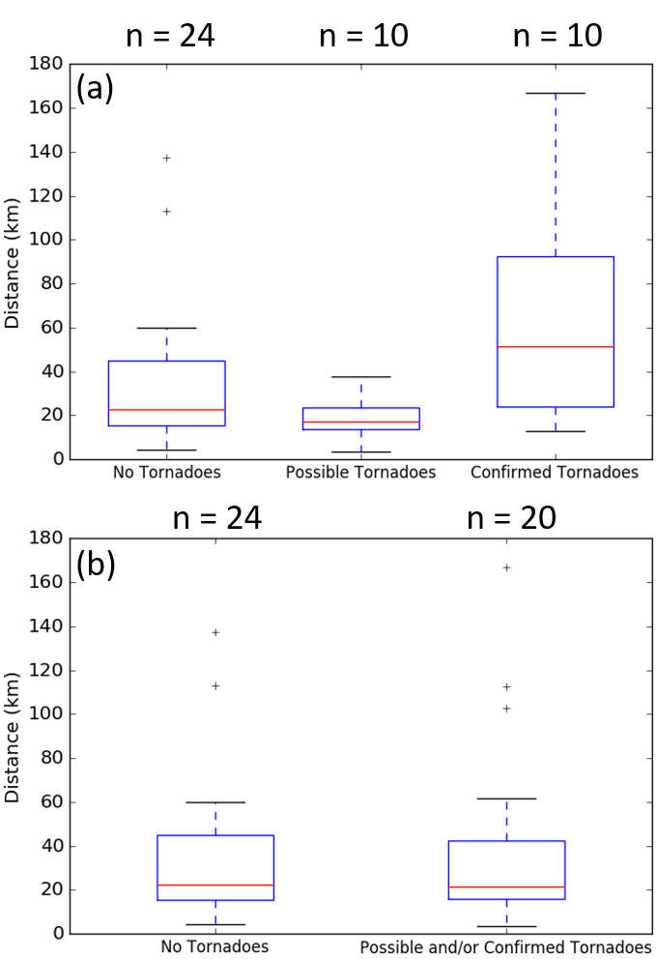
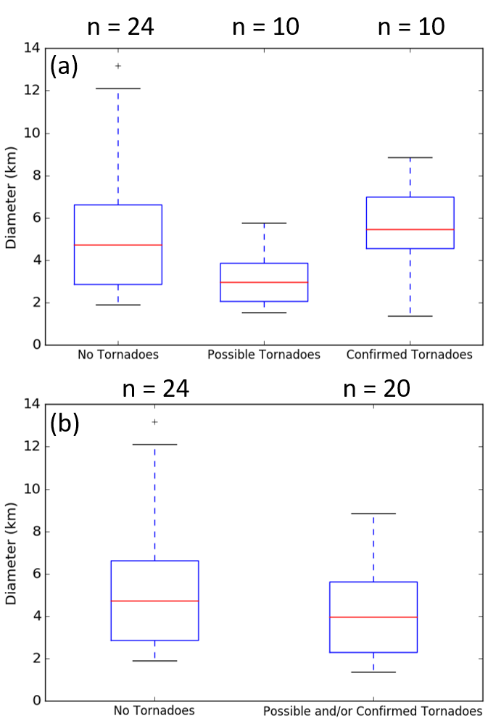
General Mesovortex Characteristics
Maximum 0.5° Rotational Velocity
Distance Traveled
Maximum 0.5° Diameter

Slide 29
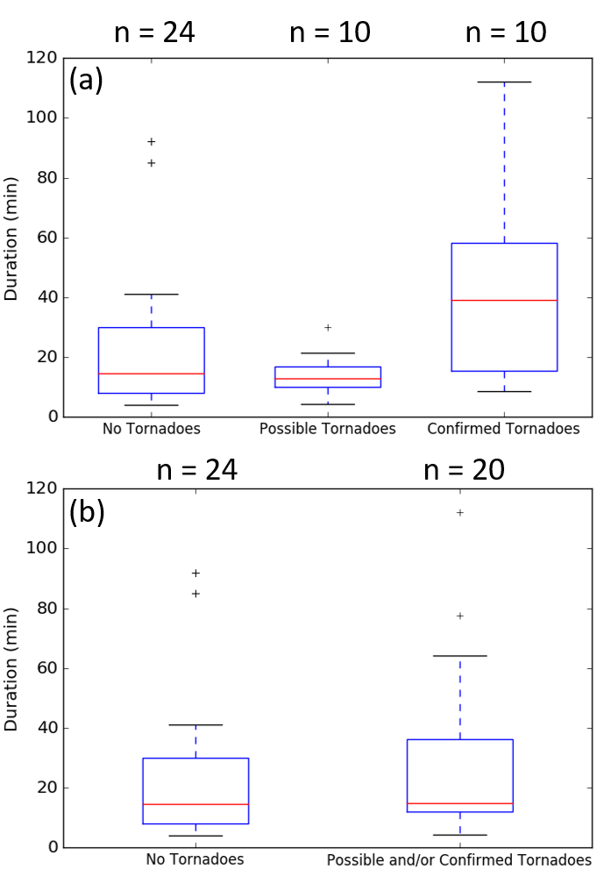
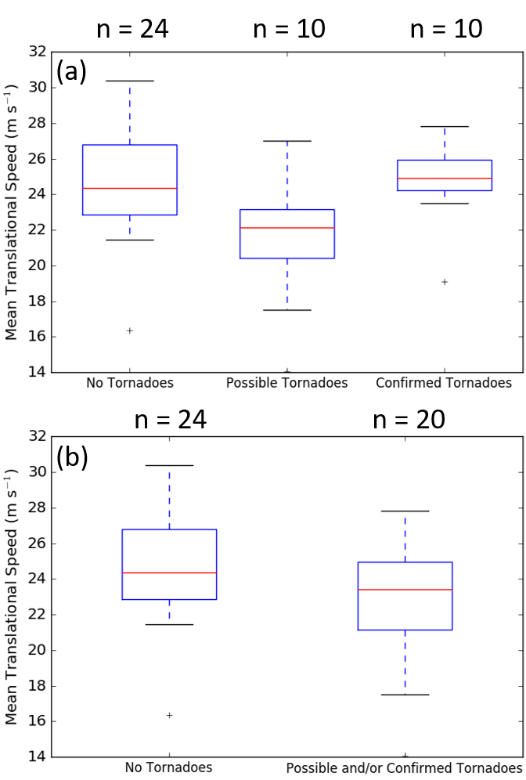
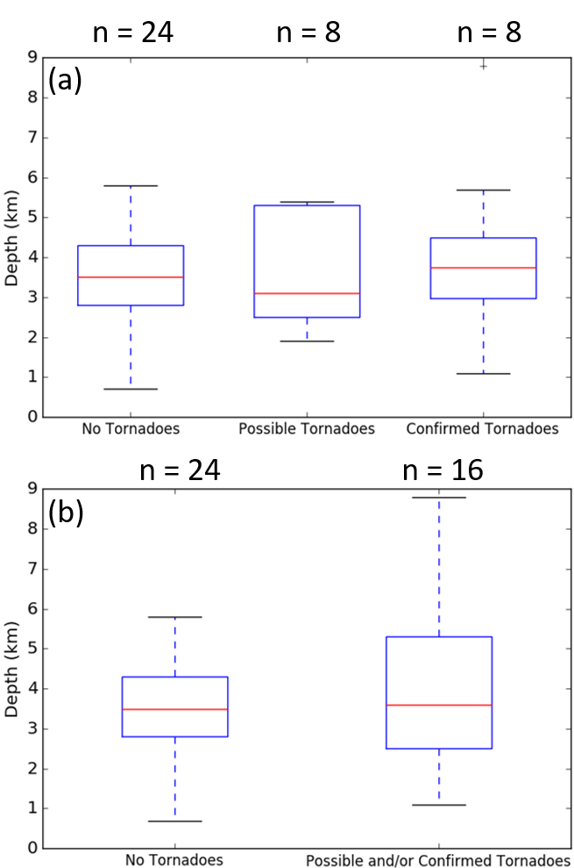
General Mesovortex Characteristics
Duration
Mean Translational Speed
Maximum Depth

Slide 30
Research and Operational Takeaways from 30 June – 1 July 2014 Mesovortices
Few substantial differences between tornadic and non-tornadic mesovortices
All cyclonic vortices – limits generation mechanisms to streamwise vorticity and release of horizontal shearing instability
How valid is the 0-3 km line-normal bulk shear vector in helping anticipate mesovortex/tornado generation?
Complex, dynamic interactions between mesovortices – how common are these?
Diagnosing damage causes from highly complex mesovortices
See Clayton et al. in Session 3 (2:05 PM this afternoon) for more on polarimetric TDSs and implications from this event

Slide 31
Acknowledgements and Additional Information
The authors would like to thank colleagues at UAH-SWIRLL and NWS Chicago for helpful discussions and insight into this work.
Partial funding for this work was supplied by NSF grant number AGS-1359771, NOAA/OAR through agreement number 2586DE-01-UAH from Dauphin Island Sea Lab, NOAA/OAR grant number NA16OAR4590216, and through support by the UAH Research and Creative Experience for Undergraduates (RCEU) program.

Slide 32
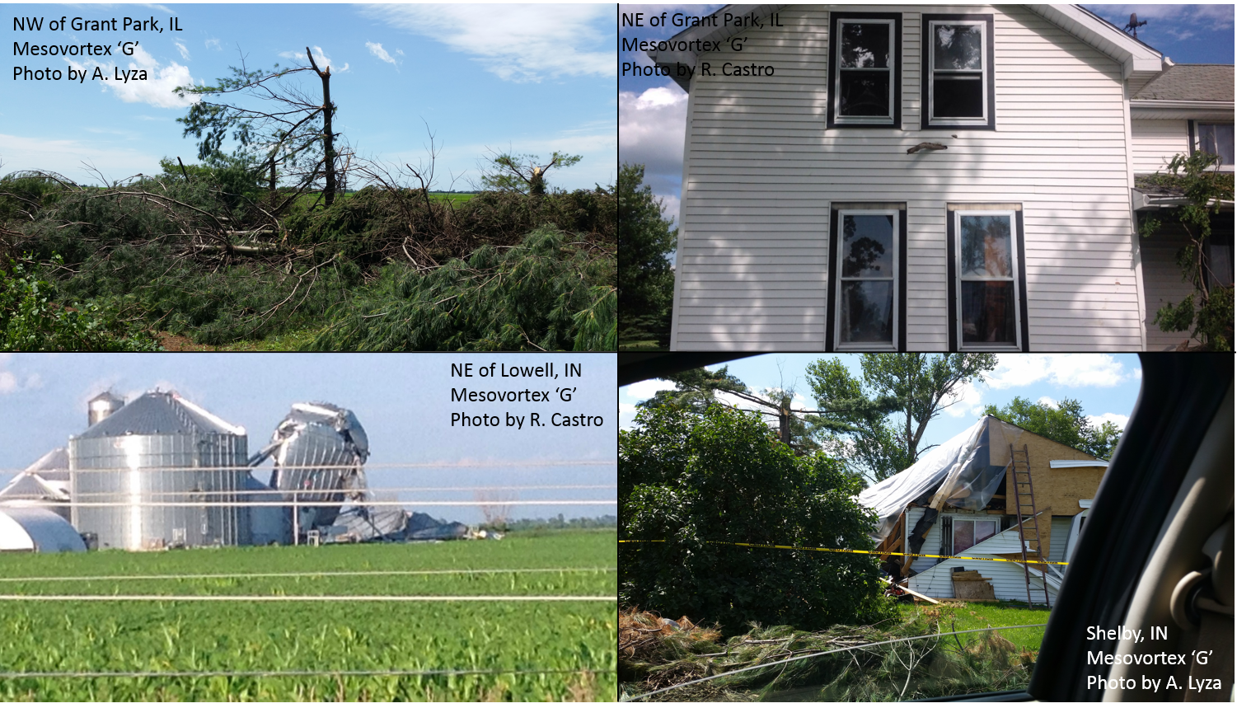
Questions?
Email: lyzaa@nsstc.uah.edu
Twitter: @tlyzawx

