Slide 1
Storm Scale Meteorological Processes in the 30 June 2014 Double Derecho Event
Eric Lenning, Richard Castro, and Matthew T. Friedlein NOAA/NWS Chicago, IL Anthony W. Lyza and Kevin R. Knupp Severe Weather Institute and Radar & Lightning Laboratories (SWIRLL) University of Alabama in Huntsville

Slide 2
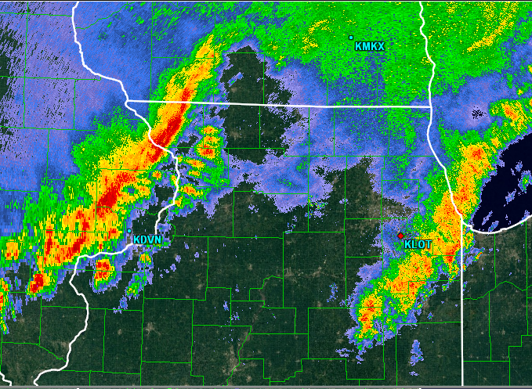
Review and Preview: 30 June 2014
Two derechoes in quick succession
Both produced widespread reports of damage
The second produced 29 tornadoes
Focus on the second QLCS – why so different?
How did atmosphere evolve after first QLCS?
What accounted for motion of second QLCS?
Radar signatures in second QLCS
SEE PART 1 OF PRESENTATION FOR DETAILS

Slide 3
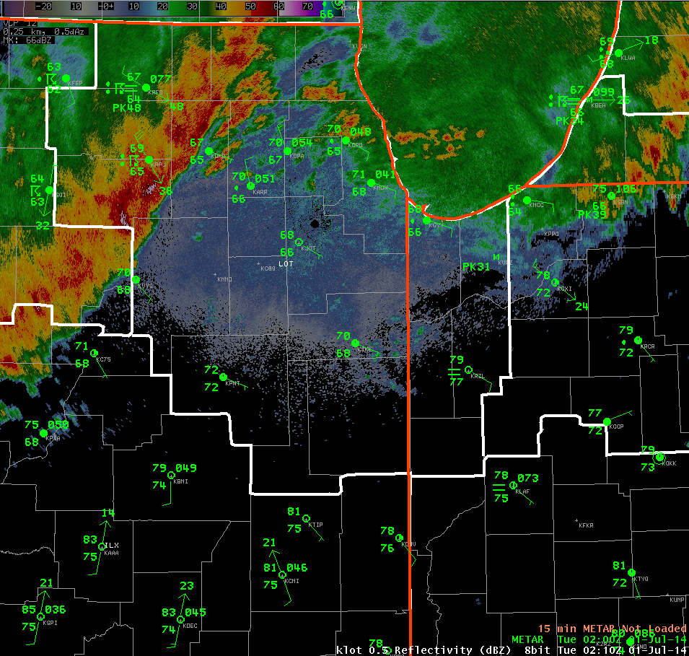

Slide 4
SECOND LINE 03Z 0-6km SHEAR:
25-30 m/s
FIRST LINE 23Z 0-6km SHEAR:
20-25 m/s

Slide 5
SECOND LINE 04Z Effective SRH:
300-700 m²/s²
FIRST LINE
23Z Effective SRH:
100-200 m²/s²

Slide 6
Motion of Second QLCS
03Z – 1 July 2014 Estimated QLCS Motion (24 m/s or 46 kt) & RAP Forward Propagating Corfidi Vectors

Slide 7
Motion of Tornadic Section of 2nd QLCS
03Z – 1 July 2014 Estimated Motion (27 m/s or 52kt)

Slide 8
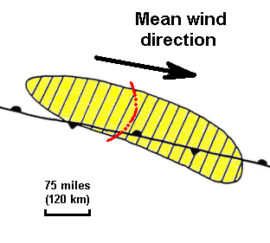
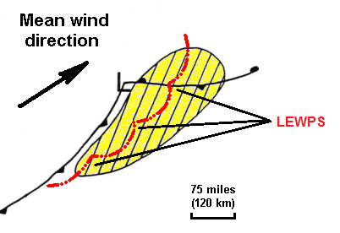
Derecho Types/Movement
Progressive: Slightly right of mean wind, often faster (~23 m/s). Propagation dominates.
Serial: Perpendicular to mean wind (≤ 15 m/s). Advection dominates.
Johns & Hirt 1987

Slide 9
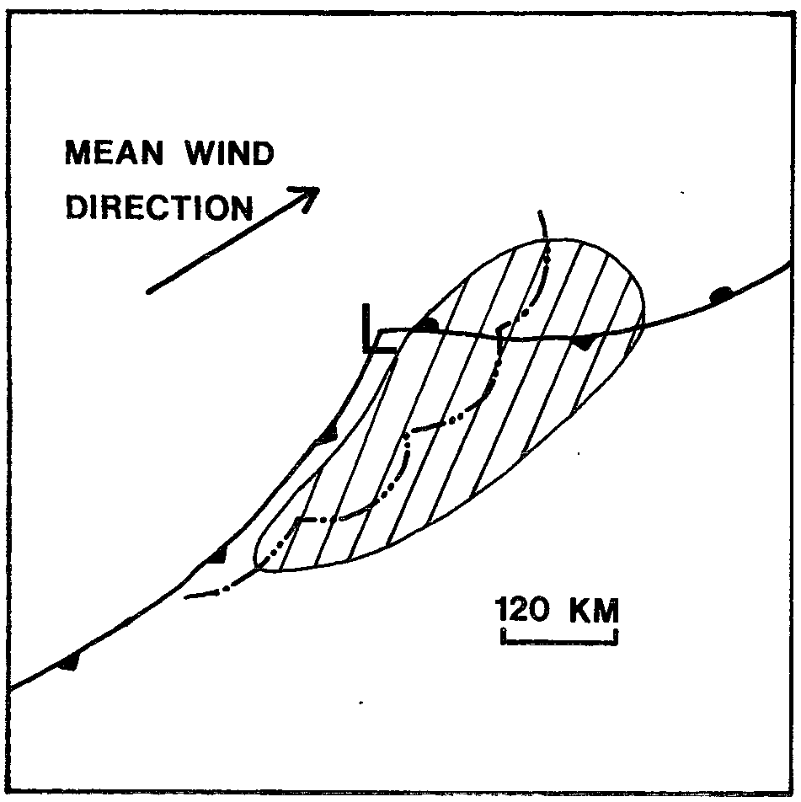
850-300mb Mean Wind vs Storm Motion
SERIAL DERECHO

Slide 10
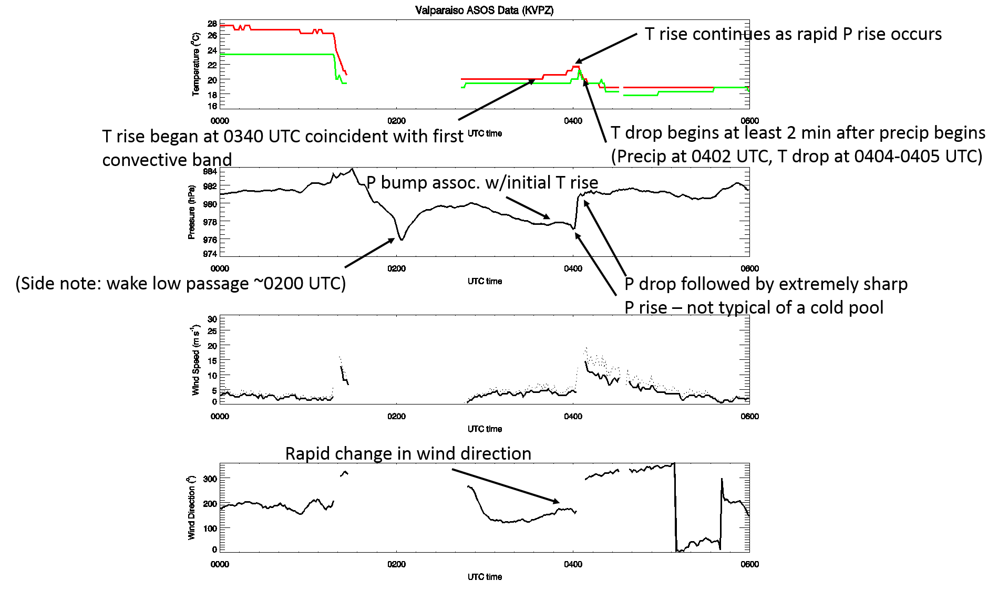
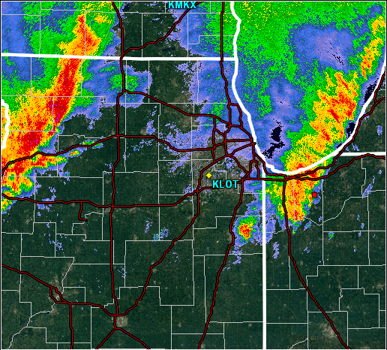
VPZ Time Series
T/DP
P
Speed
Dir
0116Z 07/01/14

Slide 11
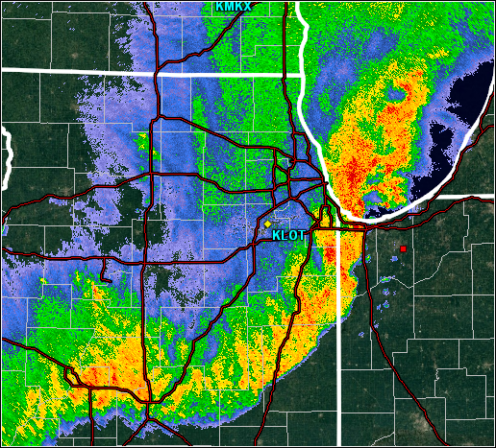
VPZ Time Series
T/DP
P
Speed
Dir
0340Z 07/01/14

Slide 12
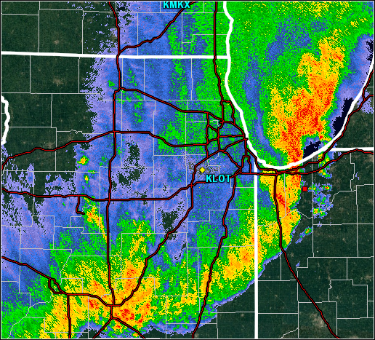
VPZ Time Series
T/DP
P
Speed
Dir
0359Z 07/01/14

Slide 13
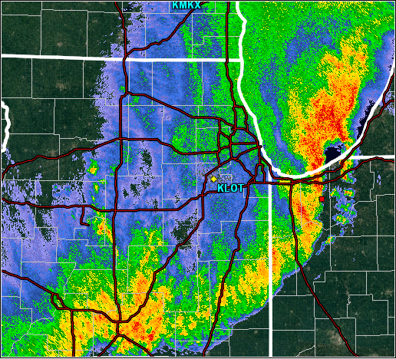
VPZ Time Series
T/DP
P
Speed
Dir
0402Z 07/01/14

Slide 14
Bore Observations & Dynamics
TEMPERATURE: Steady or rising
MIXING RATIO: Steady or decreasing
PRESSURE: Rapid rise
All are semi-permanent (not transient)

Slide 15
Destabilization of Boundary Layer
Common consequence of bores
Raise inversion height
Mix warmer, drier air to surface
Temperature rise just ahead of QLCS arrival

Slide 16
$$c=k{\left[gh\frac{ρ1−ρ0}{ρ0}\right]}^{\frac{1}{2}}$$
Speed of Density Current (shallow, with drag)
$$C_{gw}={\left[g\left(\frac{∆θv}{θv}\right)h_{0}\right]}^{\frac{1}{2}}$$
Speed of Gravity Wave
$$C_{bore}=C_{gw}{\left[\frac{1}{2}\frac{h_{1}}{h_{0}}\left(1+\frac{h_{1}}{h_{0}}\right)\right]}^{\frac{1}{2}}$$
Speed of Bore
Markowski and Richardson 2010

Slide 17
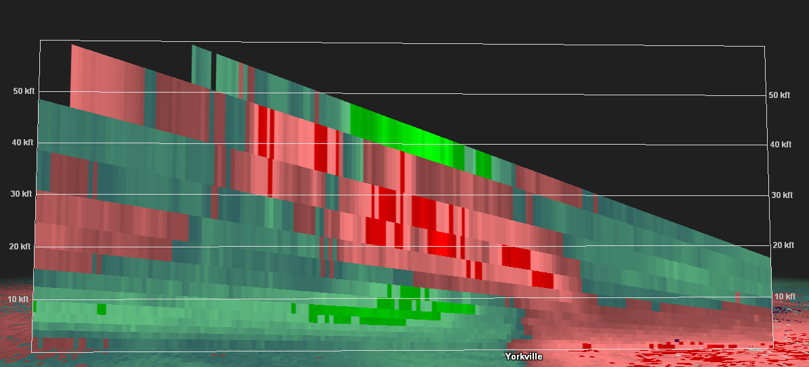

Slide 18
System Motions thru VPZ Area
 | 1st QLCS | 2nd QLCS
Actual Speed | 17 m/s | 25 m/s
Theoretical Cold Pool Speed | 16-30 m/s | 9-17 m/s
Theoretical Bore Speed | n/a | 26 m/s

Slide 19
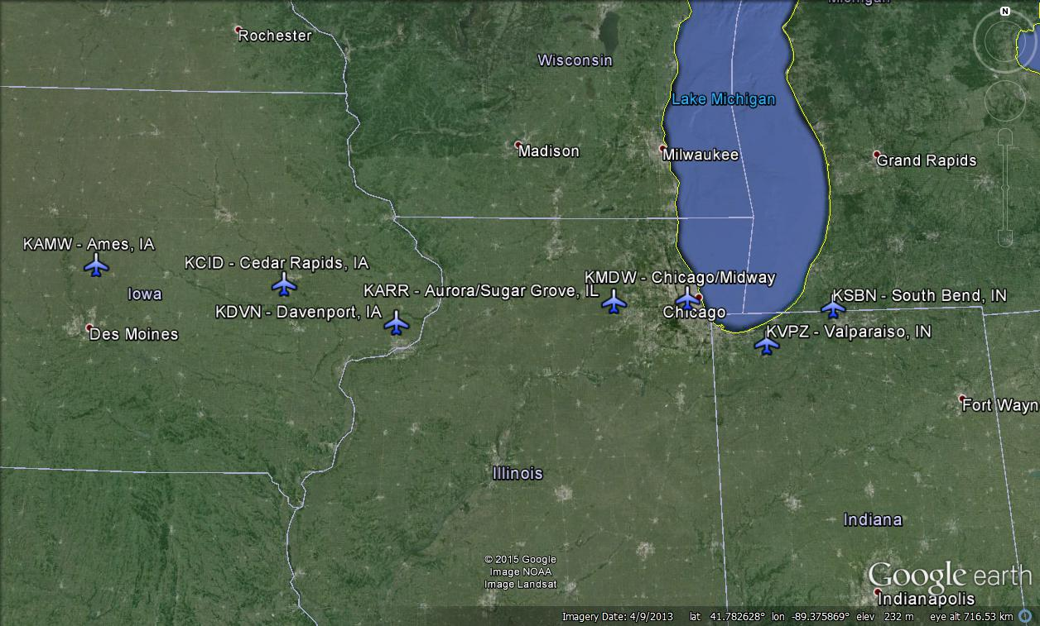
West to East Progression
AMW
CID
ARR
MDW
SBN
DVN
VPZ

Slide 20
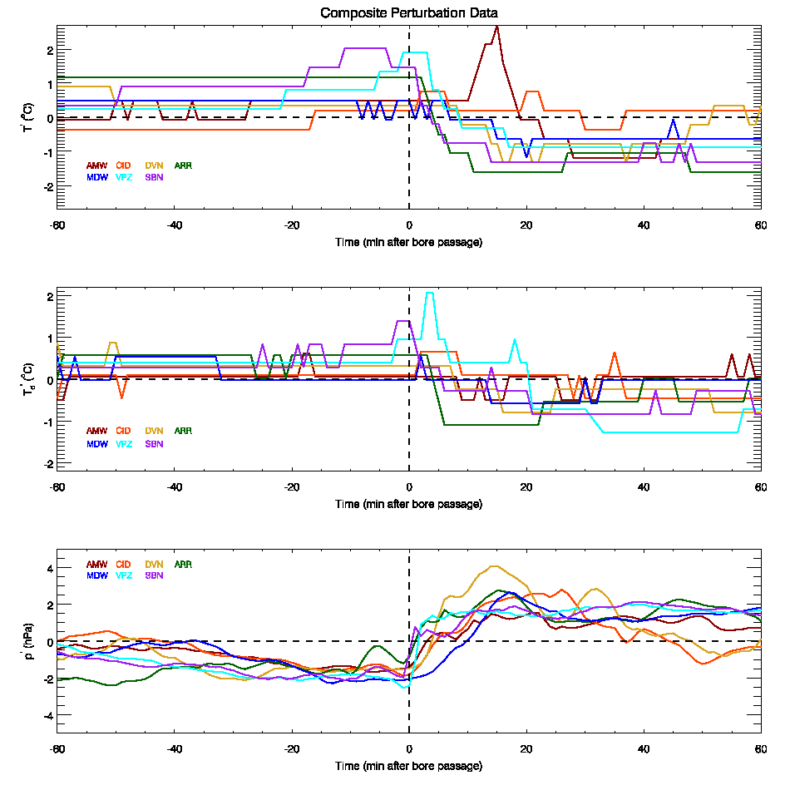
More Surface Traces
T’
AMW
CID
Td’
P’

Slide 21
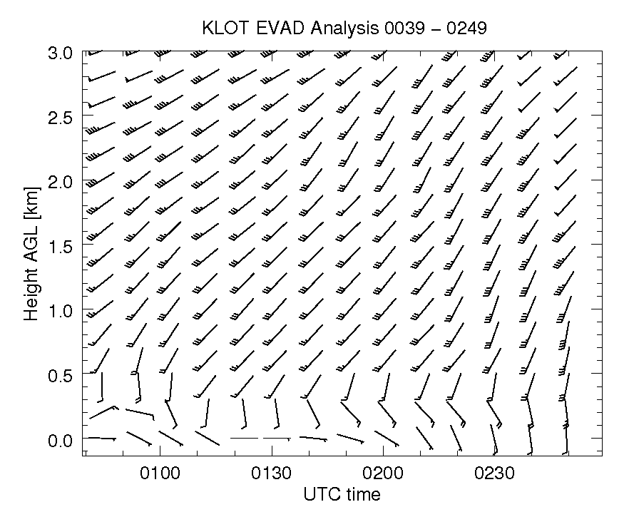

Slide 22
Bore-Driven Enhancement of SRH
SRH would have been large even with cold-pool propagation speed
Faster bore-related movement substantially increased environmental SRH
Result: SRH was extreme for this QLCS

Slide 23
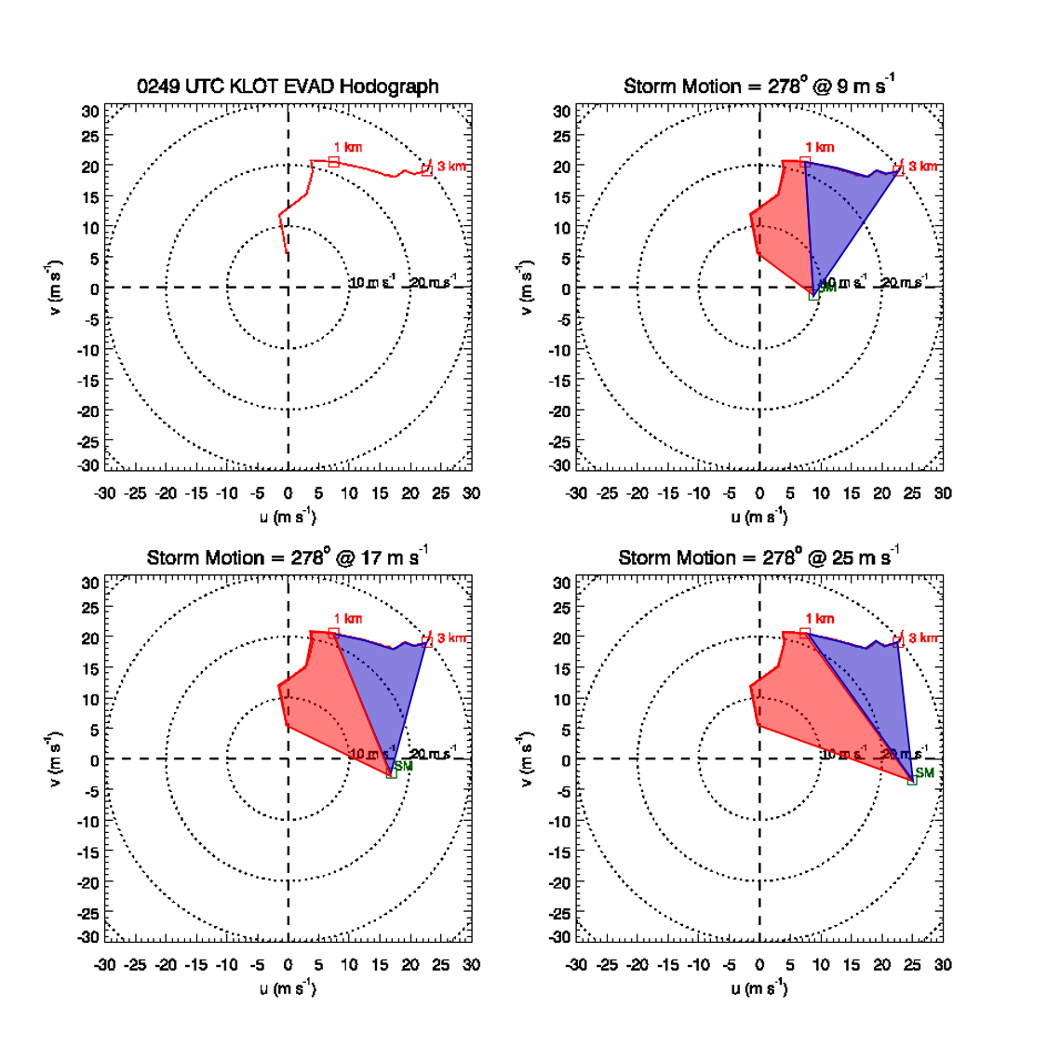
KLOT EVAD Hodographs for 0249Z 07/01/2014

Slide 24
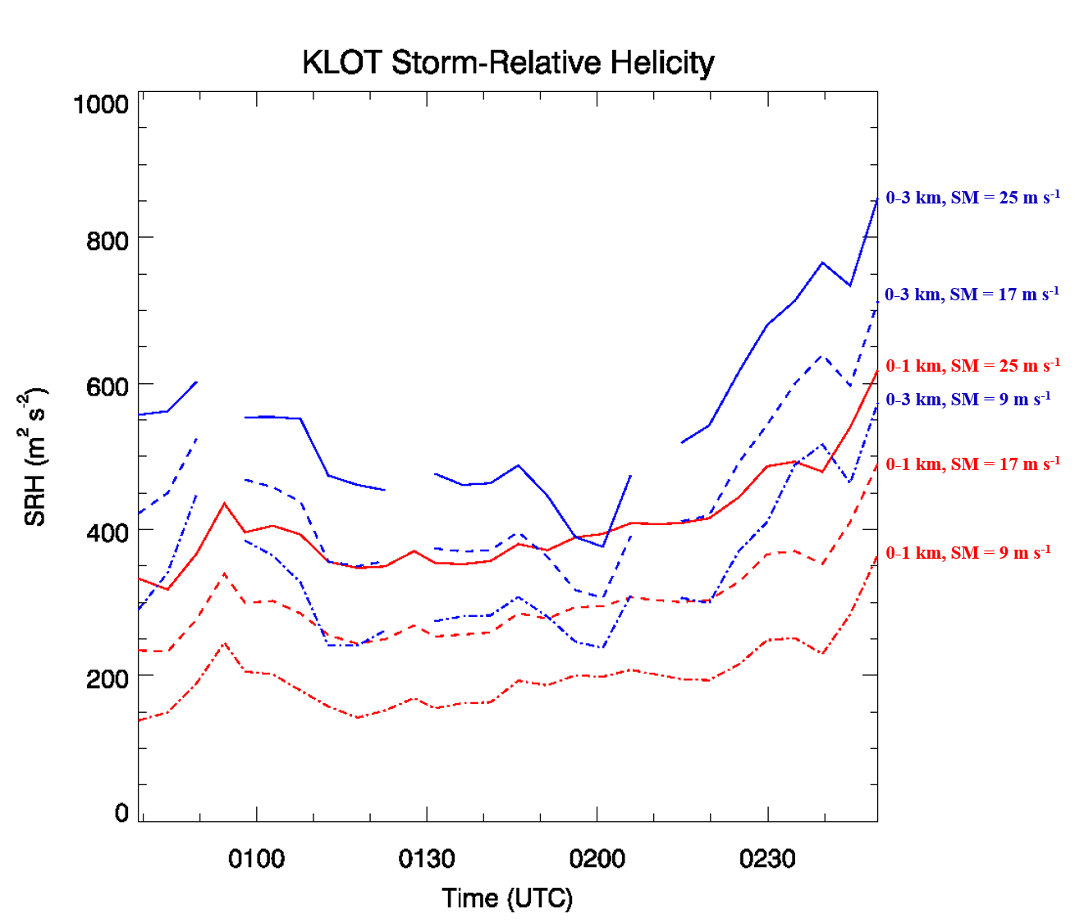

Slide 25
Overall Effect of Bore-Driven Motion
Ingest of surface or near-surface parcels via:
Low-level destabilization
Vertical motion associated with bore
Lifting of parcels to top of stable layer
Extreme SRH from faster bore-related propagation

Slide 26
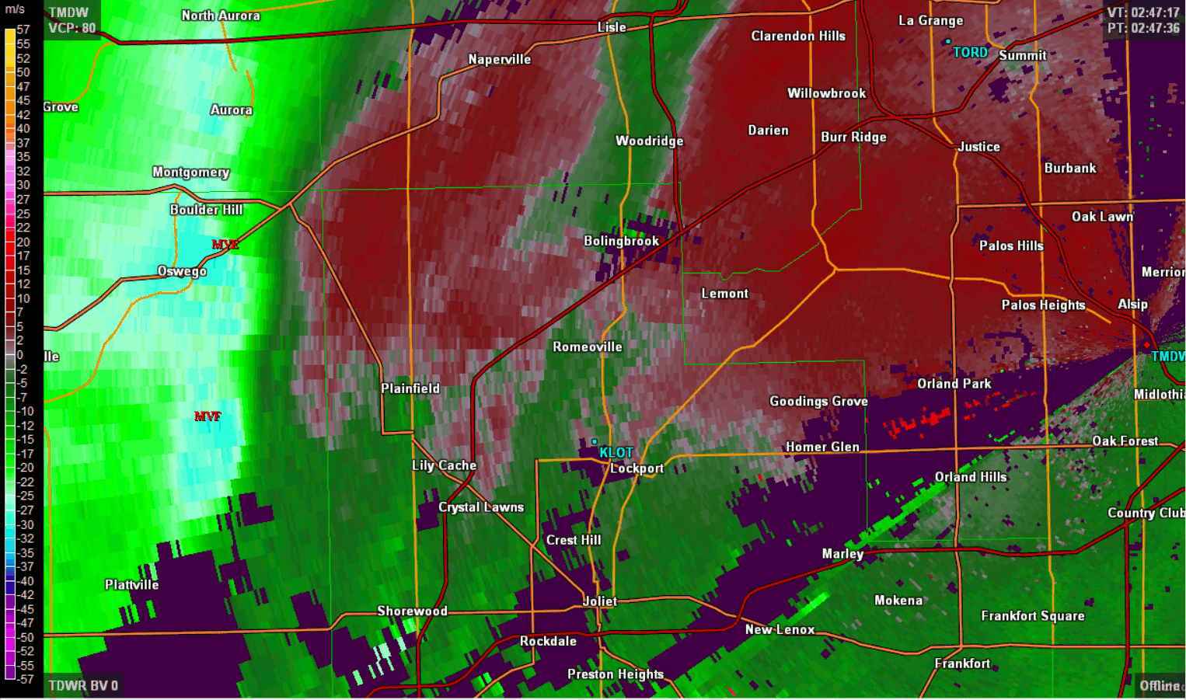
KLOT Close-up View of QLCS Tornado
Fujiwhara Interactions
Markowski & Richardson 2010

Slide 27
Questions for Future Research
How does mesovortex formation differ between a bore-driven and cold-pool driven QLCS?
How common is a bore-driven QLCS?
Does a bore-driven QLCS increase or intensify the risk of severe weather?
What was the dynamic cause of the split of MV G? Intensification of QLCS mesovortices more commonly-associated with mergers, not splits.
What is the process of tornadogenesis in large mesovortices? What is the source of surface vorticity?
Does the paradigm of highest tornado intensity being near the surface apply to QLCS tornadoes? How common is that intensity profile overall? Need many more close-proximity, high-resolution observations of tornadoes.
Plug: overview of mesovortex characteristics, behaviors, and incredible radar observations to be presented at 37th Radar Conference in Norman in September

